Slide 1
Lesson 3 FOOD

Slide 2
What we will learn today
New ‘cl’ words
Using the ‘cl’ sound
Using “or”, capitalization and punctuation
Reading practice
Notes:
Go over the learning goals.

Slide 3
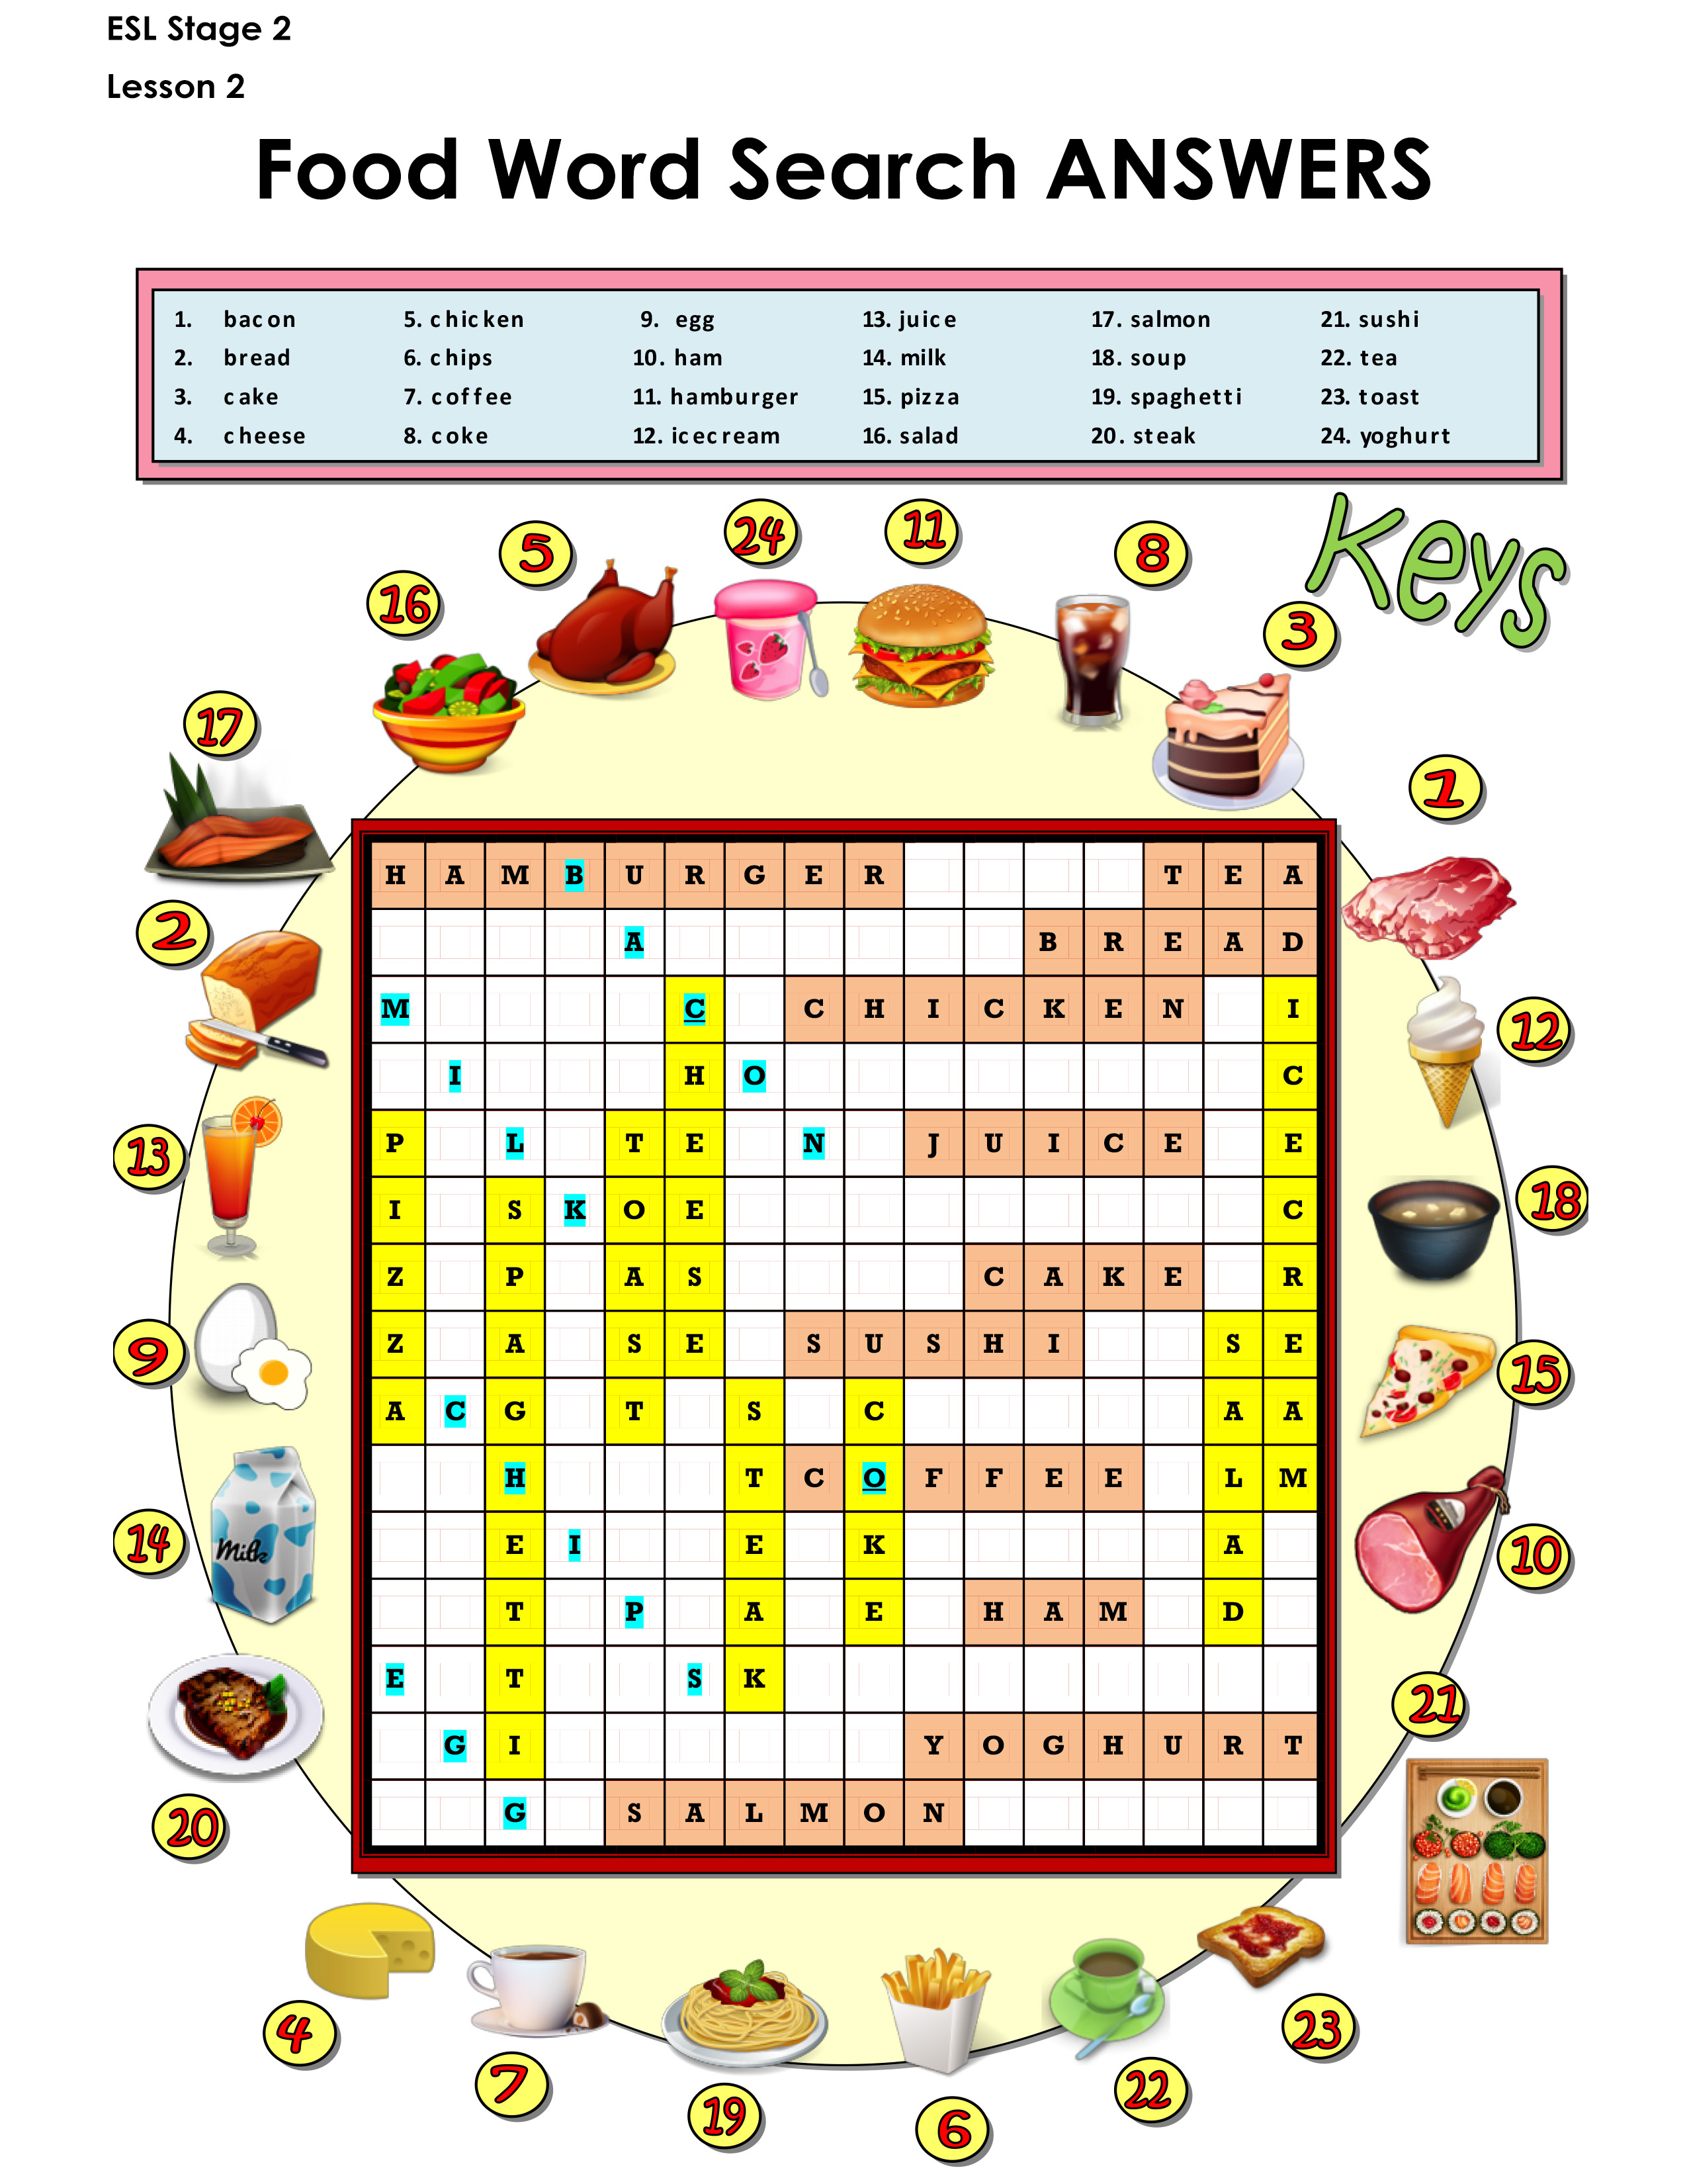
Let’s take up the homework
Notes:
Take up homework. Review each food.

Slide 4
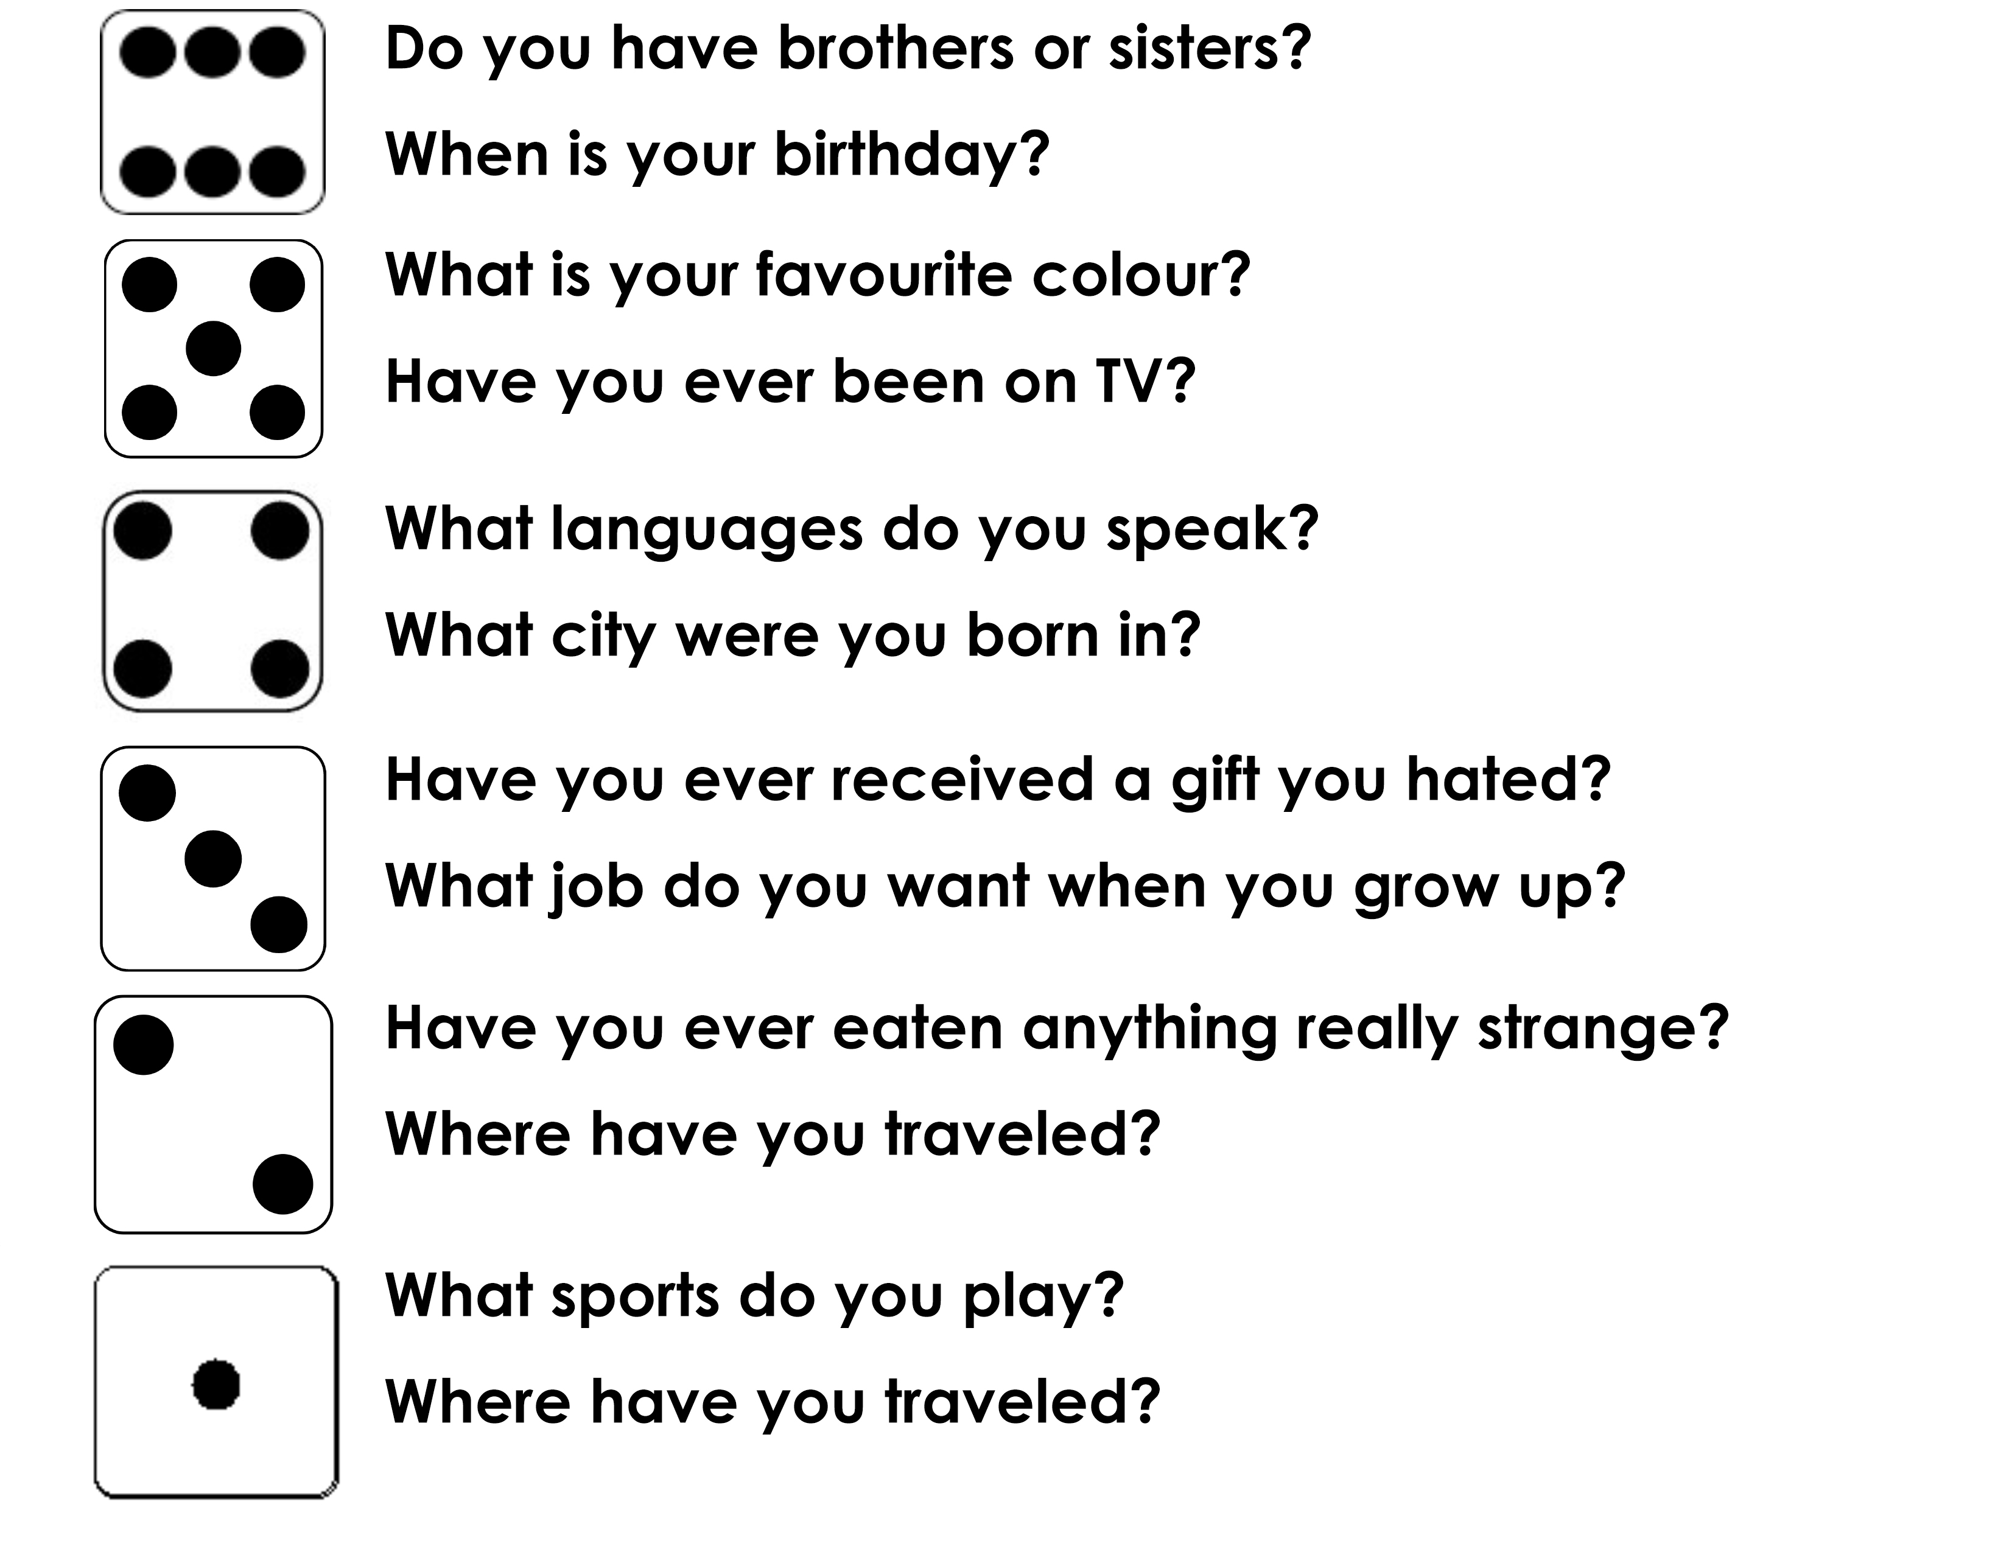
Roll of the dice http://dice.virtuworld.net/
Notes:
Roll the digital die, and go around to each student having them answer one of the two questions depending on the number rolled. You may participate as well.

Slide 5
The CL Sound
Notes:
Demonstrate how to pronounce the CL sound. Really emphasize your mouth movement so the students can see it in the video. This is a blended sound.
To pronounce the “c” sound, push tongue to the roof of the mouth while keeping the front of the tongue down behind the bottom teeth. To pronounce the “l” sound, the tip of the tongue is placed against the middle of the tooth ridge. The sound is created when air travels alongside the tip of the tongue, between the front of the tongue and the side teeth. Have students make the sound individually.

Slide 6
The CL Sound
Notes:
Say each word, articulating it clearly. Then say it again, pointing to each syllable, emphasizing the main stress on the polysyllabic words. Say the word again, in a more natural way. Instruct the students to repeat the word, chorally and then individually.

Slide 7
The CL Sound
Notes:
Say each word, articulating it clearly. Then say it again, pointing to each syllable, emphasizing the main stress on the polysyllabic words. Say the word again, in a more natural way. Instruct the students to repeat the word, chorally and then individually.

Slide 8
Match the picture to the word
Notes:
Draw a line connecting the picture to the word. If they don’t know the word, tell them to look it up and then find the picture.

Slide 9
Now you practice capitalization and punctuation
Will daniel eat lunch with me
Amy and i are going to the movies
My dog’s name is comet
samantha does gymnastics with jack
We are going to hawaii for vacation
Ouch My finger hurts
Notes:
Get students to open the “Capitalization and Punctuation Worksheet.pdf”. Read each statement. Remind the students where and when capitals and periods, question marks, or exclamation points are required. Alternate between each student for the questions.

Slide 10
Match the animal to the food they eat
Notes:
Say the word for each animal, and say the word for each food. Get the students to draw a line connecting the animal to the food. Rabbit=carrot mouse=cheese lion=meat panda-bamboo

Slide 11
Using “or”
The word “or” links two different ideas.
Would you like coffee or tea?
We can eat chicken or salad.
Notes:
Read over slide.

Slide 12
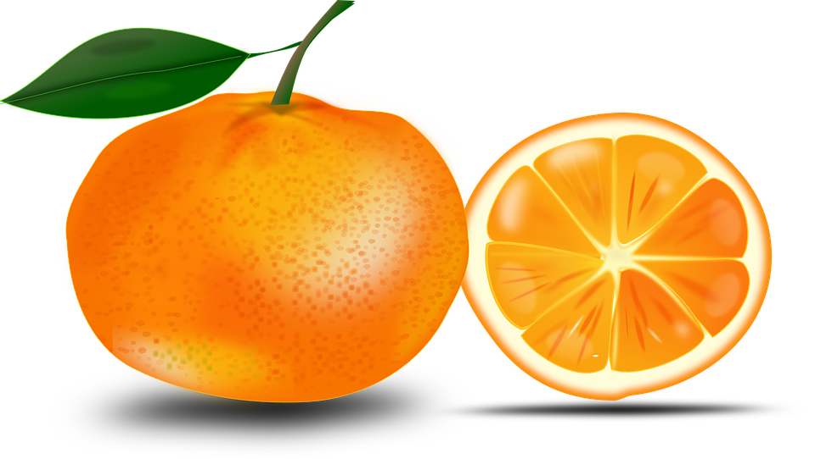
Practice “or”
Add “or” where it is missing in the following sentences.
I like noodles pasta.
Would you like a small, medium, large?
Would you like sugar milk in your coffee?
Did you try the orange juice the apple juice?
Notes:
Read each statement. Remind the students when “or” is required. Alternate between each student for the questions. Have them do it orally.

Slide 13
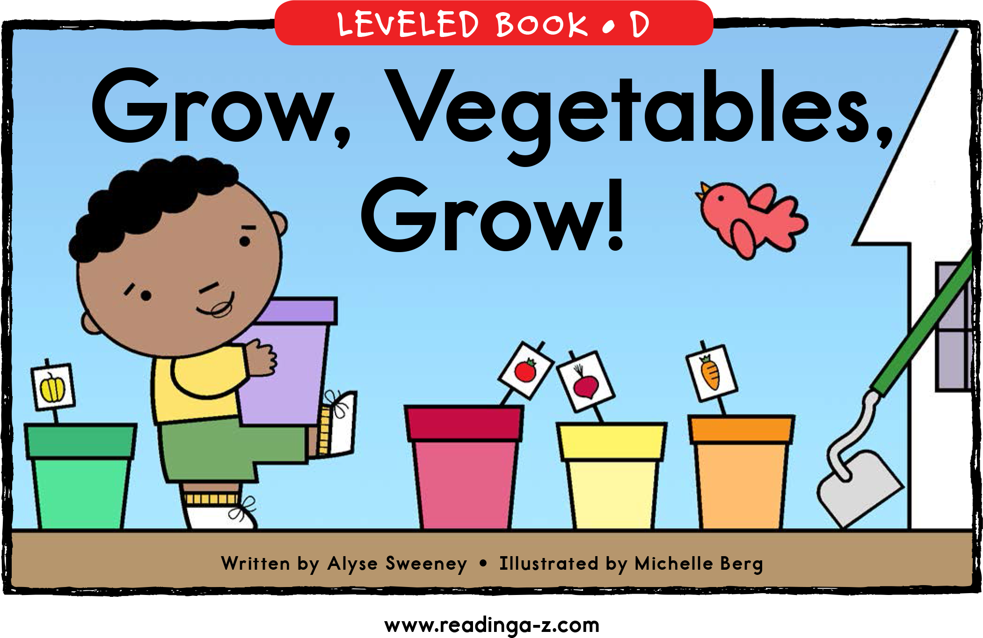
Story Time
Notes:
You read a sentence. Make sure you emphasize the intonation for the punctuation. Then get one students read it out loud. They try to imitate/echo the way the you read the text. Alternate between students.

Slide 14
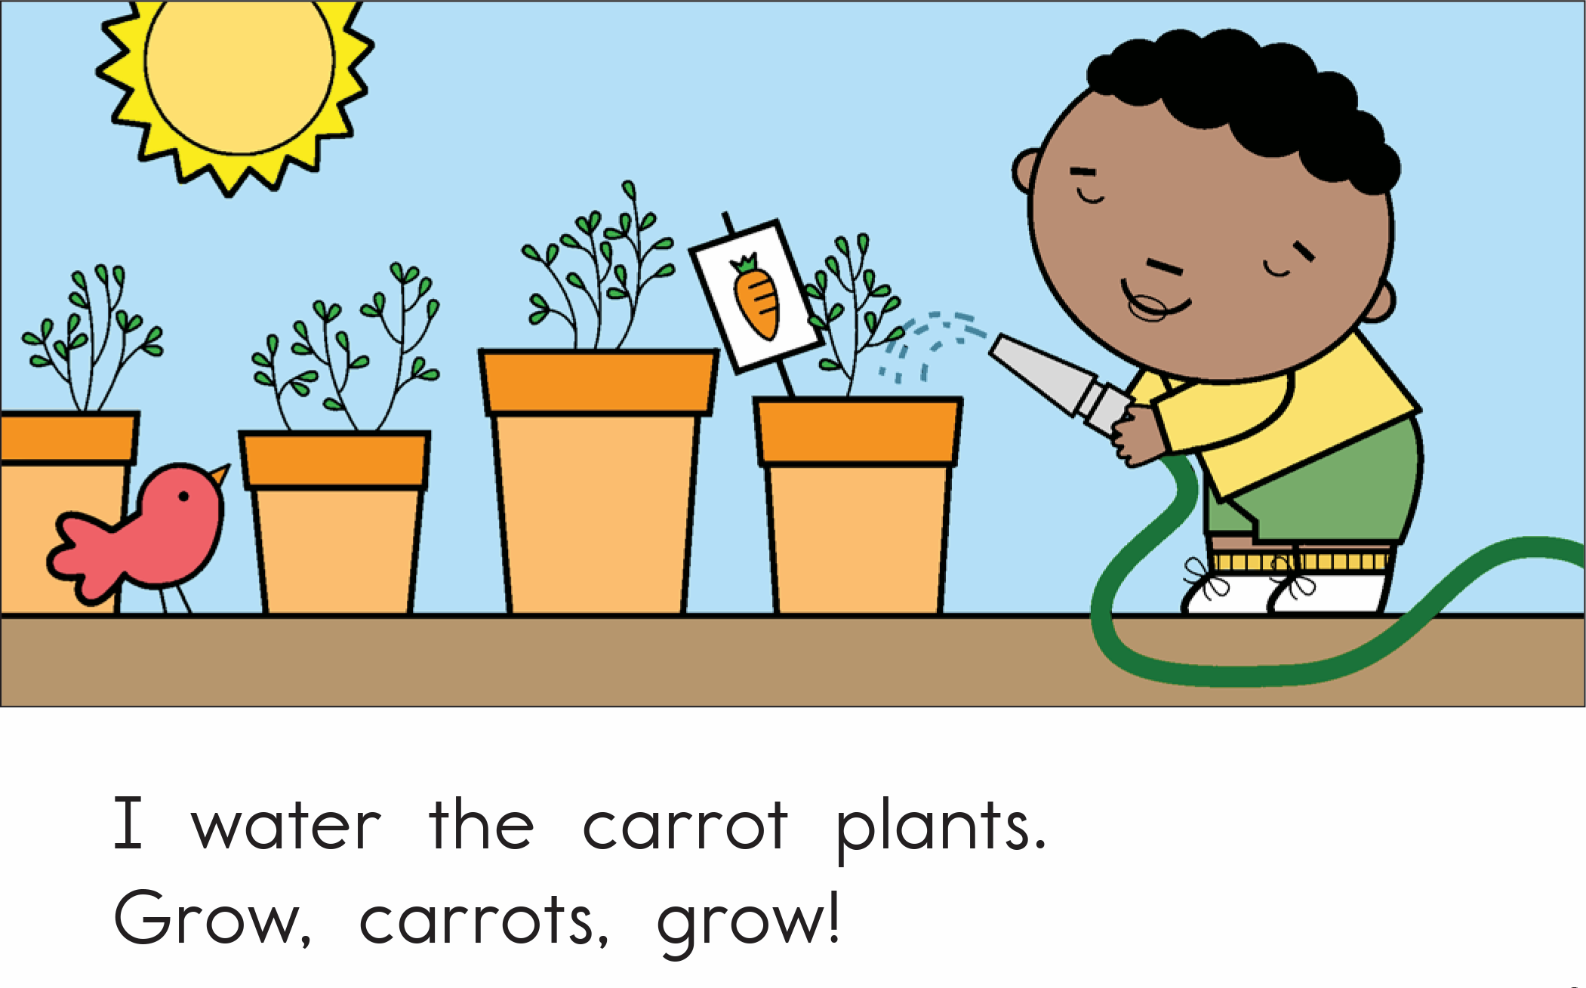
Notes:
You read a sentence. Make sure you emphasize the intonation for the punctuation. Then get one students read it out loud. They try to imitate/echo the way the you read the text. Alternate between students.

Slide 15
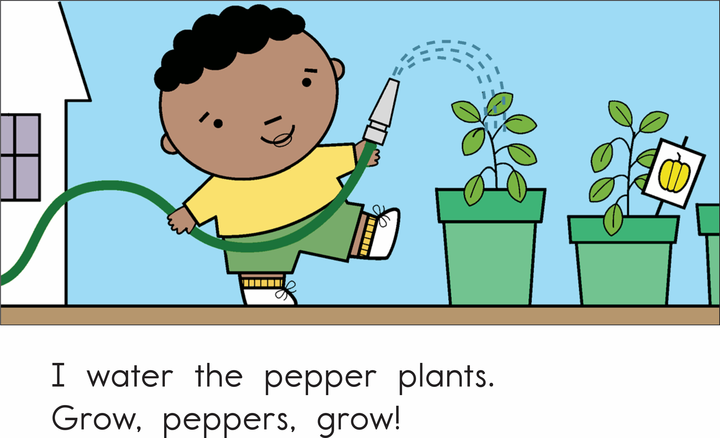
Notes:
You read a sentence. Make sure you emphasize the intonation for the punctuation. Then get one students read it out loud. They try to imitate/echo the way the you read the text. Alternate between students.

Slide 16
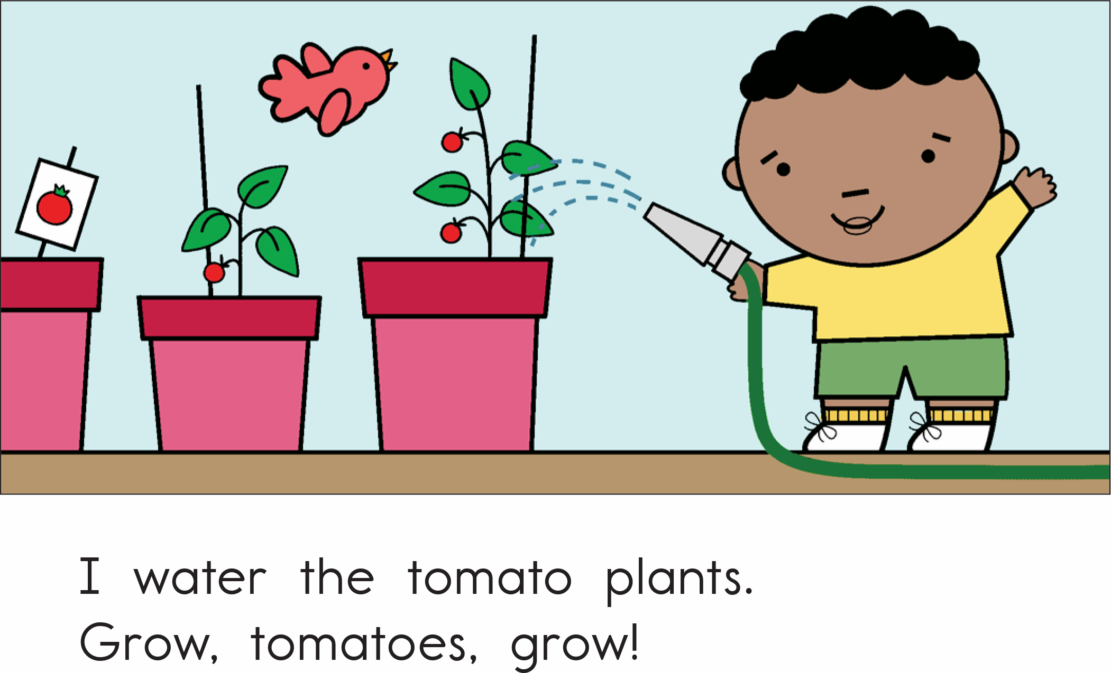
Notes:
You read a sentence. Make sure you emphasize the intonation for the punctuation. Then get one students read it out loud. They try to imitate/echo the way the you read the text. Alternate between students.

Slide 17
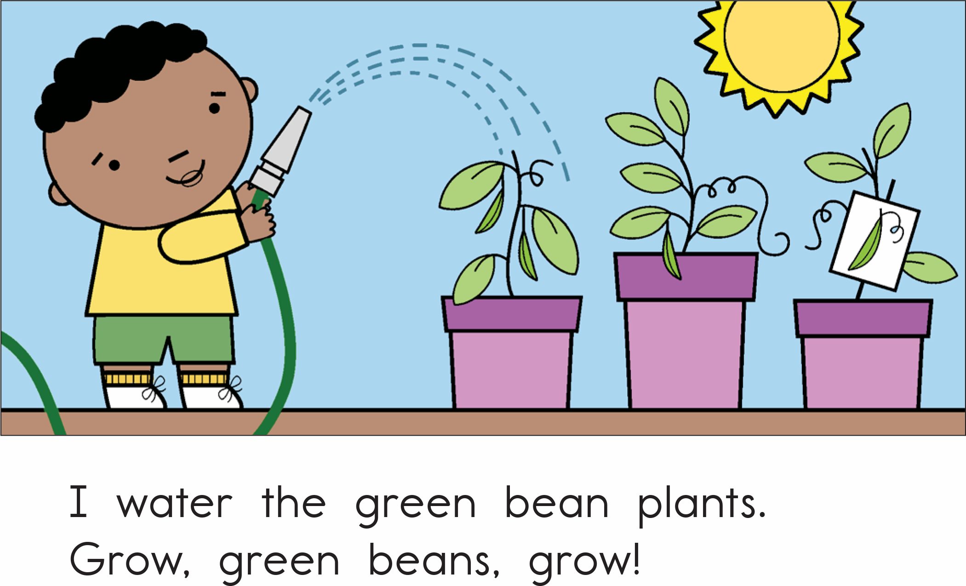
Notes:
You read a sentence. Make sure you emphasize the intonation for the punctuation. Then get one students read it out loud. They try to imitate/echo the way the you read the text. Alternate between students.

Slide 18
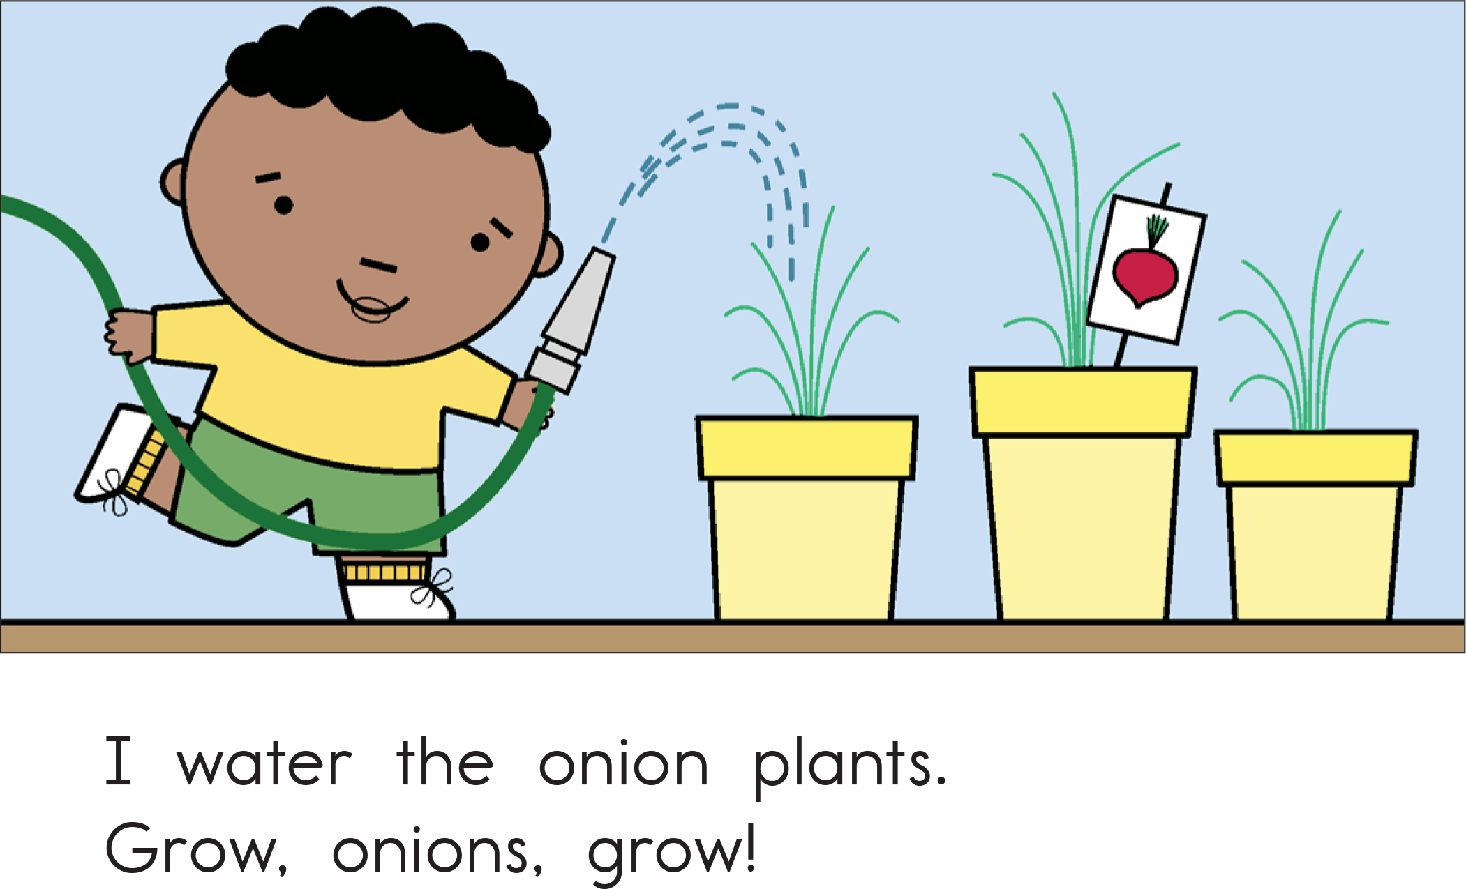
Notes:
You read a sentence. Make sure you emphasize the intonation for the punctuation. Then get one students read it out loud. They try to imitate/echo the way the you read the text. Alternate between students.

Slide 19
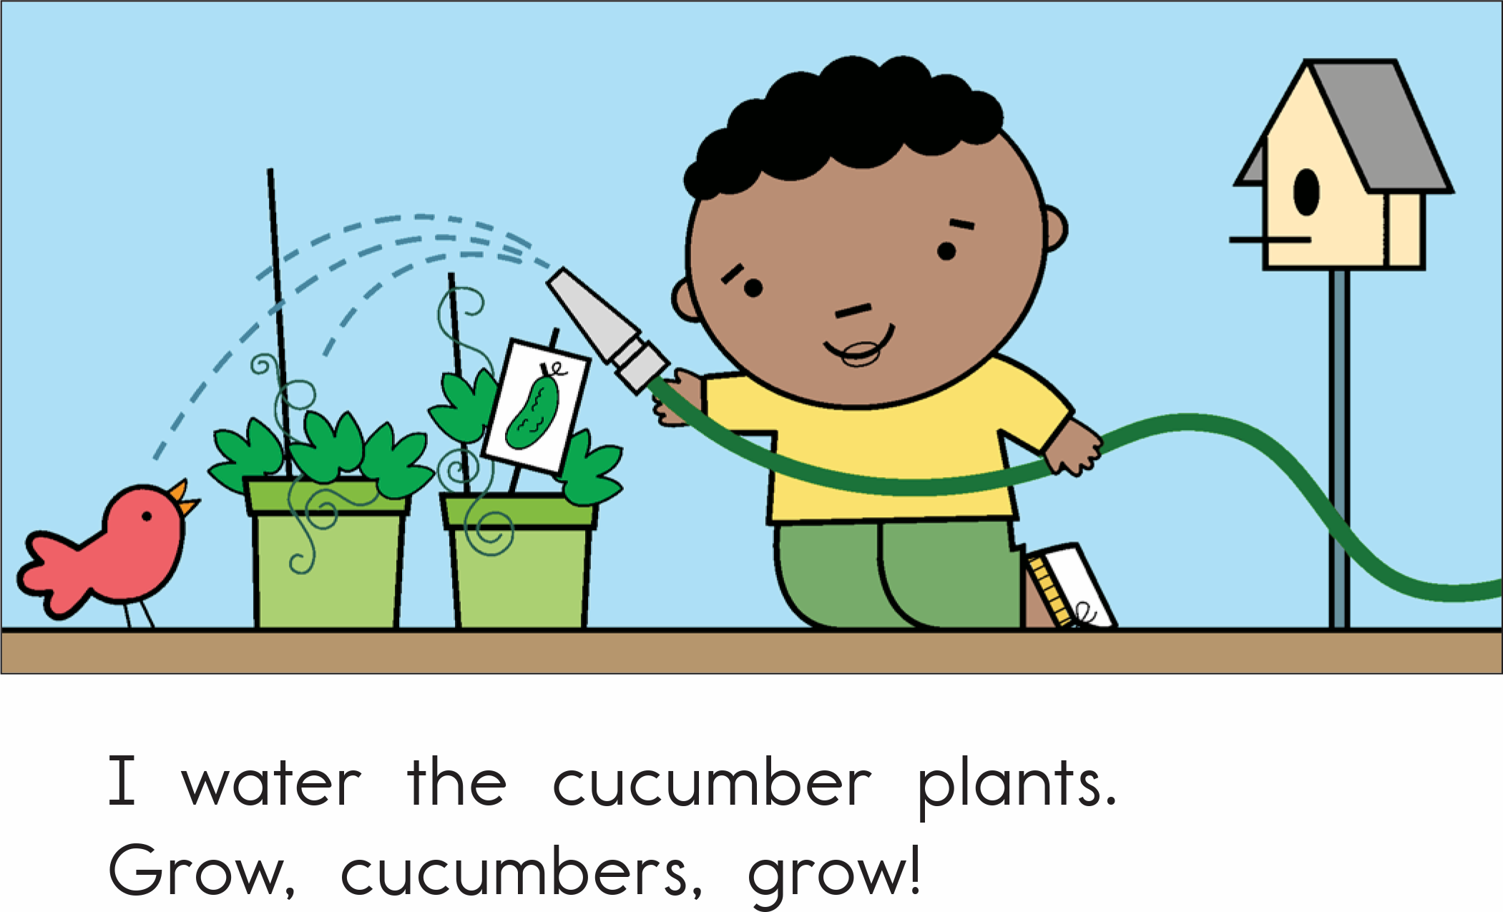
Notes:
You read a sentence. Make sure you emphasize the intonation for the punctuation. Then get one students read it out loud. They try to imitate/echo the way the you read the text. Alternate between students.

Slide 20
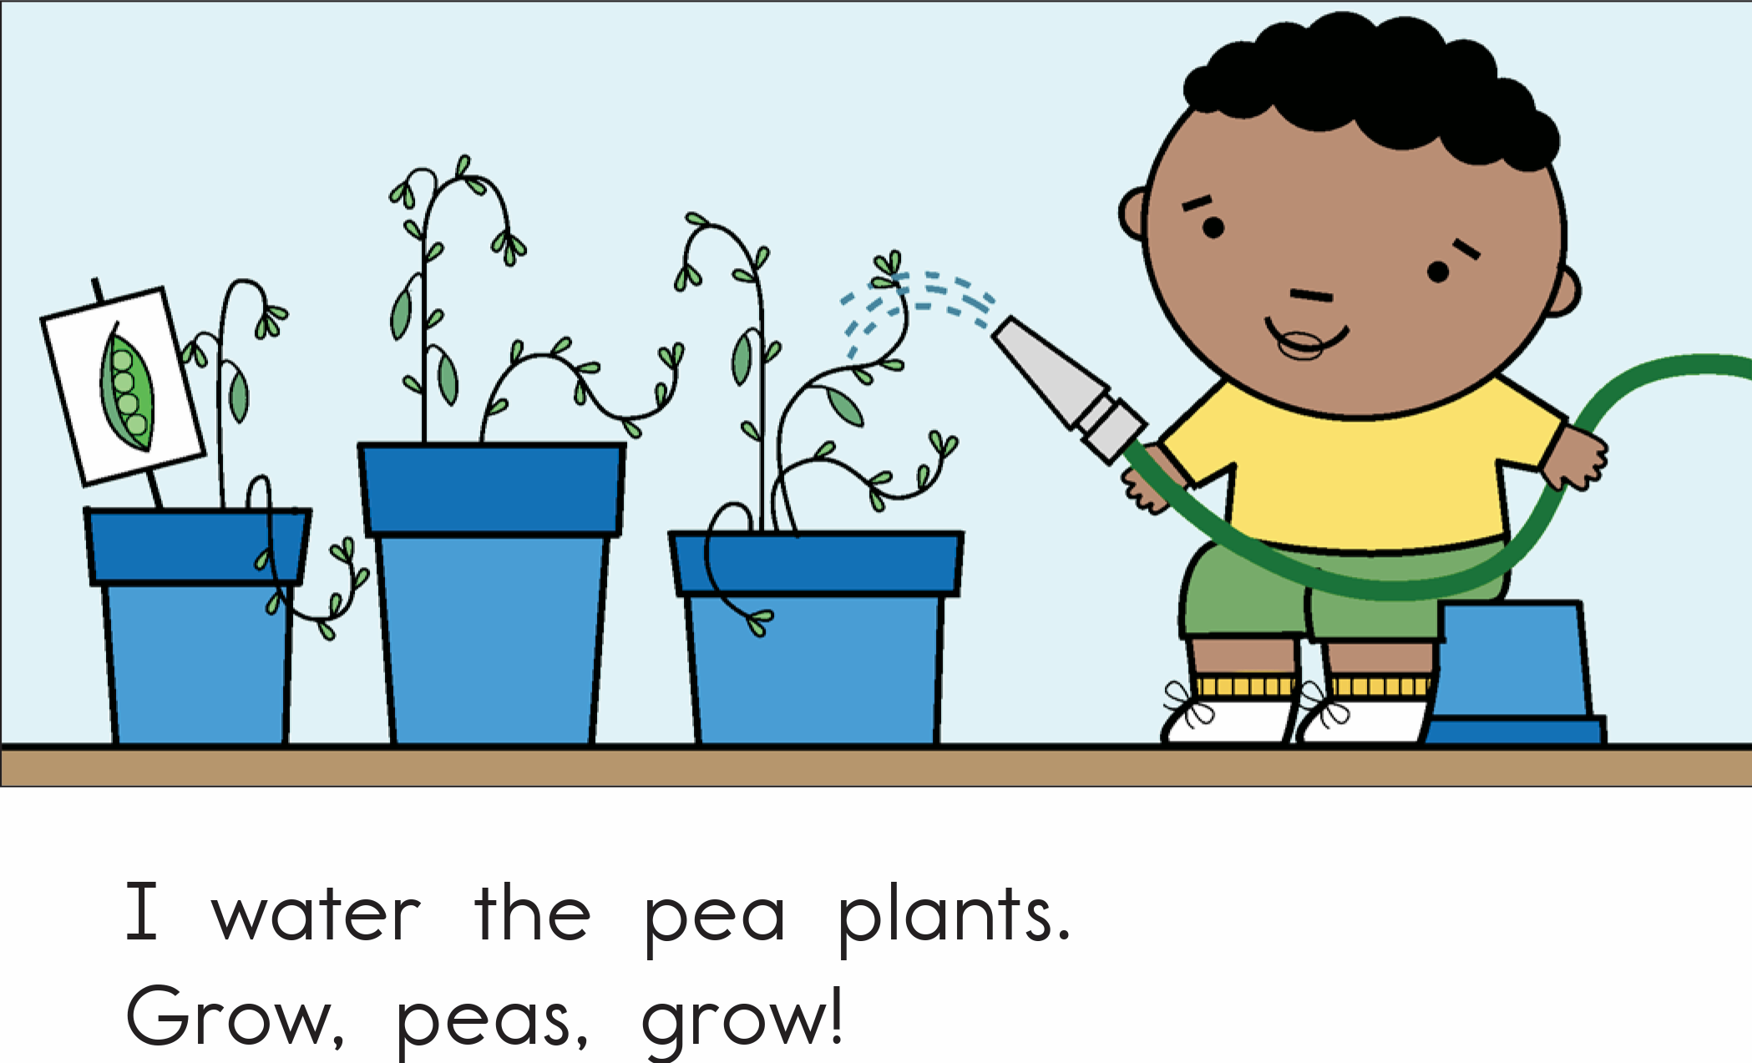
Notes:
You read a sentence. Make sure you emphasize the intonation for the punctuation. Then get one students read it out loud. They try to imitate/echo the way the you read the text. Alternate between students.

Slide 21
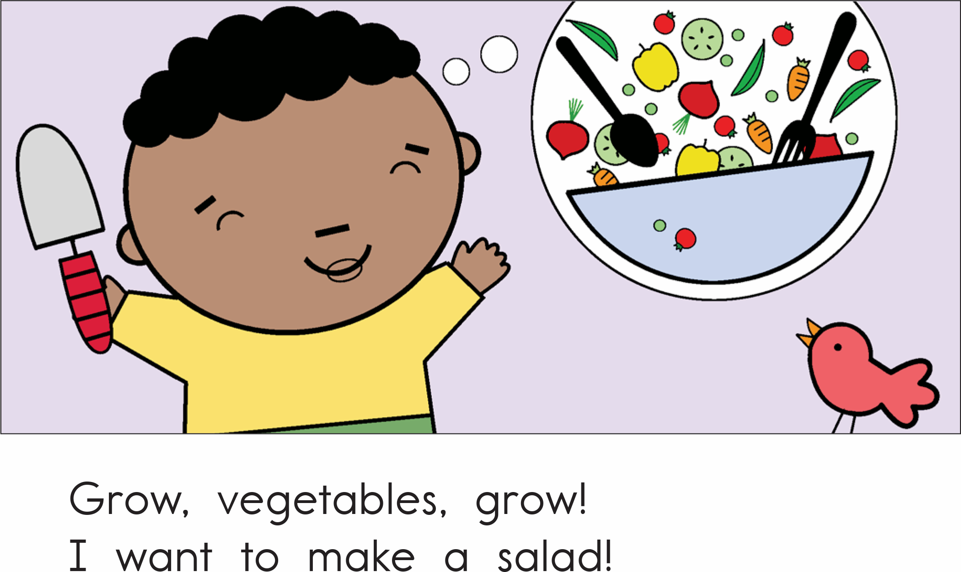
Notes:
You read a sentence. Make sure you emphasize the intonation for the punctuation. Then get one students read it out loud. They try to imitate/echo the way the you read the text. Alternate between students.

Slide 22
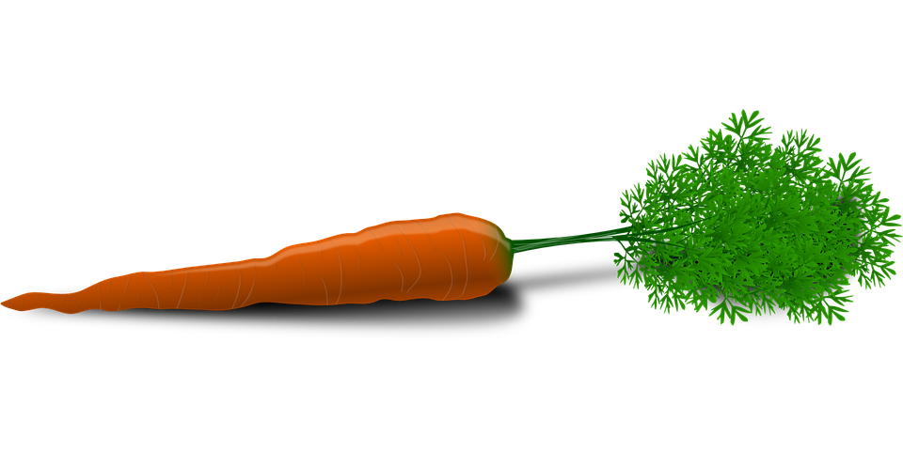
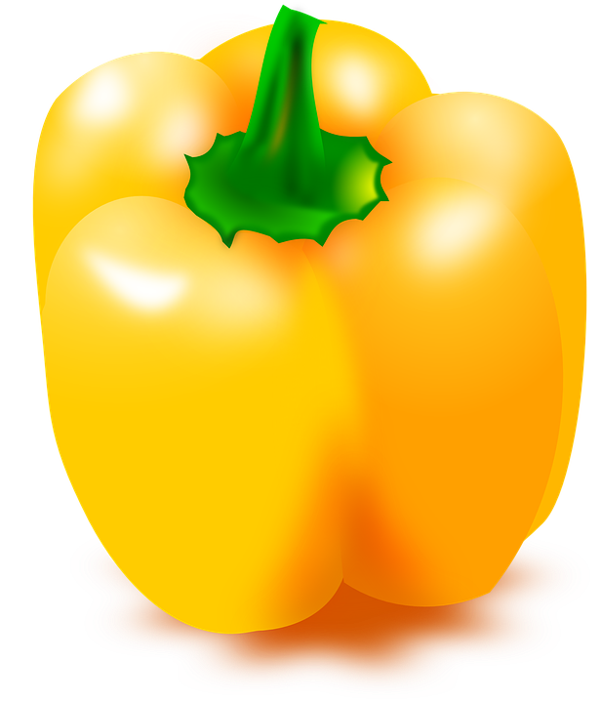
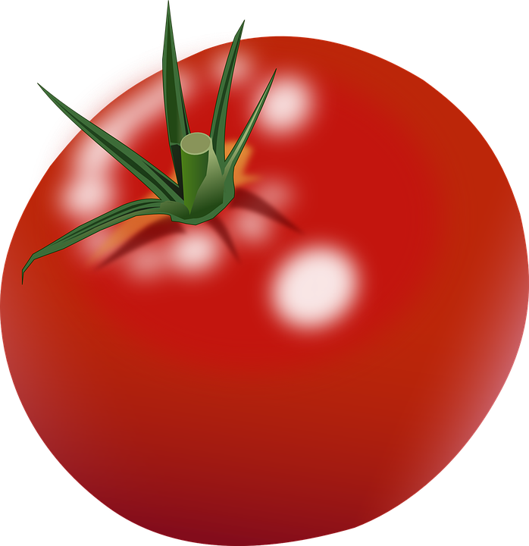
About the story
What did he have to do to make the plants grow?
What kind of vegetables was he growing?
What is he going to do with all his vegetables?
Notes:
Ask the questions orally and have students answer.

Slide 23
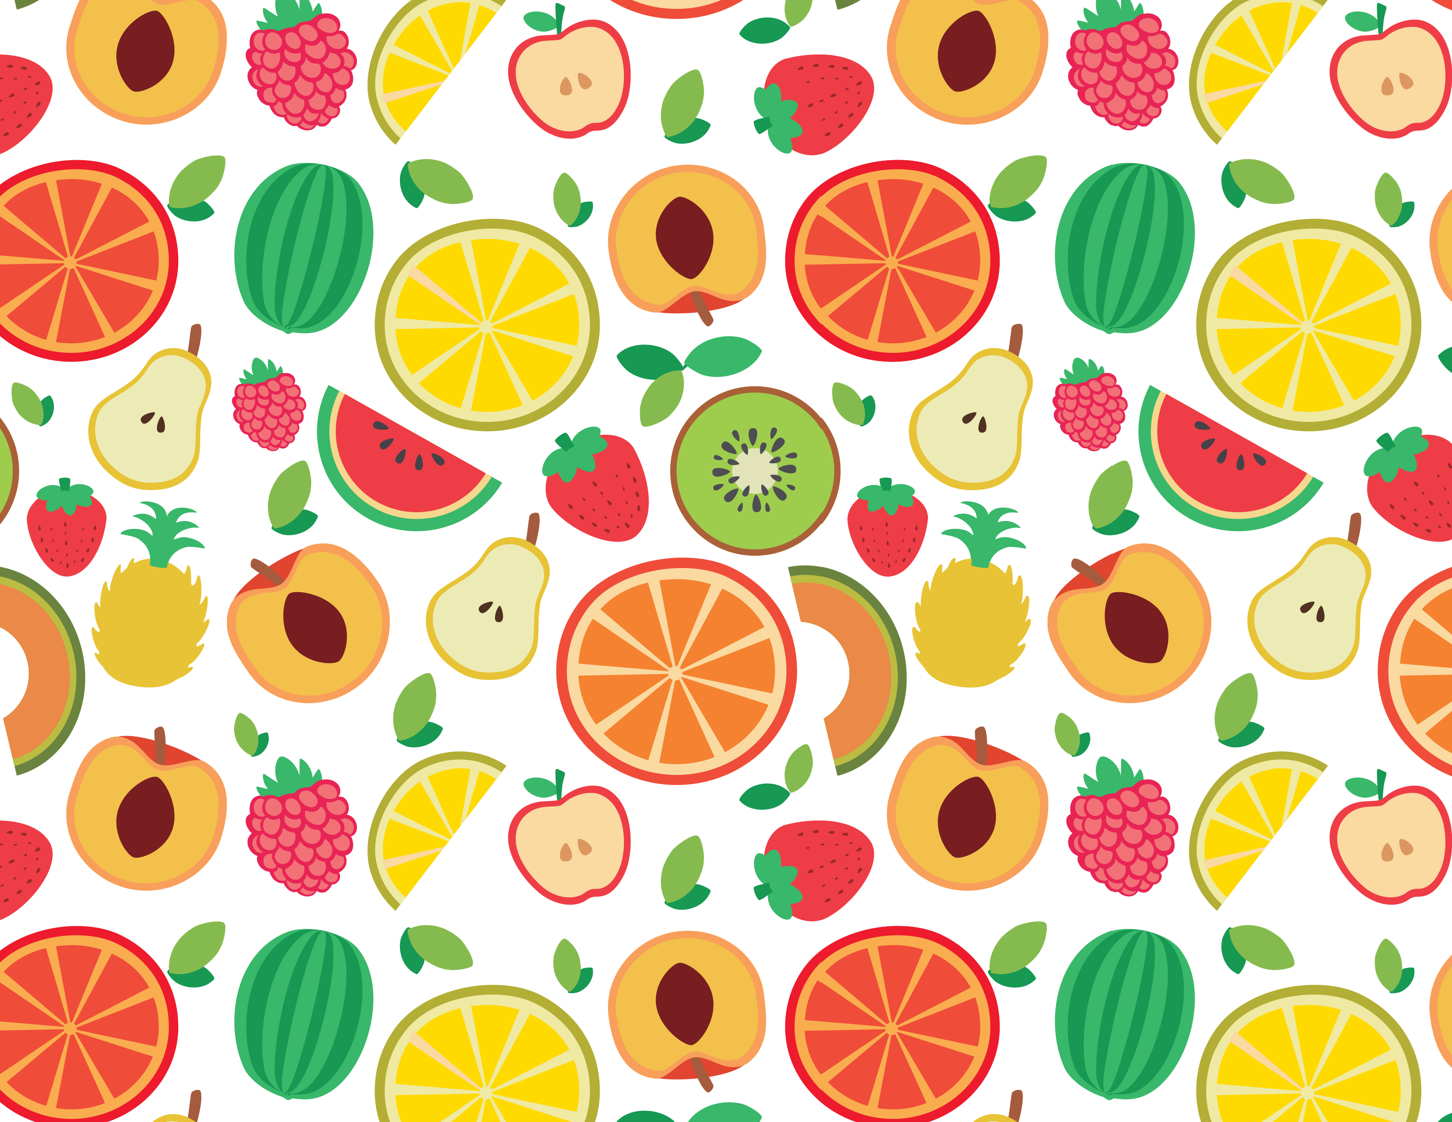
How many?
Notes:
Ask students to count specific fruits.
Peaches: 8
Raspberries: 6
Pears: 4

Slide 24
What did I learn today?
How to use “cl”
How to use “or”, capital letters, and punctuation
New “cl” words
Reading

Slide 25
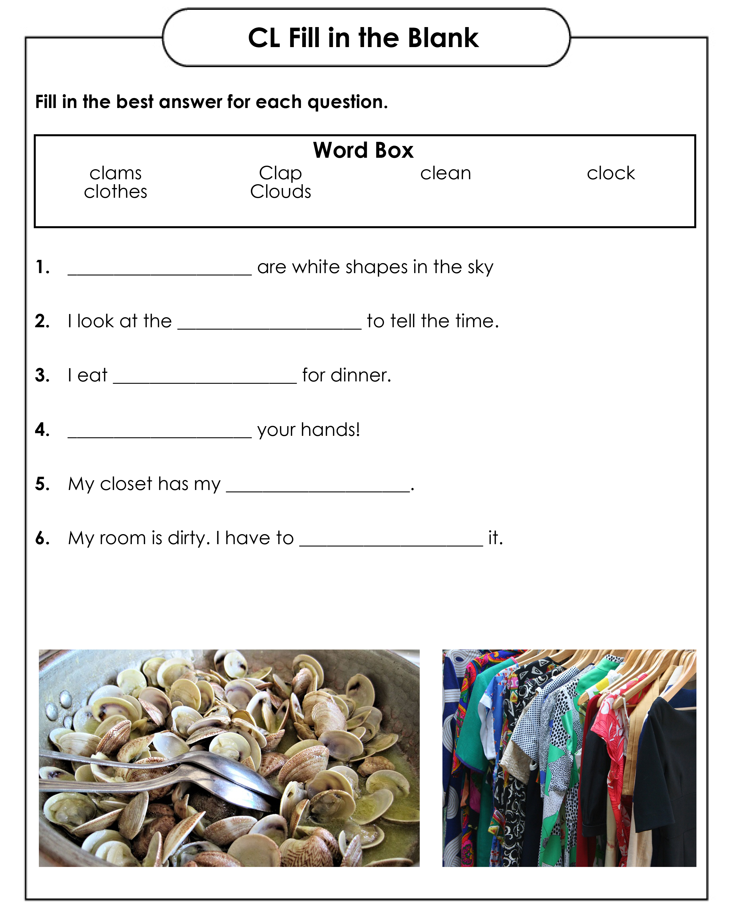
Homework
Download the “CL Fill in the Blank Worksheet.pdf” and complete it.
Notes:
Download the “CL Fill in the Blank Worksheet.pdf” and complete it.

