Slide 1
Lesson 3: Tutoring FOOD

Slide 2
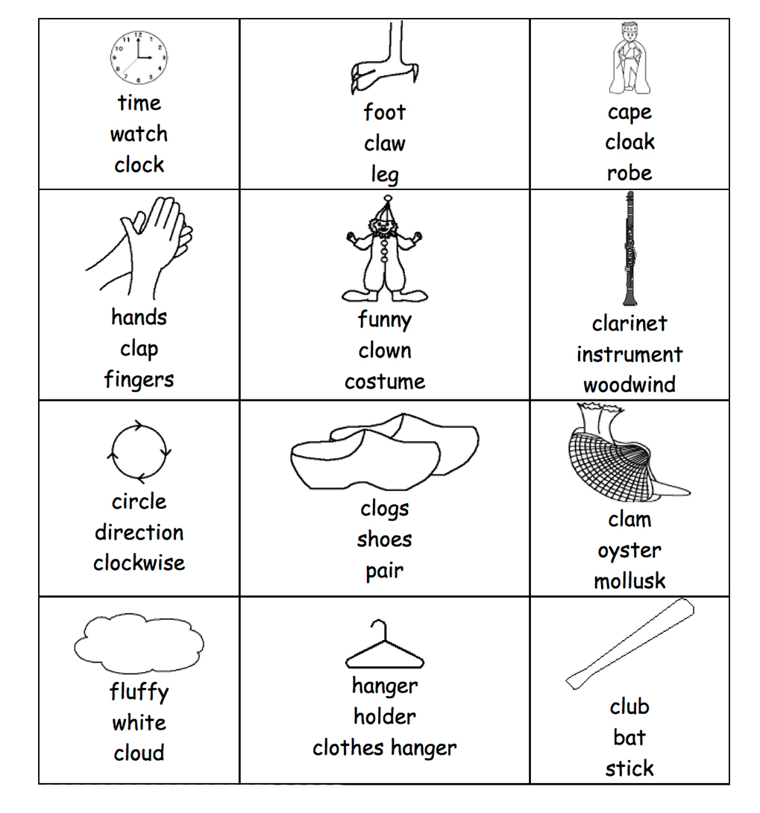
Circle the CL word

Slide 3
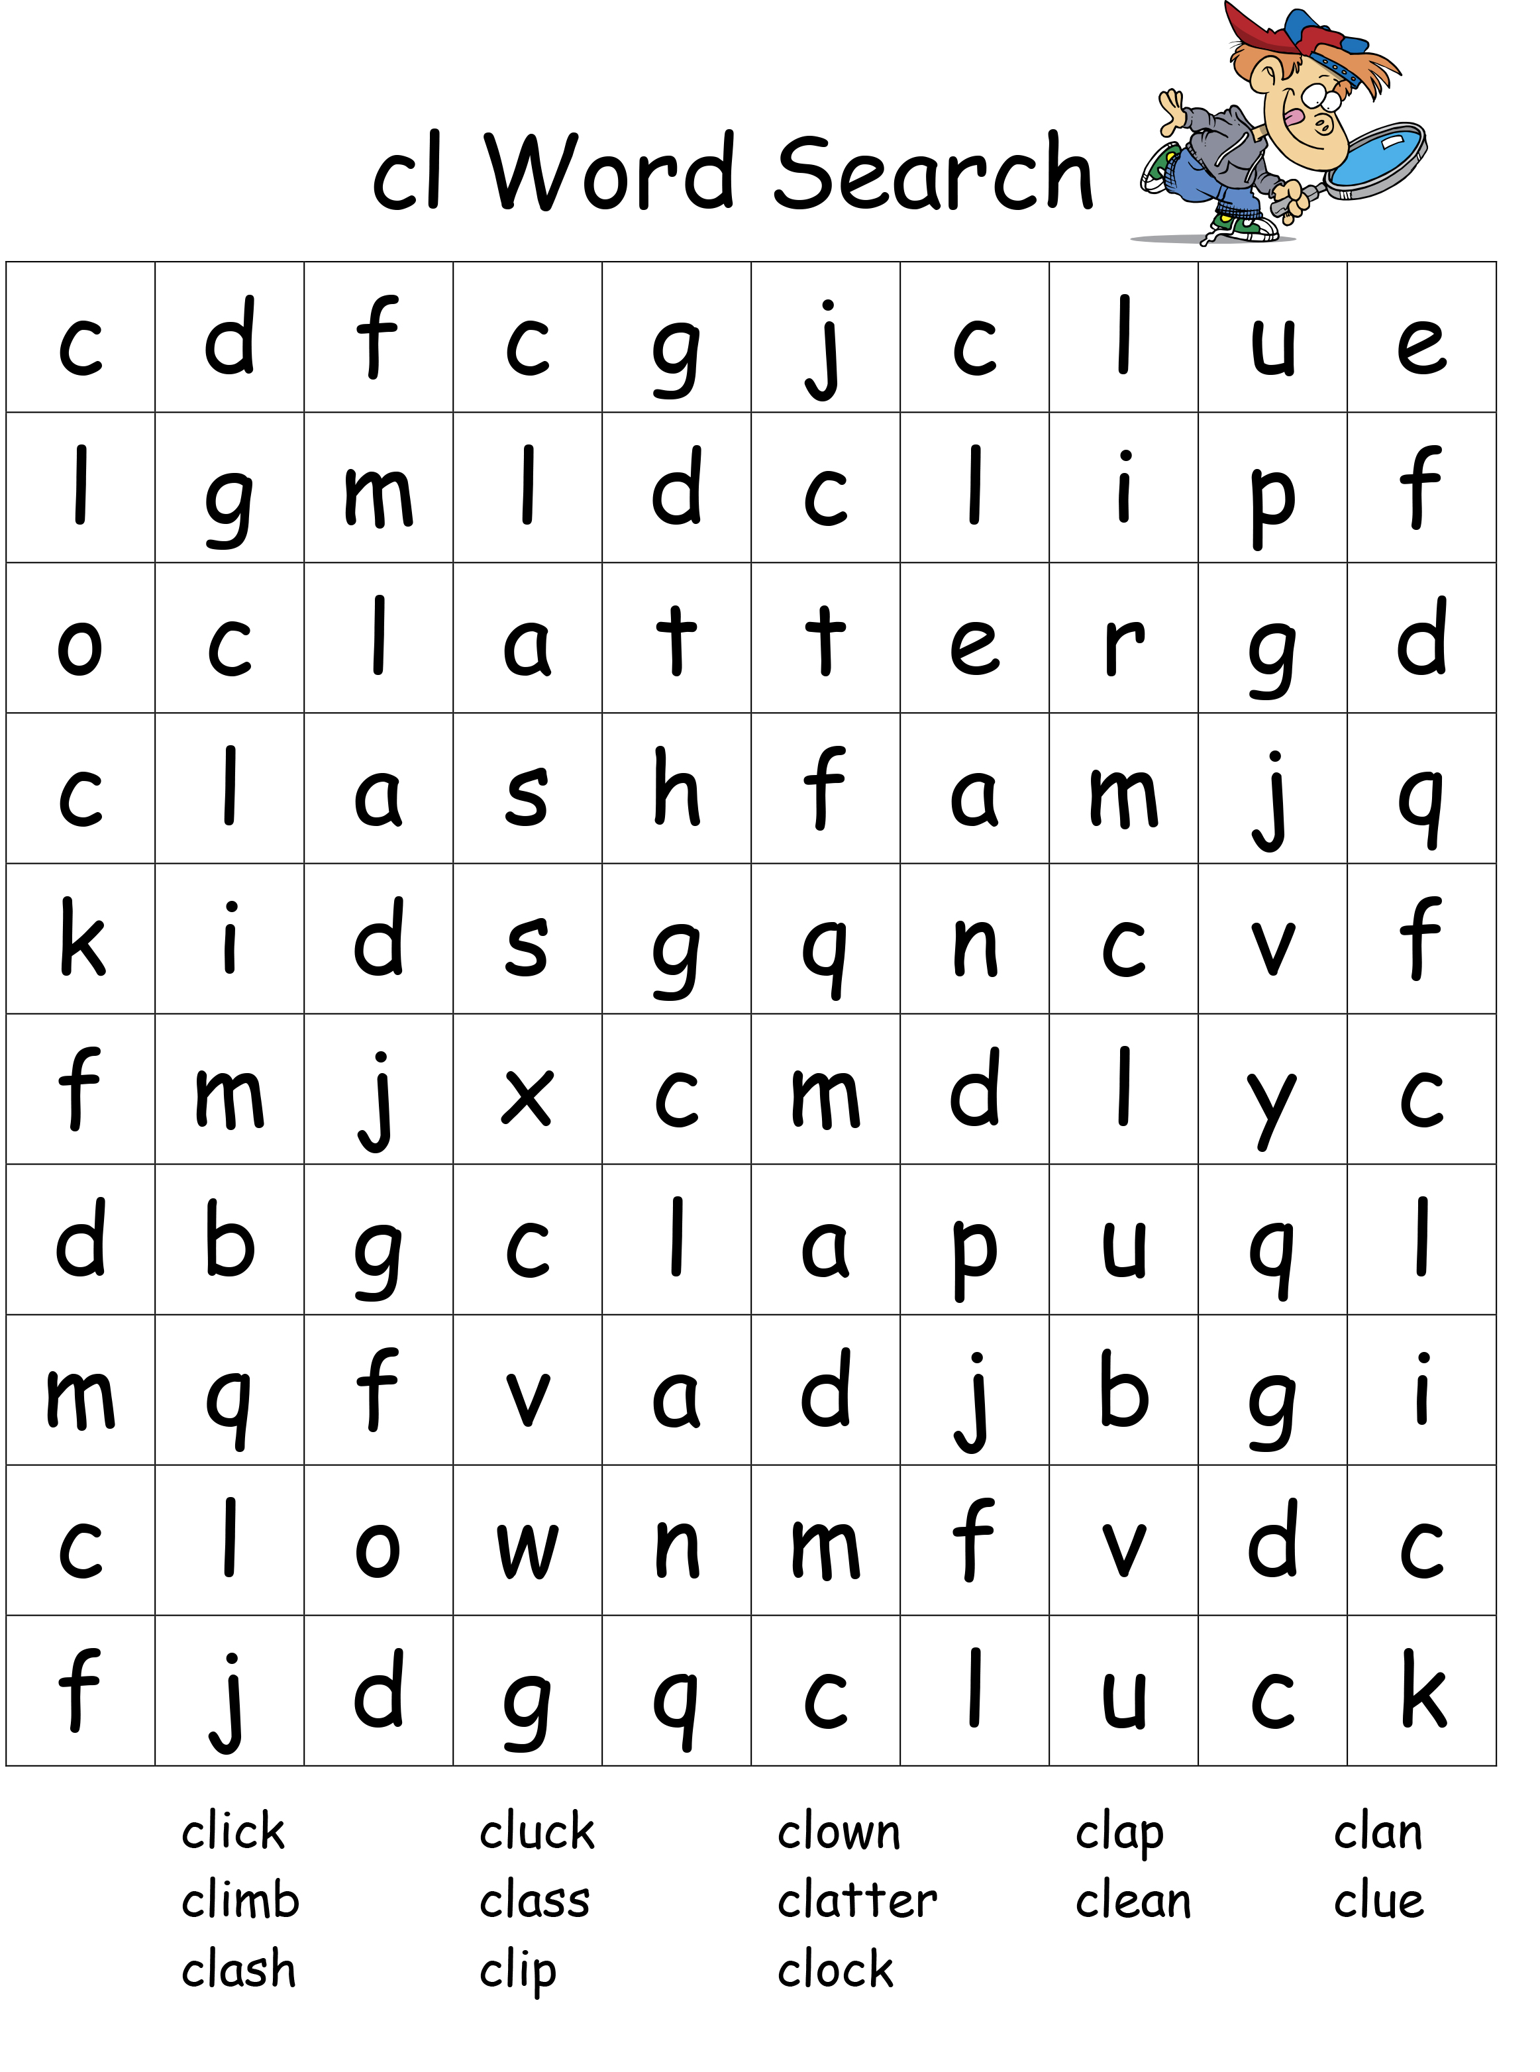
CL Word Search

Slide 4
Food words

Slide 5
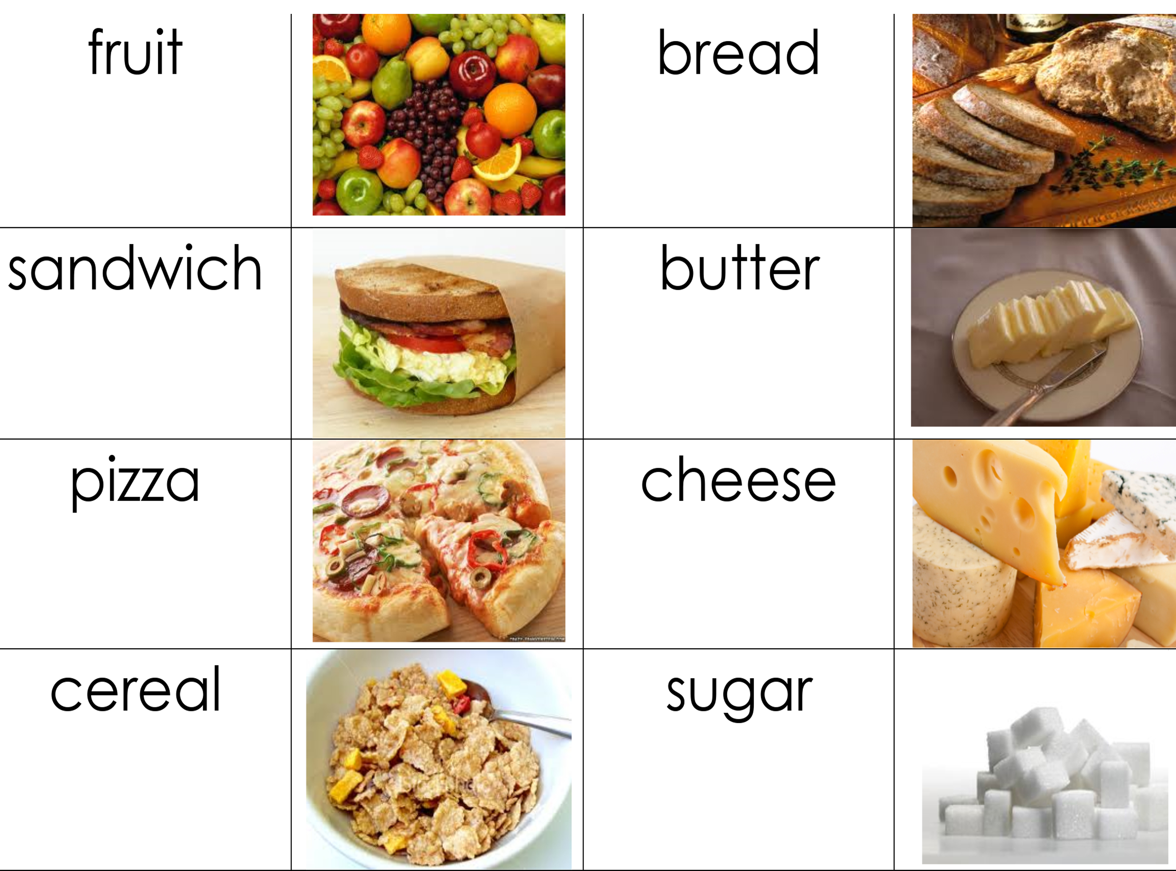
Food words

Slide 6
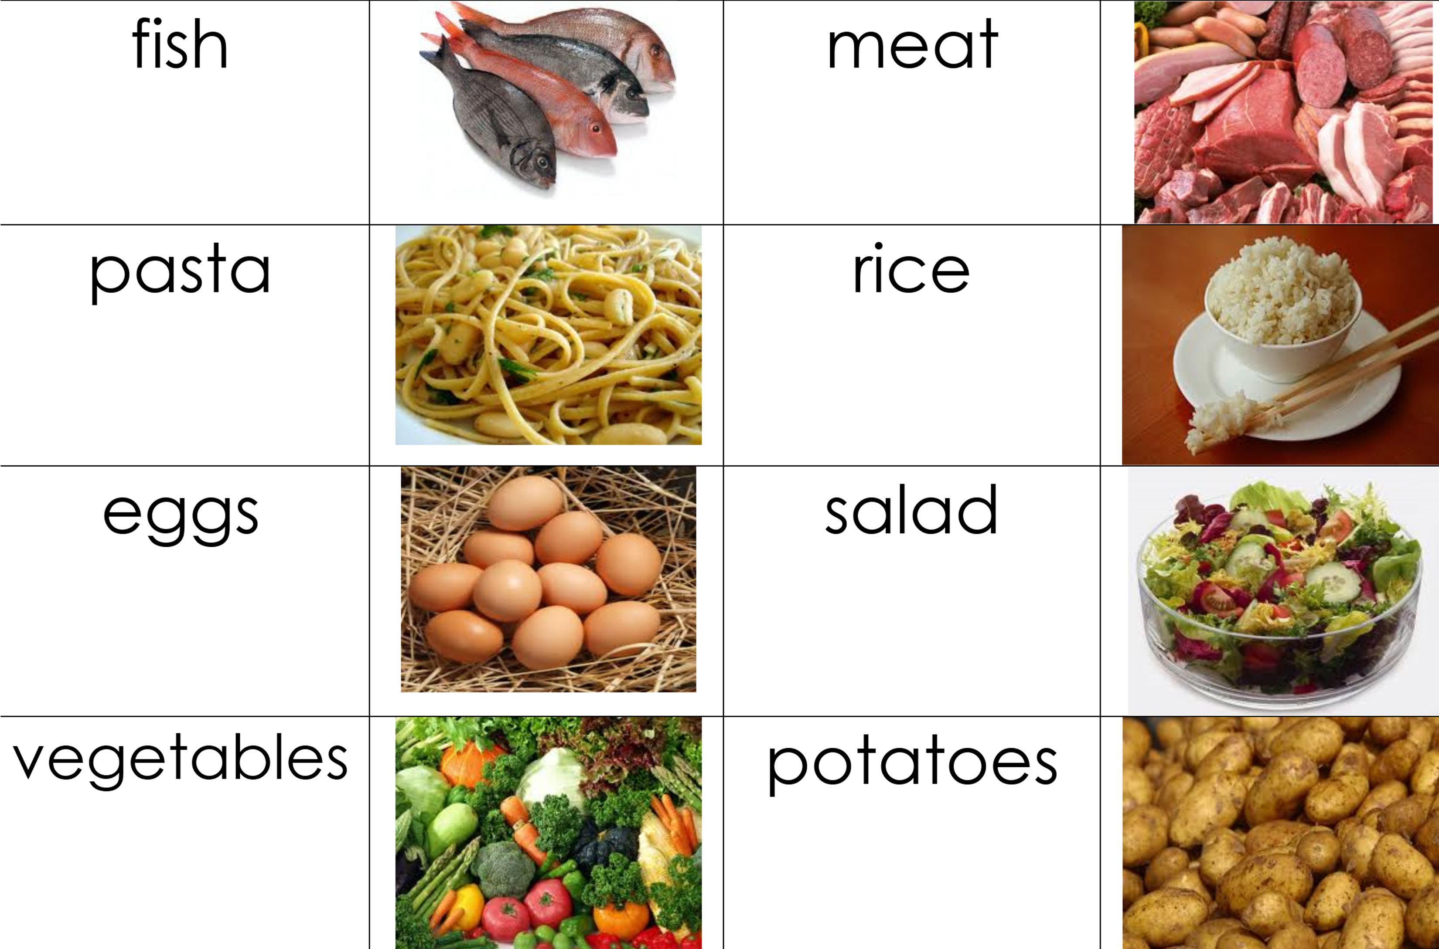
Food words

Slide 7
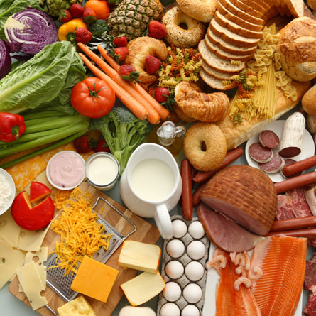
Create a meal
Create a meal from these ingredients.
Write what ingredients you would use, how you would make the meal, and what you will be eating. Is the meal for breakfast, lunch or dinner?

Slide 8
What did I learn today?
How to use “cl”
How to use “or”, capital letters, and punctuation
New “cl” words
Reading

