Slide 1
Lesson 4 FOOD

Slide 2
What we will learn today
Review ‘cl’, ‘sh’ and ‘kn’ words
Using “but”, “or”, “and” capitalization and punctuation
Reading practice
Notes:
Go over the learning goals.

Slide 3
Let’s take up last week’s homework

Slide 4
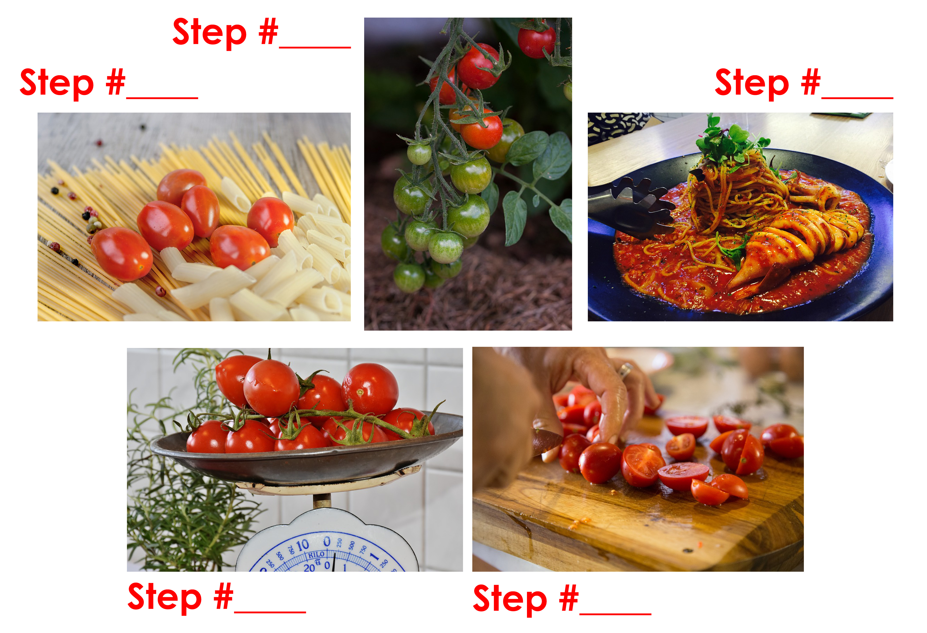
Food Preparation

Slide 5
Food Preparation
1
2/3
5
2/3
4

Slide 6
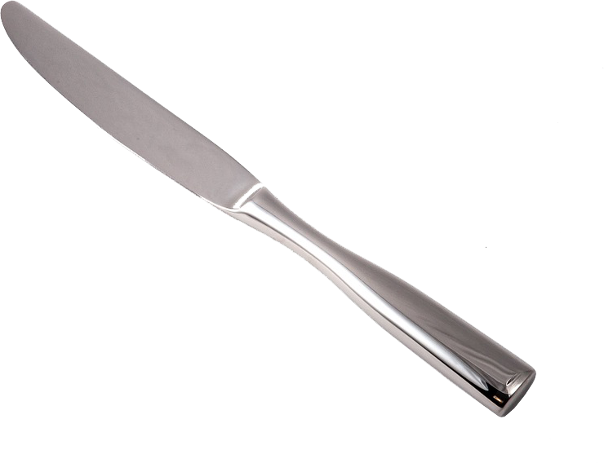
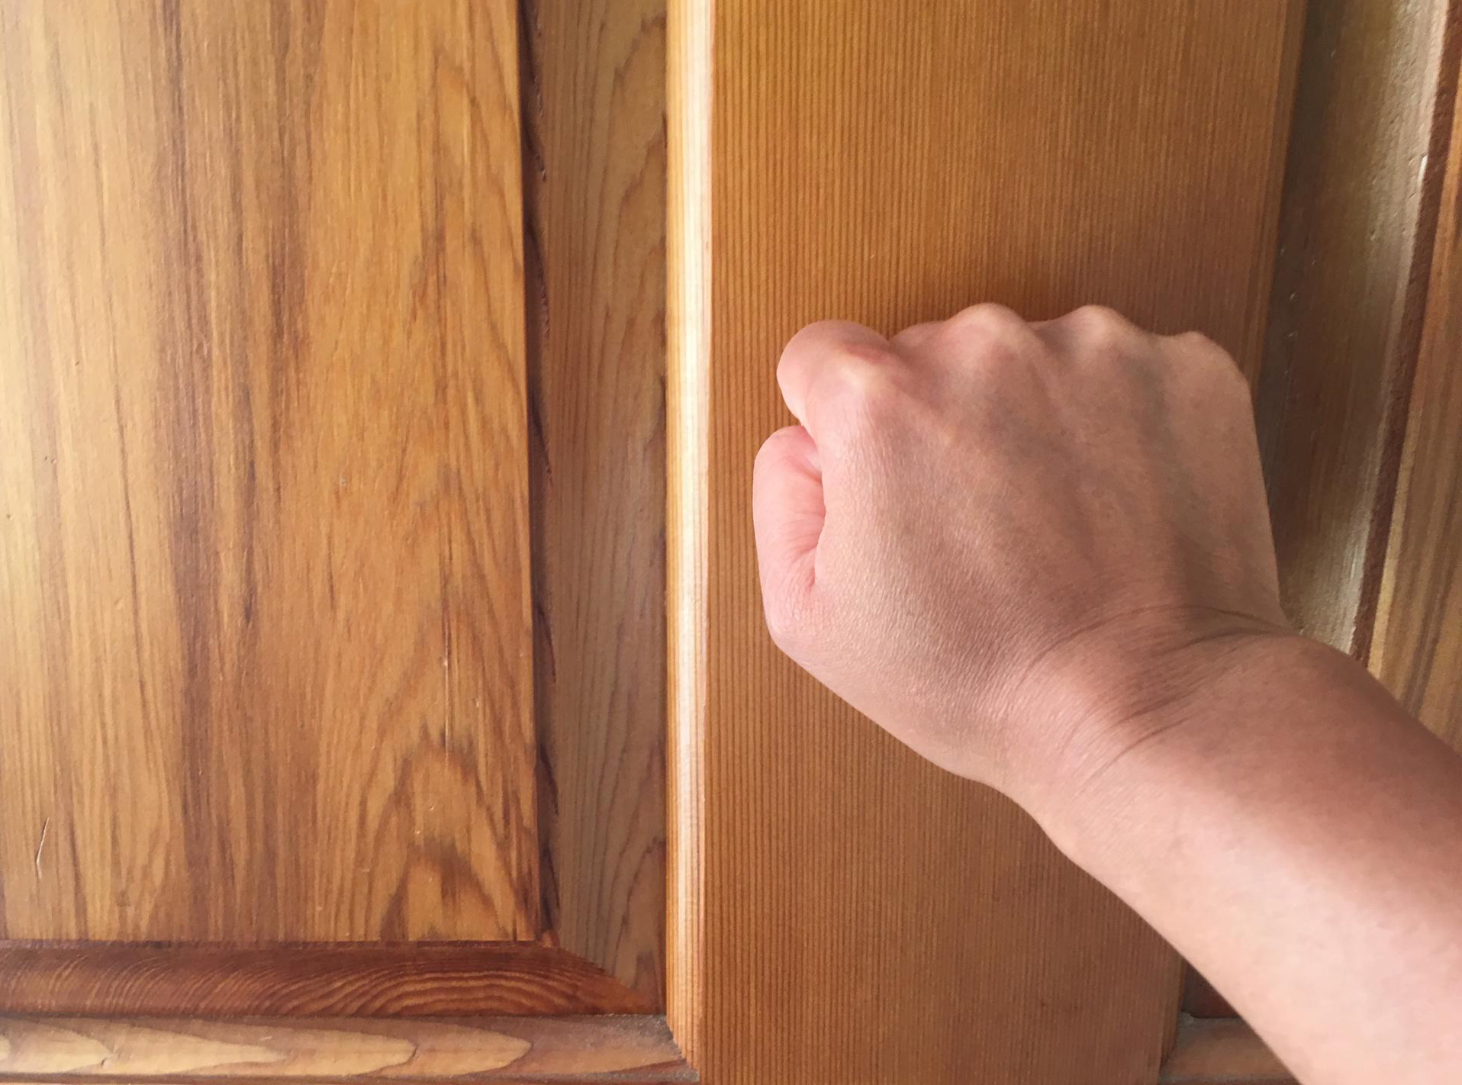
Do you remember?
kn_ _ _
kn_ _ _
kn_ _

Slide 7
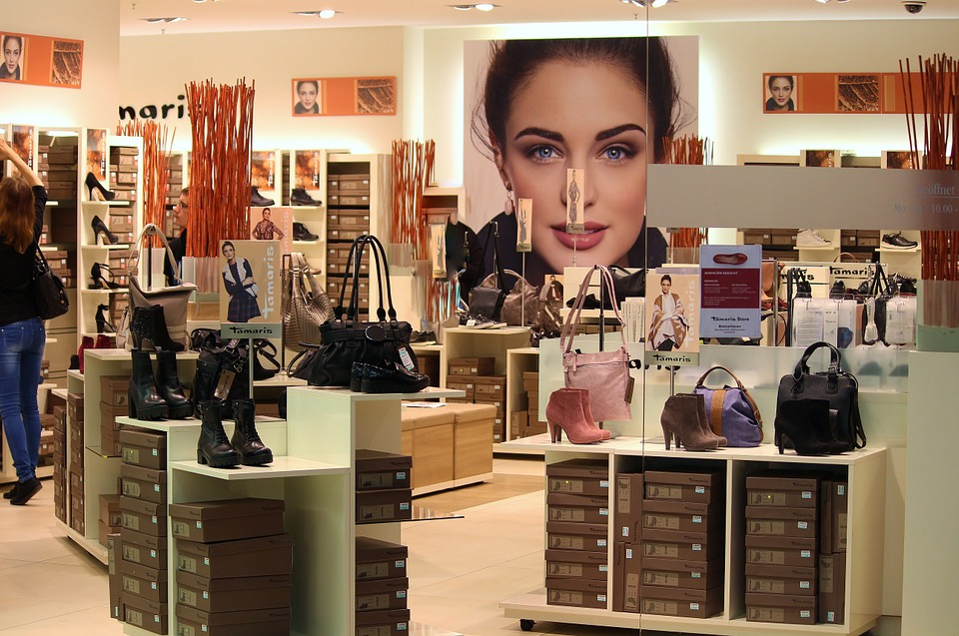
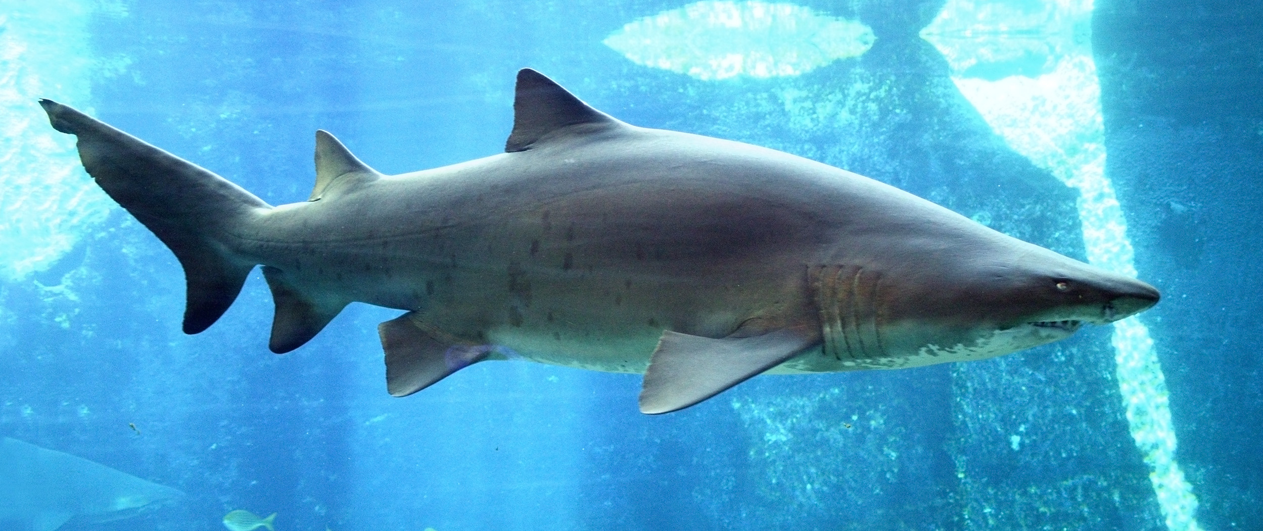
How do you spell?
sh _ _
sh _ _ _
_ _ _sh

Slide 8
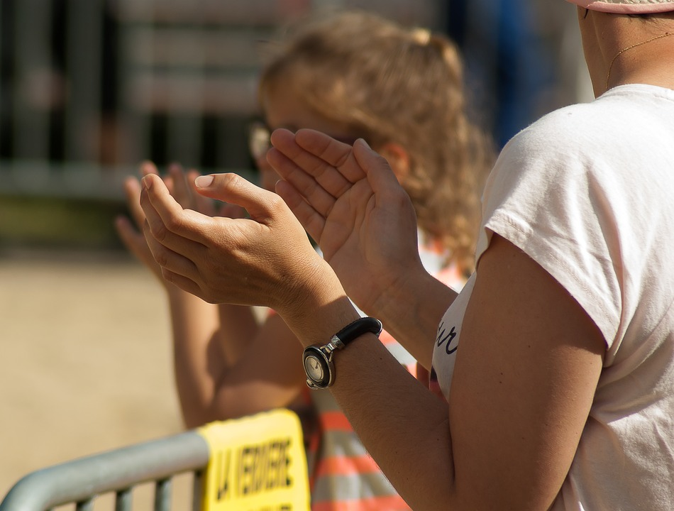
Spelling!
cl _ _
cl_ _ _
cl_ _ _

Slide 9
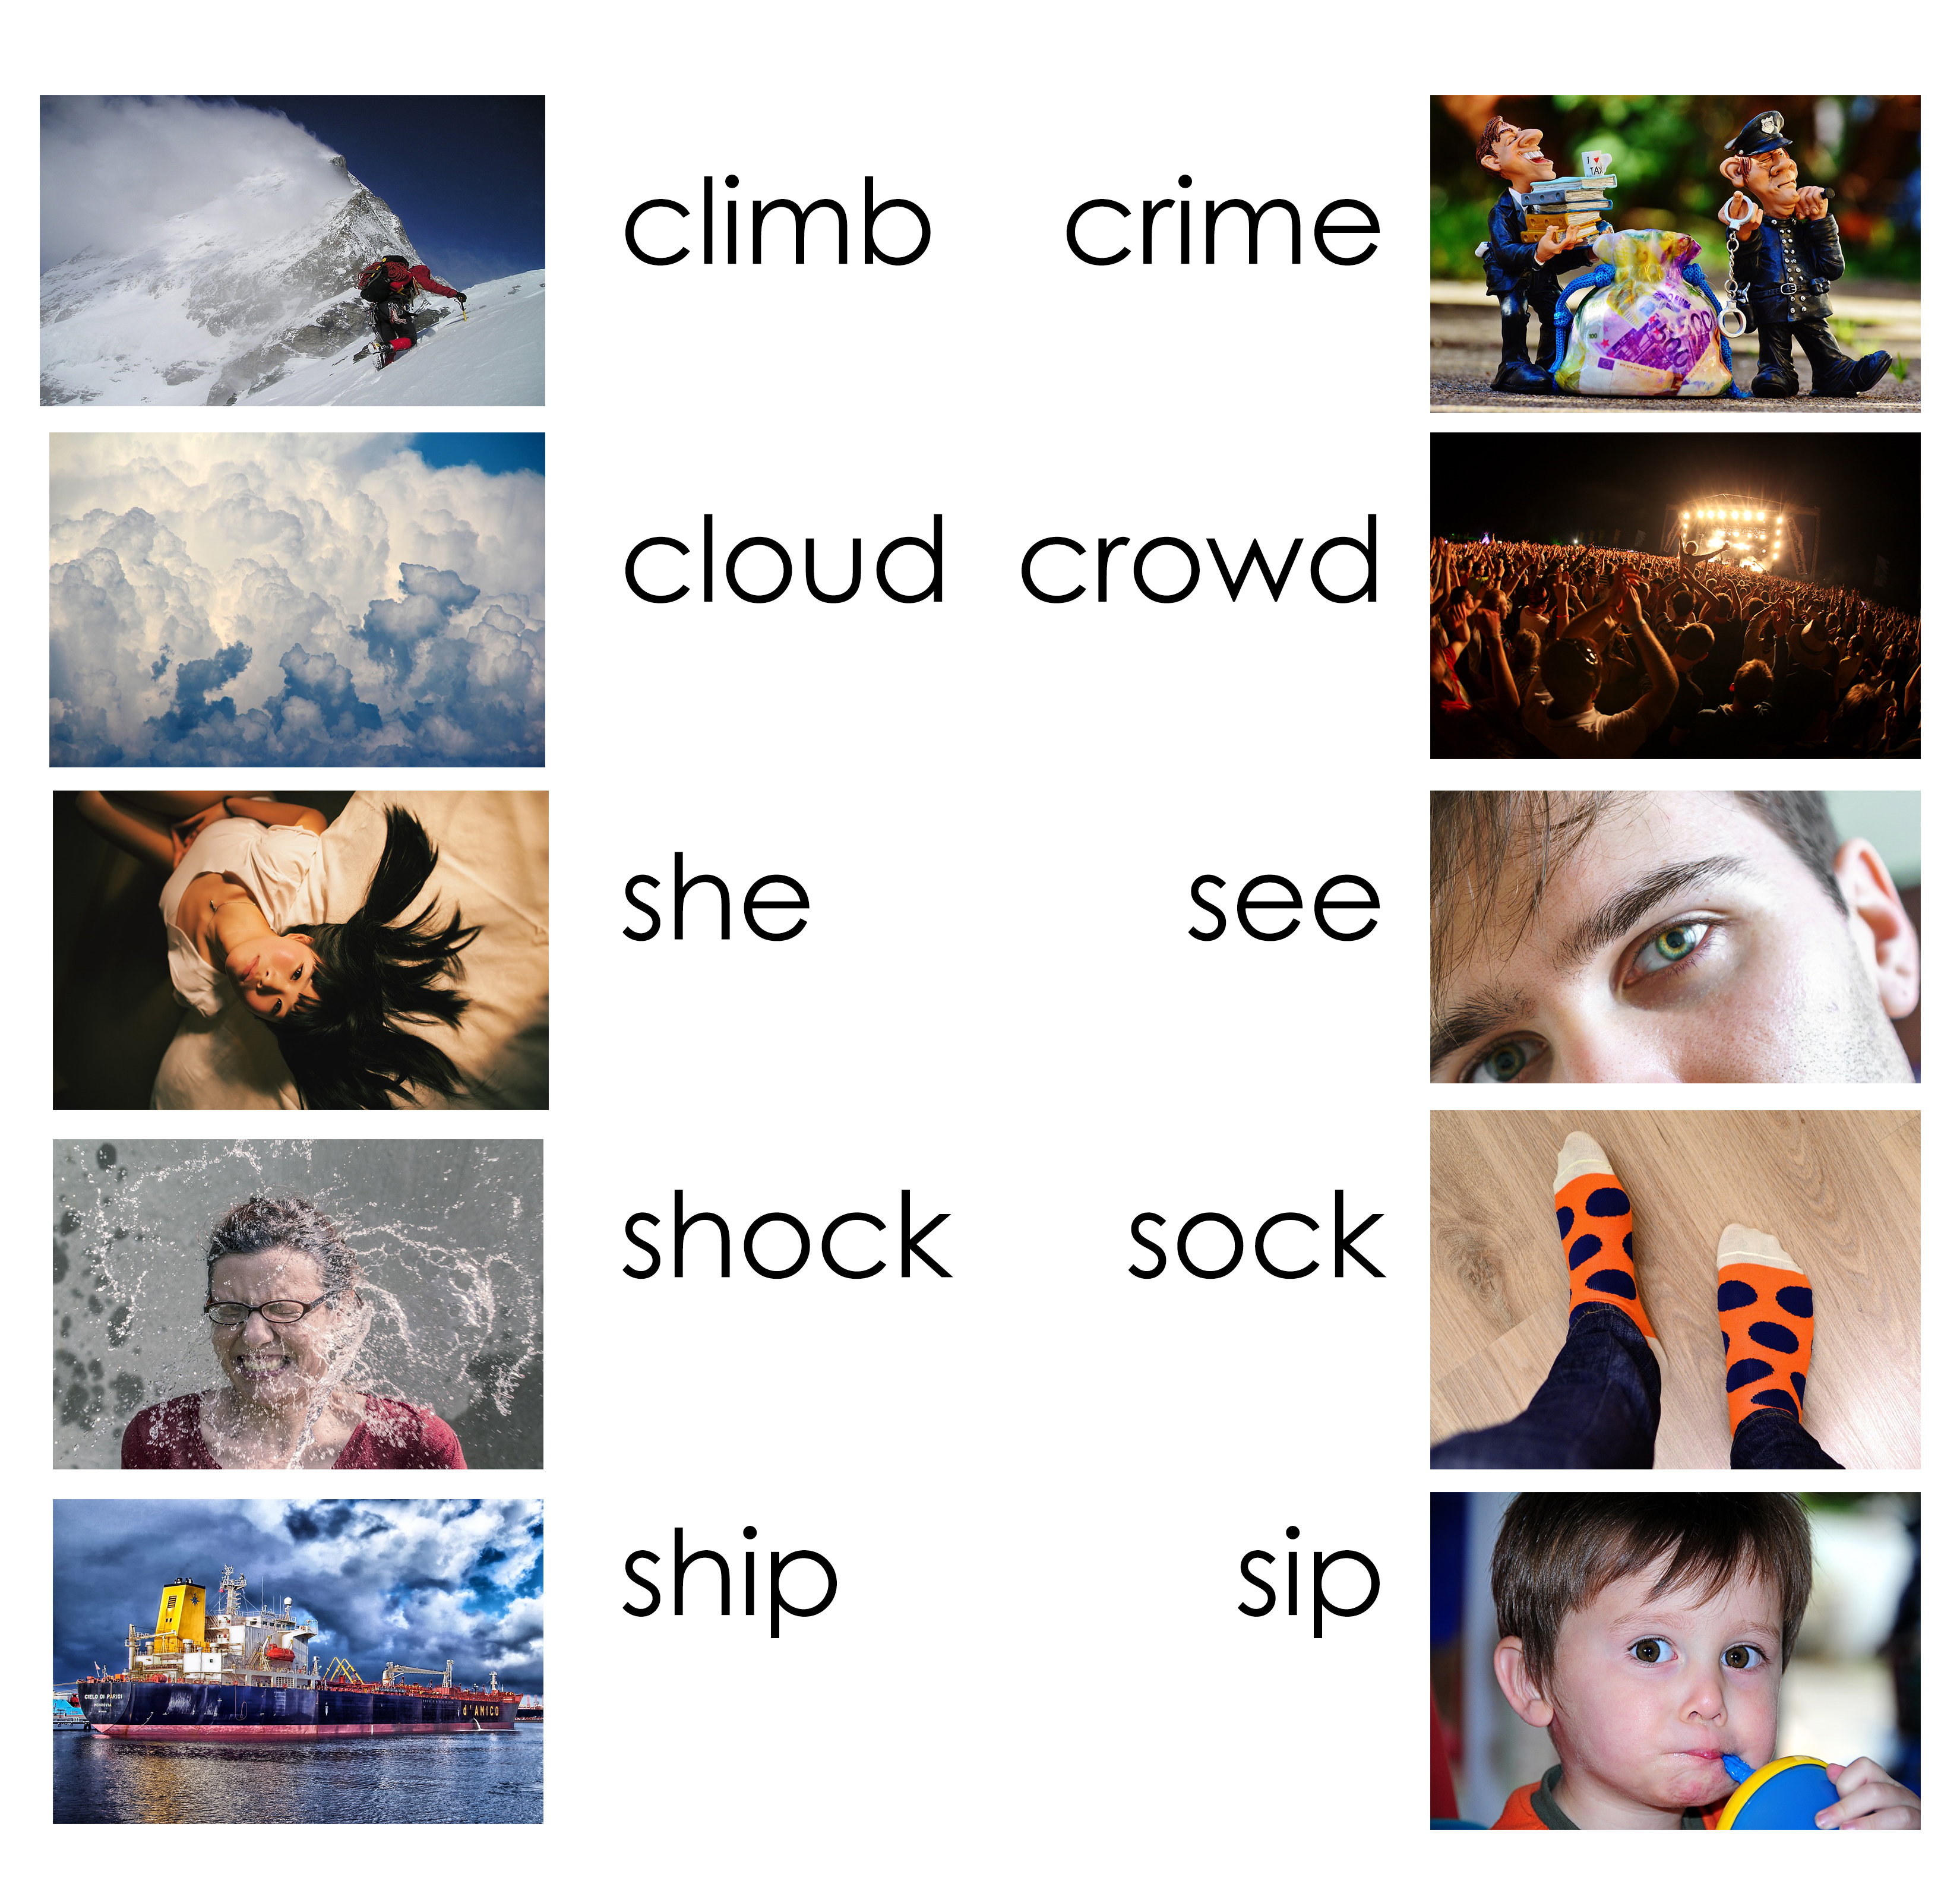
Practice saying…

Slide 10
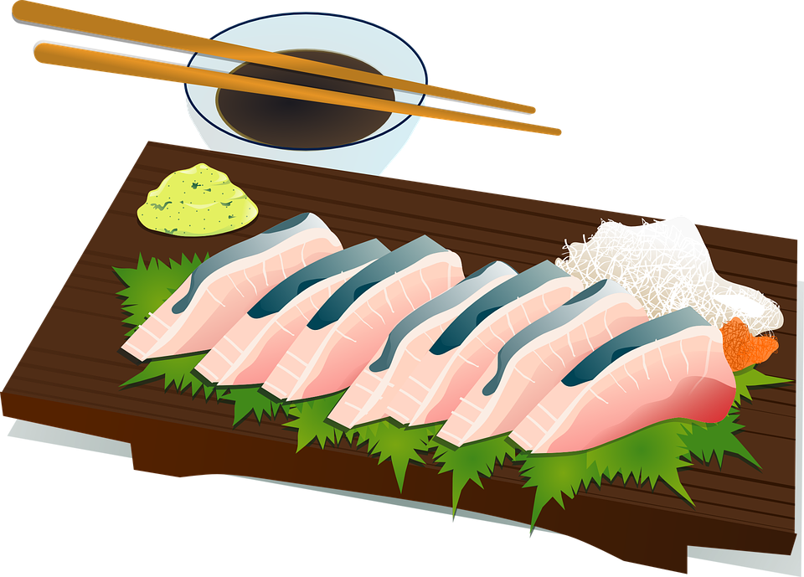
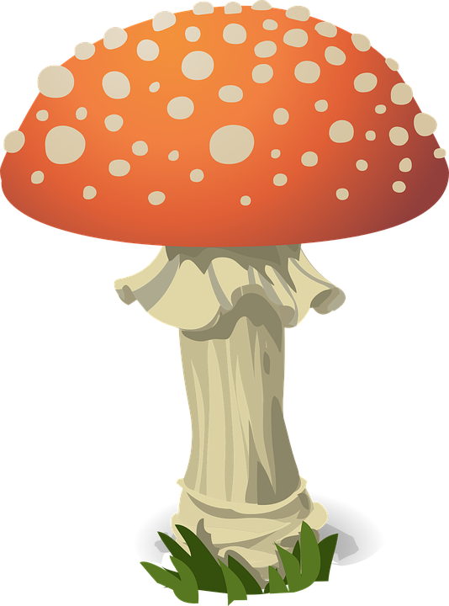
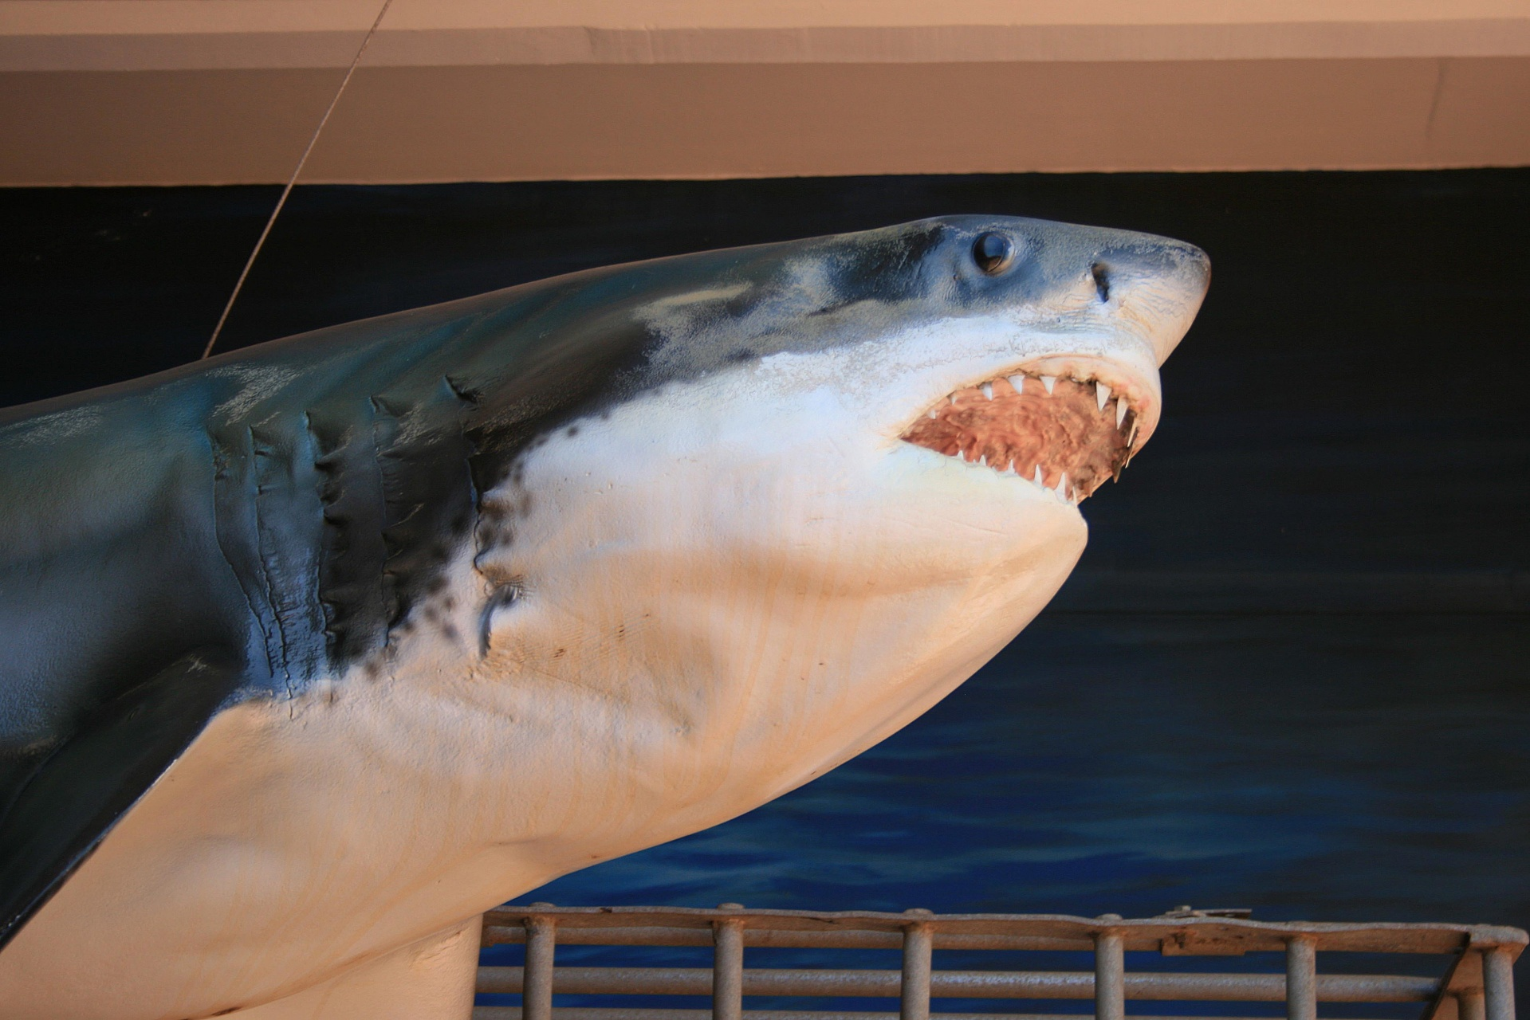
Memory

Slide 11
Practice your capitals

Slide 12
Capitalization answers

Slide 13
Using punctuation
.
Period
Used to end a sentence
This is my book.
?
Question mark
Used at the end of a question.
Where is your book?
!
Exclamation mark
Used at the end of a sentence to add volume.
Wow!! What a fantastic book!

Slide 14
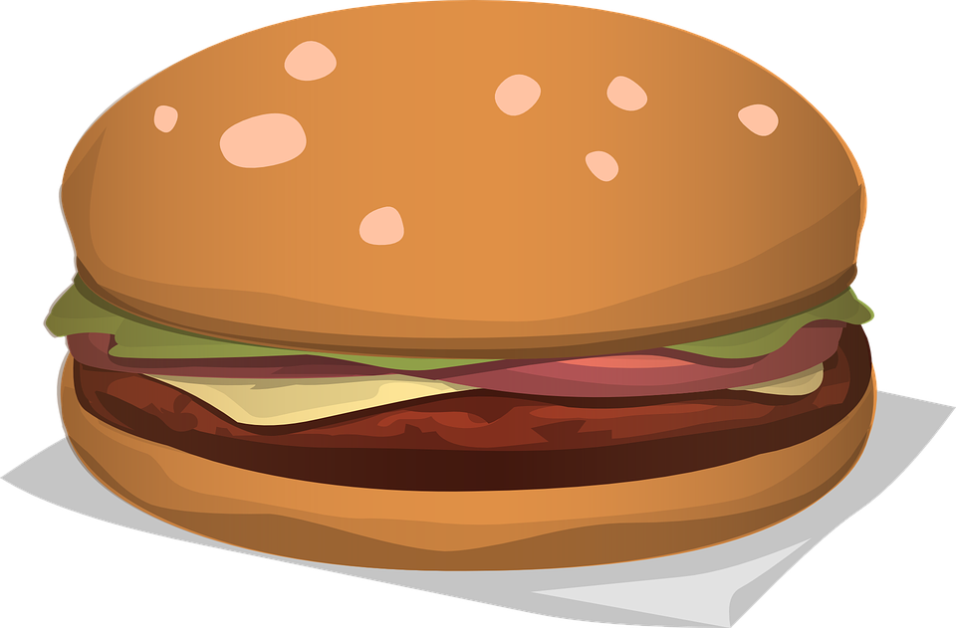
Using “but”, “and”, “or”
And: shows addition and is used when the statements are similar.
I called Jan, and we went out for lunch.
But: is used to connect statements that express opposite ideas.
I also called Steve, but he wasn't home.
Or: is used to show choices.
We could choose beef or chicken for lunch.

Slide 15
But, or, and?

Slide 16
But, or, and?

Slide 17
School lunches around the world

Slide 18
Story Time

Slide 19
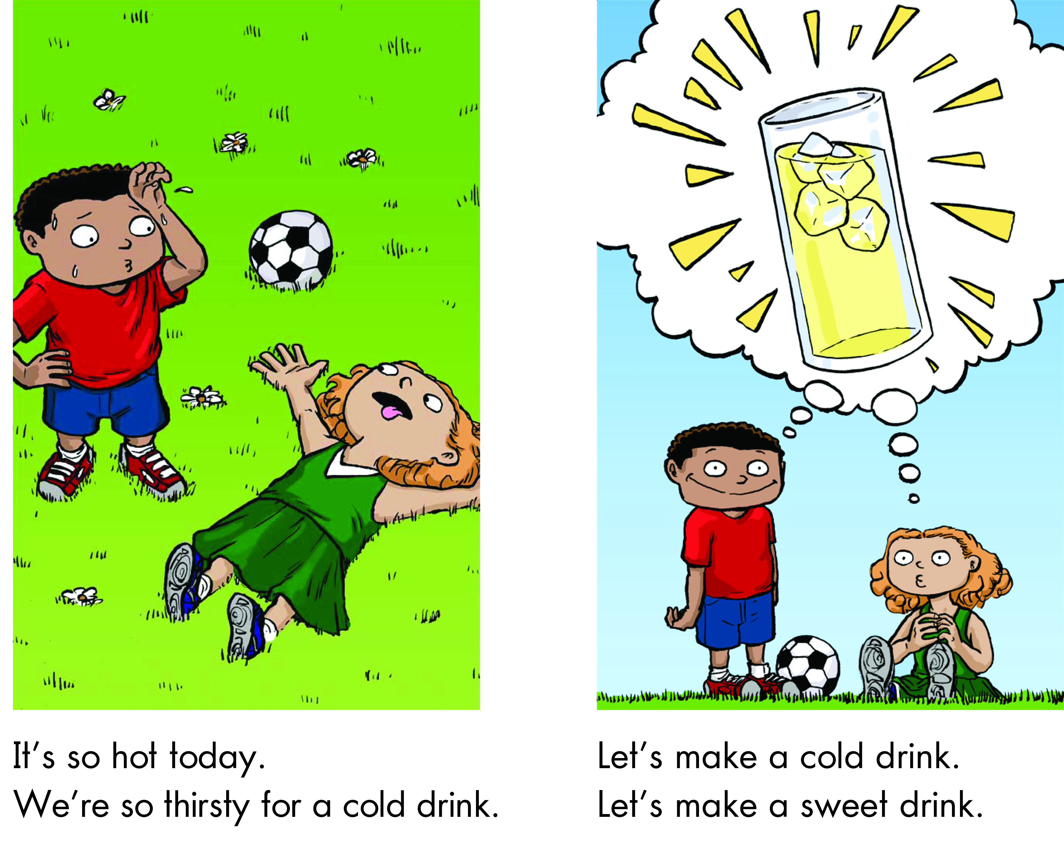

Slide 20
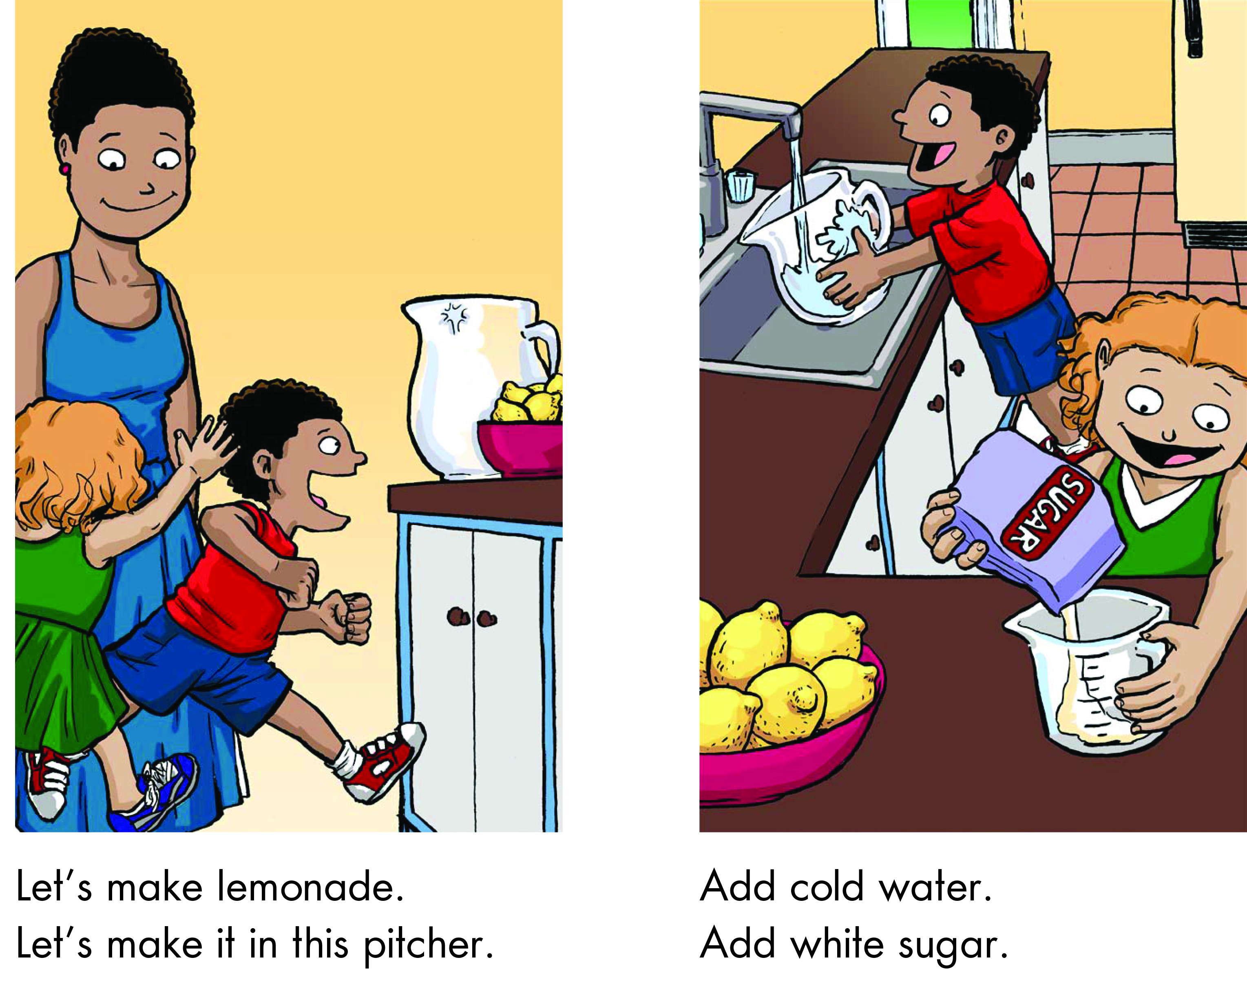

Slide 21
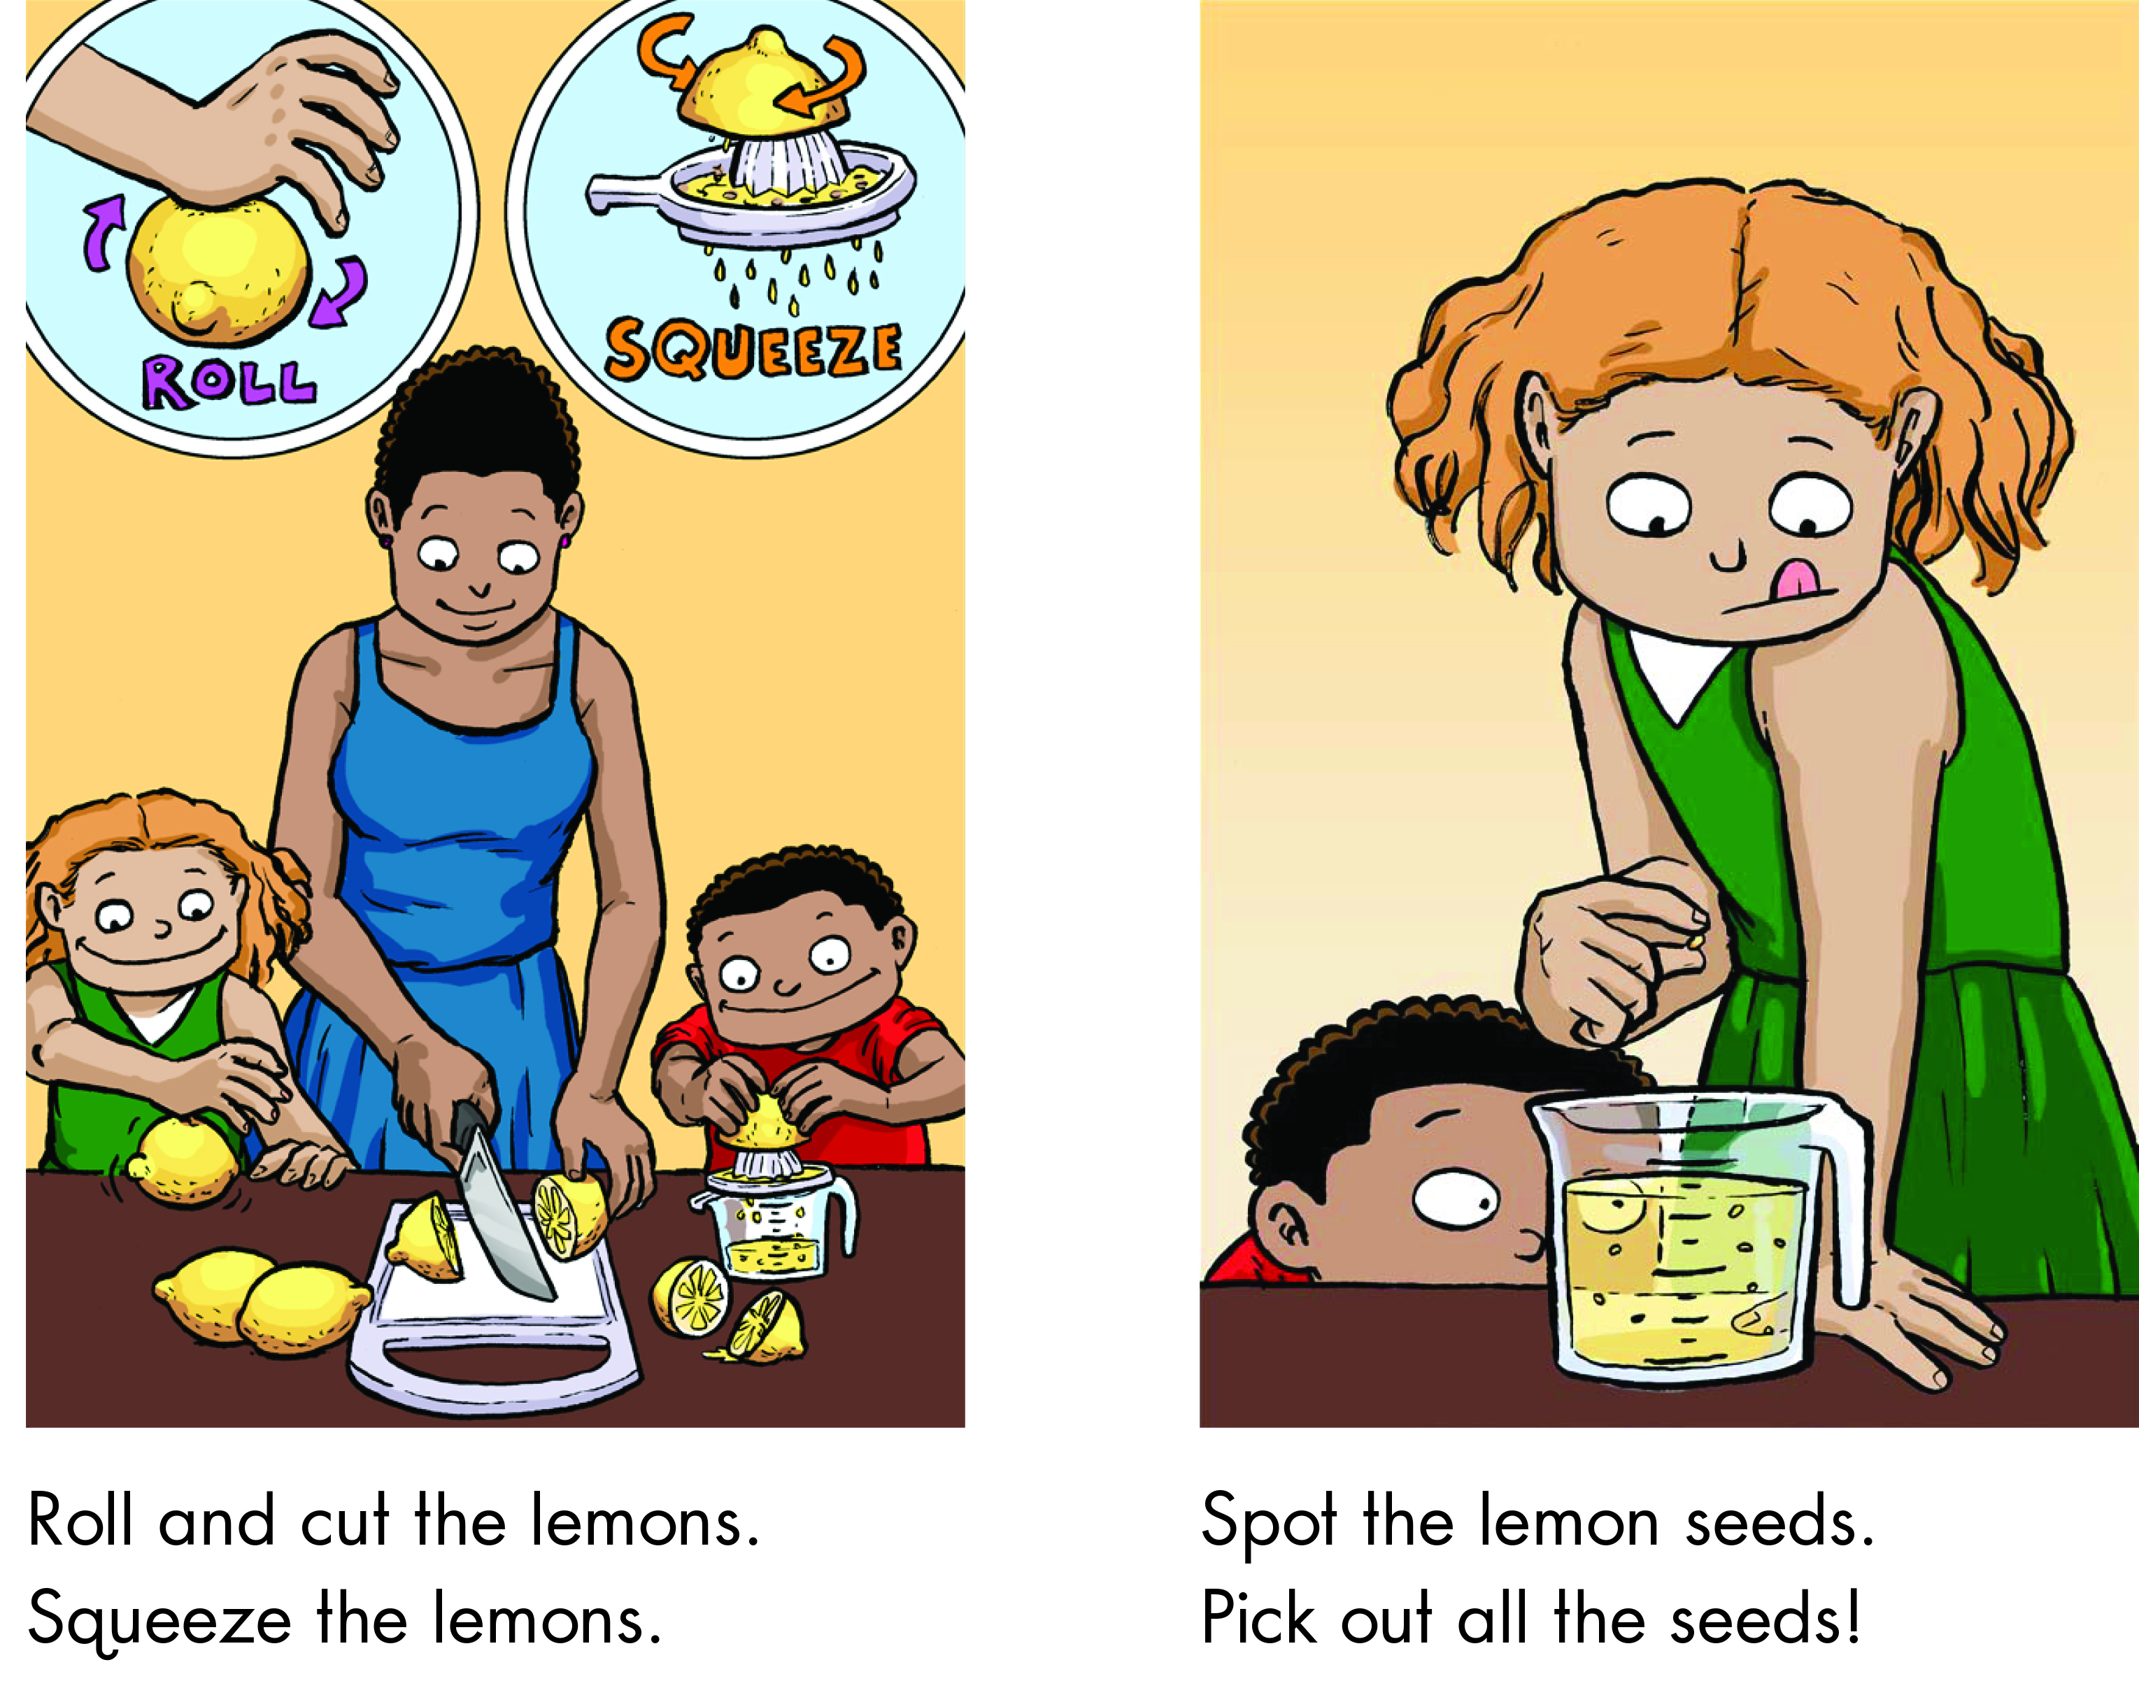

Slide 22
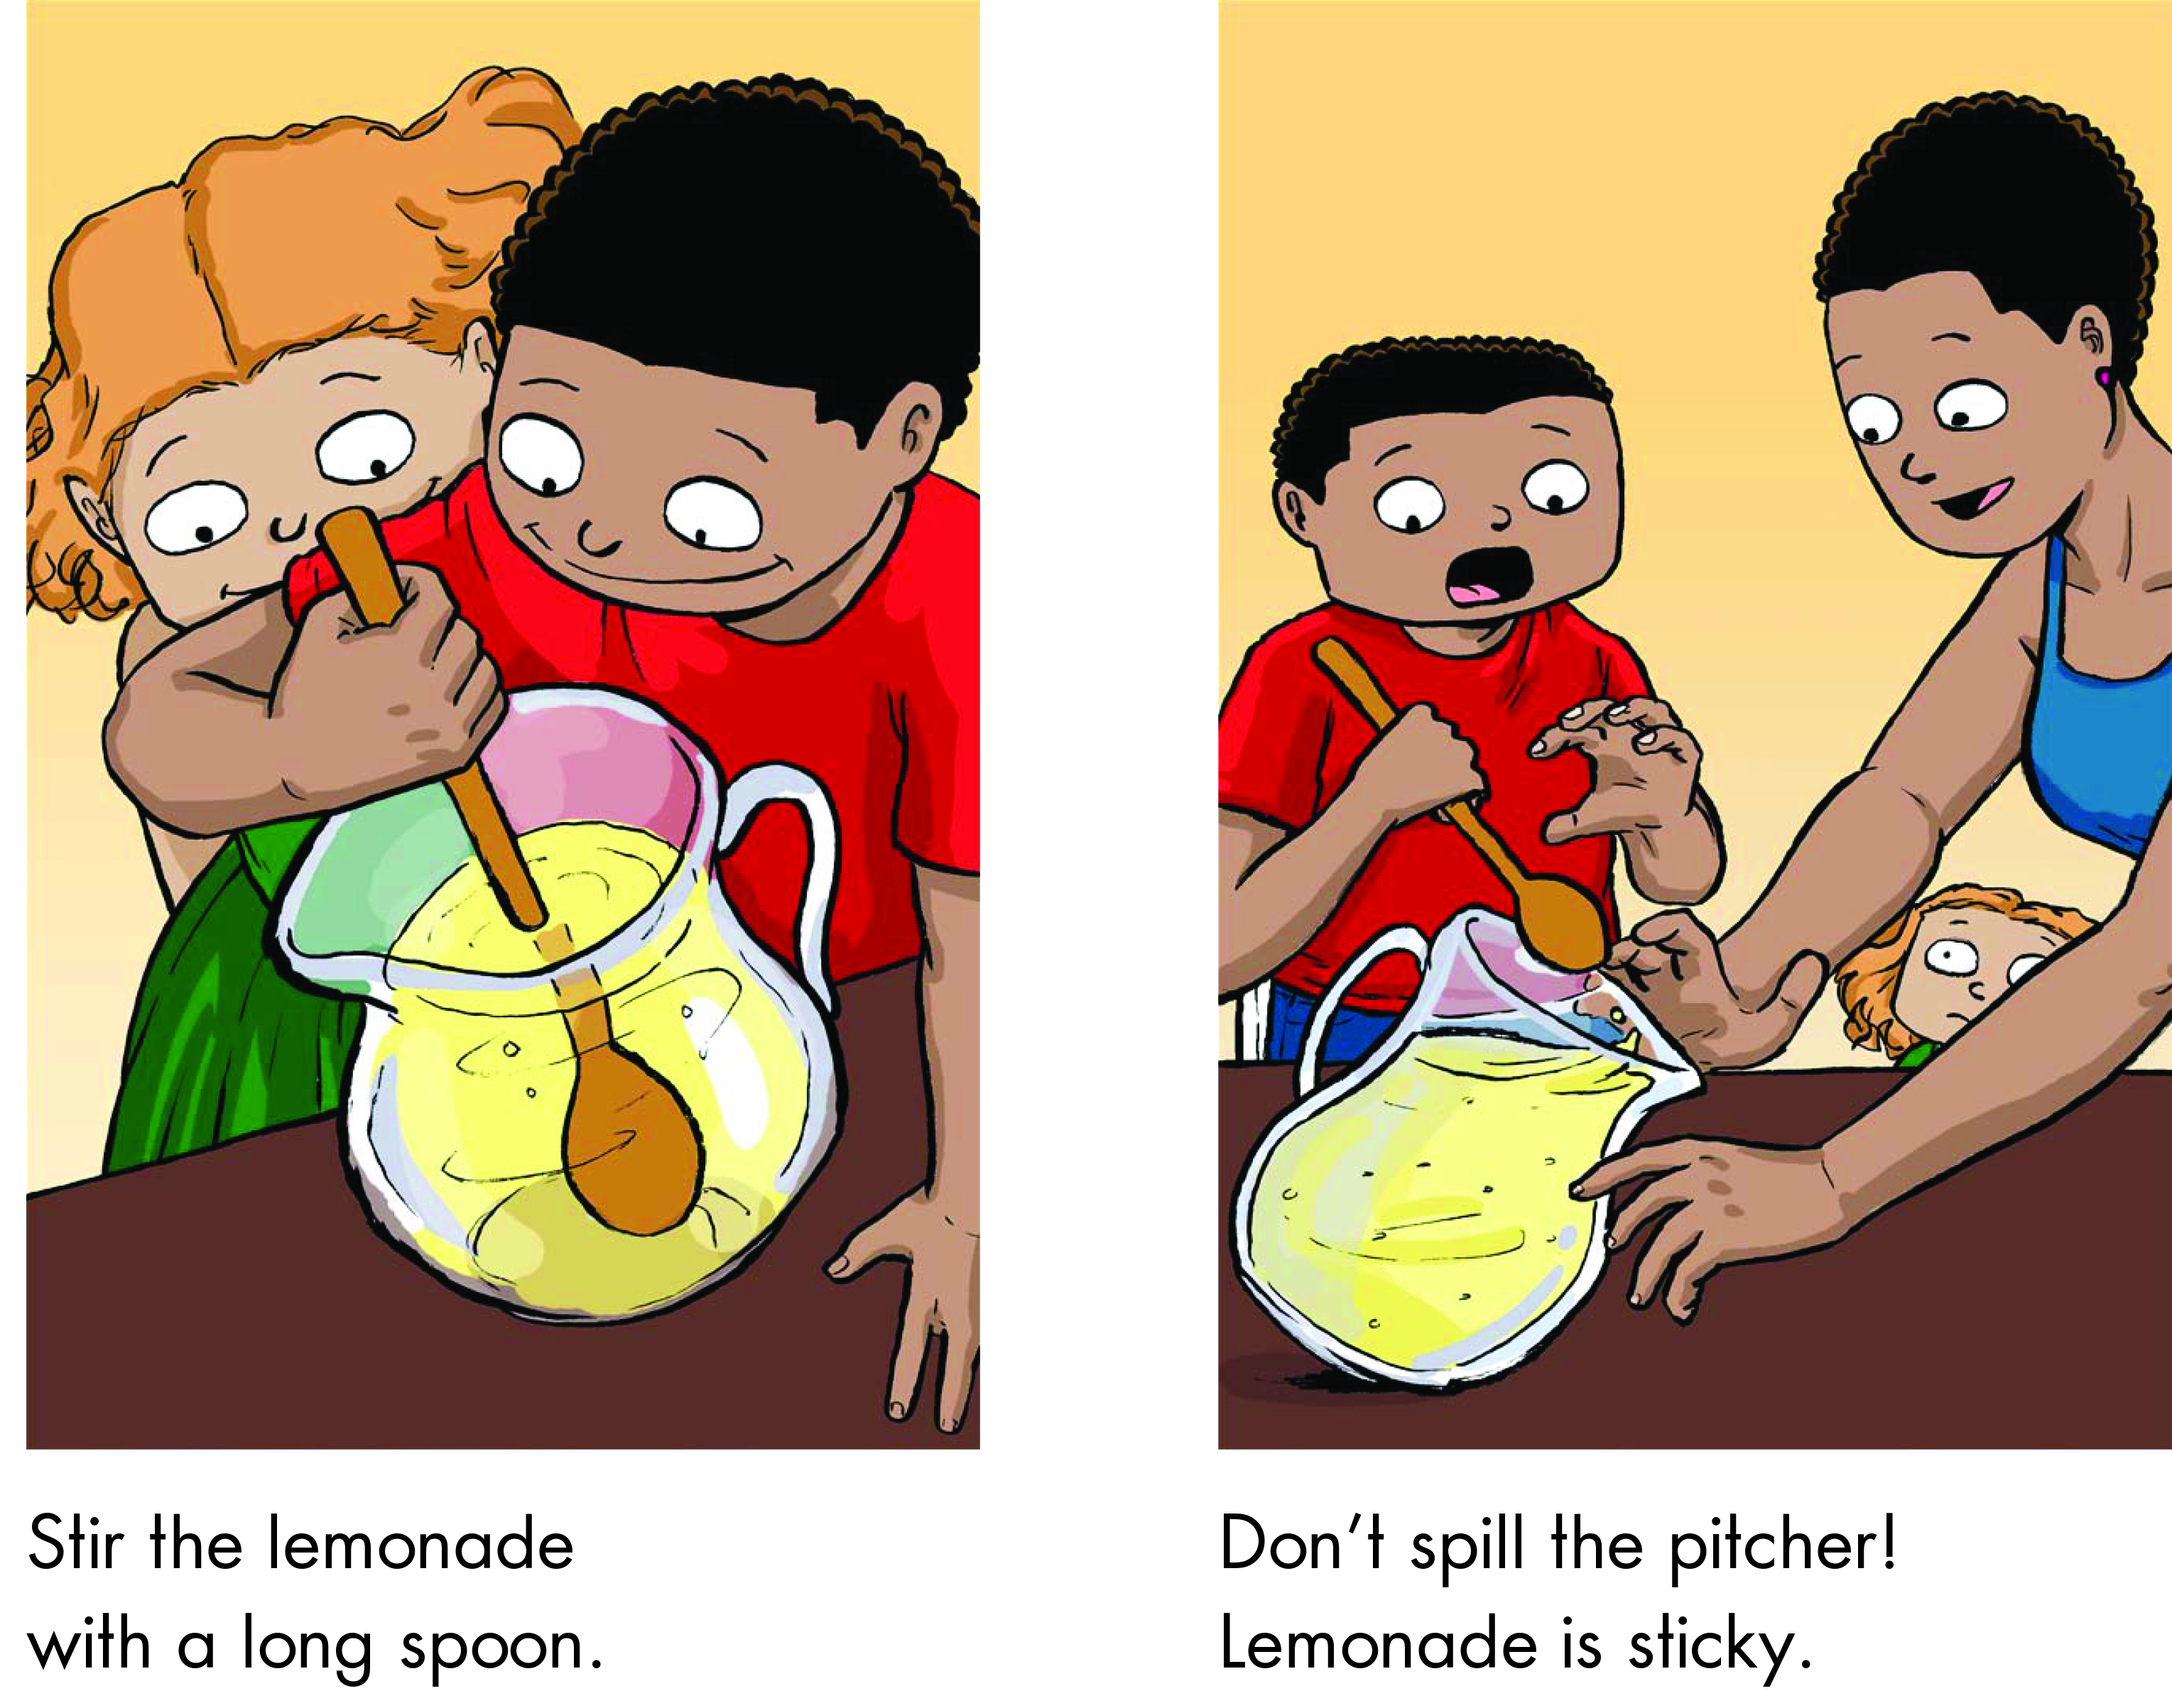

Slide 23
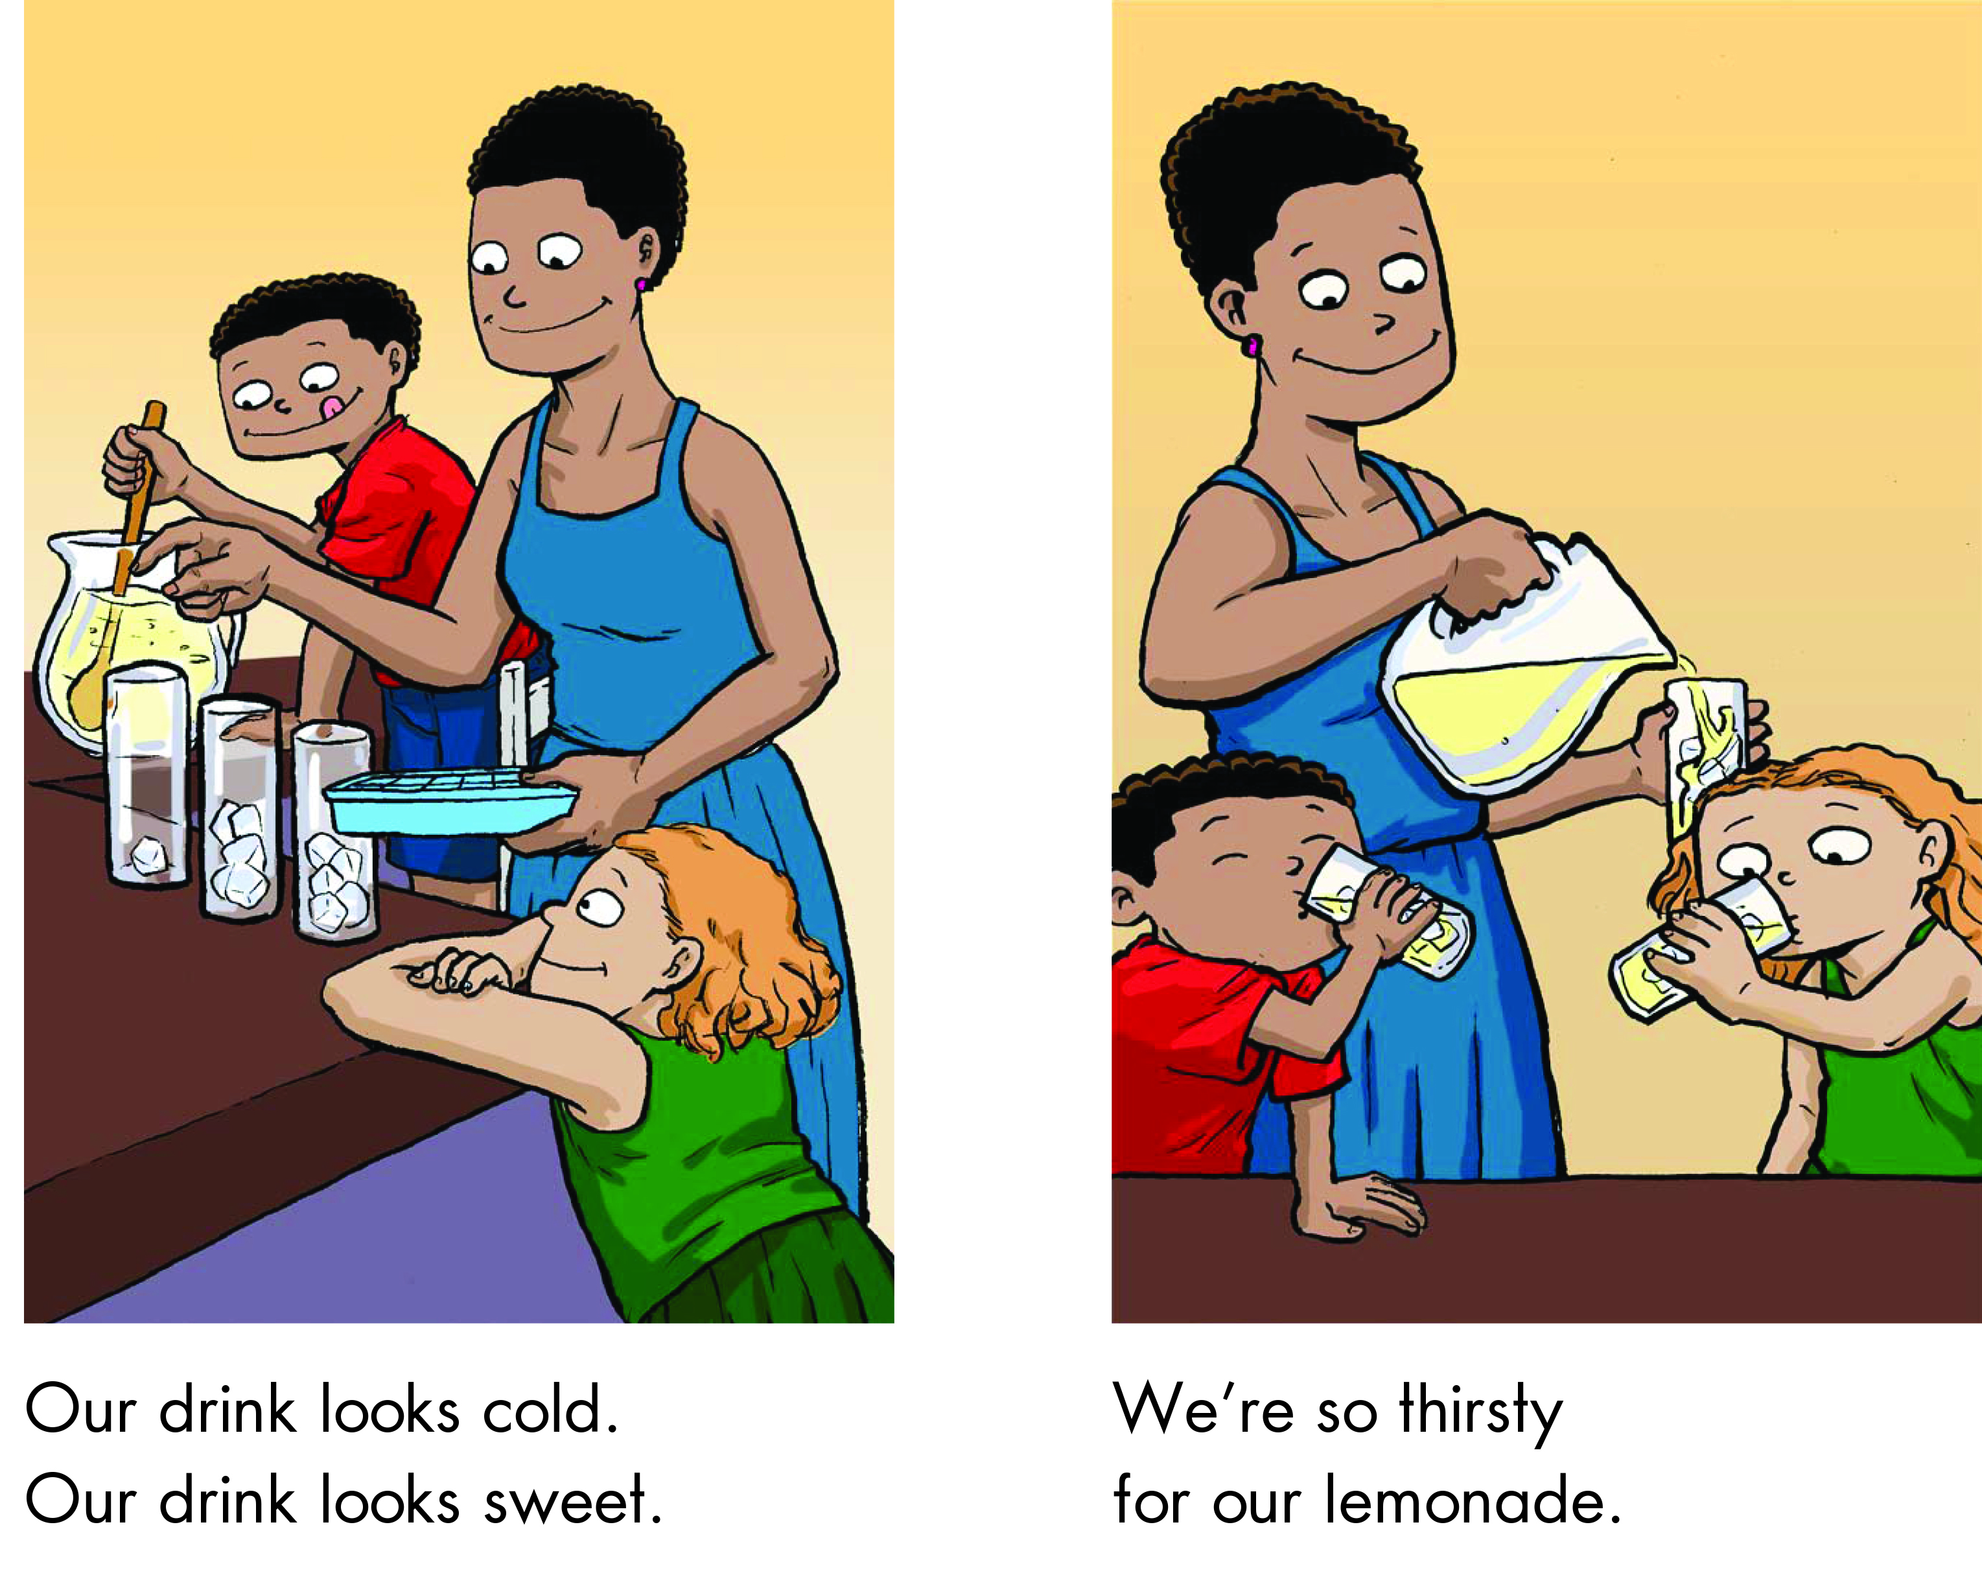

Slide 24
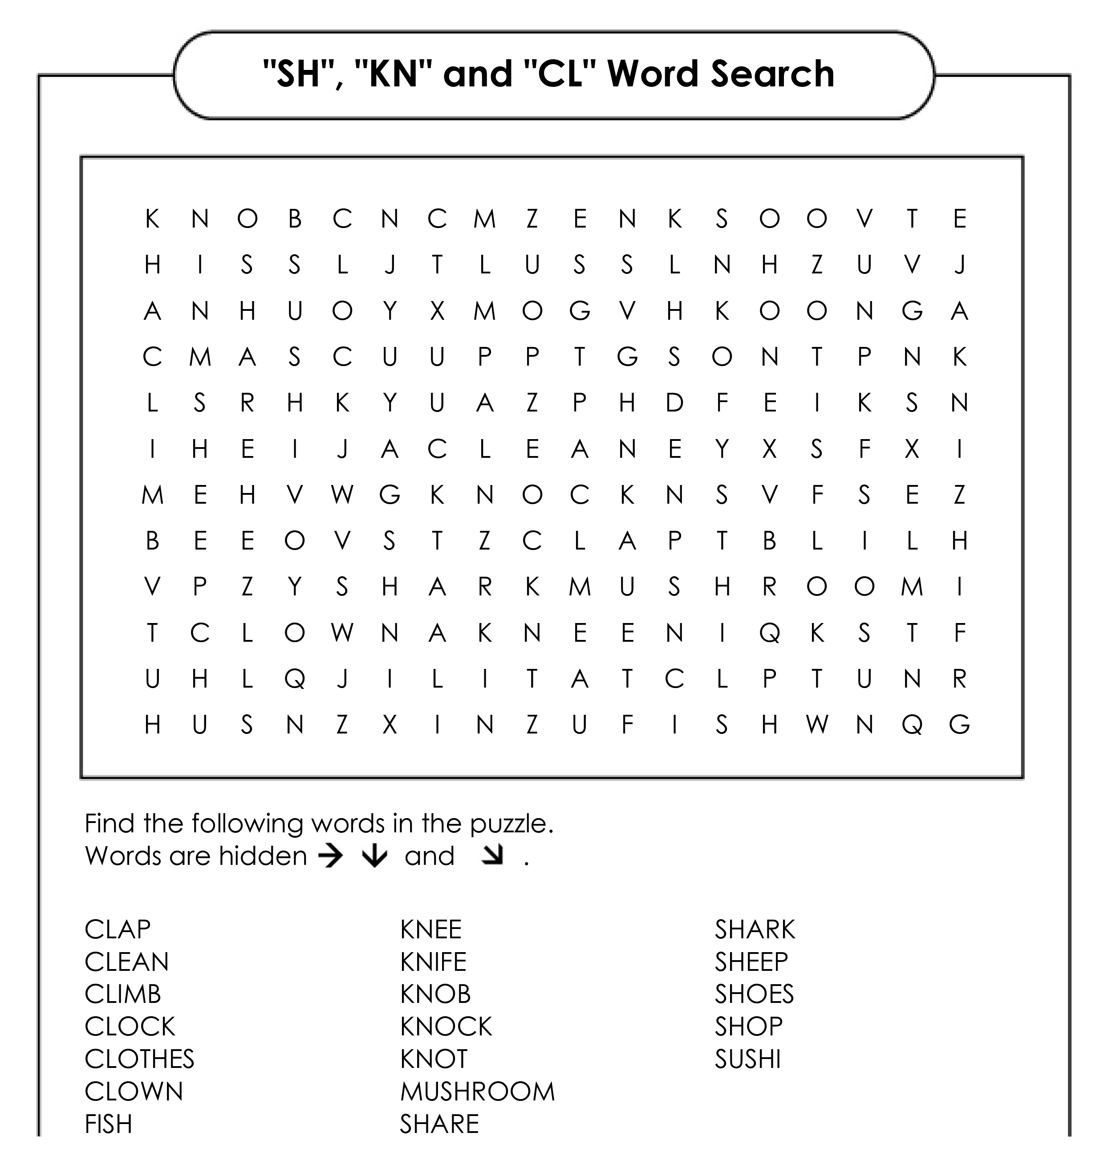
Word Search

Slide 25
Word Search Answers

Slide 26
What did I learn today?
Practiced ‘cl’, ‘sh’ and ‘kn’ words
Practiced “but”, “or”, “and”, capitalization and punctuation
How to make lemonade

Slide 27
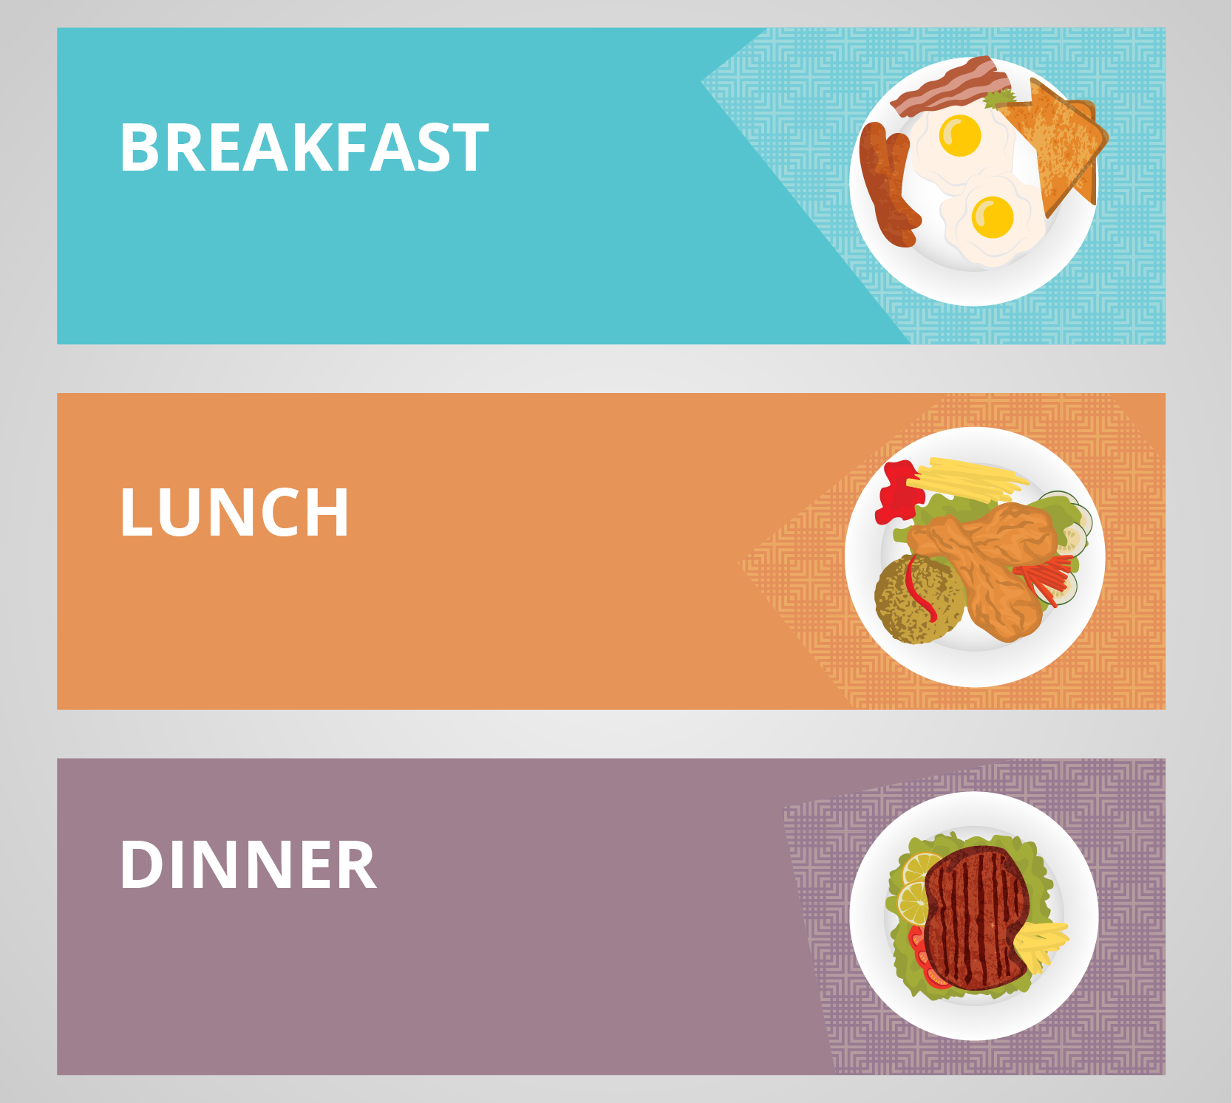
Homework
Write down what you eat and drink for BREAKFAST, LUNCH and DINNER for one day.

