Slide 1
Lesson 4 FOOD

Slide 2
What we will learn today
Review ‘cl’, ‘sh’ and ‘kn’ words
Using “but”, “or”, “and” capitalization and punctuation
Reading practice
Notes:
Go over the learning goals.

Slide 3
Let’s take up last week’s homework
Notes:
Take up last lesson’s homework.

Slide 4
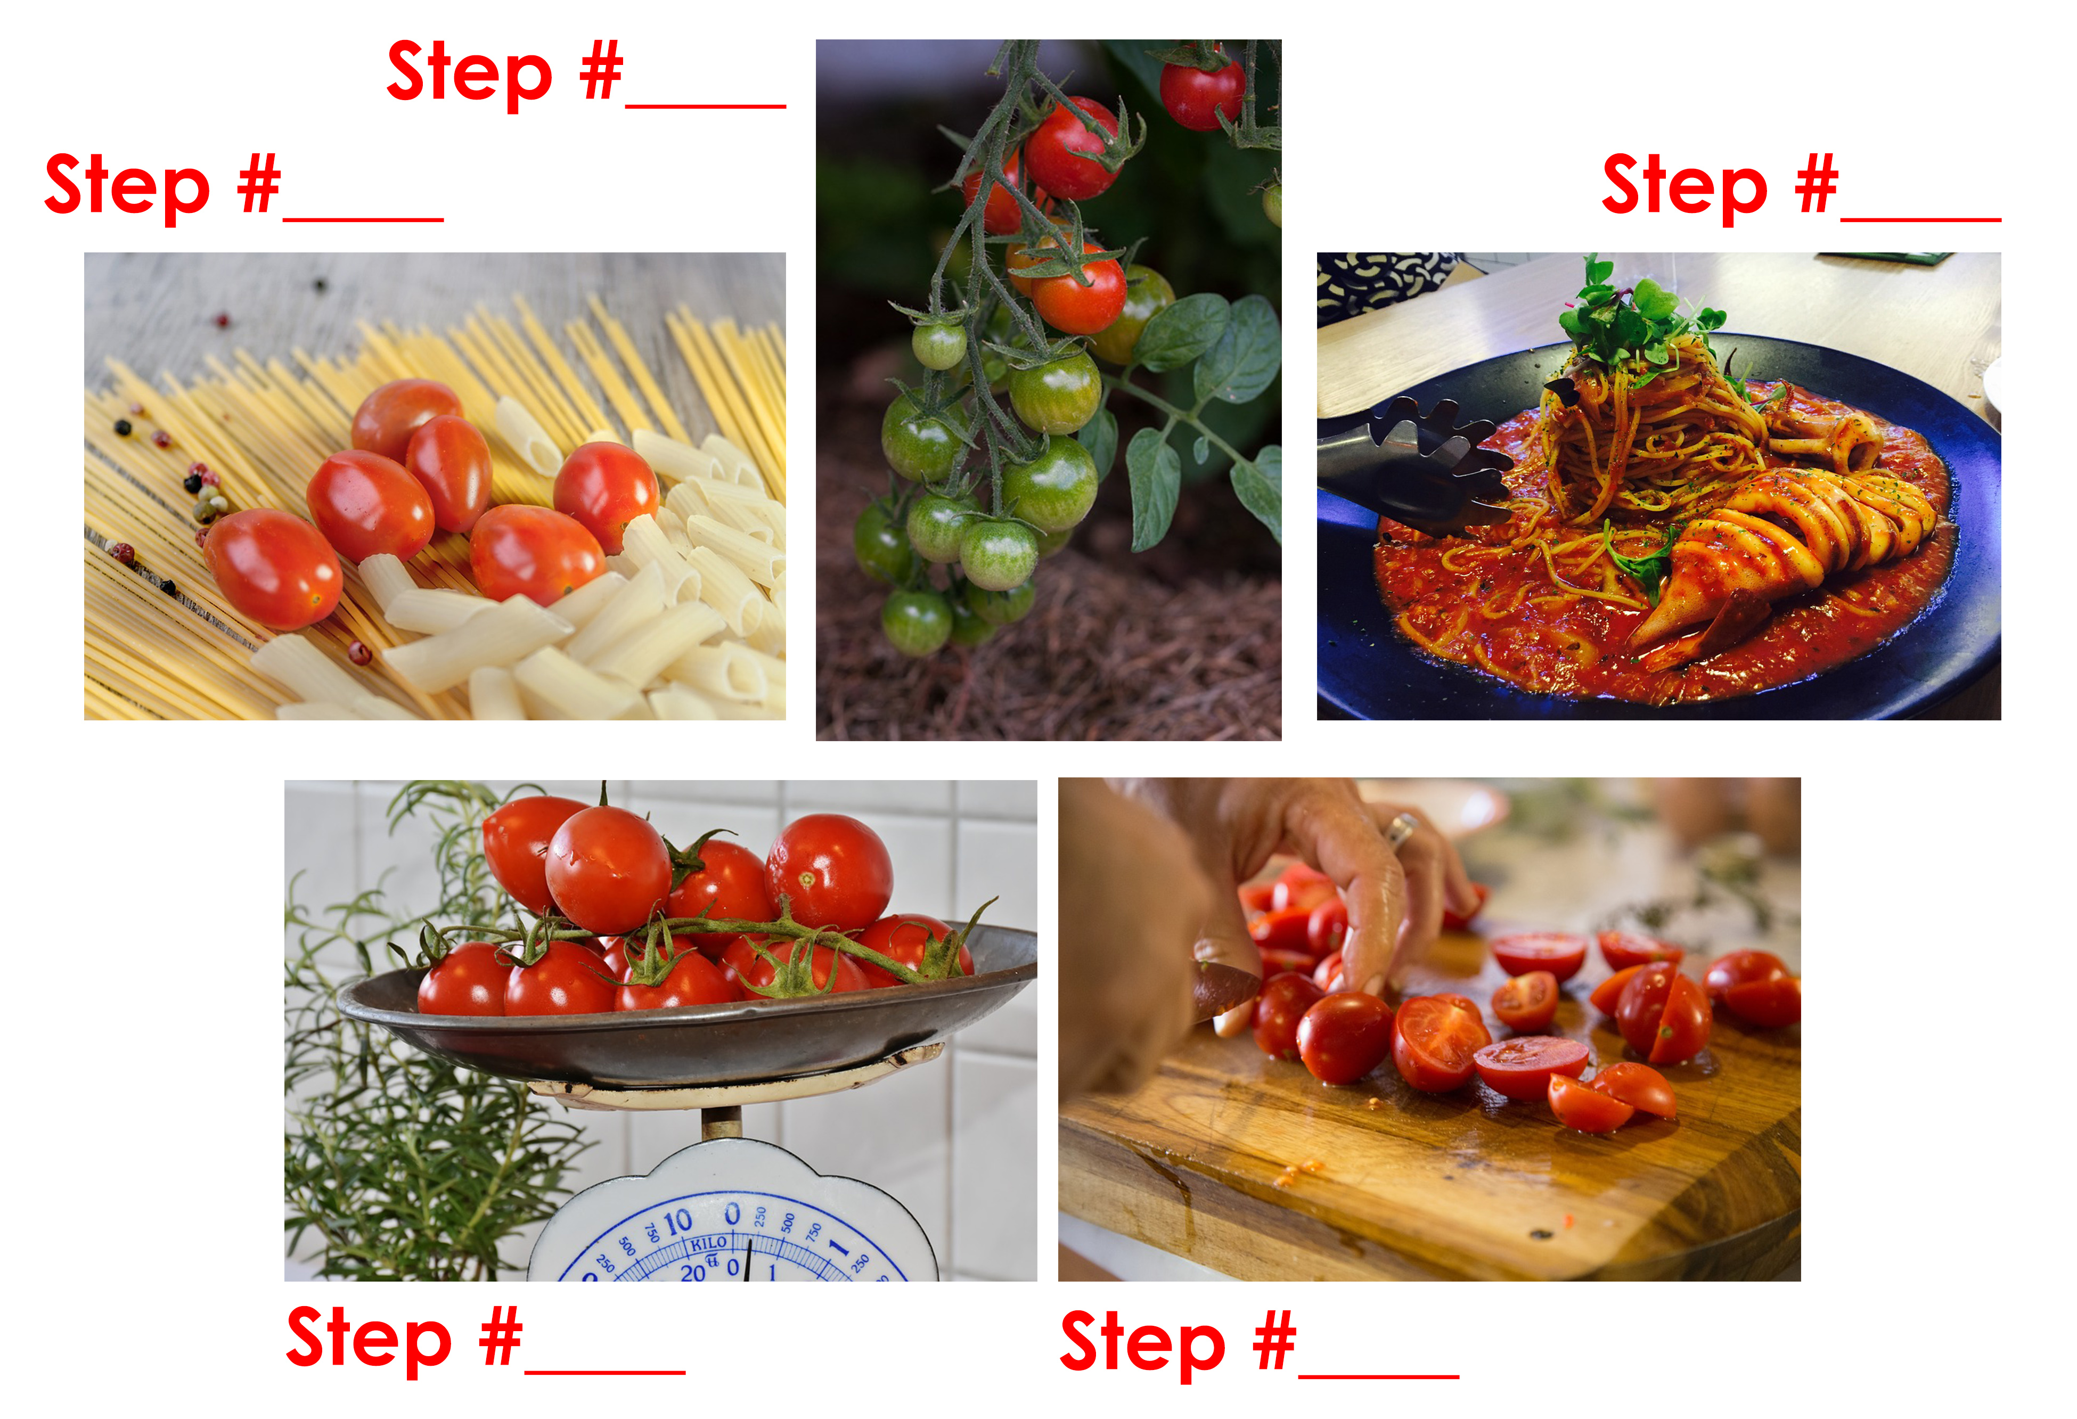
Food Preparation
Notes:
Ask students to number each step in the meal preparation. This will practice their ordinals. Get students to explain why they numbered each step with the accompanying photo.

Slide 5
Food Preparation
1
2/3
5
2/3
4
Notes:
Go over the steps.

Slide 6
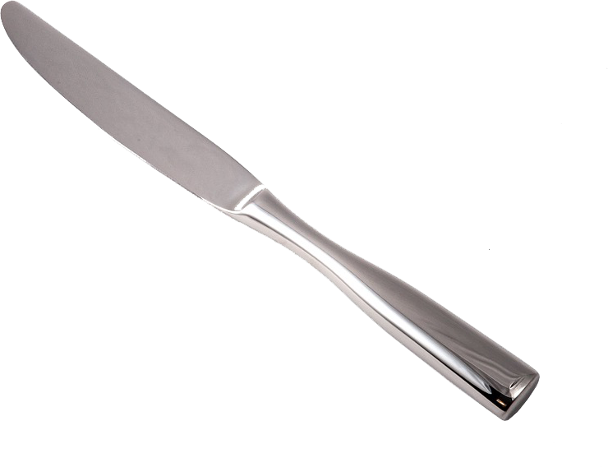
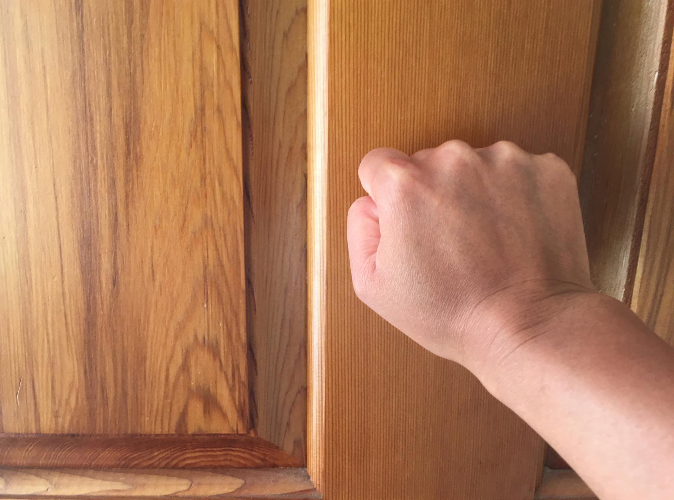
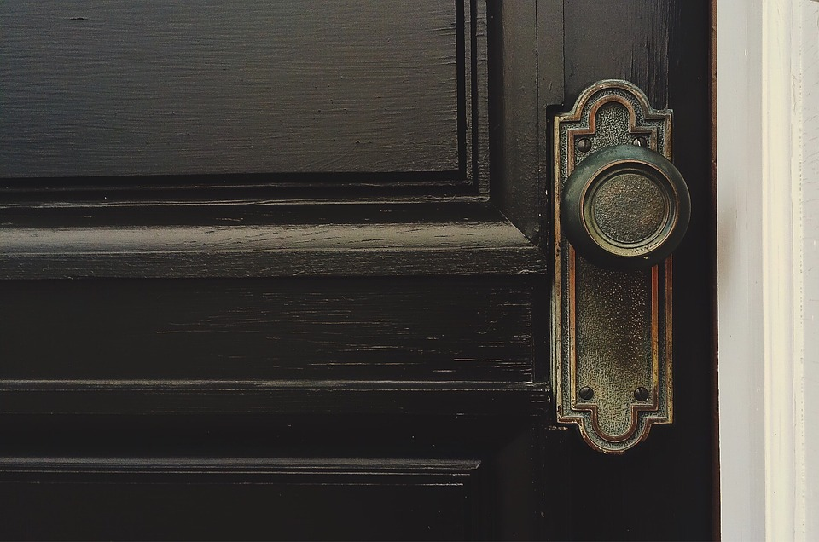
Do you remember?
kn_ _ _
kn_ _ _
kn_ _
Notes:
Ask students to spell the following words from previous units.

Slide 7
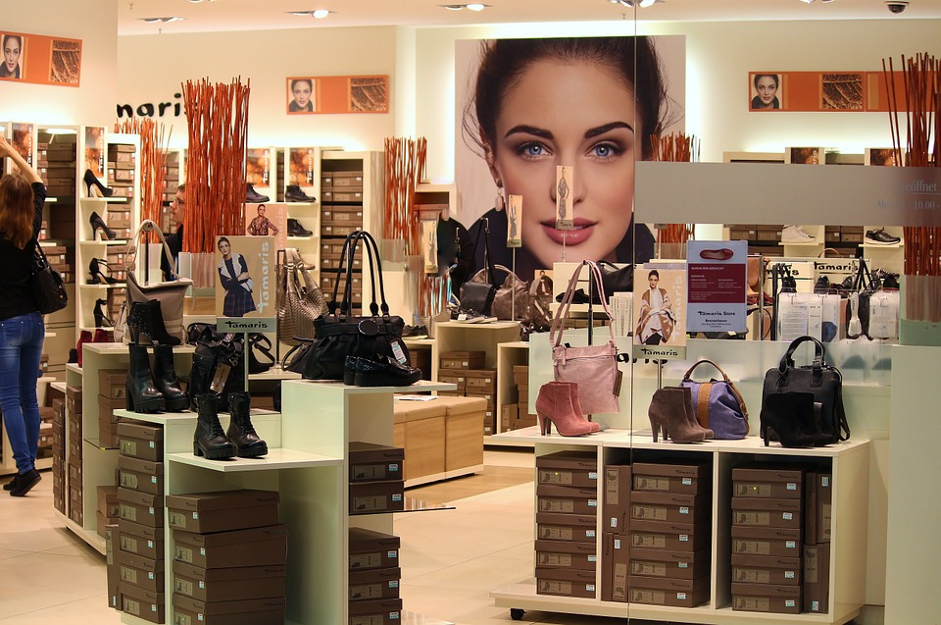
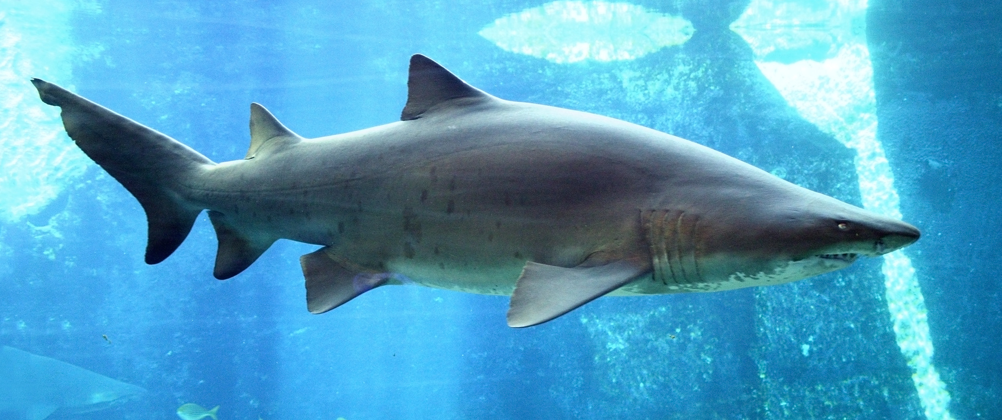
How do you spell?
sh _ _
sh _ _ _
_ _ _sh
Notes:
Ask students to spell the following words from previous units.

Slide 8
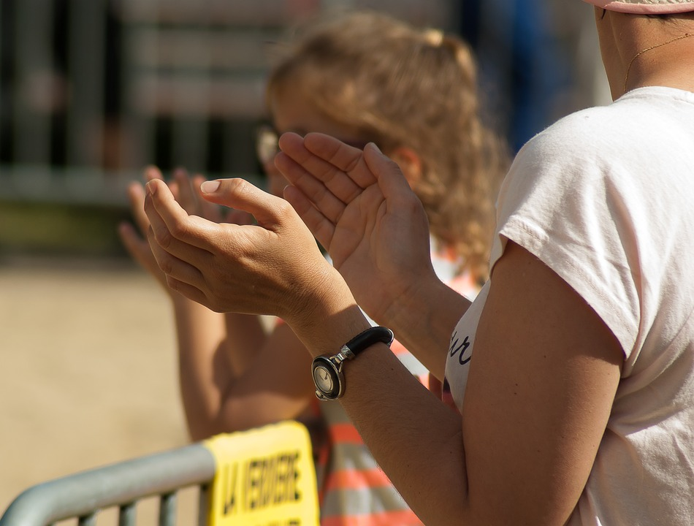
Spelling!
cl _ _
cl_ _ _
cl_ _ _
Notes:
Ask students to spell the following words from previous units.

Slide 9
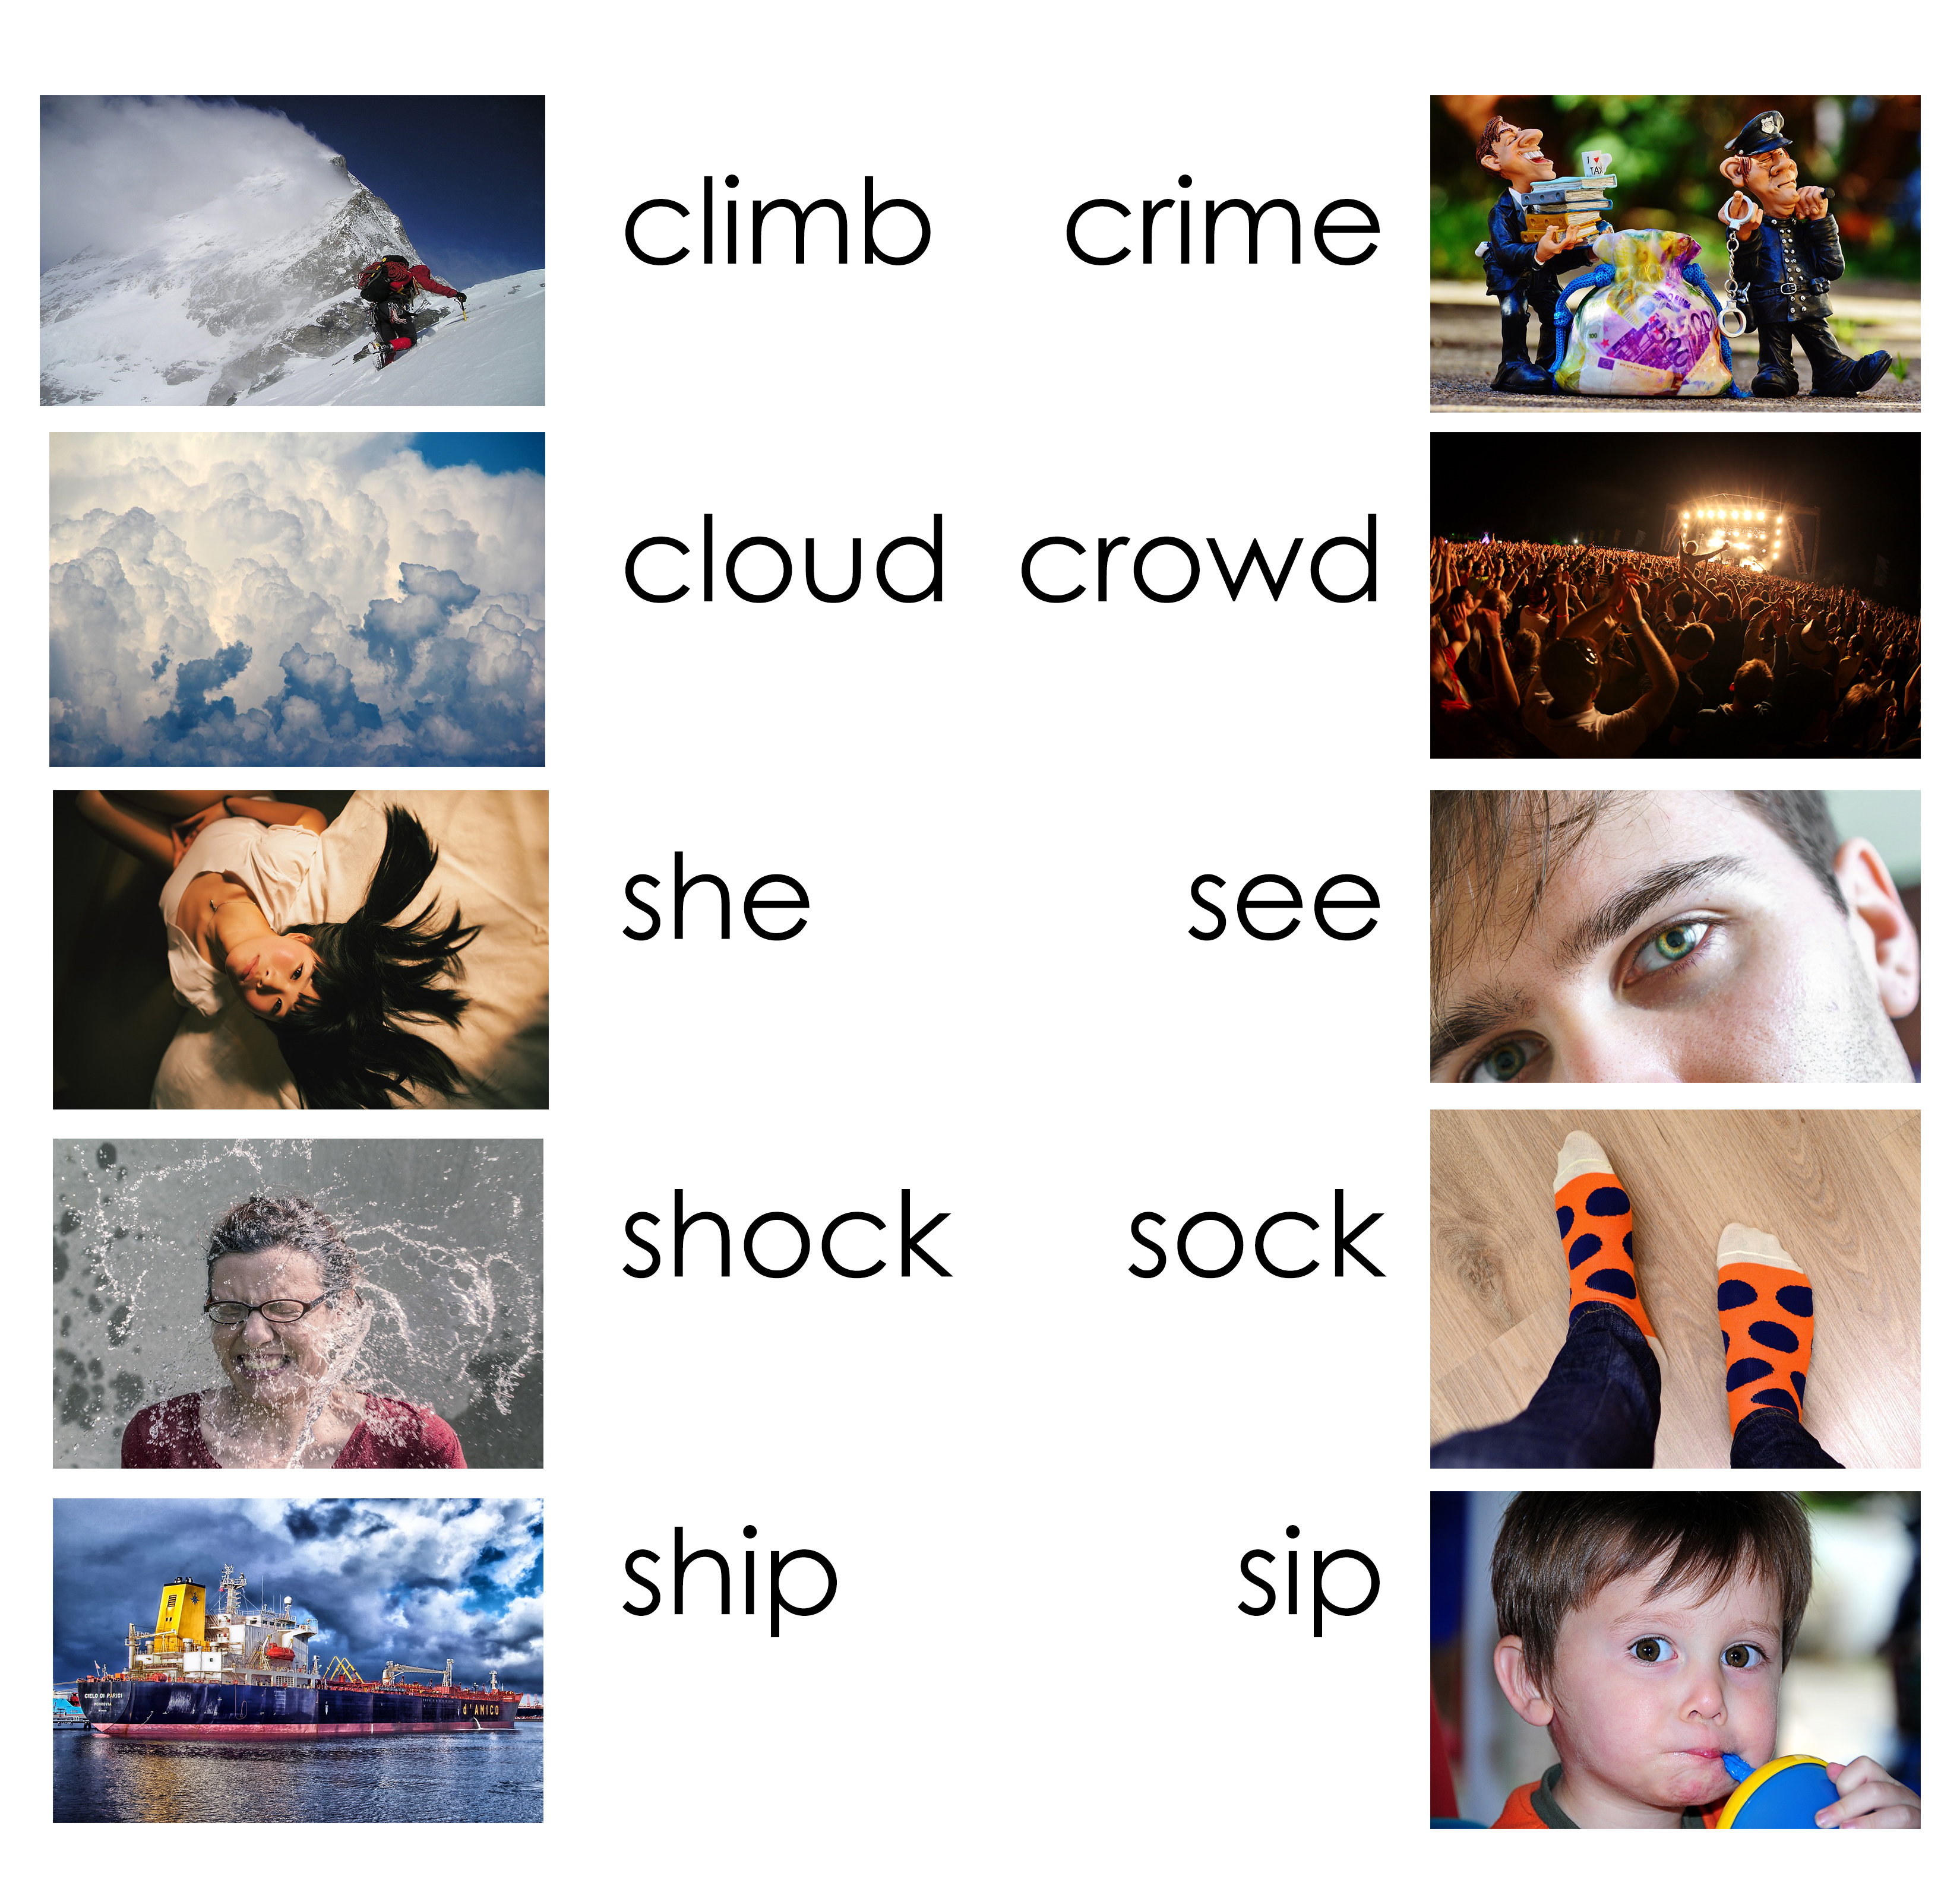
Practice saying…
Notes:
Have students practice saying each word.

Slide 10
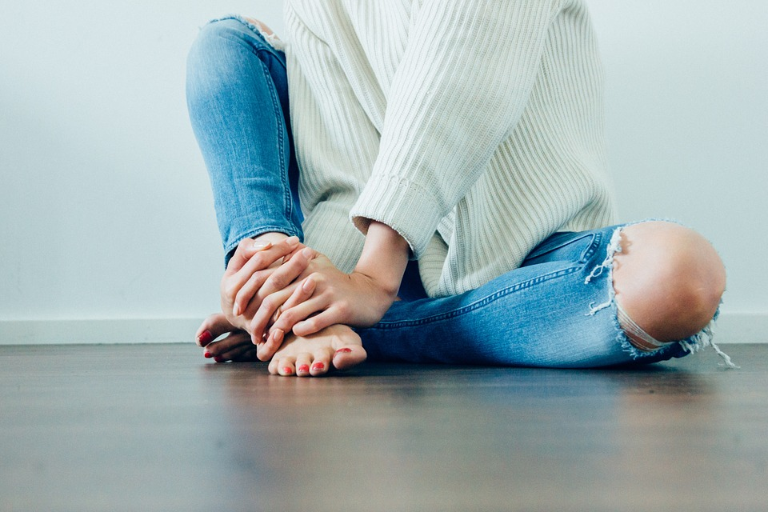
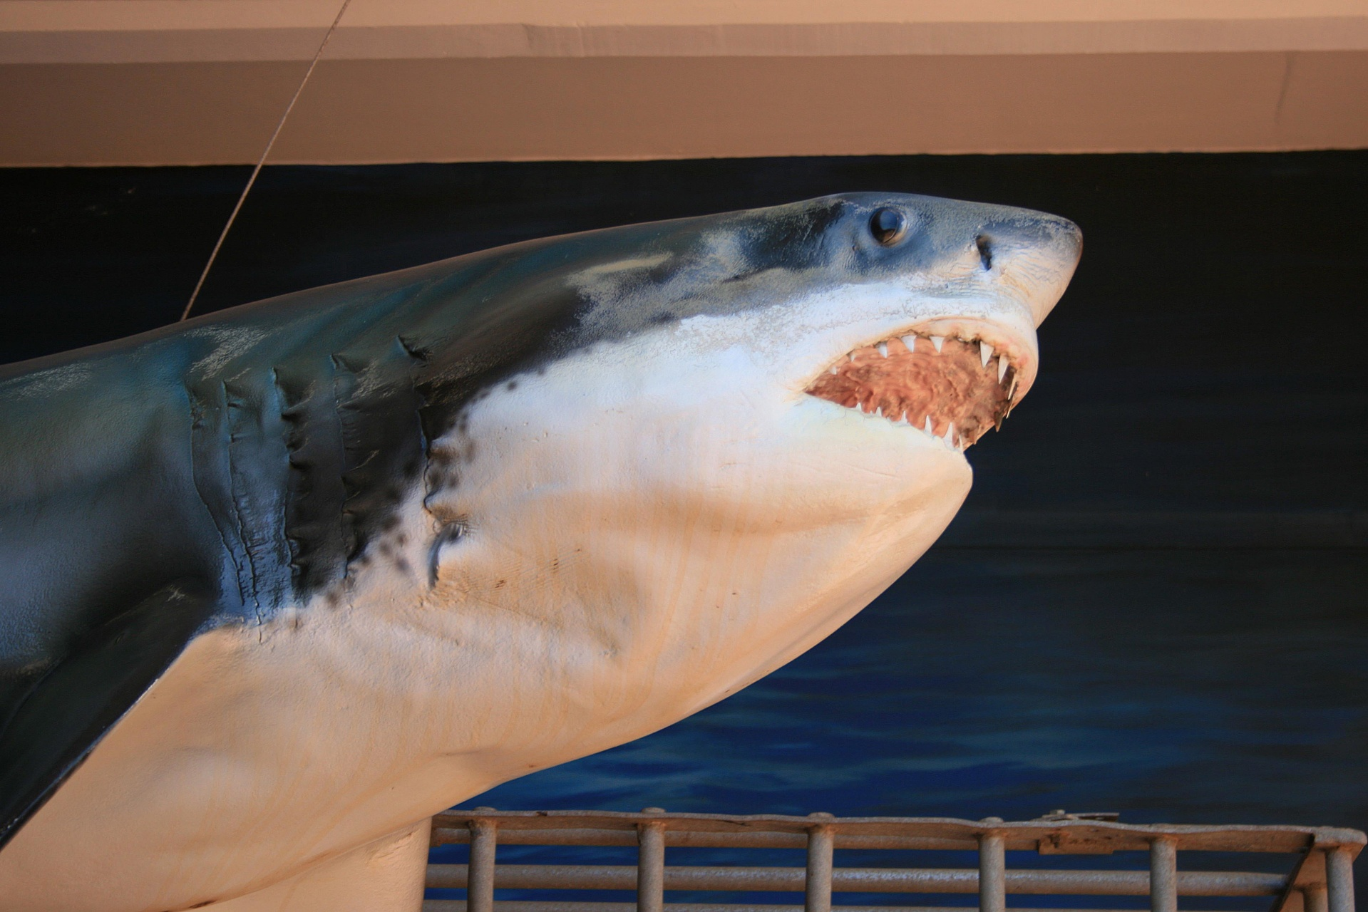
Memory
Notes:
Ask students to identify the word for the pictures.

Slide 11
Practice your capitals
Notes:
Get students to underline where capitalization is needed.

Slide 12
Capitalization answers
Notes:
Take up answers.

Slide 13
Using punctuation
.
Period
Used to end a sentence
This is my book.
?
Question mark
Used at the end of a question.
Where is your book?
!
Exclamation mark
Used at the end of a sentence to add volume.
Wow!! What a fantastic book!
Notes:
Review periods, question marks and exclamation marks.

Slide 14
Using “but”, “and”, “or”
And: shows addition and is used when the statements are similar.
I called Jan, and we went out for lunch.
But: is used to connect statements that express opposite ideas.
I also called Steve, but he wasn't home.
Or: is used to show choices.
We could choose beef or chicken for lunch.
Notes:
Review “but”, “and” and “or”.

Slide 15
But, or, and?
Notes:
1.A 2.A 3.B 4.B 5.C

Slide 16
But, or, and?
Notes:
6.C 7.C 8.B 9.C 10.B

Slide 17
School lunches around the world
Notes:
Make sure to stop video for discussion.
Questions:
Ask students what they bring/eats for lunch everyday. Which meal looked delicious? Which one would they most like to try? Which one would they not like to try at all? Do they eat lunch at school? Is there a canteen to eat in or do they have lunch delivered to the school? Do they prepare their lunches and bring it to school? Who cooks their lunches at school/on the weekend?

Slide 18
Story Time
Notes:
Read each line and alternate between each student for an echo reading.

Slide 19
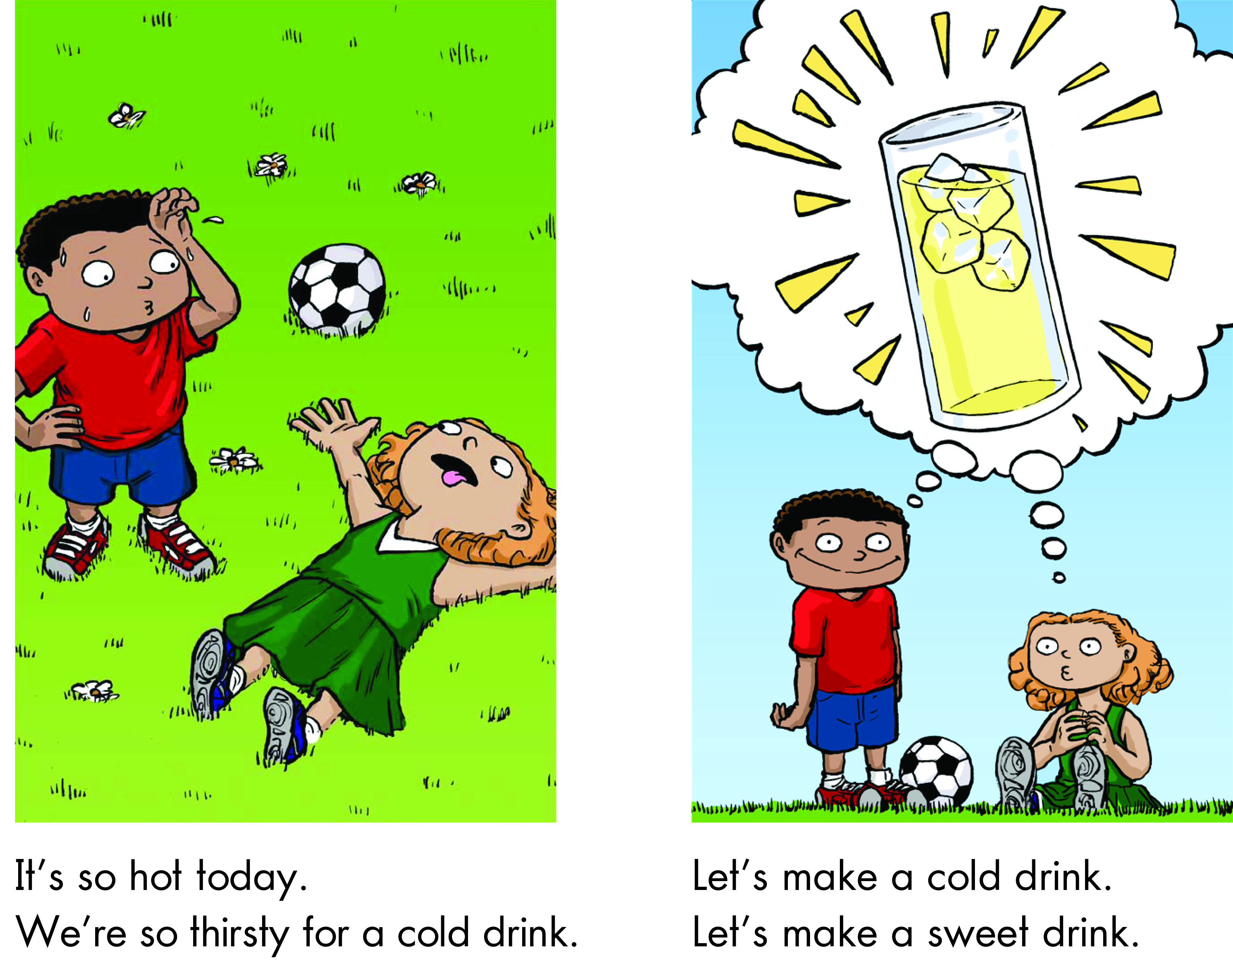
Notes:
Read each line and alternate between each student for an echo reading.

Slide 20
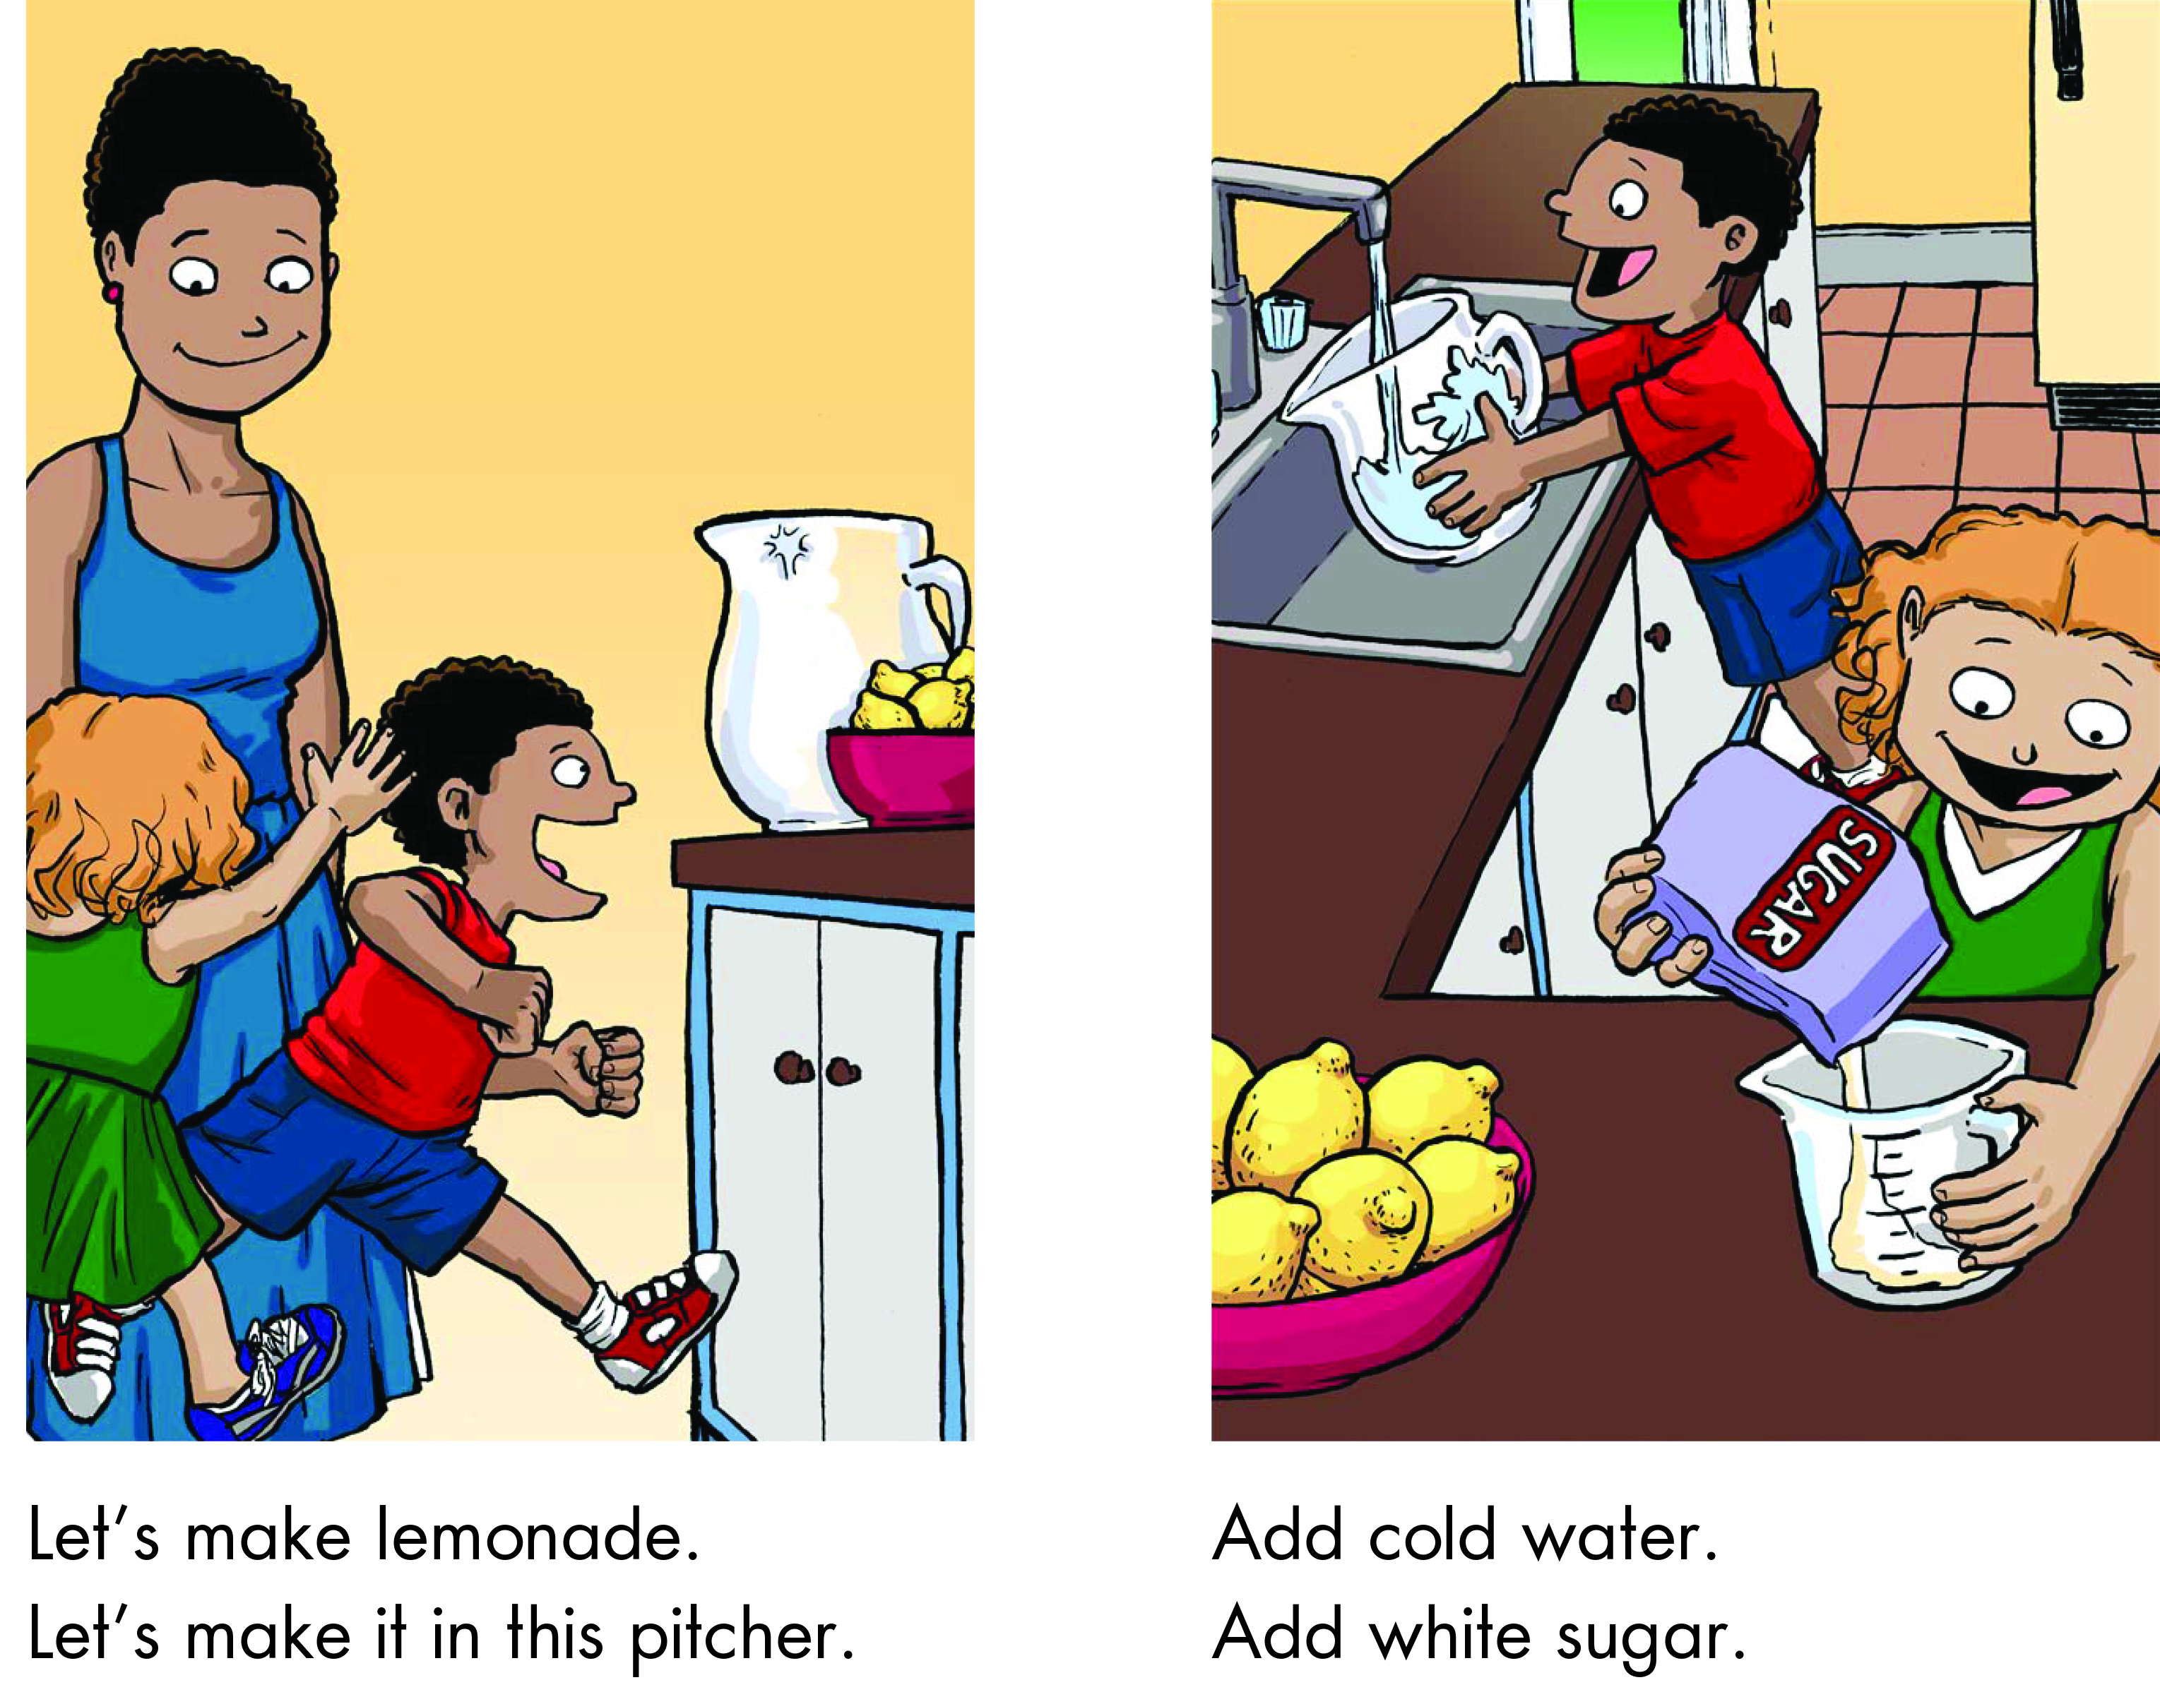
Notes:
6.C 7.C 8.B 9.C 10.B

Slide 21
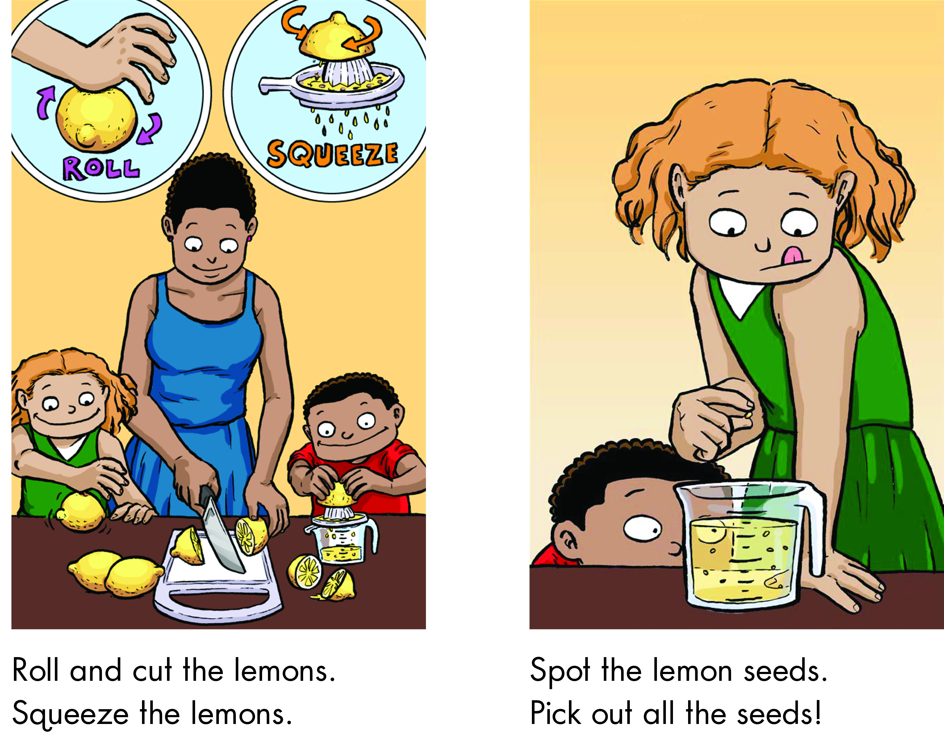
Notes:
Read each line and alternate between each student for an echo reading.

Slide 22
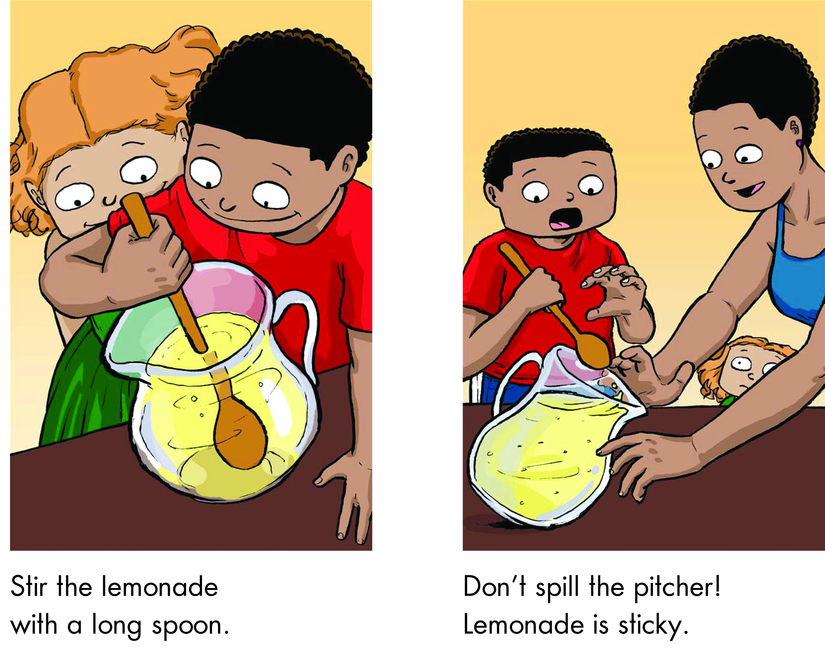
Notes:
Read each line and alternate between each student for an echo reading.

Slide 23
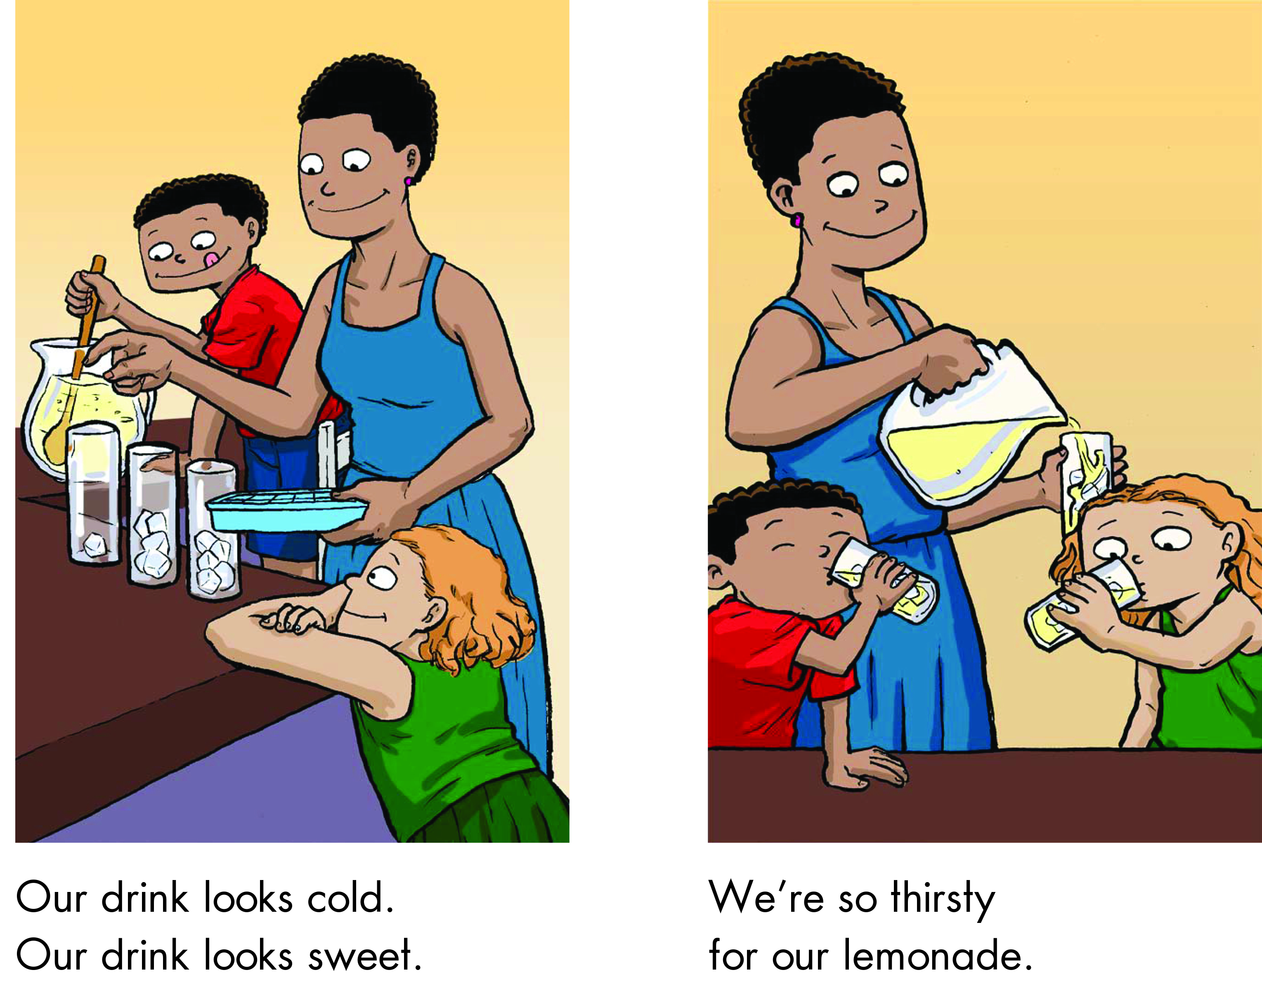
Notes:
6.C 7.C 8.B 9.C 10.B

Slide 24
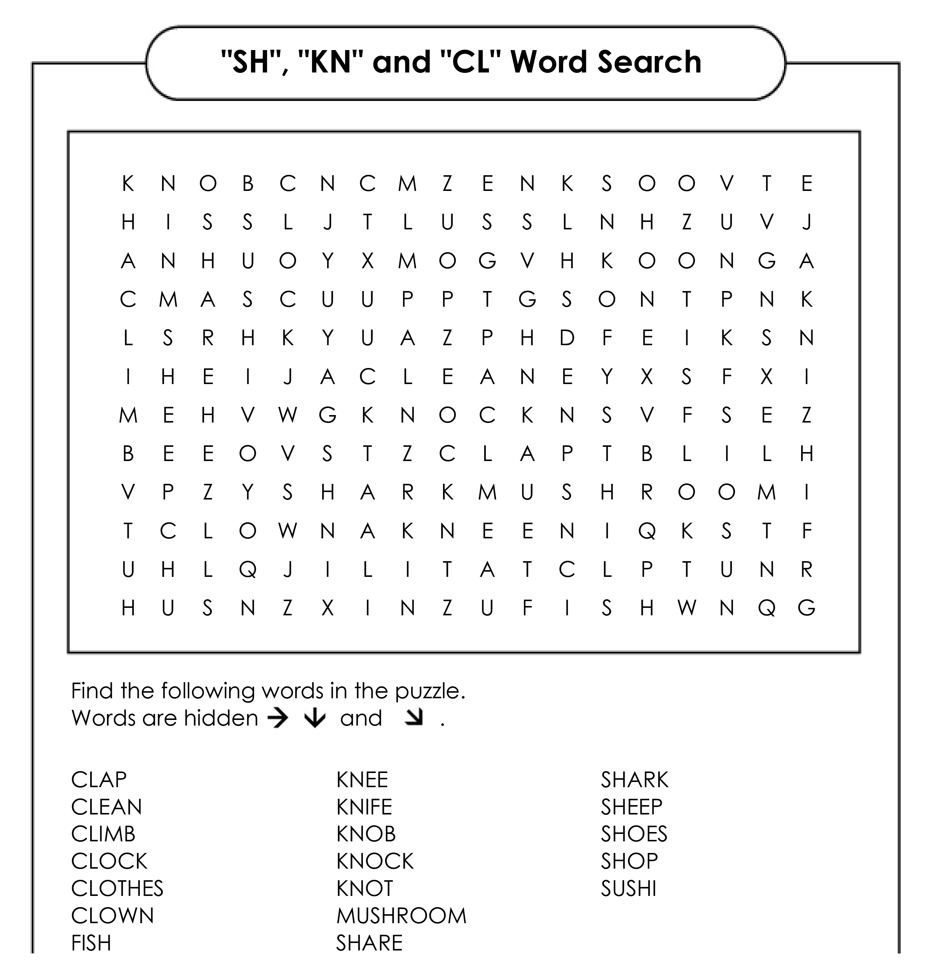
Word Search
Notes:
Get the students to download “SH KN and CL Word Search.pdf” Assign certain words to certain students.

Slide 25
Word Search Answers

Slide 26
What did I learn today?
Practiced ‘cl’, ‘sh’ and ‘kn’ words
Practiced “but”, “or”, “and”, capitalization and punctuation
How to make lemonade
Notes:
Review

Slide 27
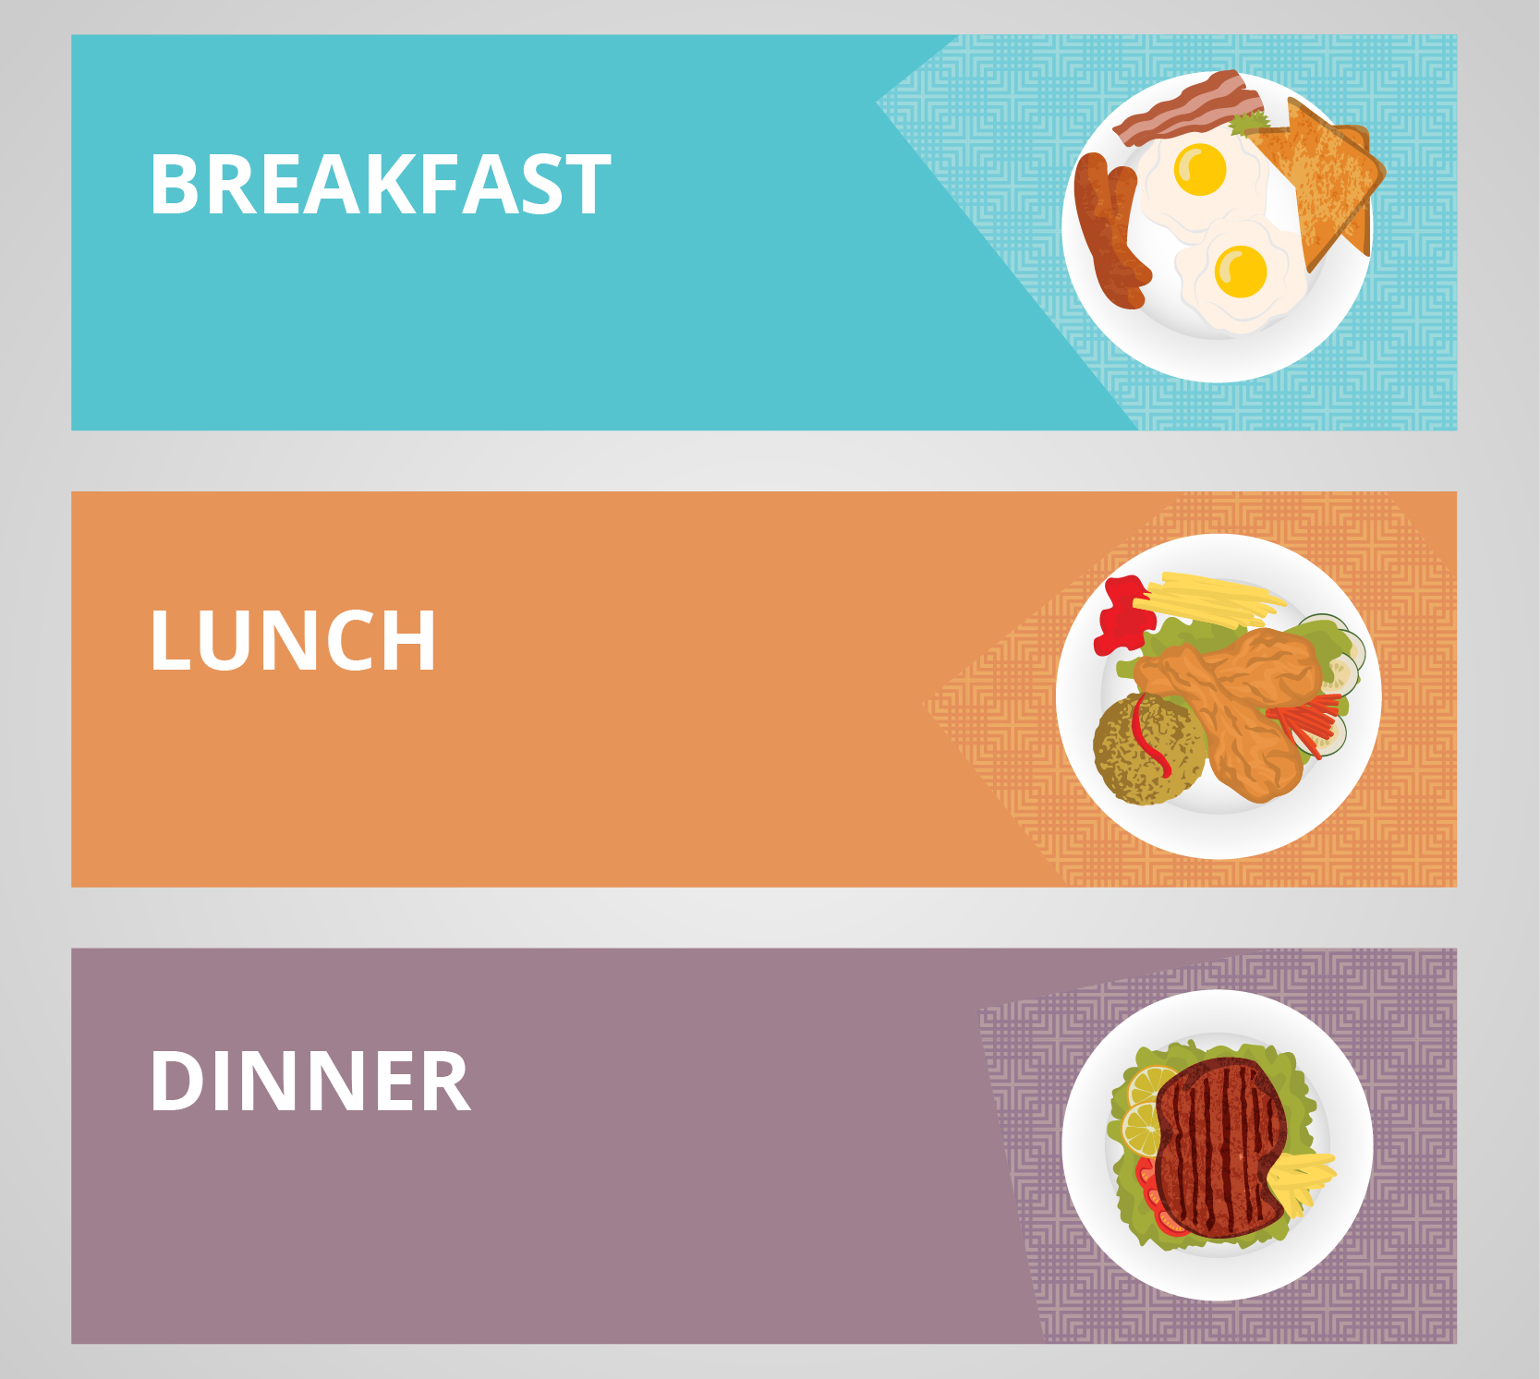
Homework
Write down what you eat and drink for BREAKFAST, LUNCH and DINNER for one day. Take photos!
Notes:
Explain homework

