Slide 1
Lesson 4: Tutoring FOOD

Slide 2
Fill in the blanks
claw
cloud
clock
class
clap
clean
clip
click
clash
clam

Slide 3
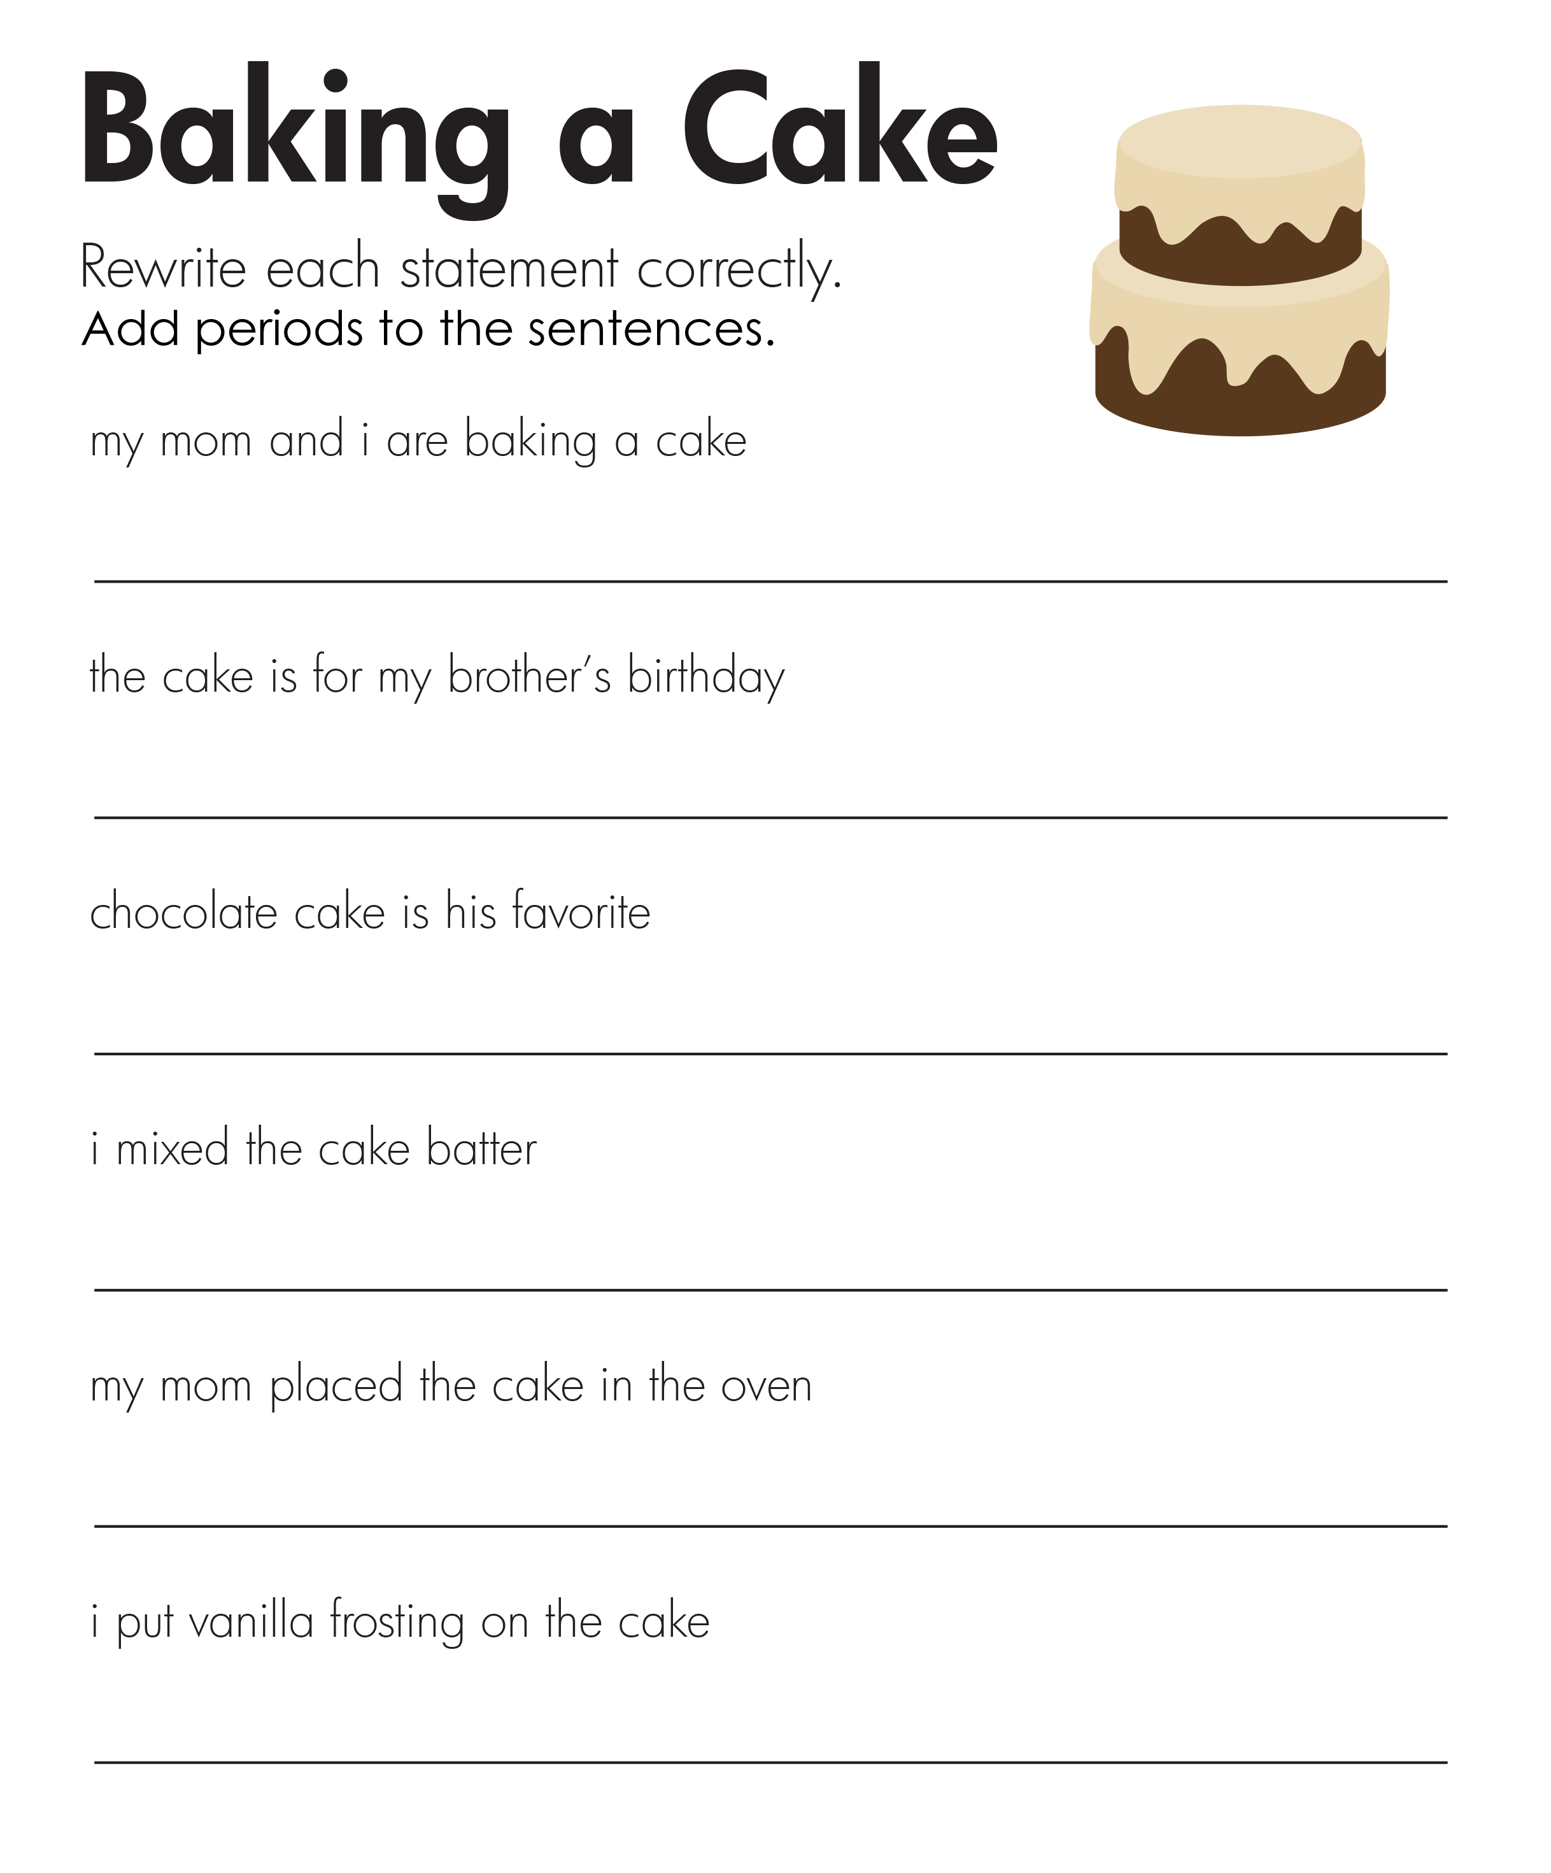
Add periods

Slide 4
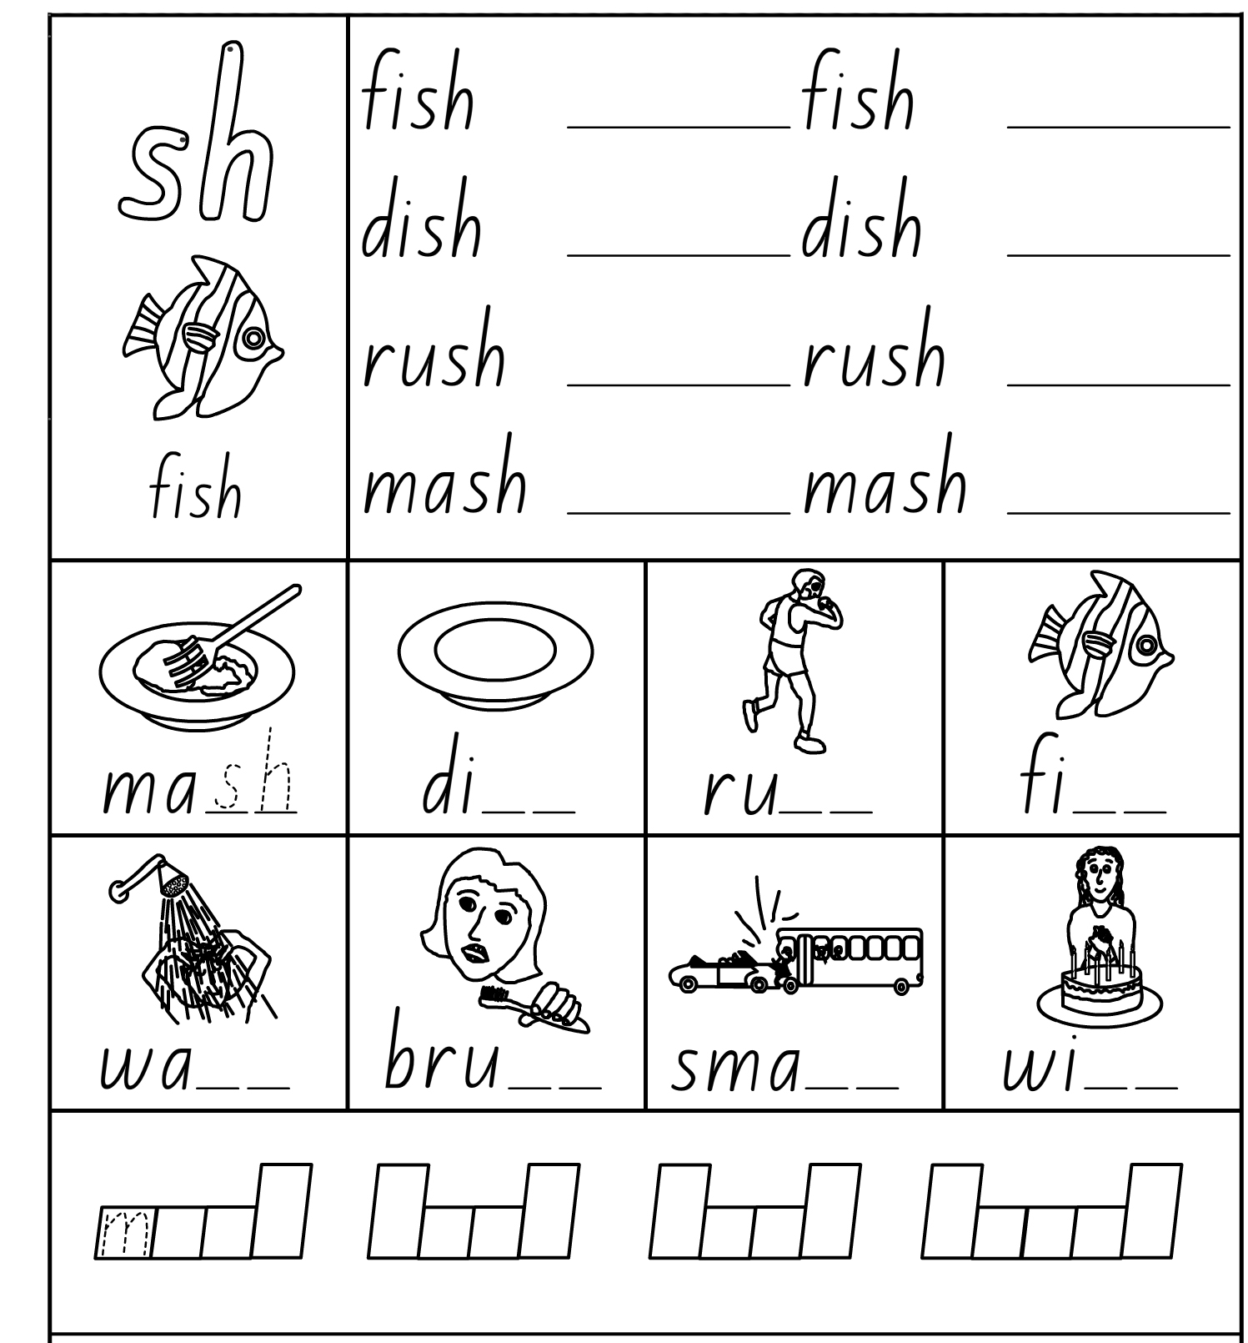
SH Practice

Slide 5
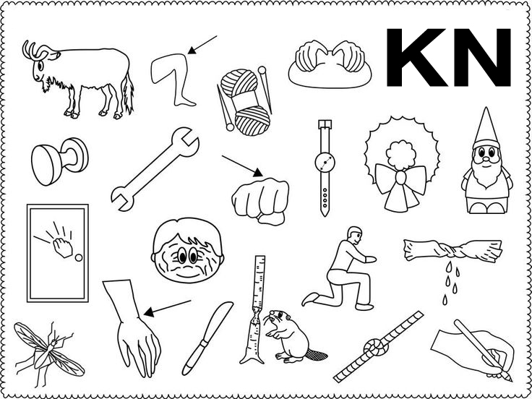
Circle the KN words

Slide 6
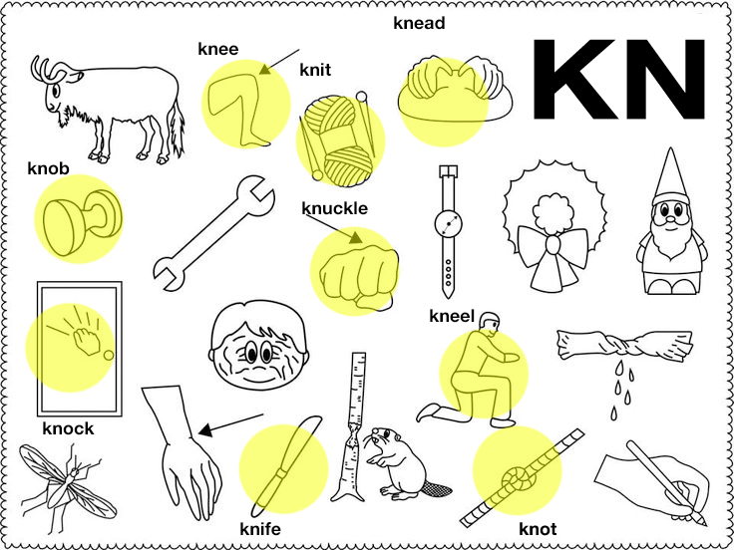
KN word answers

Slide 7
KN word answers

Slide 8
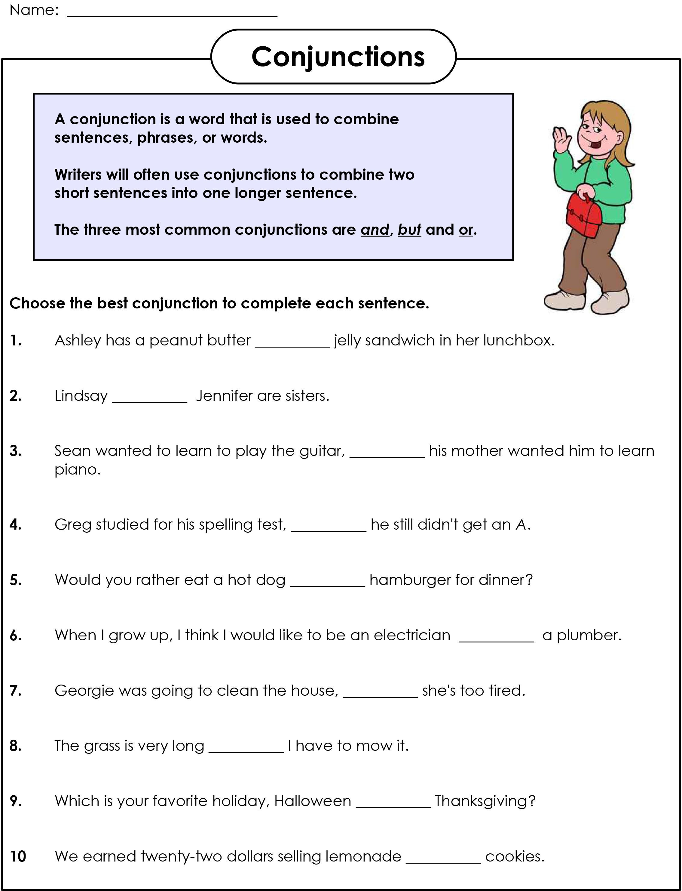
Open the And, But, Or Worksheet

Slide 9
And, But, Or Worksheet Answers

Slide 10
Practice grammar
when is he getting his new car
ouch that really hurt
im going home now
she went to the shop and bought carrots, beans, bread and milk
i visited my brother on the weekend
stop you cant go in there
when is your appointment
paul’s car is broken
he goes to bed at 8 o clock
would you like a cookie

Slide 11
What did I learn today?
Practiced ‘cl’, ‘sh’ and ‘kn’ words
Practiced “but”, “or”, “and”, capitalization and punctuation
Notes:
Review

