Slide 1
Lesson 5 FOOD

Slide 2
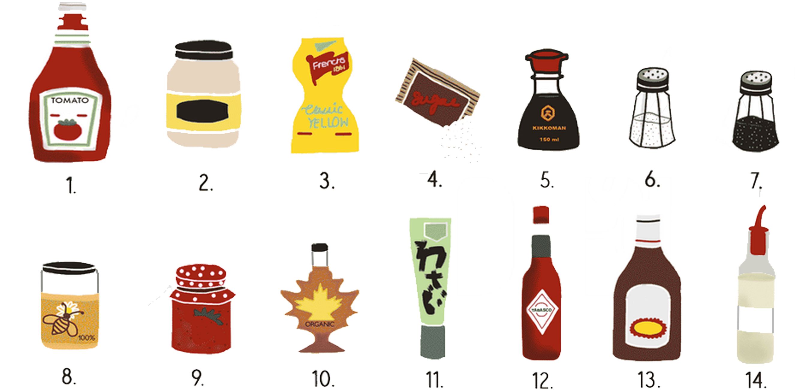
Homework Identify the condiments honey, maple syrup, mustard, salt, jam mayonnaise, sugar, vinegar, barbecue sauce, soy sauce, pepper, hot sauce, wasabi and ketchup.

Slide 3
Homework
Condiments (con-di-ments) are sauces that we put in our food to give it some extra flavor.
What condiments do you use in your culture?
Match these words with the condiments in the photo: honey, maple syrup, mustard, salt, jam mayonnaise, sugar, vinegar, barbecue sauce, soy sauce, pepper, hot sauce, wasabi and ketchup.
See condiment picture on the next slide.
Notes:
Go through the individual questions, and answer each to model answers for the students. Pose the question to each student. Remind students that adjectives are describing words for nouns for question. Ask students to write down the answers before the next class.

