Slide 1


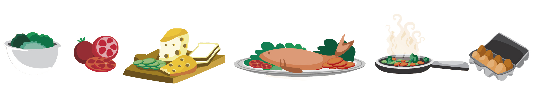
Lesson 5 FOOD

Slide 2

What we will learn today
Using “ng” and “ing”
Using “but”, “or”, “and” capitalization and punctuation
Reading and conversation practice
Notes:
Go over the learning goals.

Slide 3
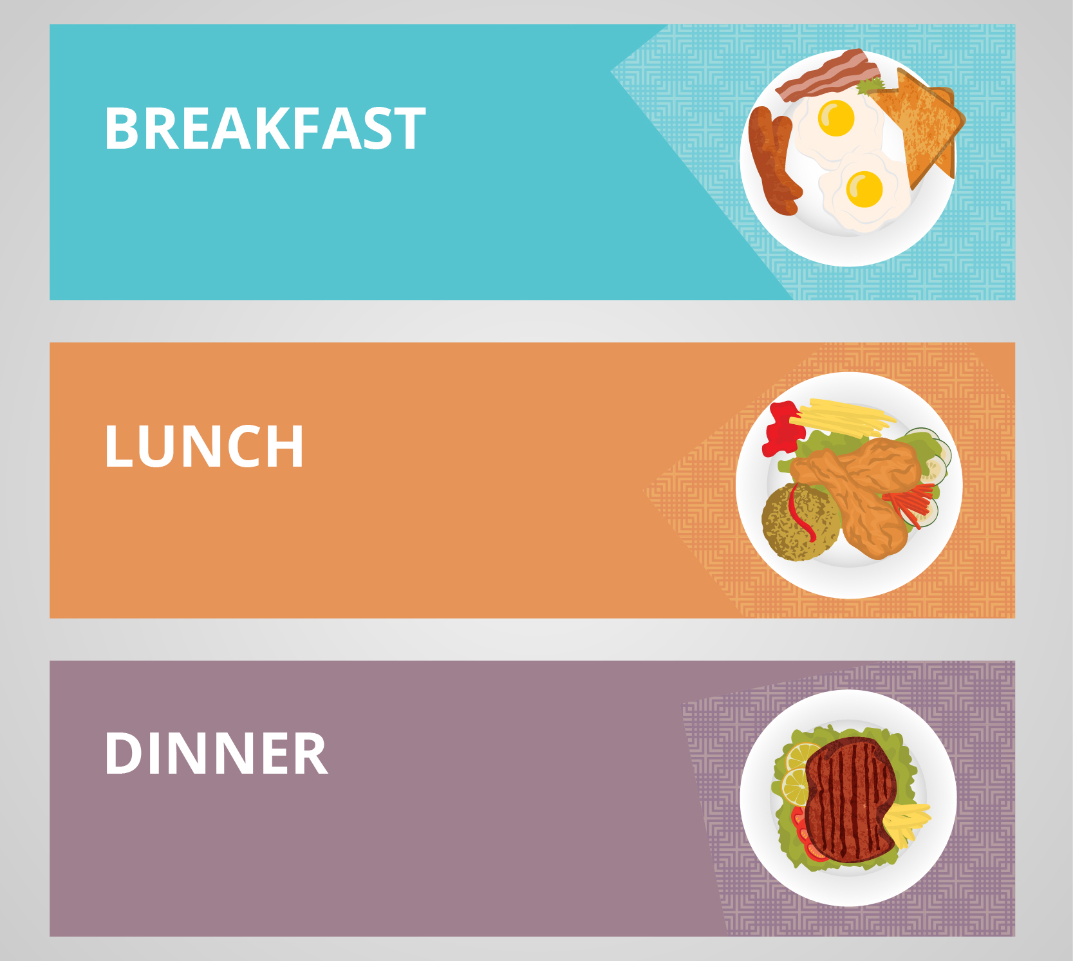
Let’s share
What did you have for breakfast, lunch and dinner? Did you take any photos?
Notes:
Get students to talk about the meals they had for breakfast, lunch and dinner.

Slide 4


NG Sound
Notes:
To make the NG sound, the middle/back part of the tongue is raising to touch the roof of the mouth. Demonstrate for the students and have them try to make the sound.

Slide 5

ING Sound
Notes:
When pronouncing “ing”, air is prevented from leaving the vocal tract when the back of the tongue lifts and presses against the soft palate at the back of the mouth. The soft palate drops, allowing air to pass out through the nose. Practice pronouncing the long “e” sound (the tongue is forward, with the body of the tongue near the tooth ridge), and then adding “ng”.

Slide 6

Let’s practice pronouncing the NG sound
Notes:
Say each word, articulating it clearly. Then say the word again, in a more natural way. Read the sentence accompanying the word. Instruct the students to repeat the word, chorally and then individually. Then, instruct the students to repeat each sentence, chorally and then individually.

Slide 7
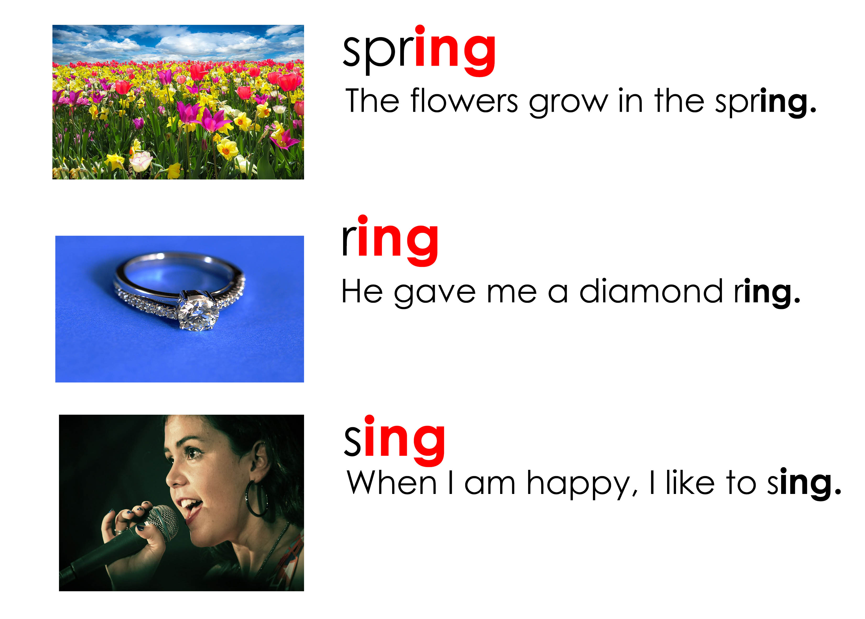
Let’s practice pronouncing the ING sound
Notes:
Say each word, articulating it clearly. Then say the word again, in a more natural way. Read the sentence accompanying the word. Instruct the students to repeat the word, chorally and then individually. Then, instruct the students to repeat each sentence, chorally and then individually.

Slide 8
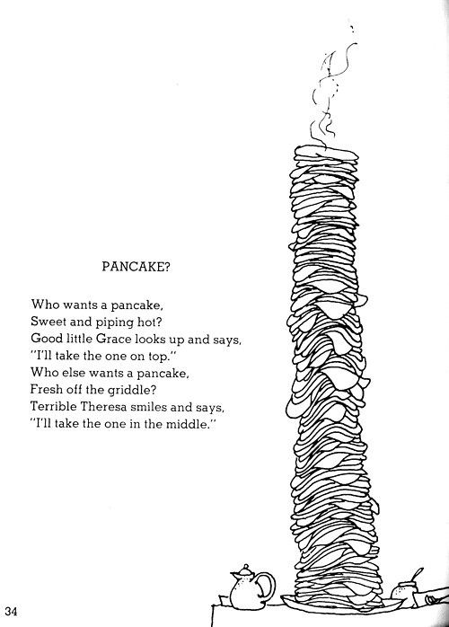
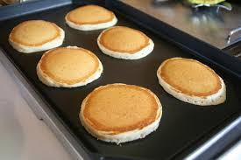
Pancake? By Shel Silverstein
griddle and pancakes
Notes:
Read each line and alternate between each student for an echo reading. Following this, circle the periods, question marks and periods.

Slide 9
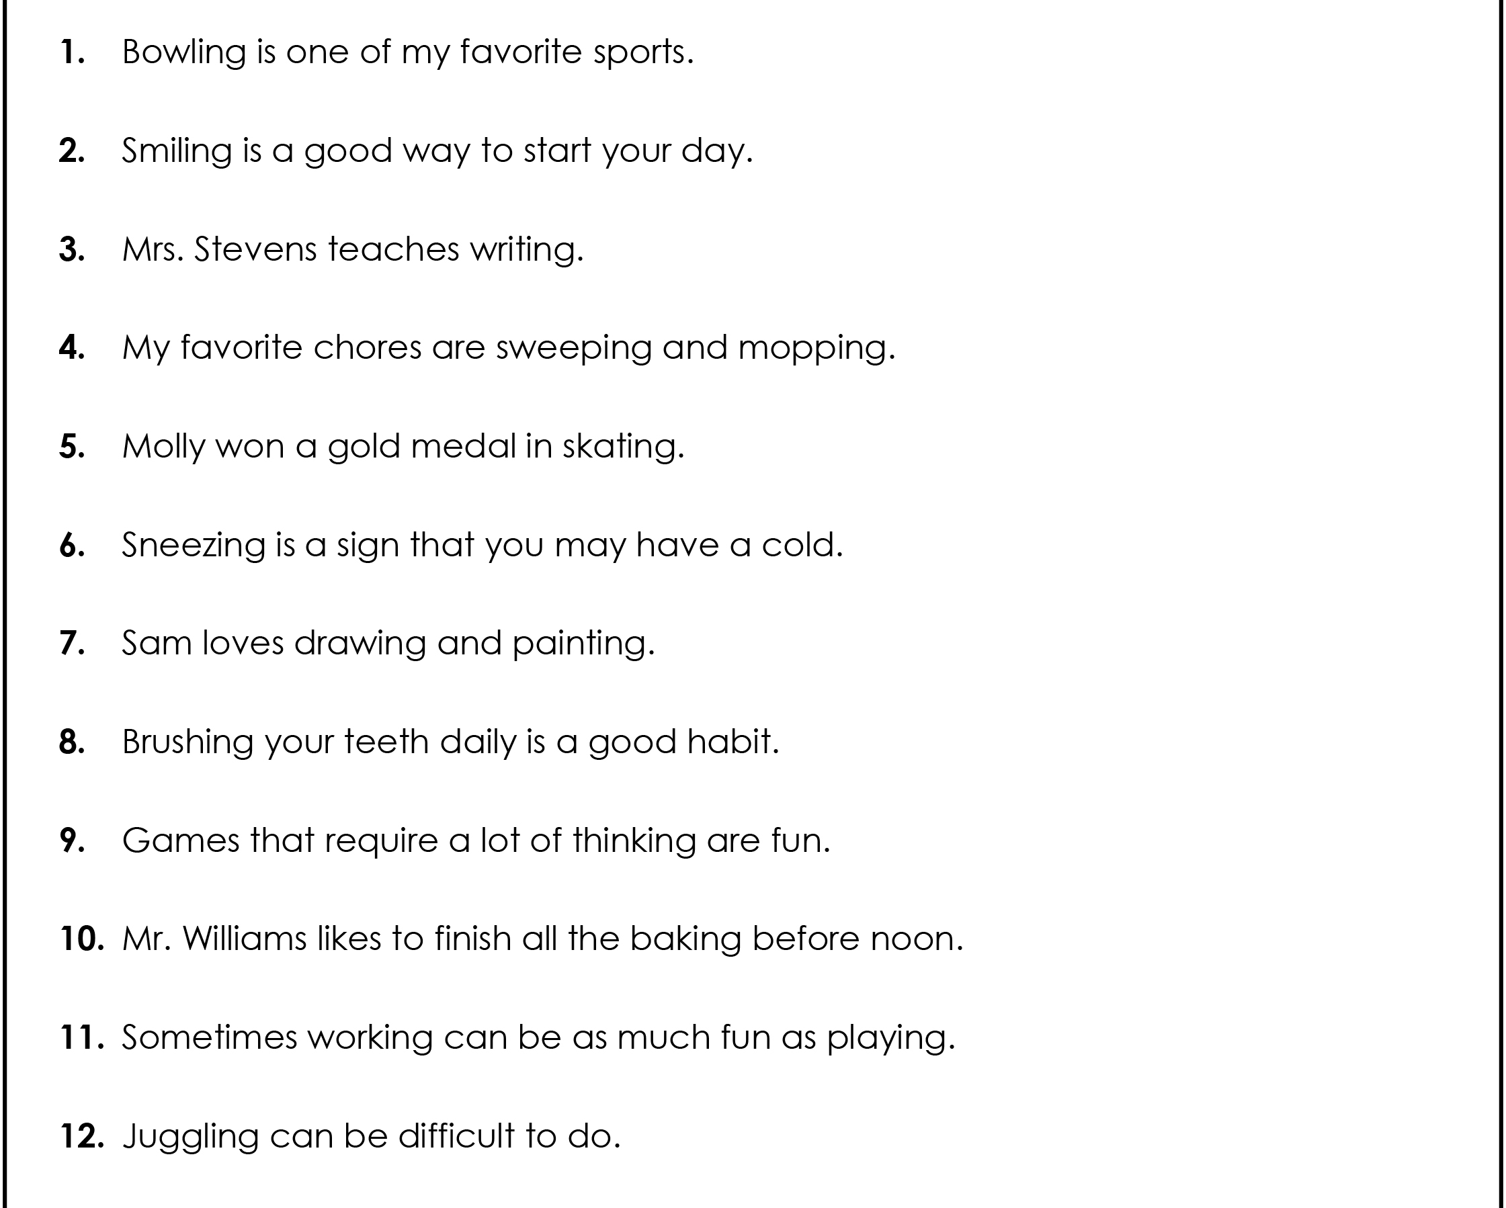
Take out your “ing” verbs worksheet
Notes:
Have students open the “”ing” verbs Worksheet.pdf”.

Slide 10
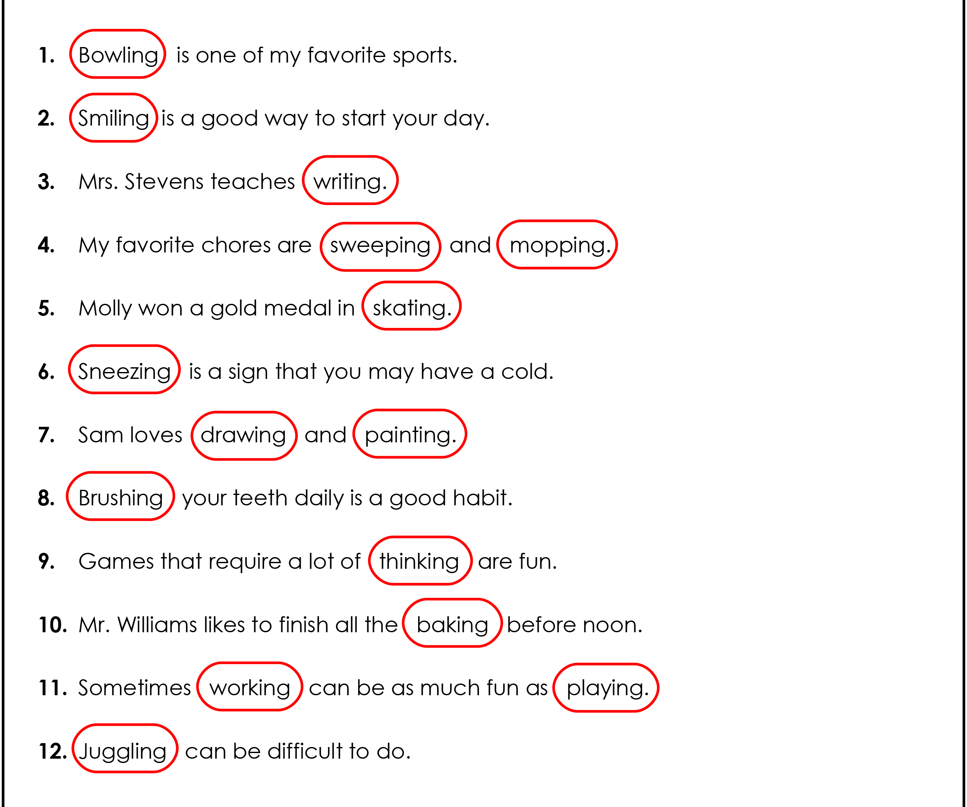
Answers

Slide 11
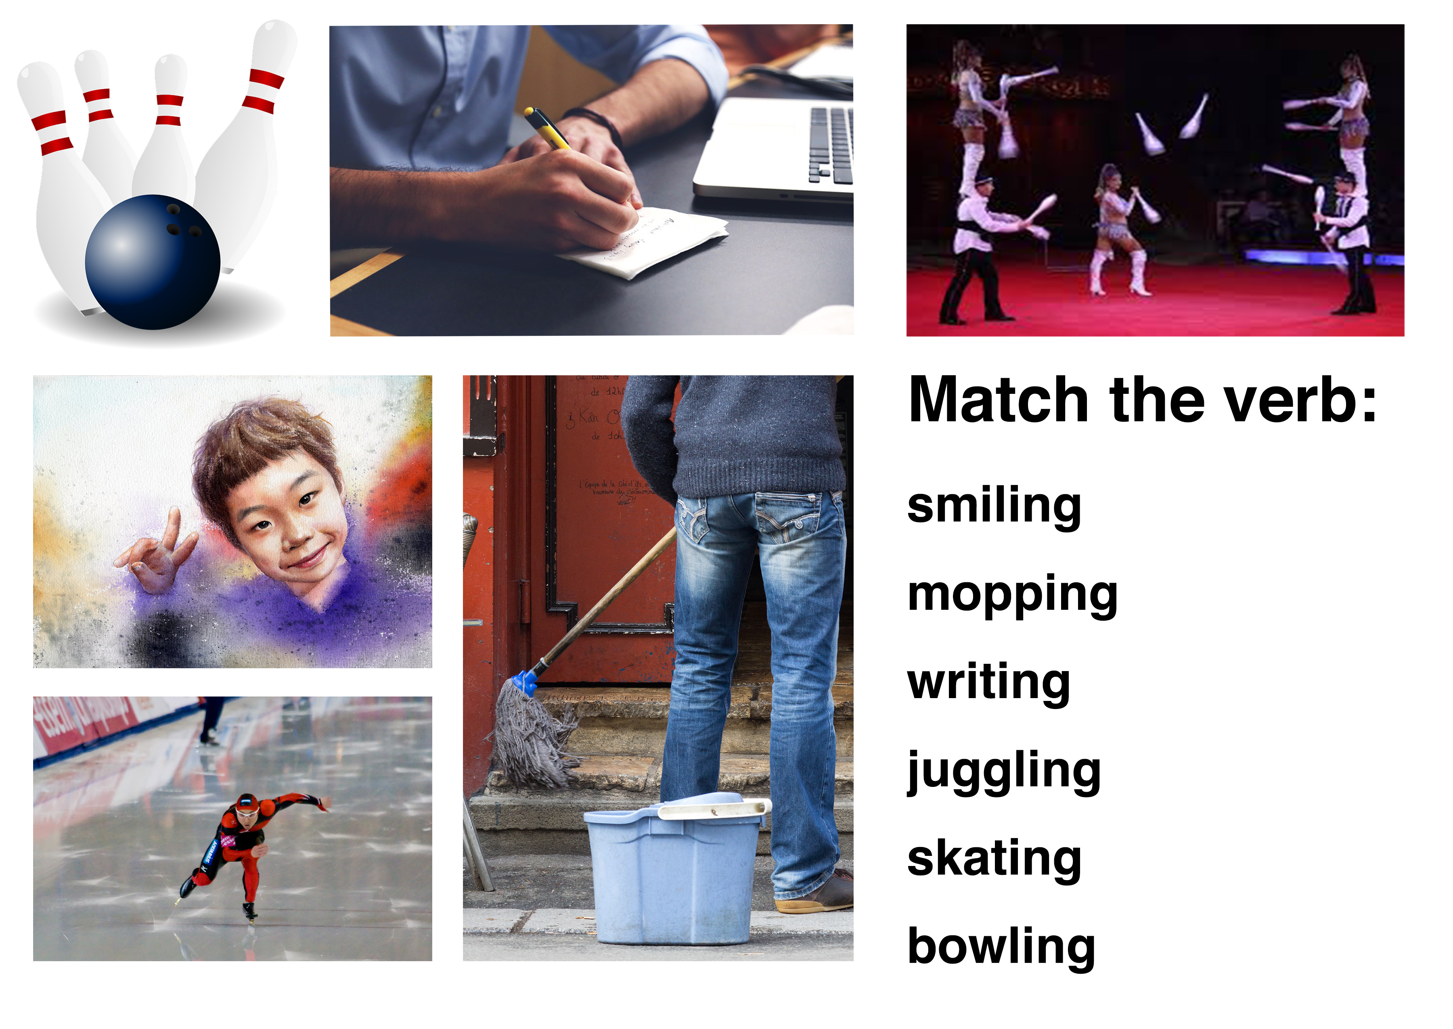
Matching
Notes:
Match the verb to the photo.

Slide 12
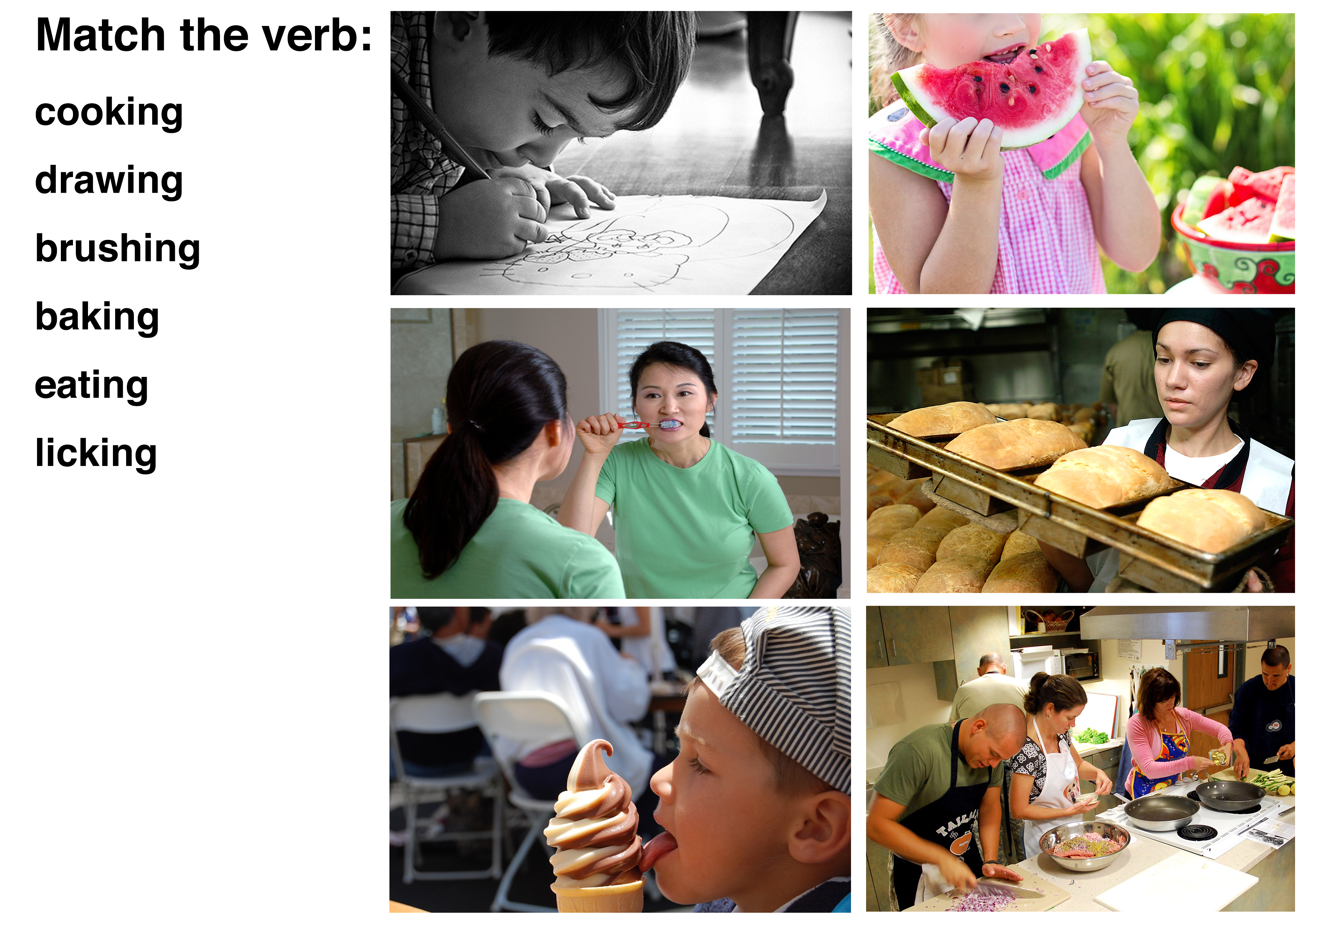
Matching
Notes:
Match the verb to the photo.

Slide 13
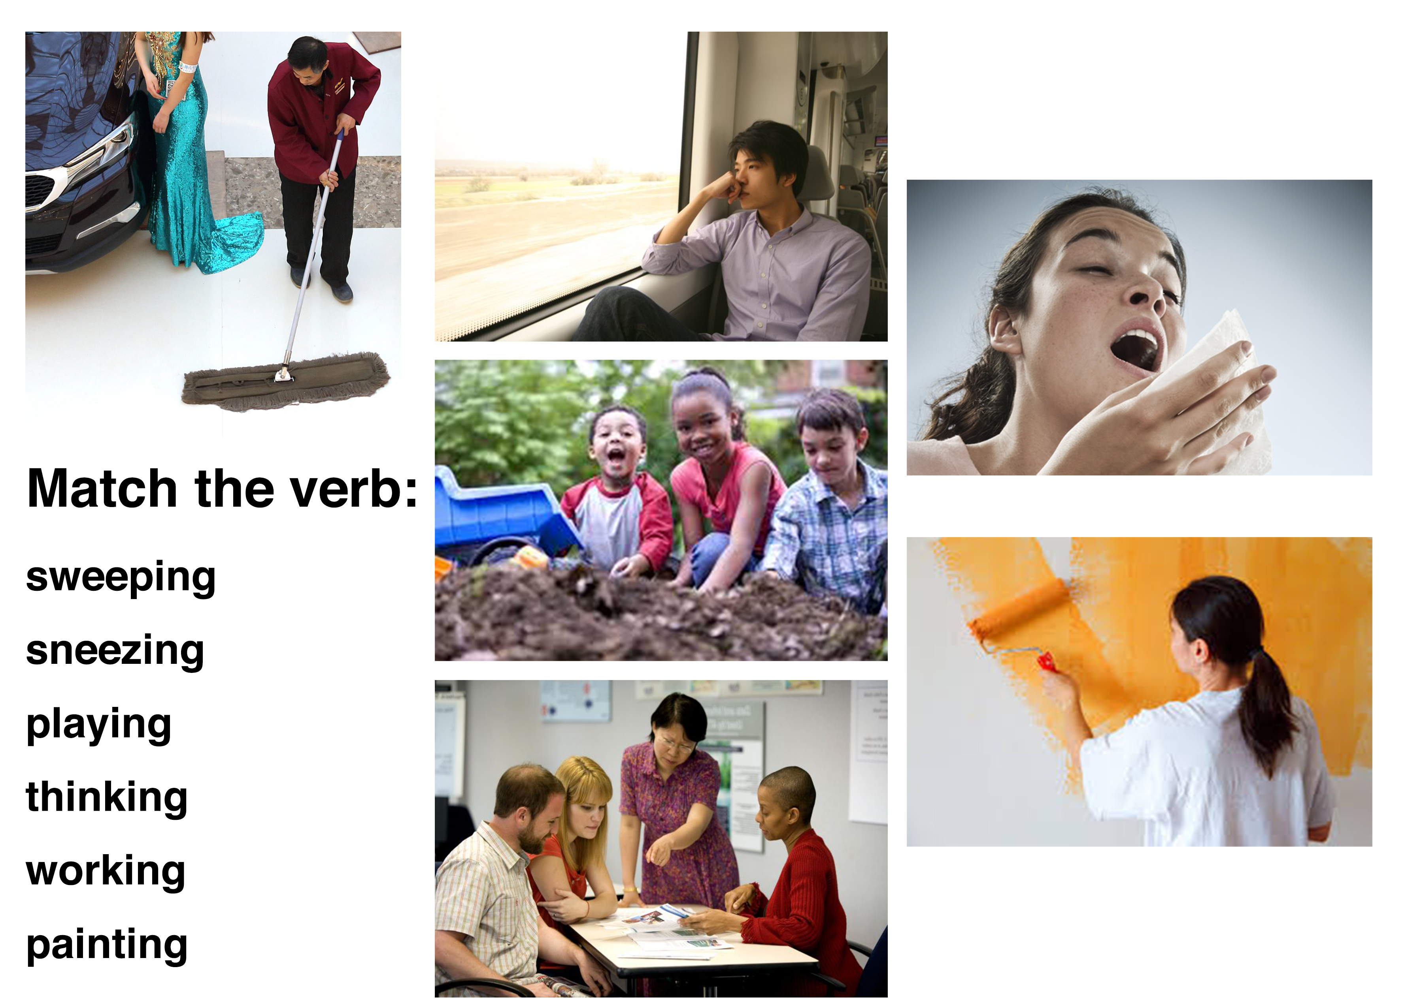
Matching
Notes:
Match the verb to the photo.

Slide 14
Circle the “ing” words
Notes:
Get students to underline the root word for all the “ing” words and write it out in full (i.e. bowling=bowl). Practice reading the vocabulary they just learned. Alternate between students for each sentence.

Slide 15
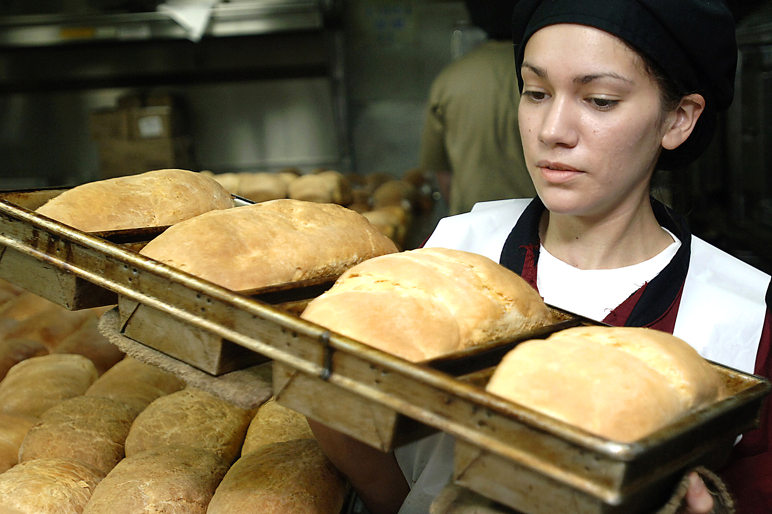
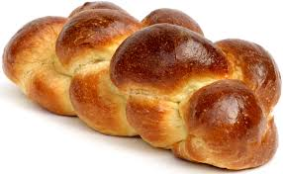
Using “because”
“Because” is used to connect sentences.
Alice went shopping.
Why?
She needed to buy bread.
Let's use ”because”.
Alice went shopping because she needed to buy bread.
Notes:
Explain slide.

Slide 16

Where is “because” missing?
Amy has a stomachache she ate too much ice cream.
I asked the waitress for an extra menu Jenna was supposed to join us for dinner.
I’m studying English I love languages.
She can cook well she learned from her mother.
Fast food is delicious it uses unhealthy ingredients.
I make eggs they are easy to cook.
Notes:
Alternate between each student getting them to say where “because” belongs.

Slide 17

Dumplings 饺子
Notes:
Play “Dumplings Around The World.mp4”
Make sure to stop the video for discussion.
Follow up questions: Do you like dumplings? What kind of dumplings do you like? Why do you think that dumplings are so popular? Why do the fillings change in different countries? Why do you think many countries have dumplings?

Slide 18
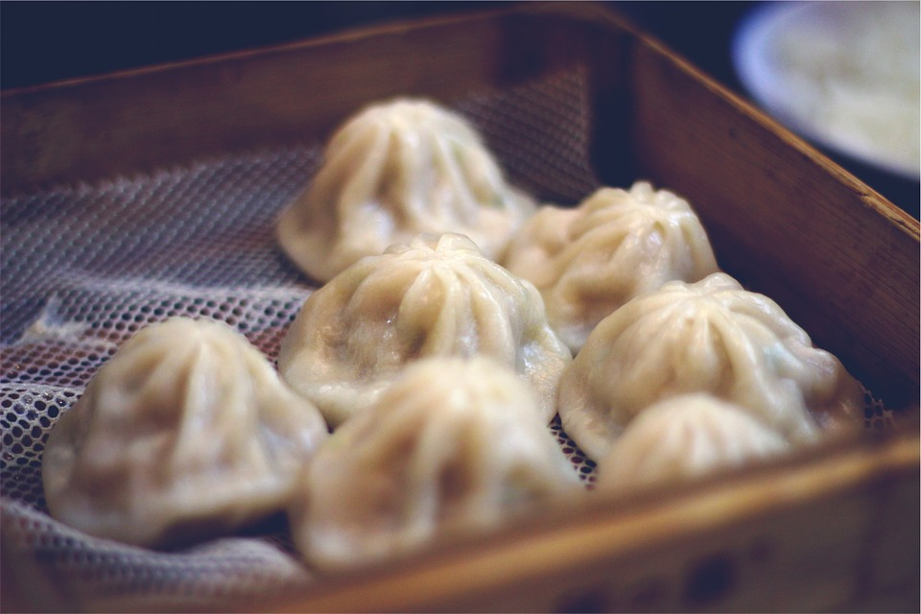
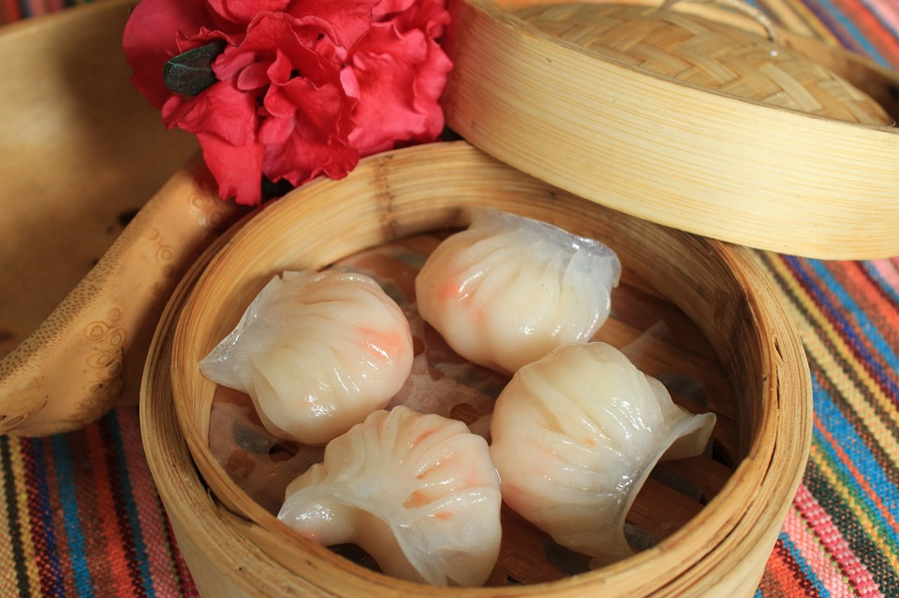
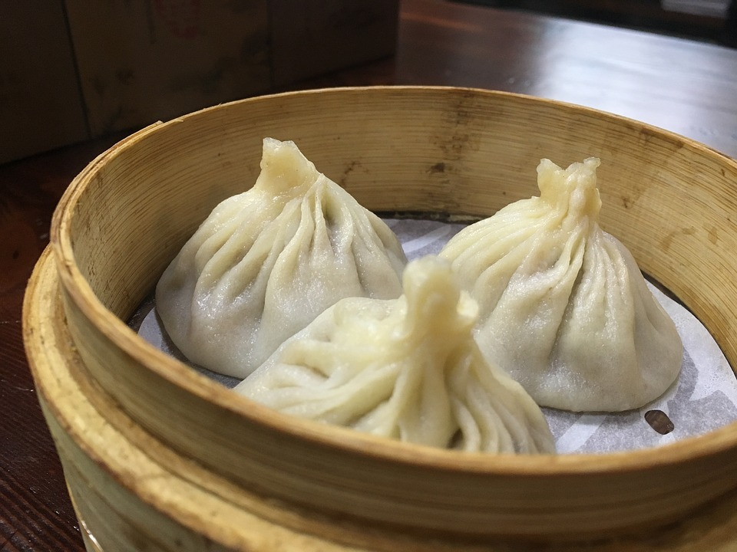
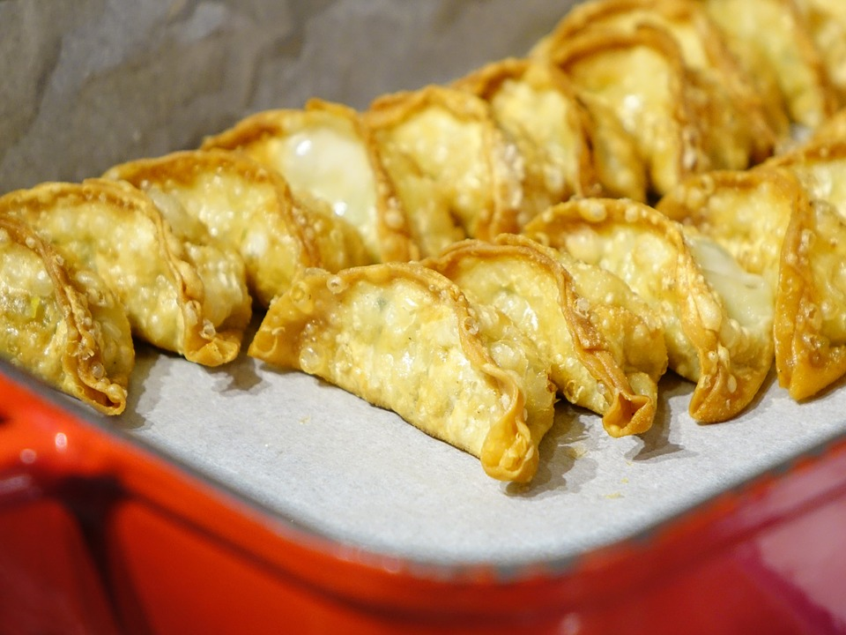
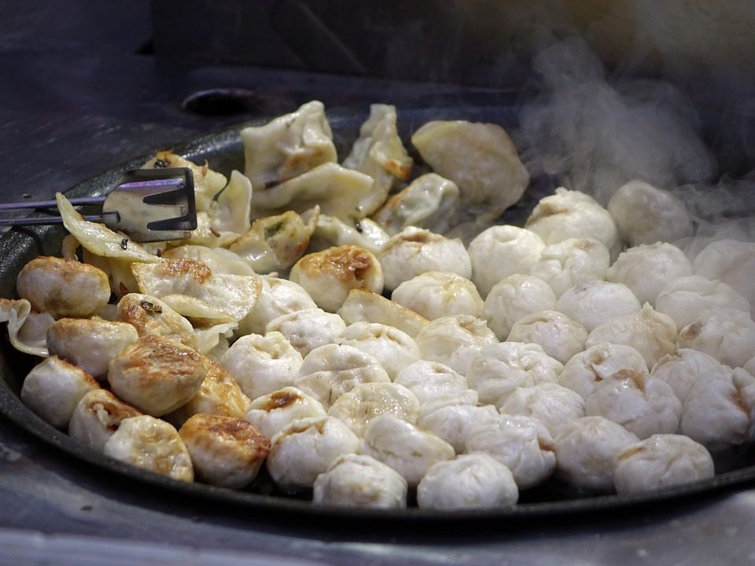
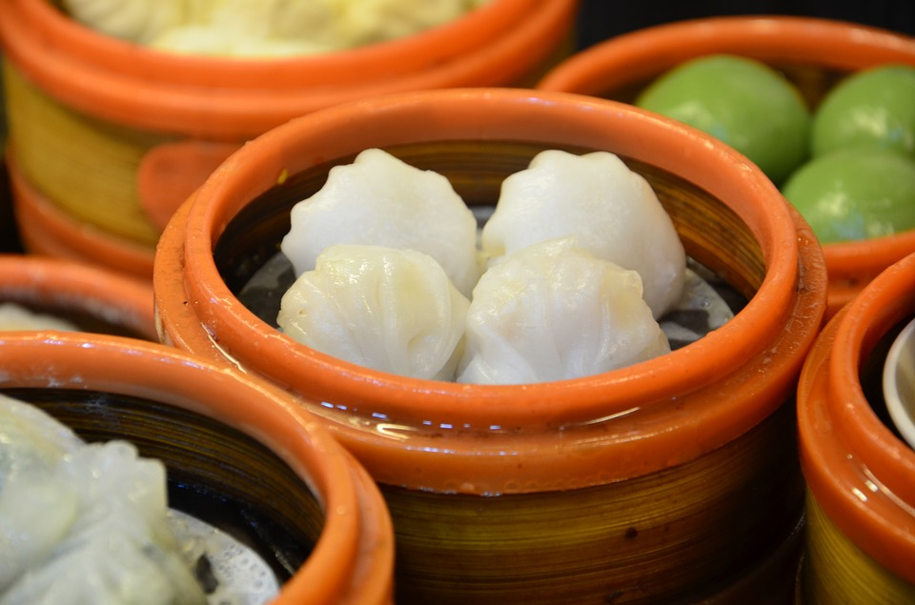
What shape would you use?
Notes:
Ask the students what shape they would choose for their dumplings.

Slide 19
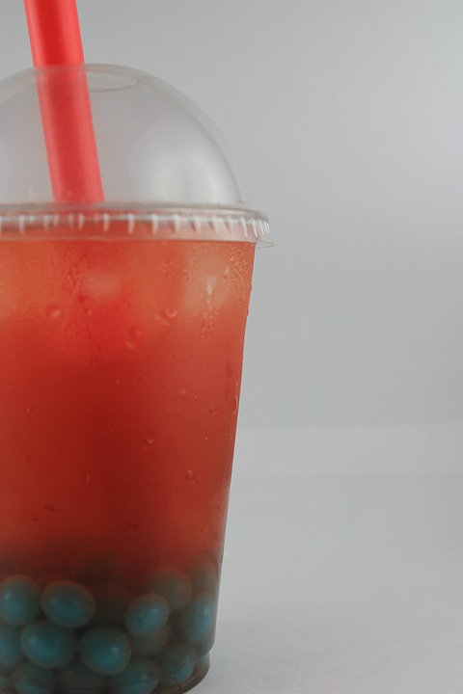
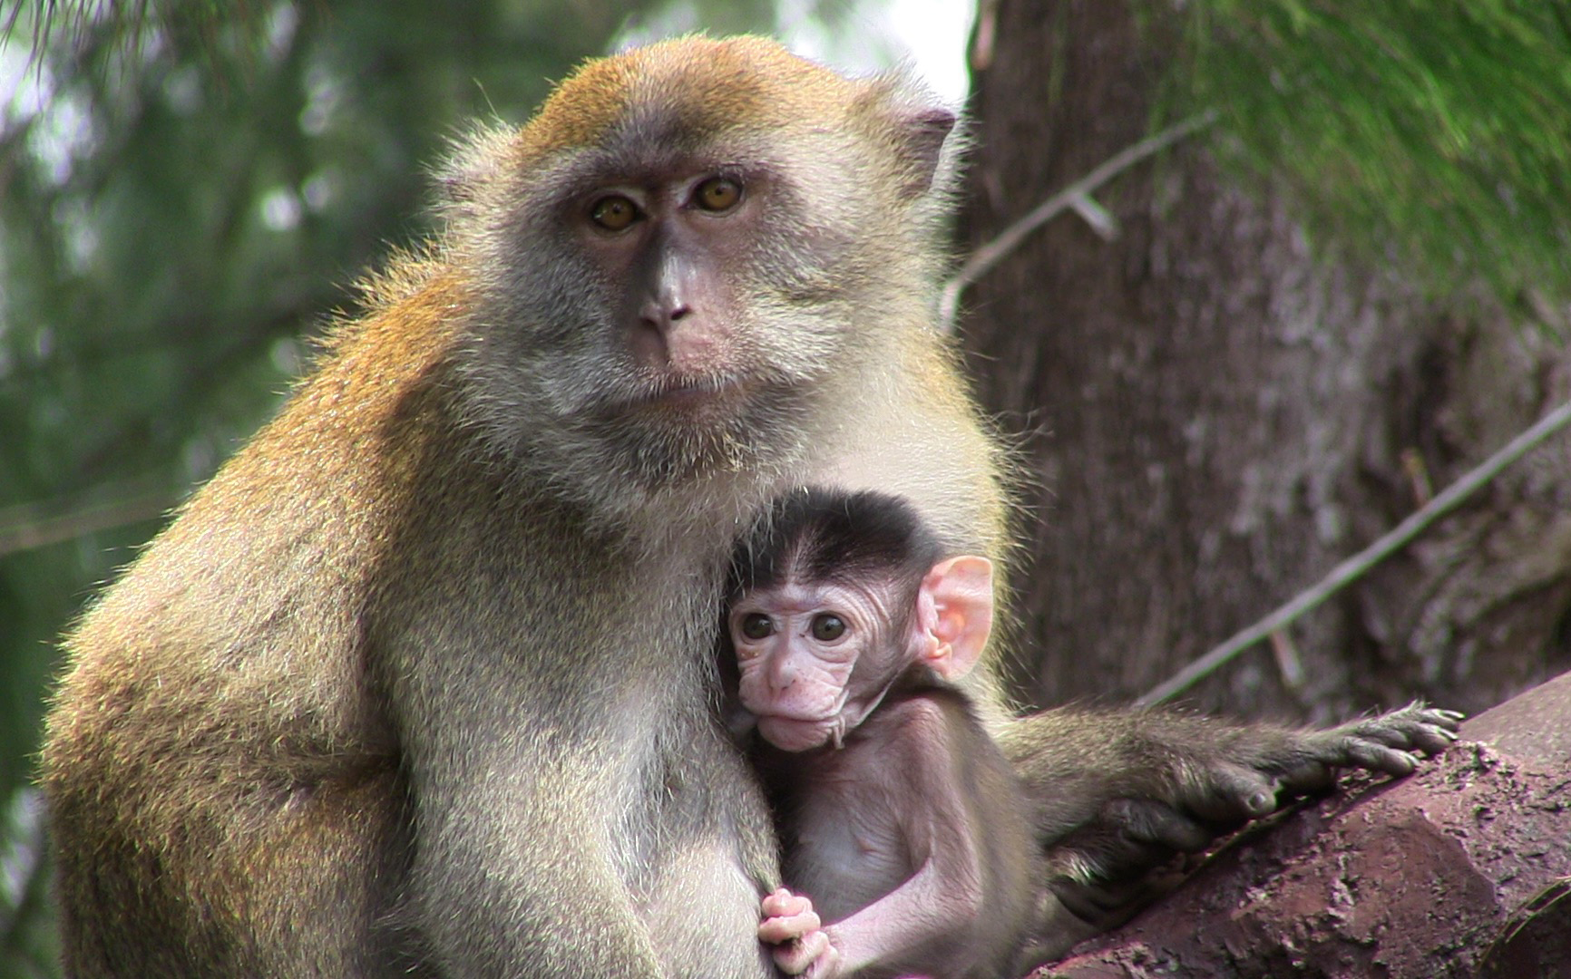
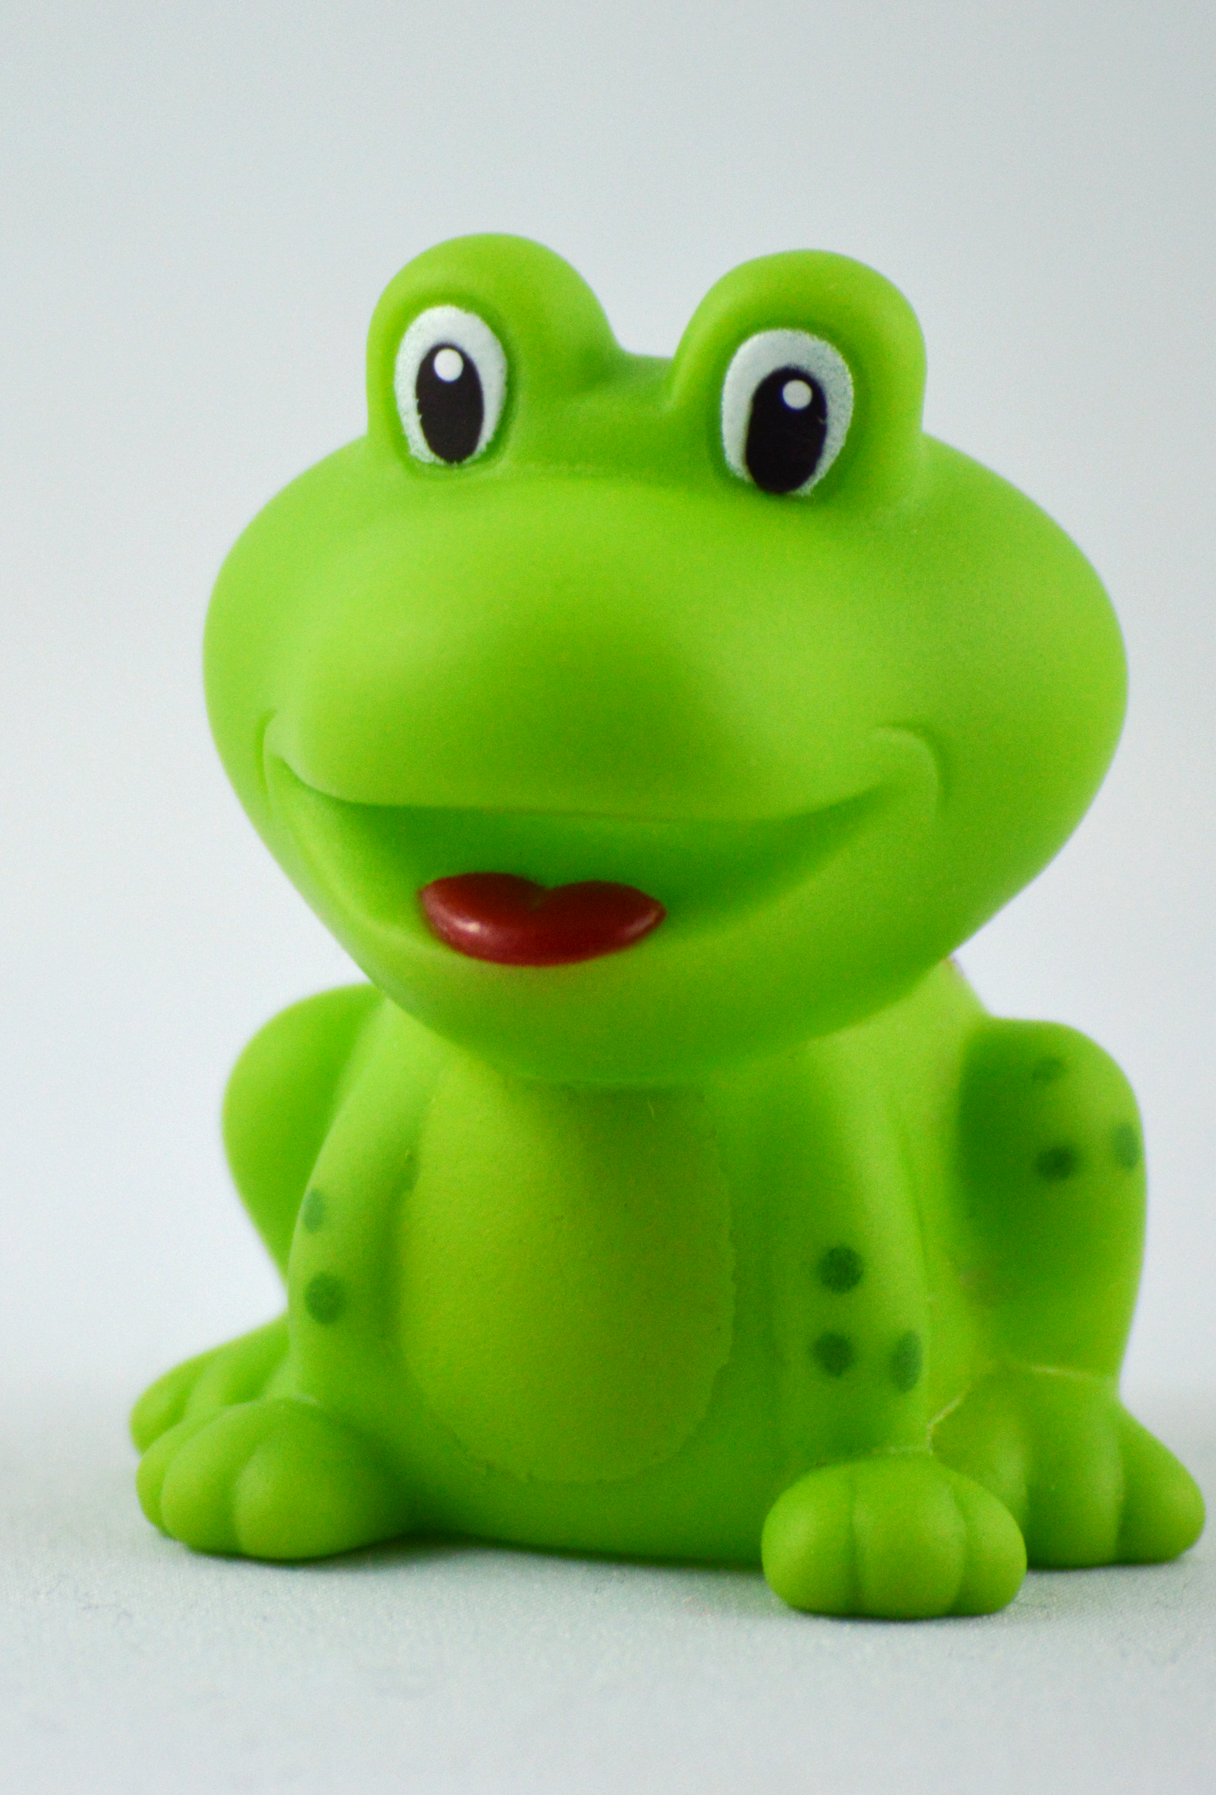
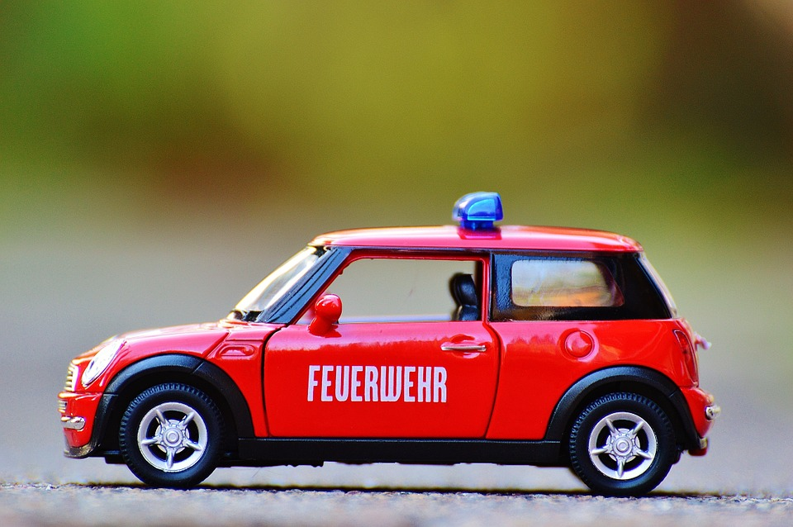
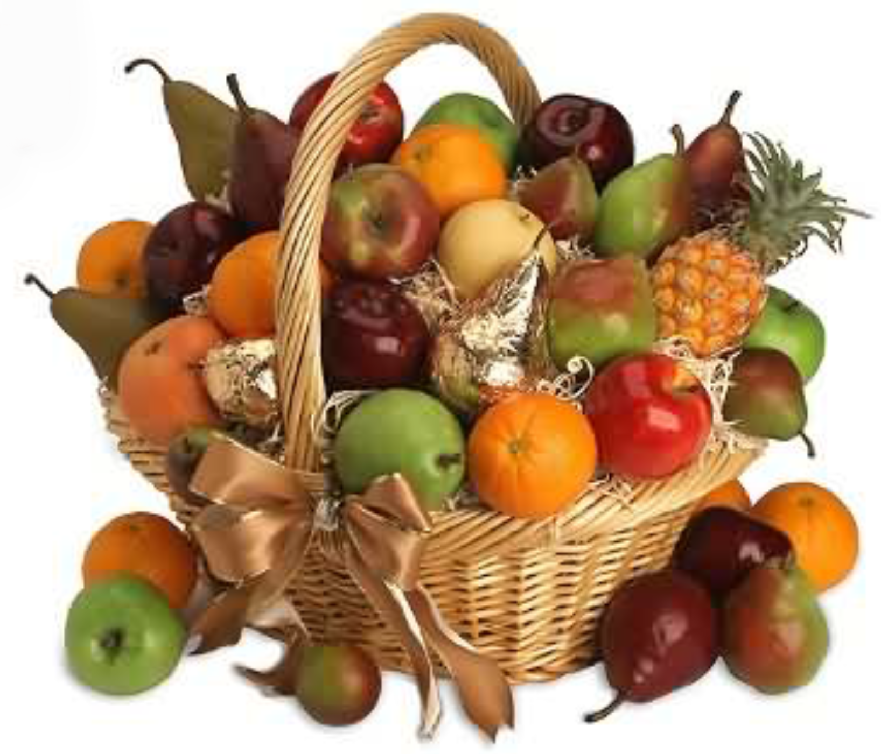
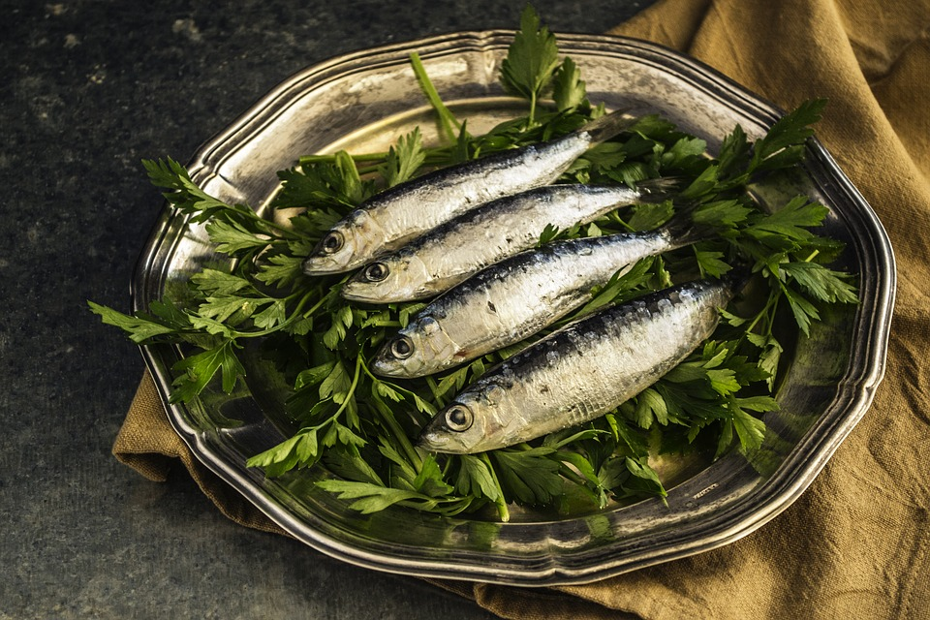
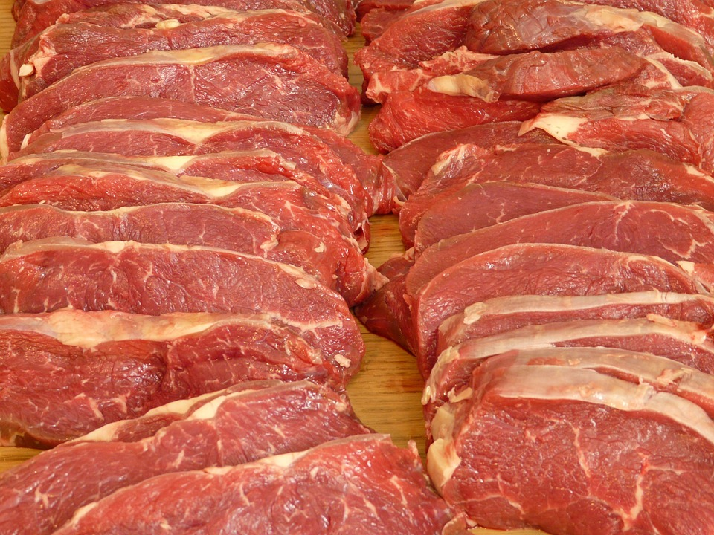
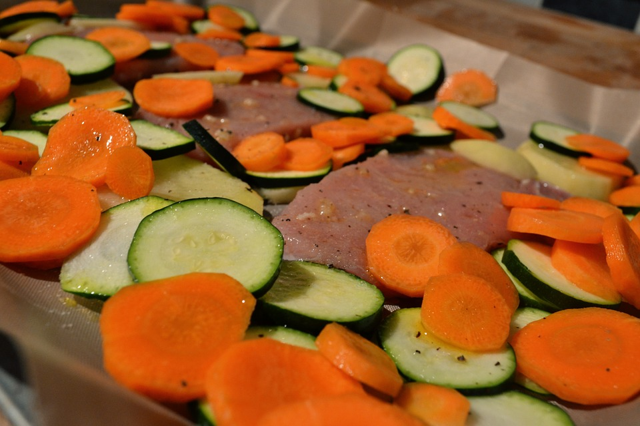
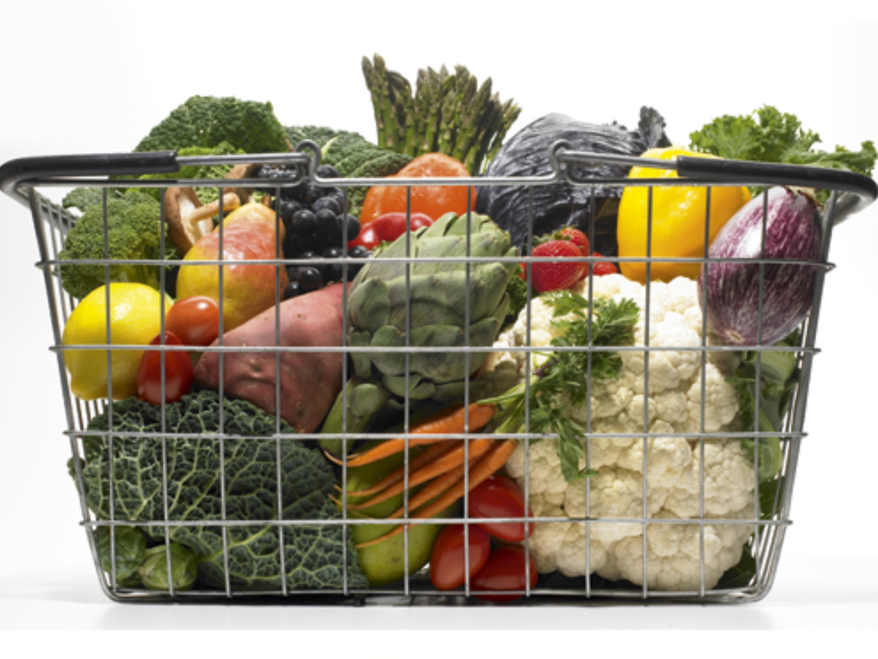

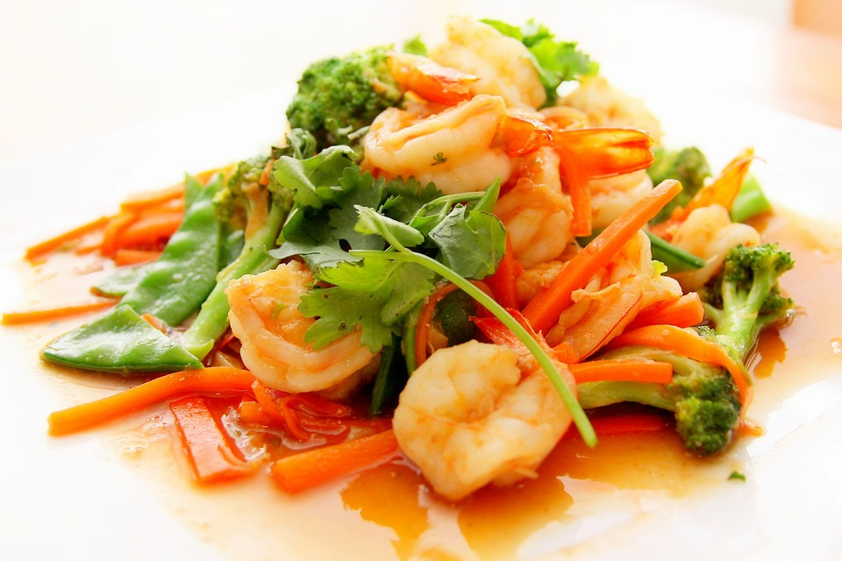
What would you put inside?
Notes:
Ask the students what ingredients they would choose for their dumplings. They could choose ingredients from the photos or others think they of.

Slide 20
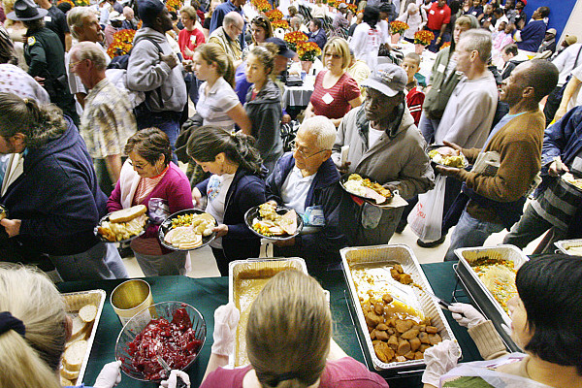
What do you think is happening in this photo?
Notes:
Ask questions like:
Why are they in a line?
Why are there so many people
Who do you think cooked the food?
Explain the concept of feeding the homeless.

Slide 21

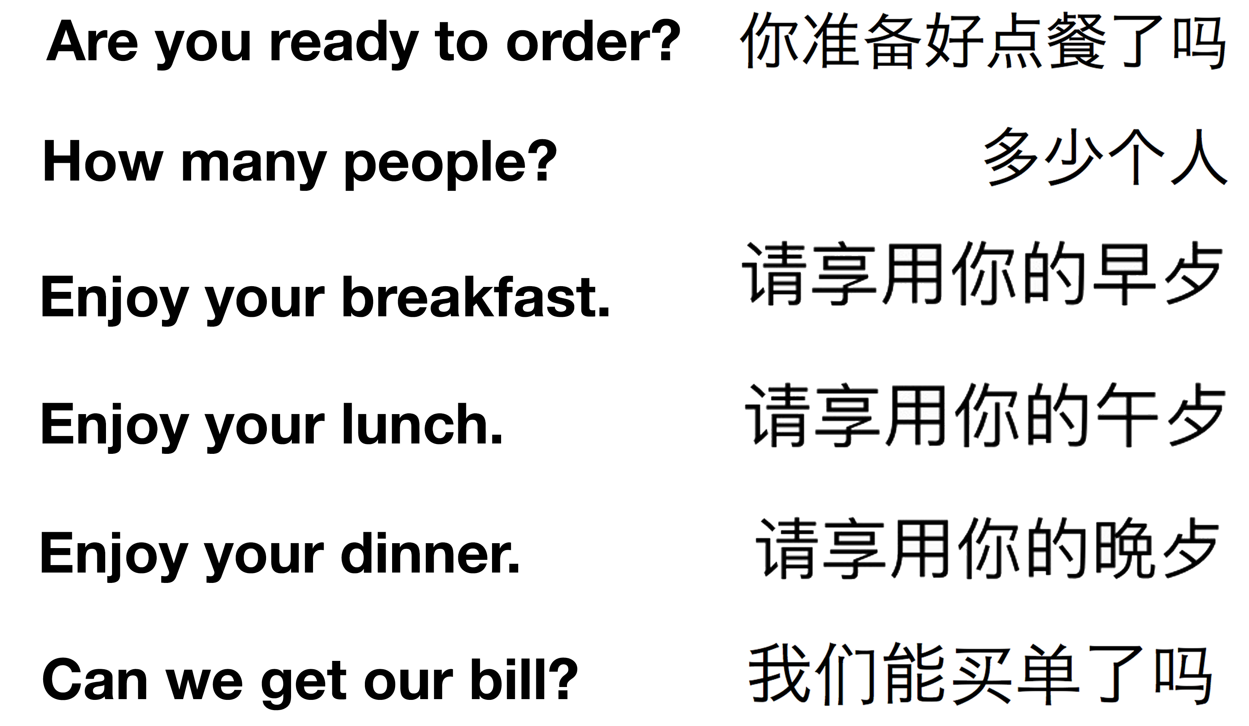
Some restaurant phrases
Notes:
Explain when you would use each phrase.

Slide 22
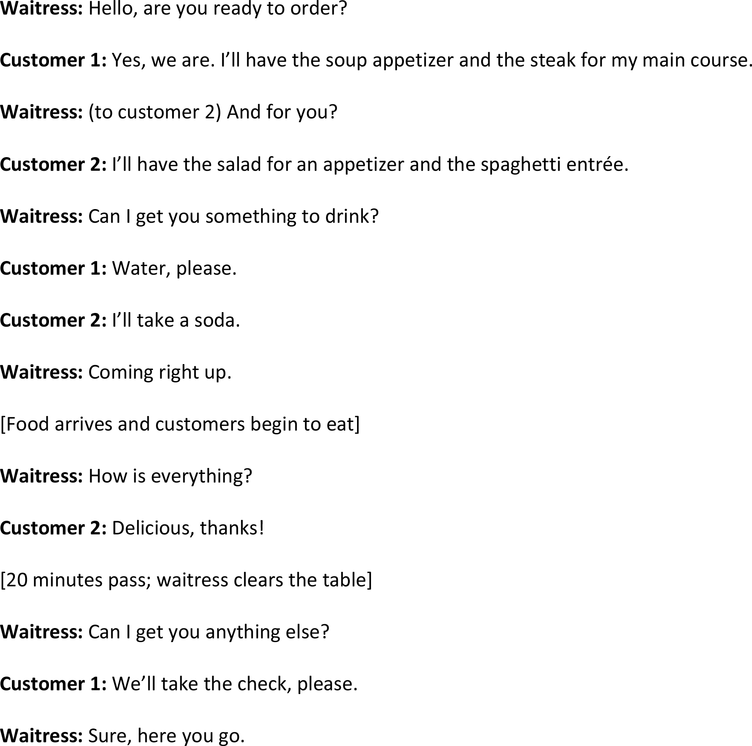
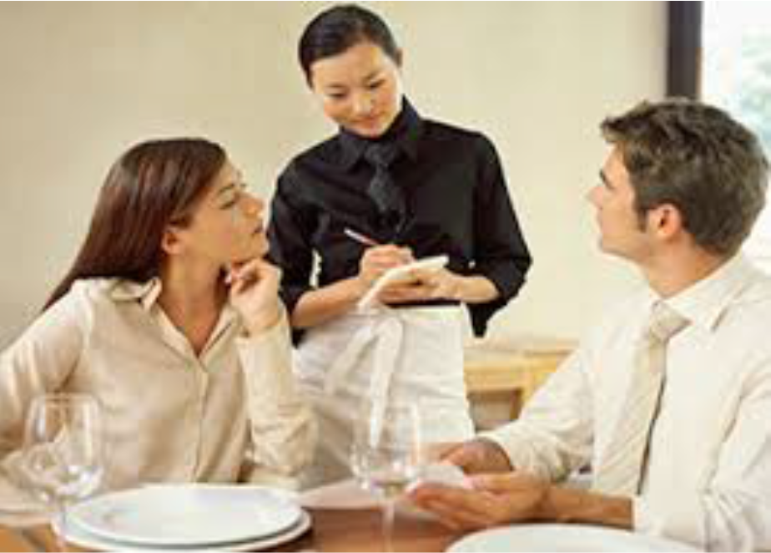
Here’s an example
Notes:
Read over the example and explain unknown vocabulary (customer, waitress, appetizer, main course/entrée, soda)

Slide 23


Homework
With your classmates, create a script for ordering food from a waiter at a restaurant.
Notes:
Get students to communicate with each other through video chat to create a script. One person should be the waiter. The others can be guests.

Slide 24

What did I learn today?
Practiced ‘ng’ and ‘ing’ words
Used ‘because’
How to read poetry
The food groups
Restaurant phrases
Notes:
Review

