Slide 1
Lesson 5: Tutoring FOOD

Slide 2
What we will learn today
Practicing “ing”
“ing” and “ng” vocabulary
Using “because”
Reading practice

Slide 3
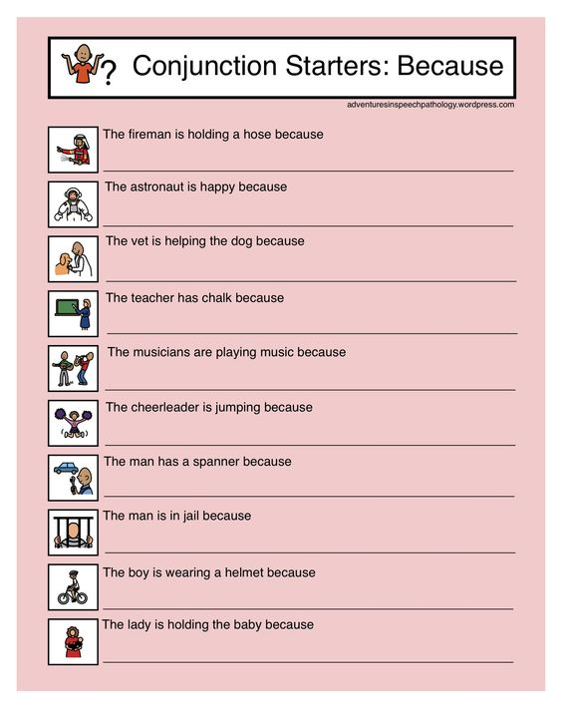

Slide 4
Where do you put “because”?
She didn’t lend me her car she needed it to go shopping.
There are a lot of children in the park there is no school today.
My teacher got angry with me I didn’t finish my work.
Amanda doesn’t have much money she spends it all on clothes.
She doesn’t eat any sweets she wants to eat healthy food.
Alice texted me she wanted to invite me to her birthday party.

Slide 5
Complete these sentences
I am learning English because __________________.
My favourite food is __________________ because __________________.
A food I dislike is __________________ because __________________.
During school lunches I like to eat __________________ because __________________.
My favourite home cooked meal is __________________ because __________________.

Slide 8
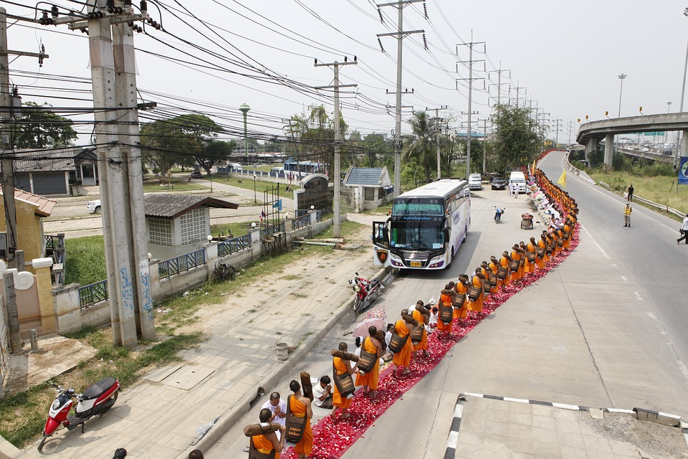
What word is this?
Hint:
To make bread
Hint:
An adjective to describe the line

Slide 9
The words are
baking
long

Slide 11
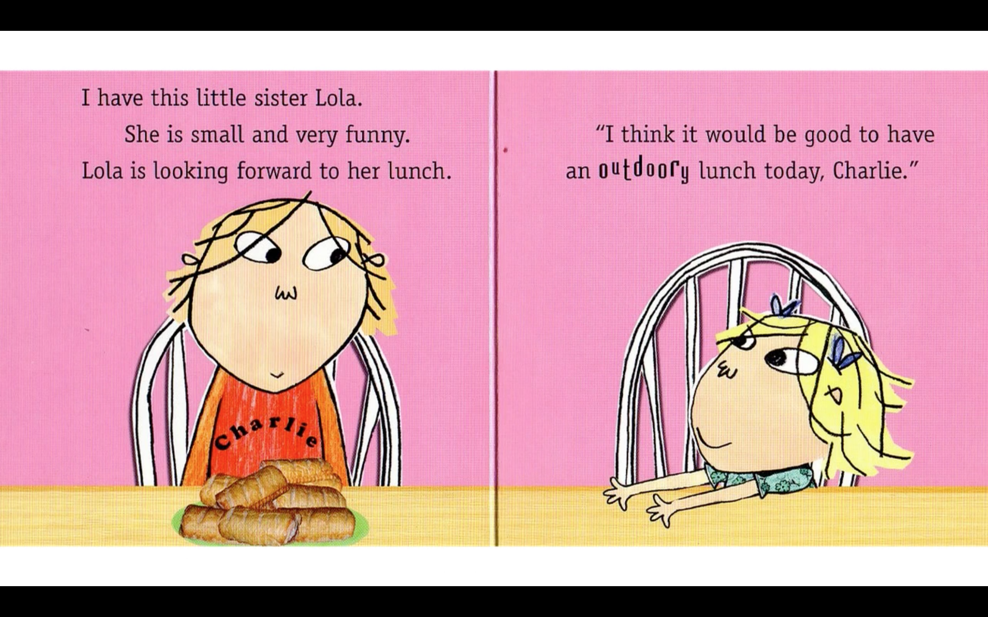

Slide 13
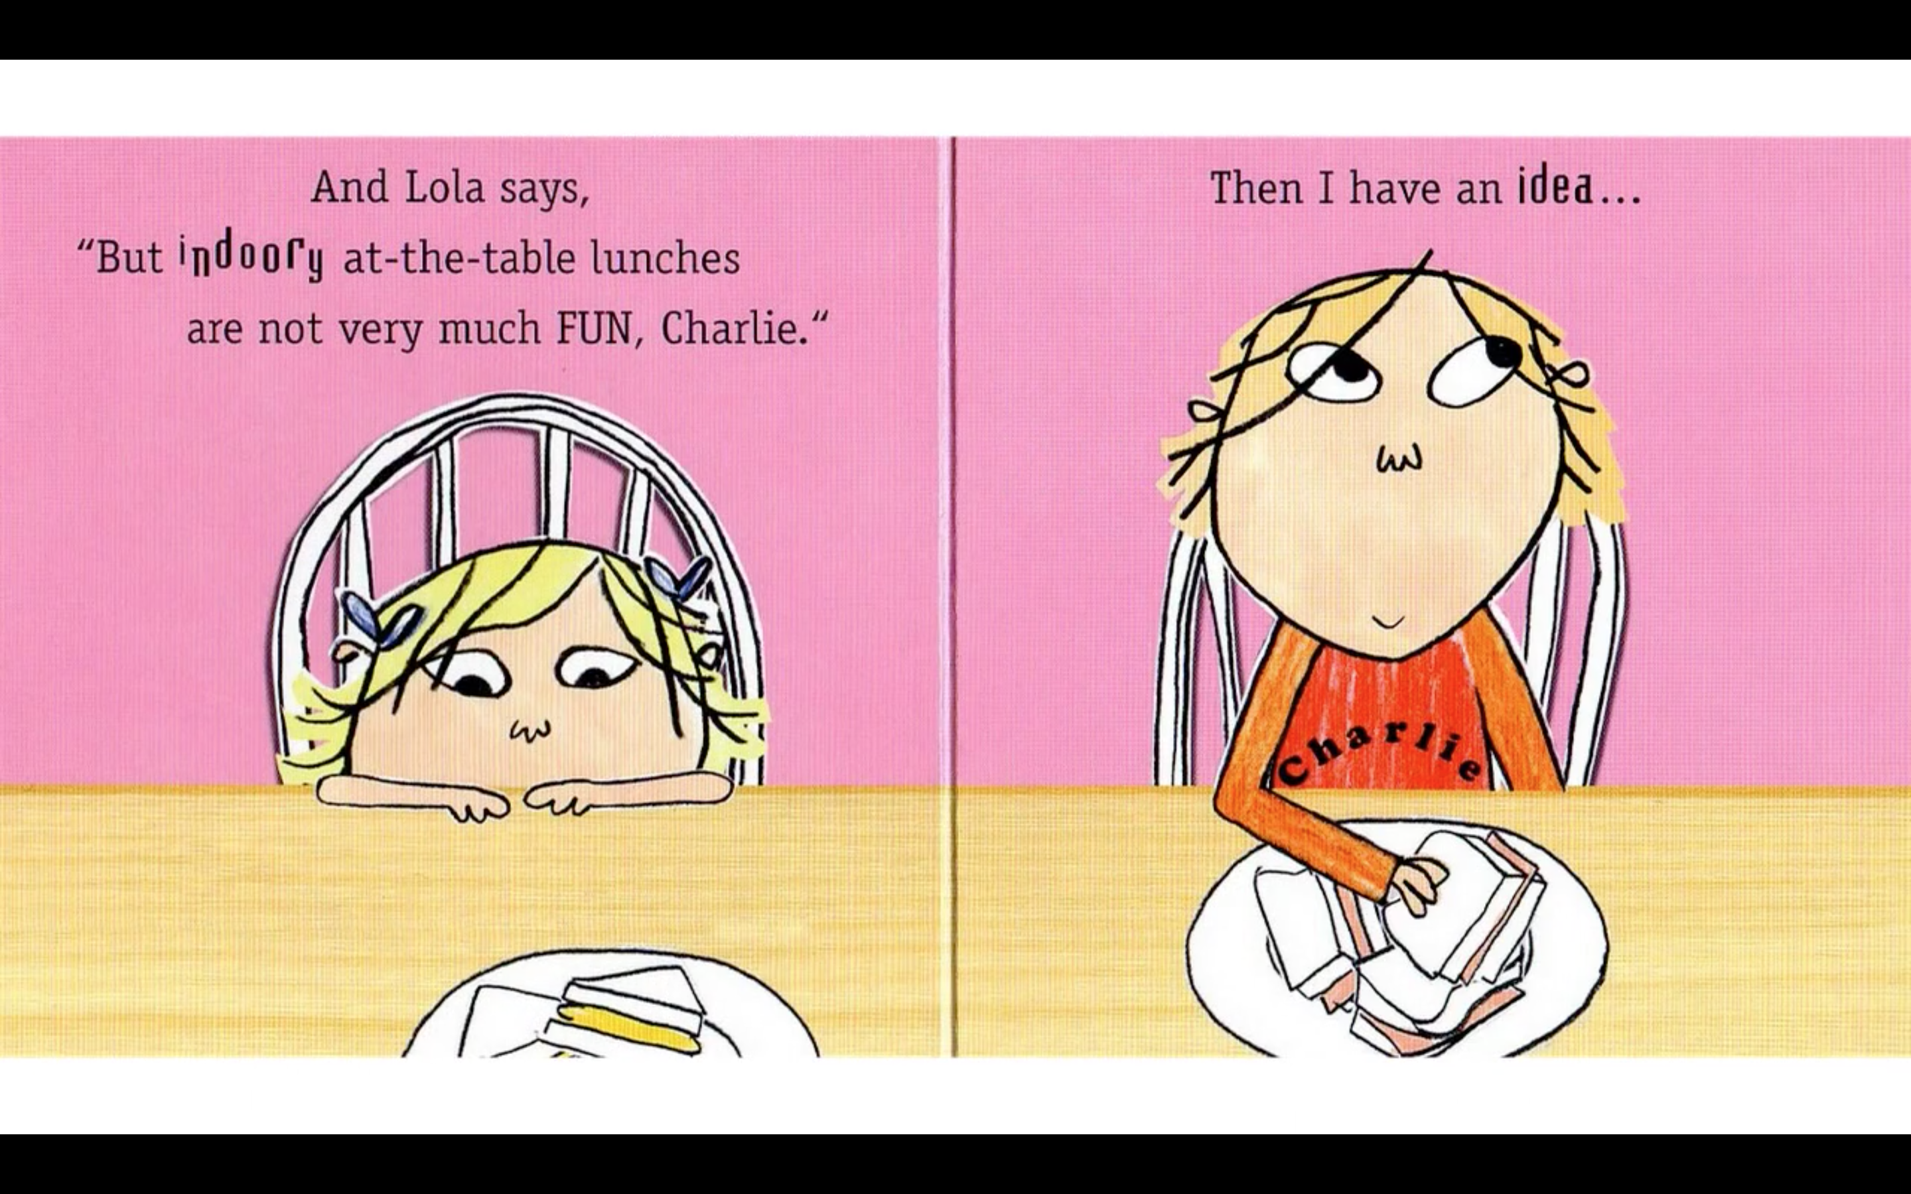

Slide 15
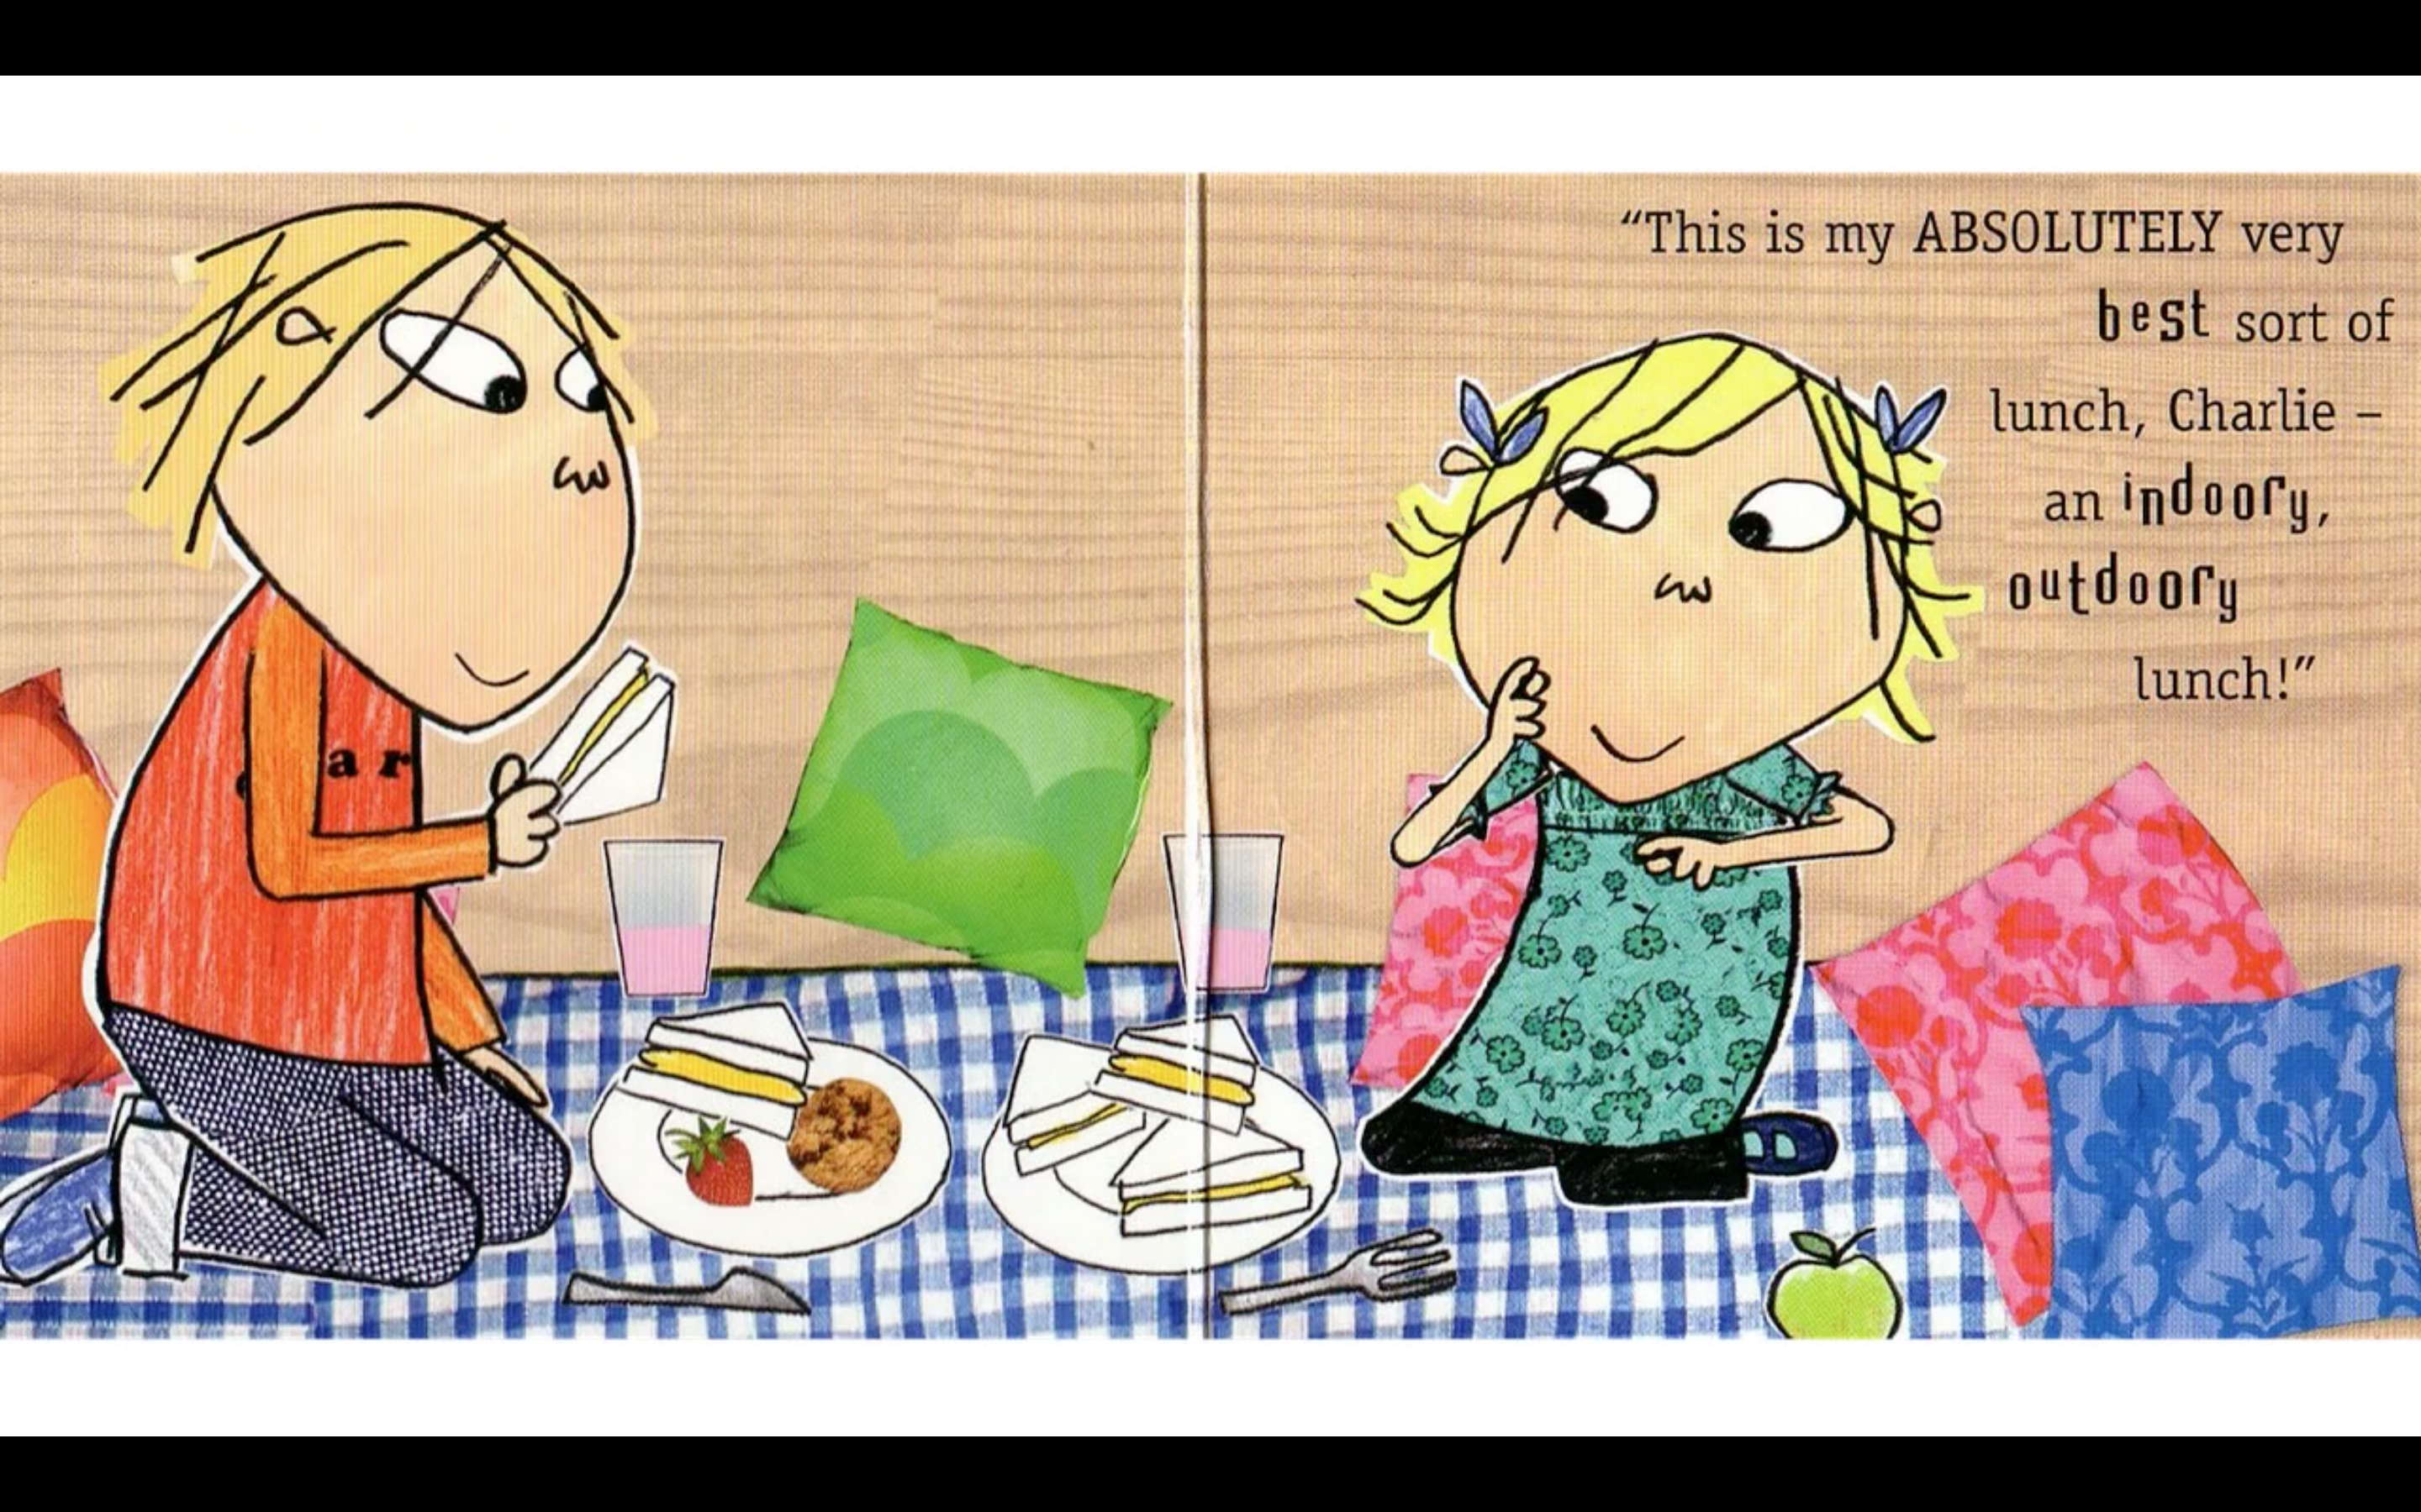

Slide 16
What did I learn today?
Practiced ‘ng’ and ‘ing’ words
Used ‘because’
Reading skills

