Slide 1
Lesson 6 FOOD

Slide 2
What we will learn today
Using “dr”
The food groups
Reading storybooks and poetry practice

Slide 3
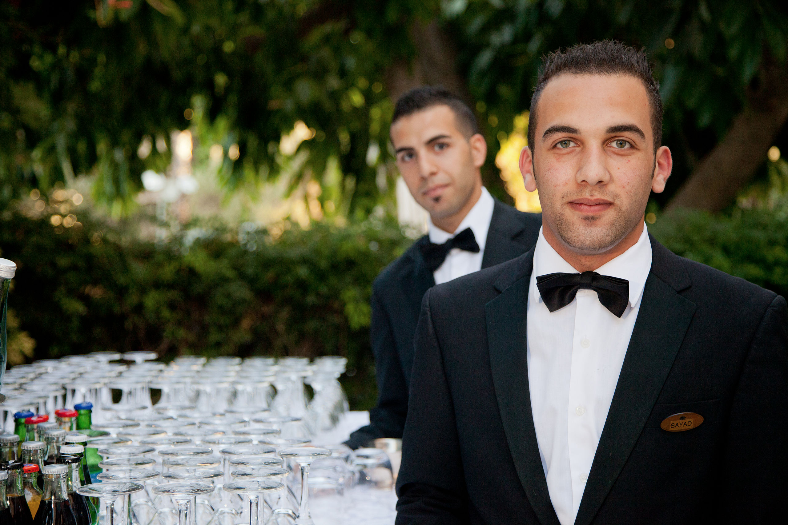
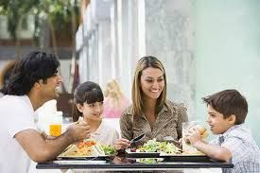
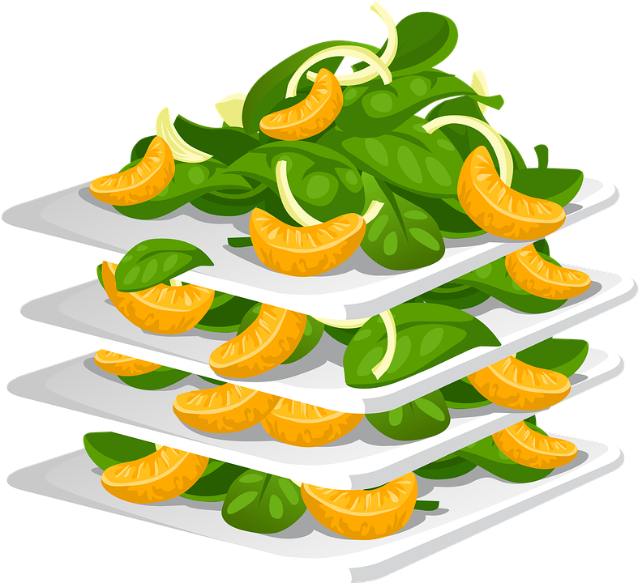
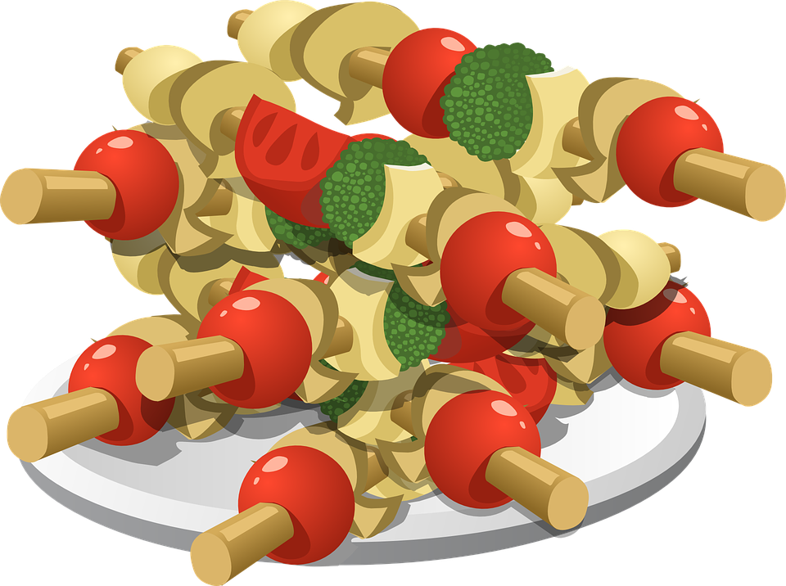
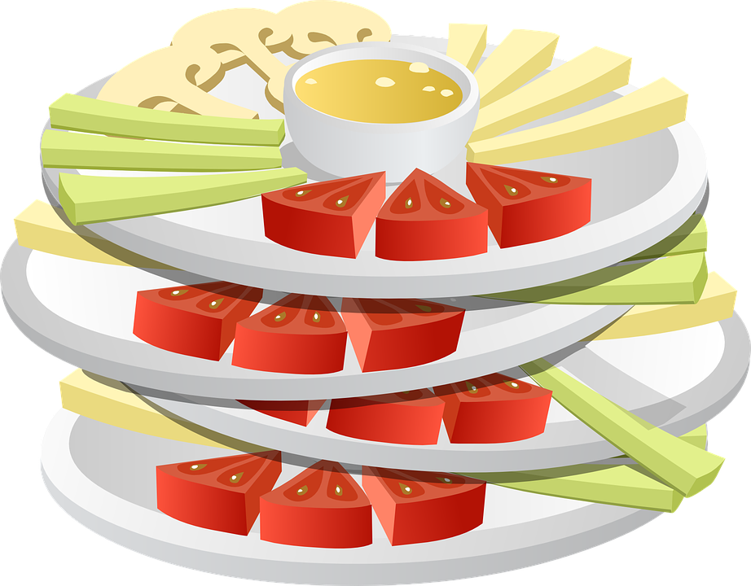
Let’s share

Slide 4
The DR sound

Slide 5
Using “dr”

Slide 6
Using “dr”

Slide 7
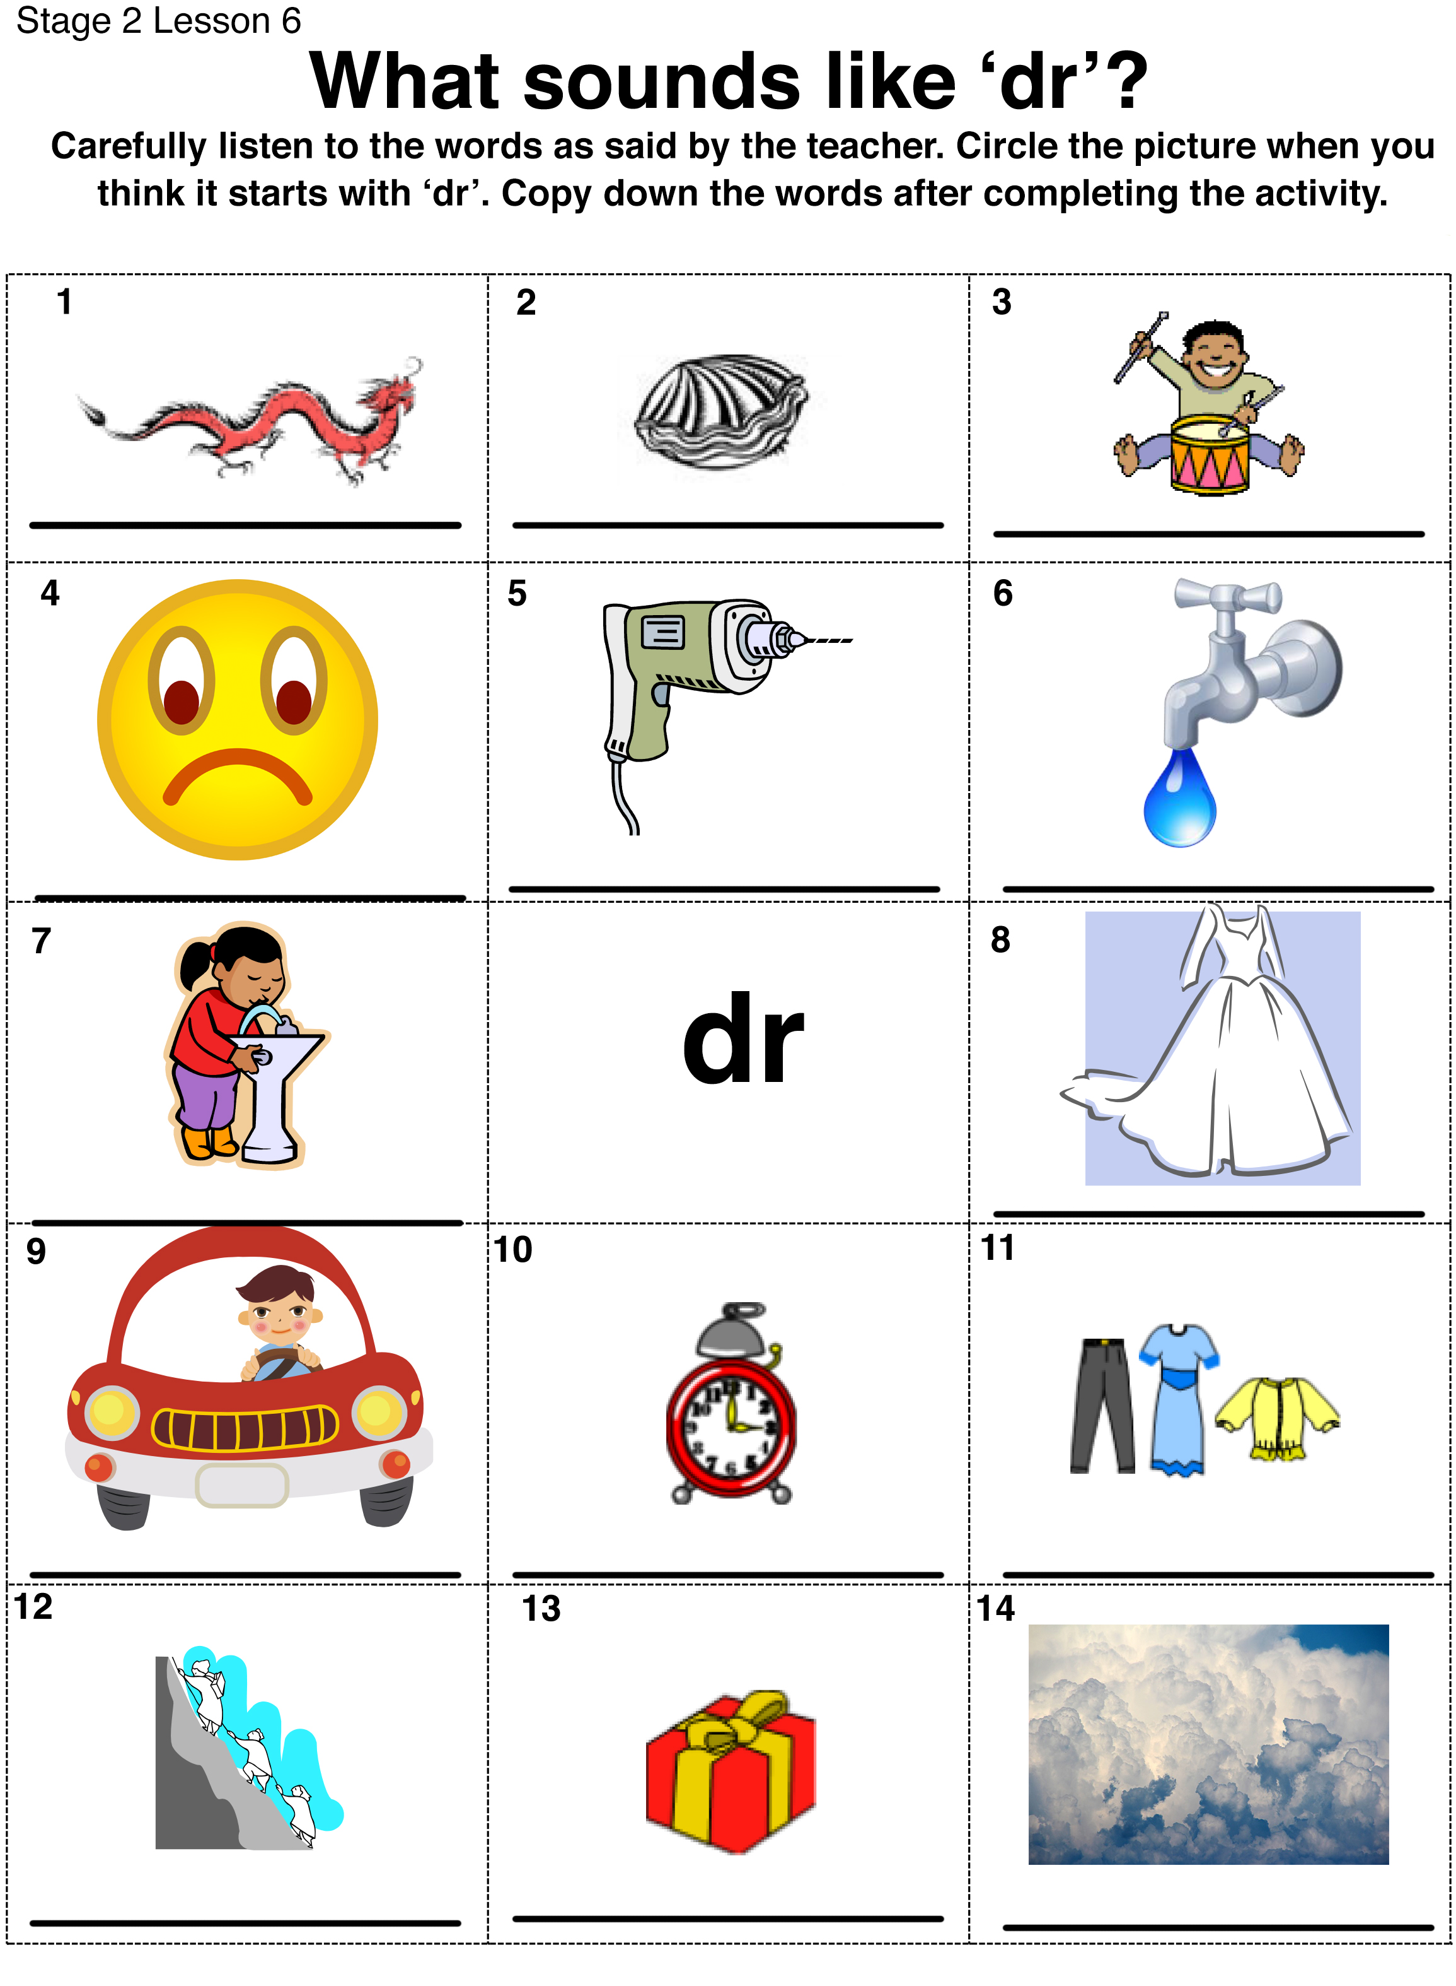
Listen for the “dr” sound

Slide 8
Answers
1. dragon 2. clam
3. drums 4. frown 5. drill 6. drip
7. drink 8. dress
9. drive 10. clock 11. clothes
12. climb 13. present 14. clouds

Slide 9
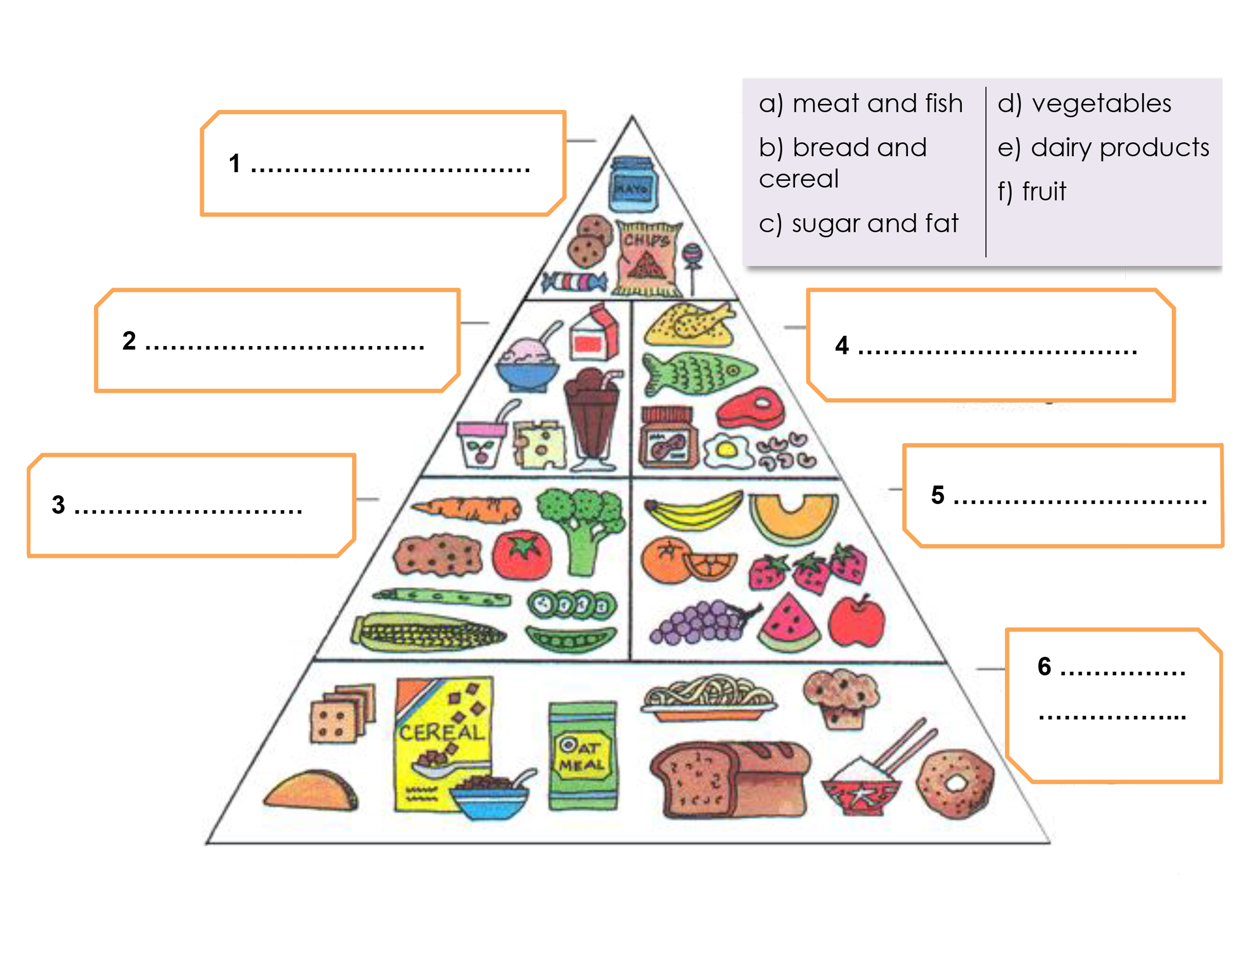
Label the food groups

Slide 10
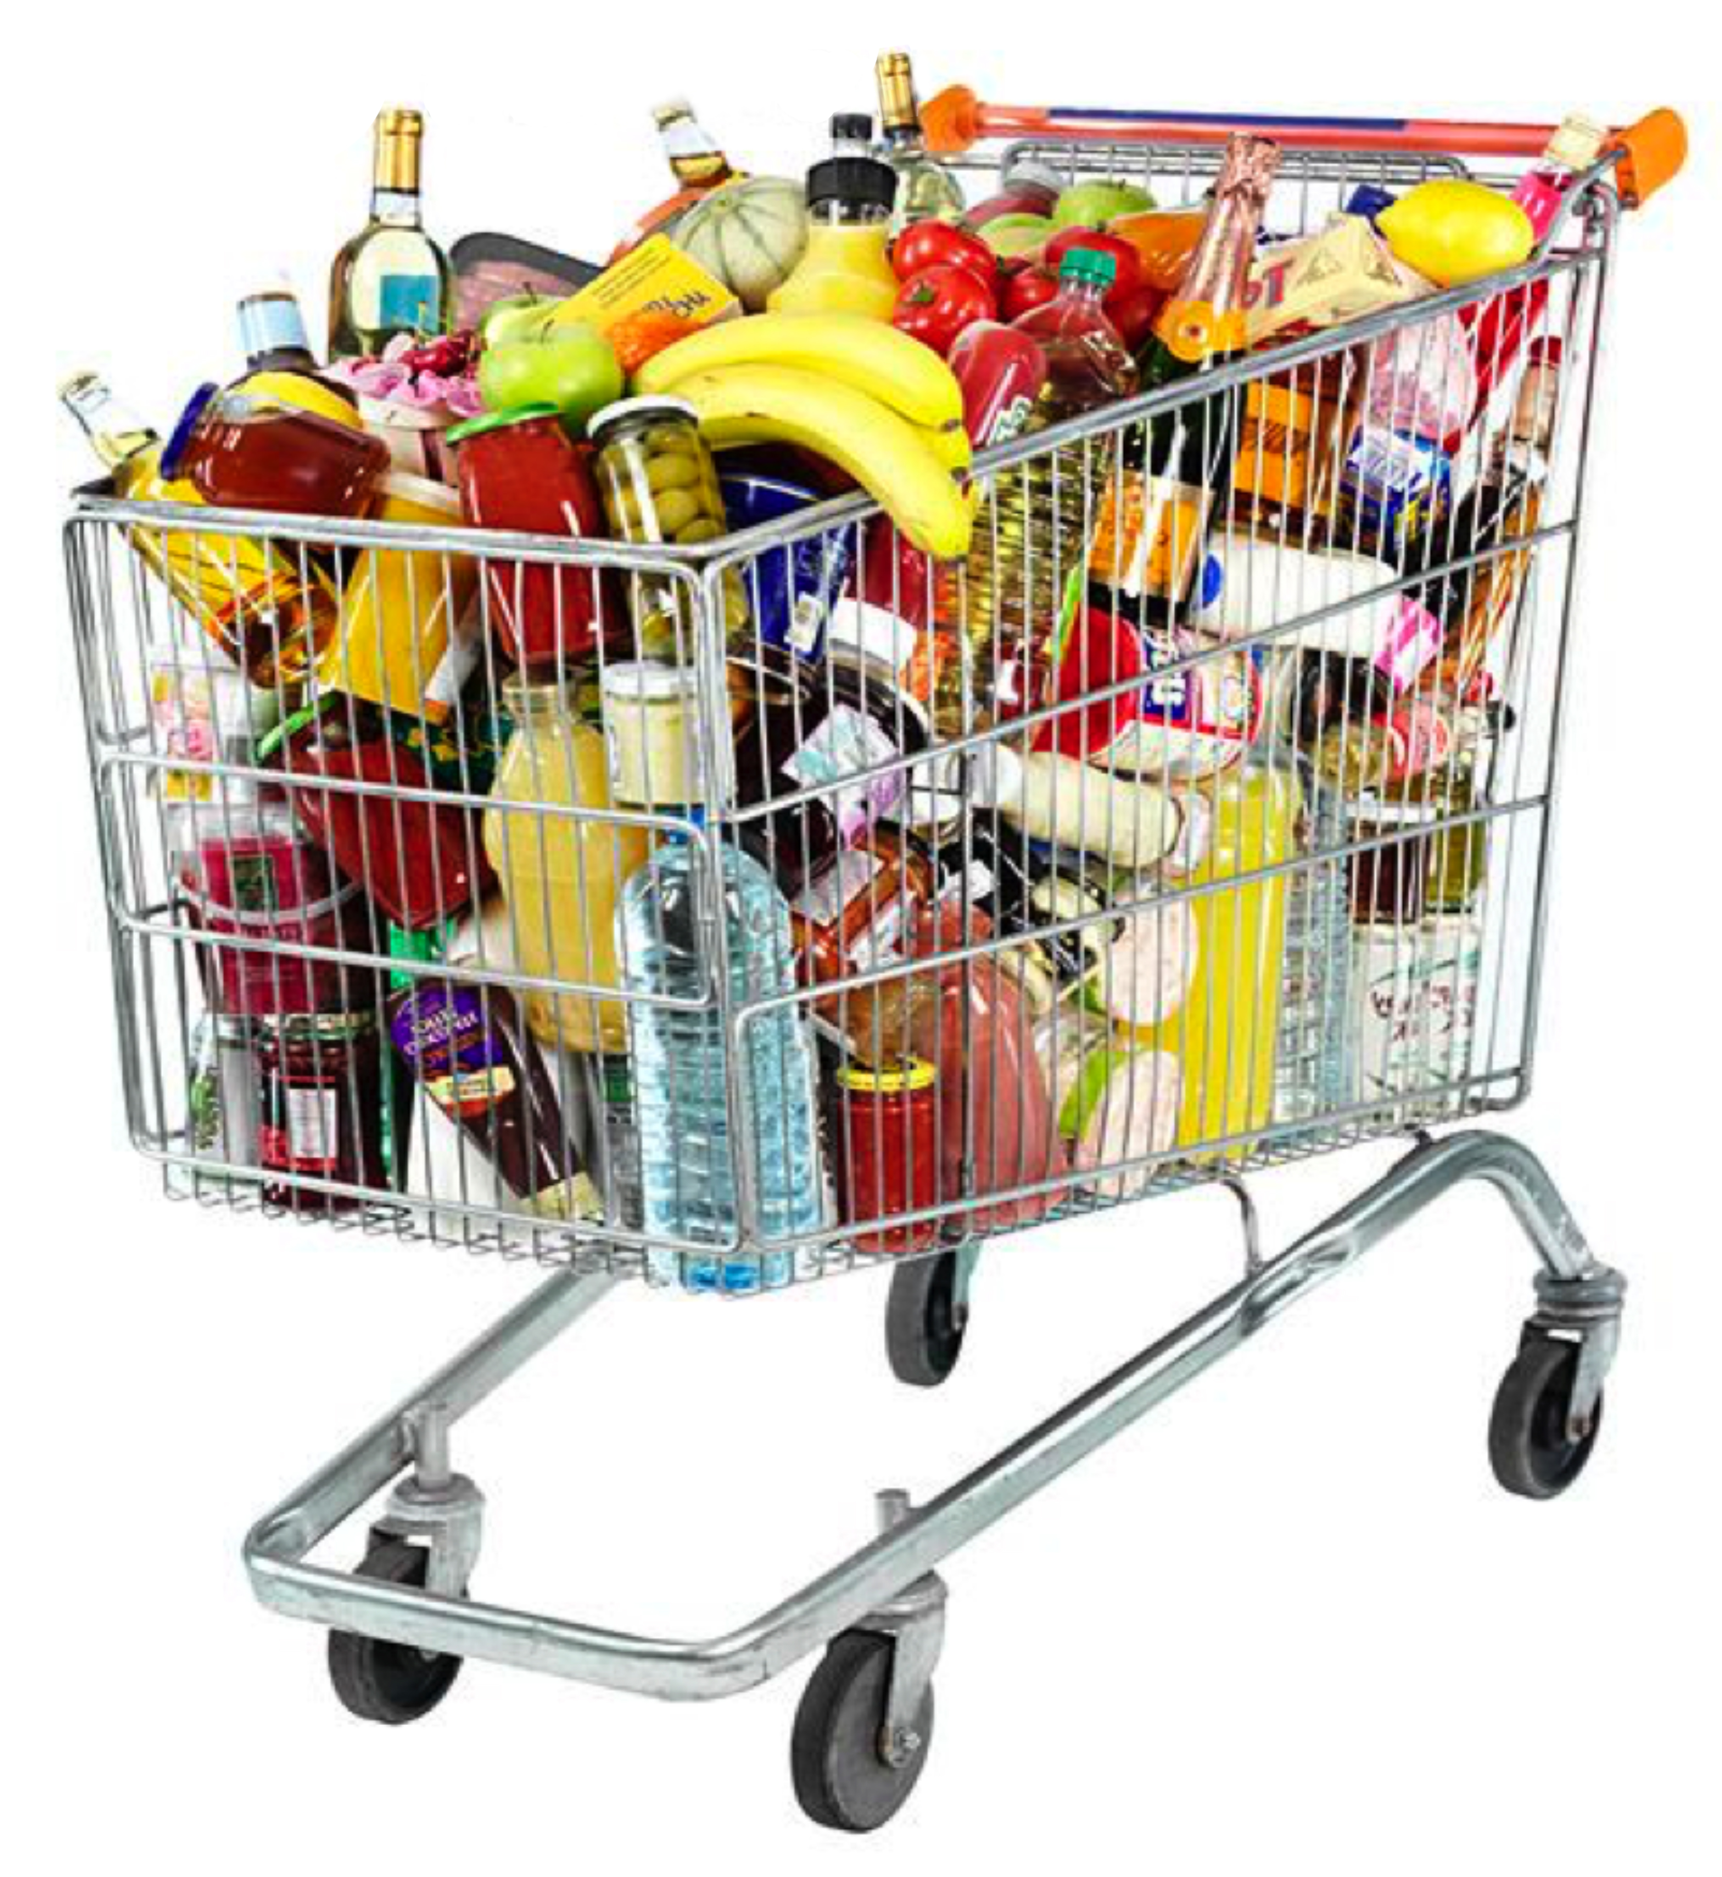
Organize the shopping cart items into food groups

Slide 11
Simon Says

Slide 12
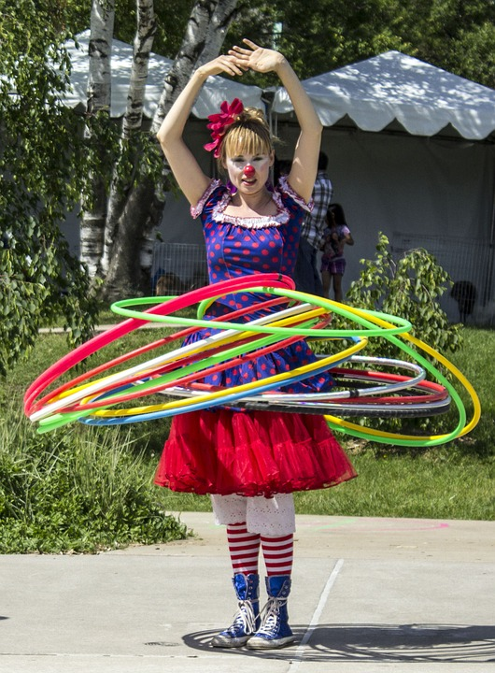
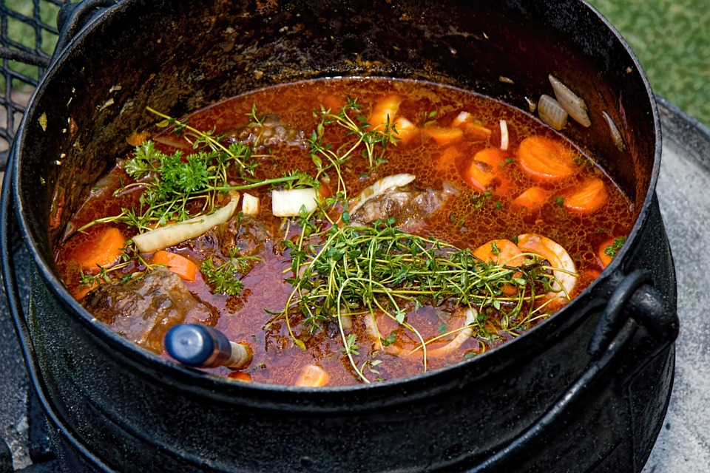
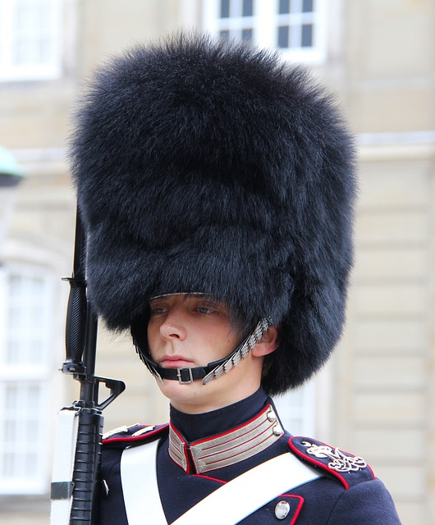
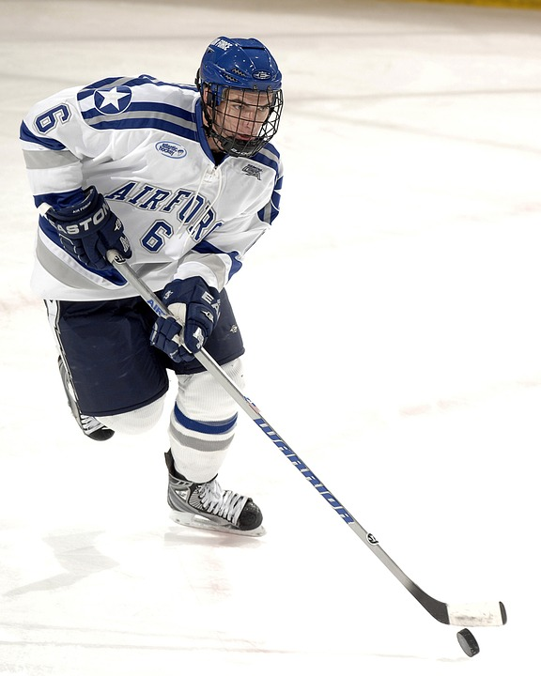
Some new words
hoop
stew
furry hat
hockey stick
sky

Slide 13
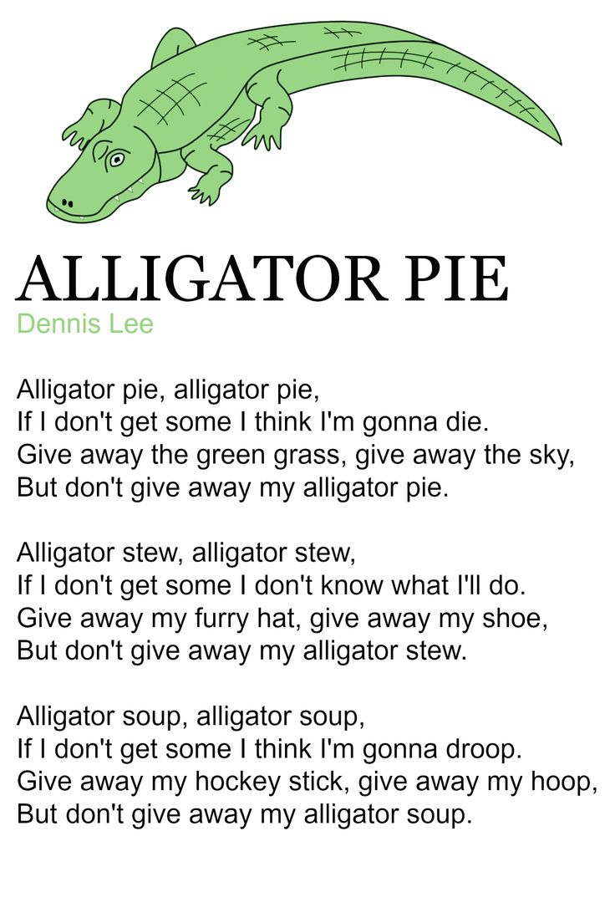
Pancake? By Shel Silverstein

Slide 14
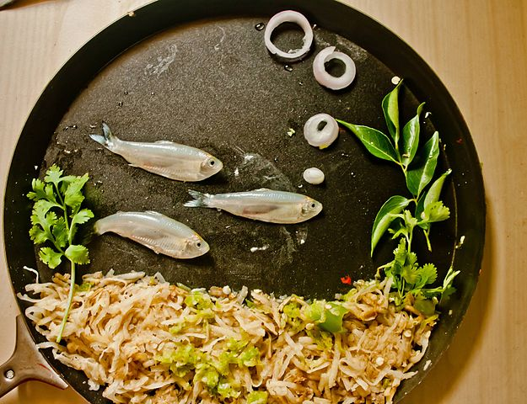
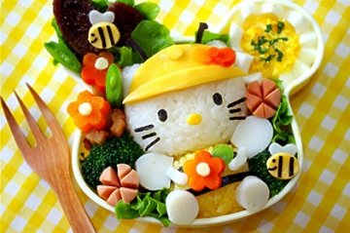
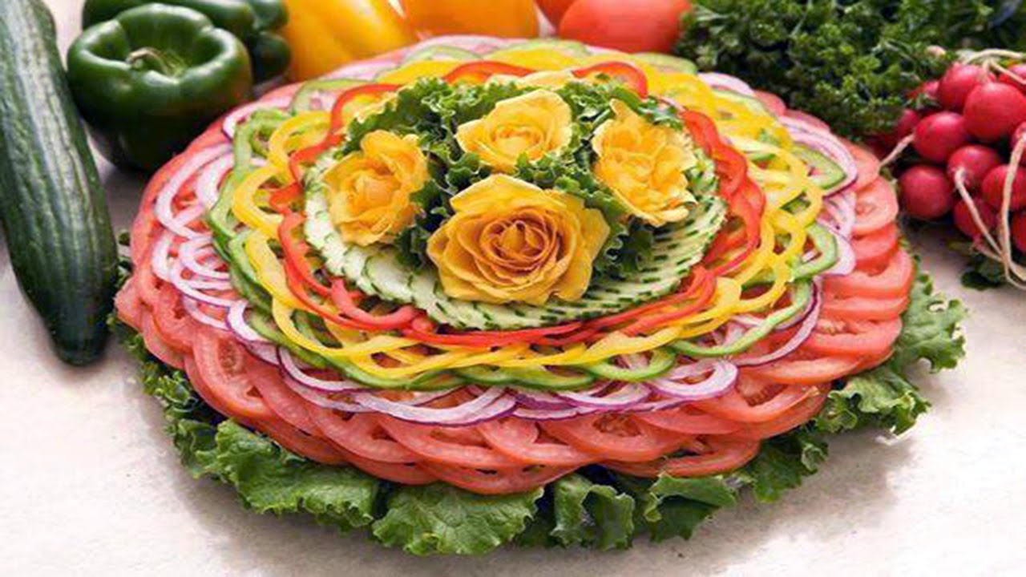
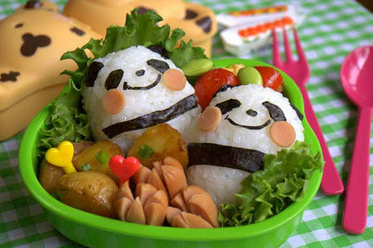
Food Art

Slide 15
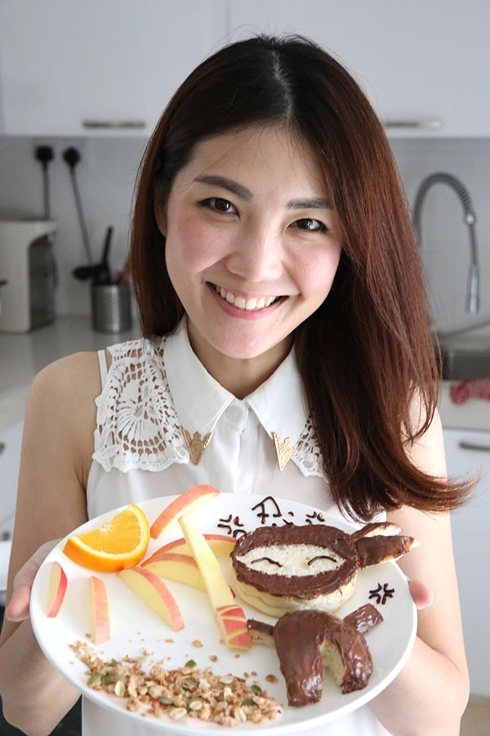
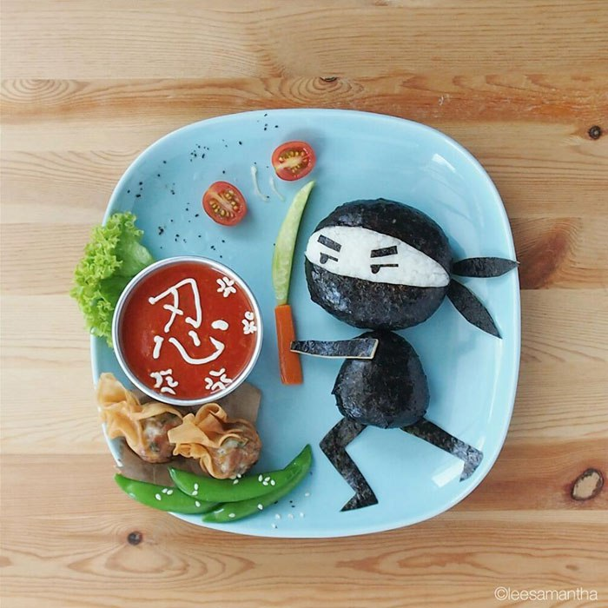
Samantha Lee Food Art

Slide 16
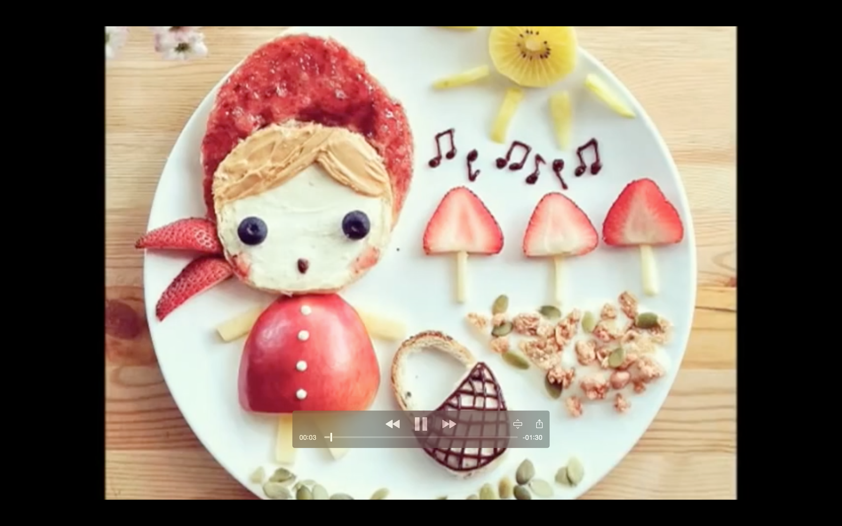
Let’s look at her work

Slide 17
Story Time

Slide 18
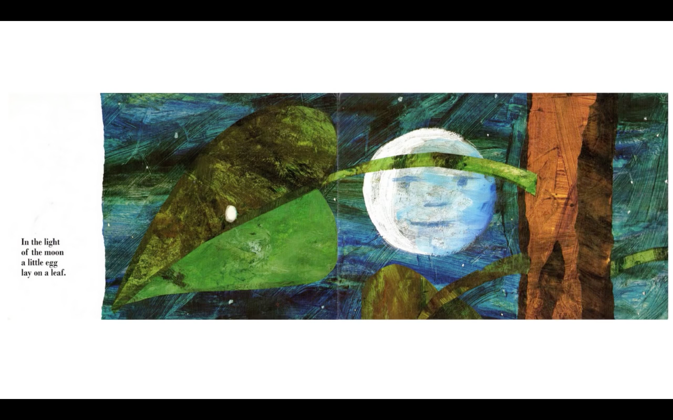

Slide 21
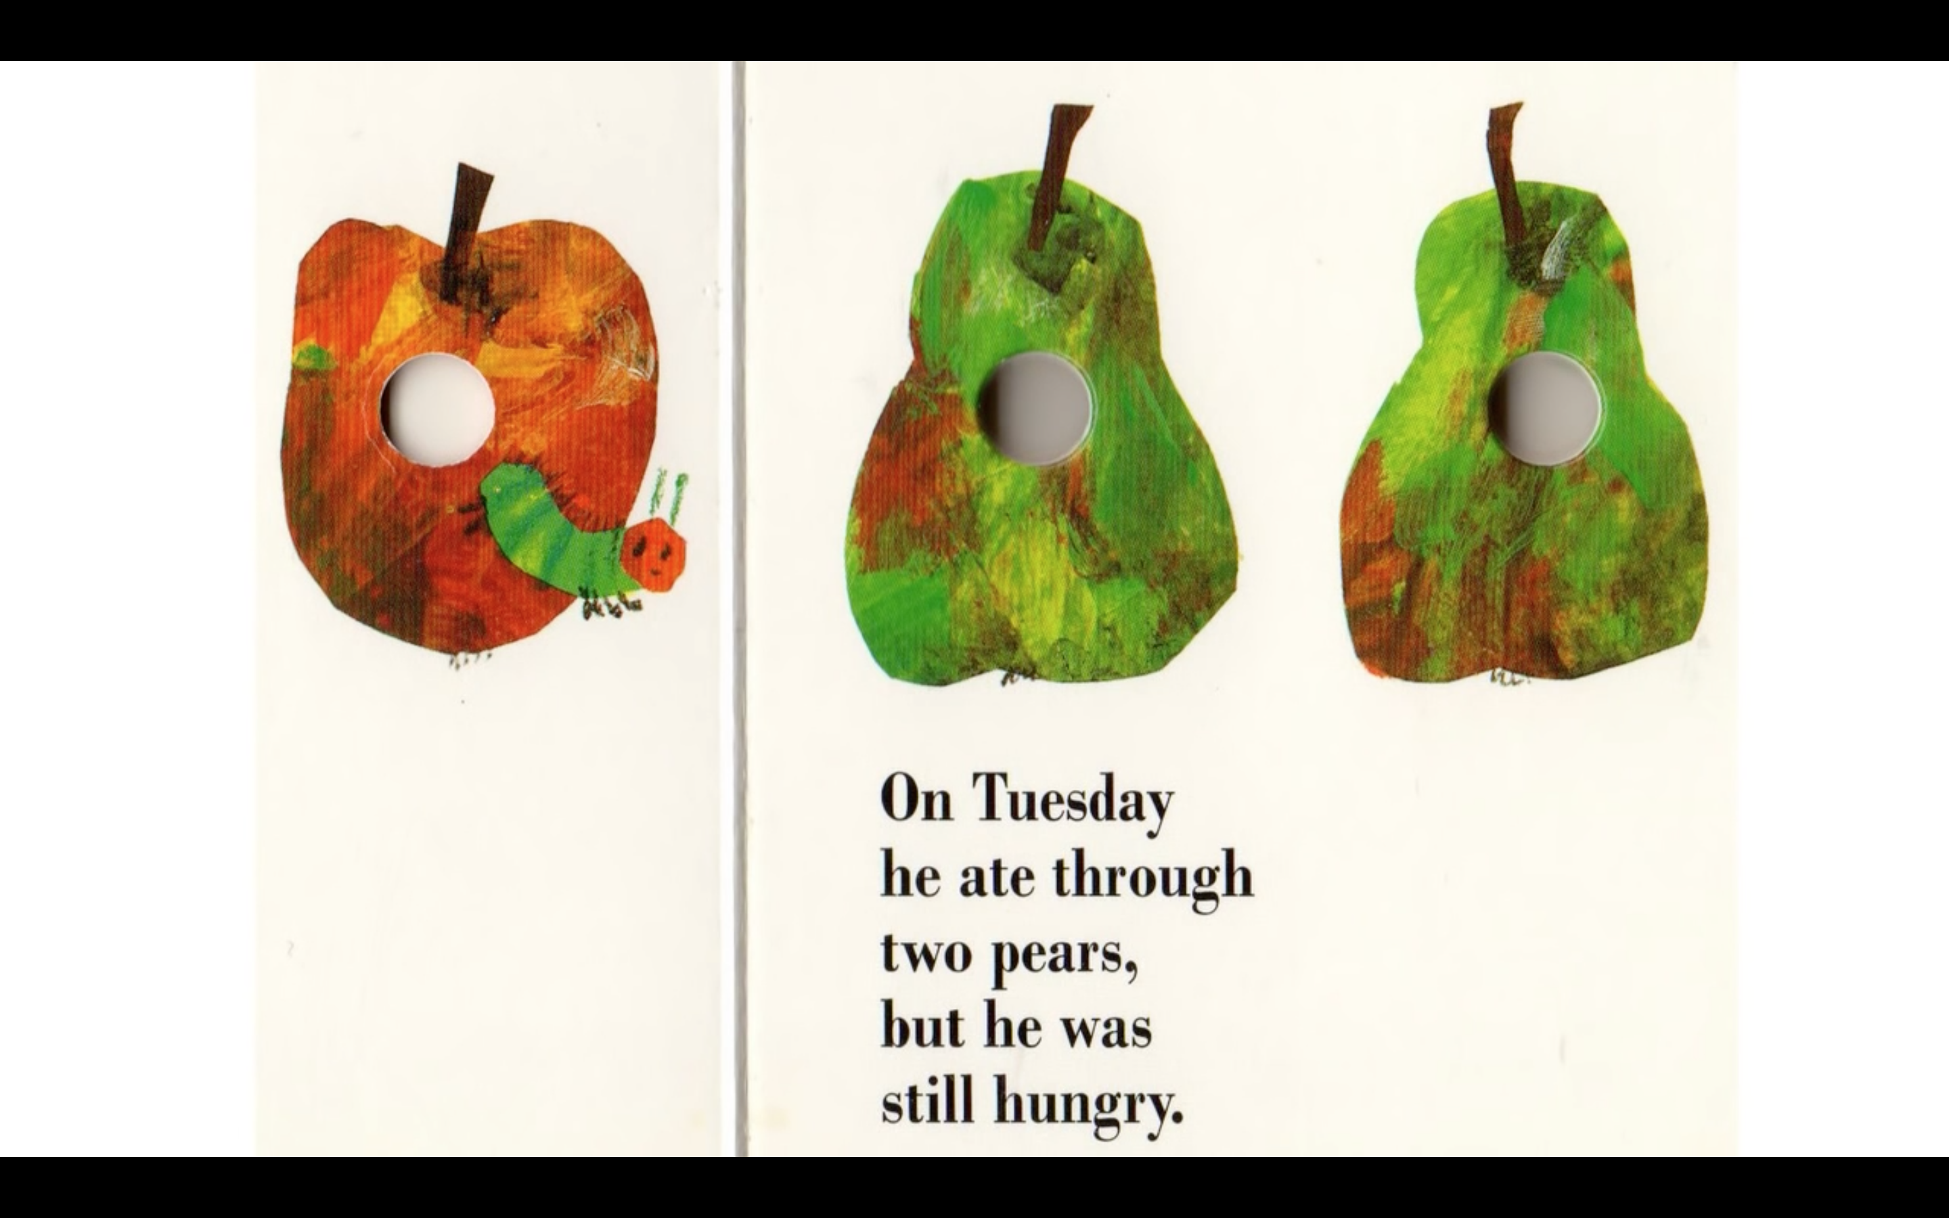

Slide 22
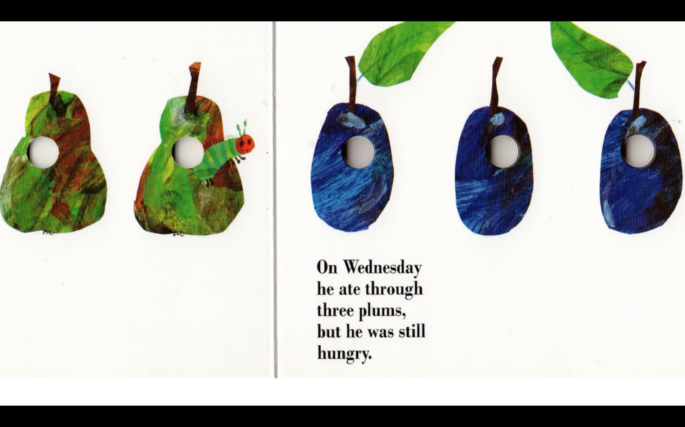

Slide 24
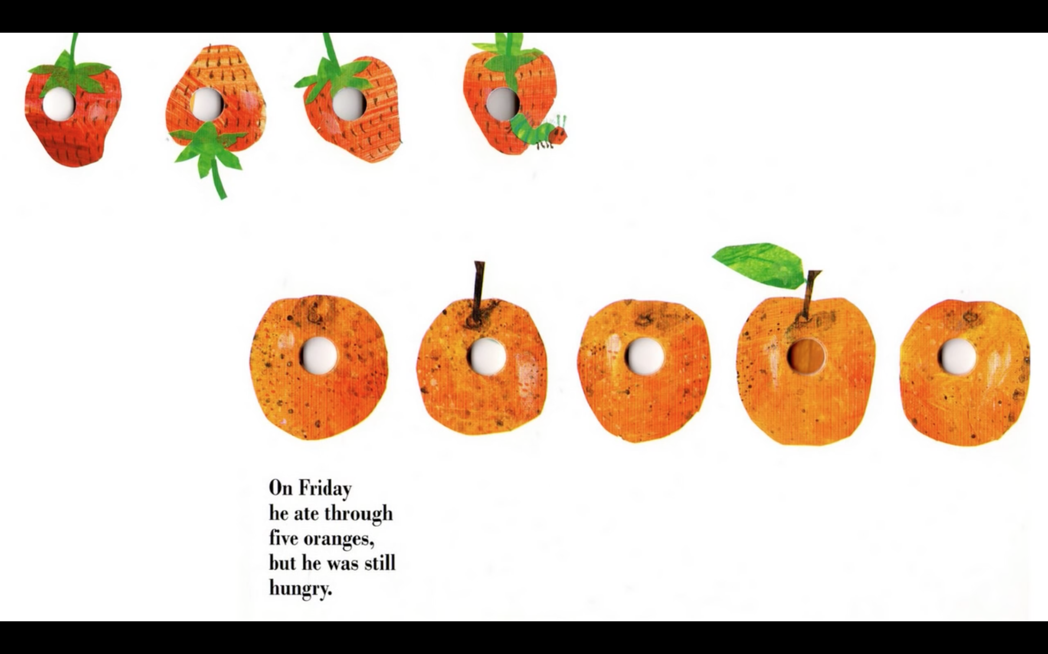

Slide 26
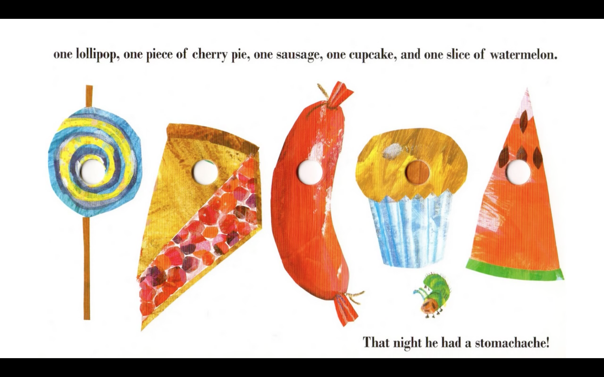

Slide 27
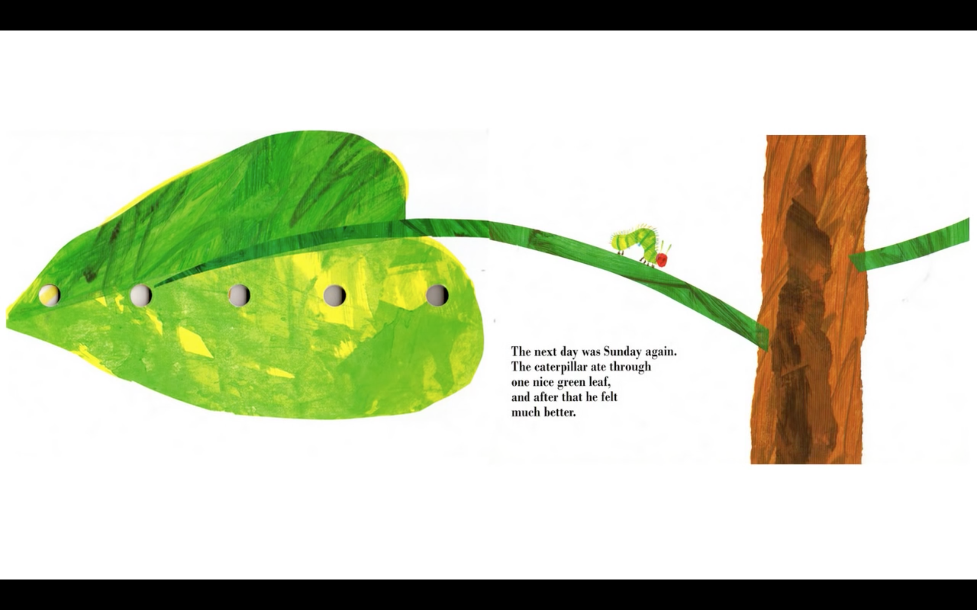

Slide 28
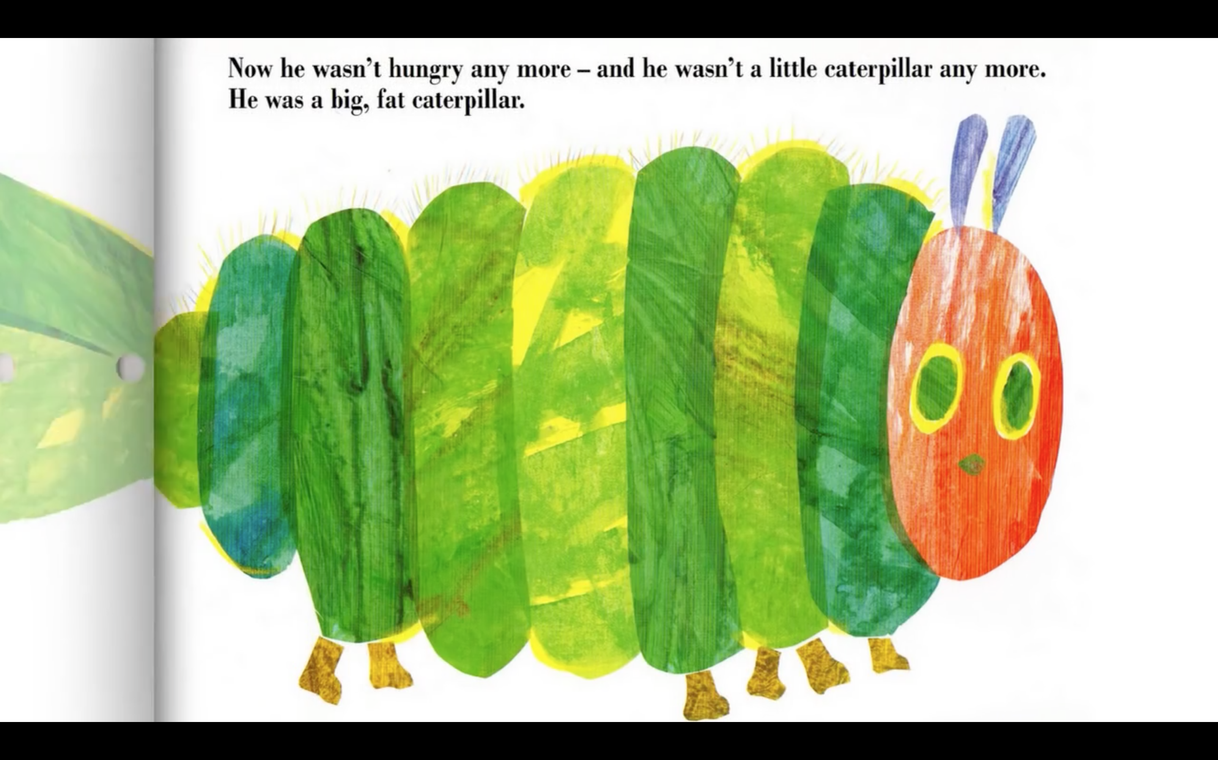

Slide 30
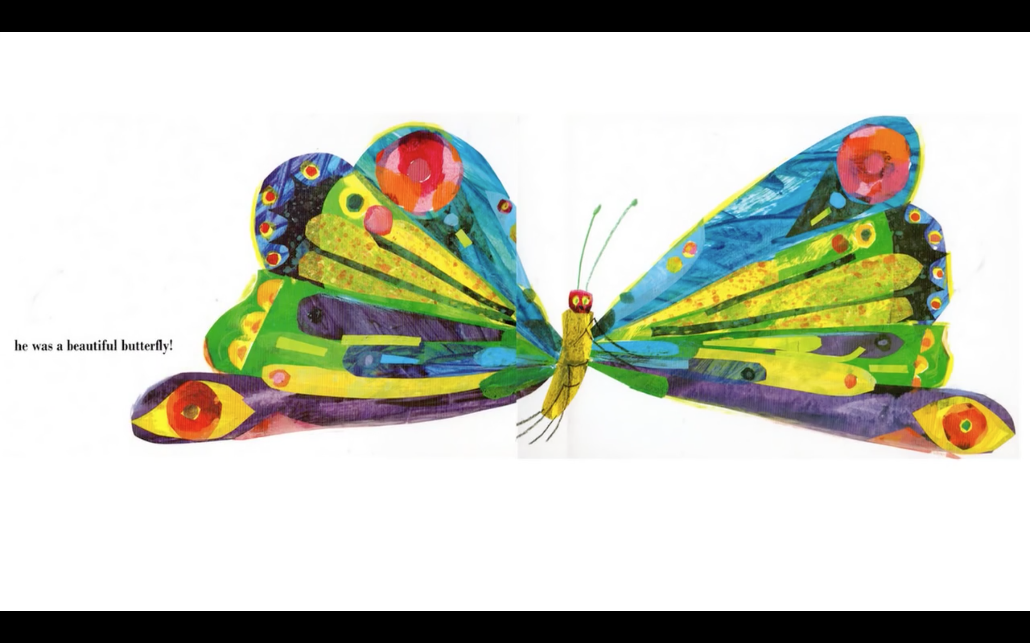

Slide 31
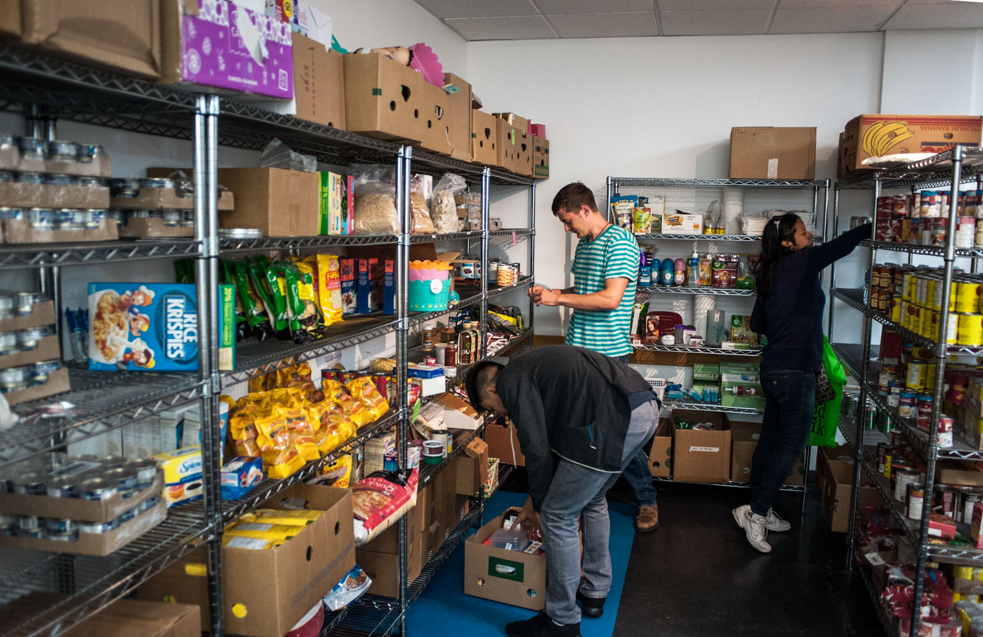
What do you think is happening in this photo?

Slide 32
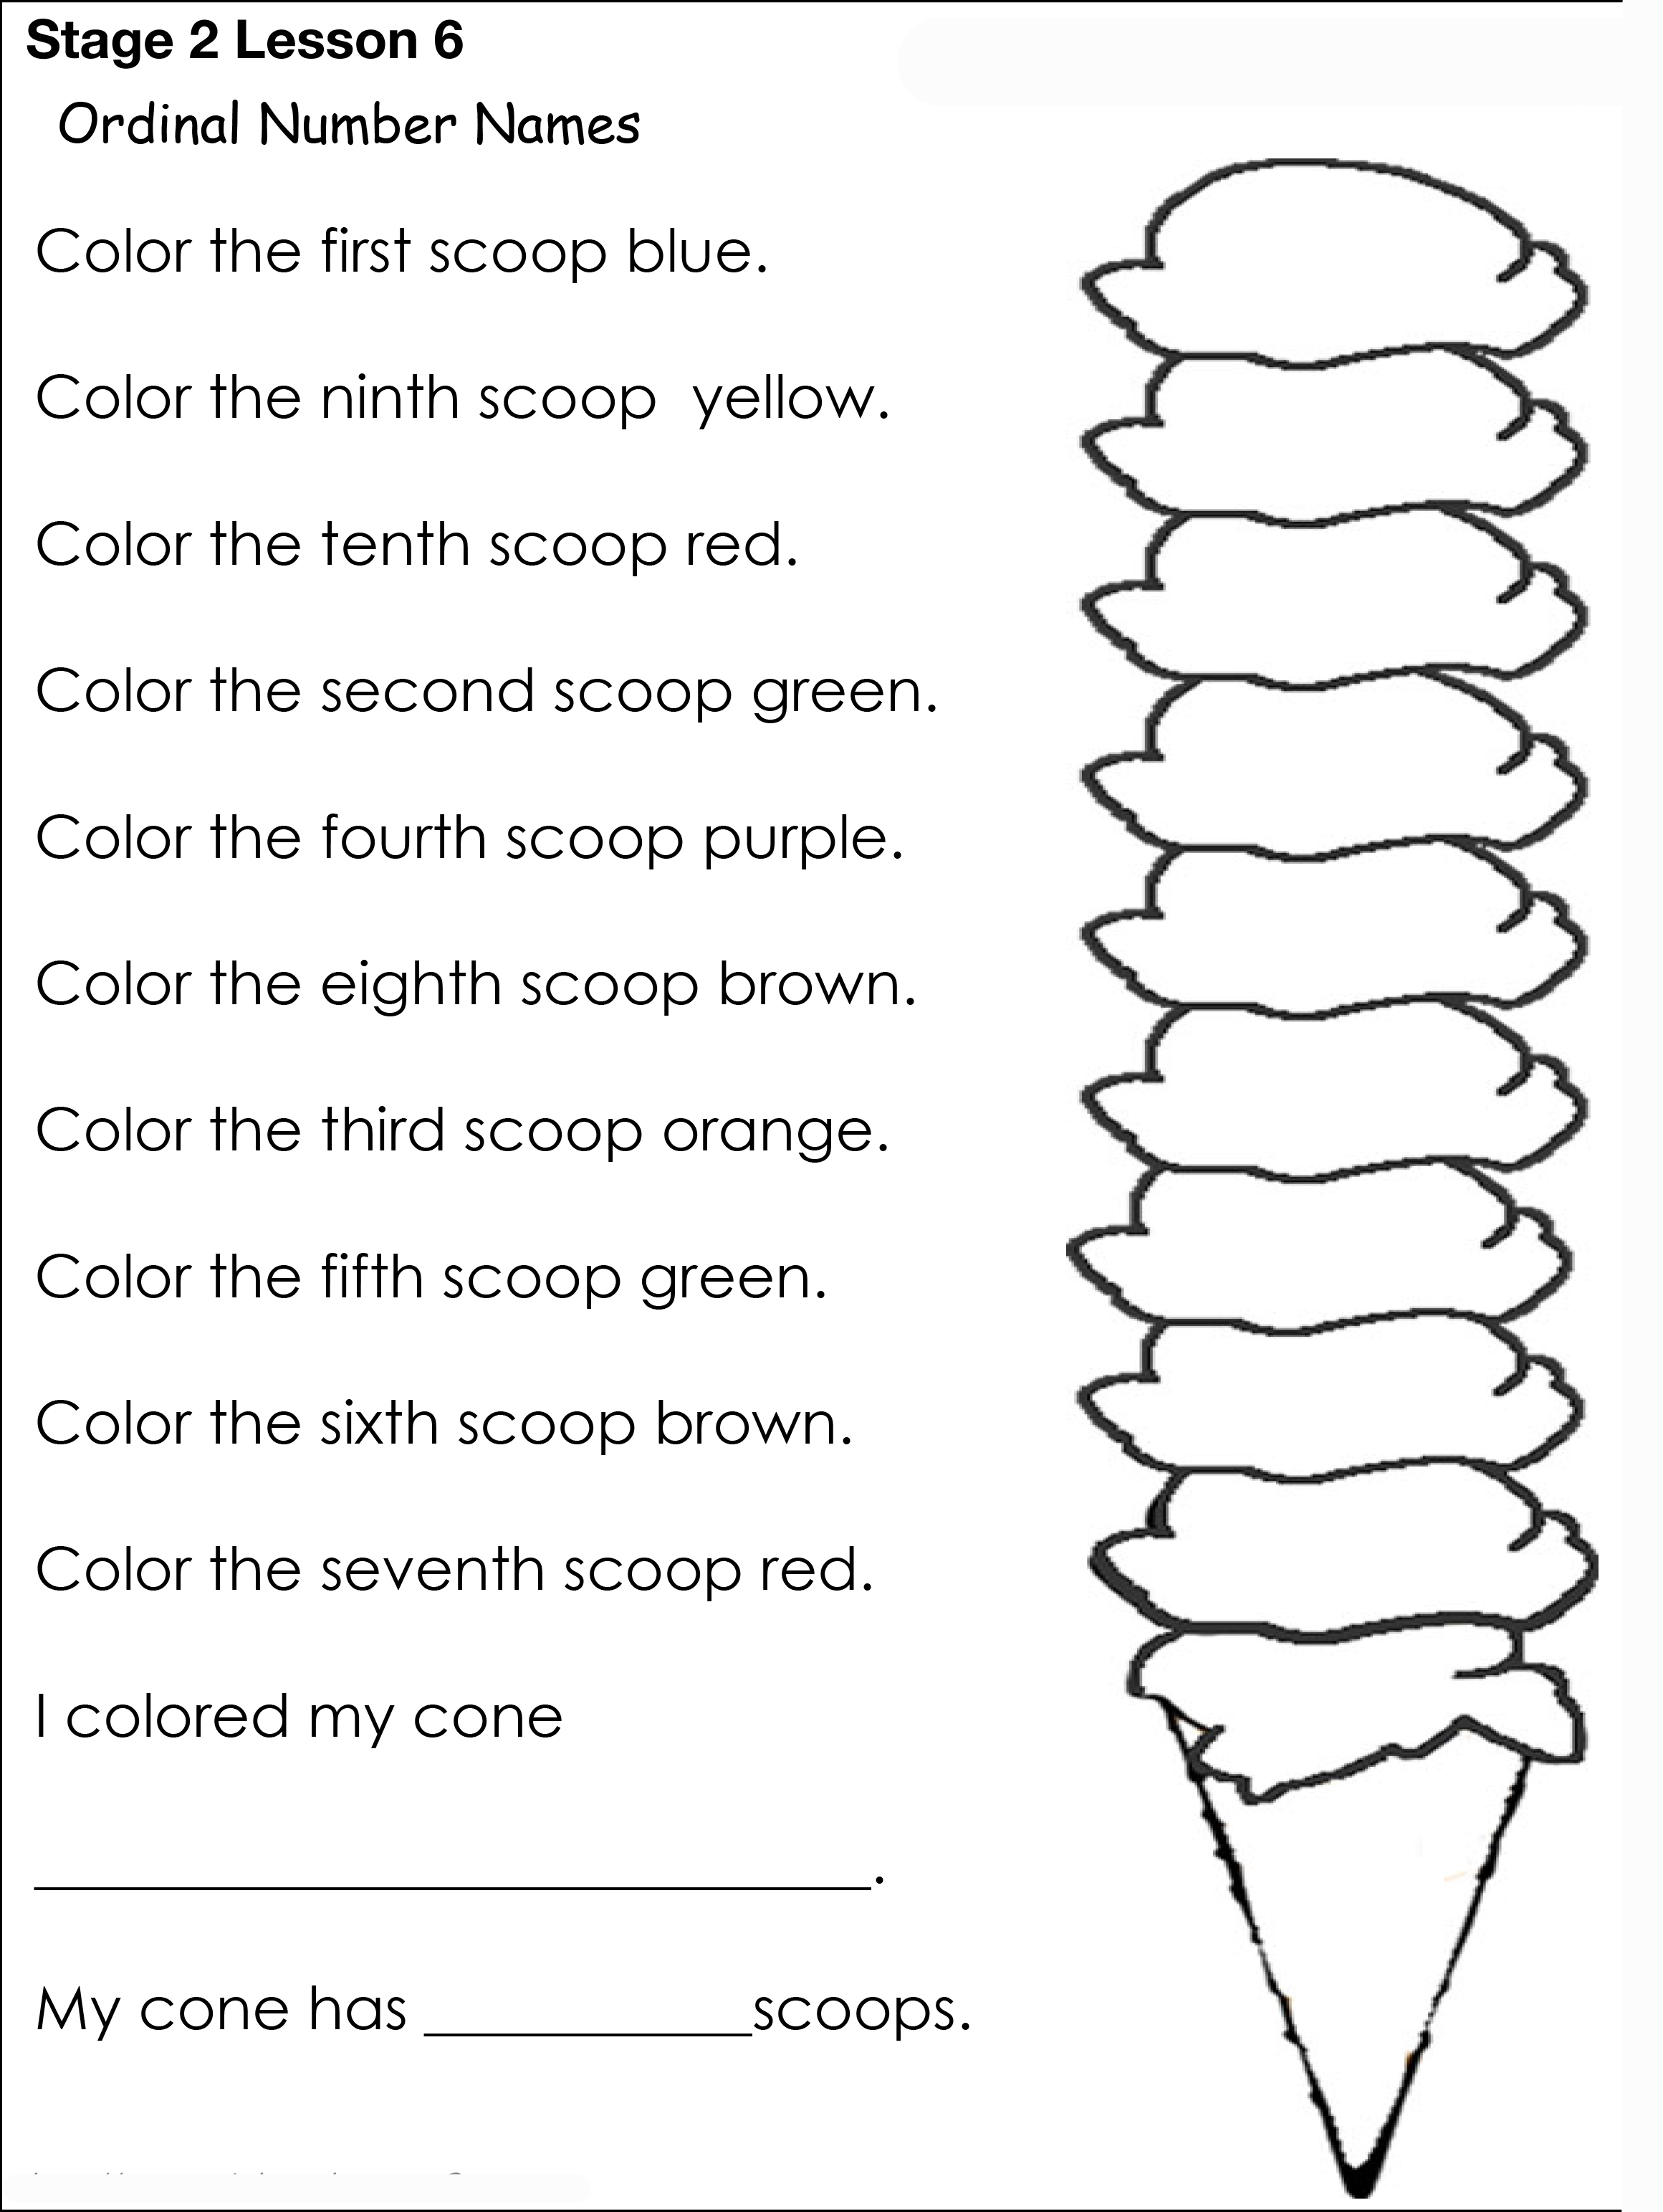
Homework

Slide 33
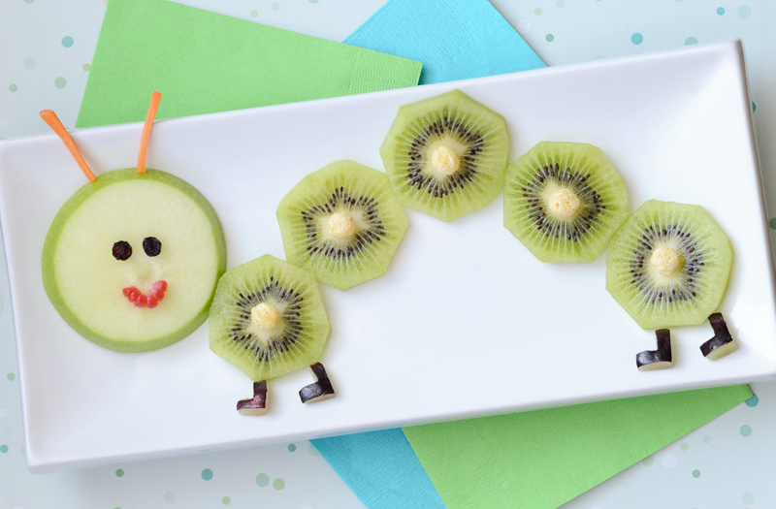
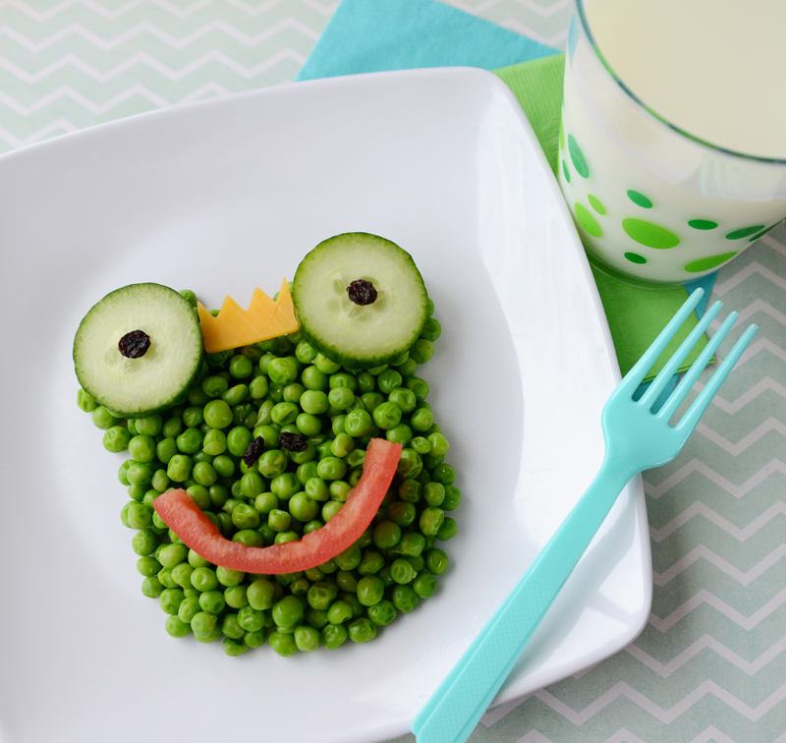
Make your own food art!
Make one of your meals into an art piece. Photograph it and share it next class. Label all the foods you used.

Slide 34
What did I learn today?
New ‘dr’ words
How to read poetry
How to read a story
The food groups

