Slide 1
Lesson 6 FOOD

Slide 2
What we will learn today
Using “dr”
The food groups
Reading storybooks and poetry practice
Notes:
Go over the learning goals.

Slide 3
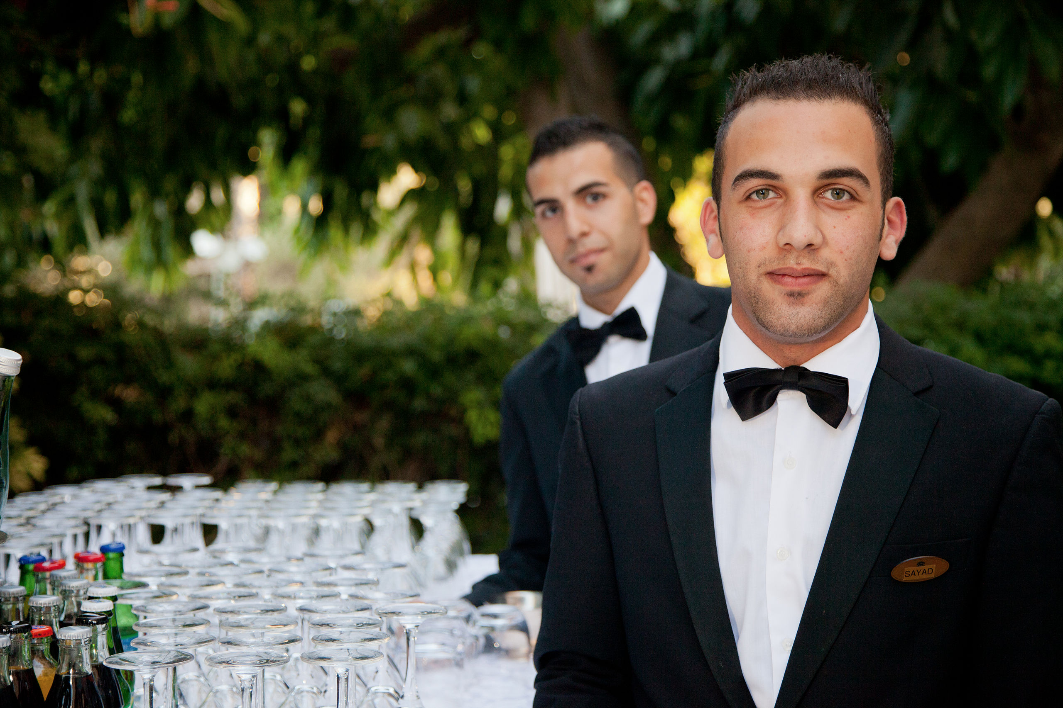
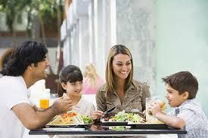
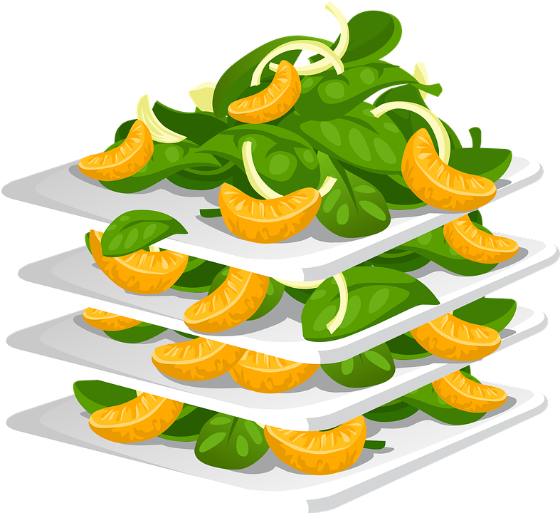
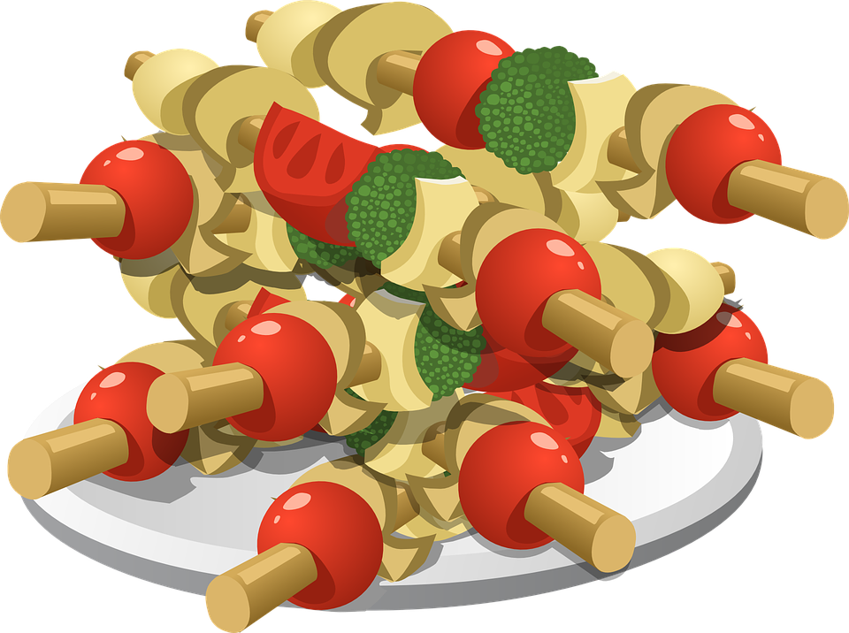
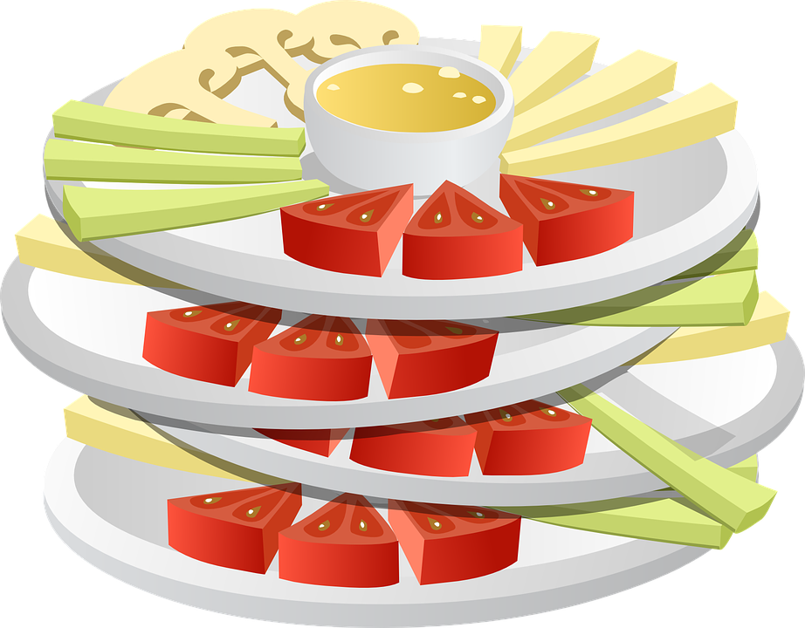
Let’s share
Notes:
Get student to recite their restaurant script.

Slide 4
The DR sound
Notes:
The tongue forward part of the tongue is raised touching the roof of the mouth behind the front teeth for the ‘d’ sound. When pronouncing the ‘r’ sound the tongue is not raised all the way to the roof. It presses against the inside of the top teeth and the tip of the tongue is pulled back. The lips has some tension and are not relaxed. They come away from the face. Demonstrate for the students and have them try to make the sound.

Slide 5
Using “dr”
Notes:
Say each word, articulating it clearly. Then say it again, pointing to each syllable, emphasizing the main stress on the polysyllabic words. Say the word again, in a more natural way. Instruct the students to repeat the word, chorally and then individually.

Slide 6
Using “dr”
Notes:
Say each word, articulating it clearly. Then say it again, pointing to each syllable, emphasizing the main stress on the polysyllabic words. Say the word again, in a more natural way. Instruct the students to repeat the word, chorally and then individually.

Slide 7
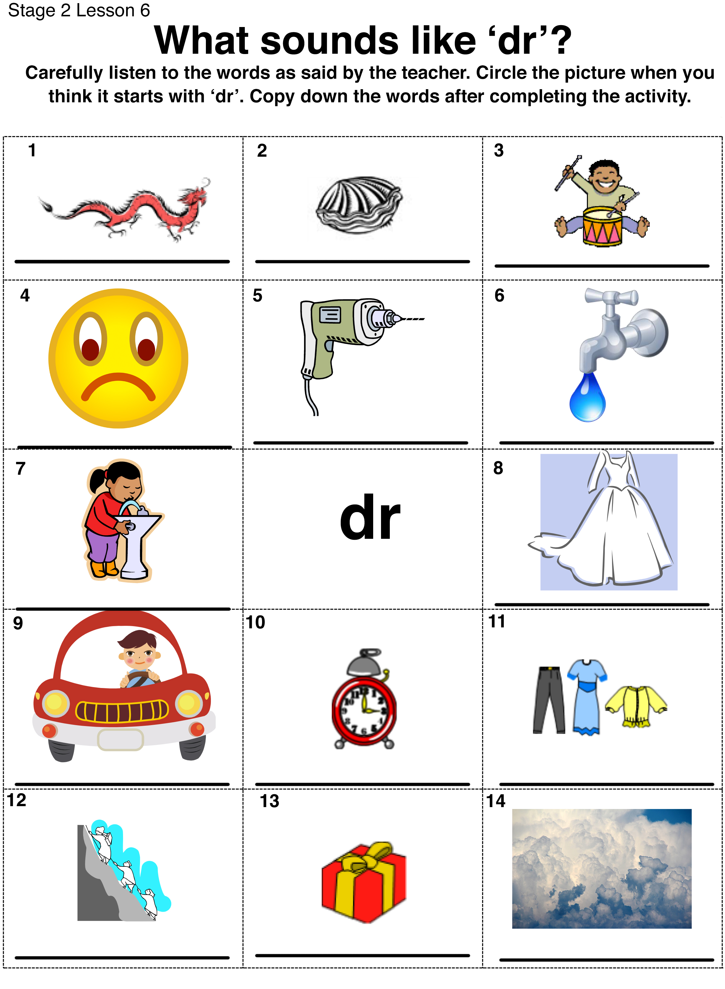
Listen for the “dr” sound
Notes:
Students are to have printed the “DR listening activity.pdf”.

Slide 8
Answers
1. dragon 2. clam
3. drums 4. frown 5. drill 6. drip
7. drink 8. dress
9. drive 10. clock 11. clothes
12. climb 13. present 14. clouds
Notes:
Go over the answers: 1. dragon 2. clam 3. drums 4. frown 5. drill 6. drip 7. drink 8. dress 9. drive 10. clock 11. clothes 12. climb 13. present 14. clouds
Get students to copy the words onto their handout.

Slide 9
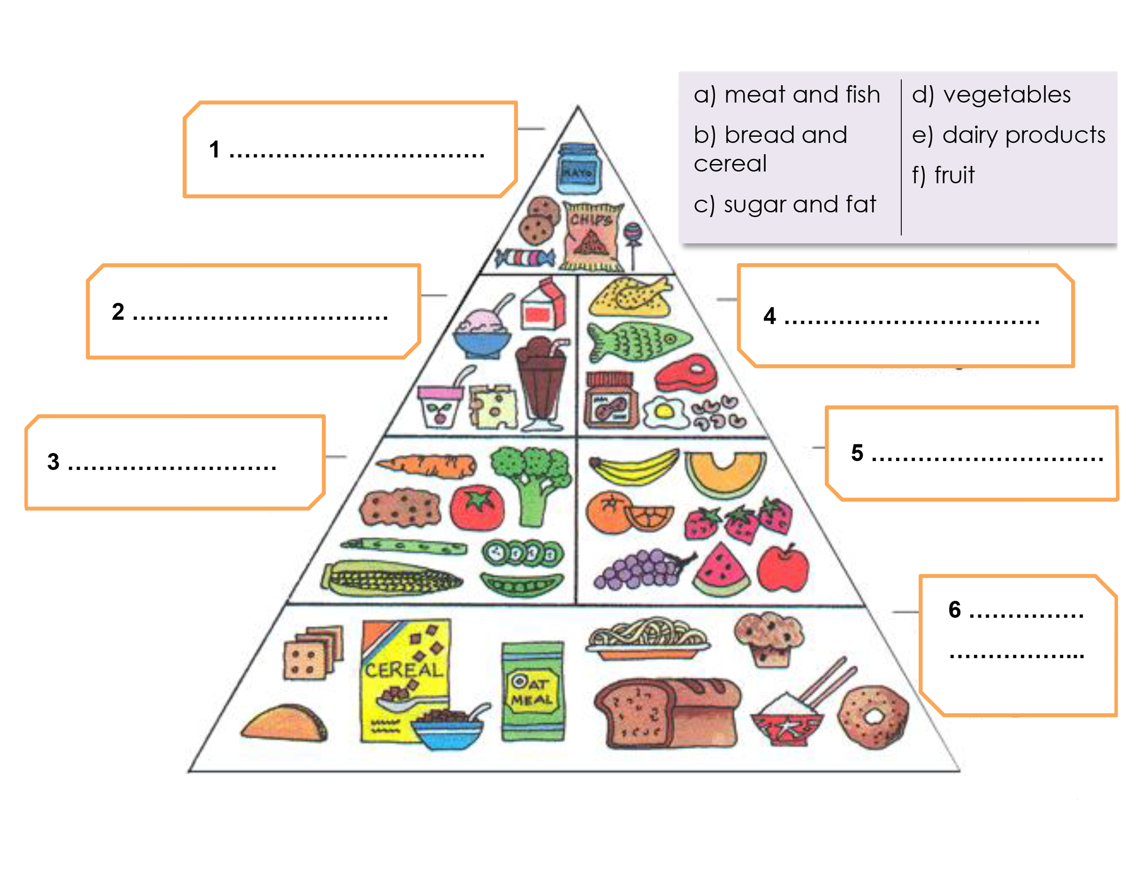
Label the food groups
Notes:
Explain the food groups to the students.

Slide 10
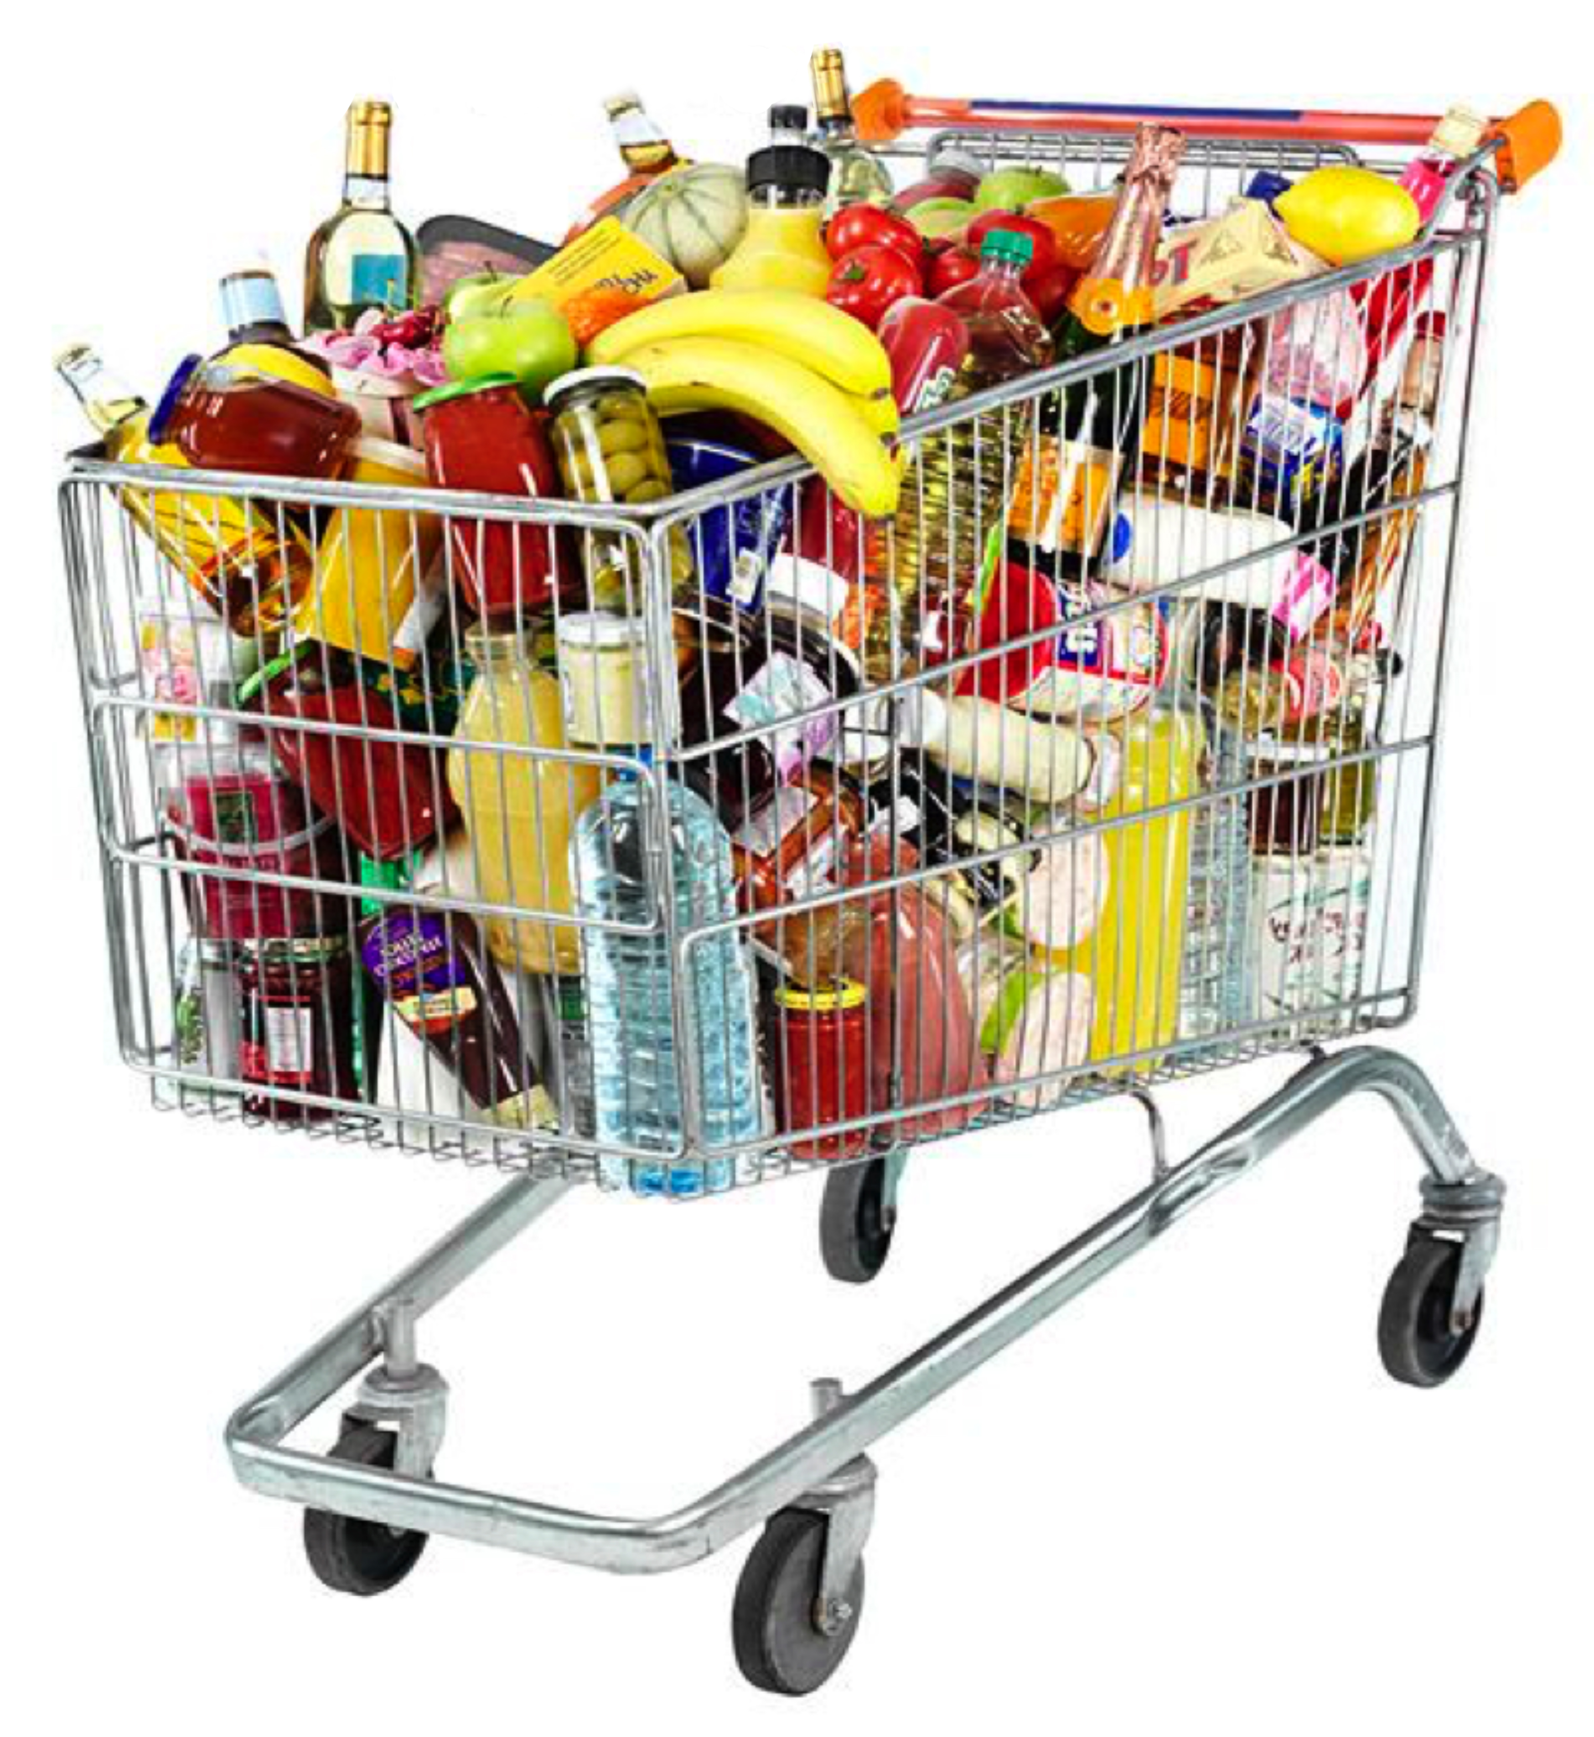
Organize the shopping cart items into food groups
Notes:
Have students verbally say the food group for certain shopping cart items.

Slide 11
Simon Says
Notes:
Play Simon Says with the students. Demonstrate each movement for them.

Slide 12
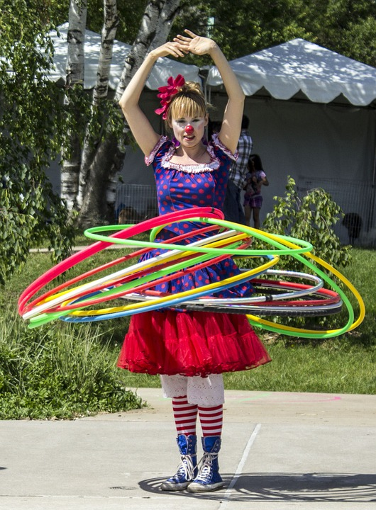
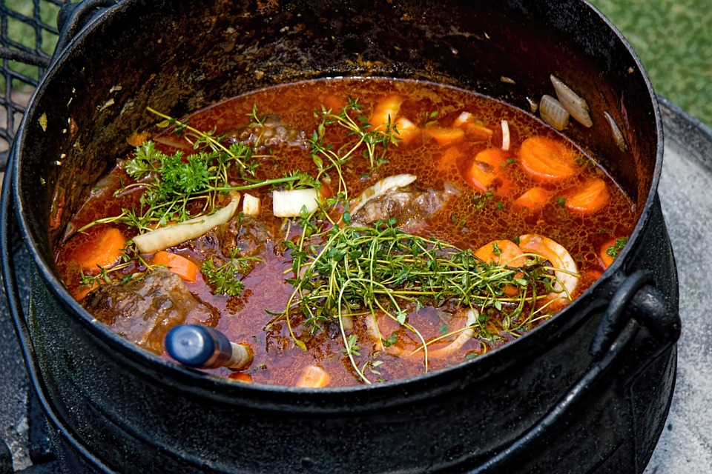
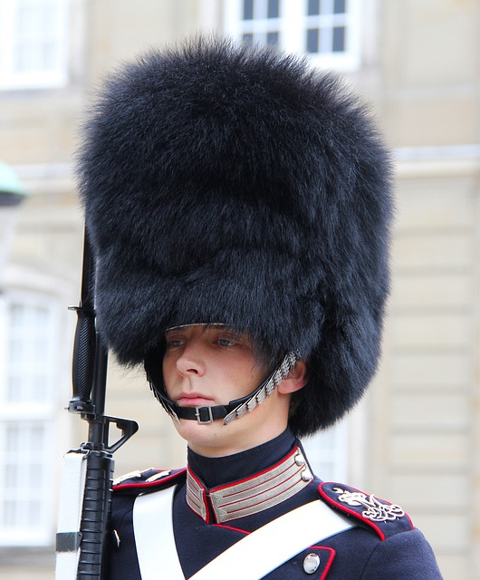
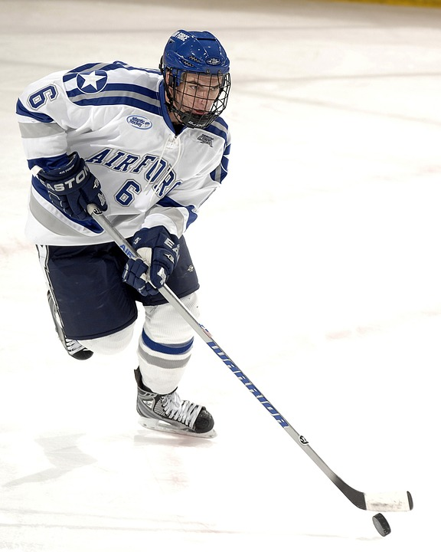
Some new words
hoop
stew
furry hat
hockey stick
sky
Notes:
Pre-teach this vocabulary for “Alligator Pie”.

Slide 13
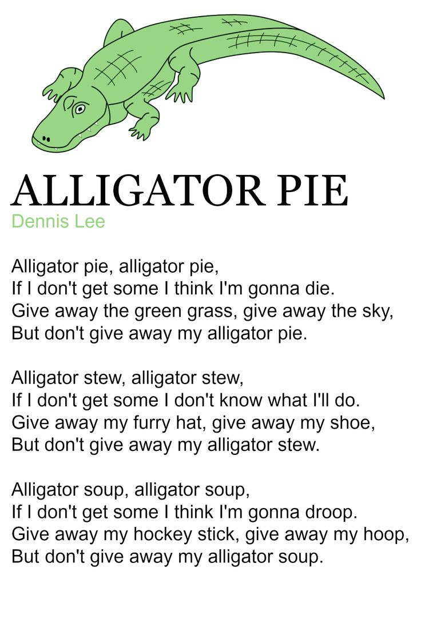
Pancake? By Shel Silverstein
Notes:
Read each line and alternate between each student for an echo reading.

Slide 14
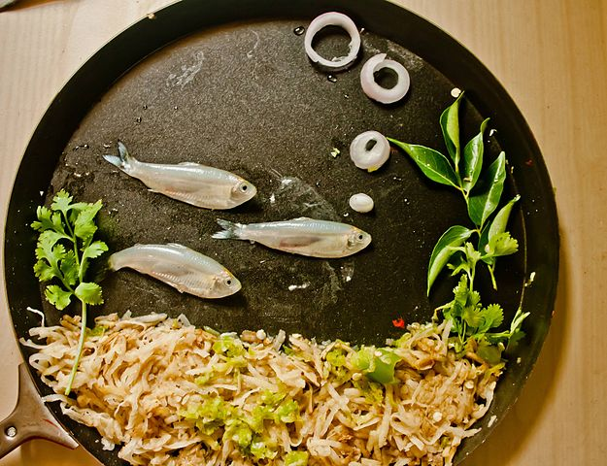
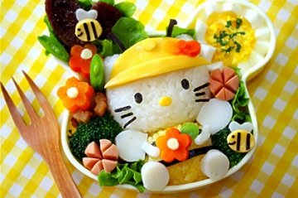
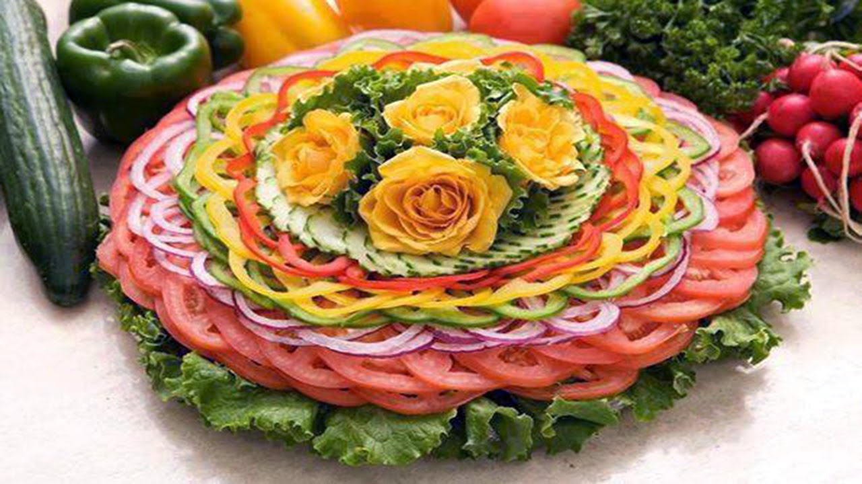
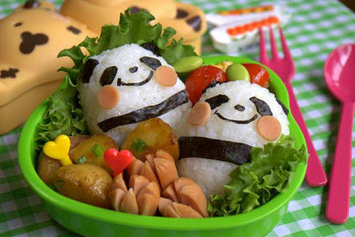
Food Art
Notes:
Ask students if they think food can be art.

Slide 15
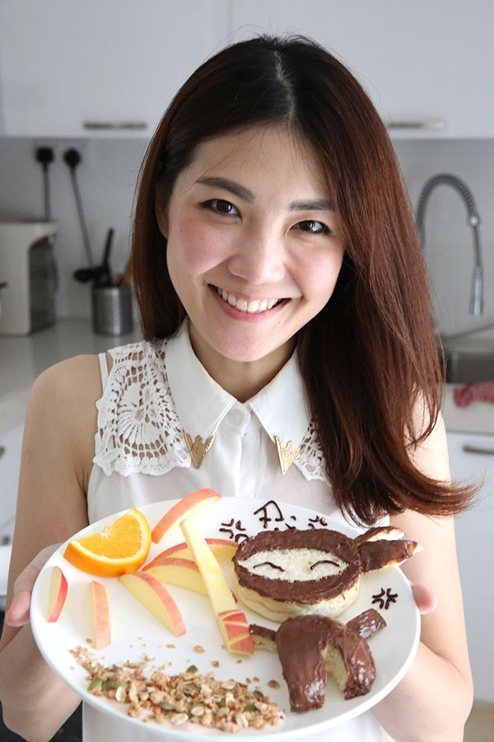
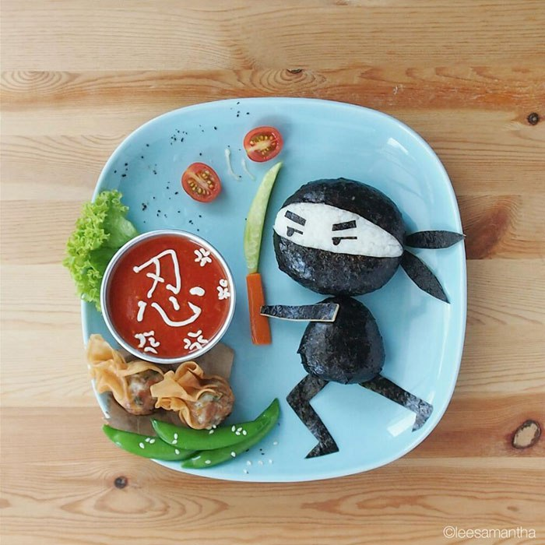
Samantha Lee Food Art
Notes:
Bio: When Malaysian mommy Samantha Lee came up with playful story-themed bento lunchboxes to get her kids to eat right, she had no idea they would also catapult her to internet fame.

Slide 16
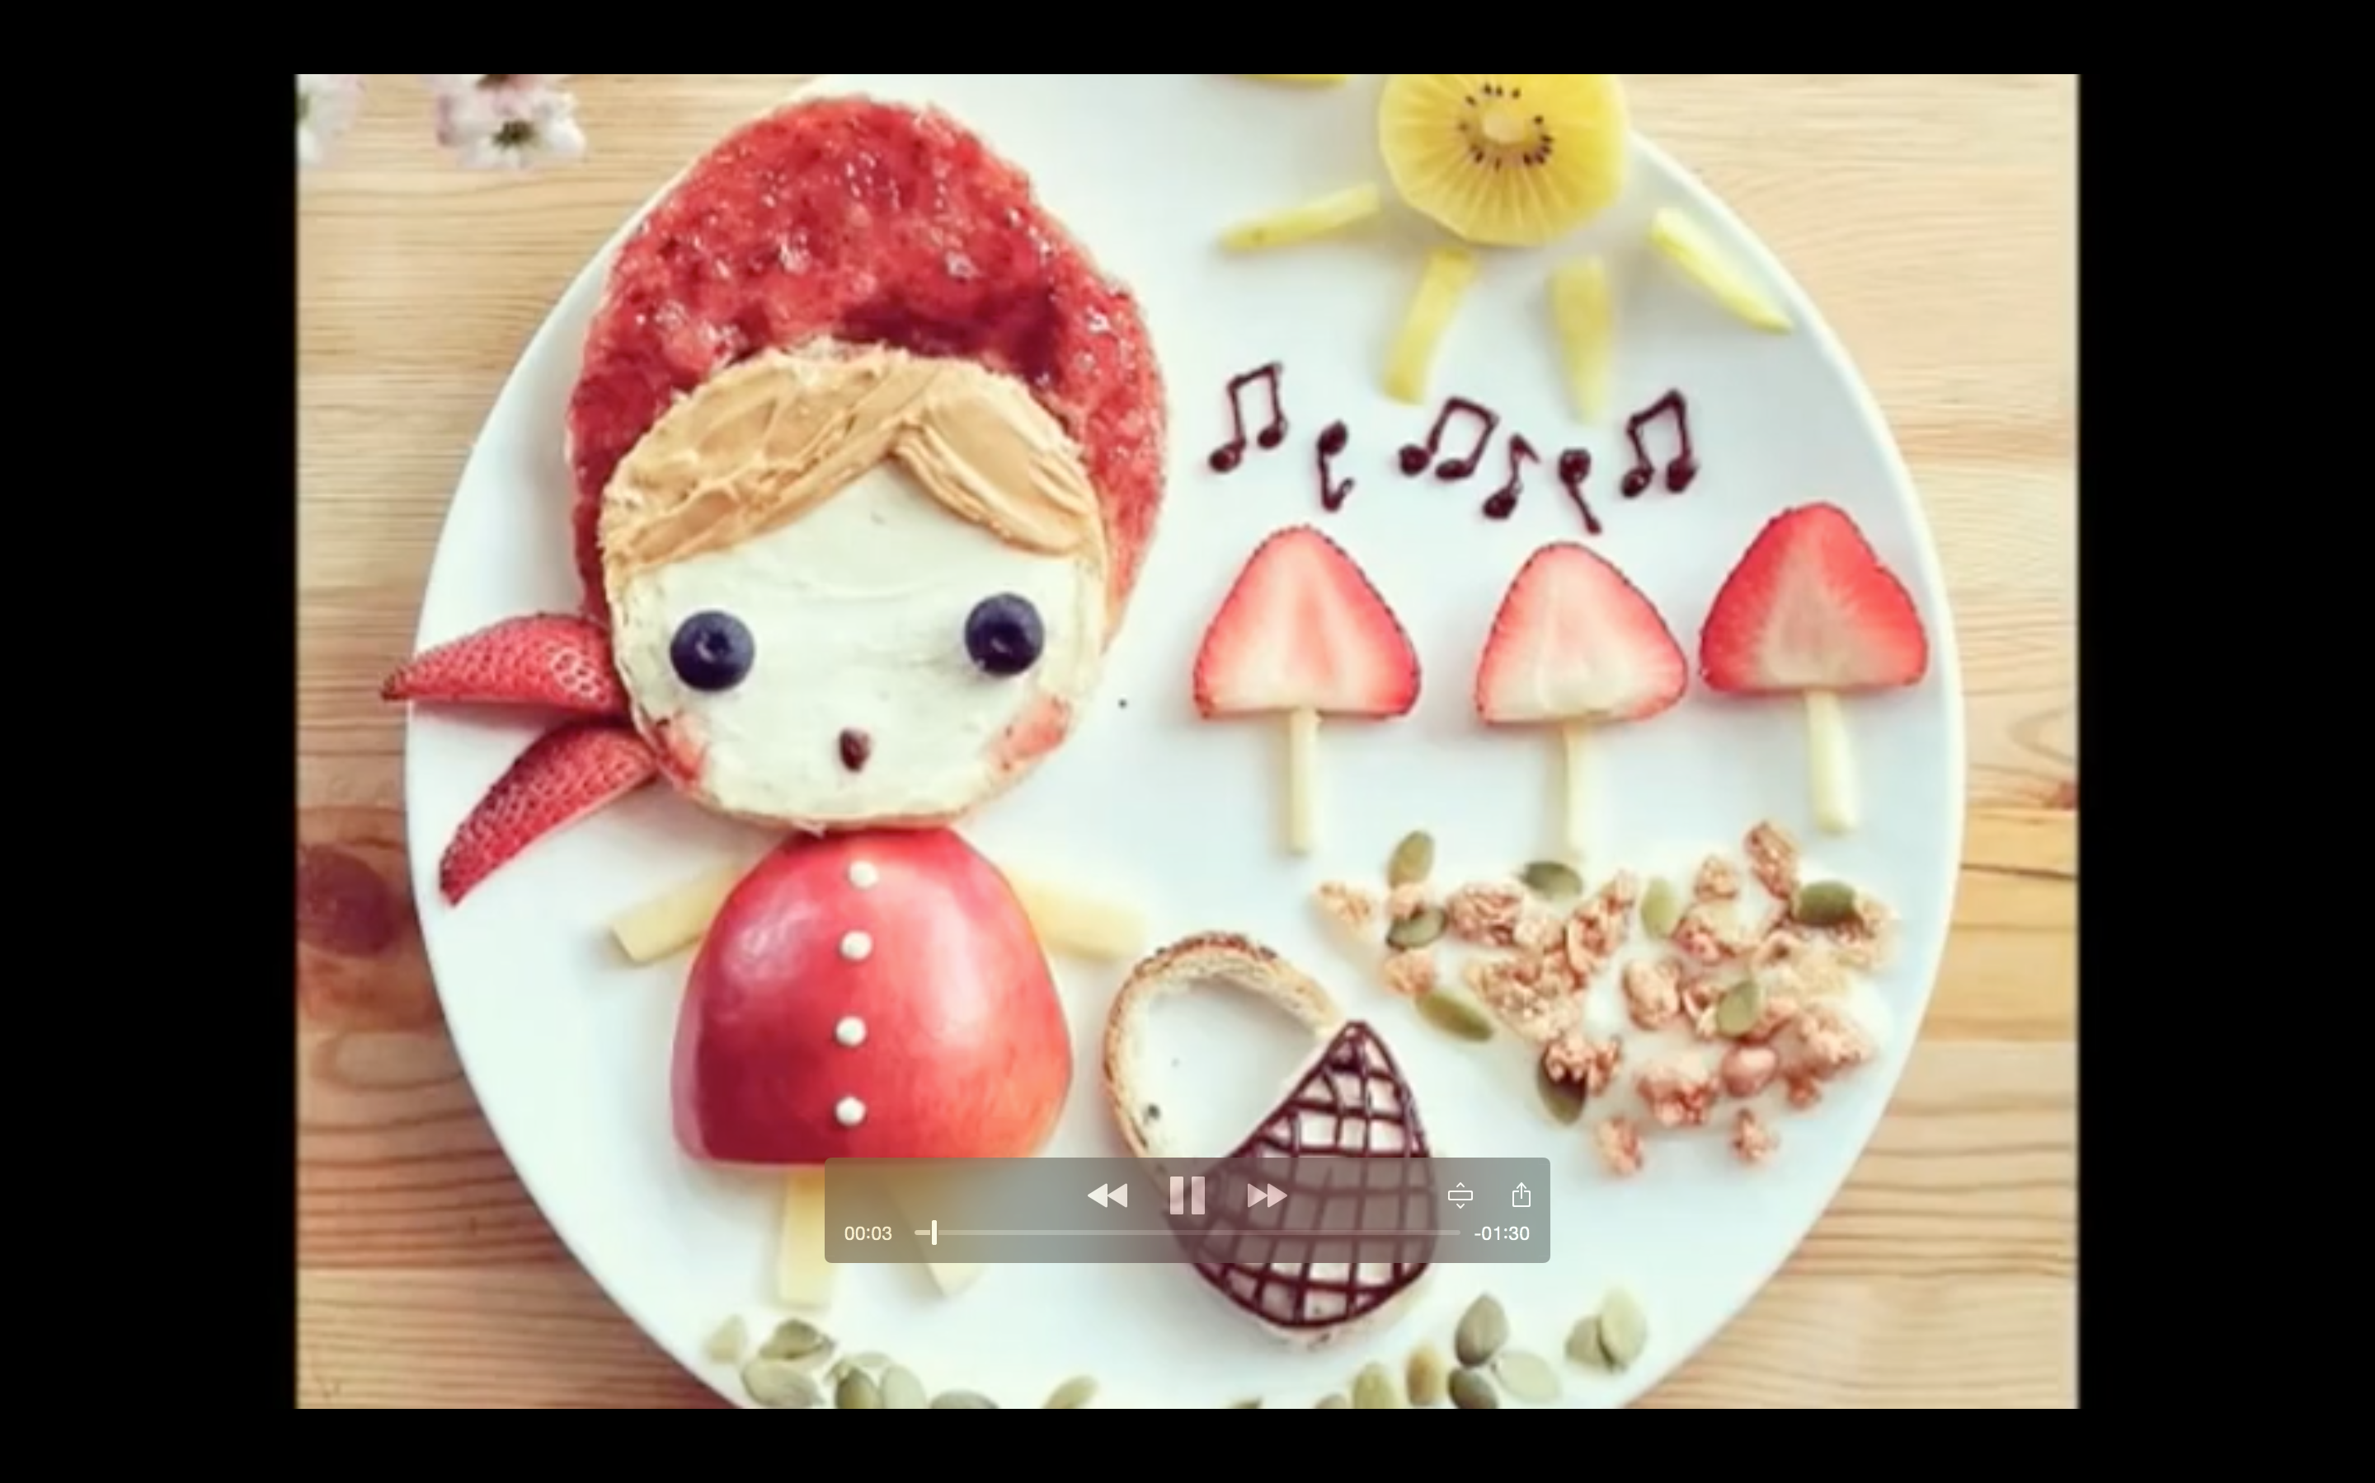
Let’s look at her work
Notes:
Play “Food Art.mp4” Ask students what the subject is and to point out what food they recognize. Make sure to stop the video for discussion

Slide 17
Story Time

Slide 18
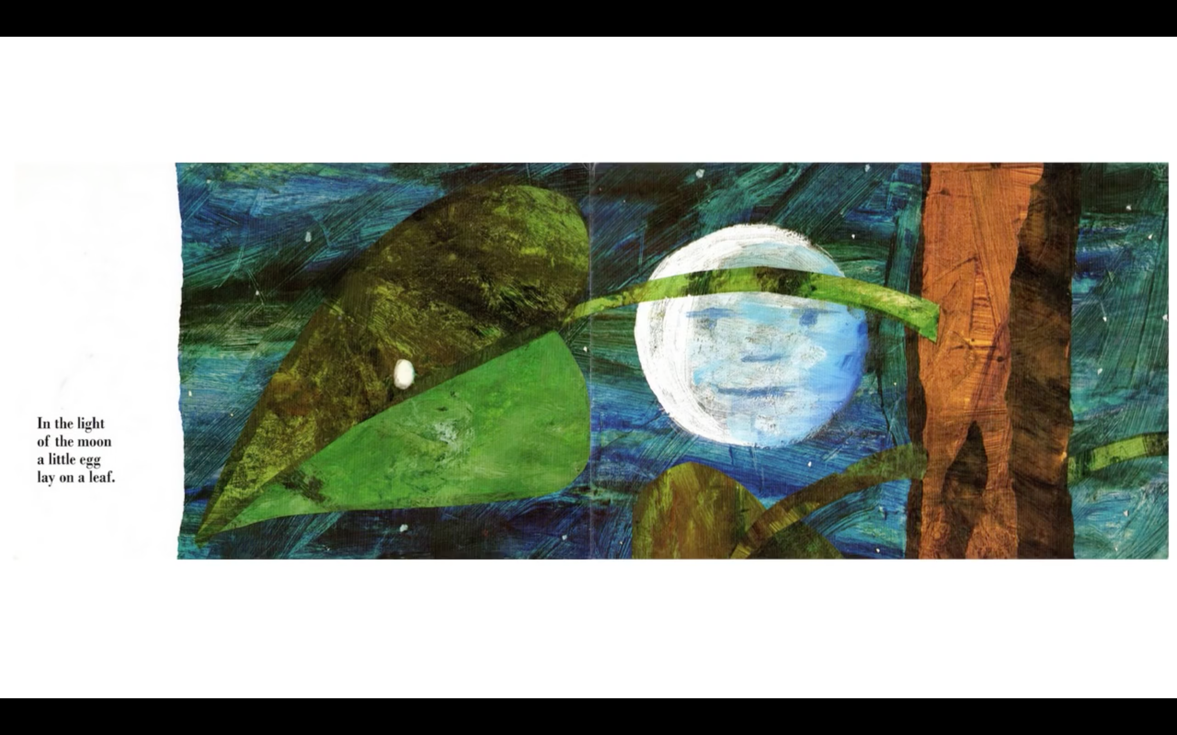
Notes:
Read each line and alternate between each student for an echo reading.

Slide 19
Notes:
Read each line and alternate between each student for an echo reading.

Slide 20
Notes:
Read each line and alternate between each student for an echo reading.

Slide 21
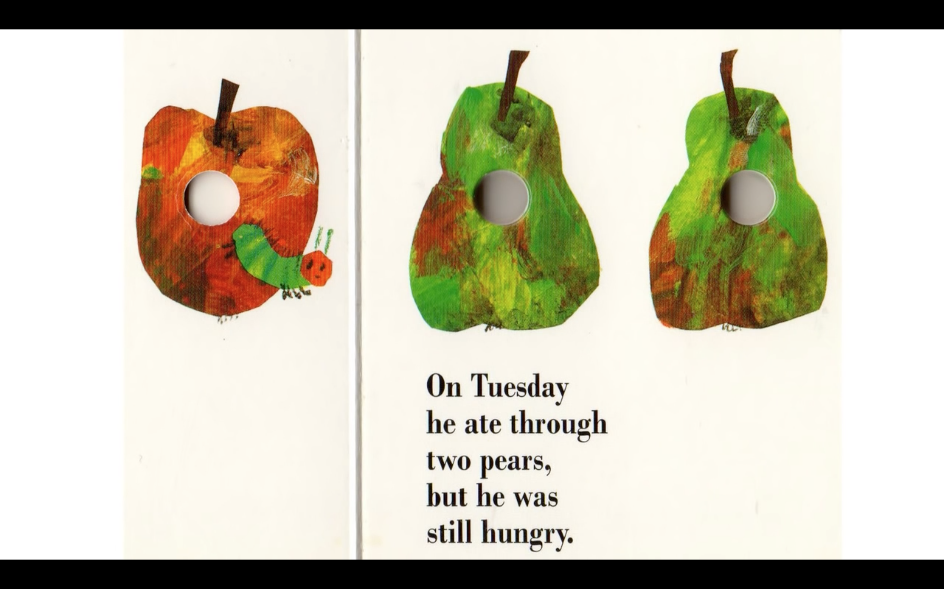
Notes:
Read each line and alternate between each student for an echo reading.

Slide 22
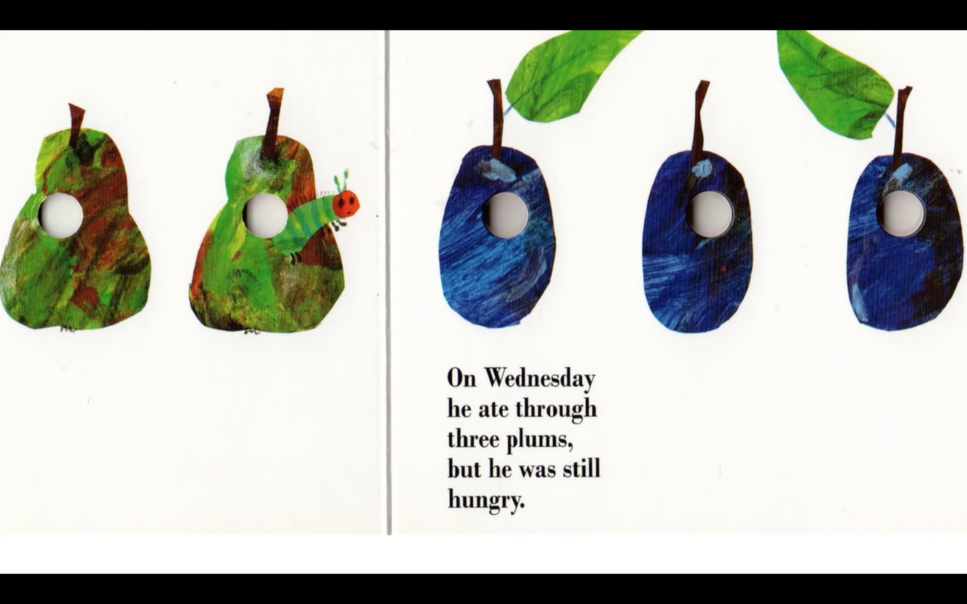
Notes:
Read each line and alternate between each student for an echo reading.

Slide 23
Notes:
Read each line and alternate between each student for an echo reading.

Slide 24
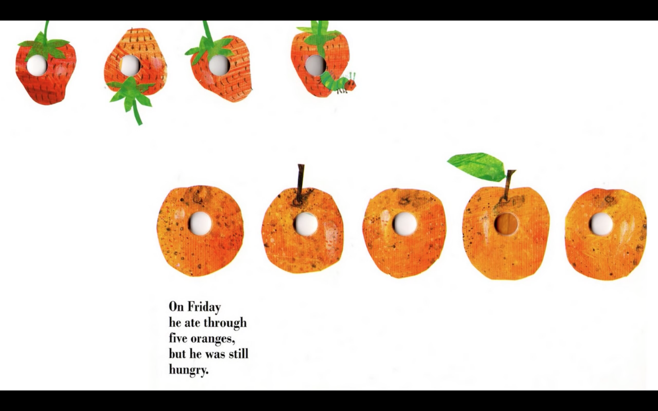
Notes:
Read each line and alternate between each student for an echo reading.

Slide 25
Notes:
Read each line and alternate between each student for an echo reading.

Slide 26
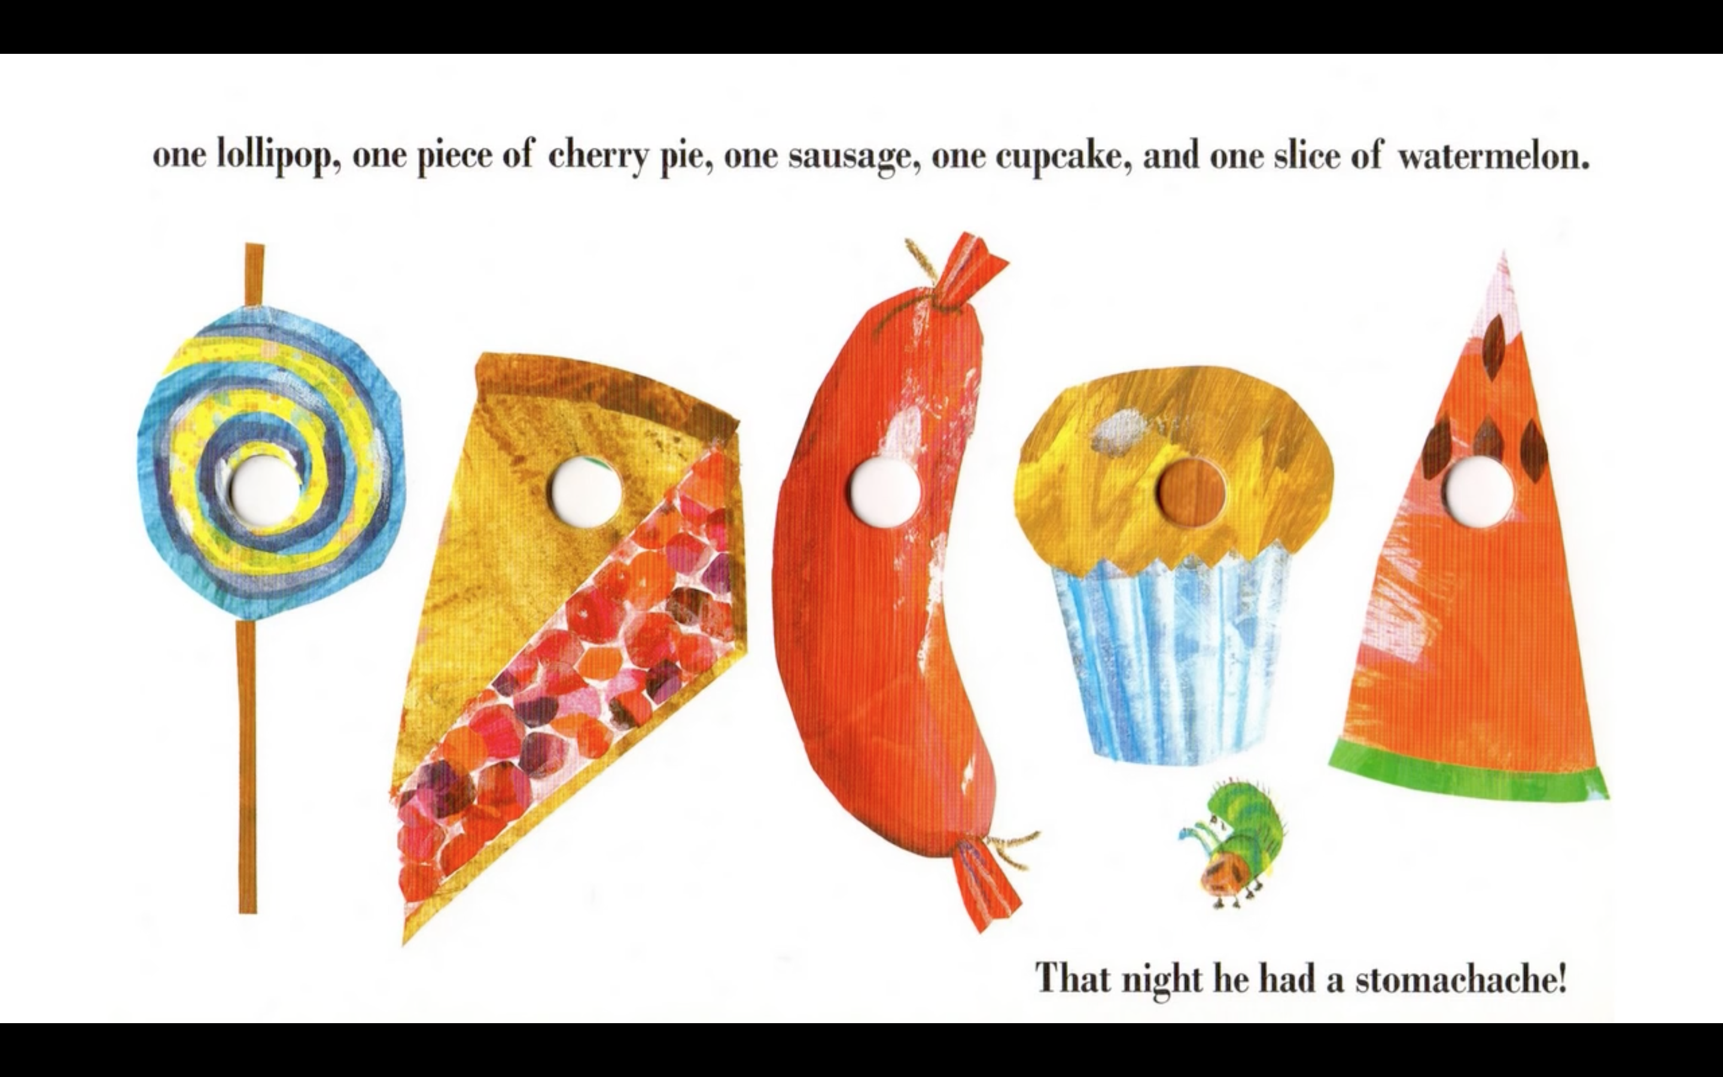
Notes:
Read each line and alternate between each student for an echo reading.

Slide 27
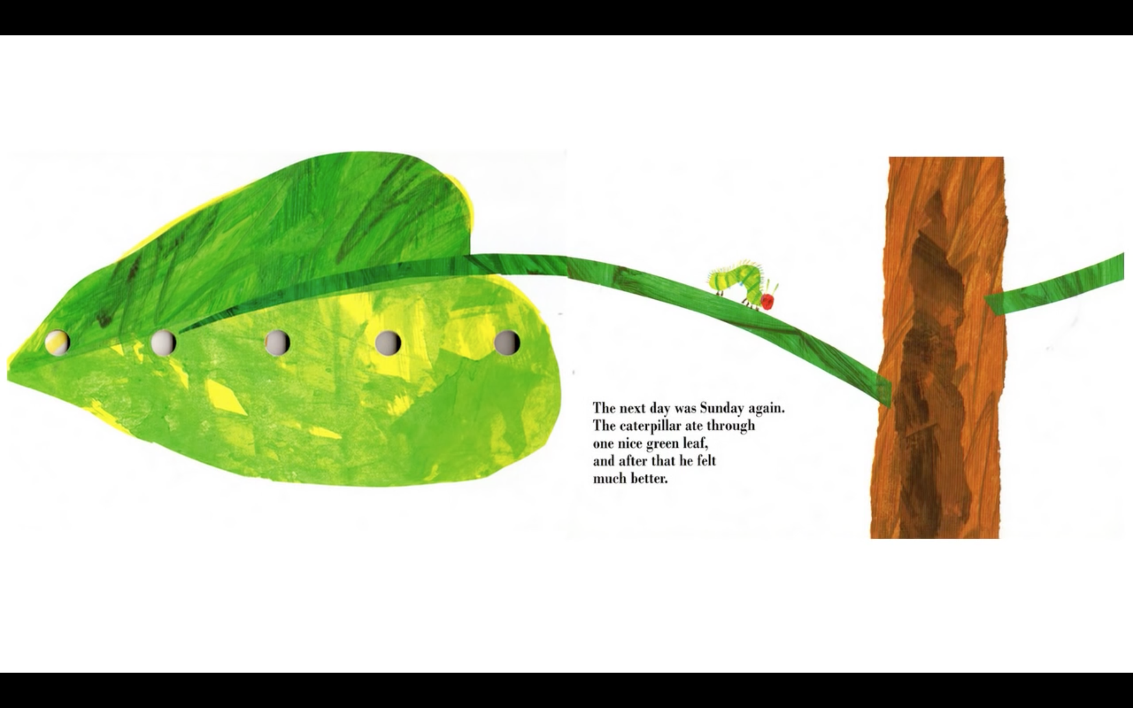
Notes:
Read each line and alternate between each student for an echo reading.

Slide 28
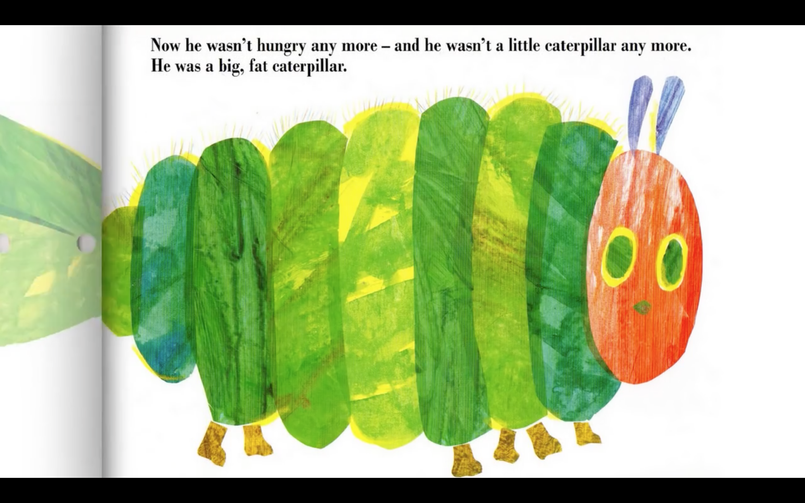
Notes:
Read each line and alternate between each student for an echo reading.

Slide 29
Notes:
Read each line and alternate between each student for an echo reading.

Slide 30
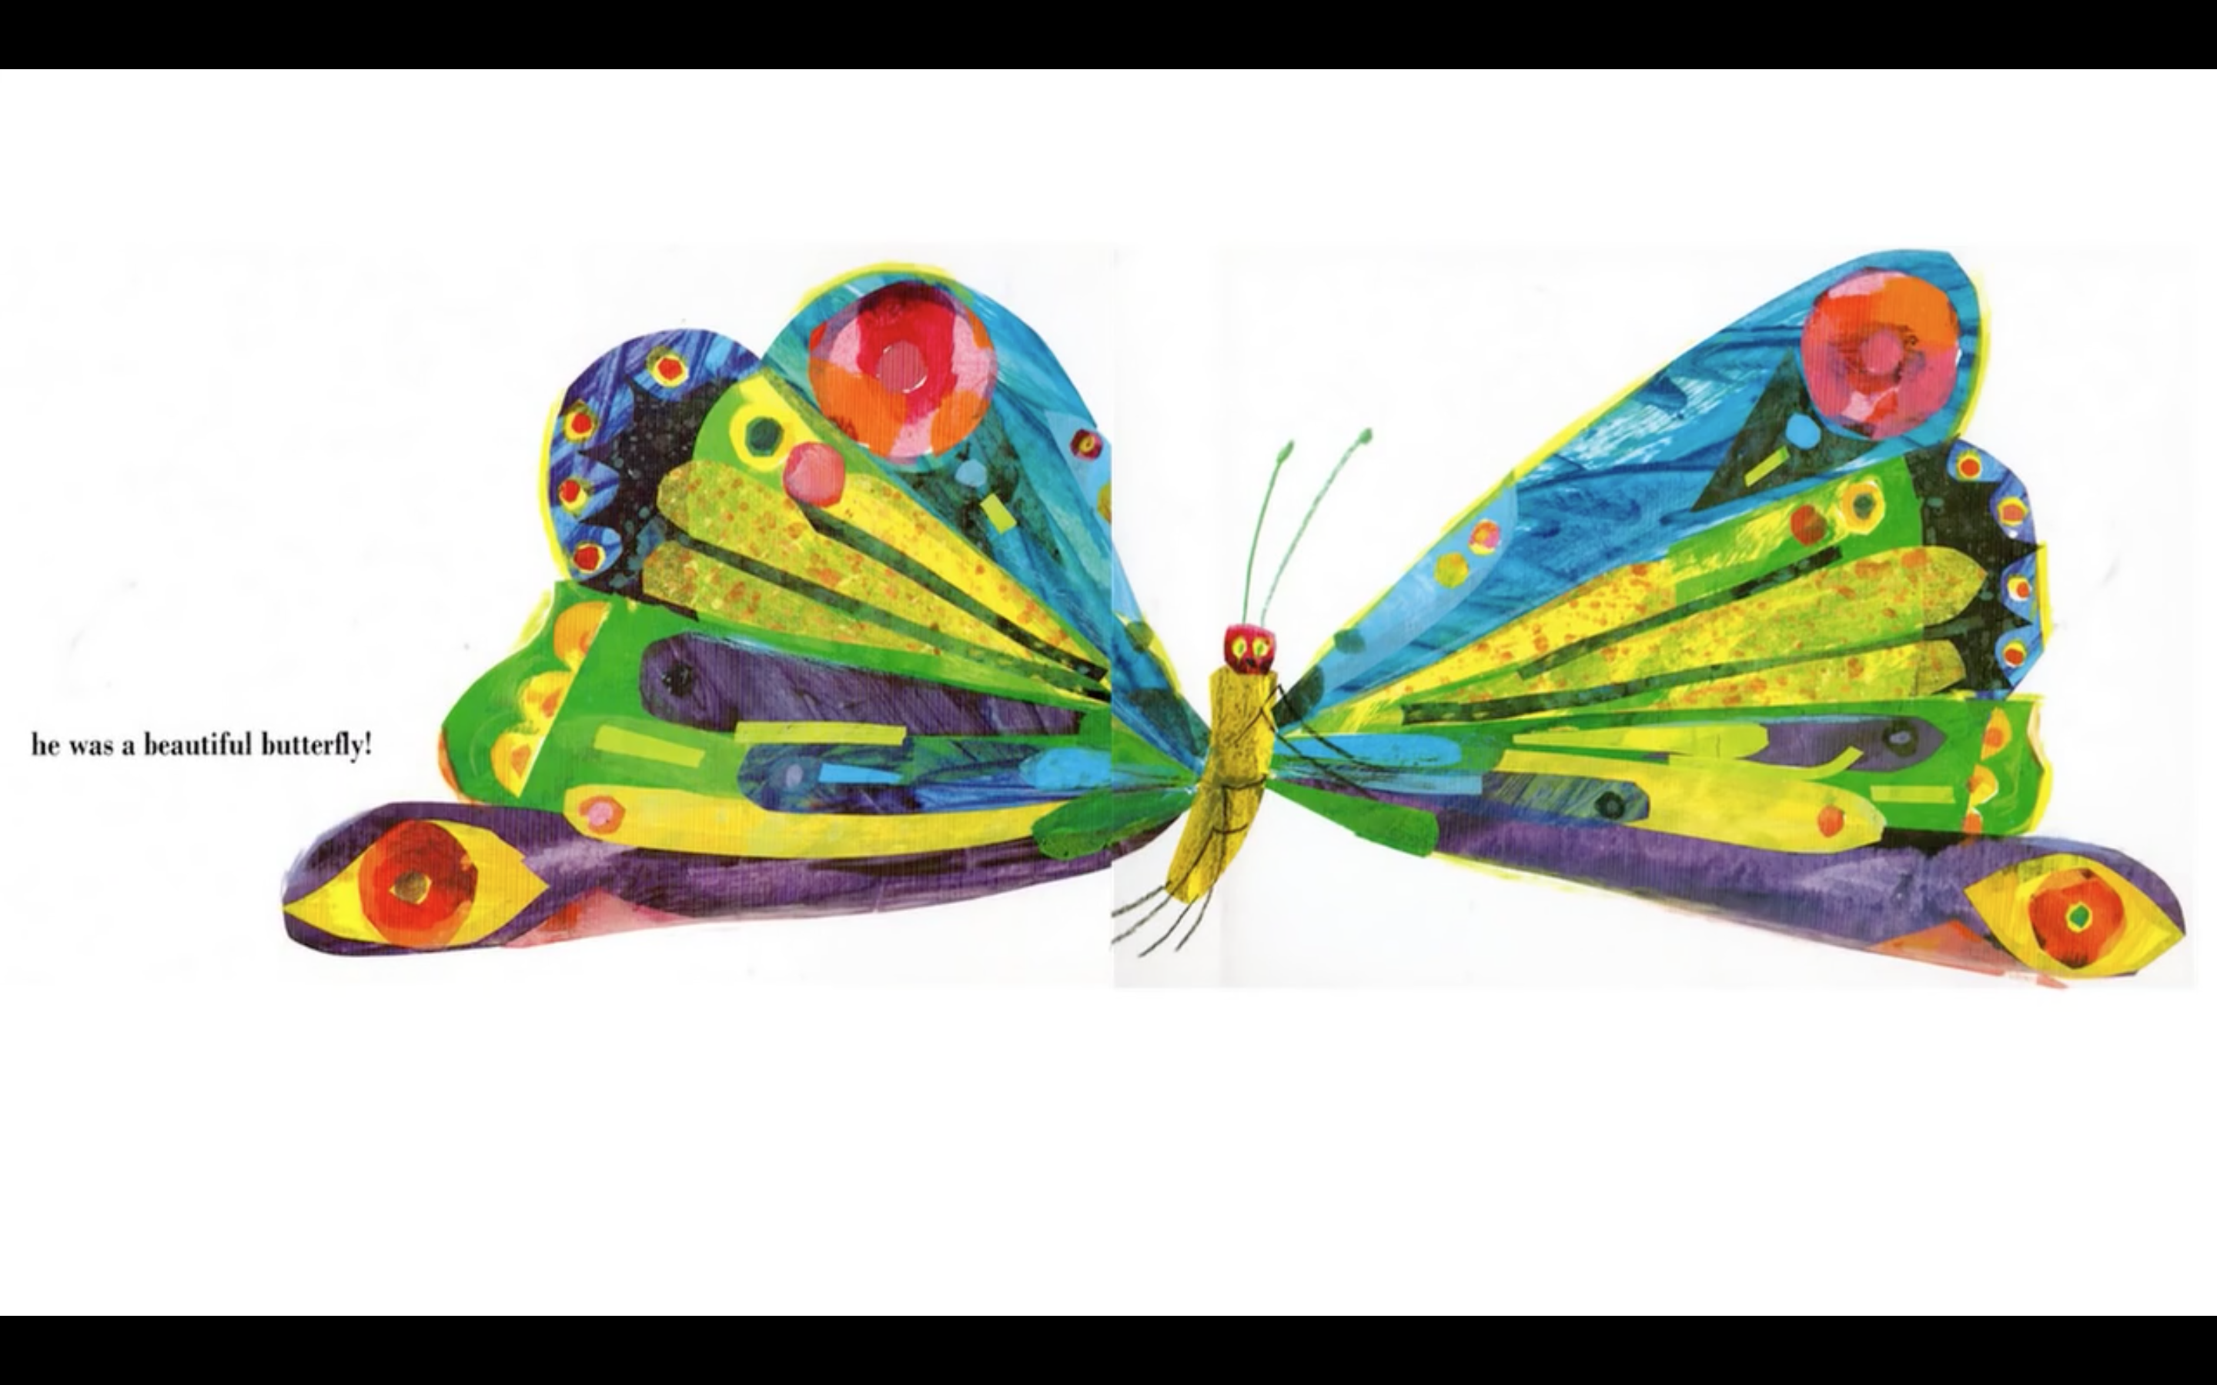
Notes:
Read each line and alternate between each student for an echo reading.

Slide 31
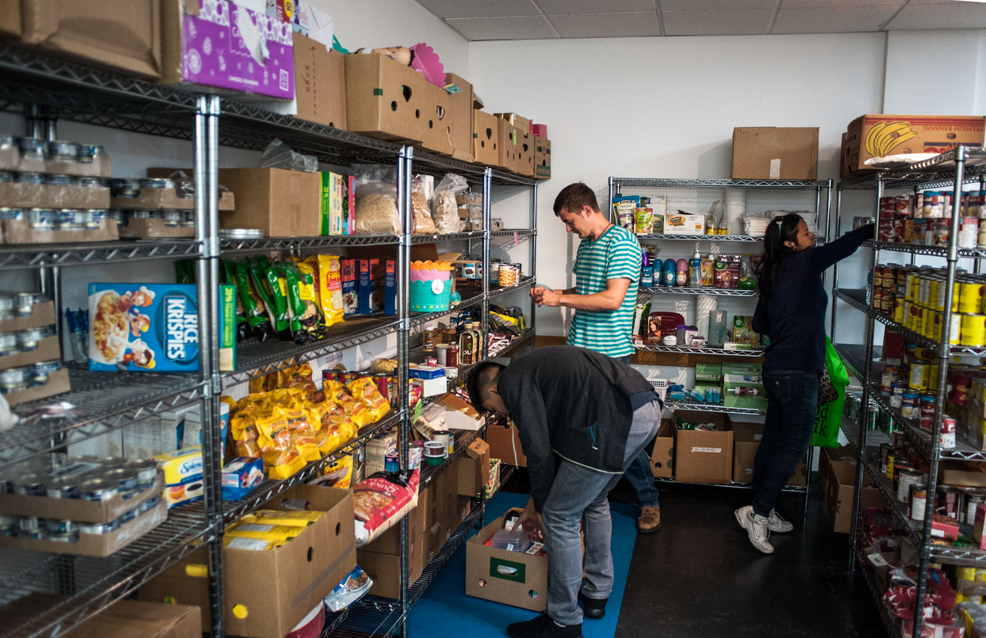
What do you think is happening in this photo?
Notes:
Ask the students if this is a grocery store, and if they conclude it isn’t, why not. Teach the difference between a grocery store and a food bank. (A grocery store is a retail store that primarily sells food./A food bank is an organization that collects donated or surplus foodstuffs and distributes them free or at low cost to programs or organizations serving people in need.) Why would there be food in a place that’s not being sold. Explain the idea of a food bank.

Slide 32
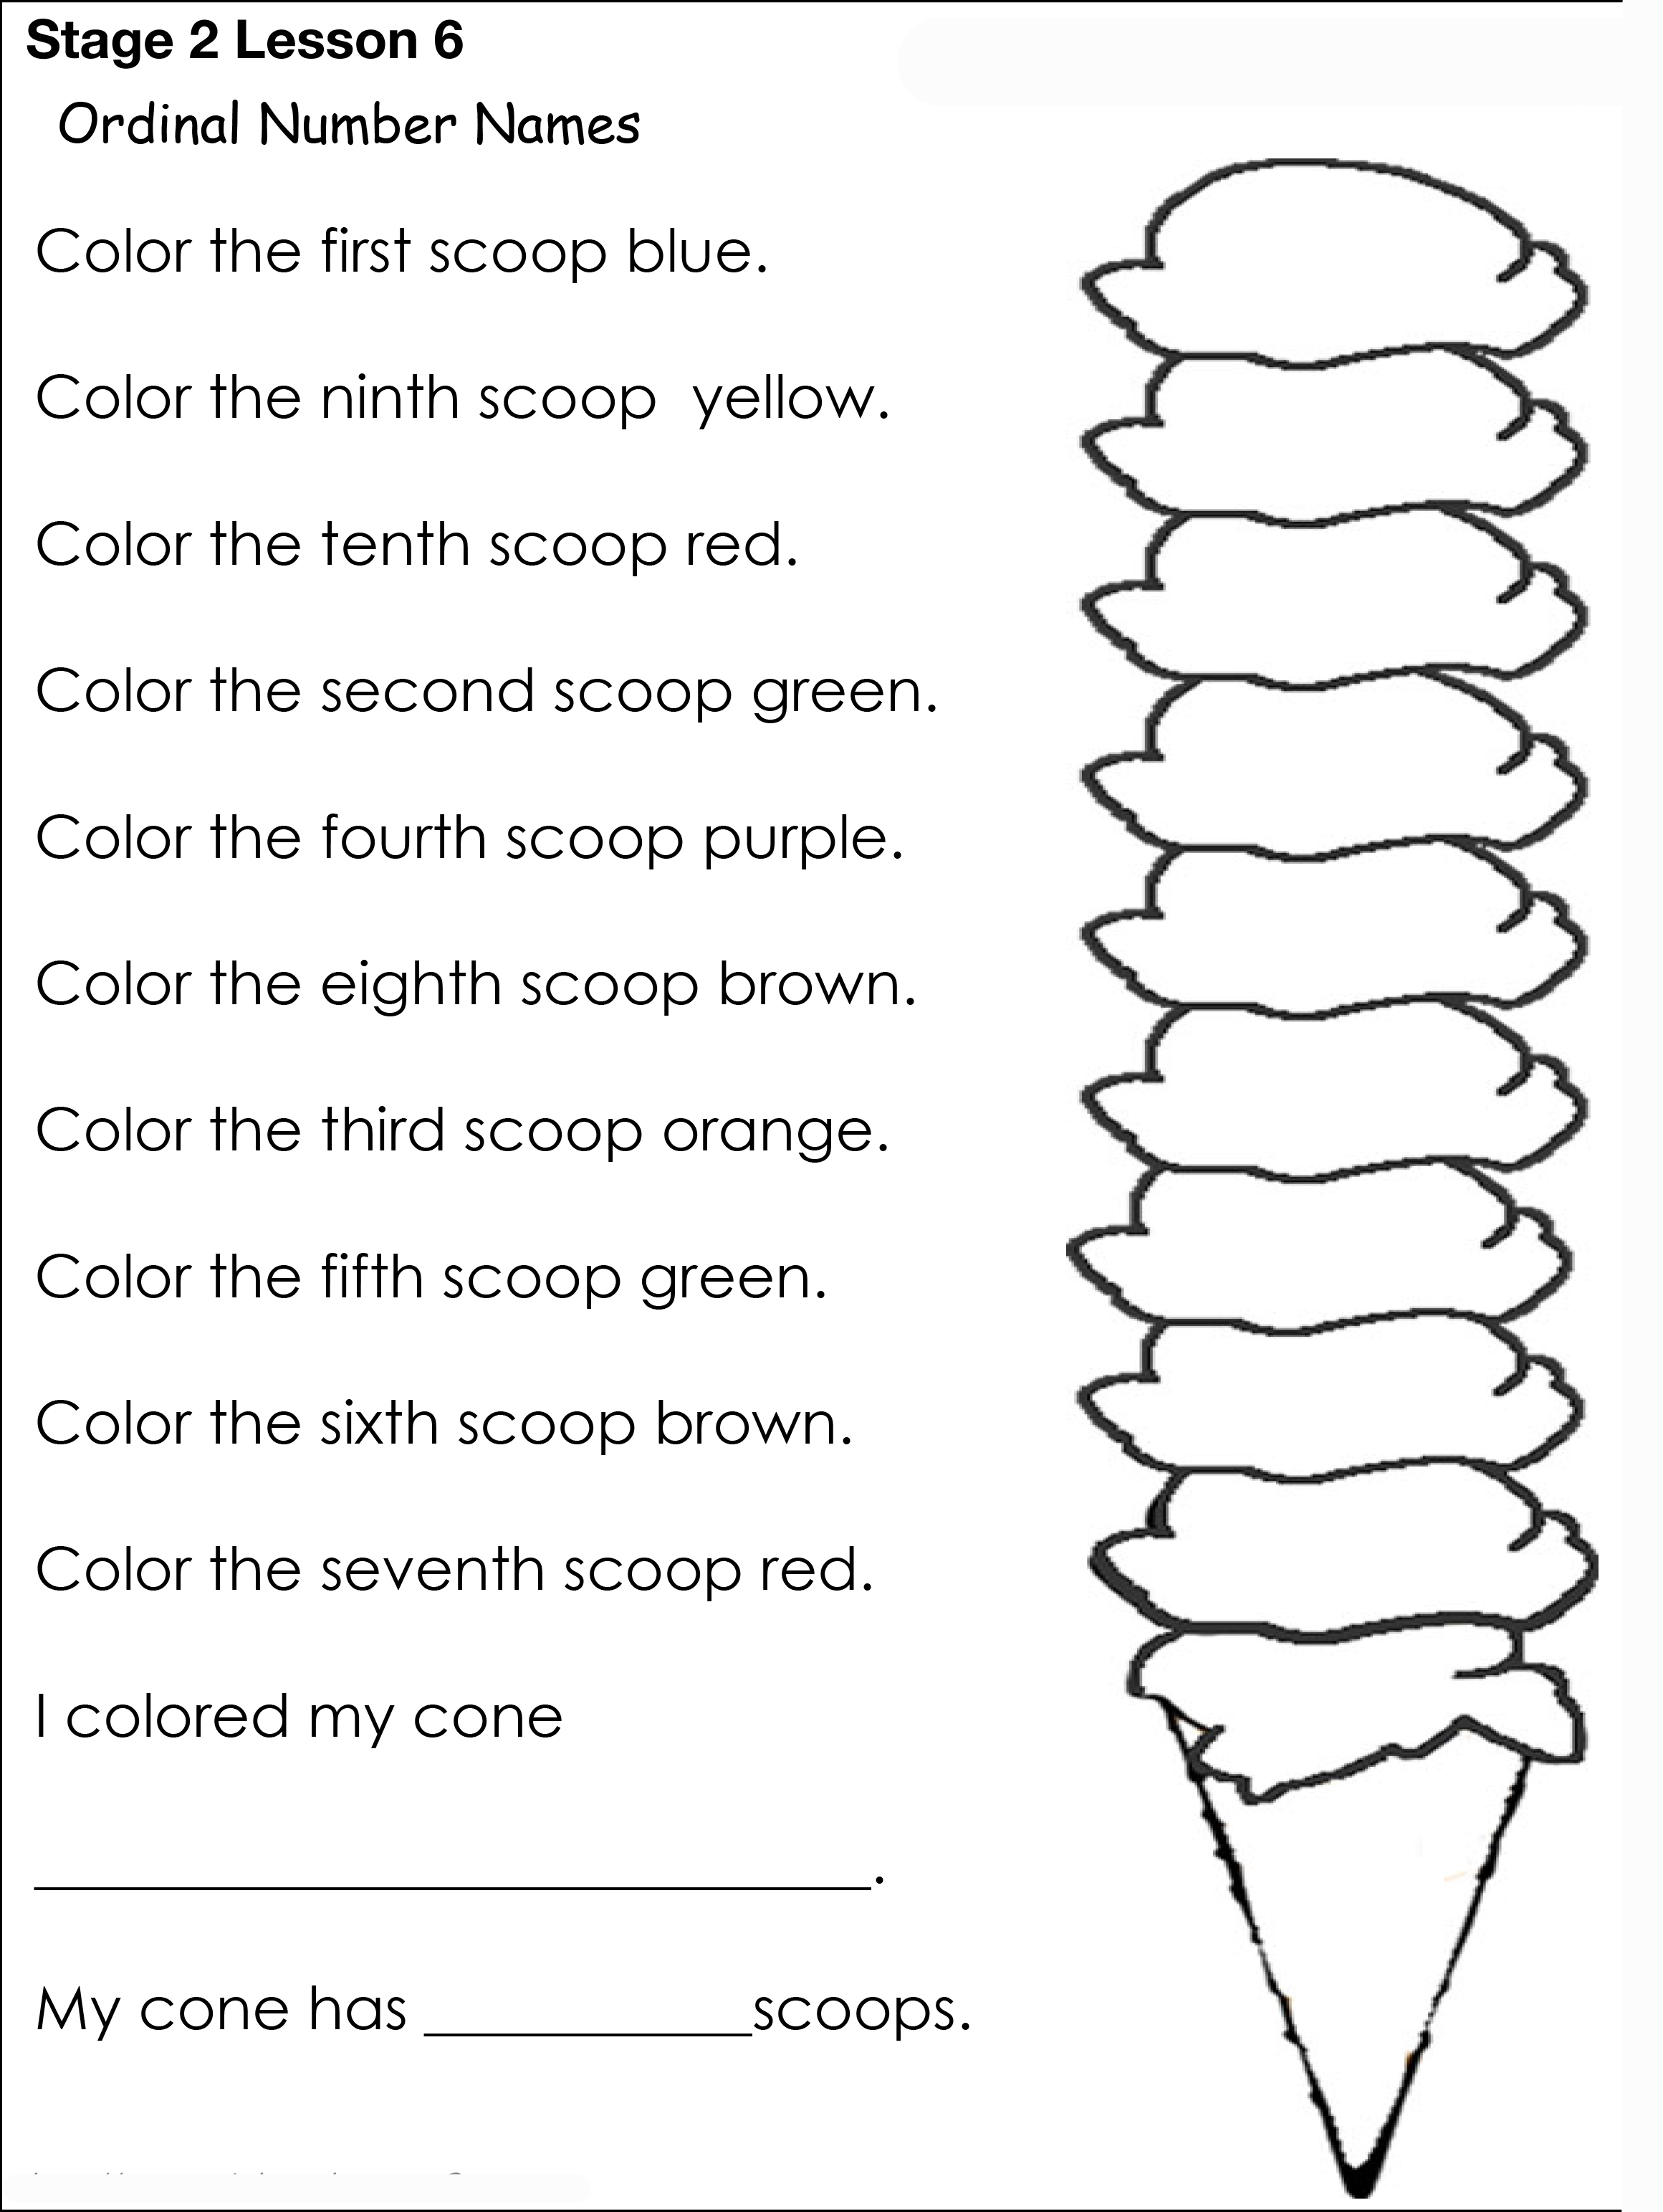
Homework
Notes:
Tell the students to download and print “Homework Ice Cream Worksheet.pdf”. Explain what a scoop of ice cream is.

Slide 33
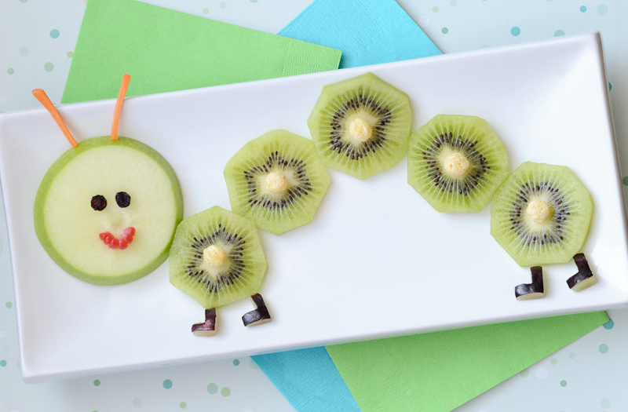
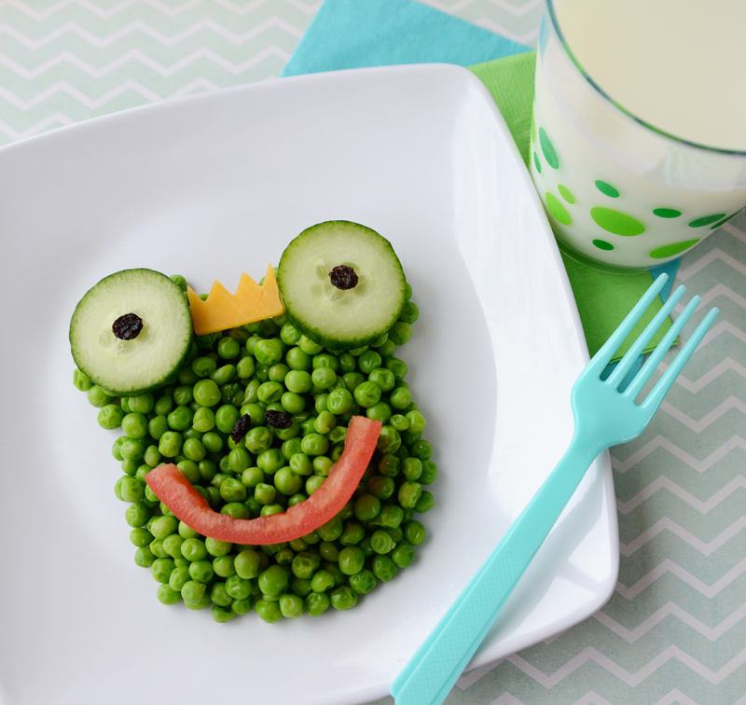
Make your own food art!
Make one of your meals into an art piece. Photograph it and share it next class. Label all the foods you used.
Notes:
Get students to create their own food art and take a photo for it next class. All the foods used should be labelled in the photo.

Slide 34
What did I learn today?
New ‘dr’ words
How to read poetry
How to read a story
The food groups
Notes:
Review

