Slide 1
Lesson 6: Tutoring FOOD

Slide 2
What we will learn today
Reading a poem
Kitchen verbs
Reading a story
a/an
Food rainbow
Notes:
Go over the learning goals.

Slide 3
Notes:
Explain what “desserts” means (a sweet course usually served at the end of a meal). Have students circle the desserts. Then, go over each of the foods and give the English word for each graphic.

Slide 4
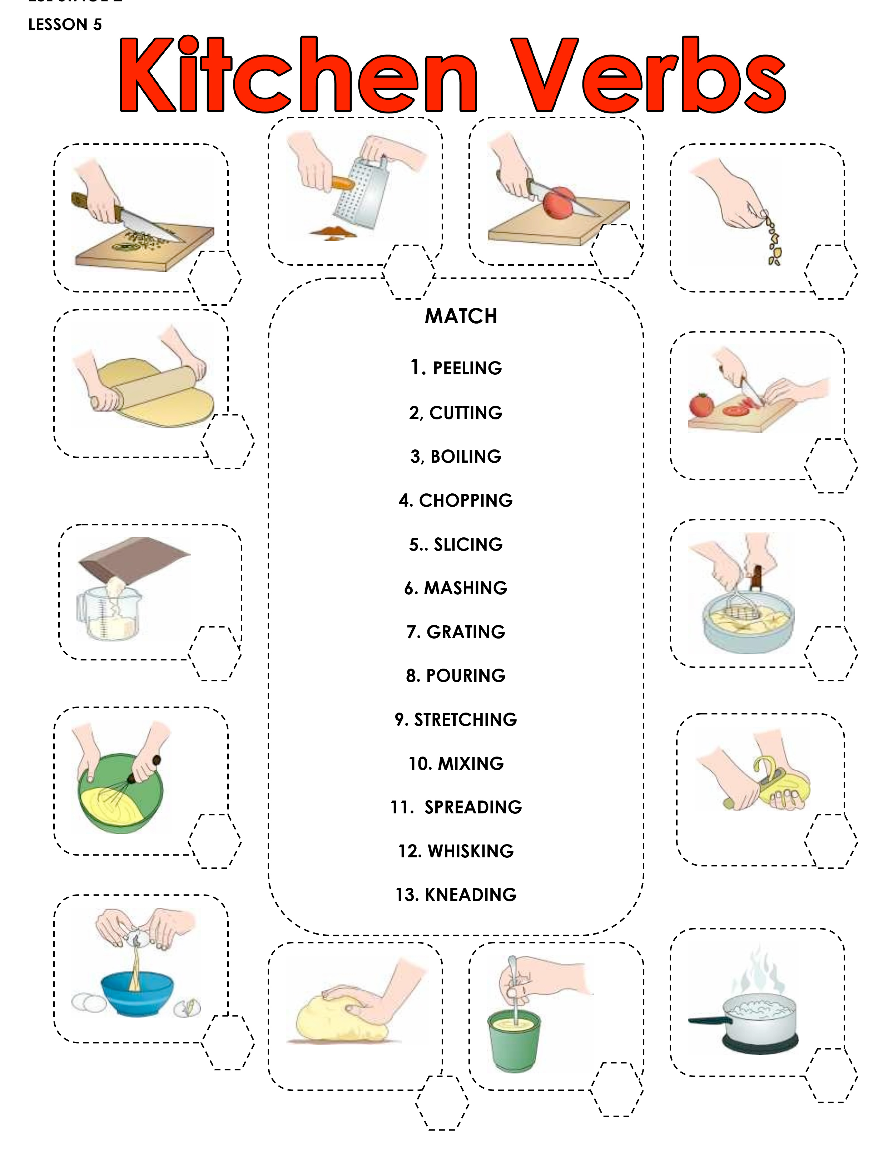
In the kitchen
Notes:
Ask students to take out their “Kitchen Verb Activity.pdf“ worksheet. Go over the definitions and have them fill out the numbers.

Slide 5
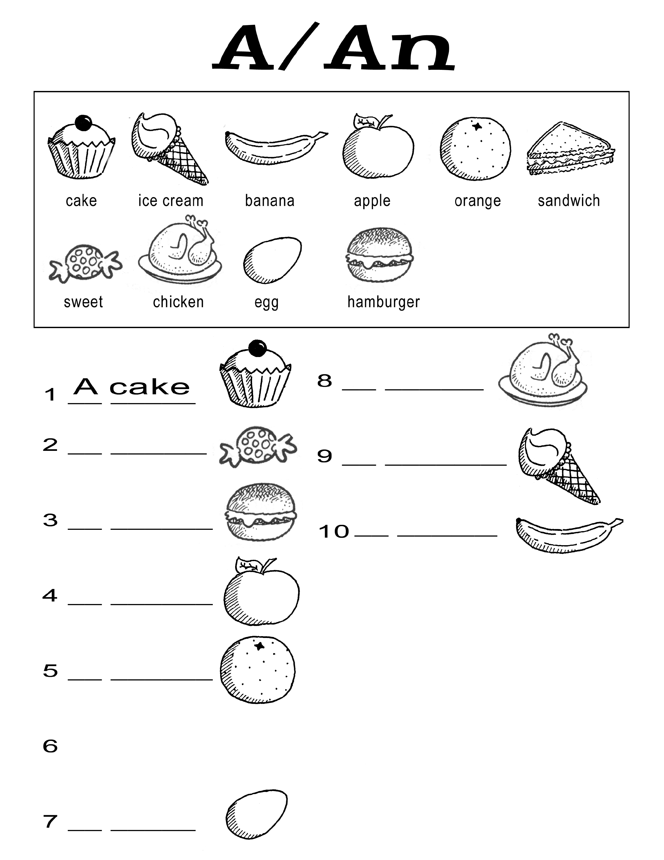

Slide 6
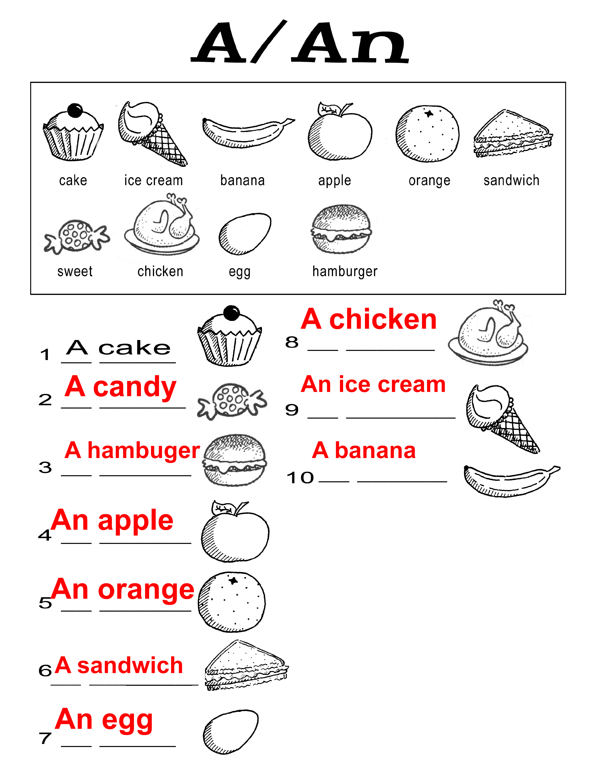

Slide 7
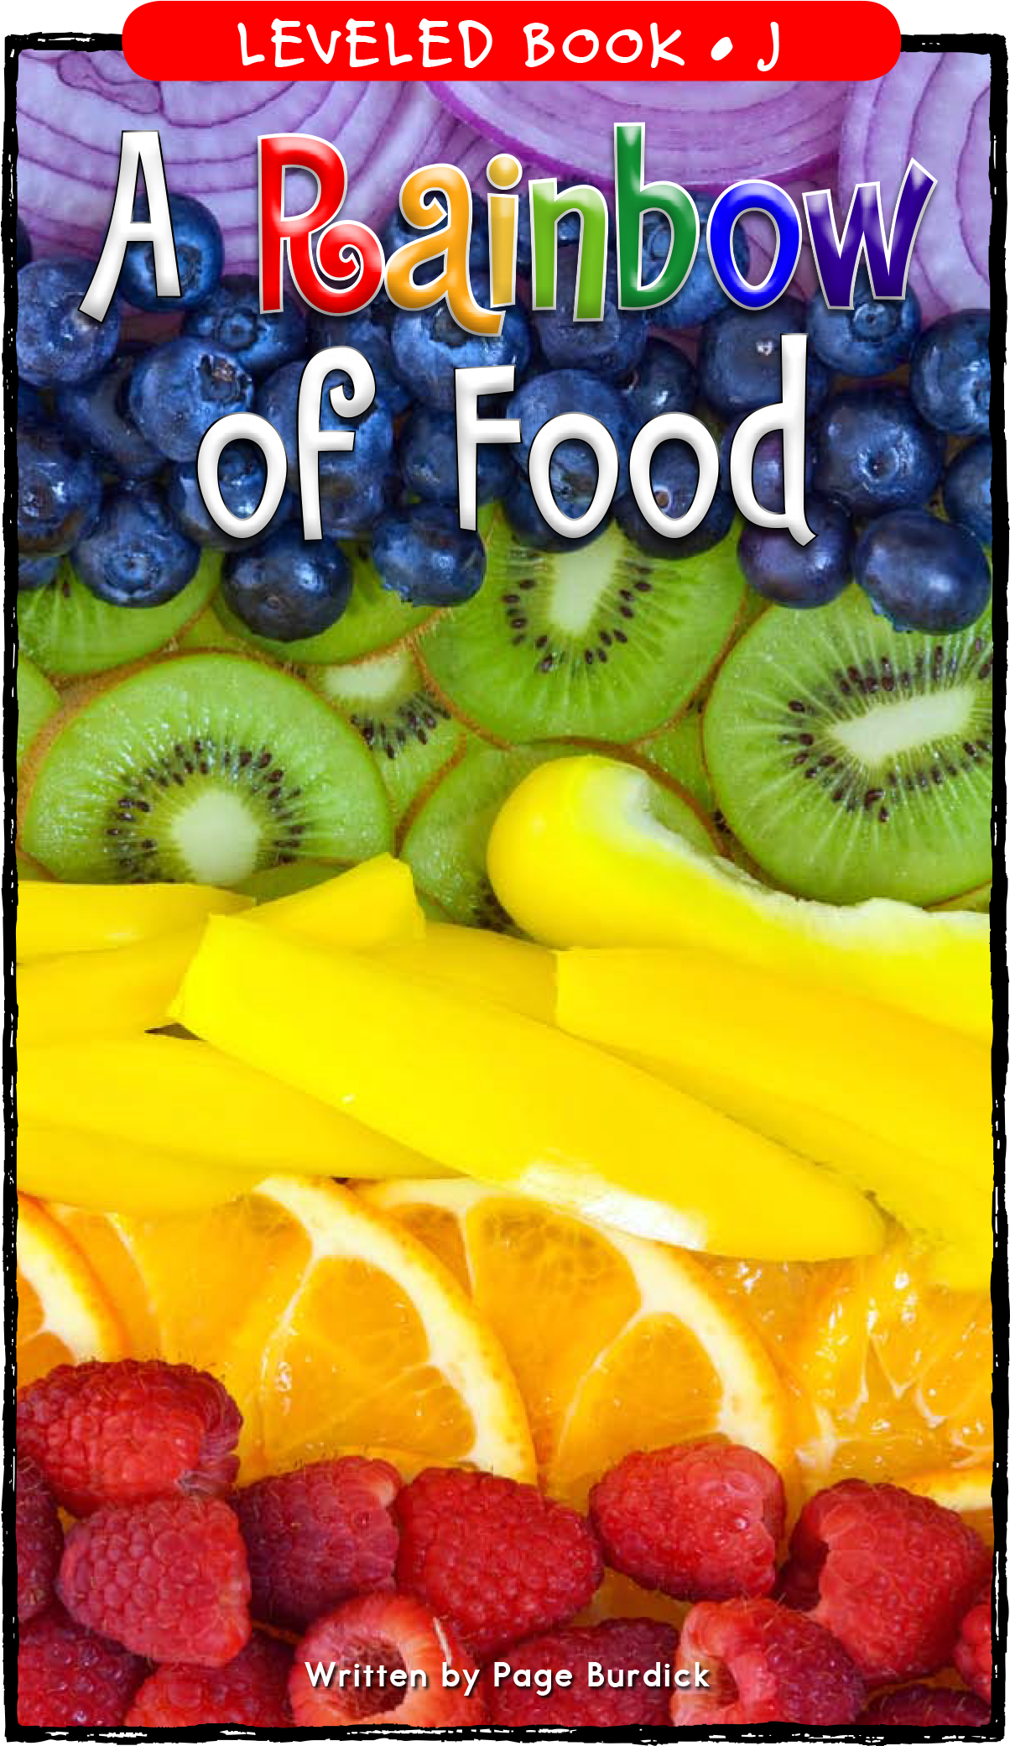
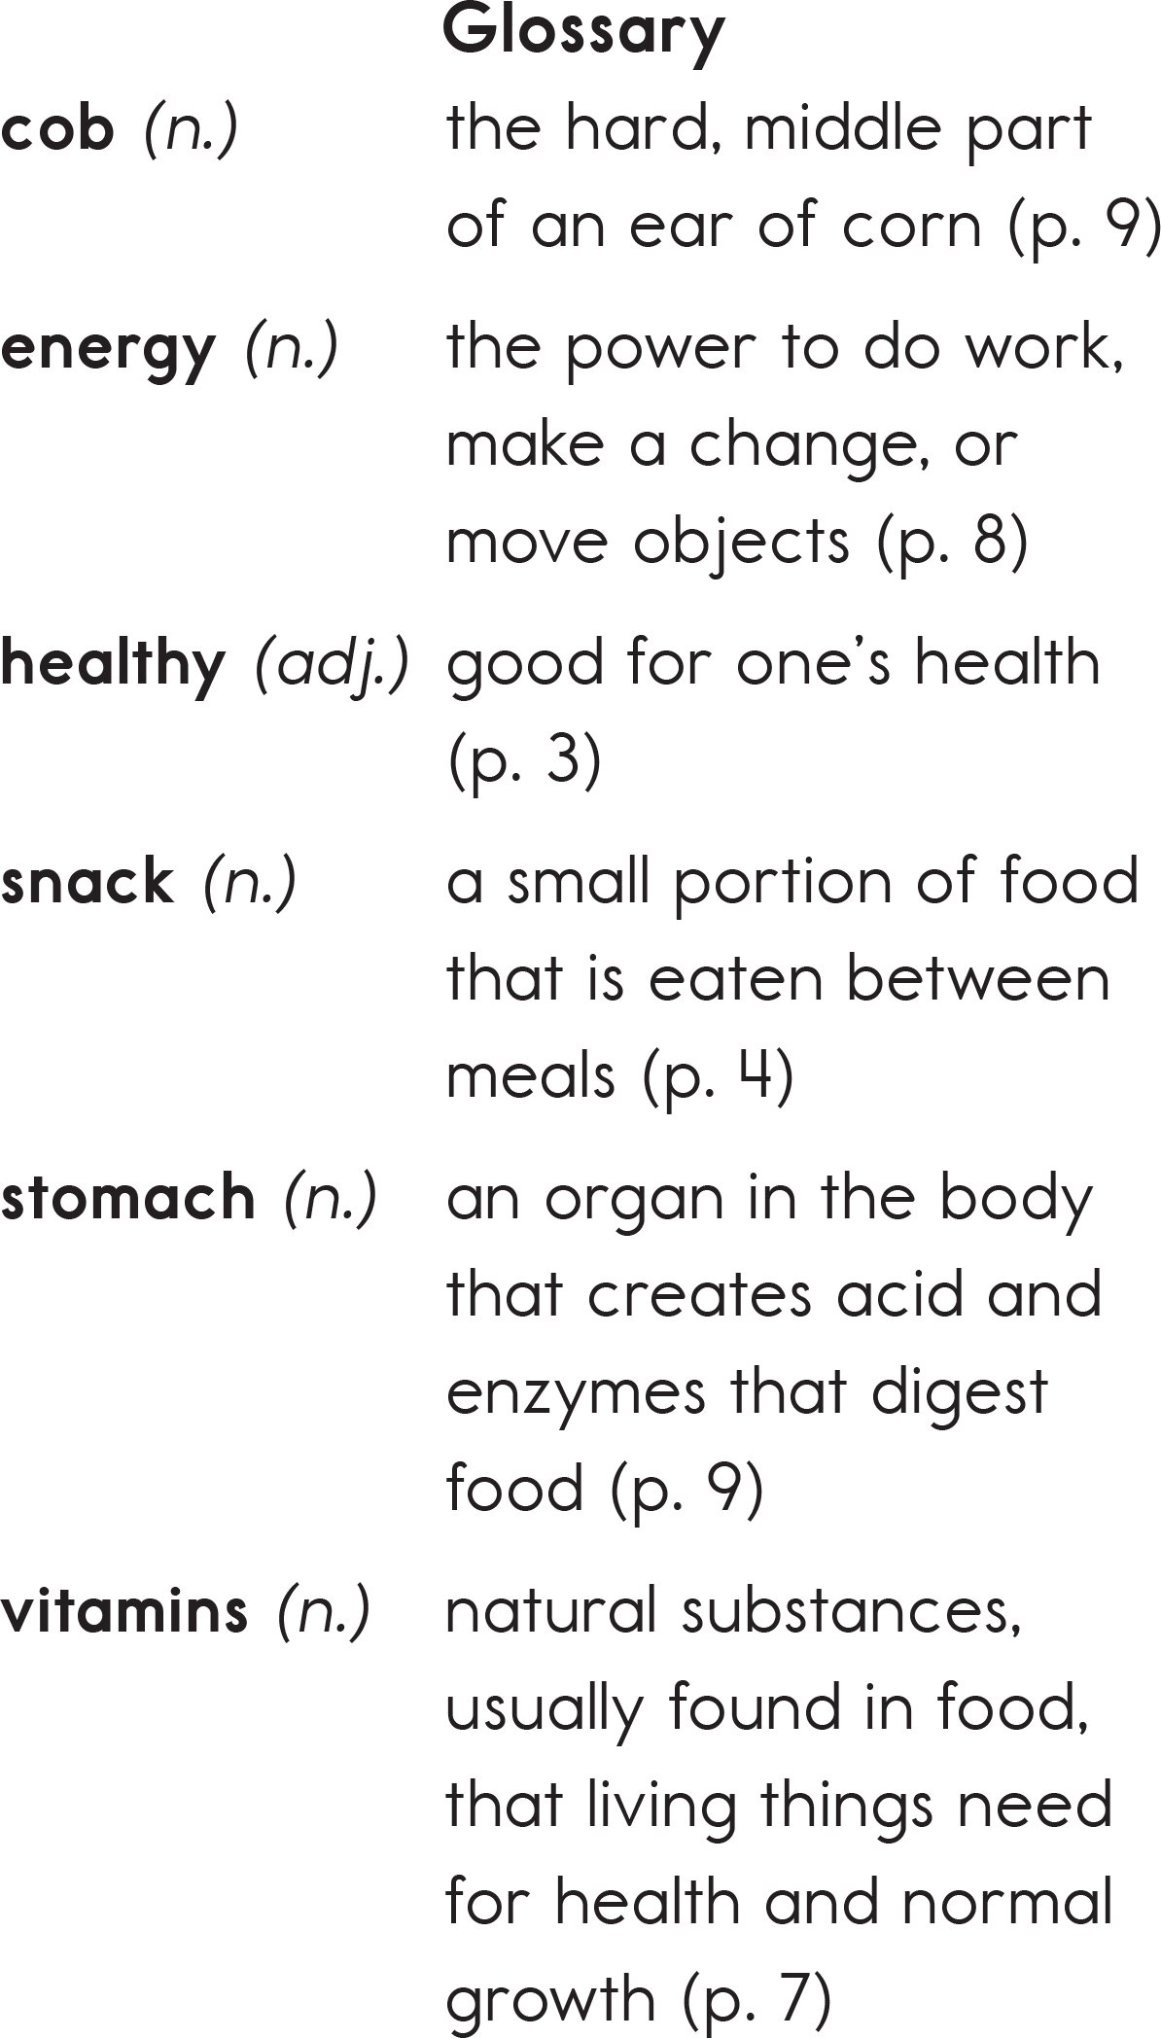
Story Time
Notes:
Pre-teach the vocabulary on the right.

Slide 10
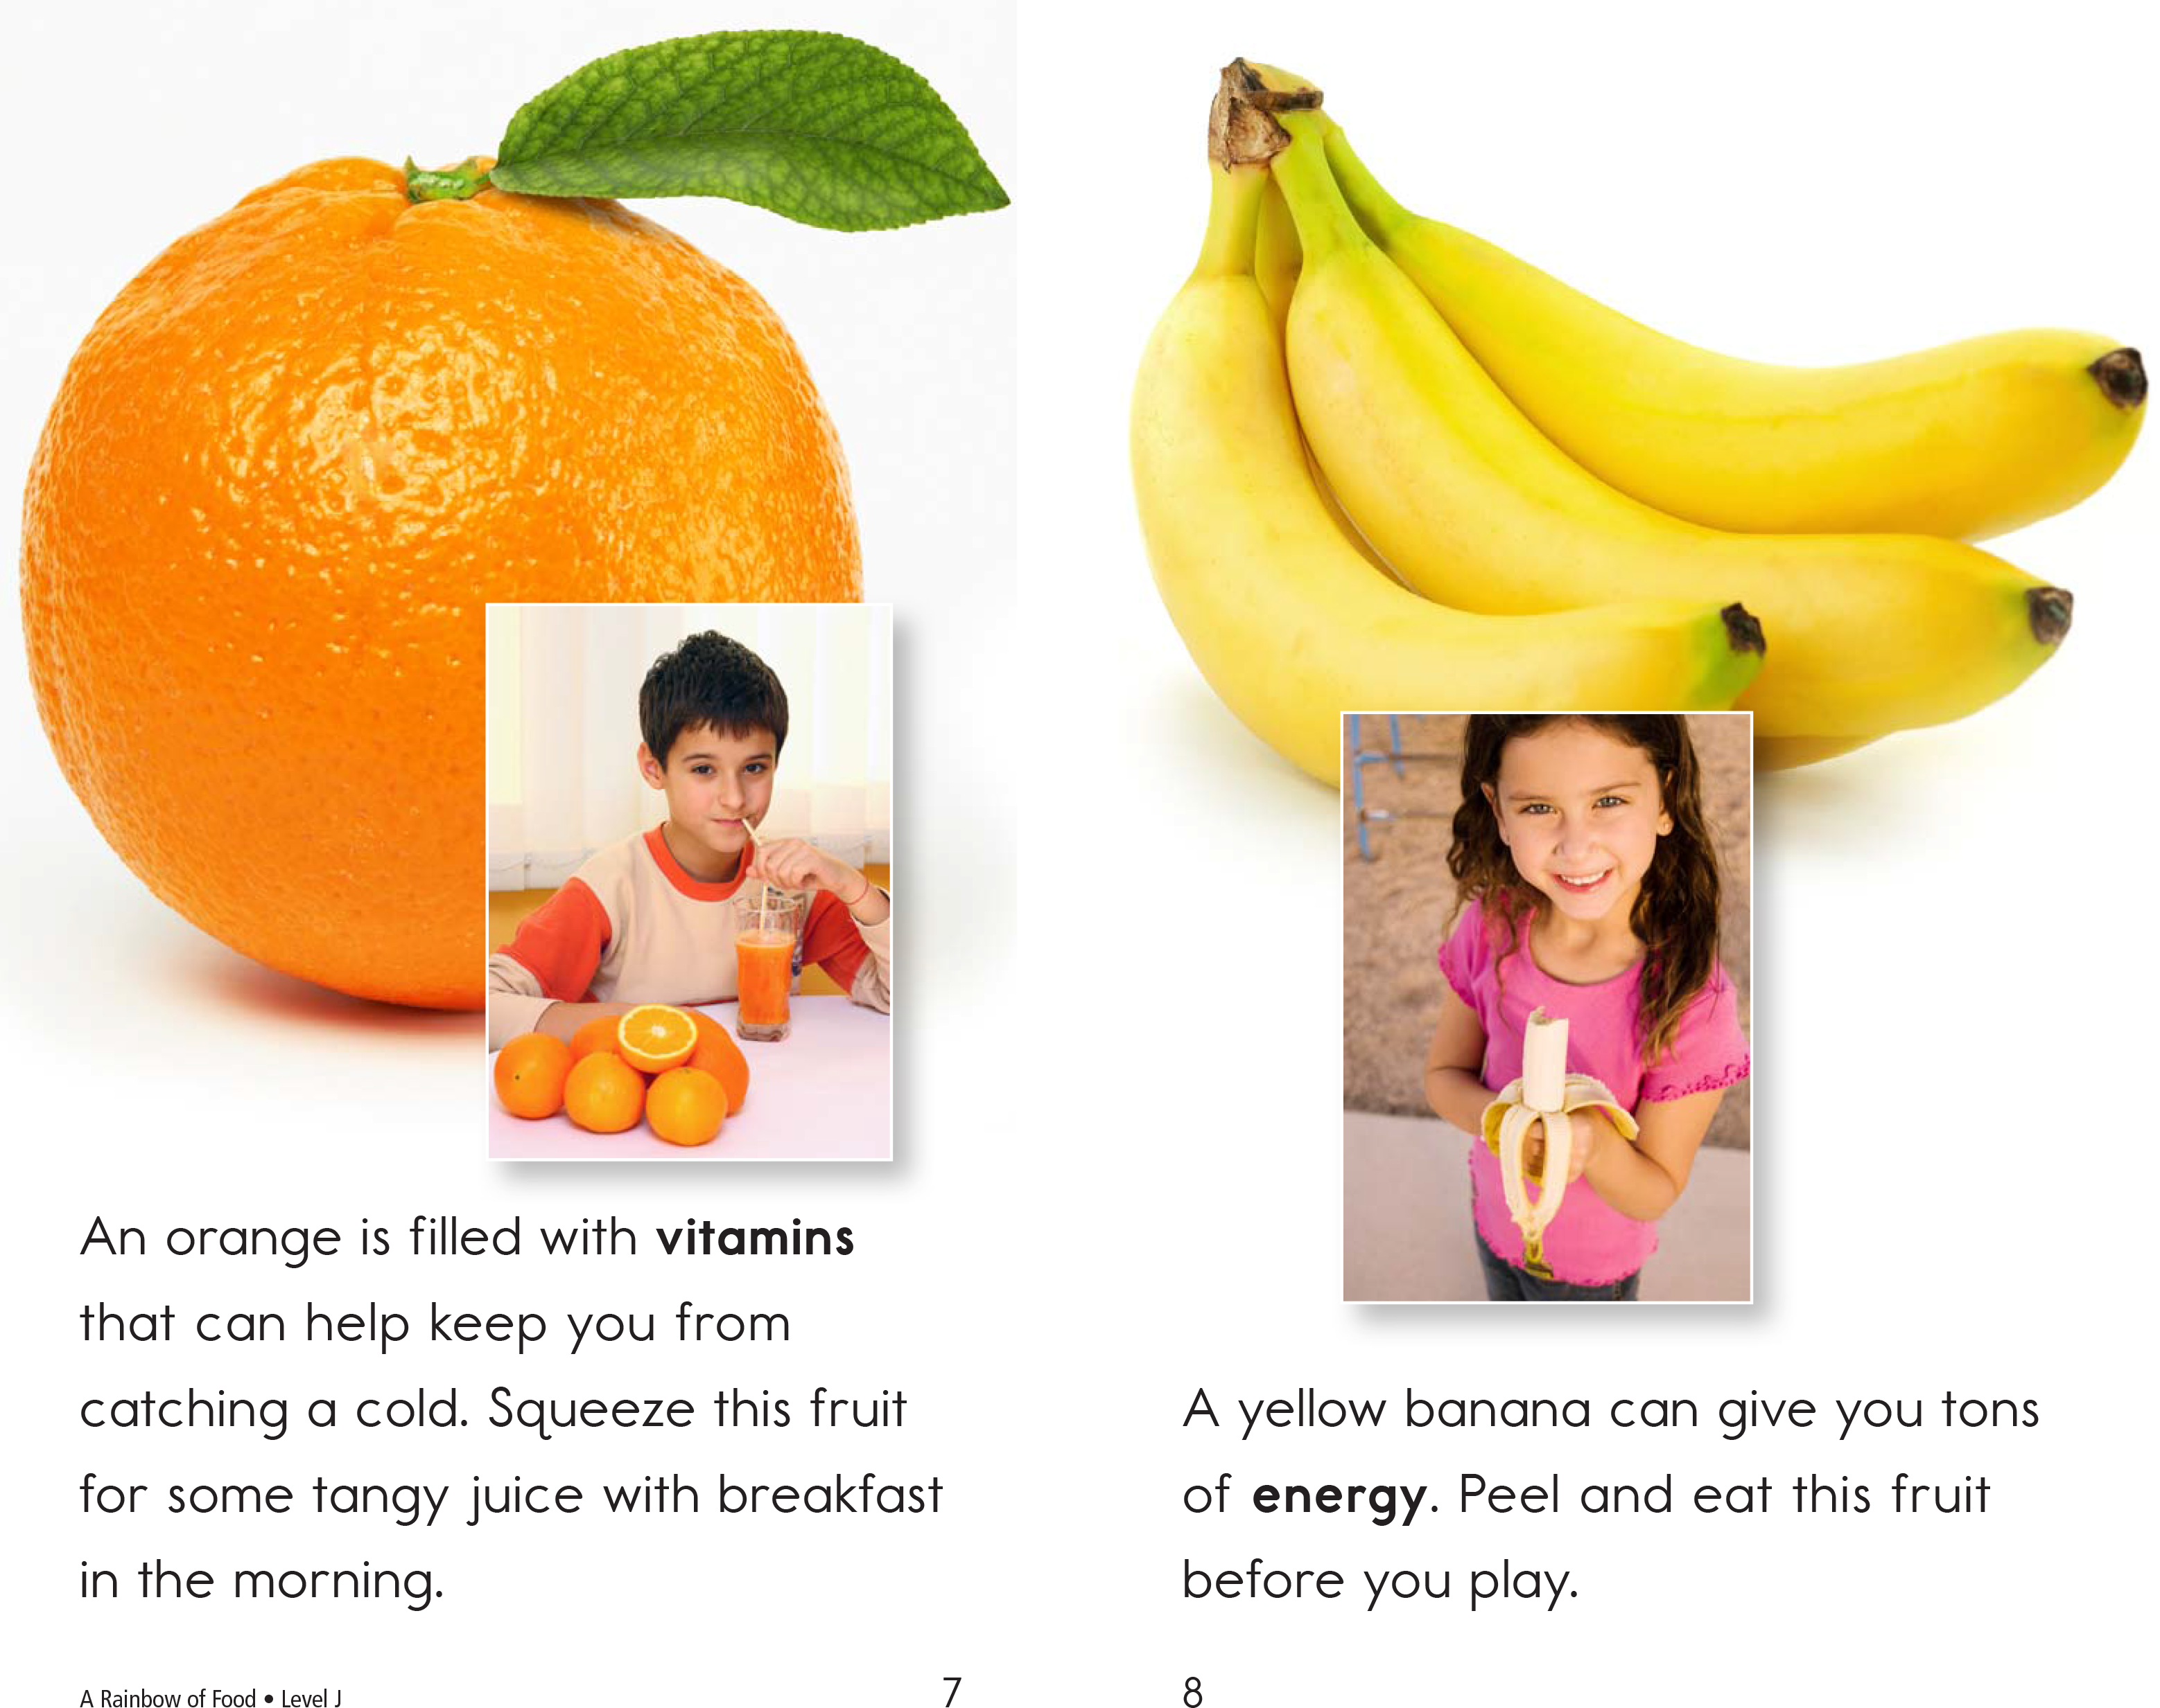

Slide 13
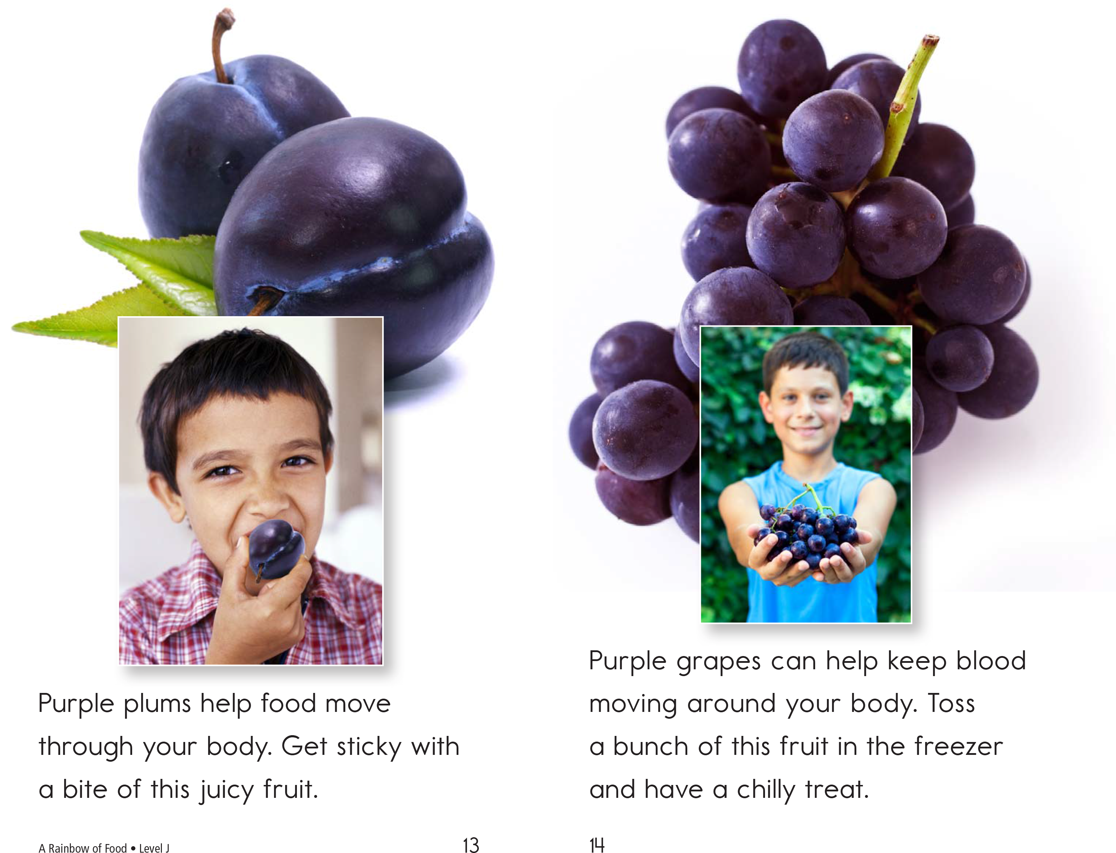

Slide 14
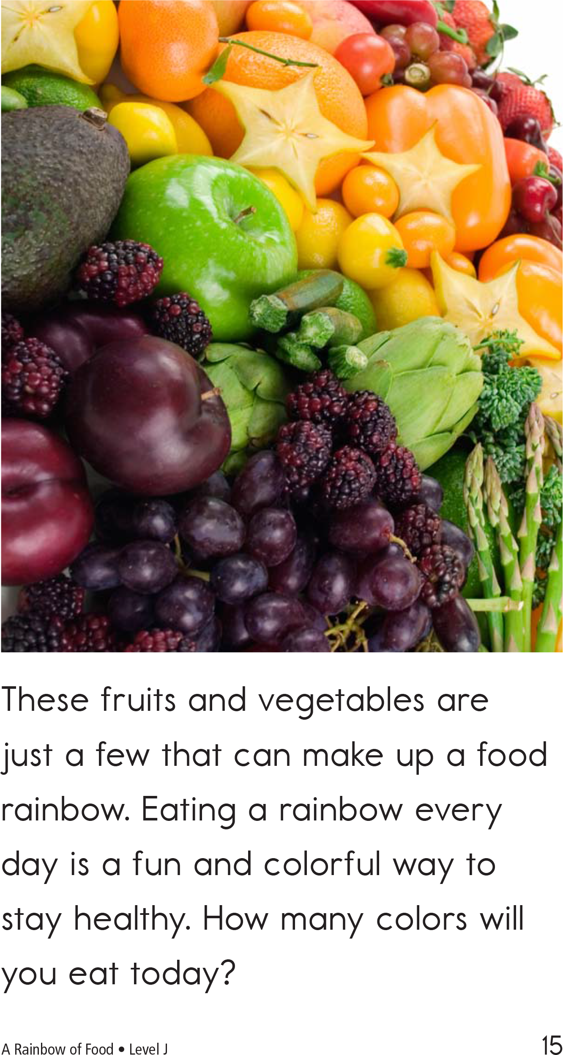

Slide 15
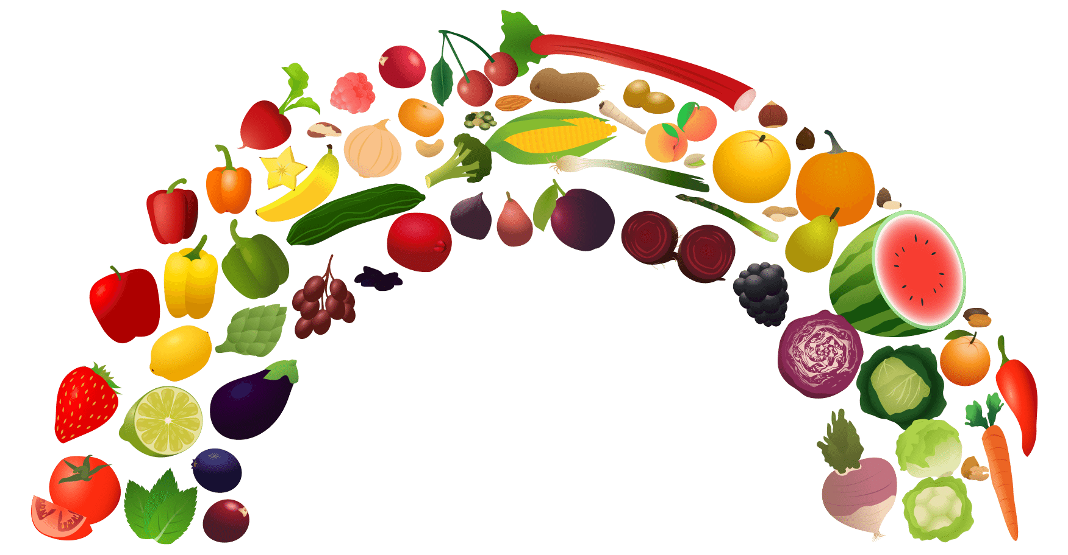
What are some other foods you can think of for each colour in the food rainbow?
Notes:
Explain what “desserts” means (a sweet course usually served at the end of a meal). Have students circle the desserts. Then, go over each of the foods and give the English word for each graphic.

Slide 16
What did I learn today?
Practiced ‘ng’ and ‘ing’ words
Used ‘because’
Reading skills
Notes:
Review

