Slide 1
Lesson 7 FOOD

Slide 2
What we will learn today
Saying the ‘tr’ sound
Plant and animals foods
Reading a story about cake
Writing a paragrpah

Slide 3
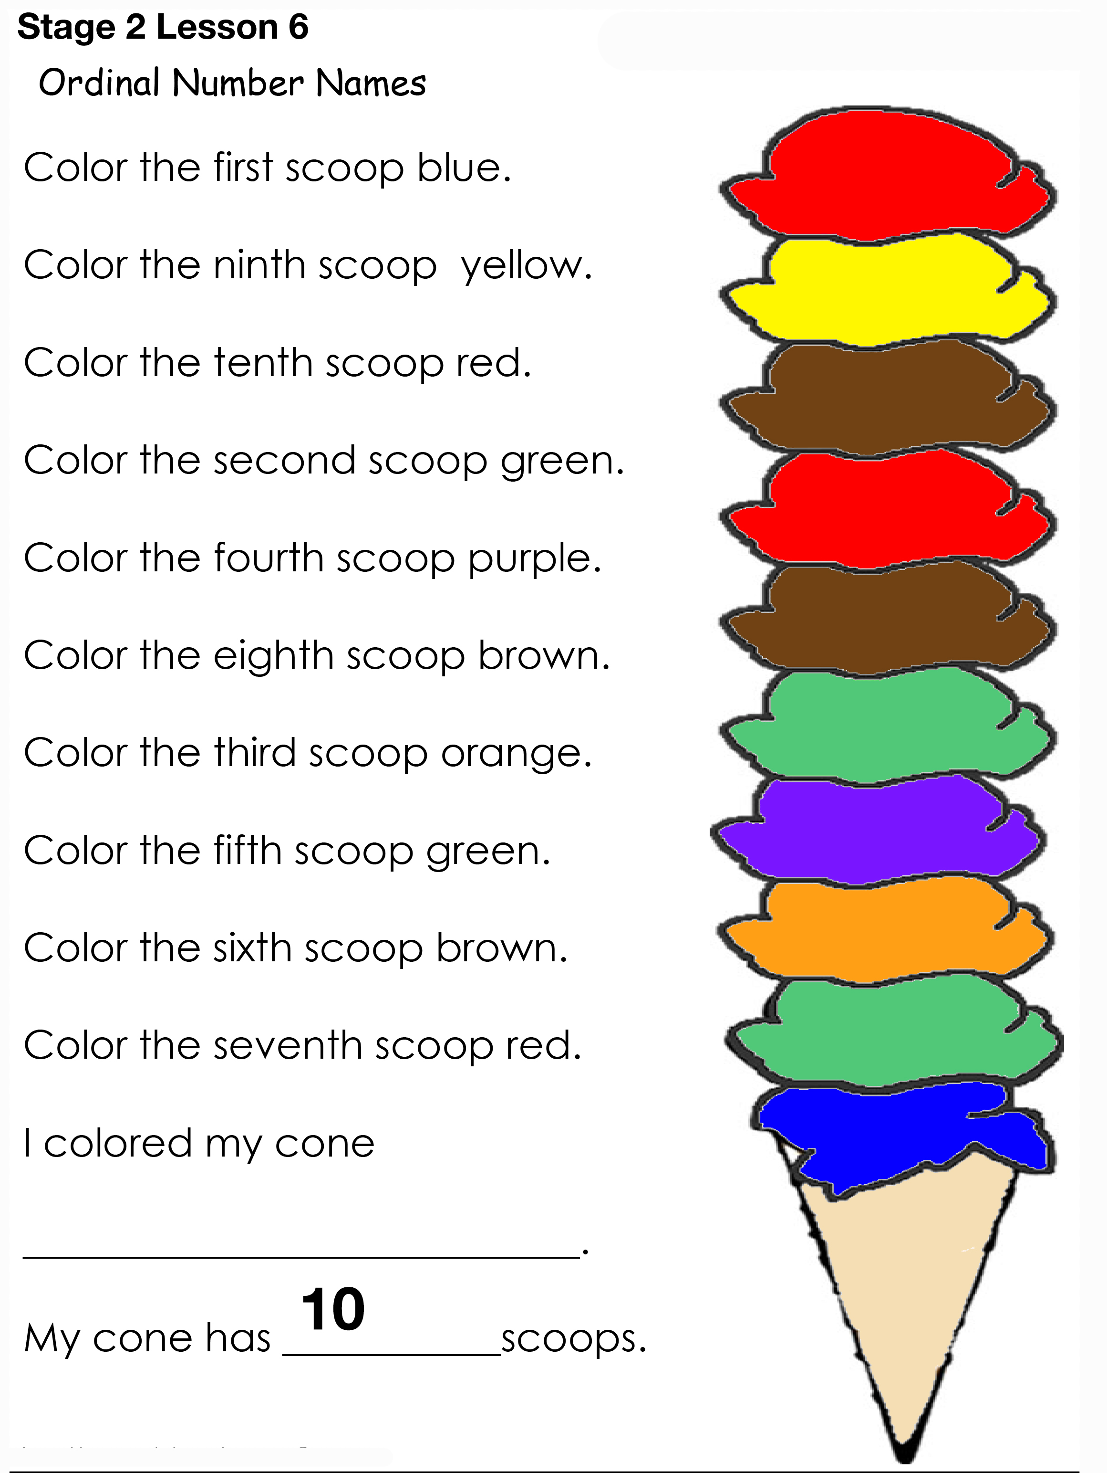
Ice cream homework

Slide 4
The TR sound

Slide 5
Using “tr”

Slide 6
Using “tr”

Slide 7
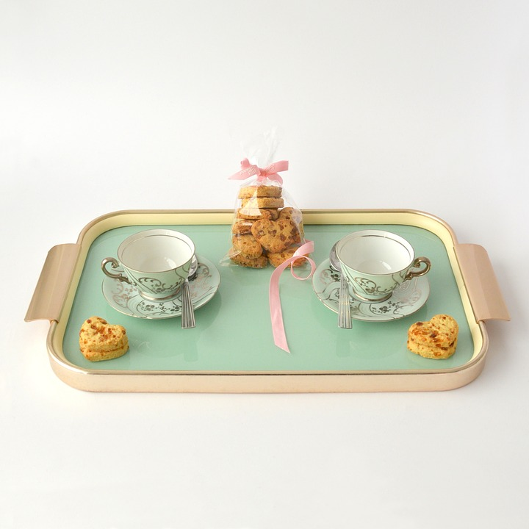
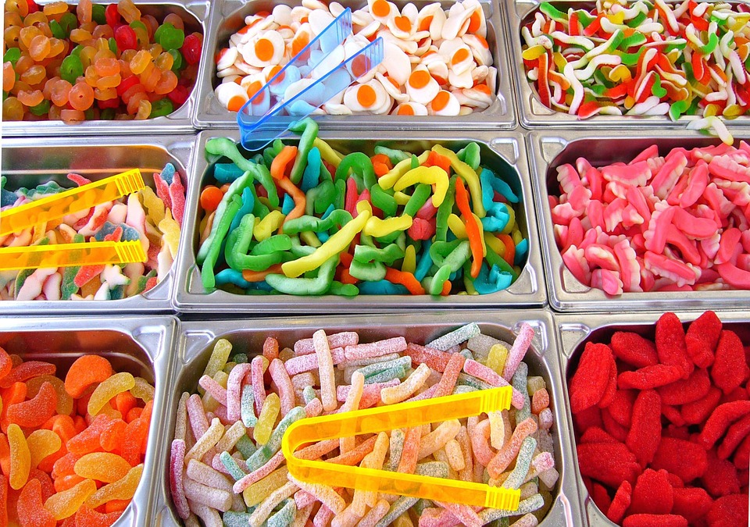
Some other “tr” words
trip
tray
track
treat

Slide 8
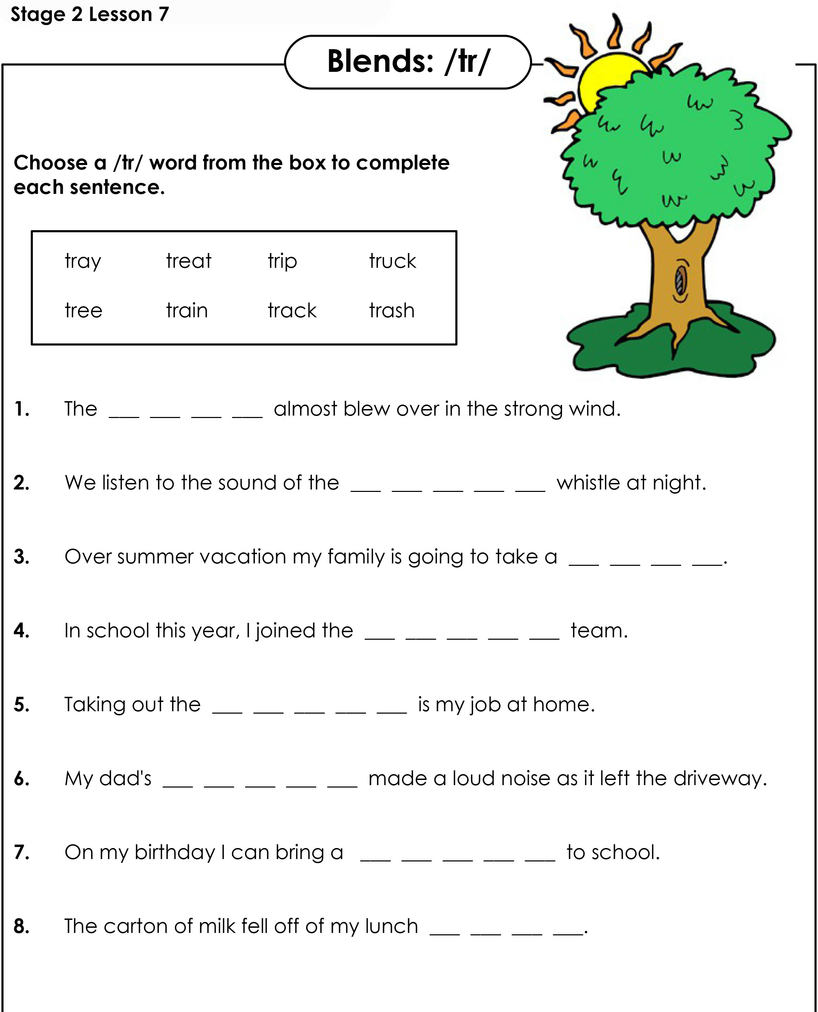
“tr” Worksheet

Slide 9
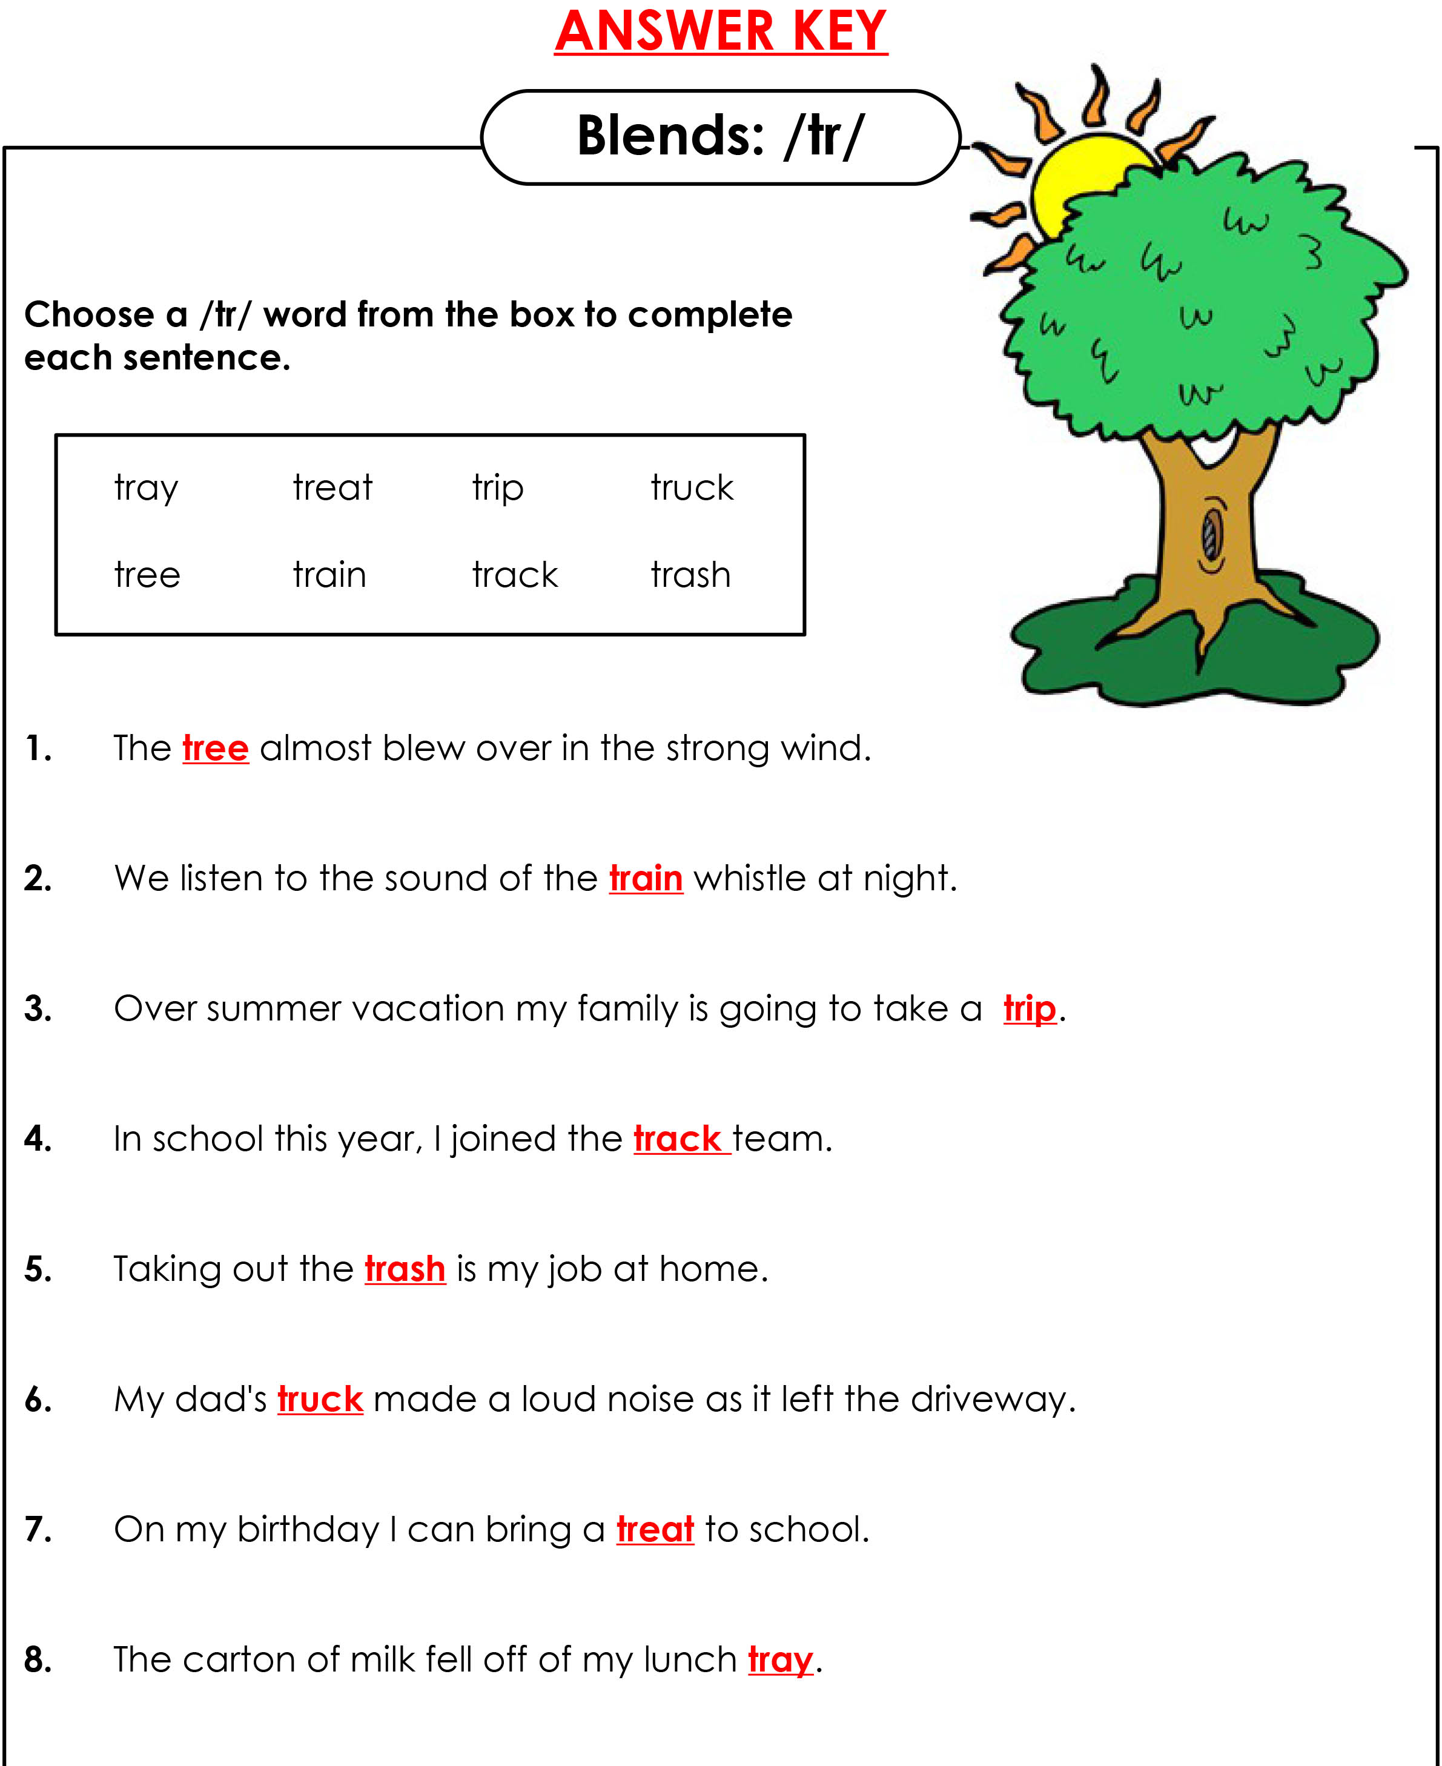
Answers

Slide 10
How many?

Slide 11
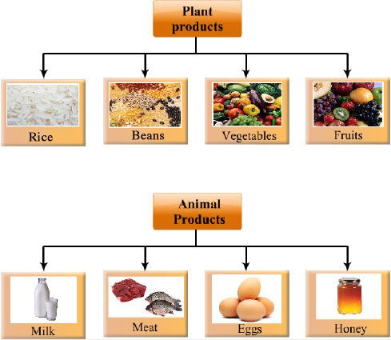
Plant and animals

Slide 12
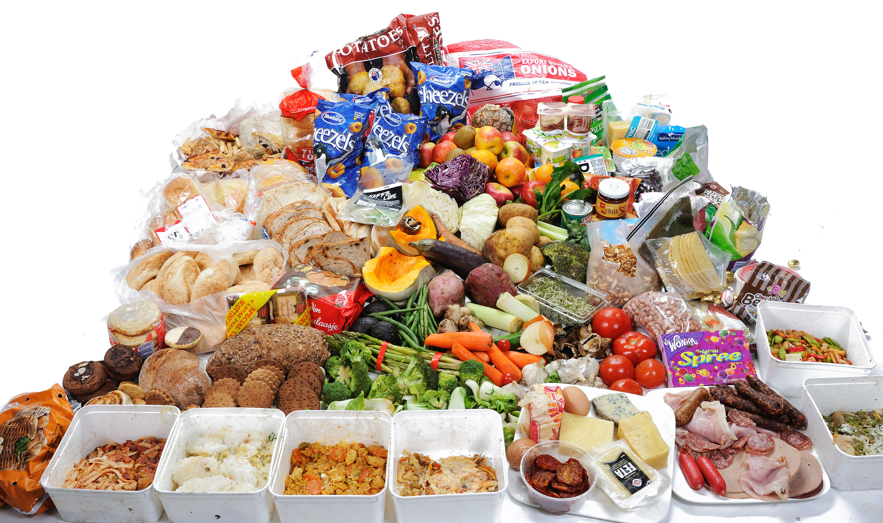
Plant or animal?

Slide 13
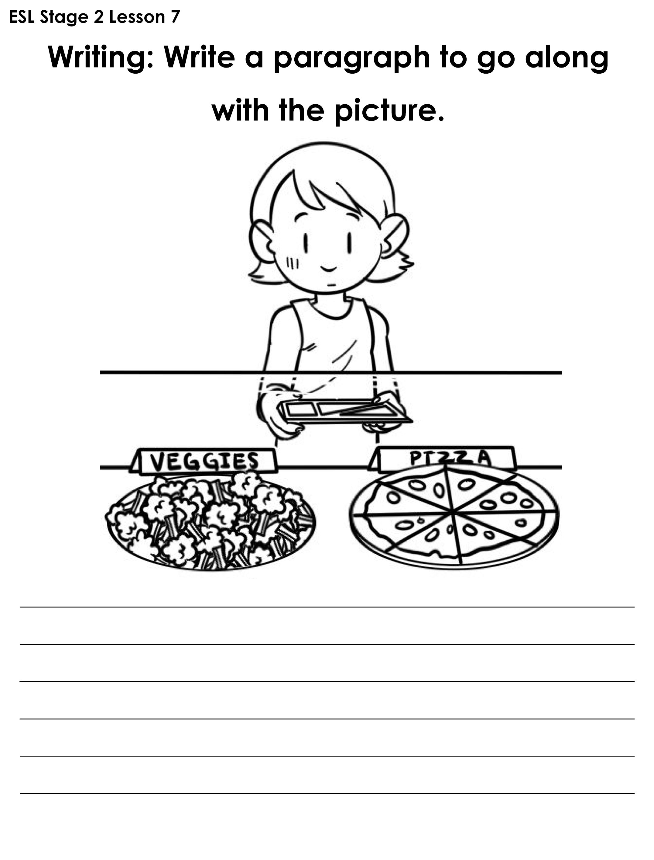
What’s for lunch?

Slide 14
And, but, or, because
I like milk ___ I don't like tea. and but or because
2. I can eat peanuts ___ I can eat almonds. and but or because

Slide 15
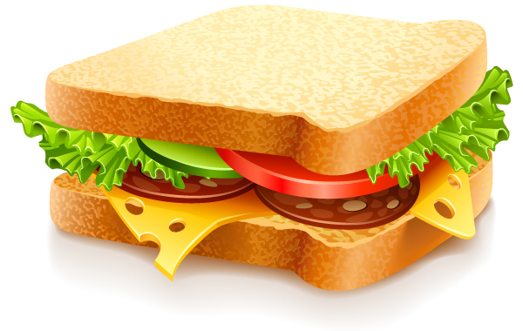
Mine and yours
Possessive pronouns are used in English to avoid repeating information that is already clear.
Subject: I = mine
you = yours
This sandwich is my lunch, not your lunch. This sandwich is mine, not yours.

Slide 16
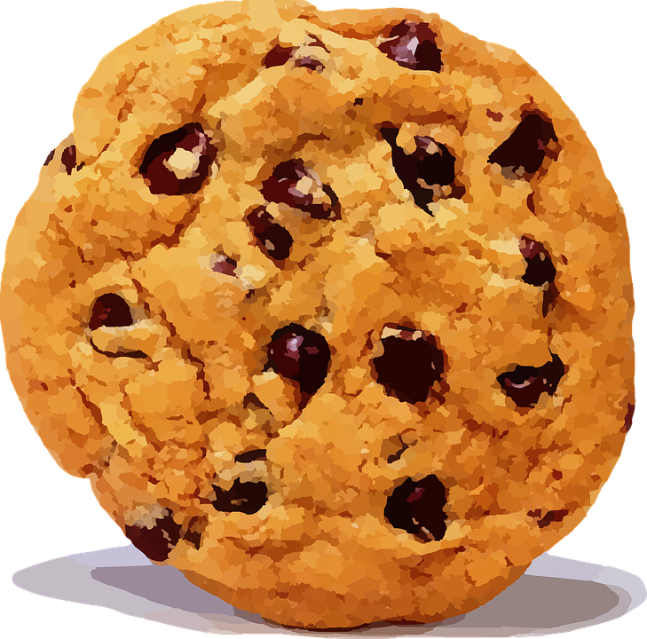
Let’s practice
(you) This drink is _____________.
(you) The cookie is _____________.
(I) That lunch bag isn't _____________. My lunch bag is at home.
(I) It's not _____________. We don't have a car.
(you) That snack is _____________.

Slide 17
Story Time

Slide 19
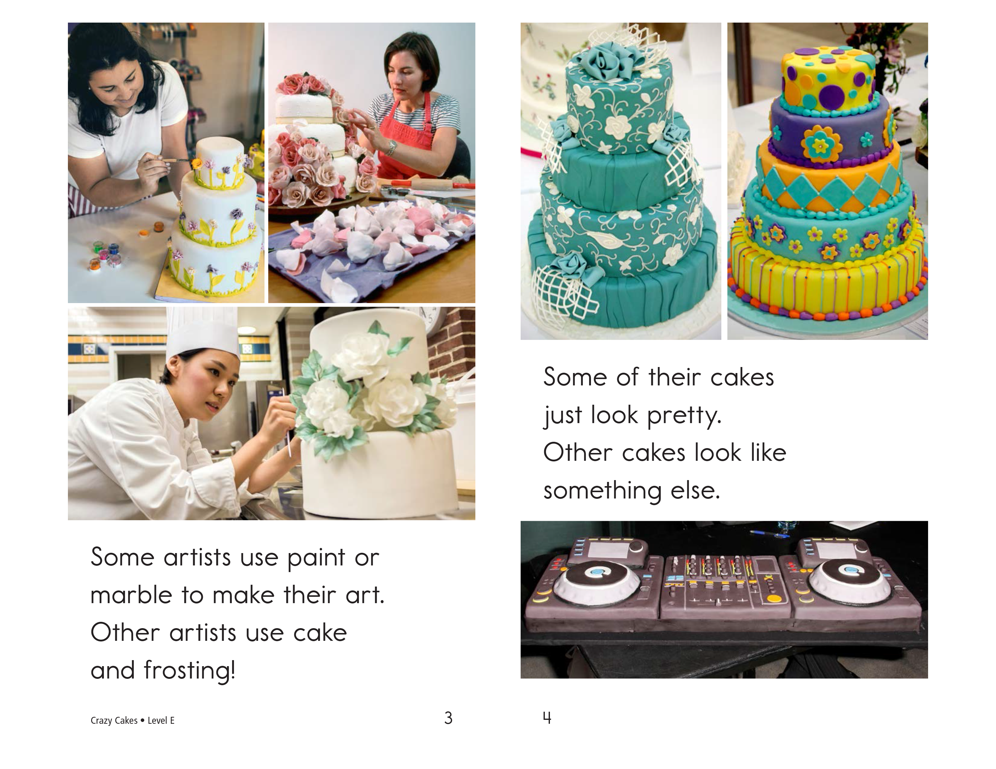

Slide 20
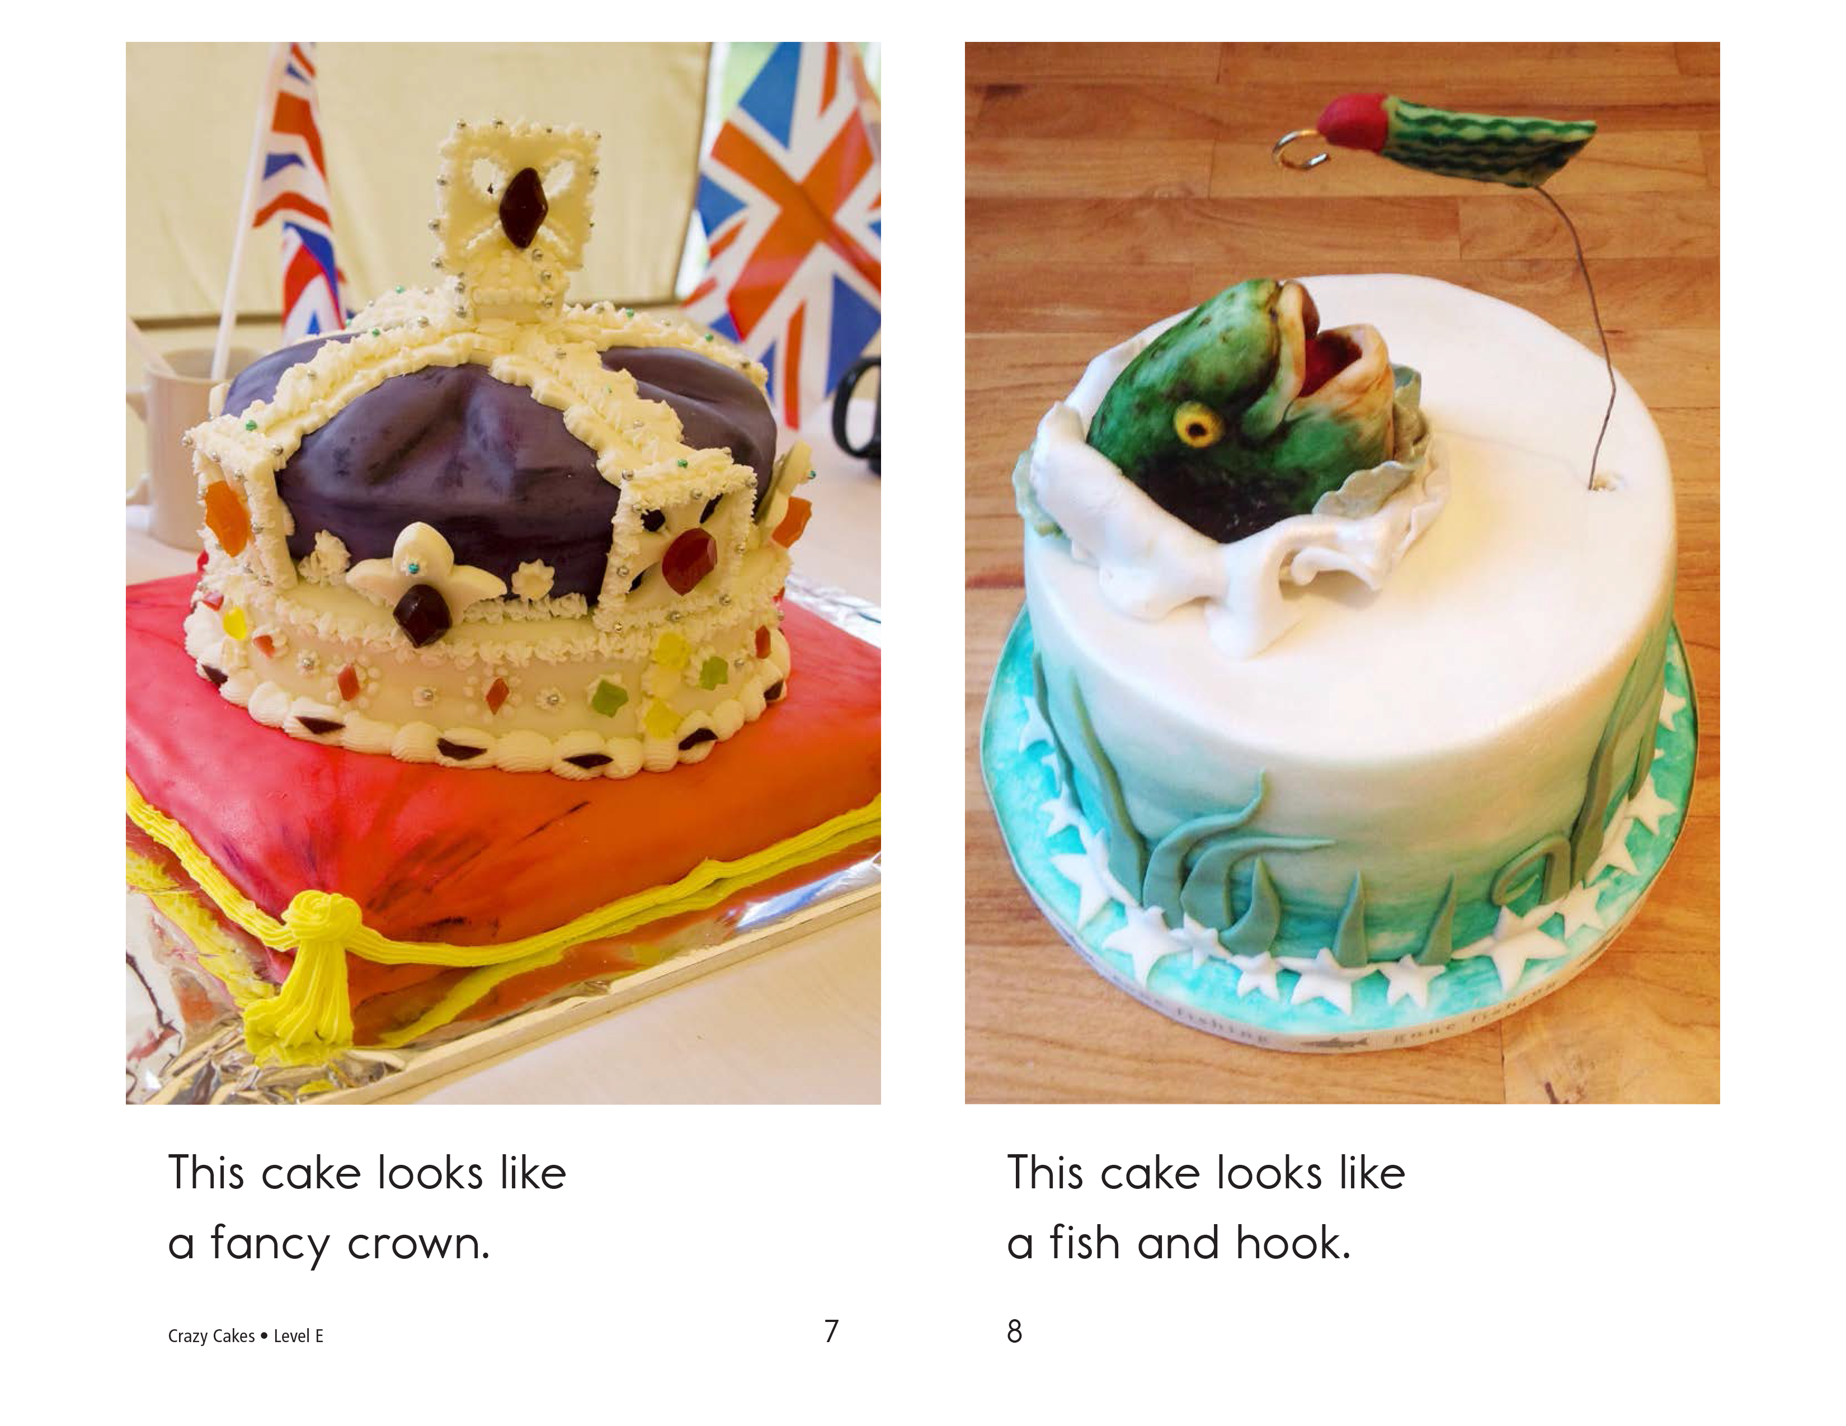

Slide 23
Design!

Slide 24
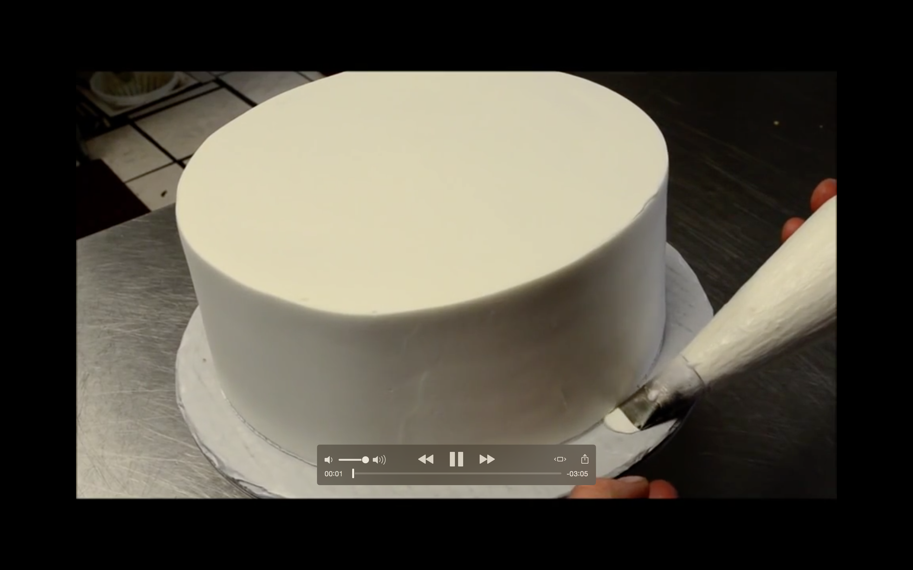
Wedding Cake Decorating

Slide 25
Homework
Write a paragraph that uses all of your new “tr” words. Make it funny! They are:
truck
tree
train
trumpet
trash
trunk

Slide 26
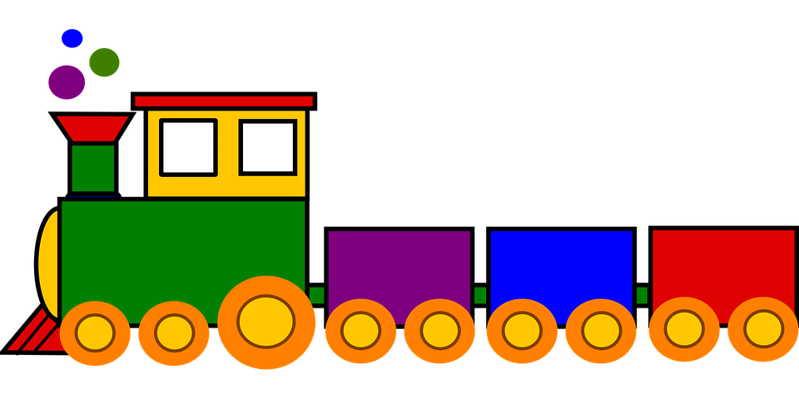
An example
I had a trumpet in the trunk of my truck. I left my keys in the trash. I was going to be late for my date with my girlfriend, the tree, so I took the train. She missed my trumpet playing.

Slide 27
What did I learn today?
New ‘tr’ words
Plant and animal foods
How to read a story
Writing a paragraph

