Slide 1


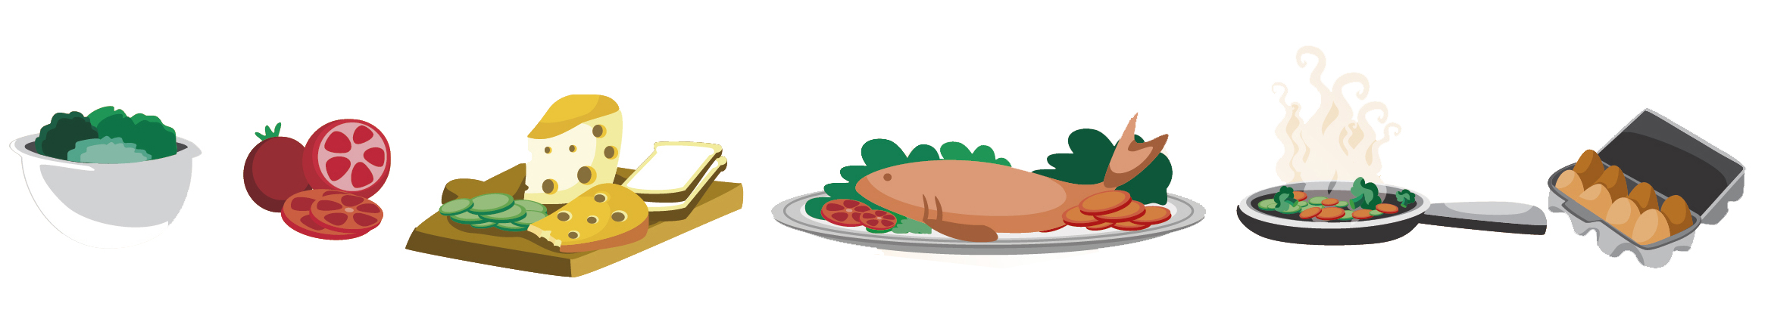
Lesson 7
FOOD

Slide 2

What we will learn today
Saying the ‘tr’ sound
Plant and animals foods
Reading a story about cake
Writing a paragrpah
Notes:
Go over the learning goals.

Slide 3
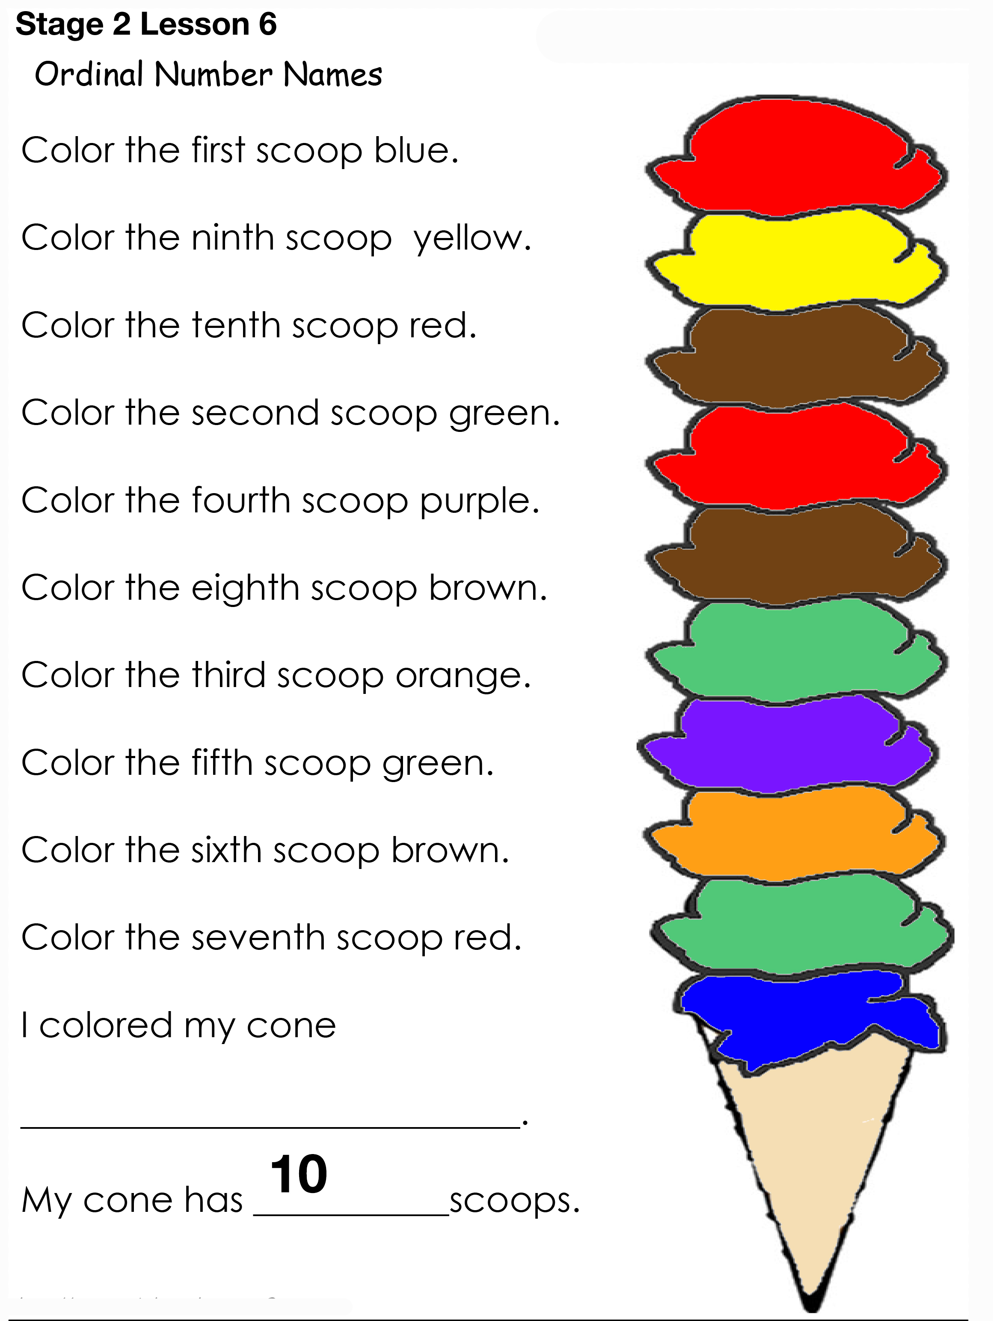
Ice cream homework
Notes:
Go over each colour for the ice cream scoops. Ask students to show their hand coloured pages on video.

Slide 4


The TR sound
Notes:
Tell students to pronounce the “tr” sound put your tongue against the roof of your mouth and blow a little air through your mouth. Demonstrate this to the students and have them practice.

Slide 5
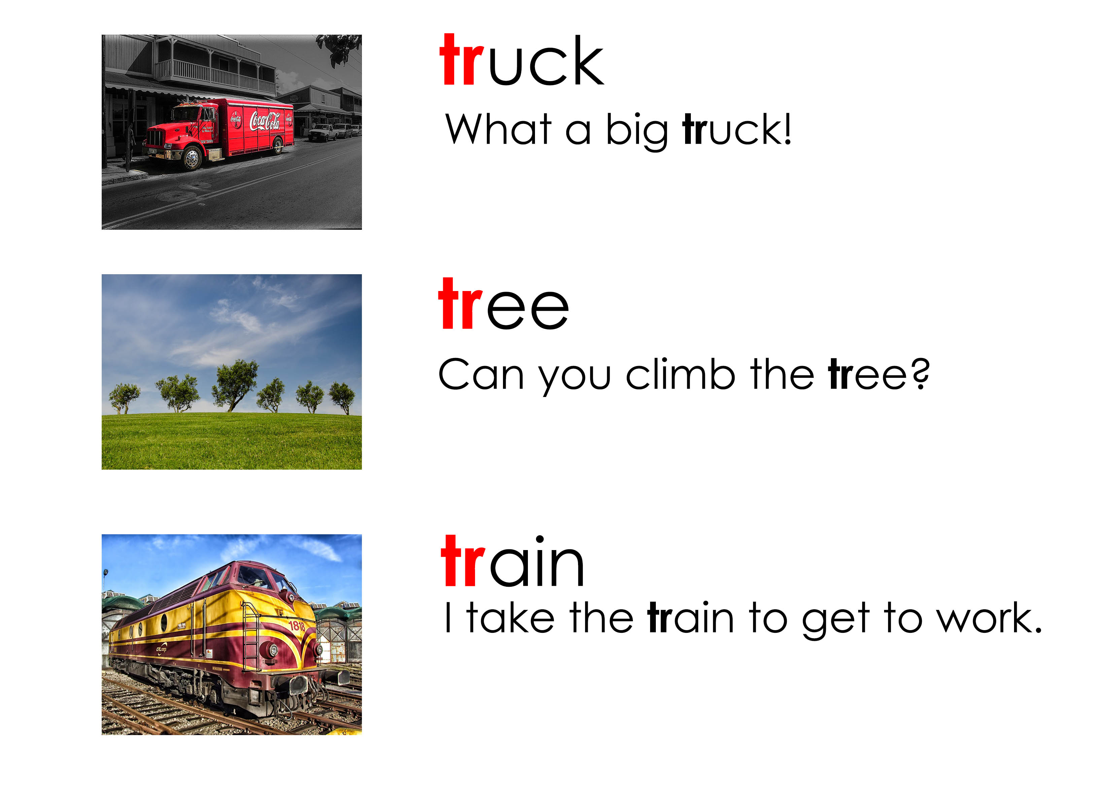
Using “tr”
Notes:
Say each word, articulating it clearly. Then say it again, pointing to each syllable, emphasizing the main stress on the polysyllabic words. Say the word again, in a more natural way. Instruct the students to repeat the word, chorally and then individually.

Slide 6
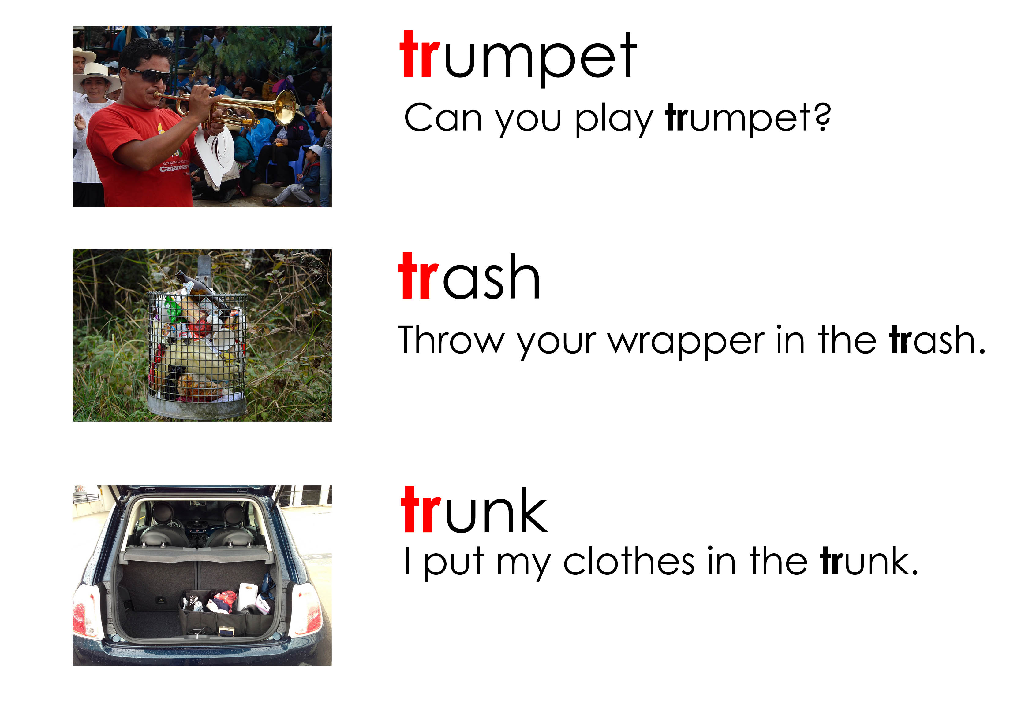
Using “tr”
Notes:
Say each word, articulating it clearly. Then say it again, pointing to each syllable, emphasizing the main stress on the polysyllabic words. Say the word again, in a more natural way. Instruct the students to repeat the word, chorally and then individually.

Slide 7

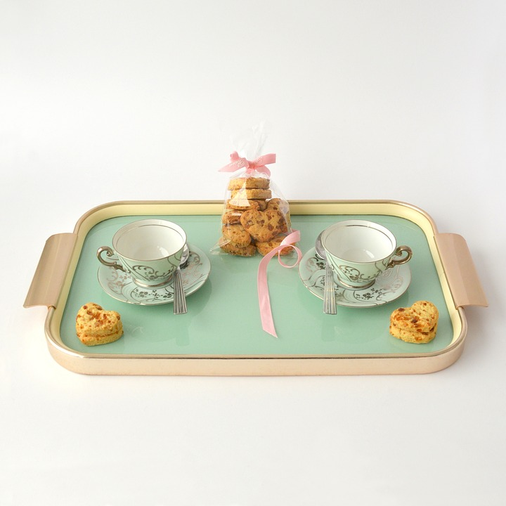

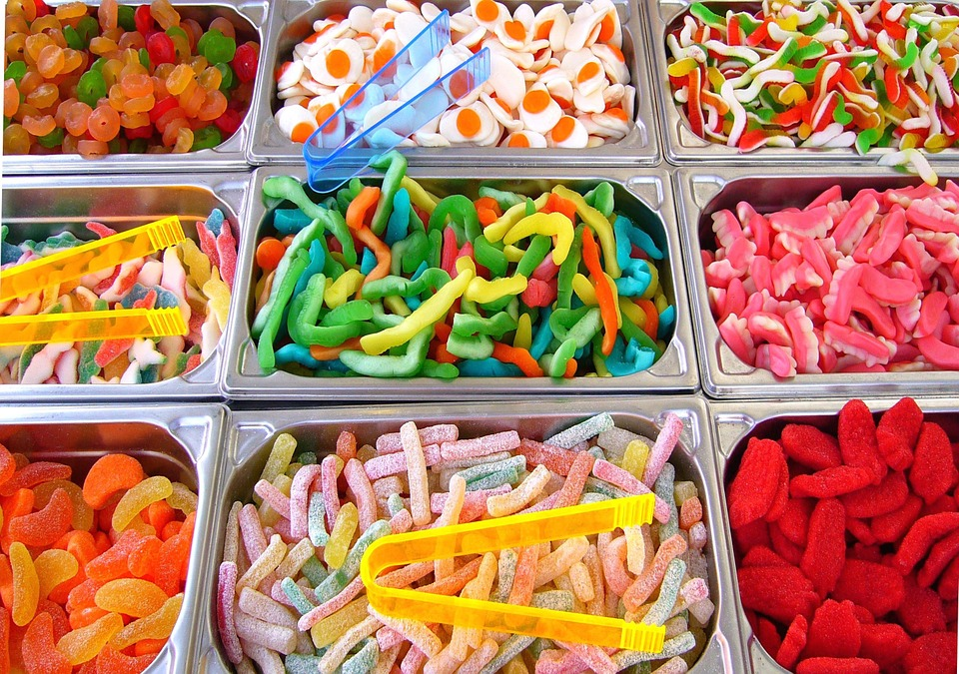
Some other “tr” words
trip
tray
track
treat
Notes:
Pre-teach this vocabulary for the following activity.

Slide 8
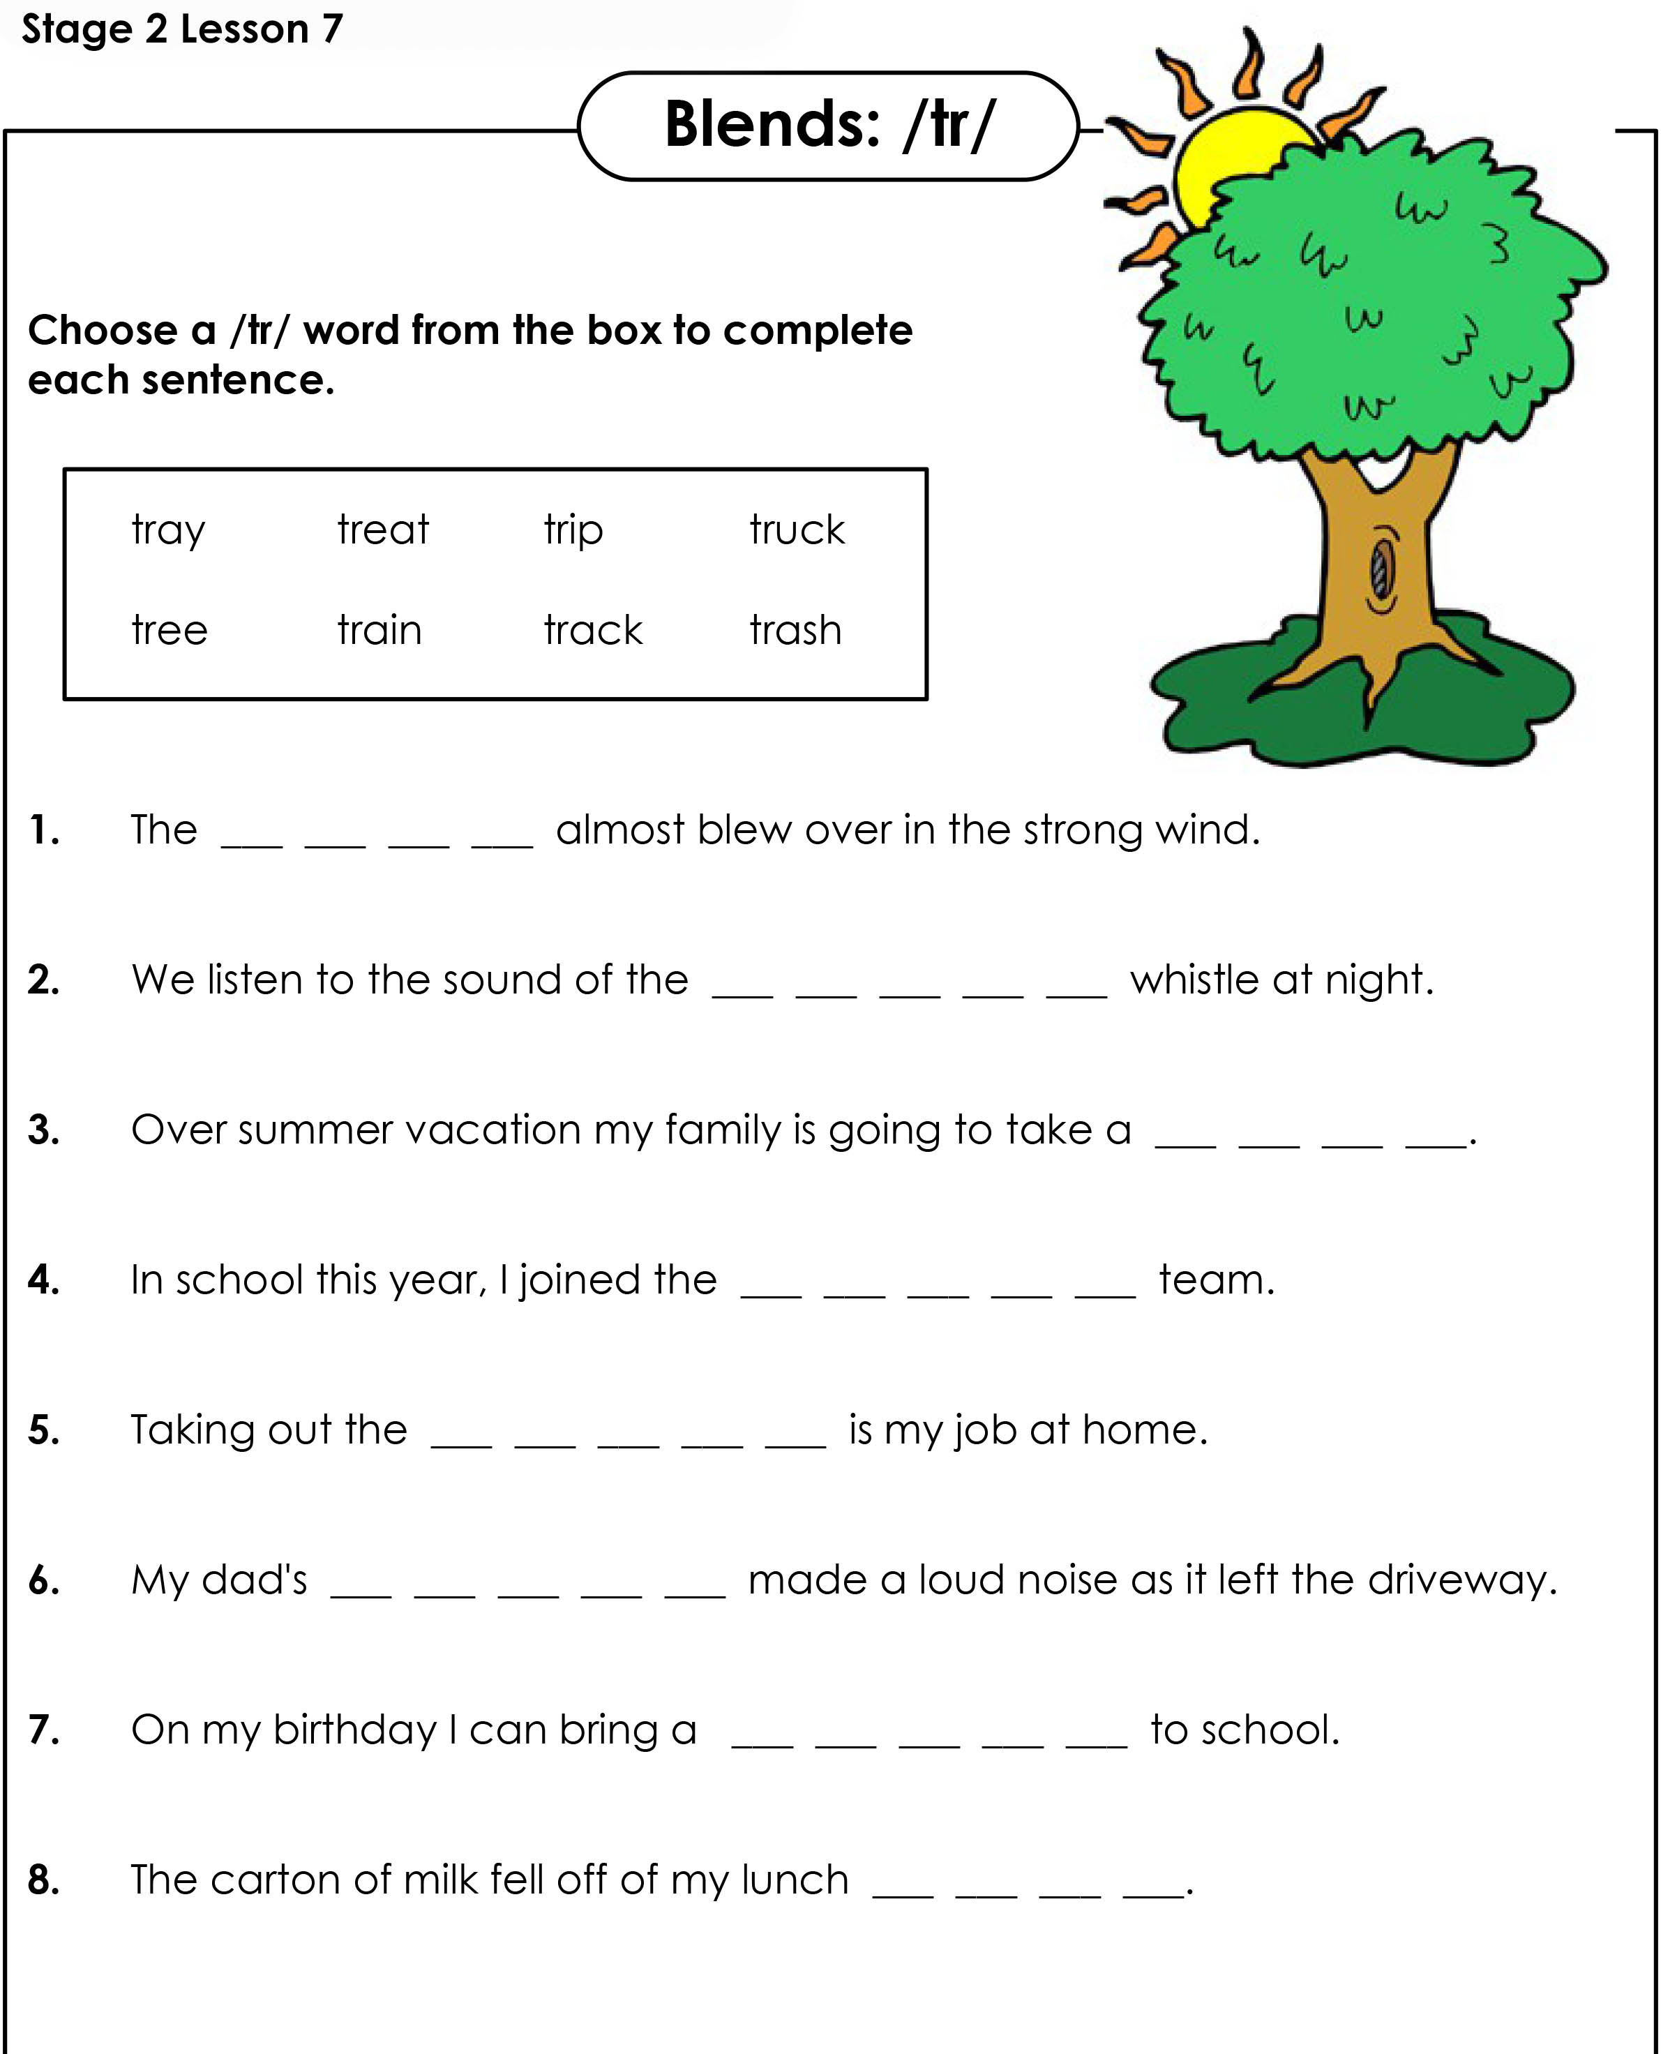
“tr” Worksheet
Notes:
Open “TR Worksheet.pdf”. Complete the activity.

Slide 9
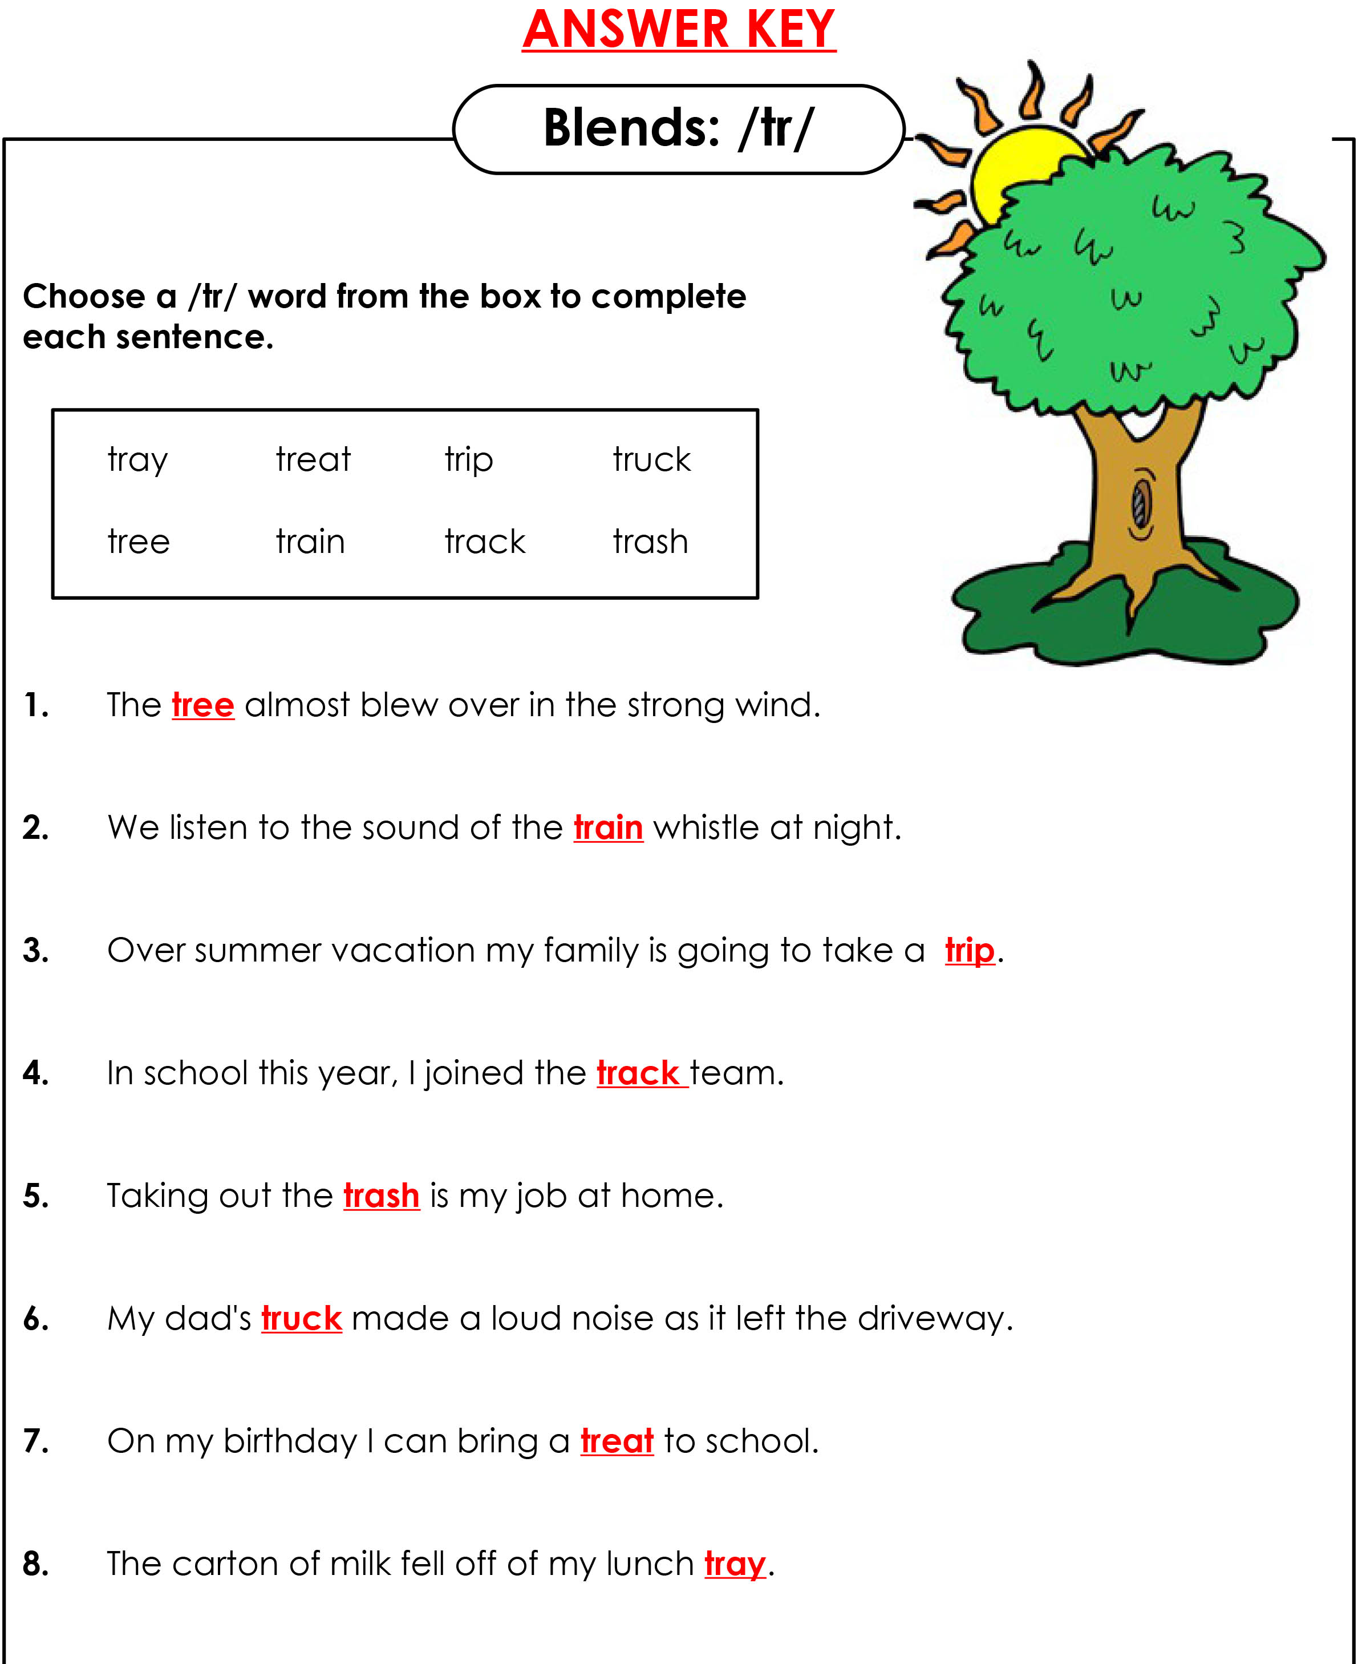
Answers
Notes:
Go over answers

Slide 10

How many?
Notes:
Ask students to count specific food.
Fries: 16
Burgers: 20

Slide 11
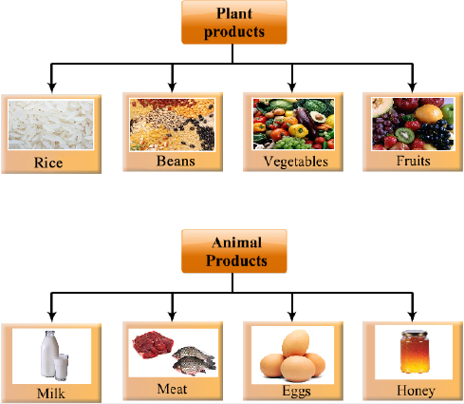
Plant and animals
Notes:
Explain the difference between plant and animal food products.

Slide 12
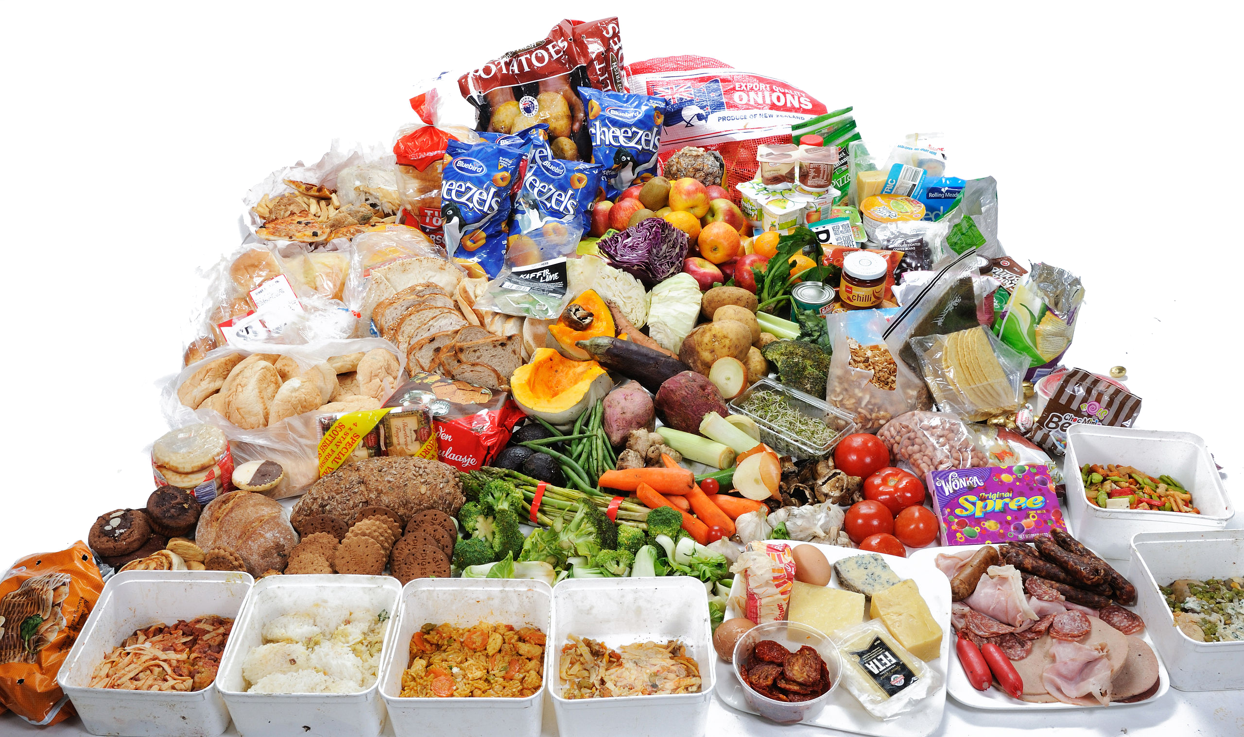
Plant or animal?
Notes:
Point to certain foods and ask if it’s plant or animal based. Or, have the students circle plant and/or animal food products.

Slide 13
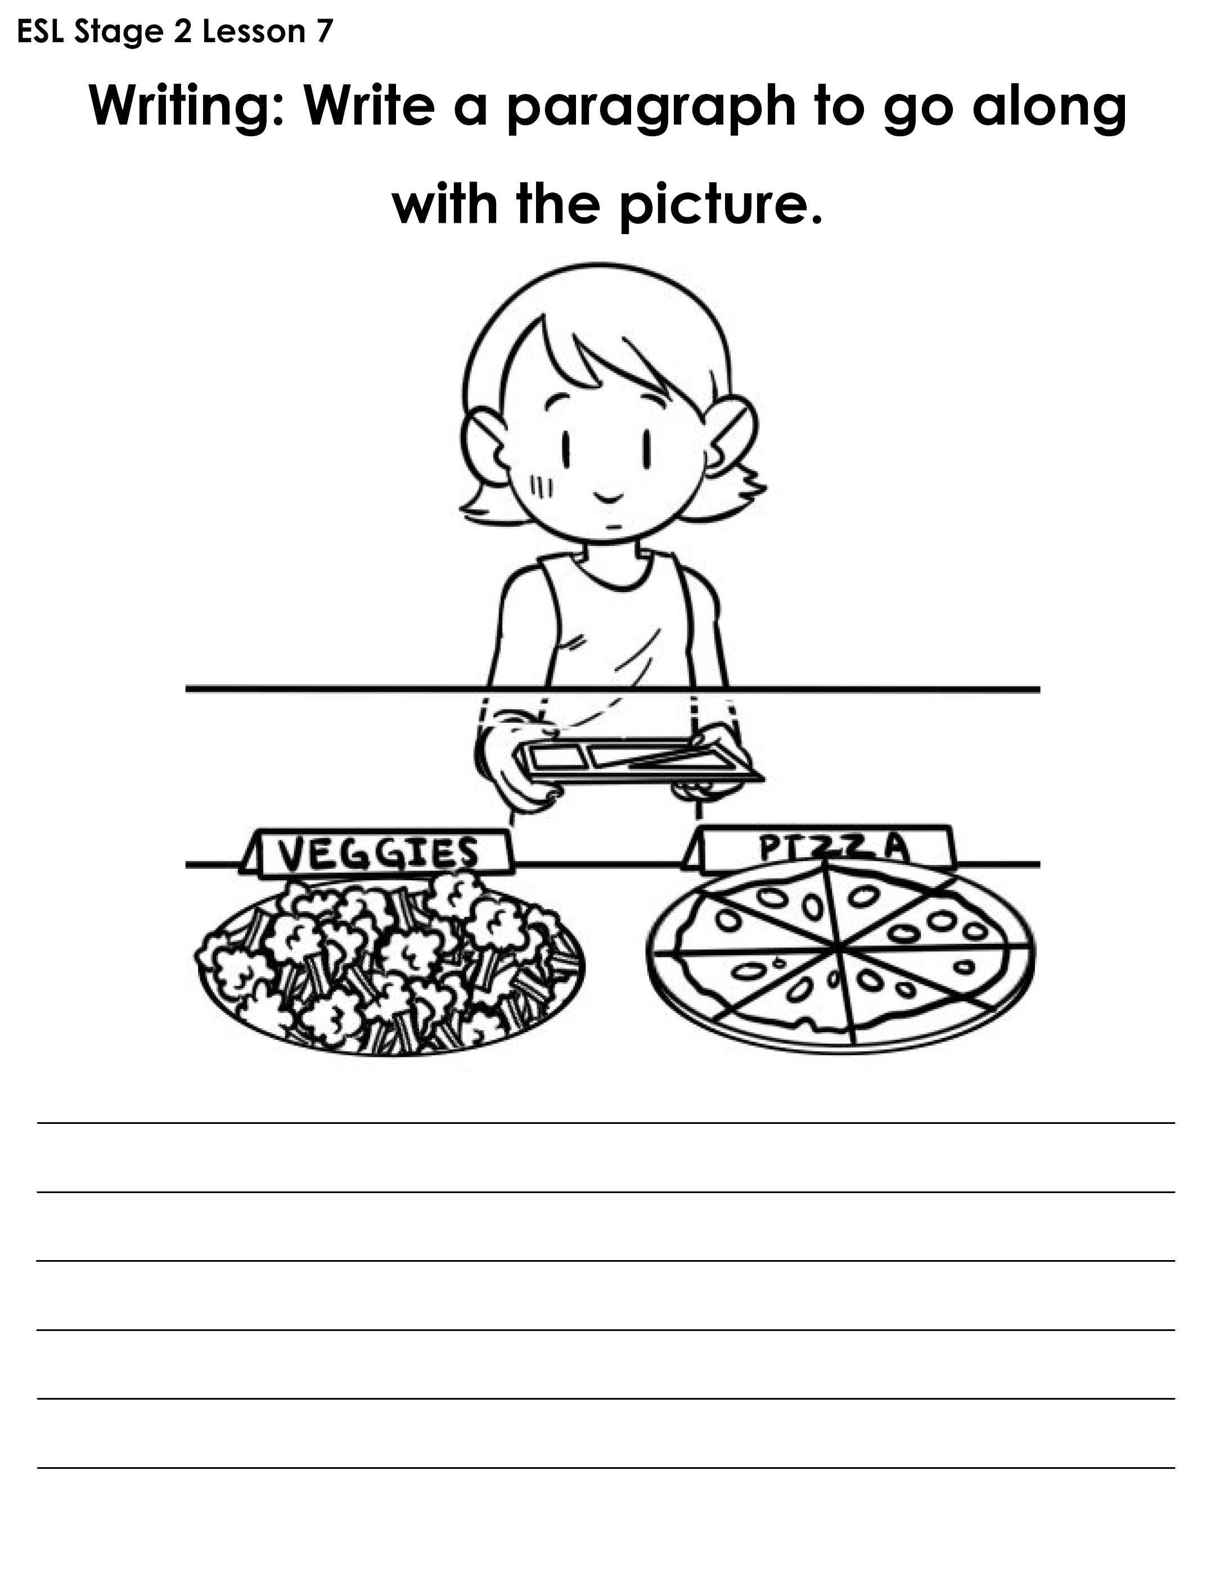
What’s for lunch?
Notes:
Write a paragraph together. Brainstorm ideas and then have one student give the first sentence, the next student adds on another idea with a second sentence, etc. The teacher should write teach sentence on the whiteboard. Make it funny!
Provide prompts, like, “Is the person going to decide to choose the healthy or unhealthy meal?”

Slide 14
And, but, or, because
I like milk ___ I don't like tea.
and
but
or
because
2. I can eat peanuts ___ I can eat almonds.
and
but
or
because
Notes:
Tell students to take out the “And, But, Or, Because Worksheet.pdf”. Do the first two examples together. Review when and why you use each conjunction.
1. but 2. and 3. because 4. or 5. and 6. or 7. because 8. but 9. because 10. and

Slide 15
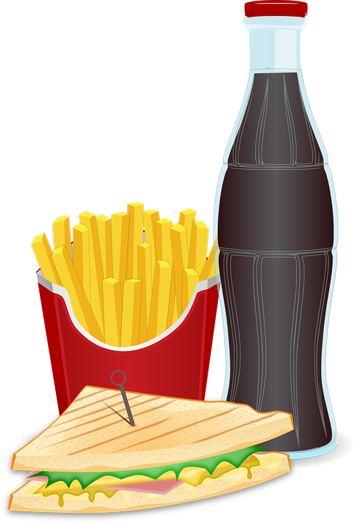
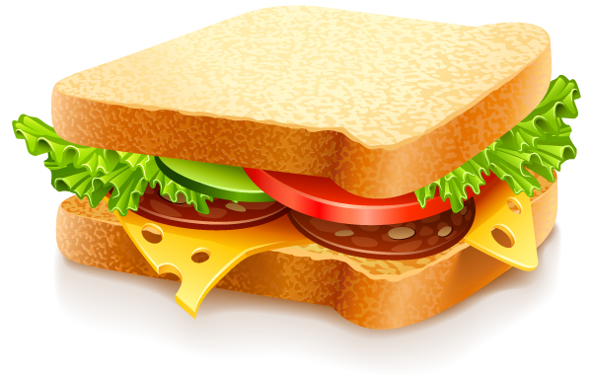

Mine and yours
Possessive pronouns are used in English to avoid repeating information that is already clear.
Subject: I = mine
you = yours
This sandwich is my lunch, not your lunch. This sandwich is mine, not yours.
Notes:
Explain slide.

Slide 16
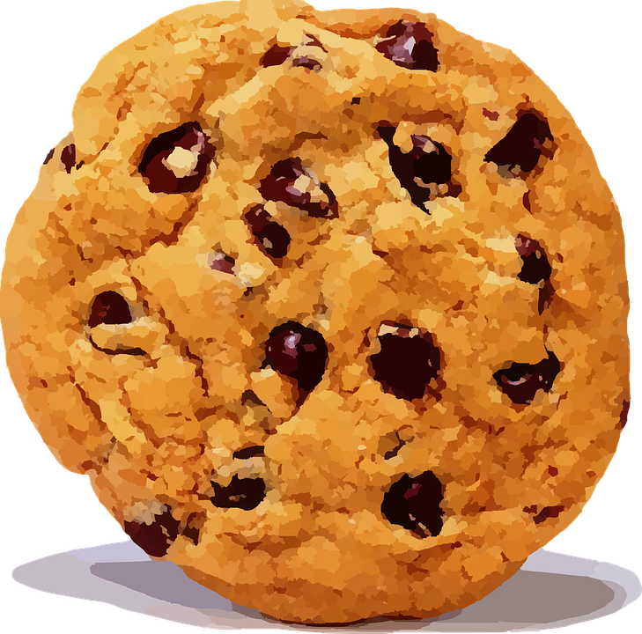
Let’s practice
(you) This drink is _____________.
(you) The cookie is _____________.
(I) That lunch bag isn't _____________. My lunch bag is at home.
(I) It's not _____________. We don't have a car.
(you) That snack is _____________.
Notes:
Alternate between each student. 1. yours 2. yours 3. mine. 4. mine. 5. your

Slide 17

Story Time
Notes:
Read each line and alternate between each student for an echo reading.

Slide 18
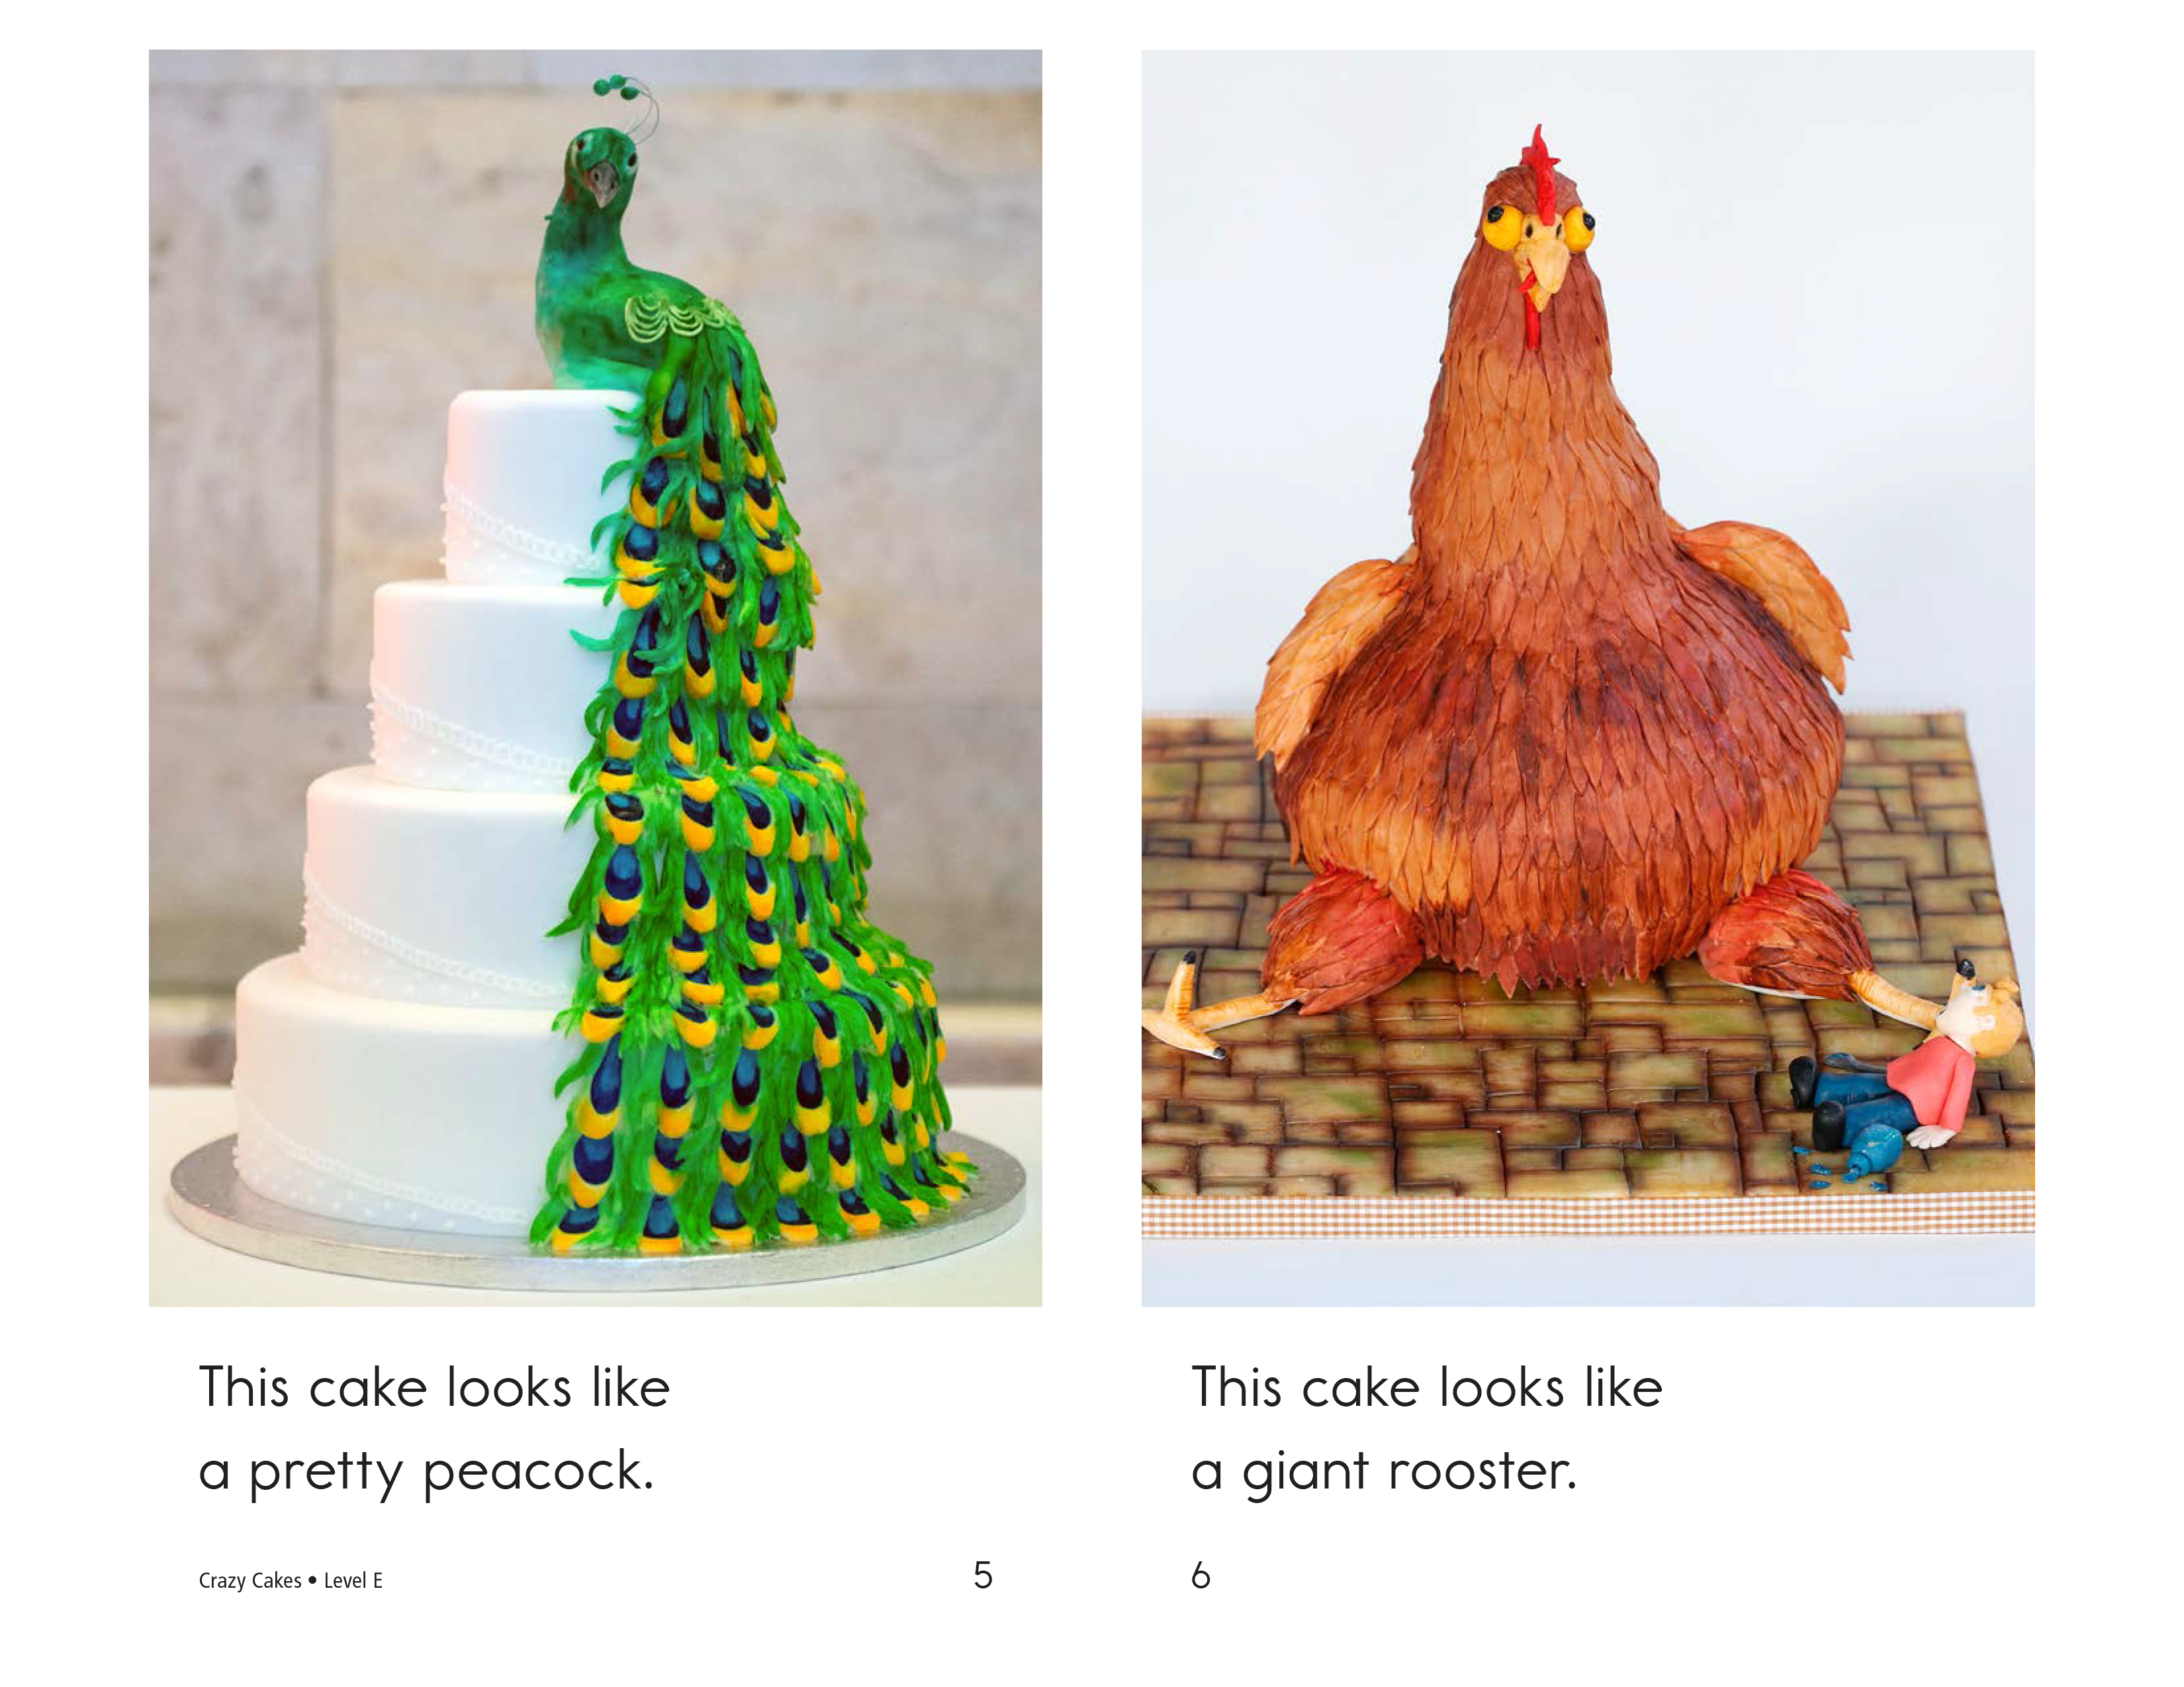
Notes:
Read each line and alternate between each student for an echo reading.

Slide 19
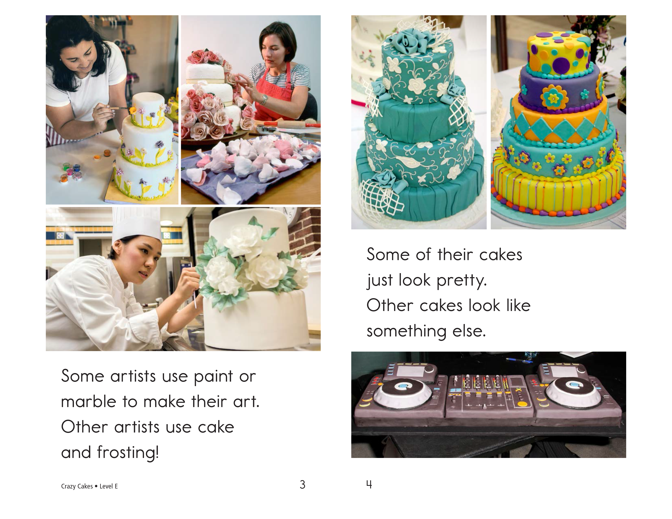
Notes:
Read each line and alternate between each student for an echo reading.

Slide 20
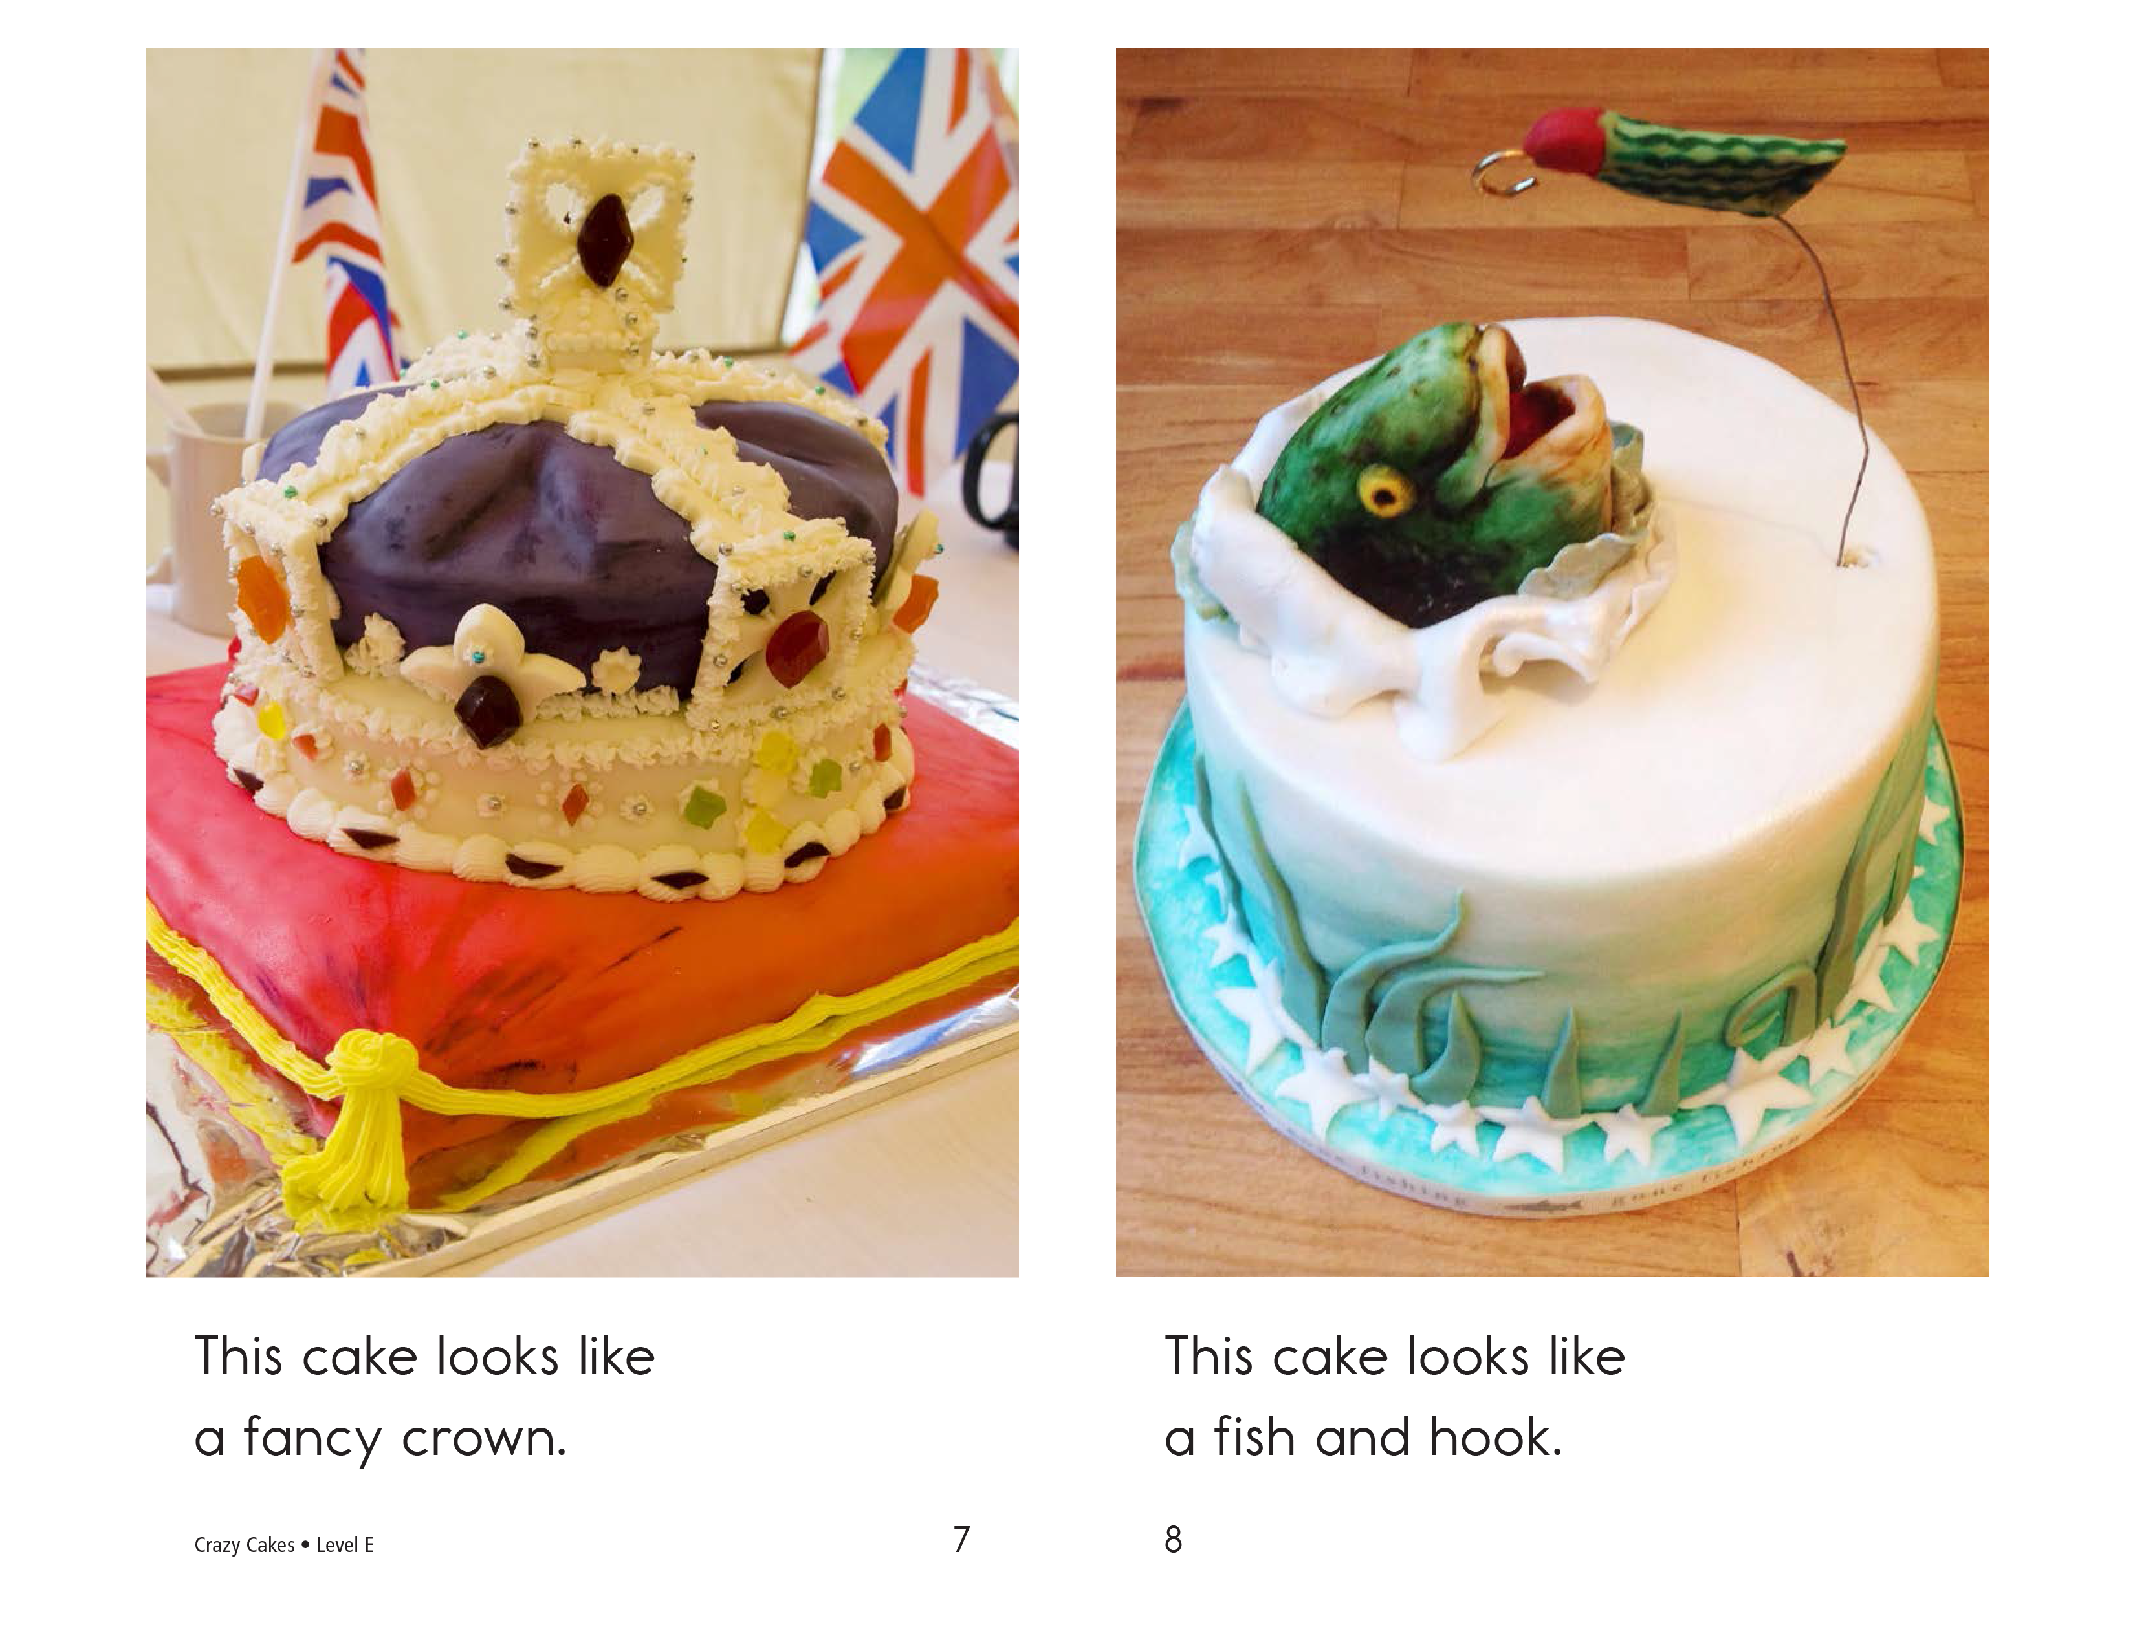
Notes:
Read each line and alternate between each student for an echo reading.

Slide 21
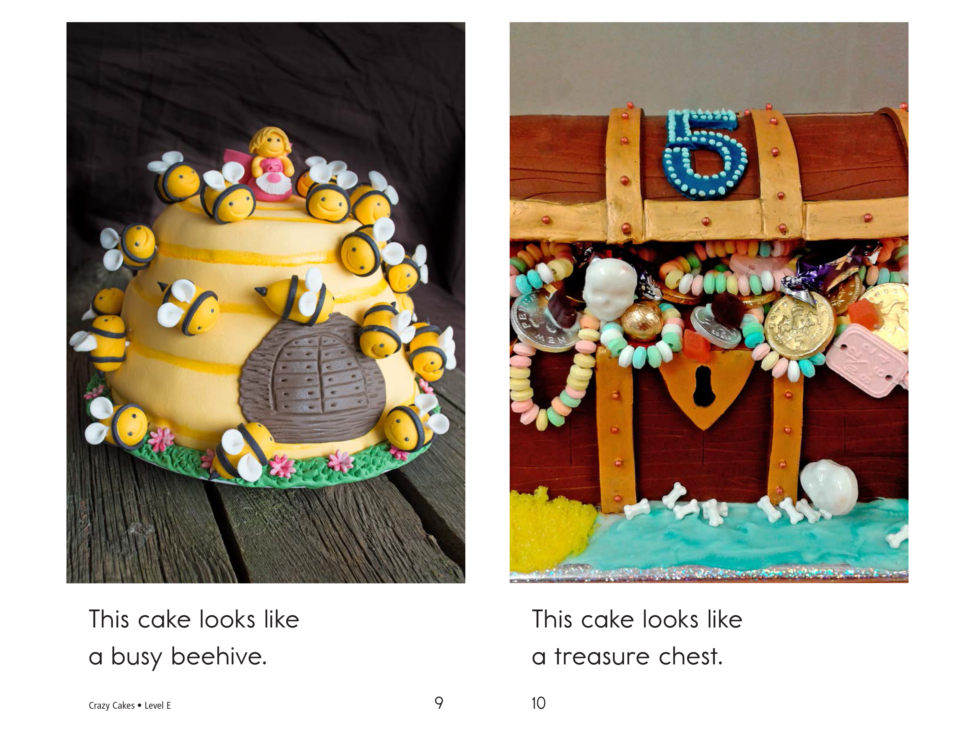
Notes:
Read each line and alternate between each student for an echo reading.

Slide 22
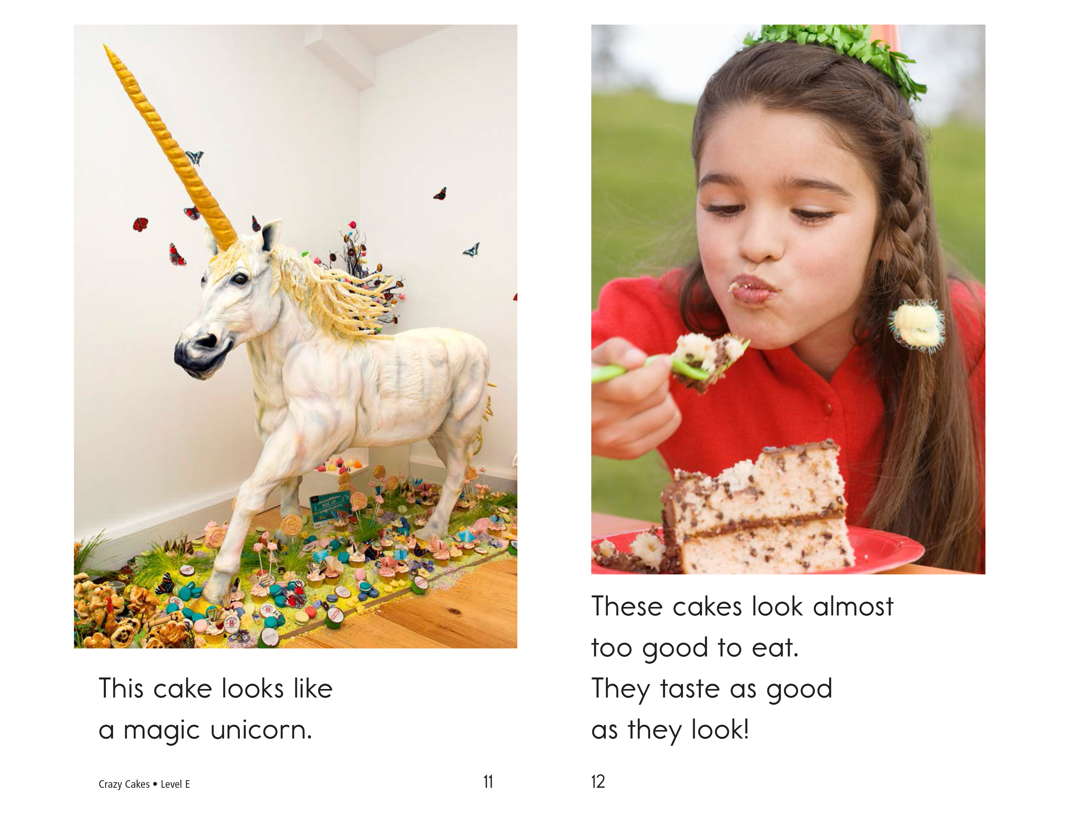
Notes:
Read each line and alternate between each student for an echo reading.

Slide 23

Design!
Notes:
Post the cake on the whiteboard. Get the students to add some decorations and/or colour to the cake. Brainstorm a theme, and work together deciding how the cake should look.
Get the students to add some decorations and/or colour to the cake.

Slide 24
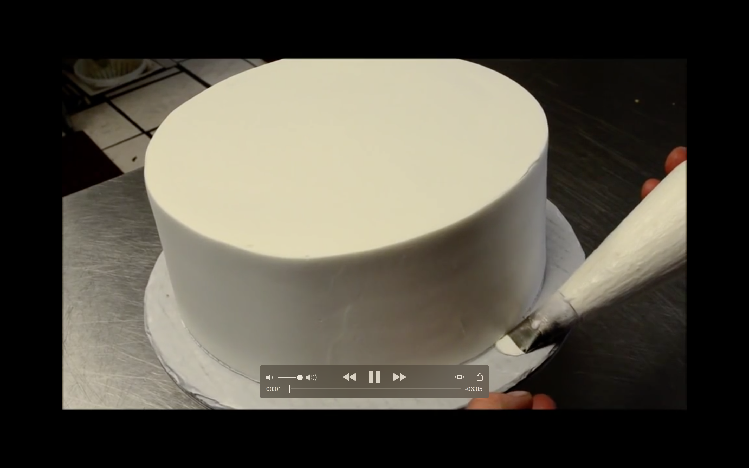
Wedding Cake Decorating
Notes:
Play this video “Wedding Cake Decorating.mp4” for the students.

Slide 25




Homework
Write a paragraph that uses all of your new “tr” words. Make it funny! They are:
truck
tree
train
trumpet
trash
trunk
Notes:
Explain slide and read example.

Slide 26


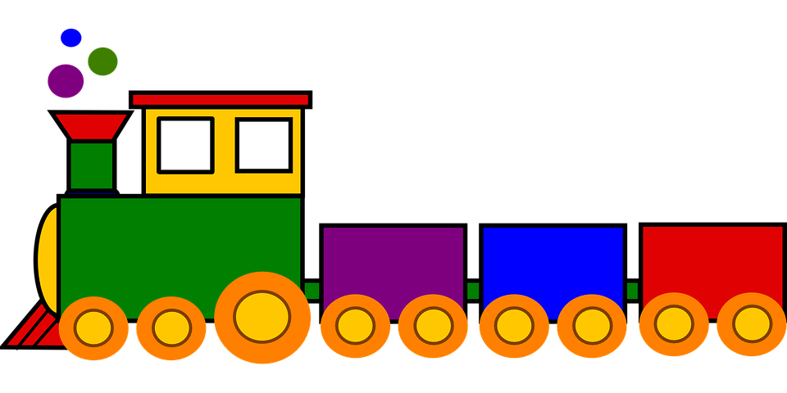
An example
I had a trumpet in the trunk of my truck. I left my keys in the trash. I was going to be late for my date with my girlfriend, the tree, so I took the train. She missed my trumpet playing.

Slide 27

What did I learn today?
New ‘tr’ words
Plant and animal foods
How to read a story
Writing a paragraph
Notes:
Review the lesson.

