Slide 1
Lesson 7: Tutoring FOOD

Slide 2
What we will learn today
Using tr words
Kitchen utensils
Reading a story
Word search
Notes:
Go over the learning goals.

Slide 3
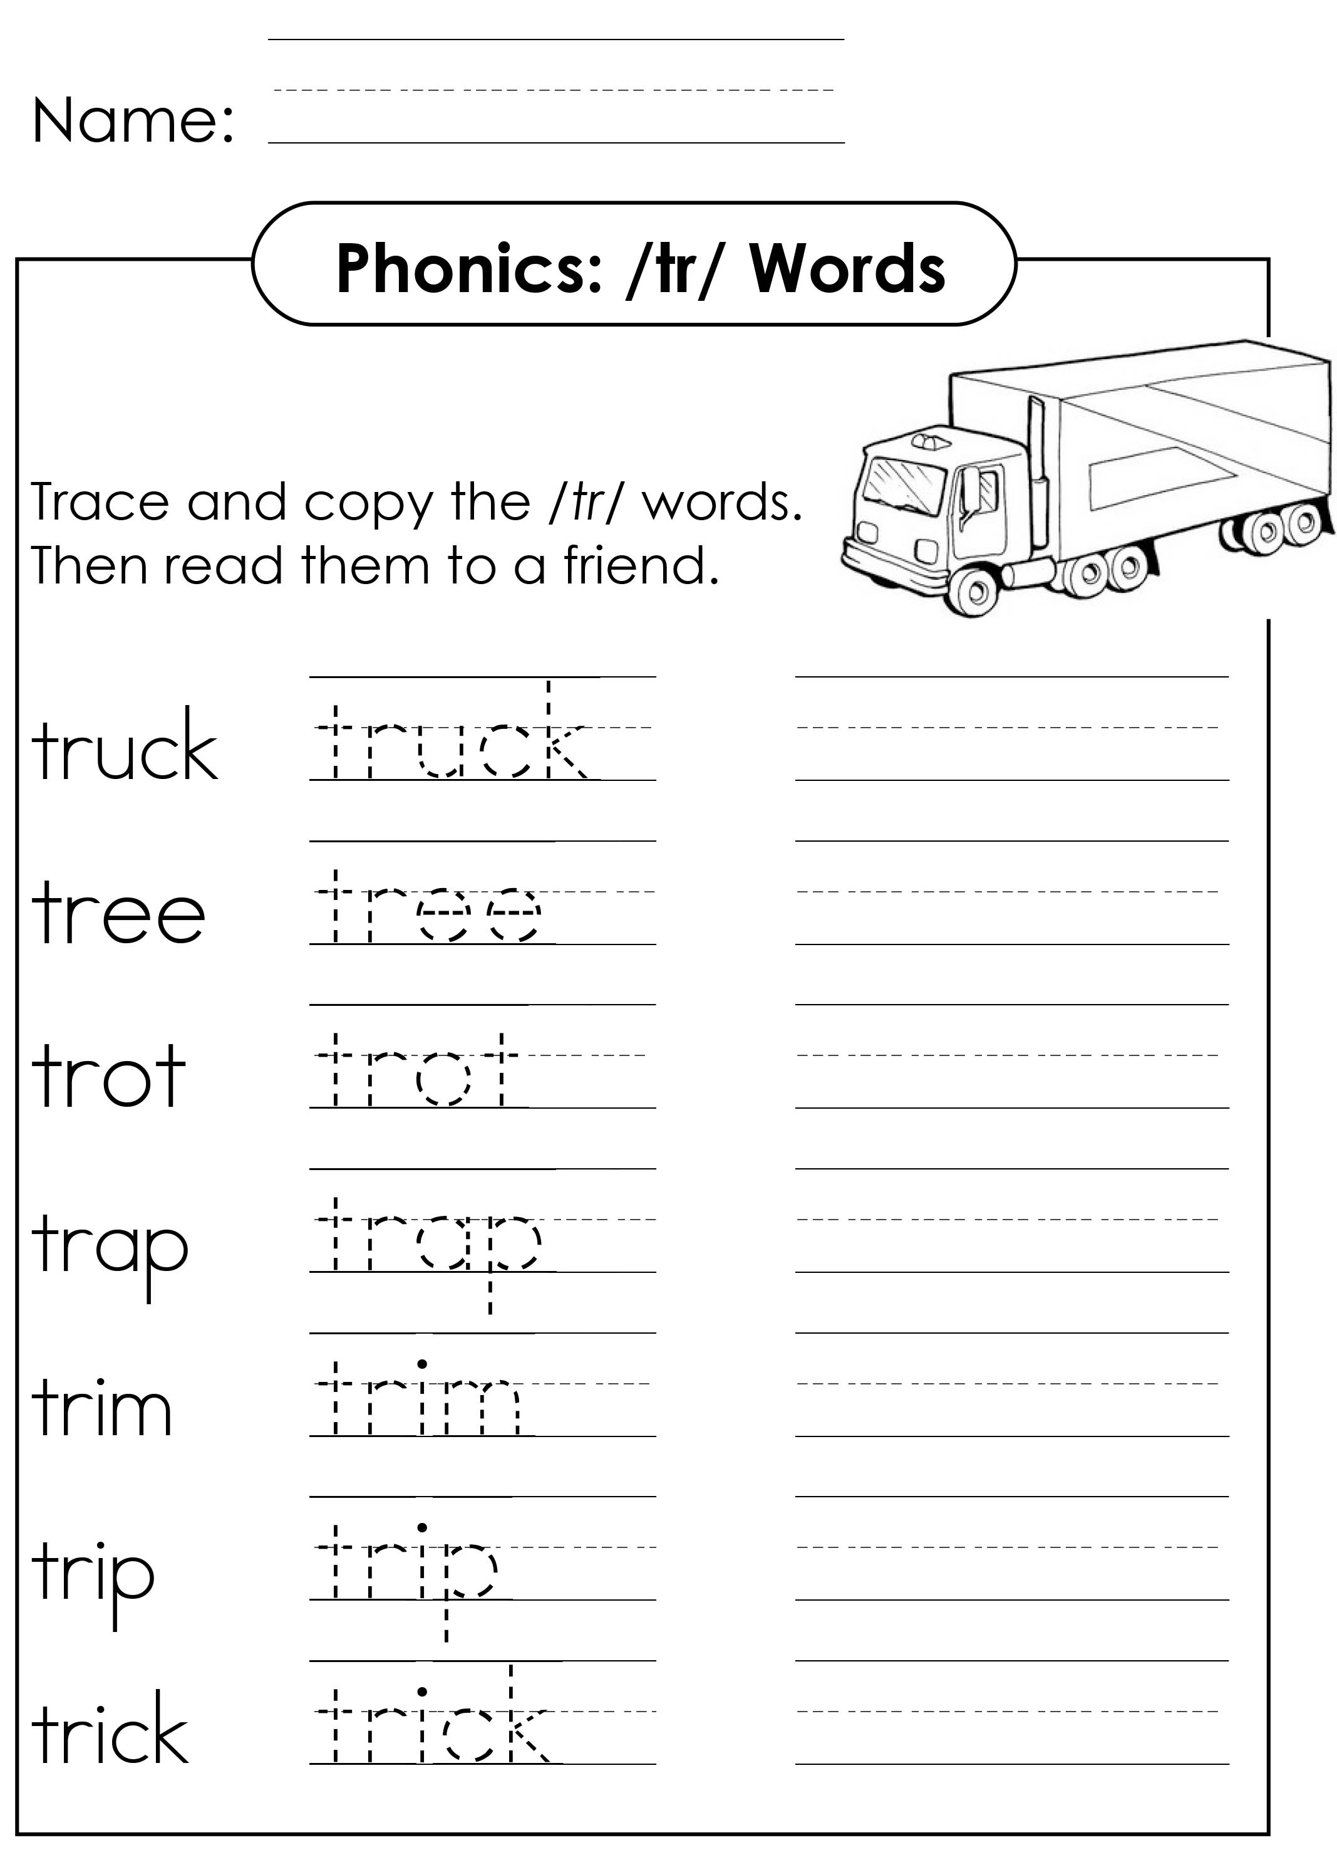
Trace and copy
Notes:
Download and print “Tutoring TR Words Copy Worksheet.pdf”. Teach new vocabulary to the students, and get them to write the word.

Slide 4
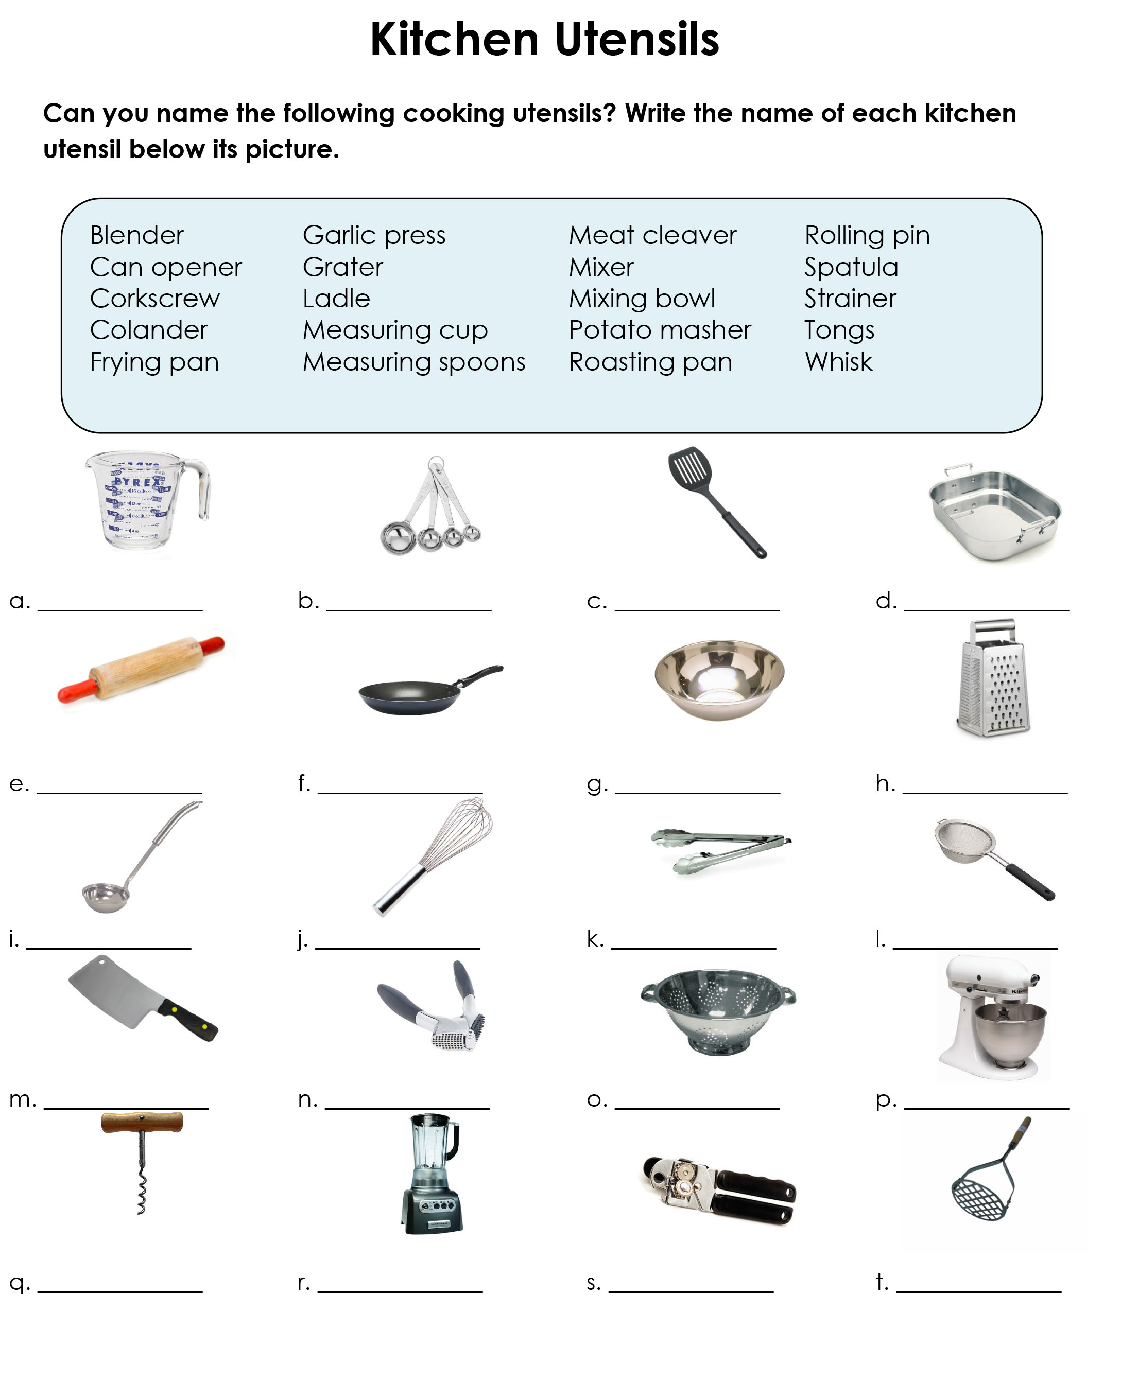
Utensils Worksheet Download “Tutoring Kitchen Utensils Workseet.pdf”

Slide 5
Utensils Worksheet Answers

Slide 6
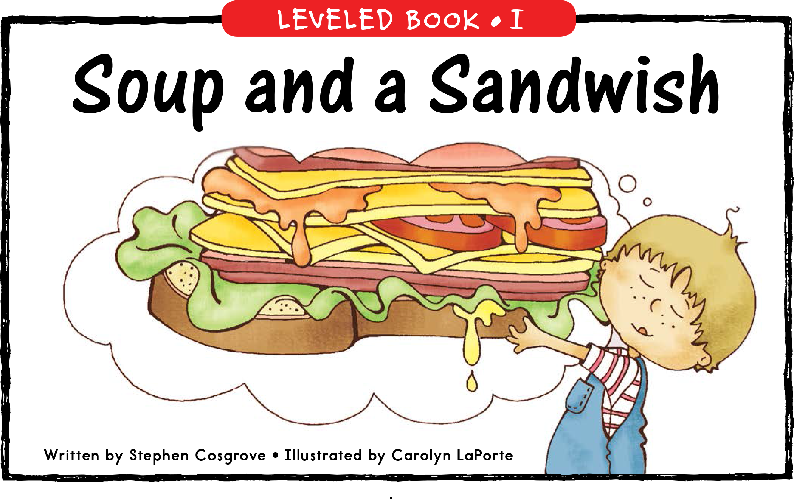
Story Time

Slide 7
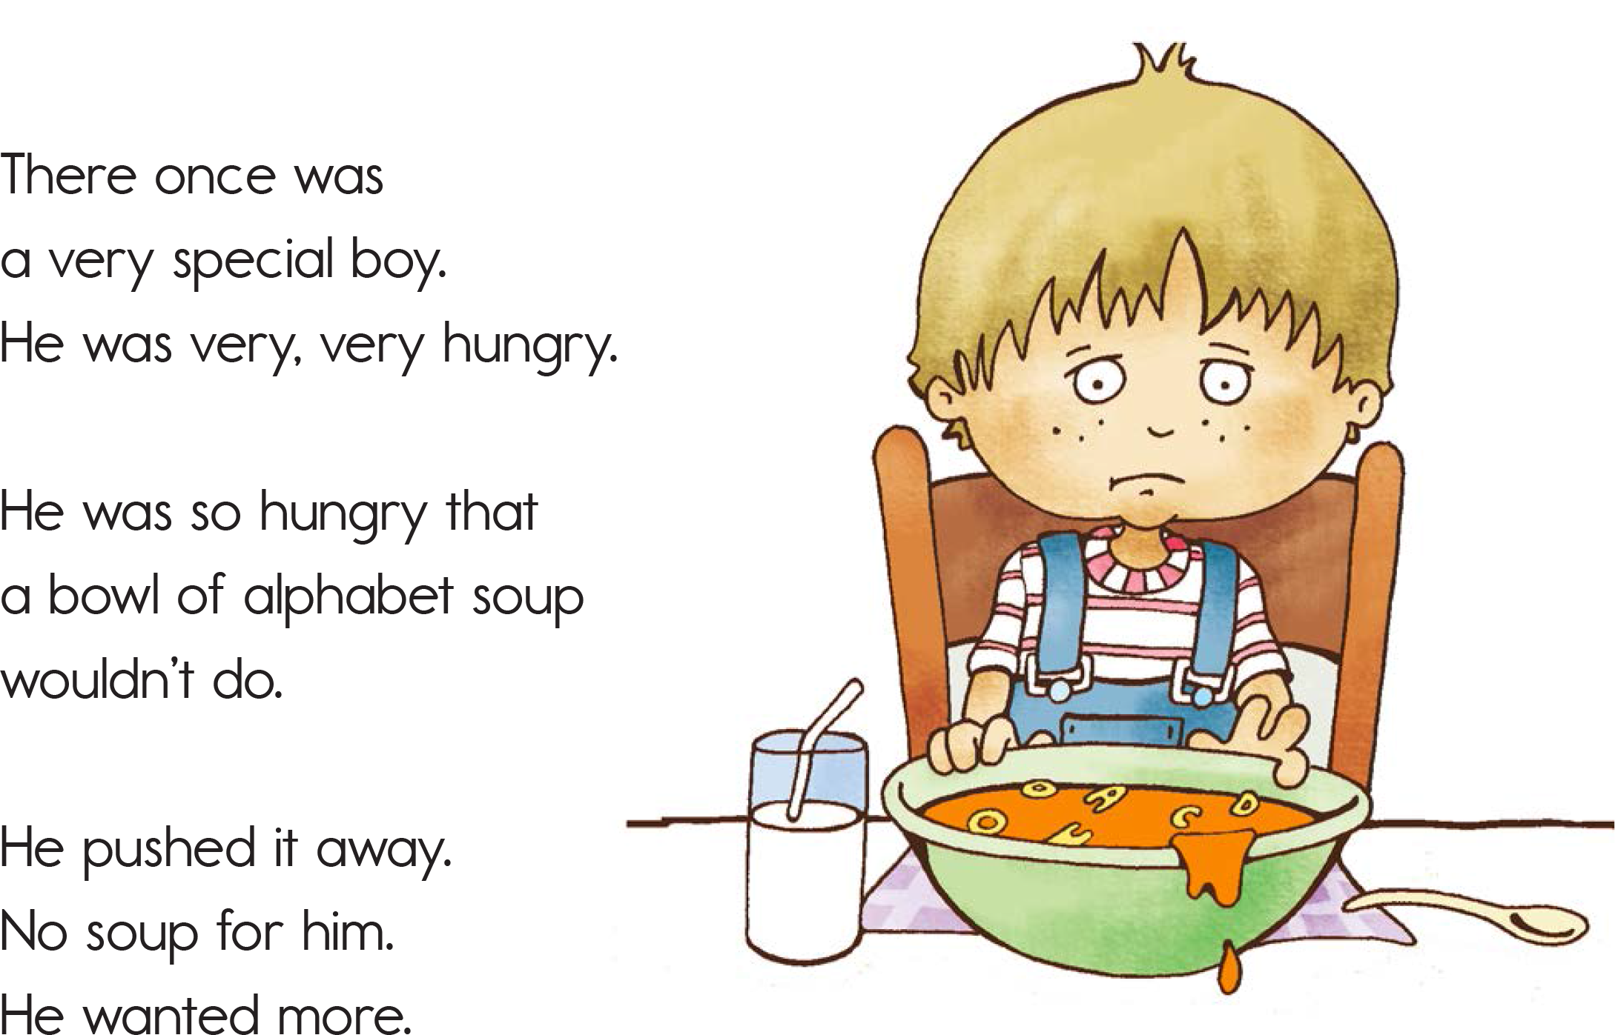

Slide 8
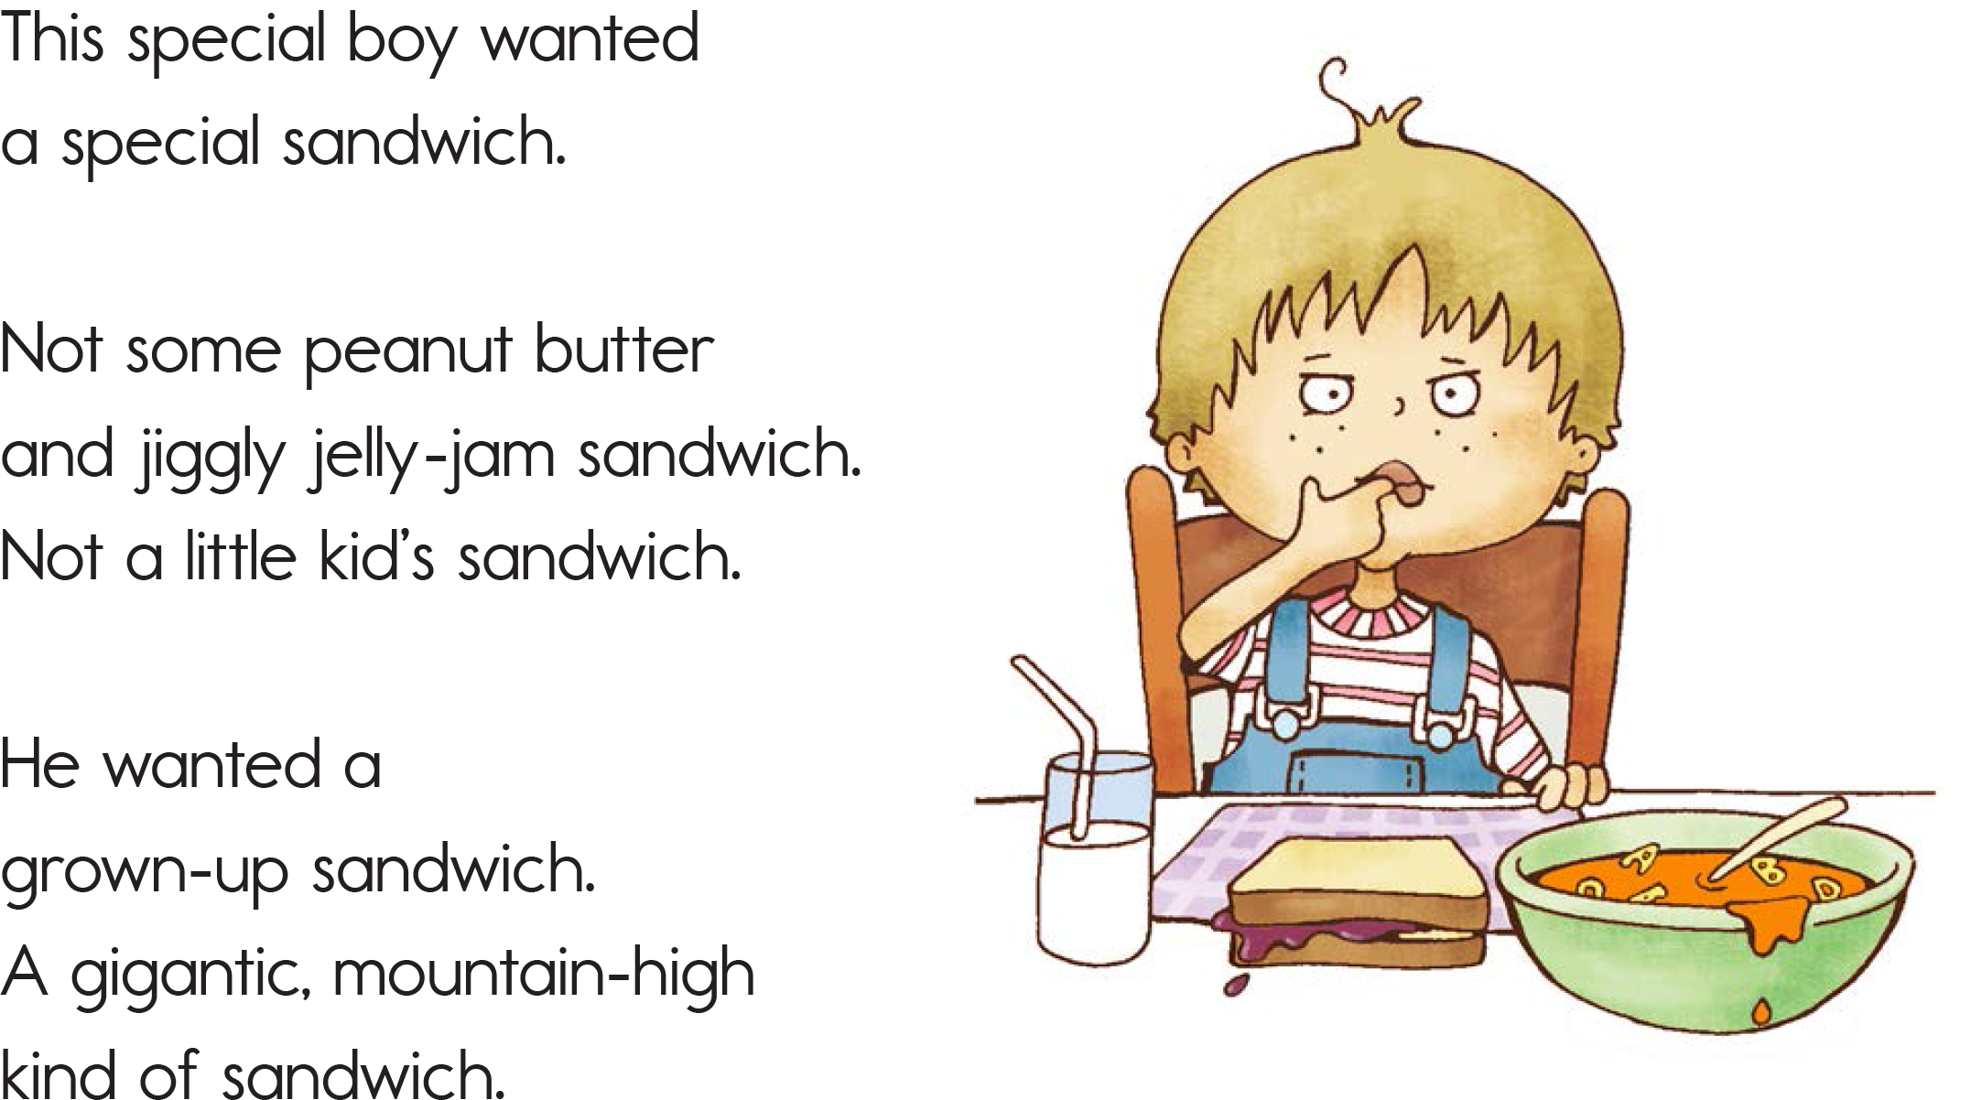

Slide 9
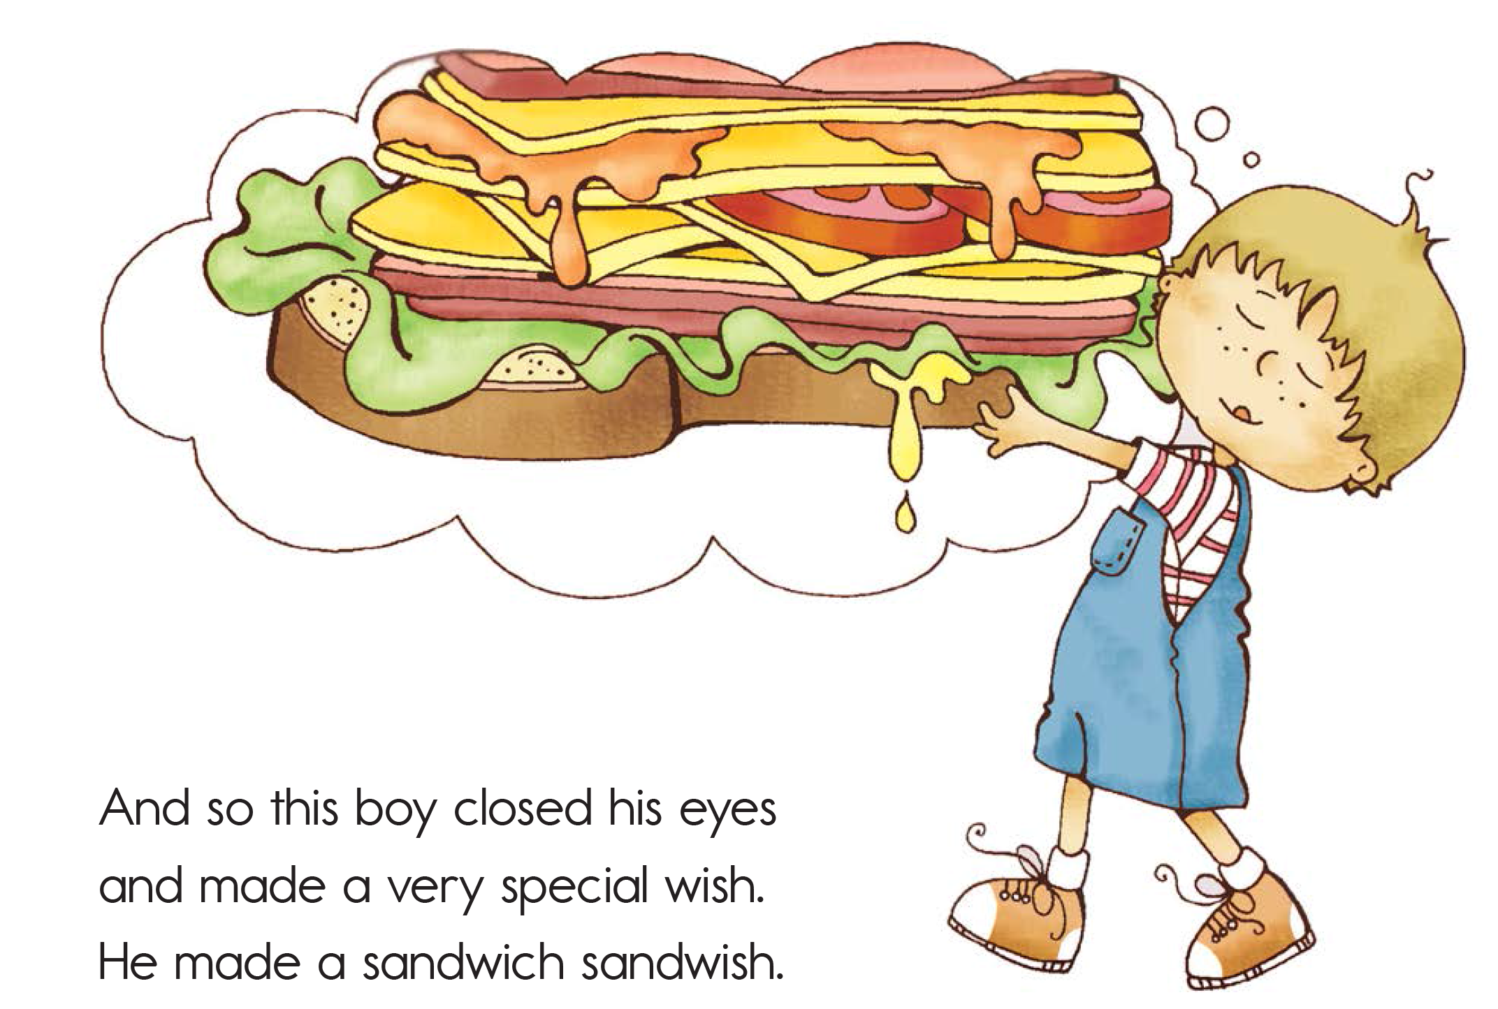

Slide 10
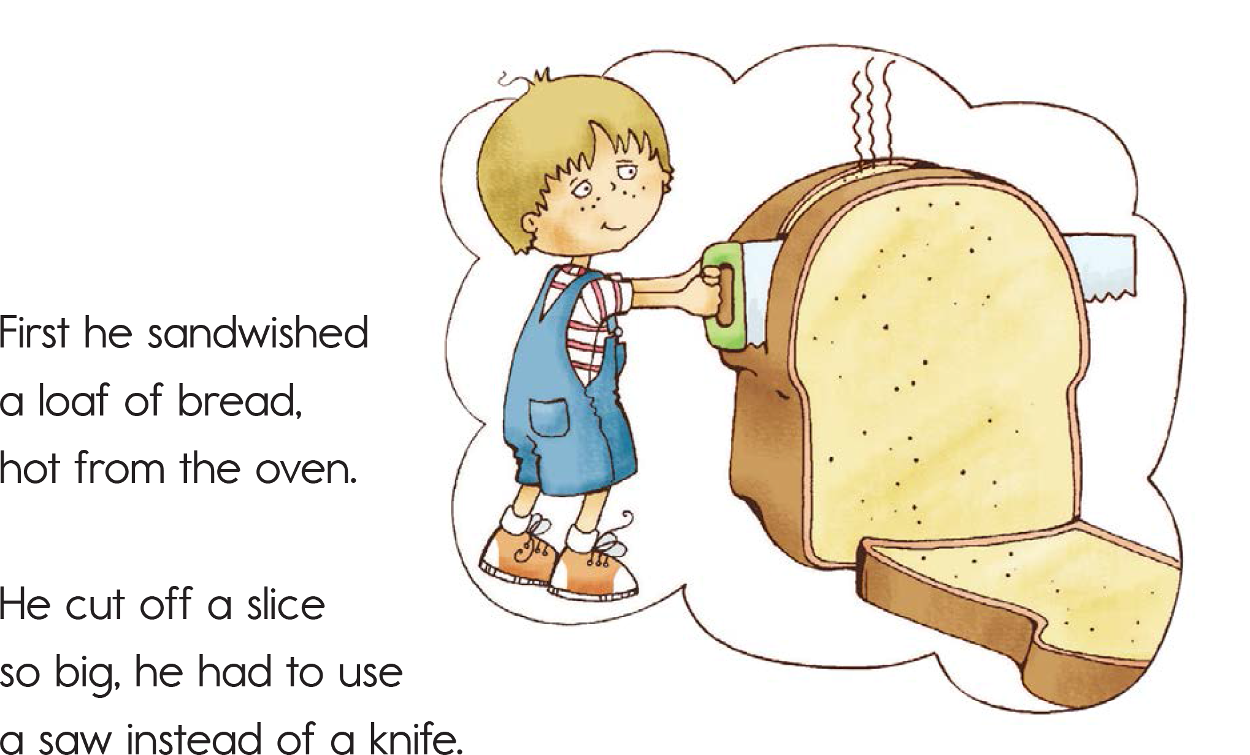

Slide 11
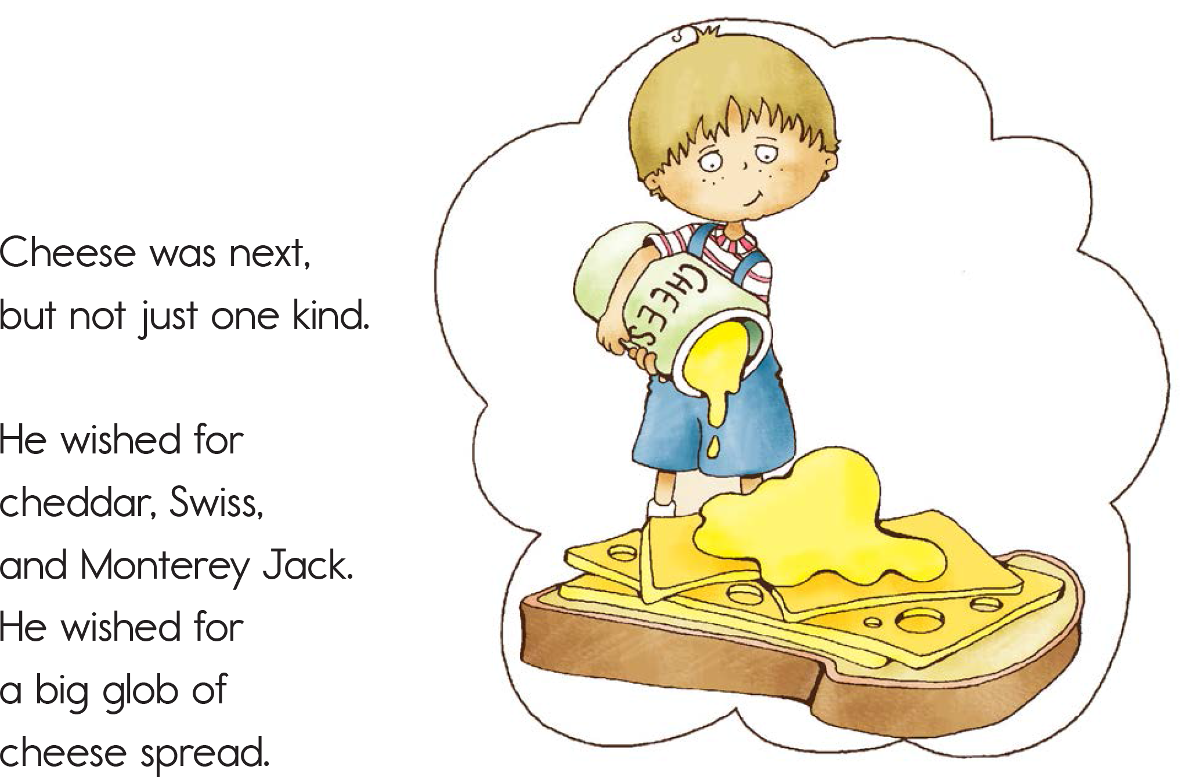

Slide 12
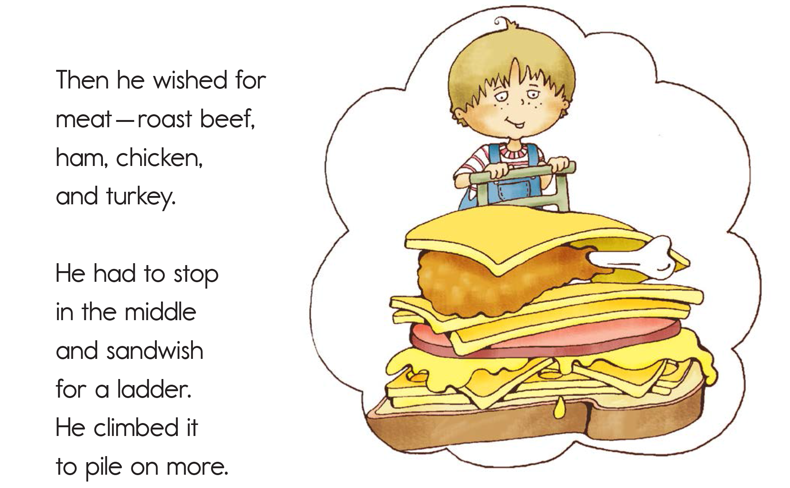

Slide 13
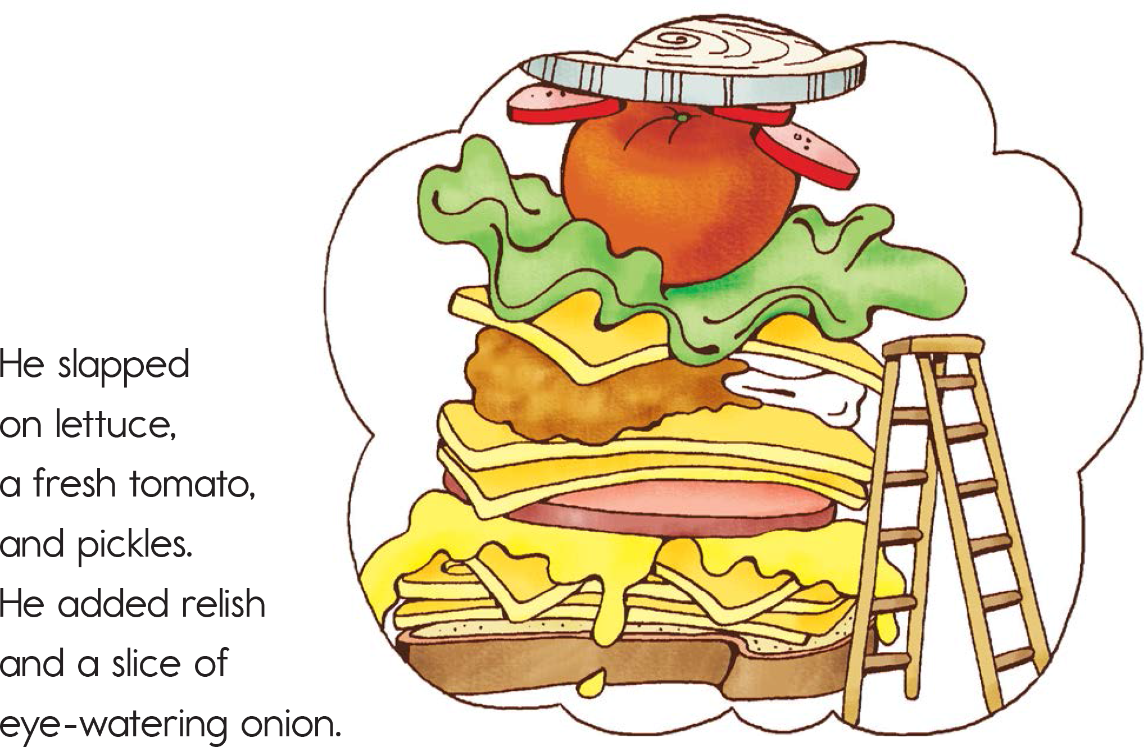

Slide 14
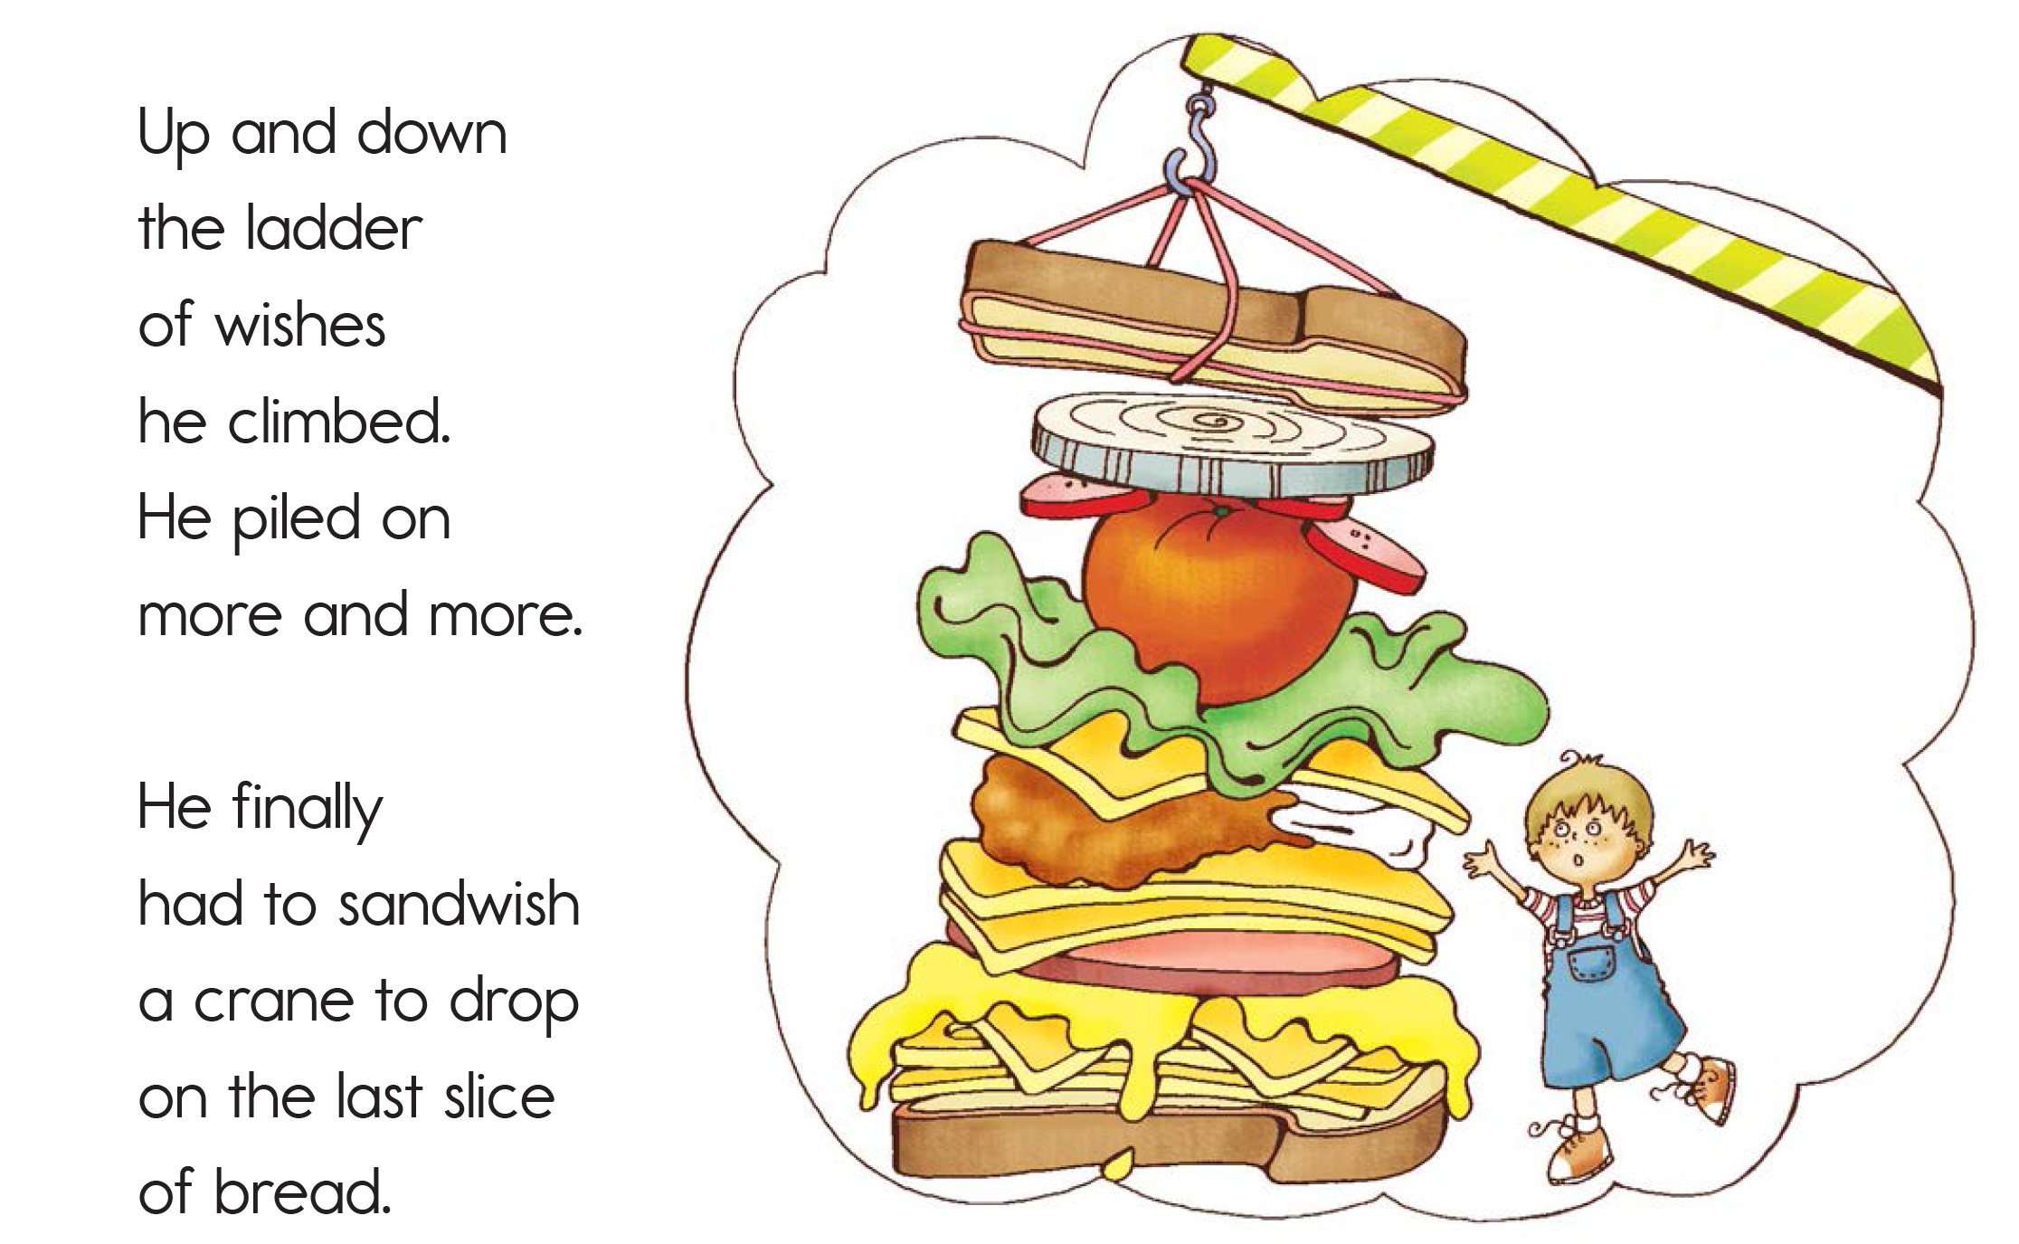

Slide 15
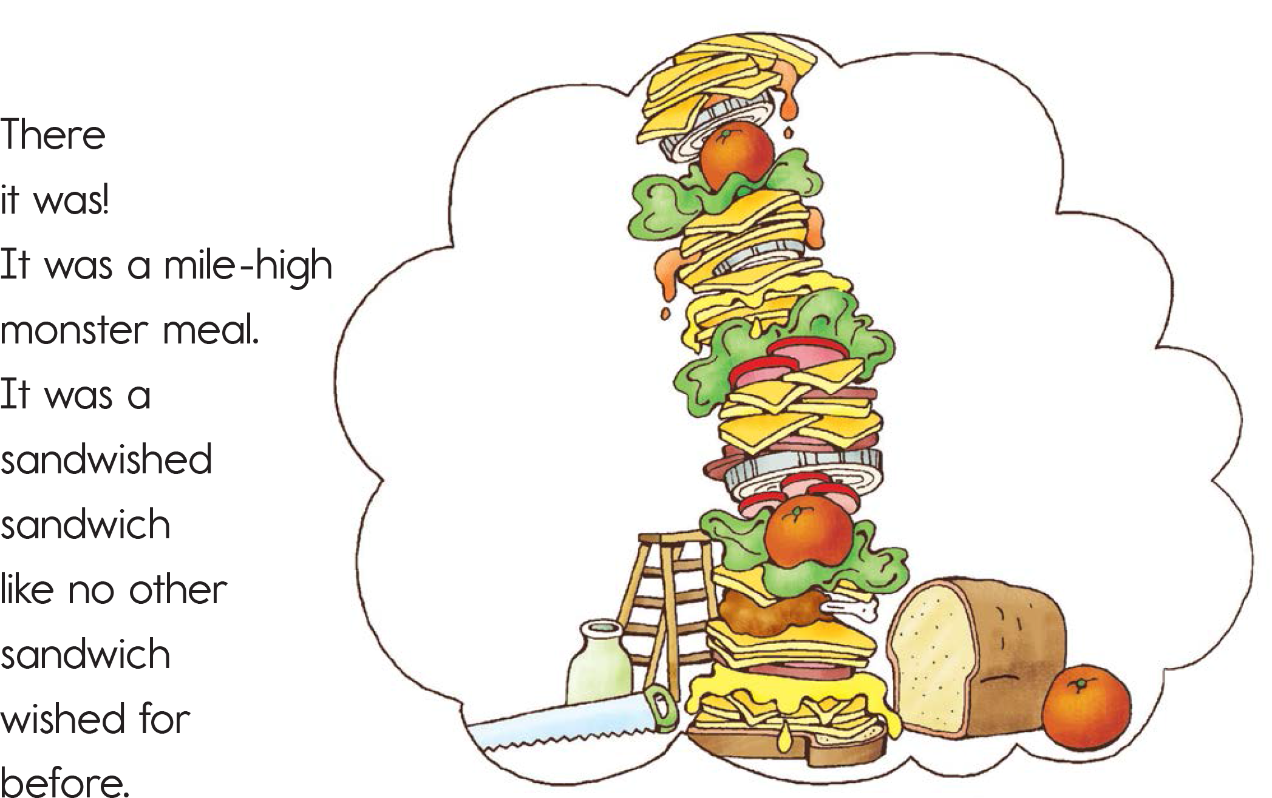

Slide 16
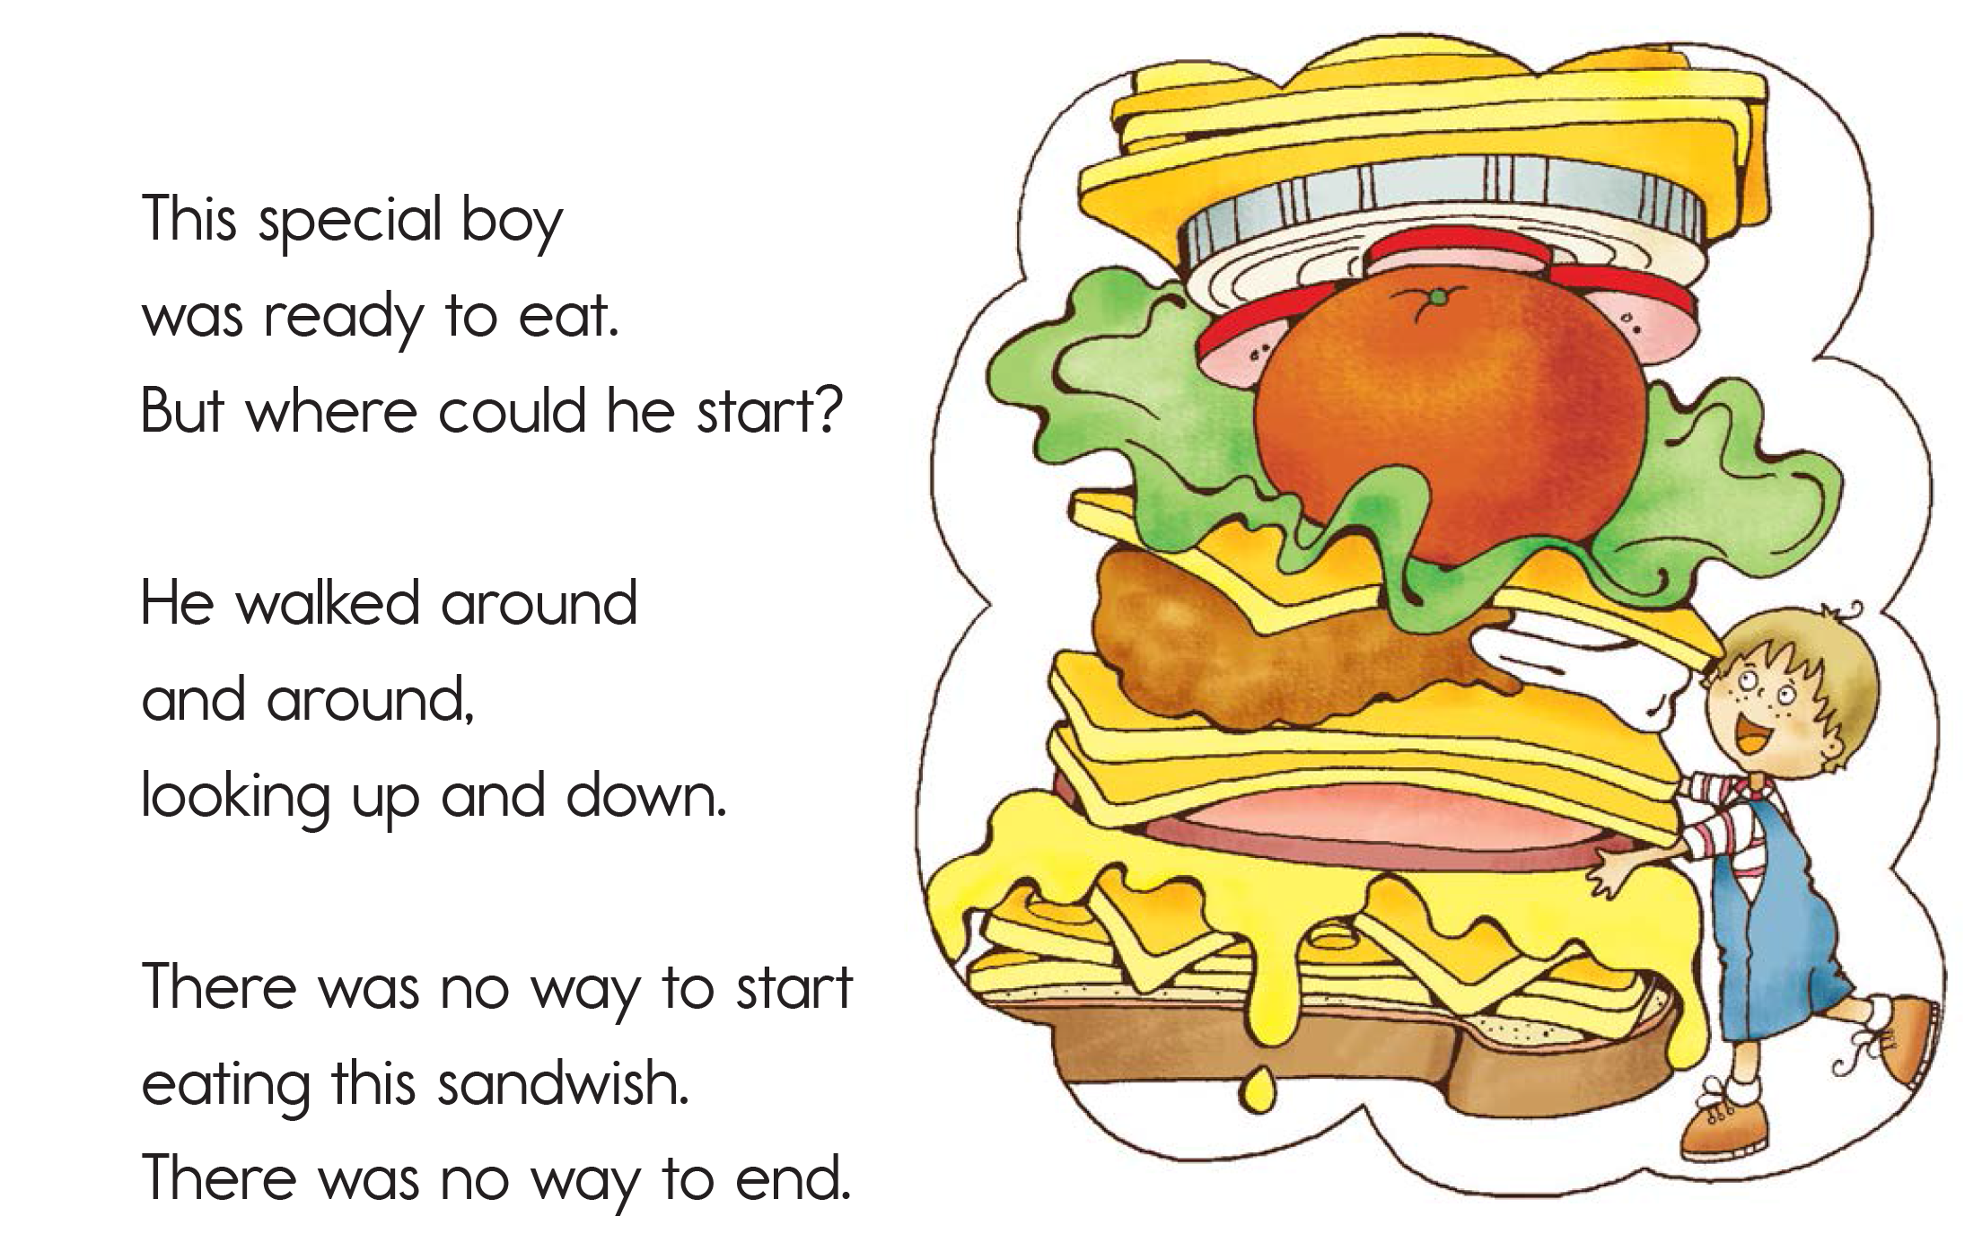

Slide 17
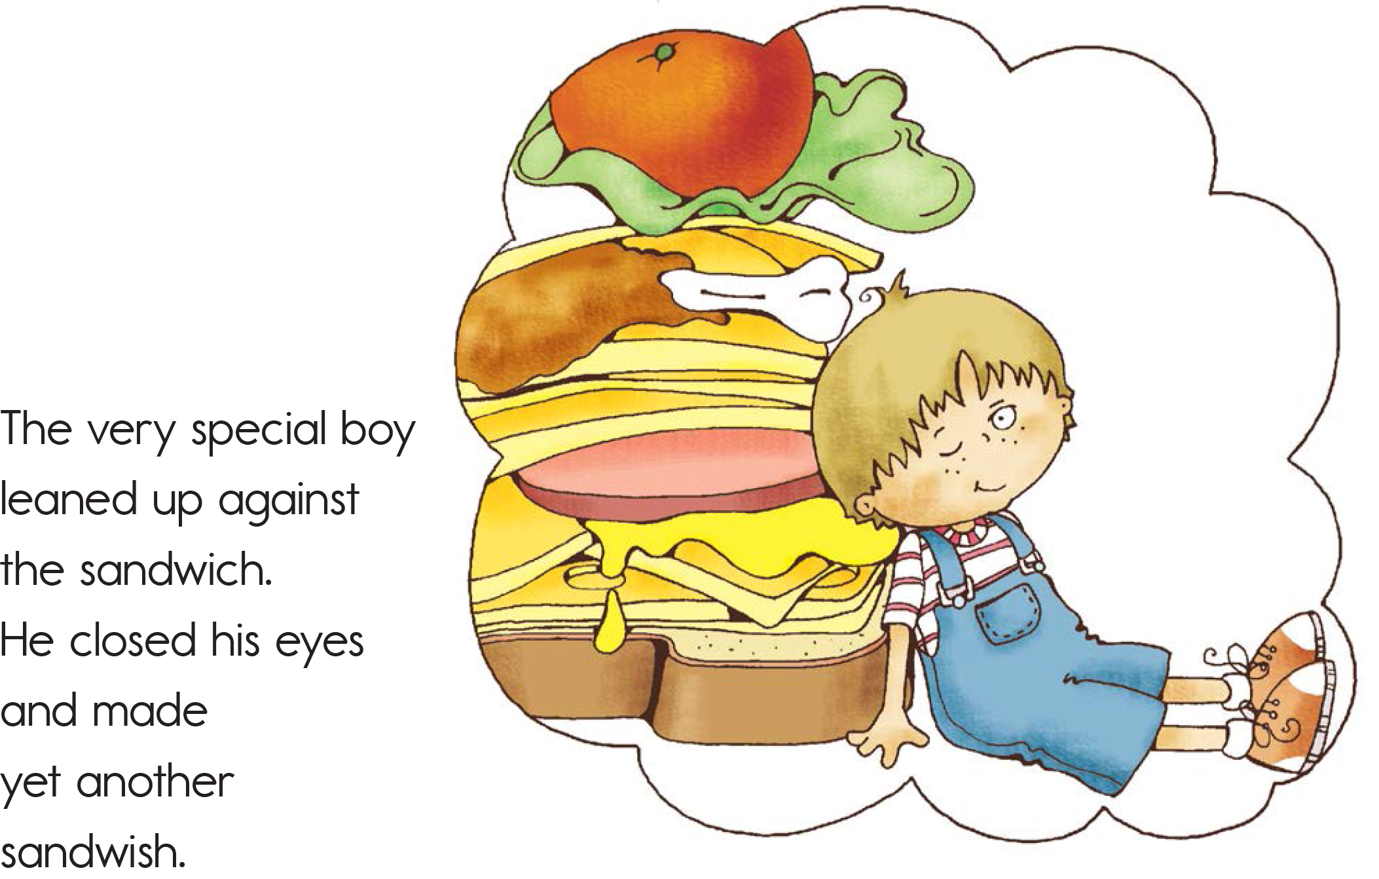

Slide 18
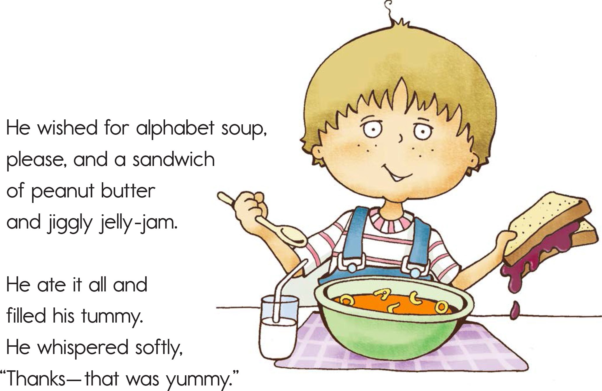

Slide 19
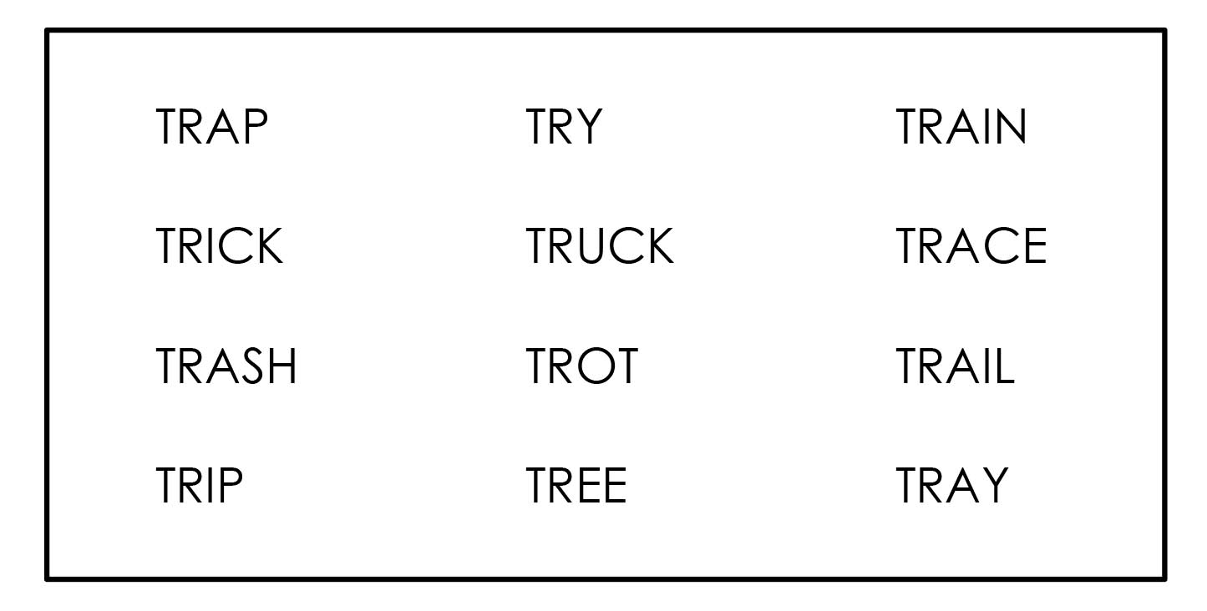
Word Search
Notes:
Complete the word search.

Slide 20
What did I learn today?
Practiced ‘tr’ words
Word search
Kitchen tools
Read a story about a sandwich
Notes:
Review

