Slide 1


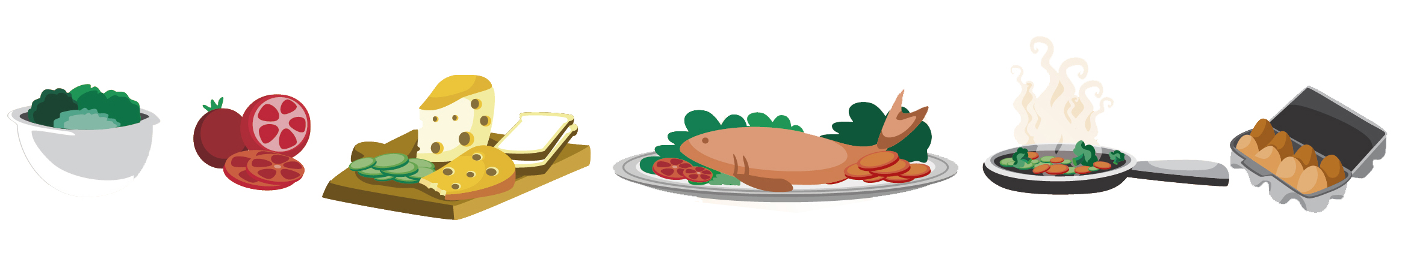
Lesson 8
FOOD

Slide 2

What we will learn today
Reviewing the “ing”, “ng”, “dr” and “tr” words
Spelling
Using “and”, “but”, “or” and “because”
Some international foods
Reading

Slide 3


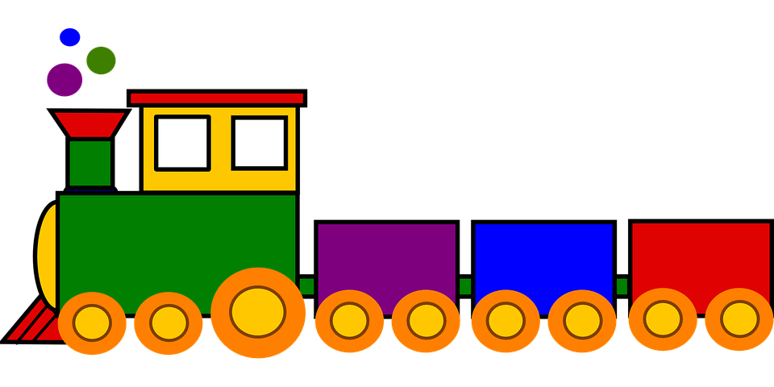
Our “tr” paragraphs
I had a trumpet in the trunk of my truck. I left my keys in the trash. I was going to be late for my date with my girlfriend, the tree, so I took the train. She missed my trumpet playing.

Slide 4
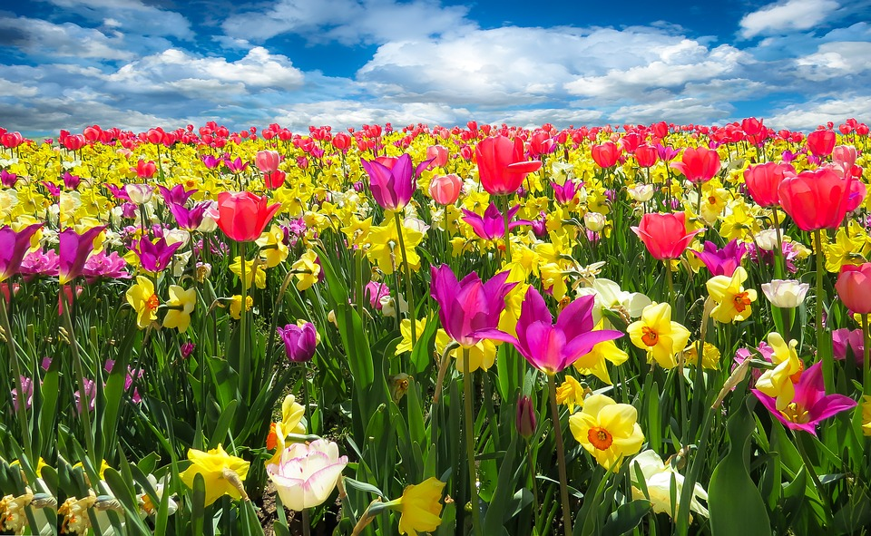
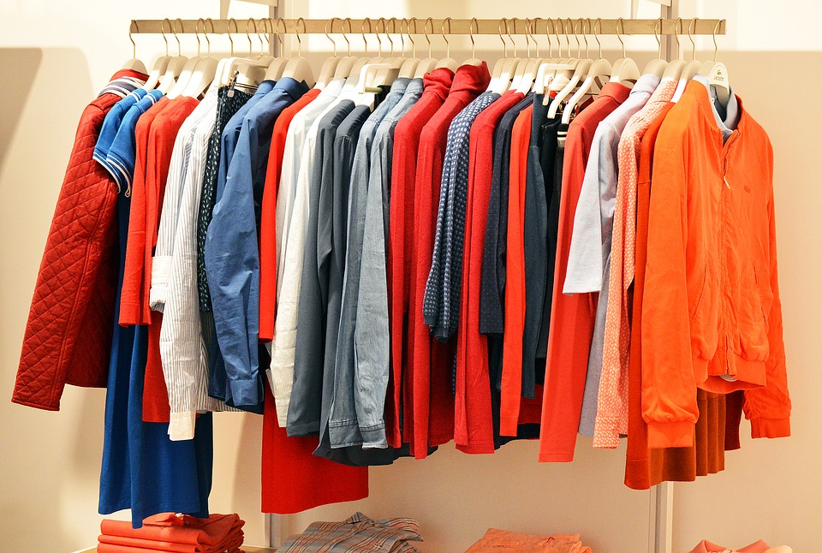
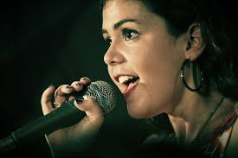
Do you remember?
_ _ _ ing
_ _ ng
_ ing

Slide 5
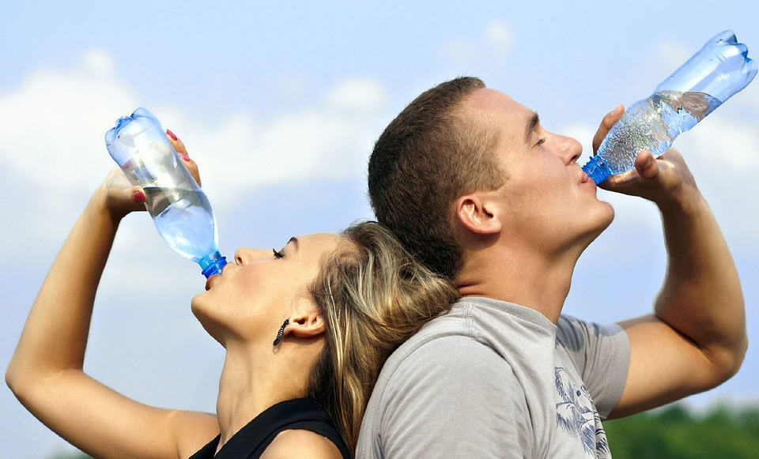
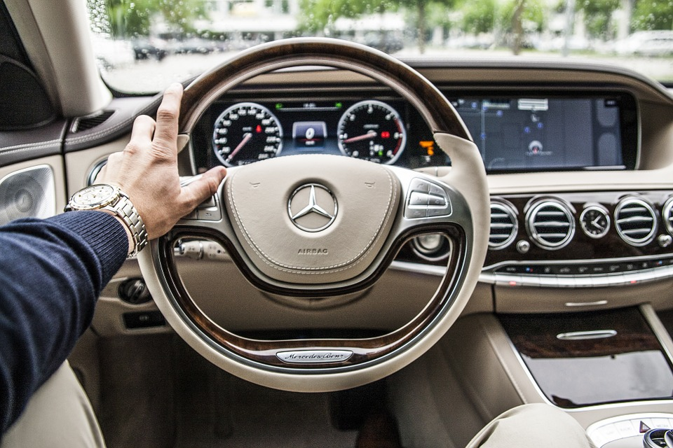
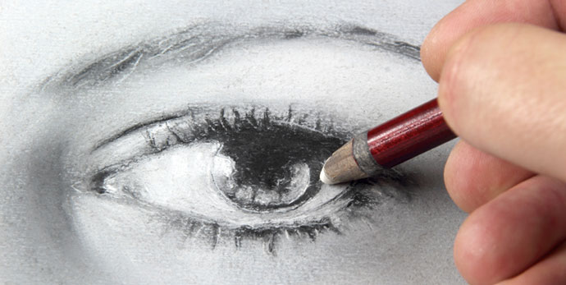
How do you spell?
dr_ _ _
dr _ _ _ _ _
dr_ _ _

Slide 6
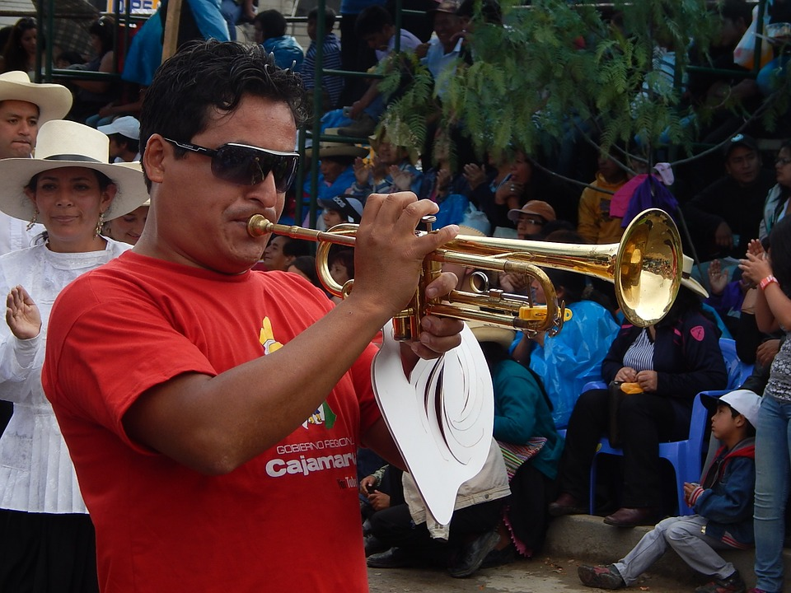
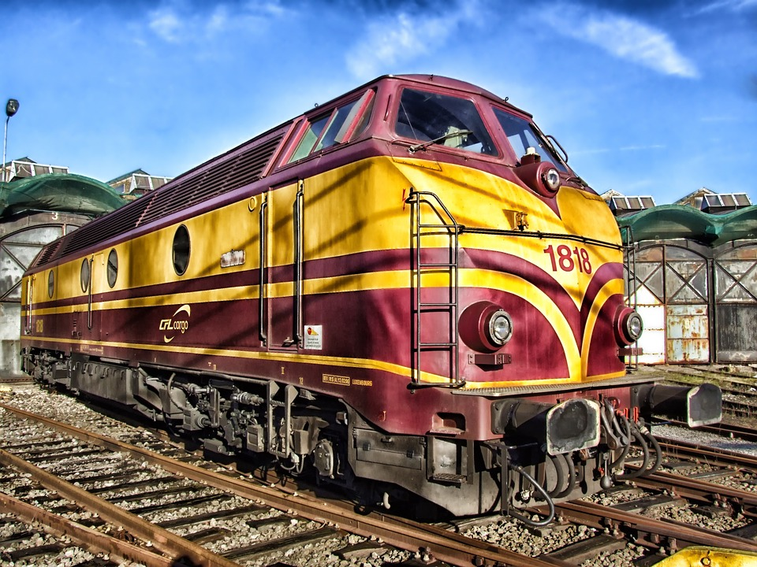
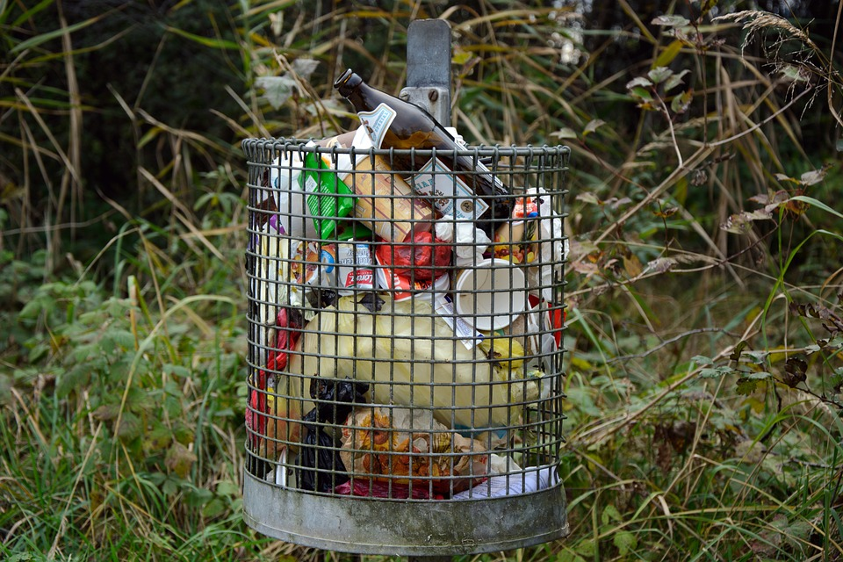
Spelling!
tr _ _ _ _ _
tr_ _ _
tr_ _ _

Slide 7
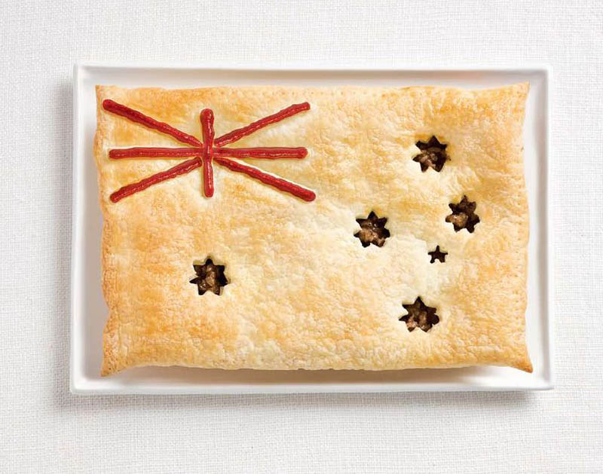
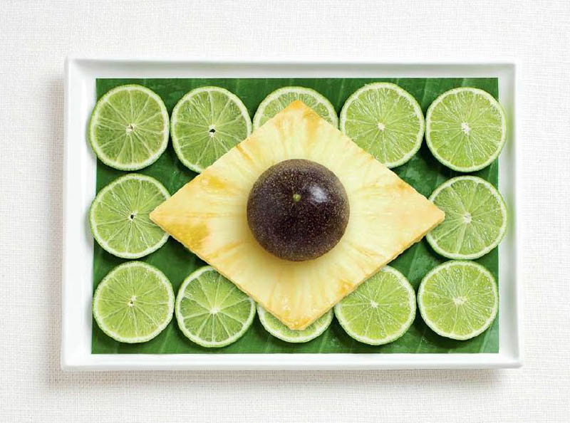
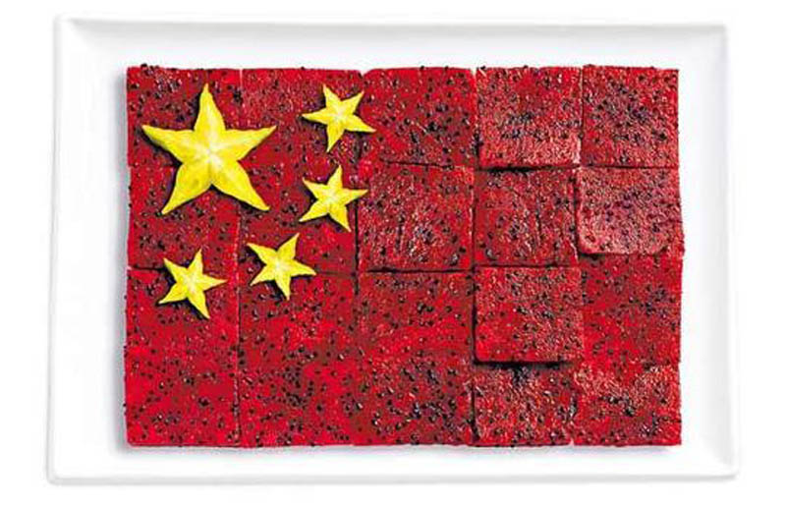
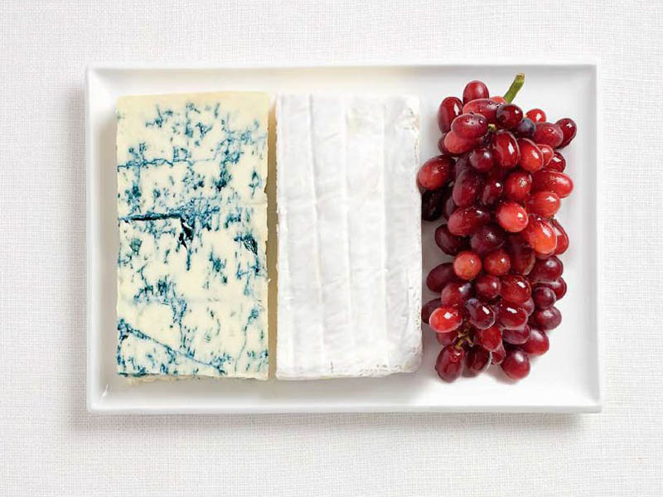
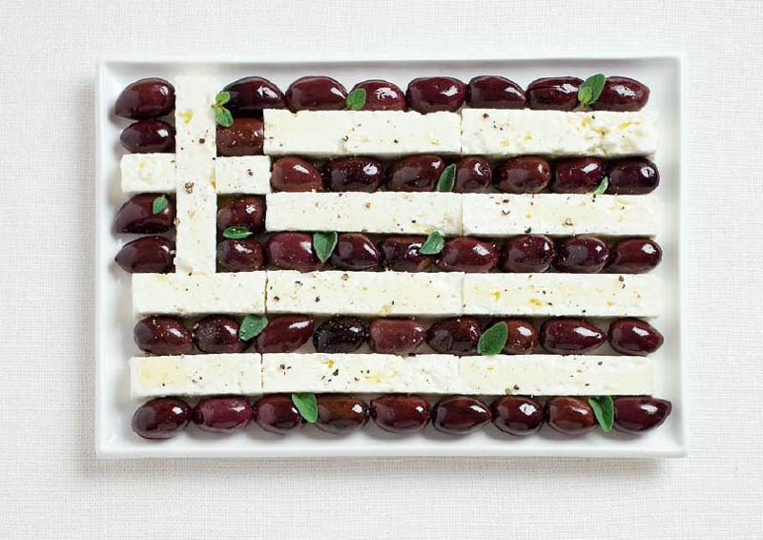
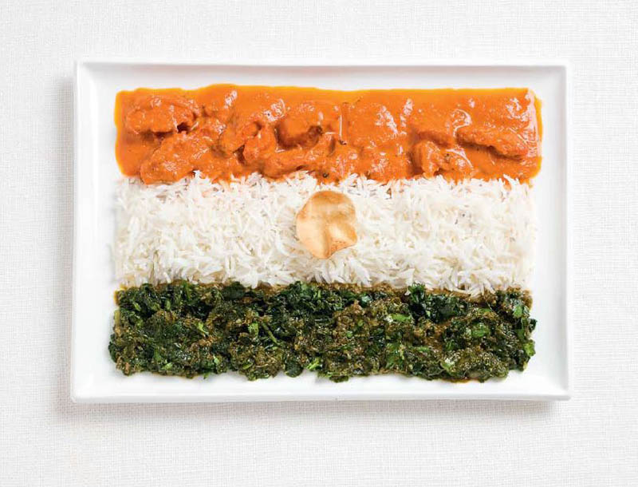
World Food Flags

Slide 8
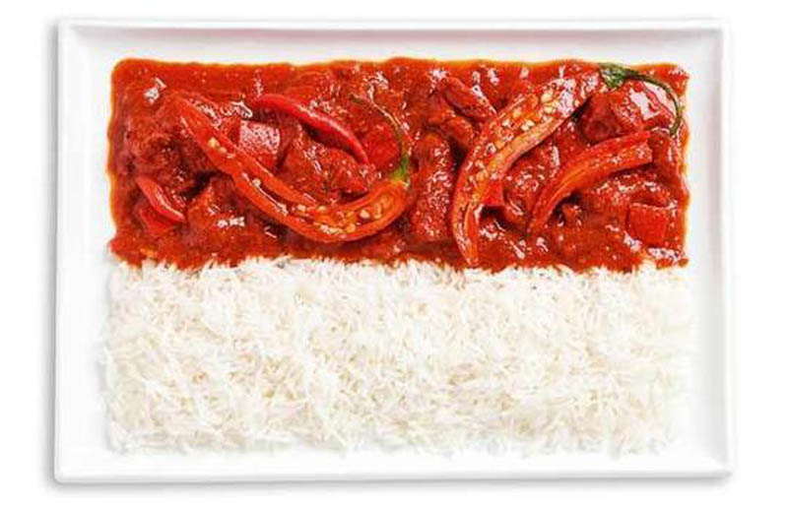
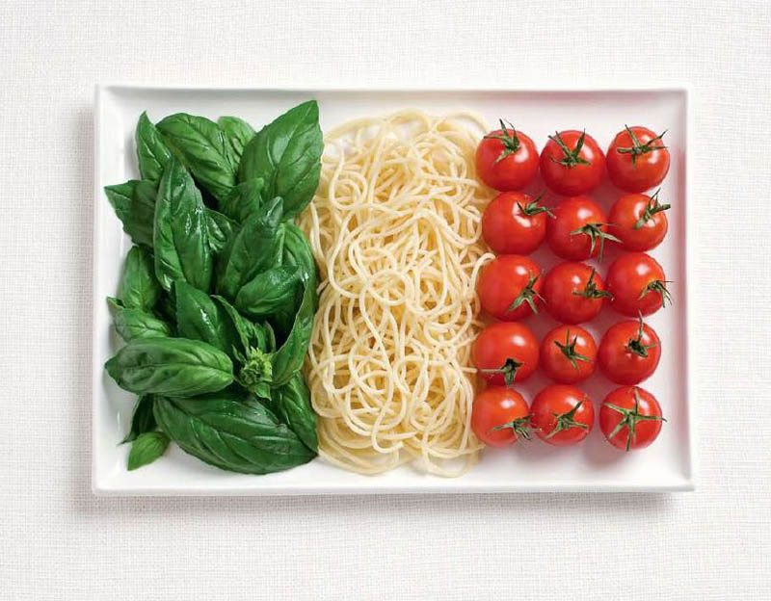
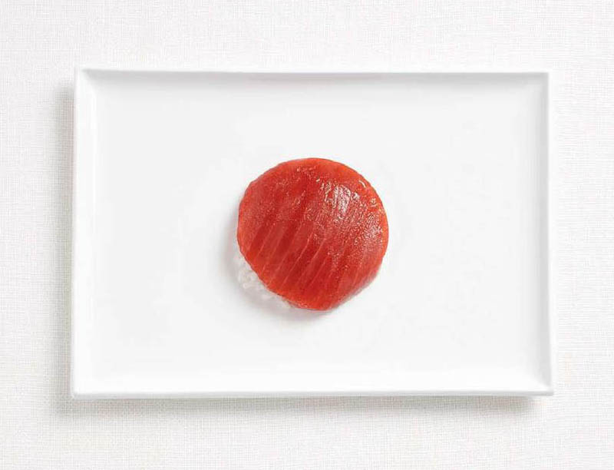
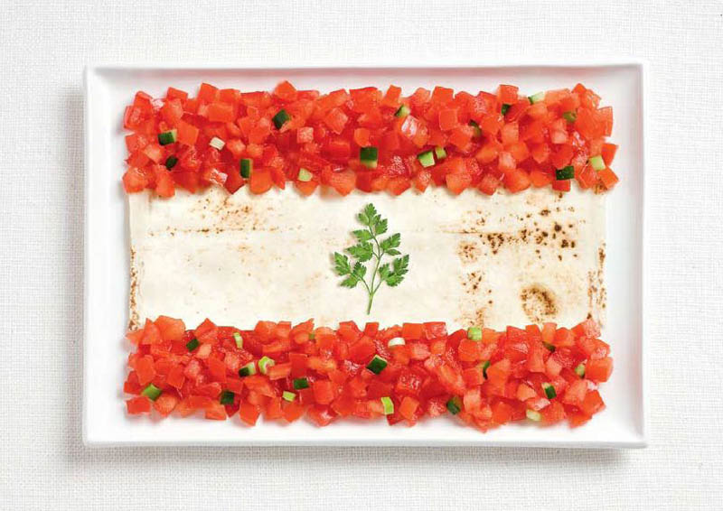
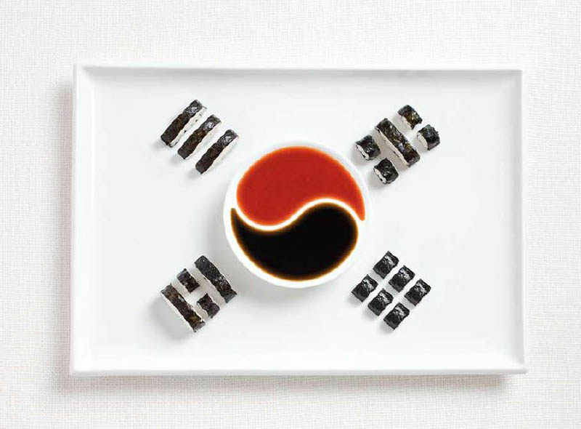
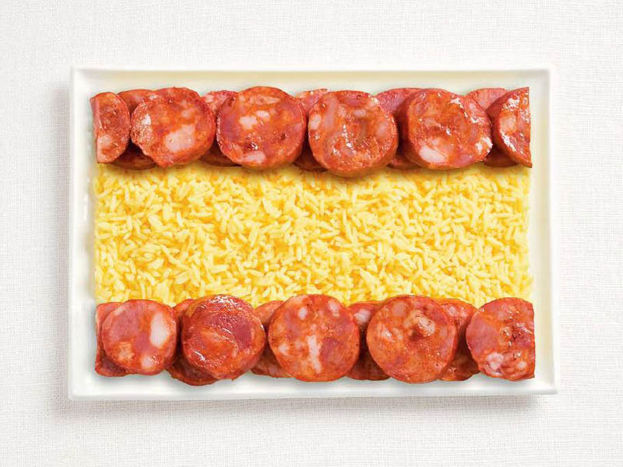
World Food Flags

Slide 9
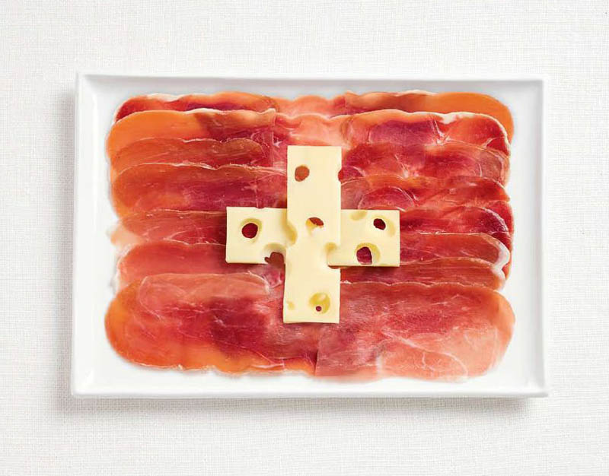
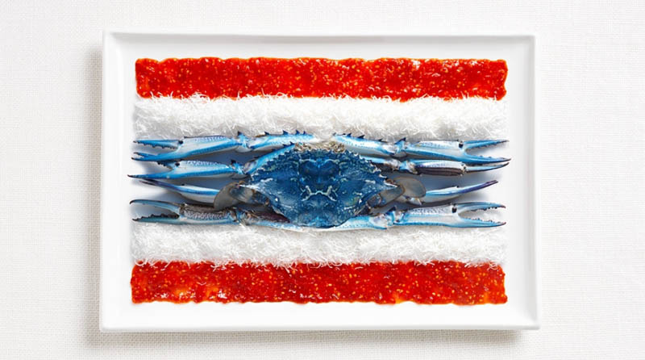
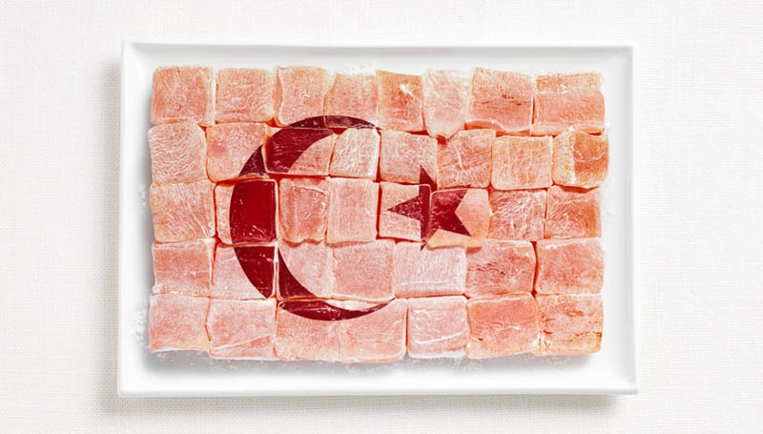
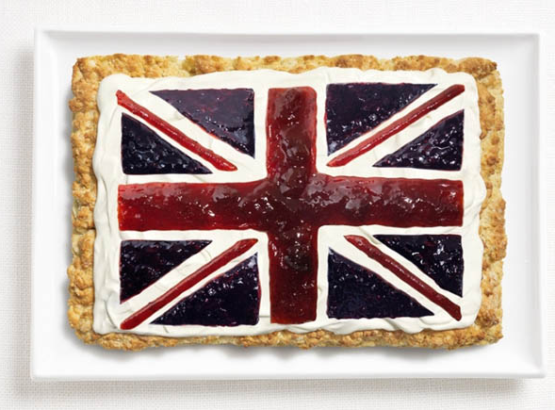
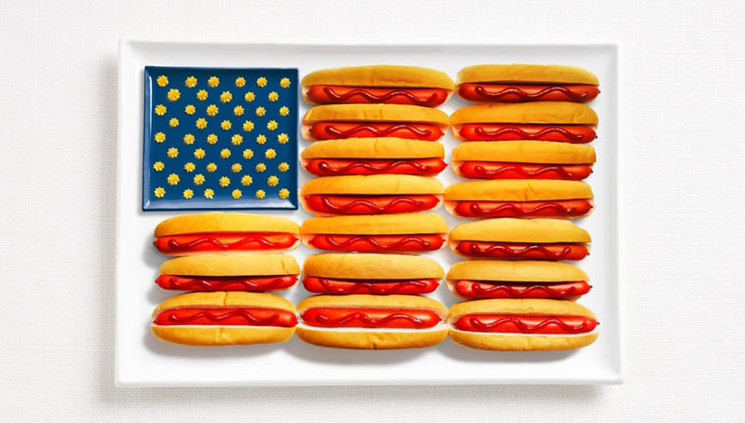
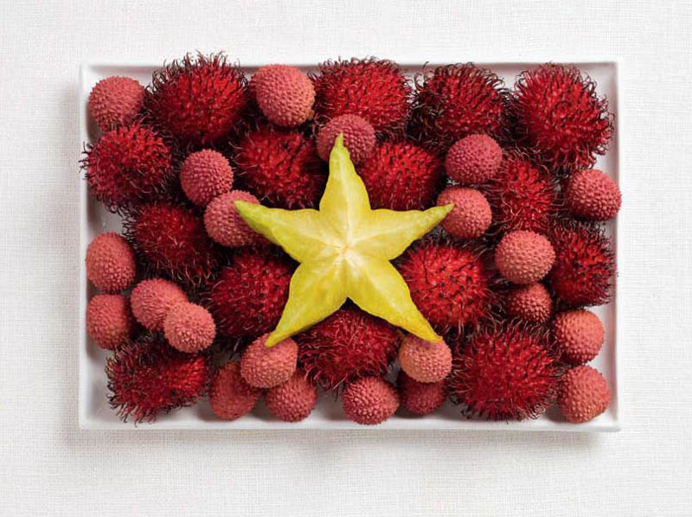
World Food Flags
Match the verb to the photo.

Slide 10
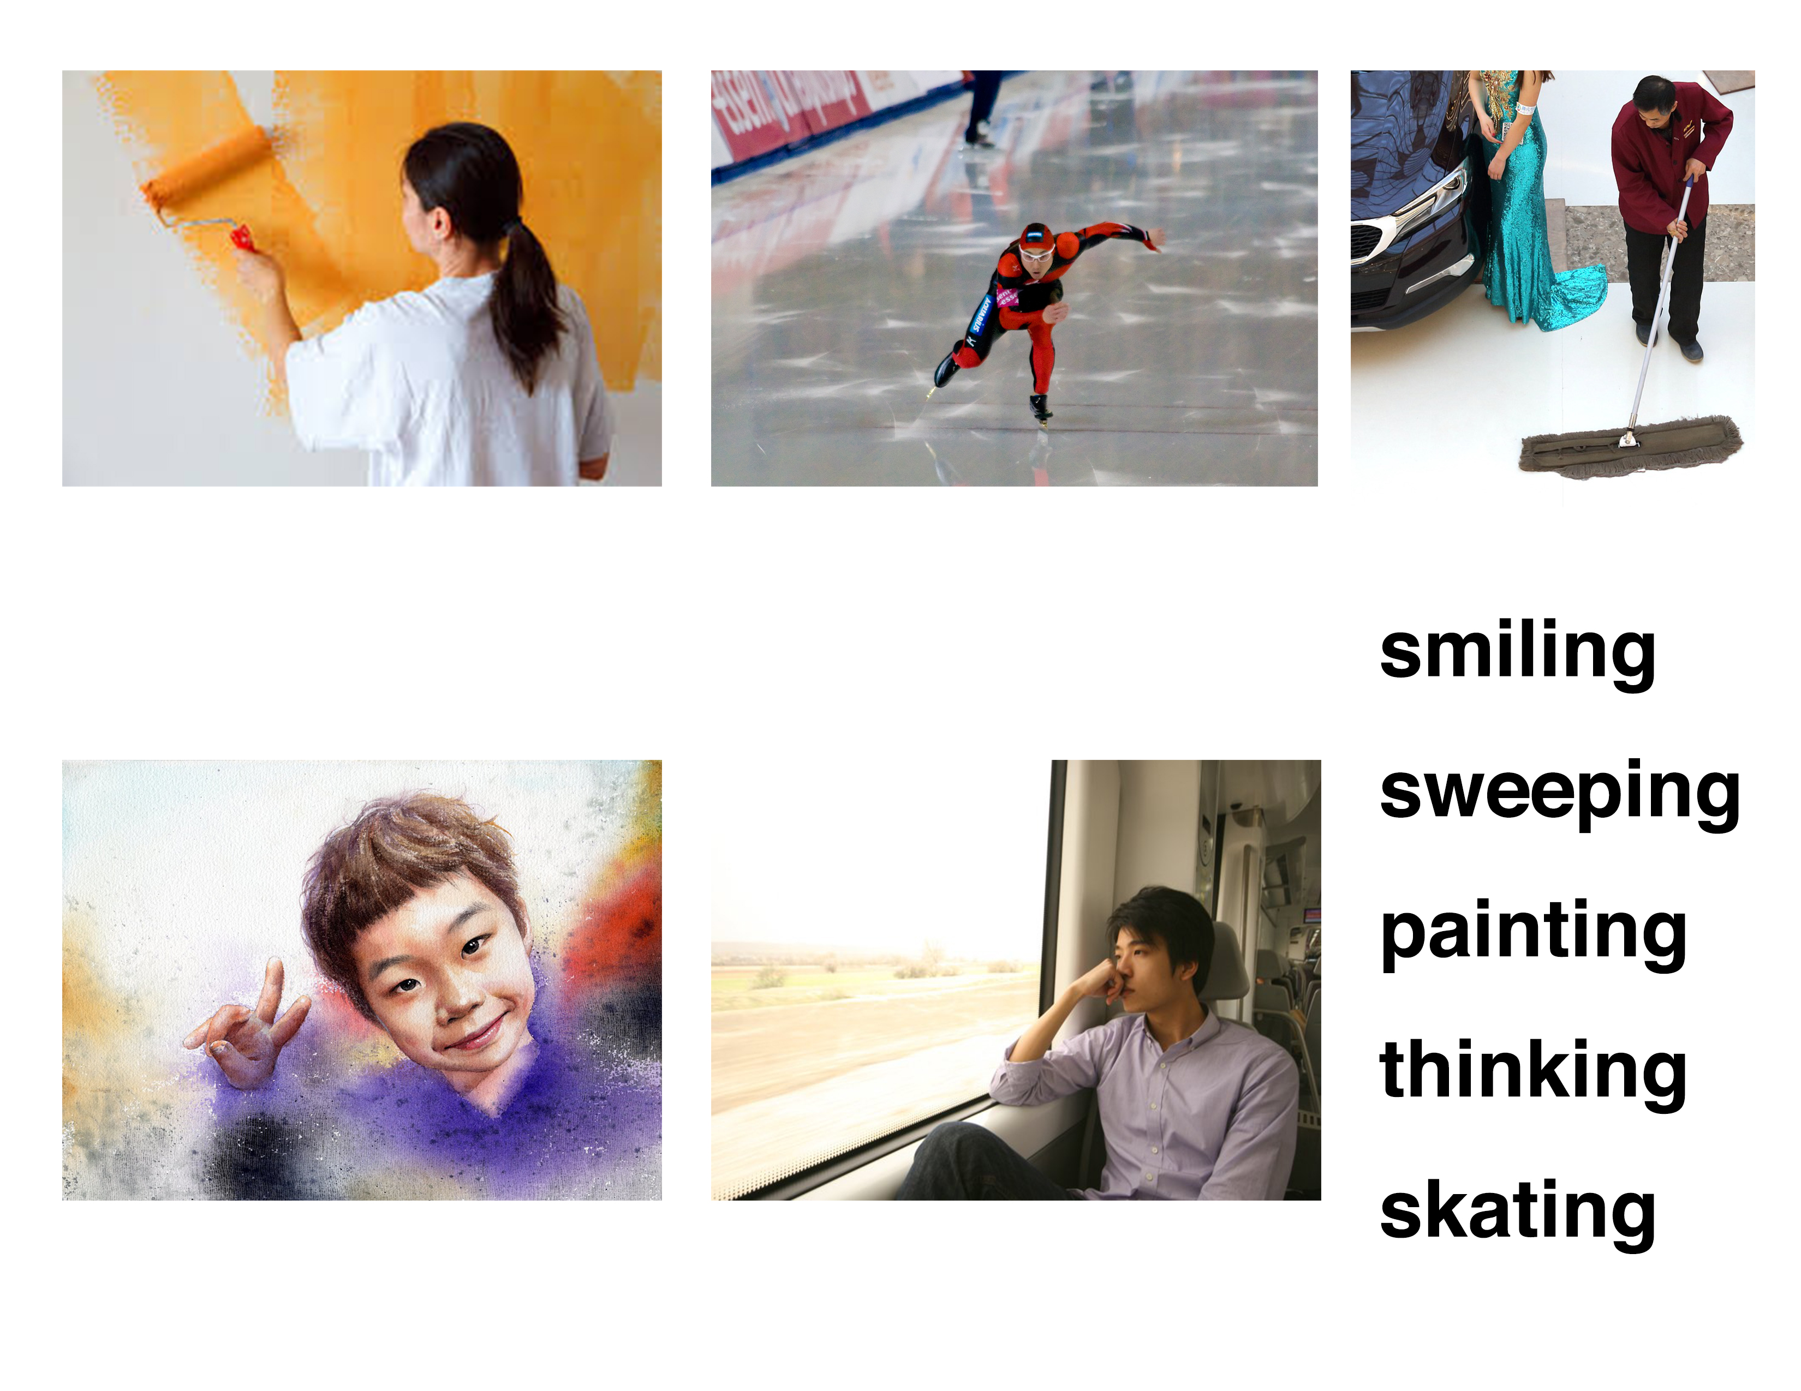
Matching

Slide 11
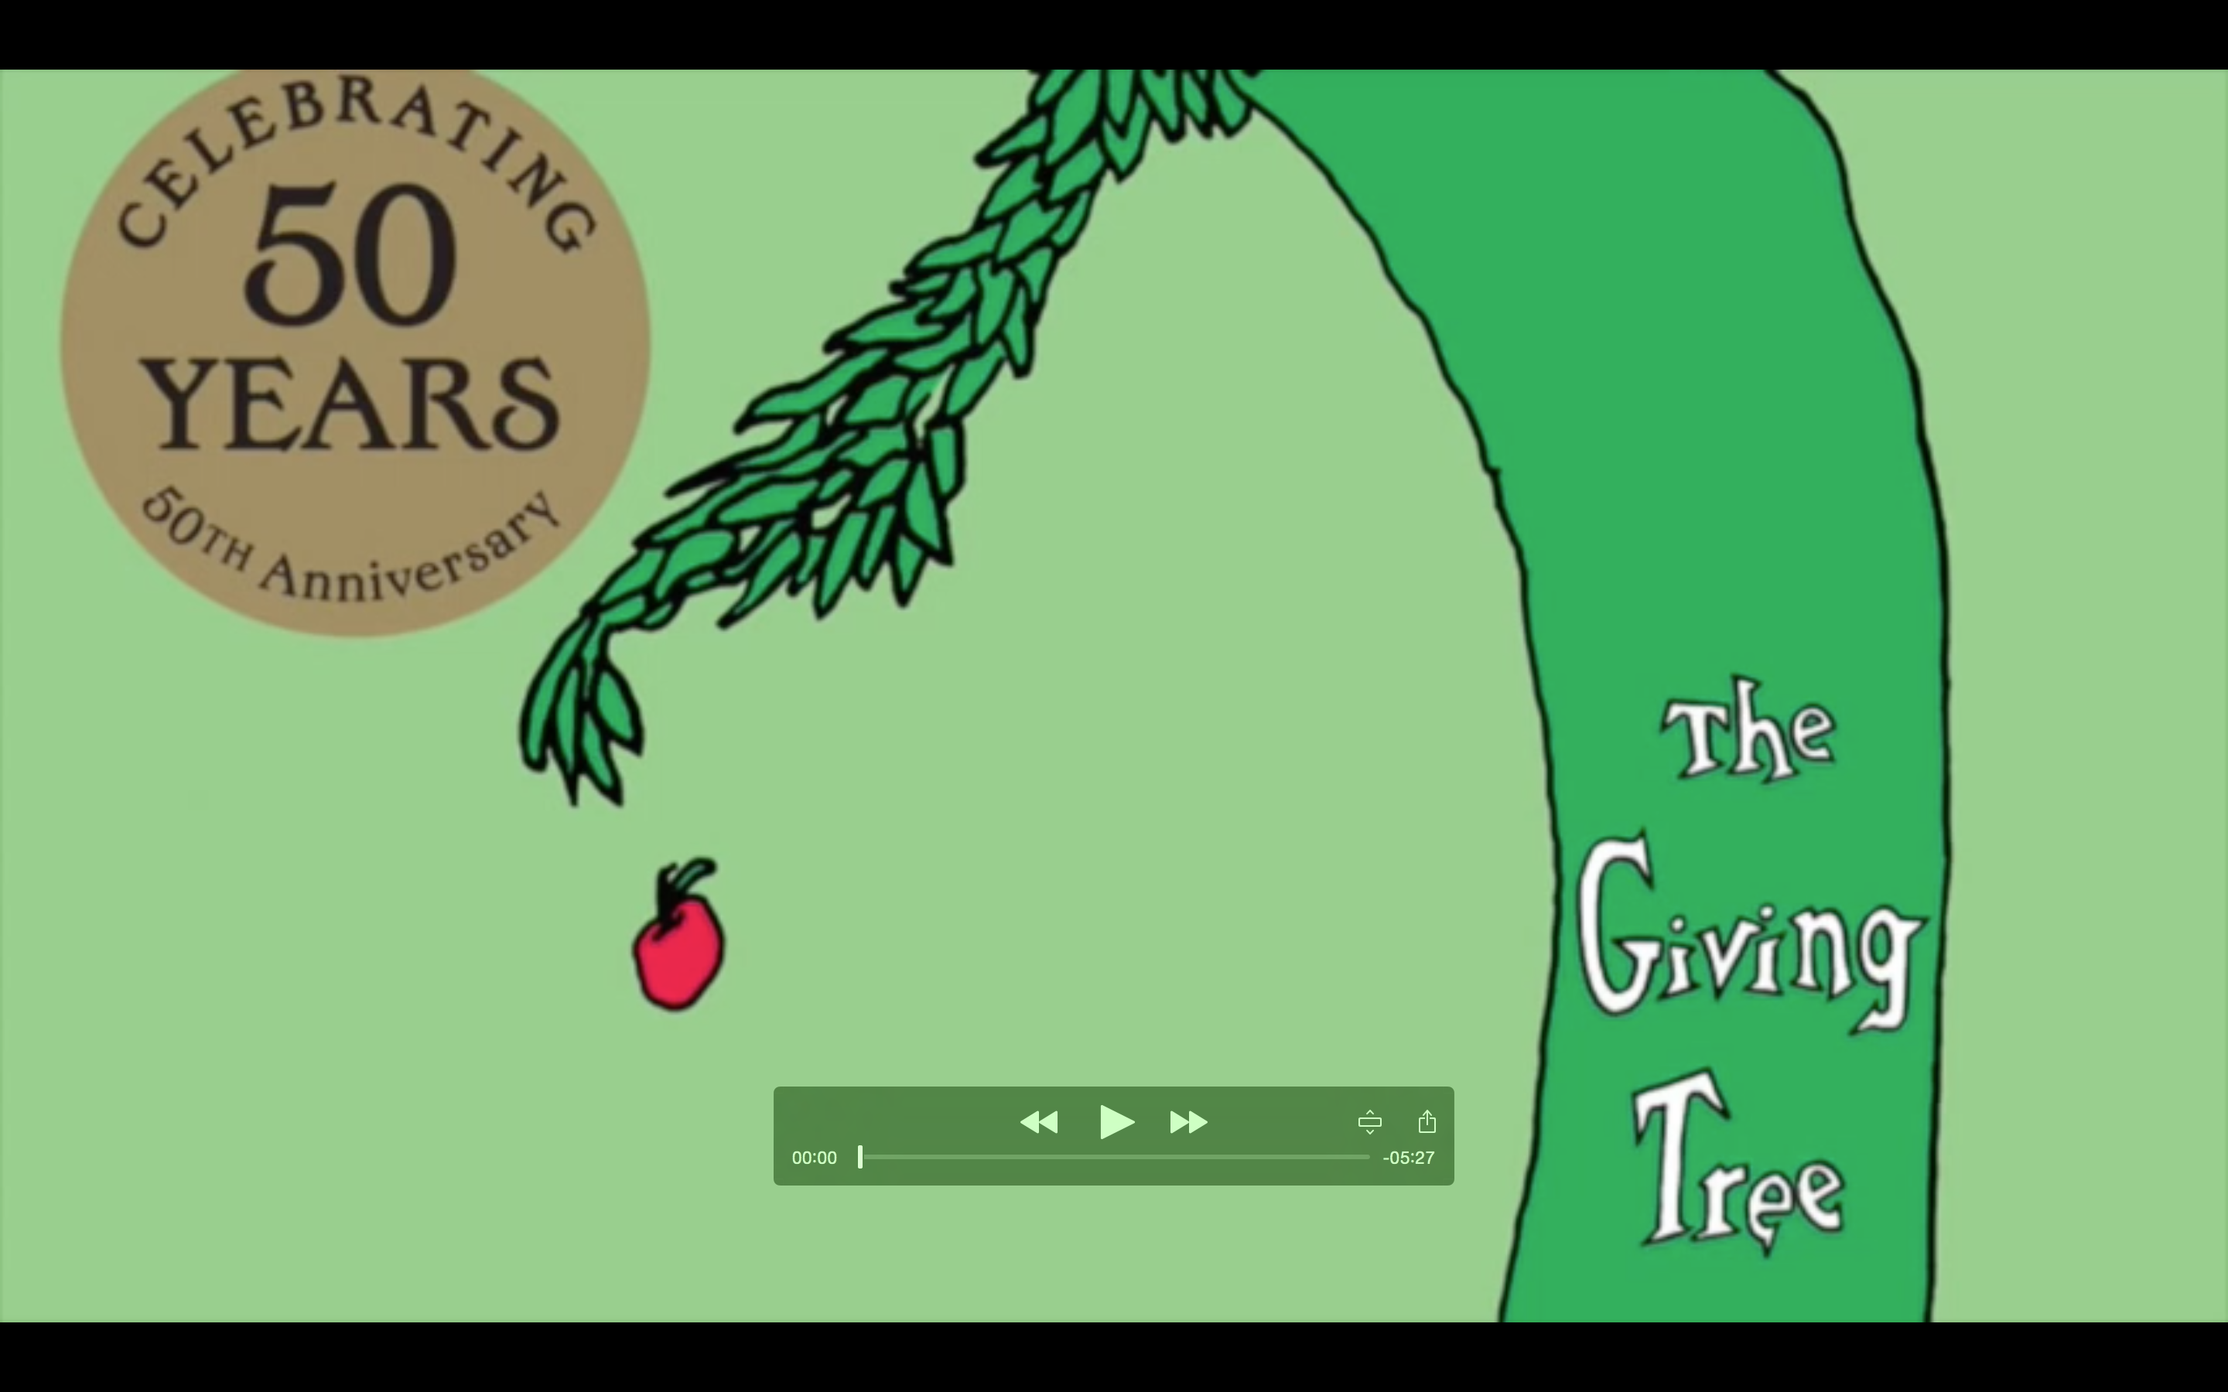
Story Time

Slide 12
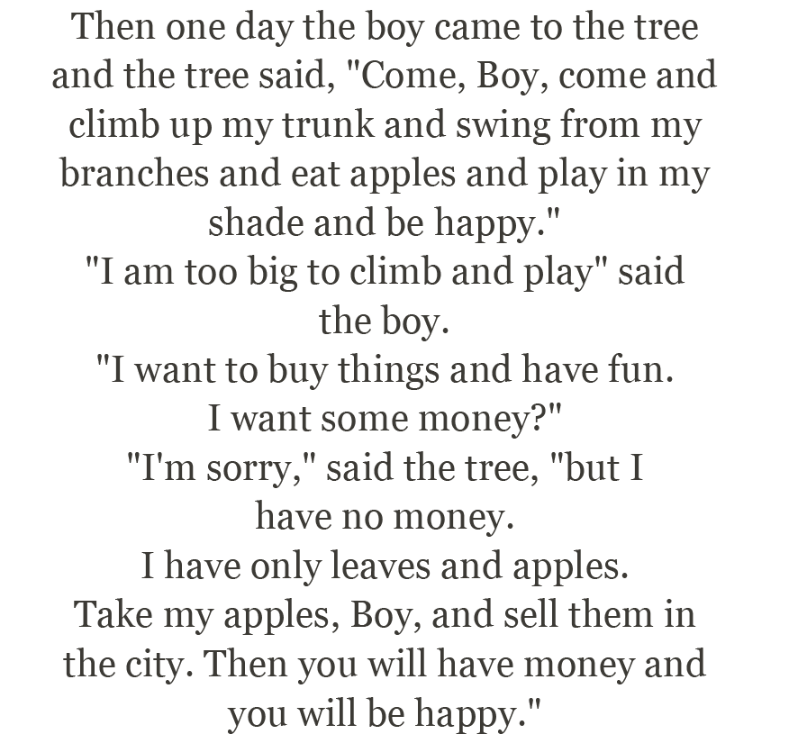


Slide 13
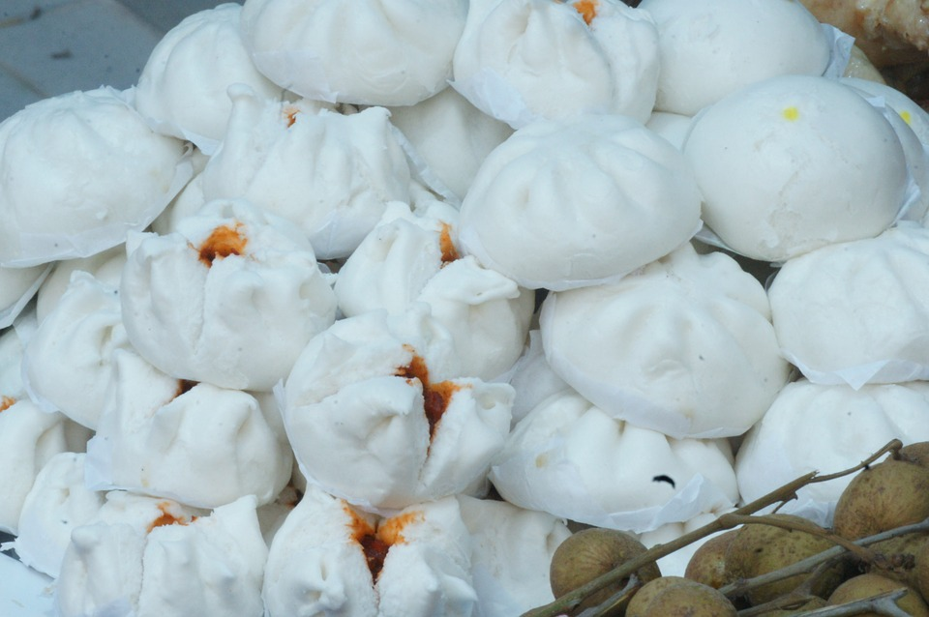
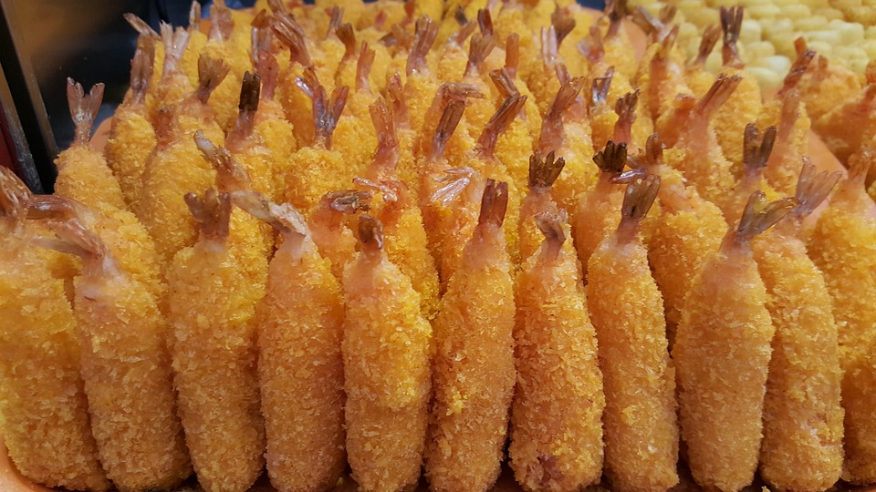
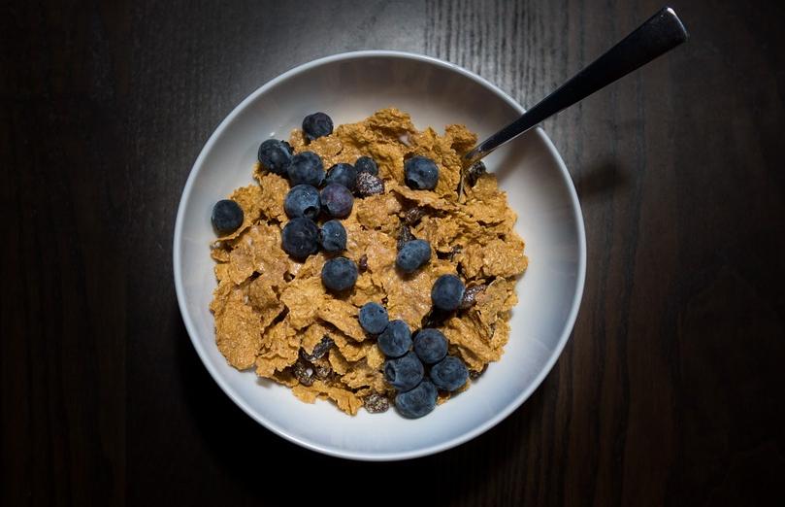
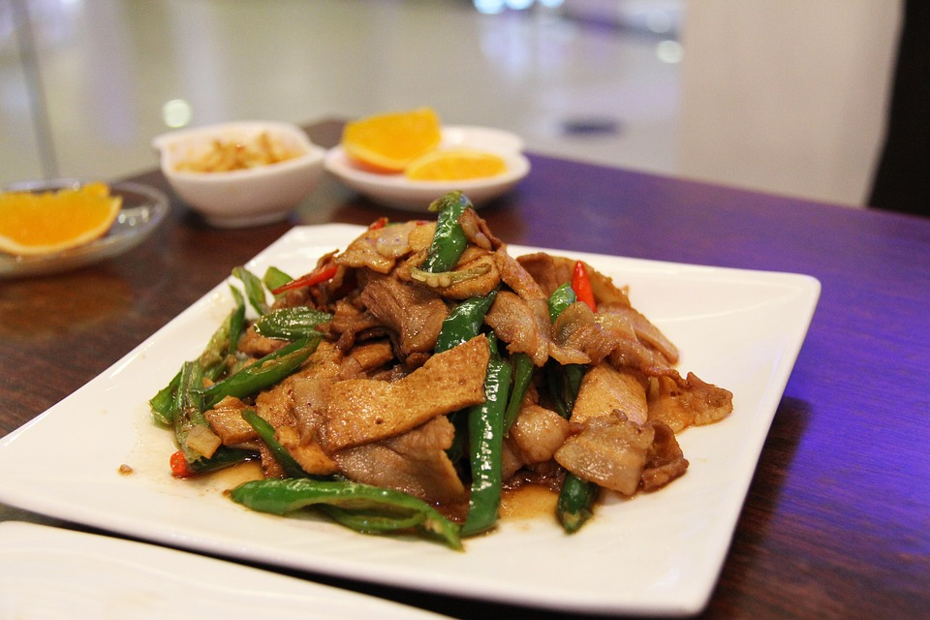
Which food groups?

Slide 14
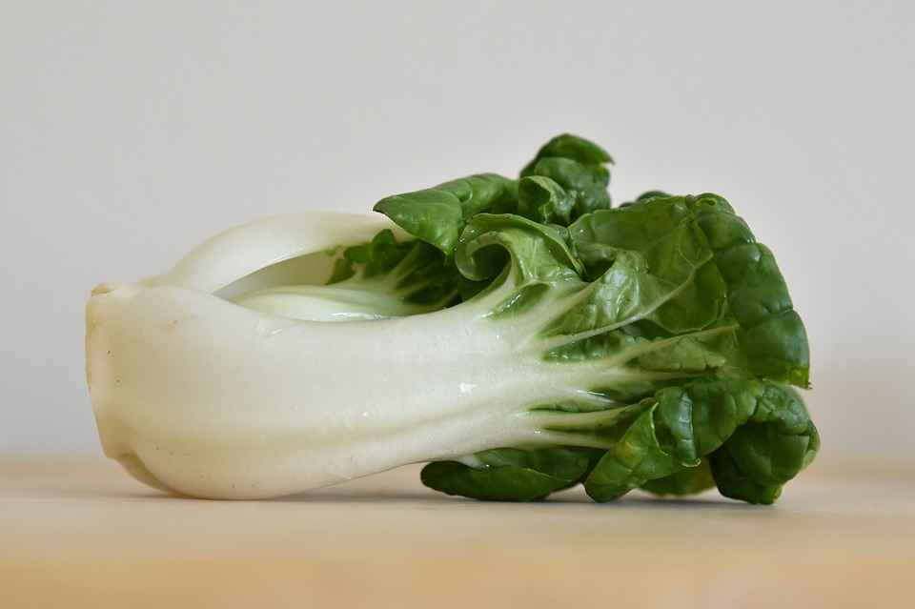
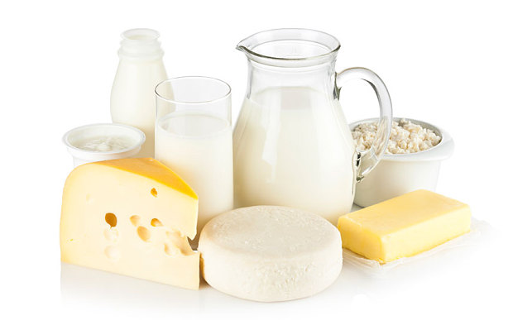
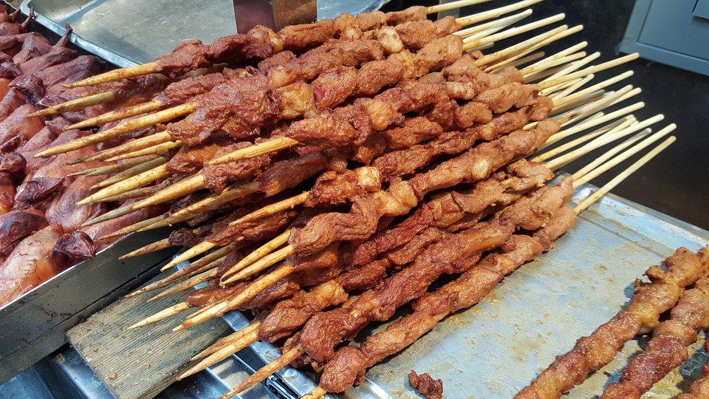
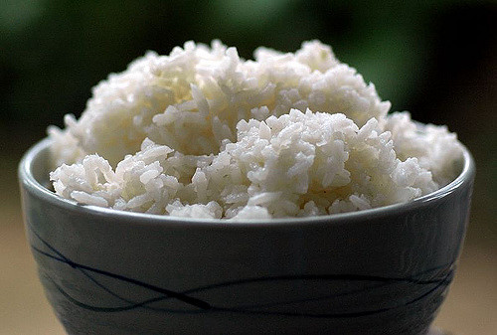
Which food groups?

Slide 15
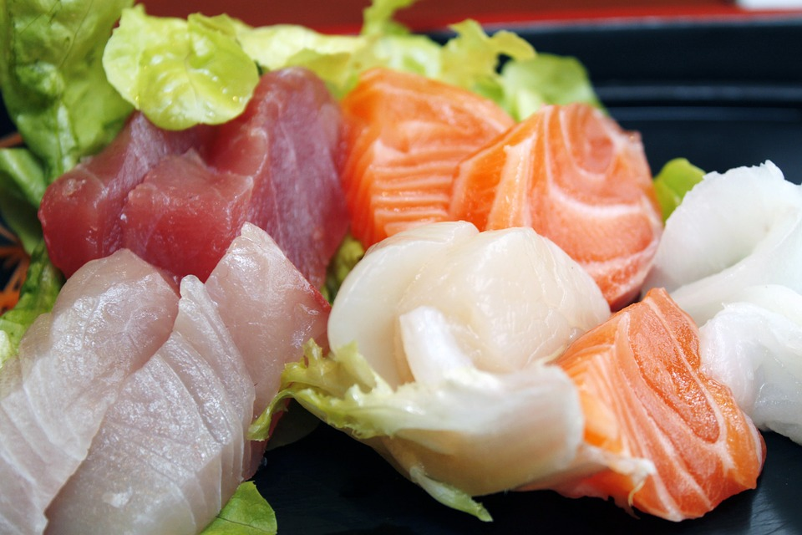
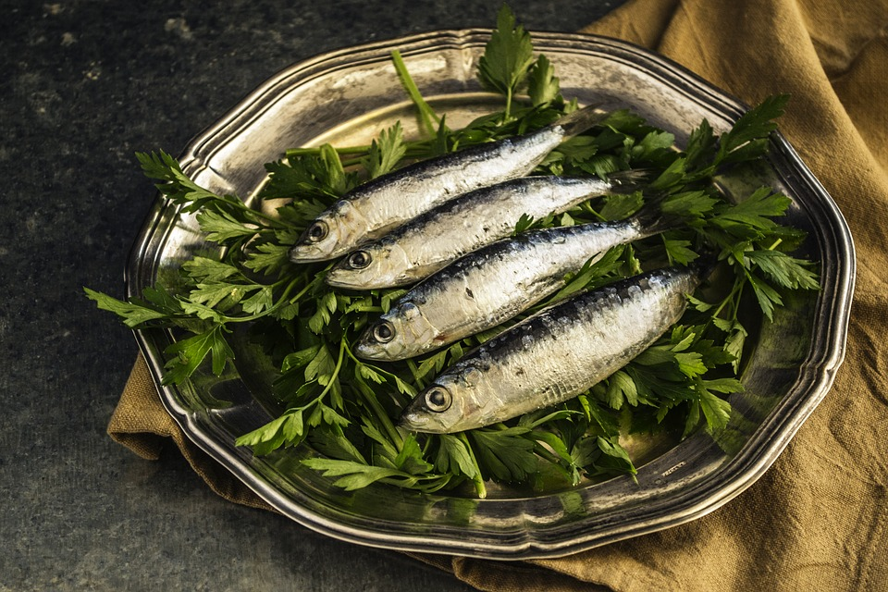
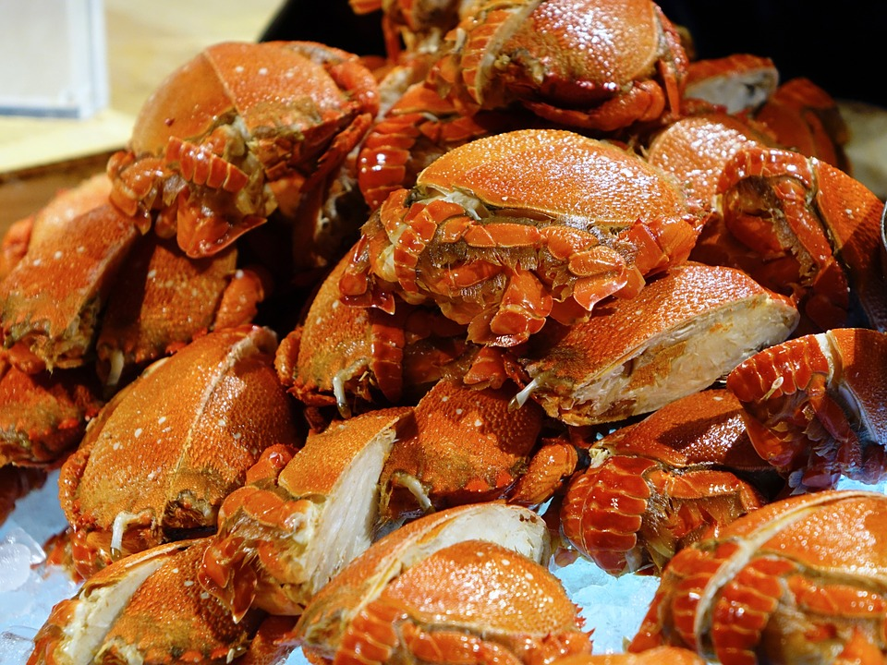
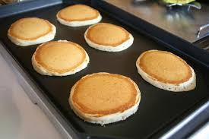
Which food groups?

Slide 16
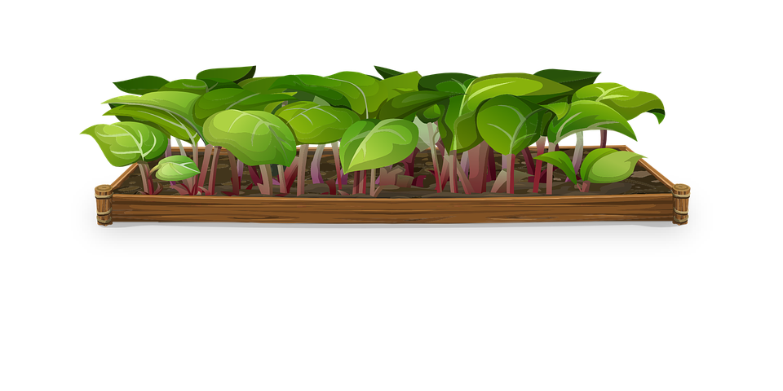
Mine or yours?
This pear is_____. (I)
I don't like Tom's vegetable garden, but I like____. (you)
Here is your chocolate. The snack on the desk is _____ . (I)
That's my drink, and the fries are____ too!

Slide 17
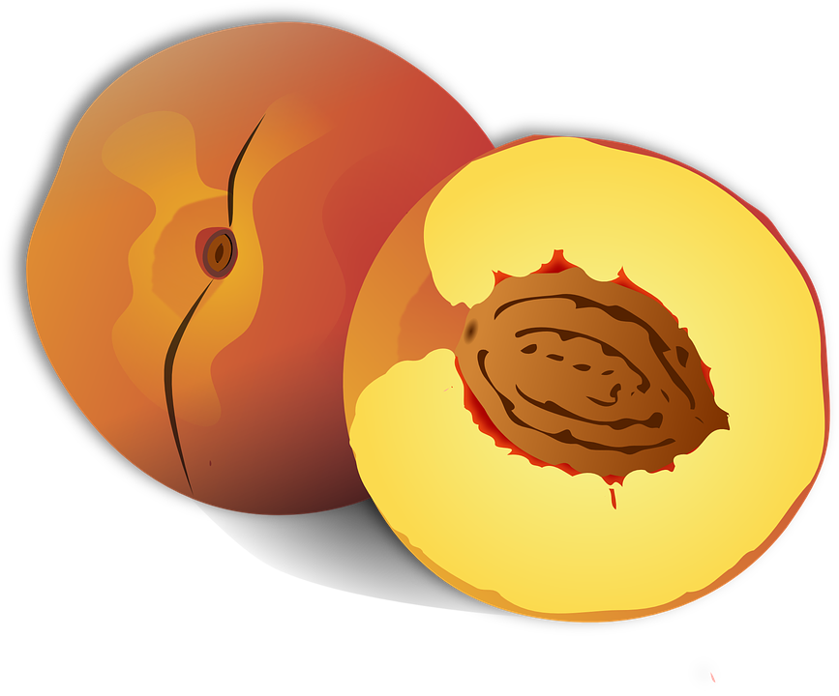
Mine or yours?
Is this John's peach or______? (you)
That's my meal. That's _____! (I)
I think this is not_____(you) and that is not_____(I).
She's a friend of_____.(I)

Slide 18

Do you remember?
“Because” is used to connect sentences.
The word “and” is used to join a group of words.
The word “or” links two different ideas.
“But” is used to connect statements that express opposite ideas.

Slide 19
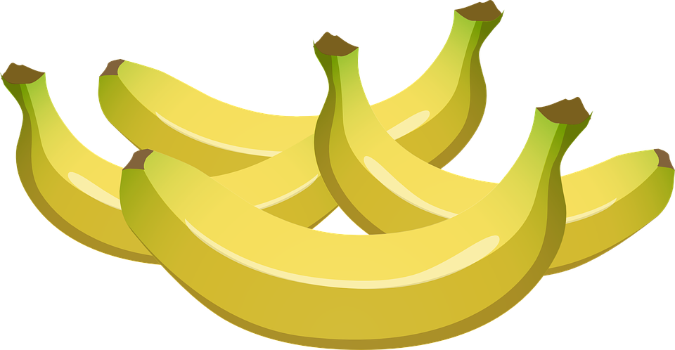
Finish these sentences
I like bananas, but ...
He enjoys breakfast and …
My mom wants juice or …
Would you like noodles or …
I missed lunch because …

Slide 20
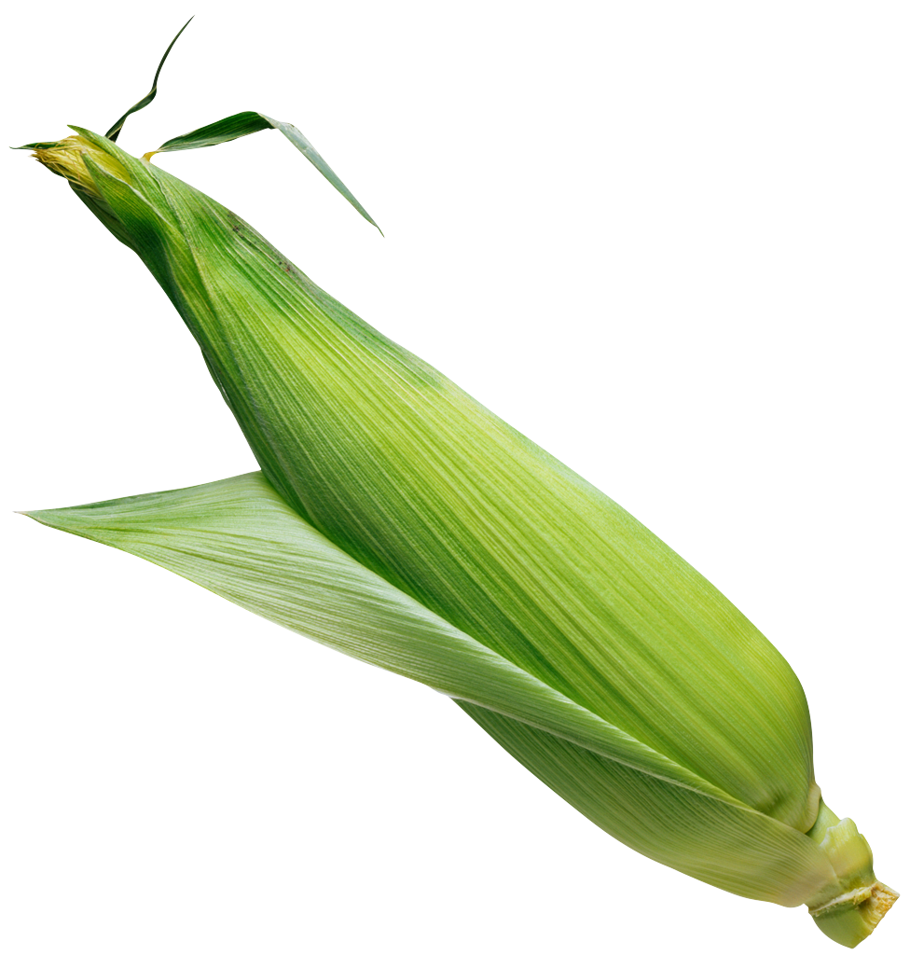
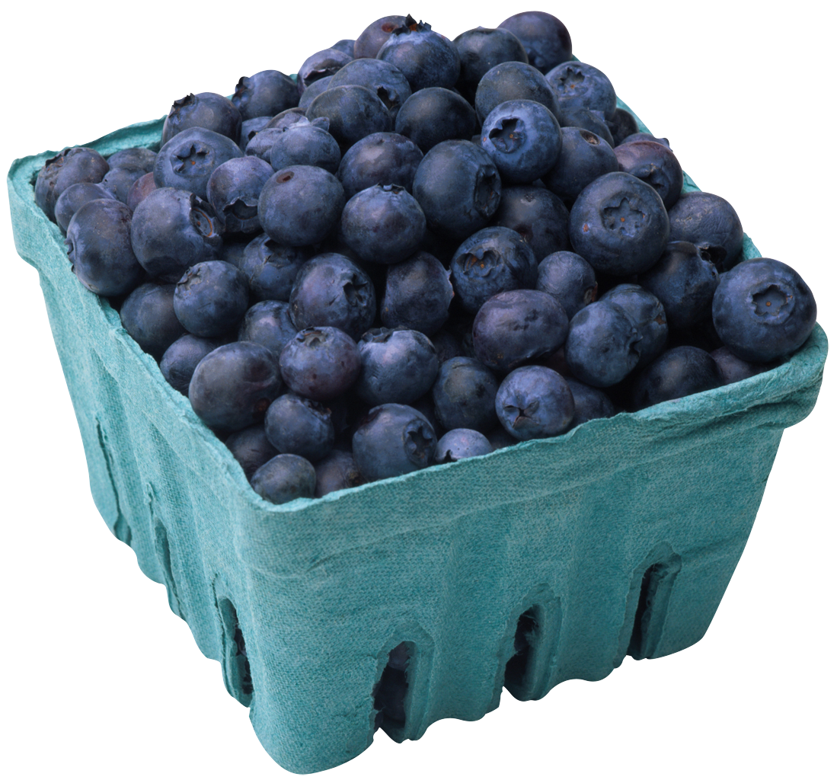
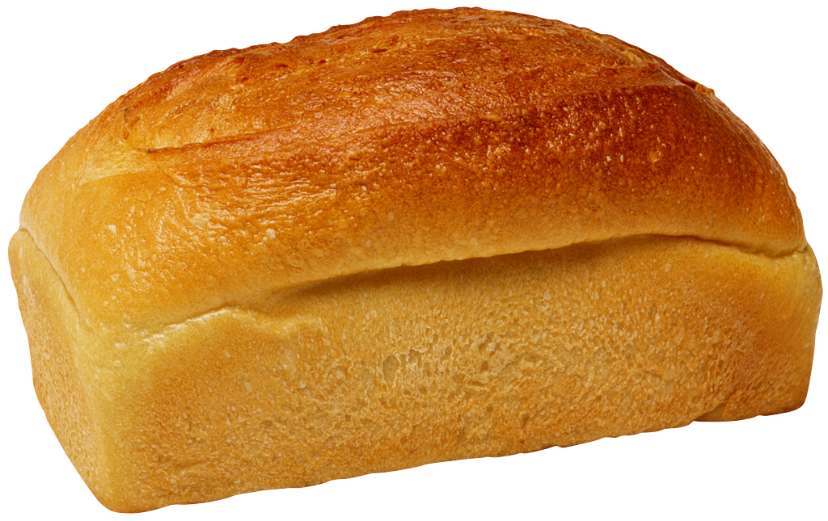










Pictionary

Slide 21

Complete the text with
“and”, “or”, “but”, or “because”
I wake up at 8:30 in the morning. I am hungry ______ there isn’t any food in the fridge. I want milk, cereals ______ orange juice. Then, I go to the shop ______ it is locked ______ it’s closed. I go back home and into the kitchen. There is some grapefruit juice and brown bread. ______ I don’t like grapefruit juice ______ brown bread! This is not a good morning, so I go back to
bed until the shop opens.

Slide 22
Complete the text with
“and”, “or”, “but”, or “because”
I wake up at 8:30 in the morning. I am hungry but there isn’t any food in the fridge. I want milk, cereals and orange juice. Then, I go to the shop but it is locked because it’s closed. I go back home and into the kitchen. There is some grapefruit juice and brown bread. But I don’t like grapefruit juice and brown bread! This is not a good morning, so I go back to
bed until the shop opens.

Slide 23



Correct the underlined word using
“and”, “or”, “but”, or “because”
1. We won’t have a picnic but it’s cold.
2. They don’t like meat because fish.
3.It’s summer because I’m not hot.
4. Take your umbrella and it’s raining.
5. Do you want cheese because grapes?

Slide 24


Differences
Describe the difference between these foods. Talk about colour, size, shape, food group, and anything else you can think of.
fried chicken
broccoli

Slide 25

What did I learn today?
Reviewed “mine”, “yours”, “but”, “because”, “or” and “and”
Practiced “ing”, “ng”, “dr” and “tr” words
Foods around the world
How to read a story

Slide 26

Homework
Notes:
For homework, students should make al list of what they eat for one day and decide if it belongs to plants, animals or both.

