Slide 1
Lesson 8 FOOD

Slide 2
What we will learn today
Reviewing the “ing”, “ng”, “dr” and “tr” words
Spelling
Using “and”, “but”, “or” and “because”
Some international foods
Reading
Notes:
Go over the learning goals.

Slide 3
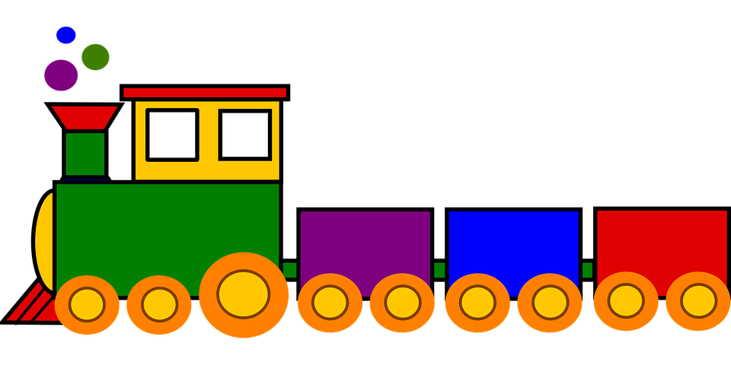
Our “tr” paragraphs
I had a trumpet in the trunk of my truck. I left my keys in the trash. I was going to be late for my date with my girlfriend, the tree, so I took the train. She missed my trumpet playing.
Notes:
Get the students to share their funny “tr” paragraphics.

Slide 4
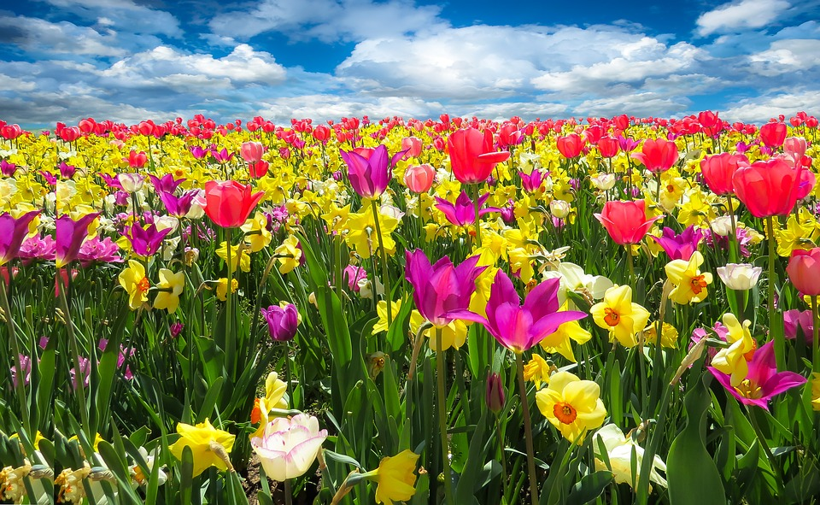
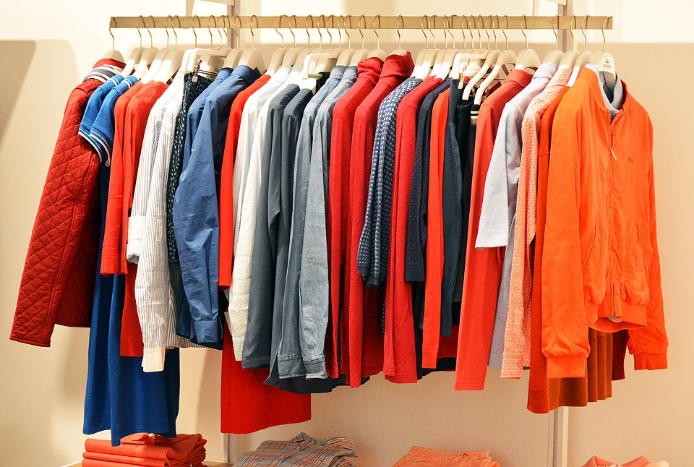
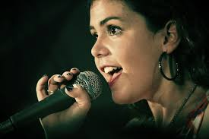
Do you remember?
_ _ _ ing
_ _ ng
_ ing
Notes:
Ask students to recall and spell the following words from previous units.

Slide 5
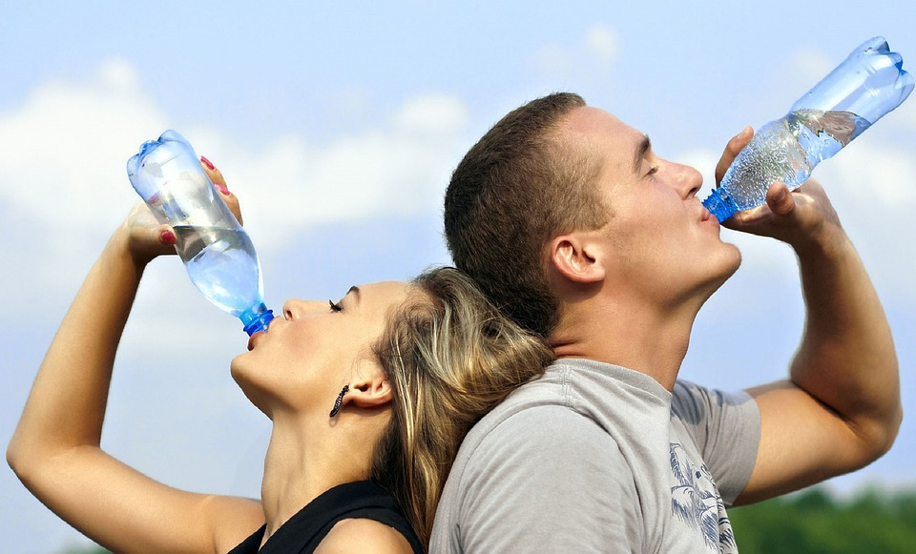
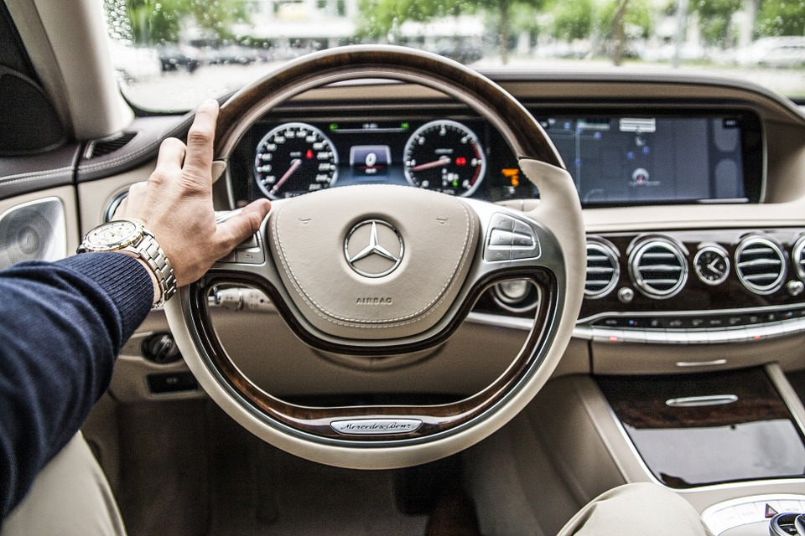
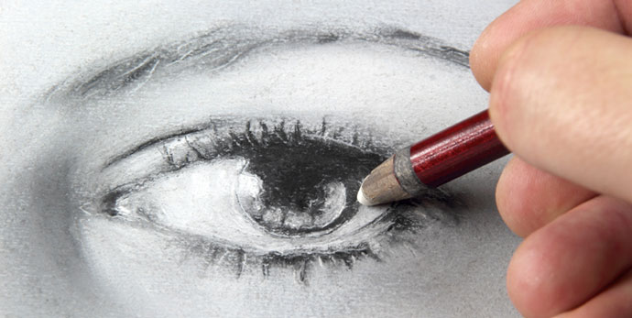
How do you spell?
dr_ _ _
dr _ _ _ _ _
dr_ _ _
Notes:
Ask students to recall and spell the following words from previous units.

Slide 6
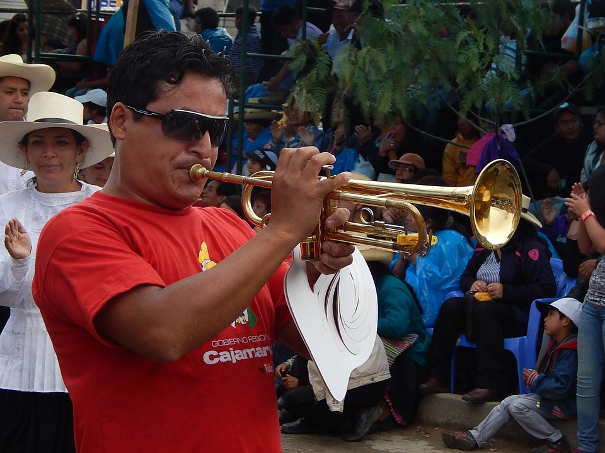
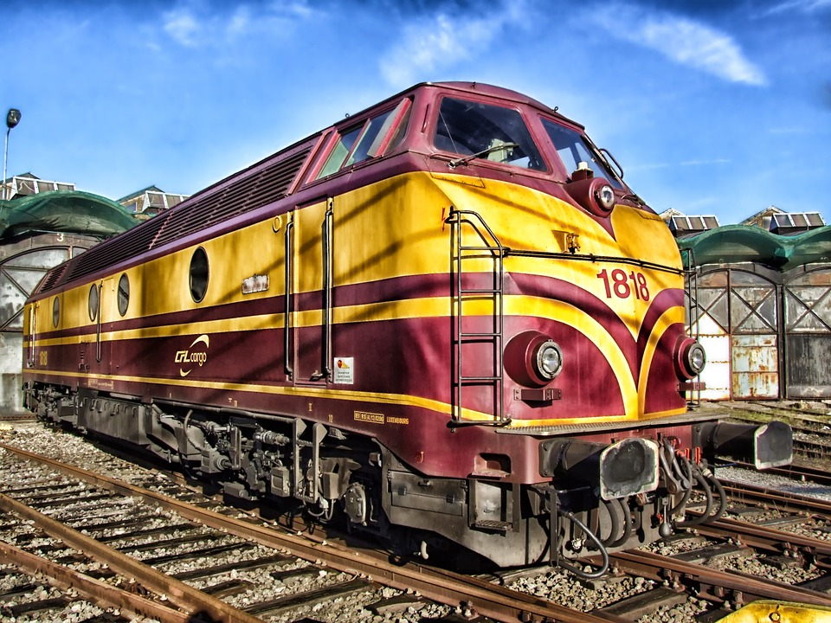
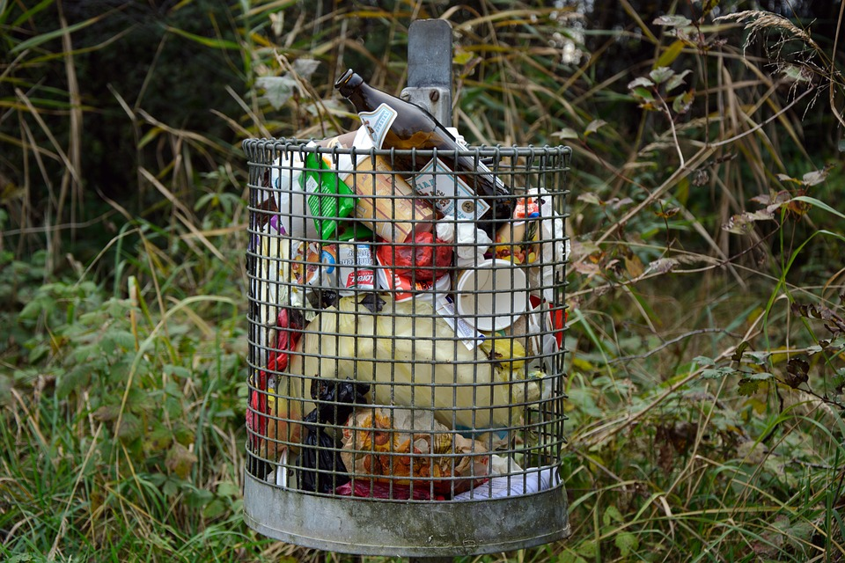
Spelling!
tr _ _ _ _ _
tr_ _ _
tr_ _ _
Notes:
Ask students to recall and spell the following words from previous units.

Slide 7
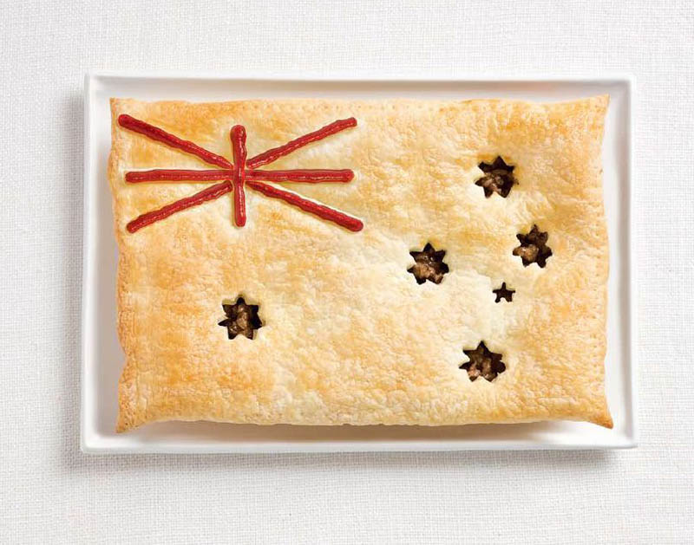
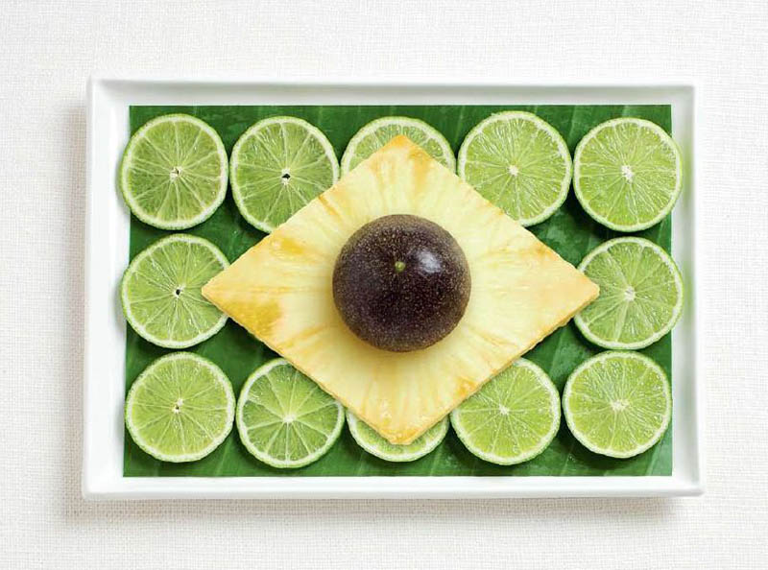
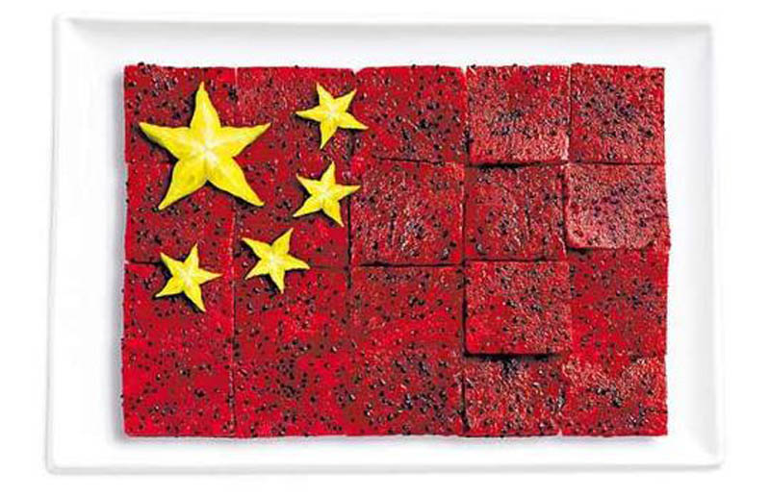
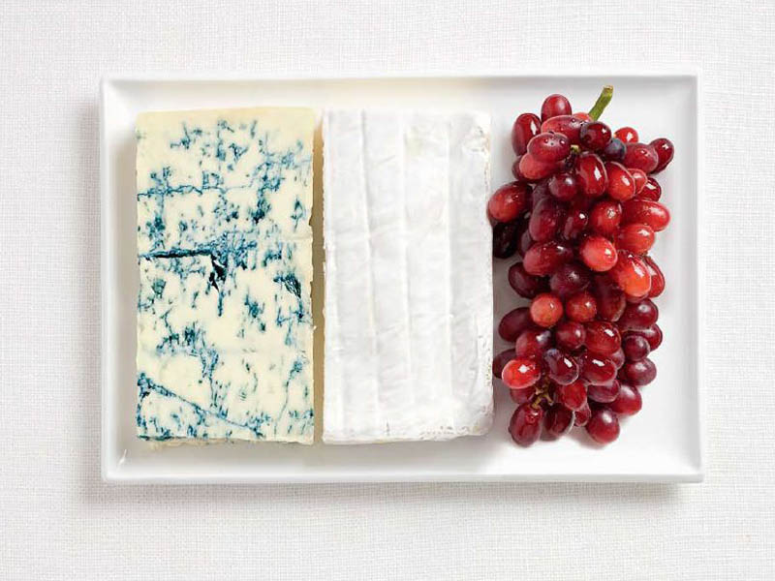
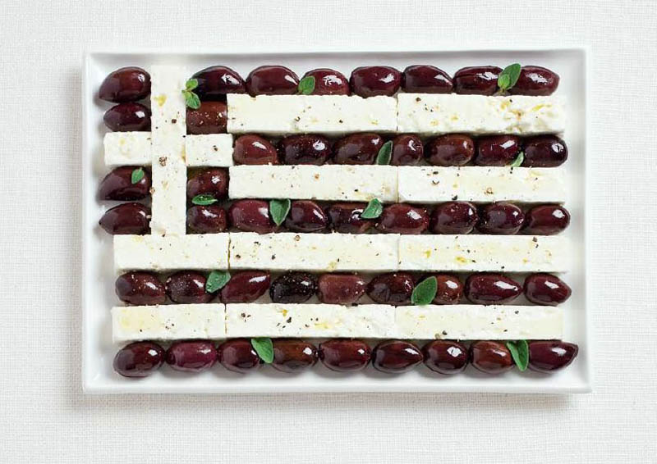
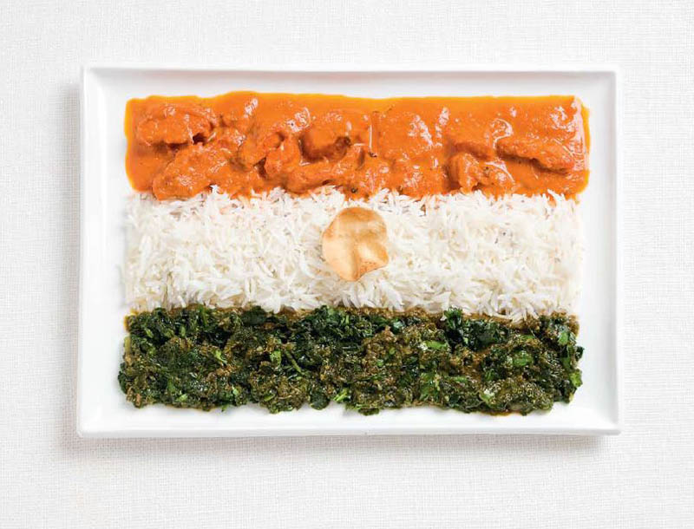
World Food Flags
Notes:
Australia, Brazil, China
France, Greece, India
https://www.visualnews.com/2013/08/27/national-flags-created-foods-country-commonly-associated/

Slide 8
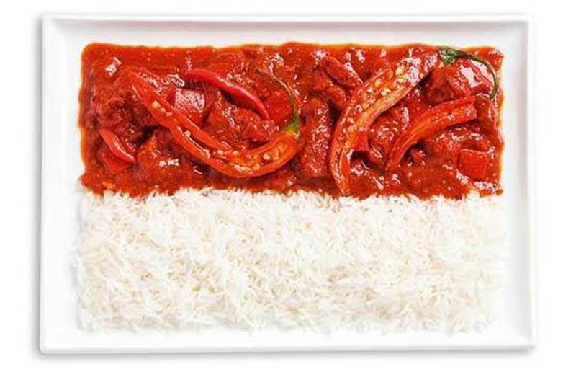
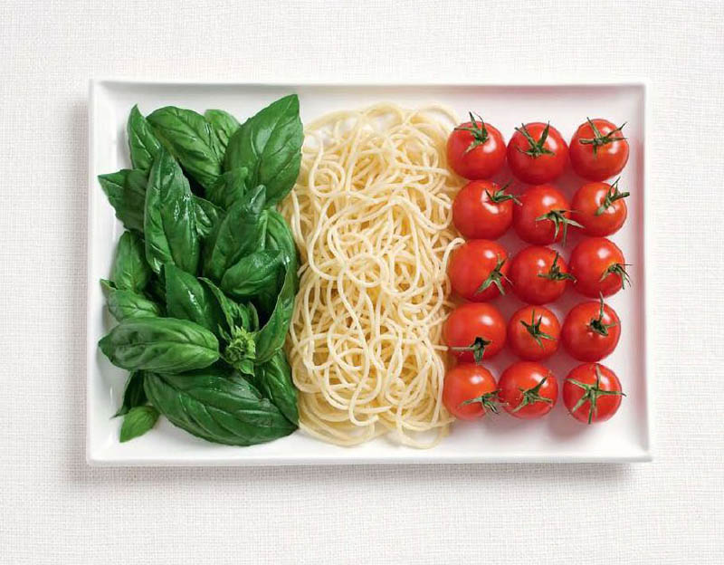
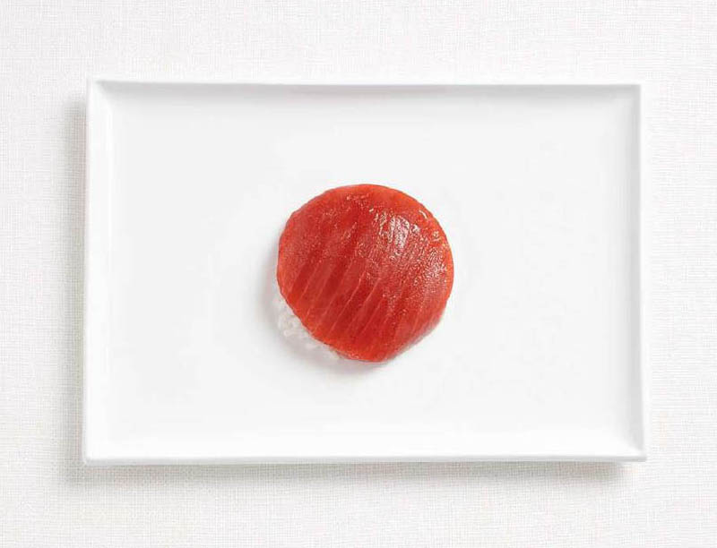
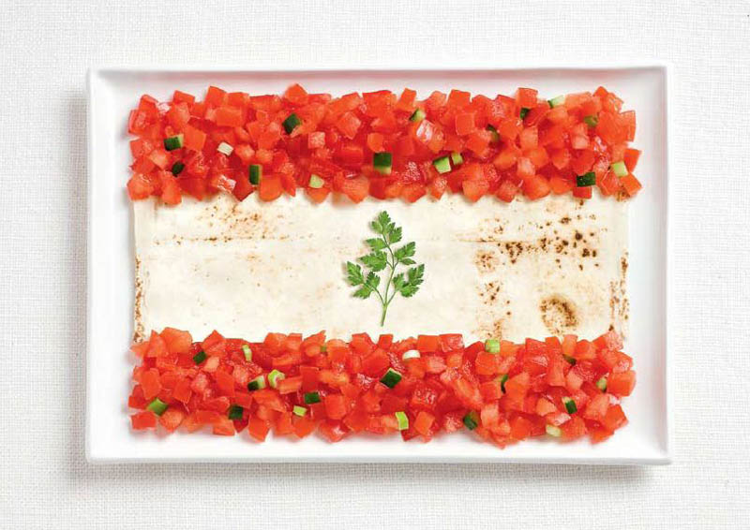
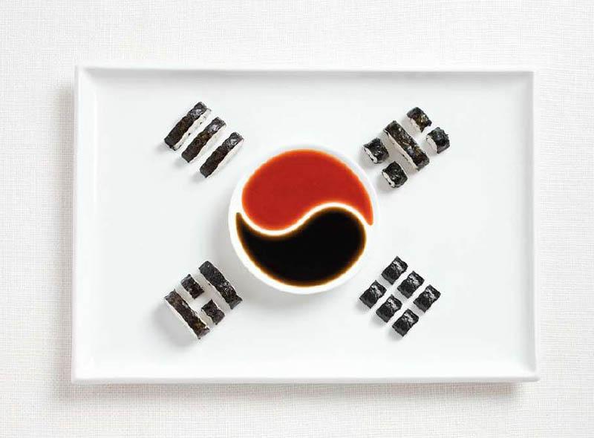
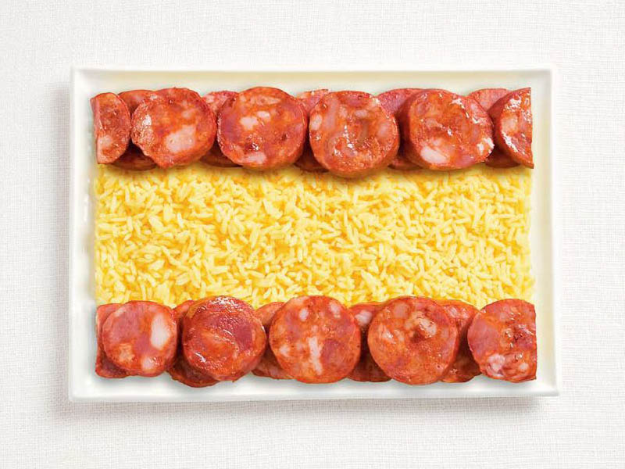
World Food Flags
Notes:
Indonesia, Italy, Japan
Lebanon, Korea, Spain
https://www.visualnews.com/2013/08/27/national-flags-created-foods-country-commonly-associated/

Slide 9
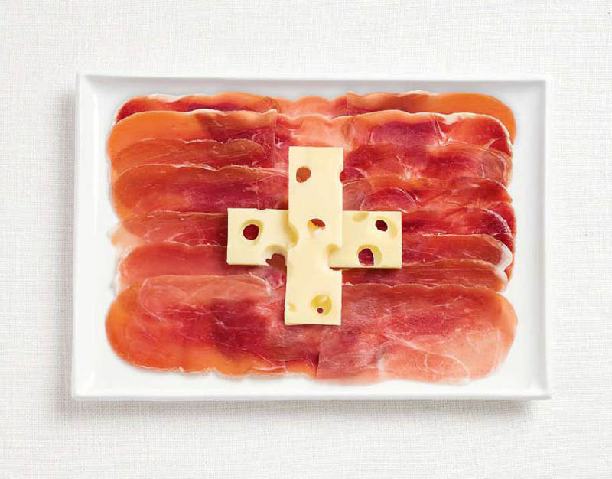
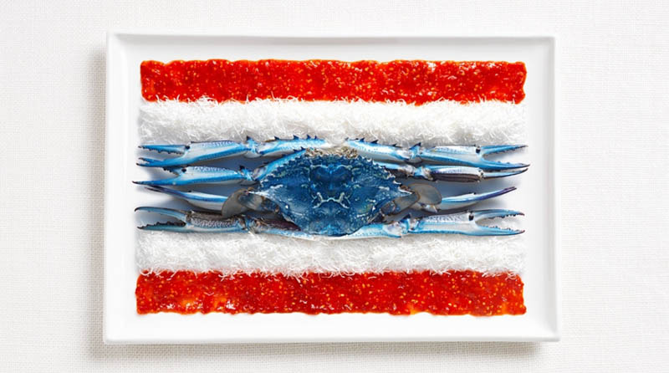
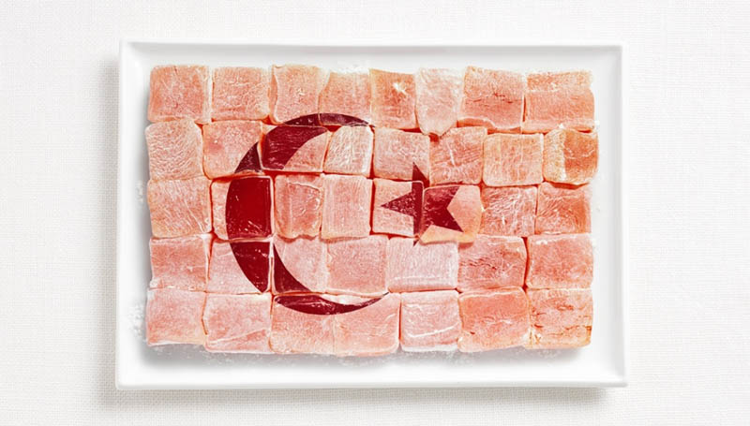
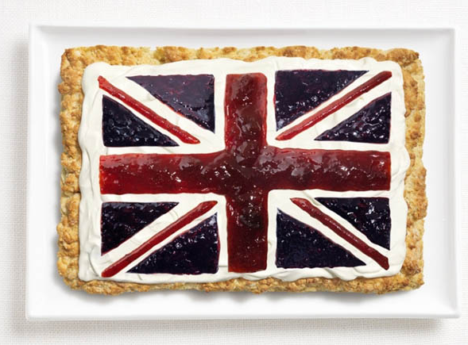
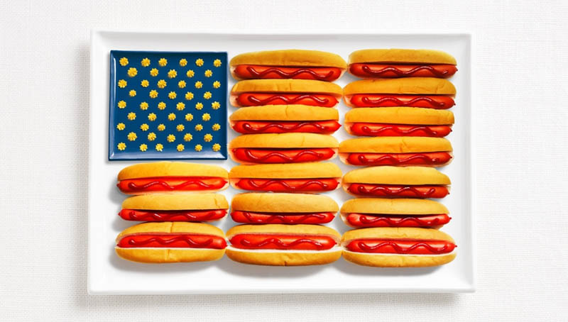
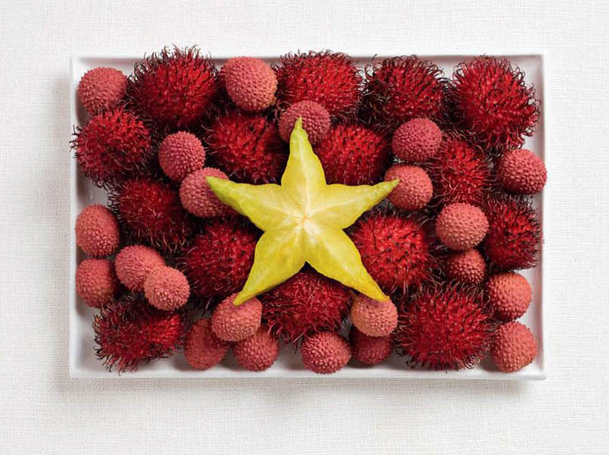
World Food Flags
Match the verb to the photo.
Notes:
Switzerland, Thailand, Turkey
United Kingdom, USA, Vietnam
https://www.visualnews.com/2013/08/27/national-flags-created-foods-country-commonly-associated/

Slide 10
Matching
Notes:
Match the verb to the photo.

Slide 11
Story Time
Notes:
Play “The Giving Tree.mp4”. The file has no sound, so you need to read along with it.

Slide 12
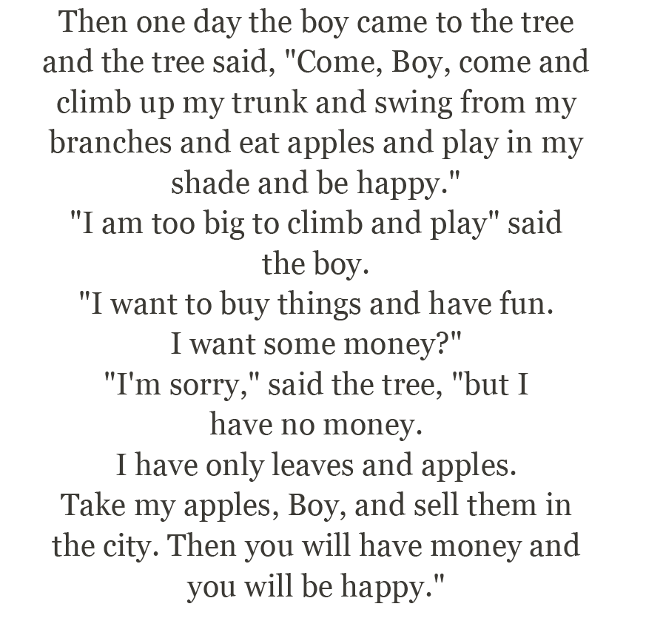
Notes:
Get students to underline all the instances of “and” and “but”.
Some discussion questions:
Why do you think the tree loved the boy in the beginning?
Why do you think the boy loved the tree?
Have you ever given something away and later wished that you hadn’t?
Is it easier to give something away if the receiver truly appreciates the gift?
When you give something to someone, do you expect something in return?
Is the boy happy at the end of the story?
Is the tree happy?
If you were the tree would you be happy? Why?

Slide 13
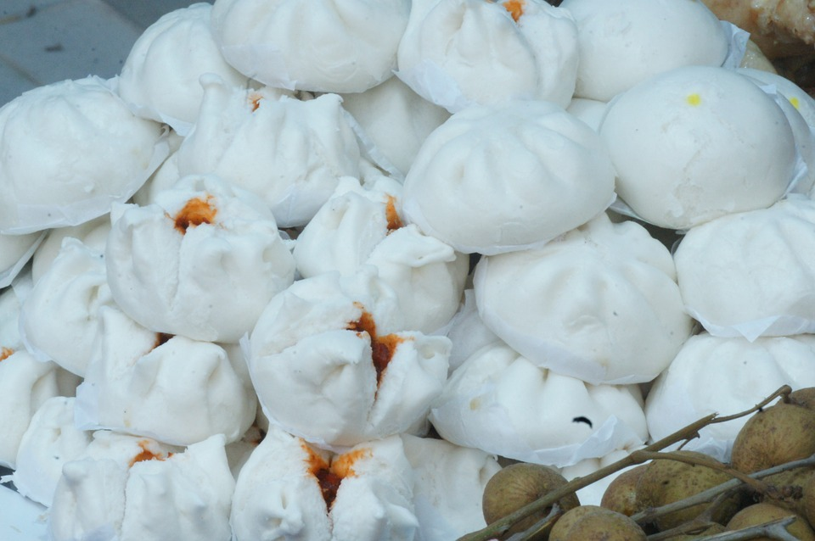
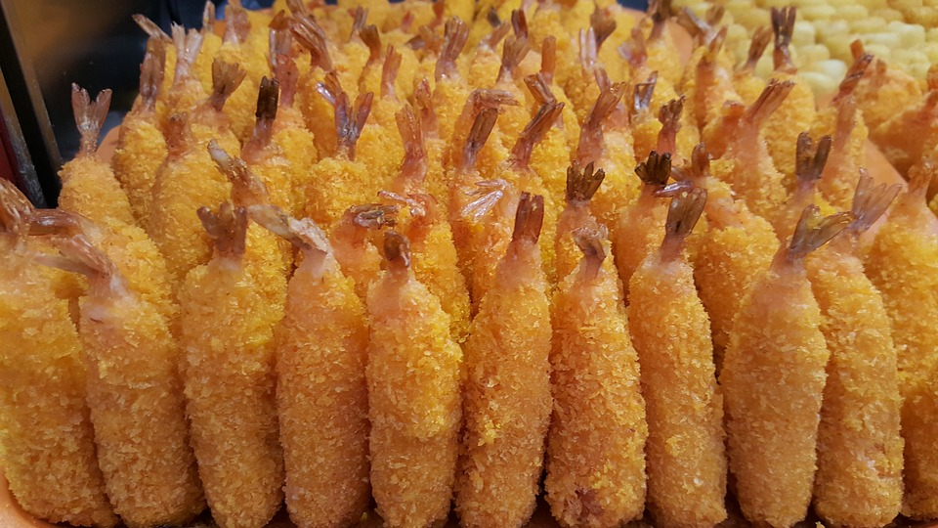
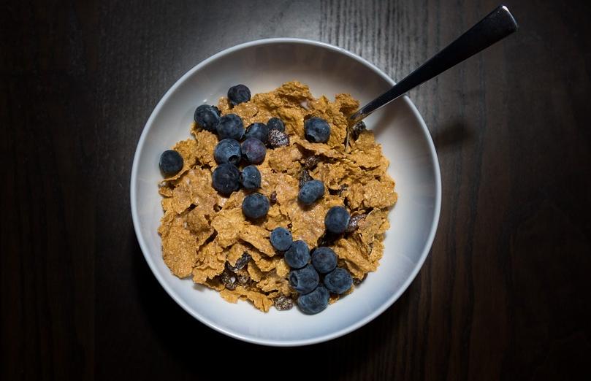
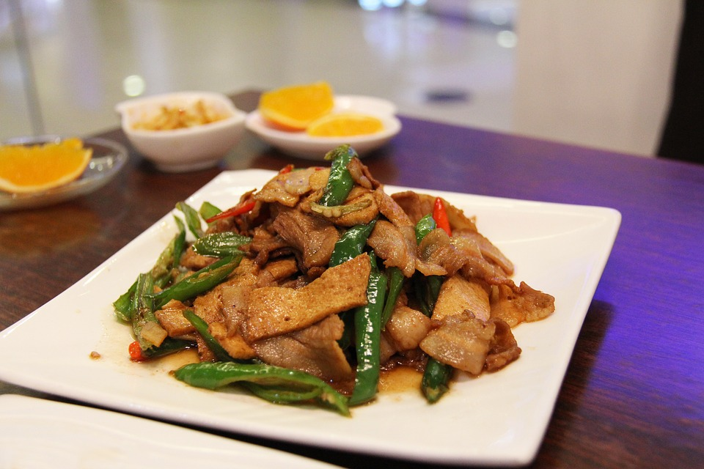
Which food groups?
Notes:
Ask the students which food group for each picture.

Slide 14
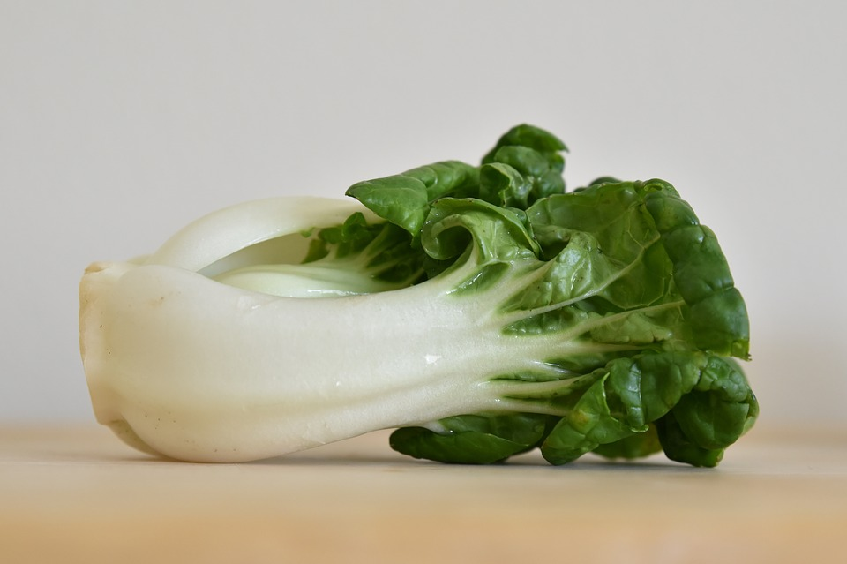
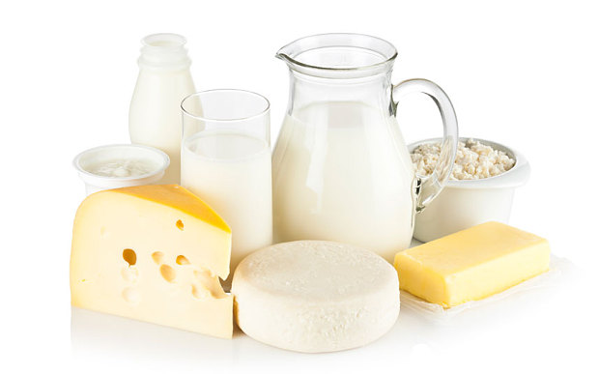
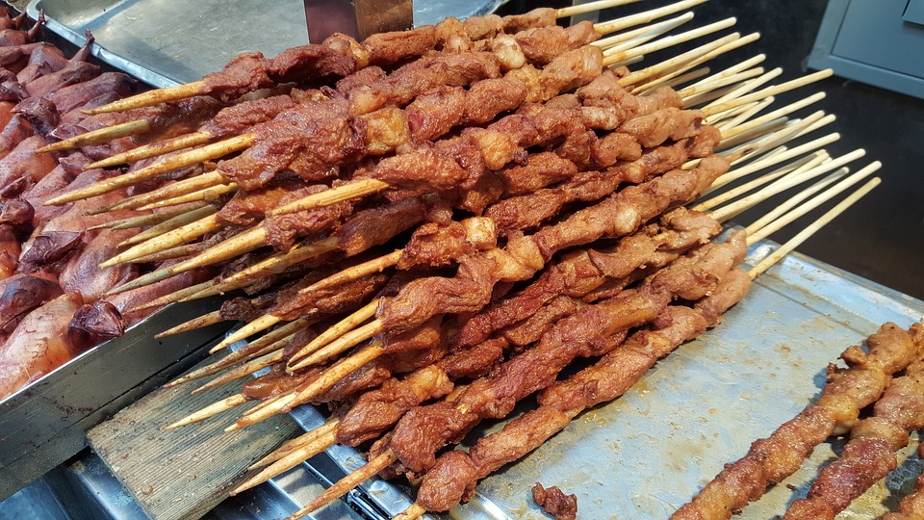
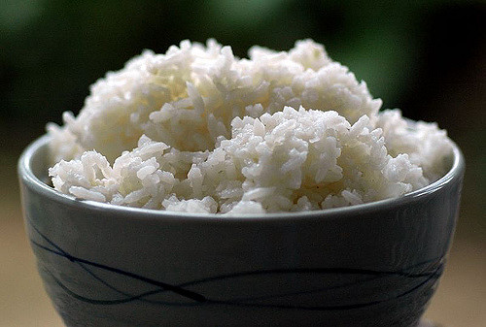
Which food groups?
Notes:
Ask the students which food group for each picture.

Slide 15
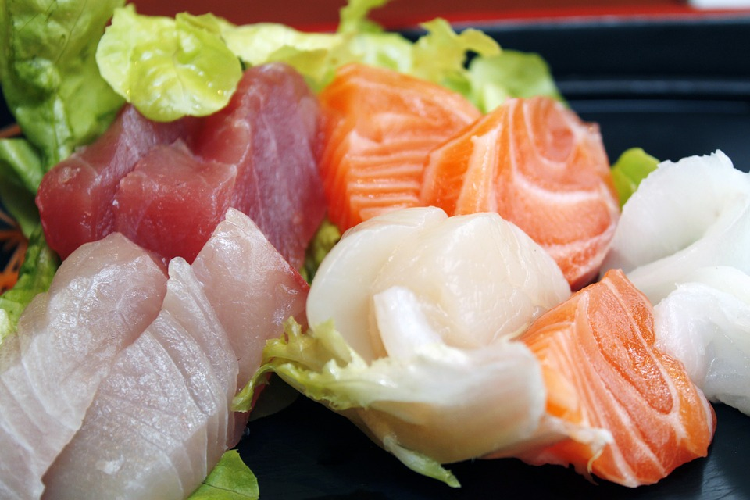
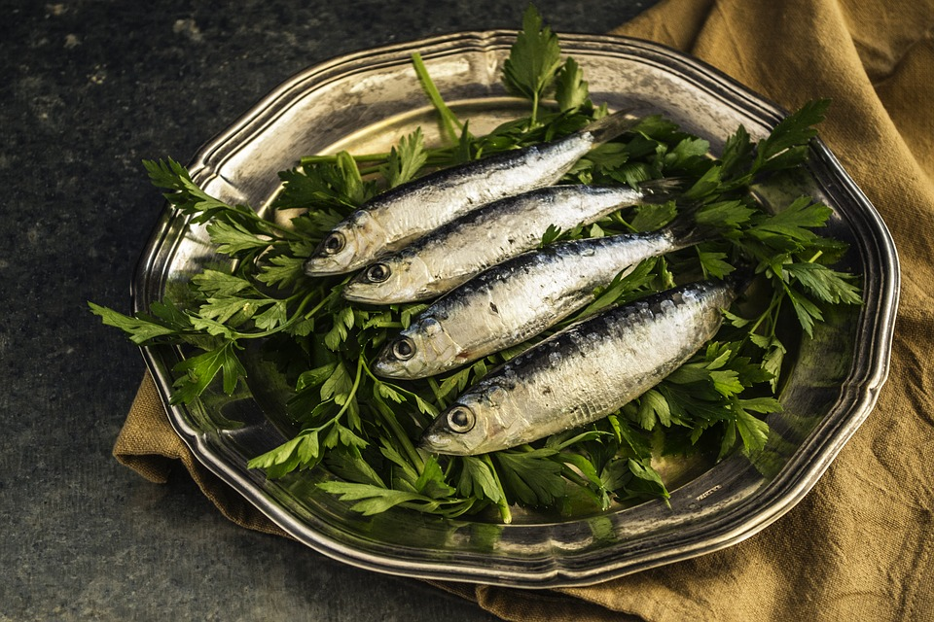
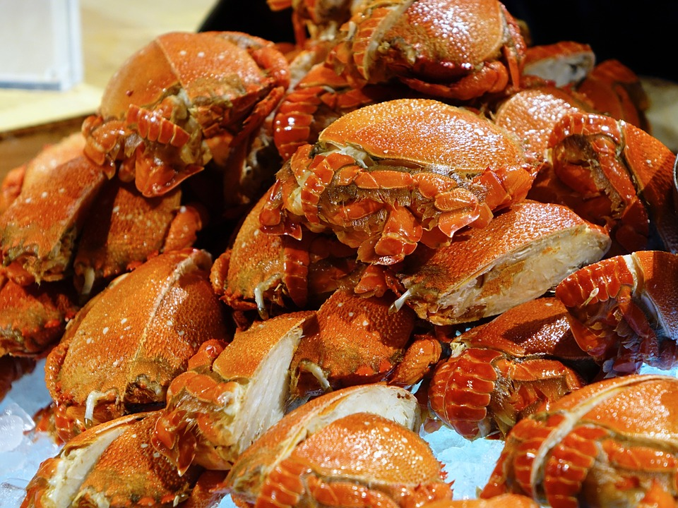
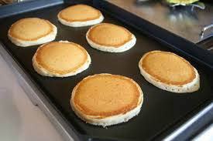
Which food groups?
Notes:
Match the verb to the photo.

Slide 16
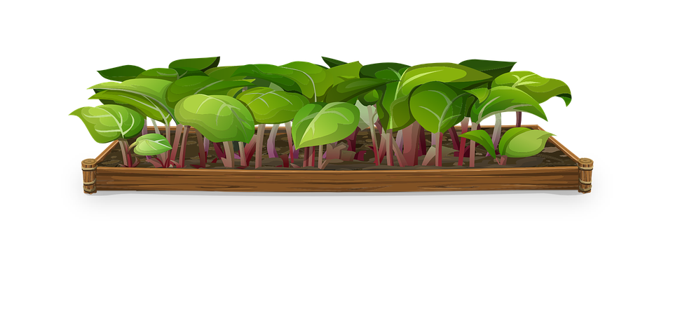
Mine or yours?
This pear is_____. (I)
I don't like Tom's vegetable garden, but I like____. (you)
Here is your chocolate. The snack on the desk is _____ . (I)
That's my drink, and the fries are____ too!
Notes:
Get the students to verbally do the questions. Alternate between each student. 1. mine 2. yours 3. mine 4. mine

Slide 17
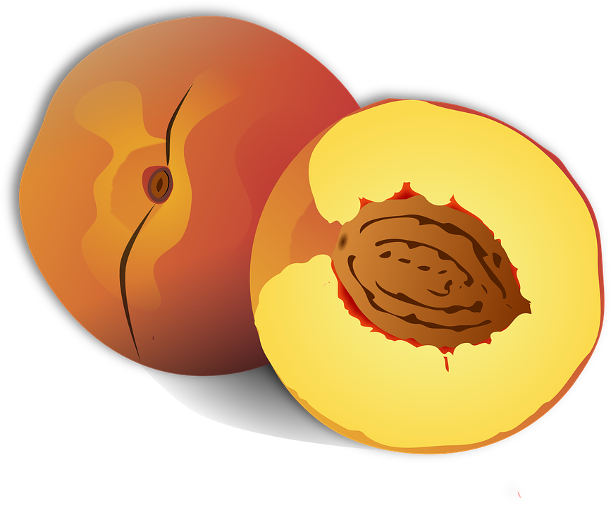
Mine or yours?
Is this John's peach or______? (you)
That's my meal. That's _____! (I)
I think this is not_____(you) and that is not_____(I).
She's a friend of_____.(I)
Notes:
Get the students to verbally do the questions. Alternate between each student. 5. yours 6. mine 7. yours mine 8. mine

Slide 18
Do you remember?
“Because” is used to connect sentences.
The word “and” is used to join a group of words.
The word “or” links two different ideas.
“But” is used to connect statements that express opposite ideas.
Notes:
Explain Slide

Slide 19
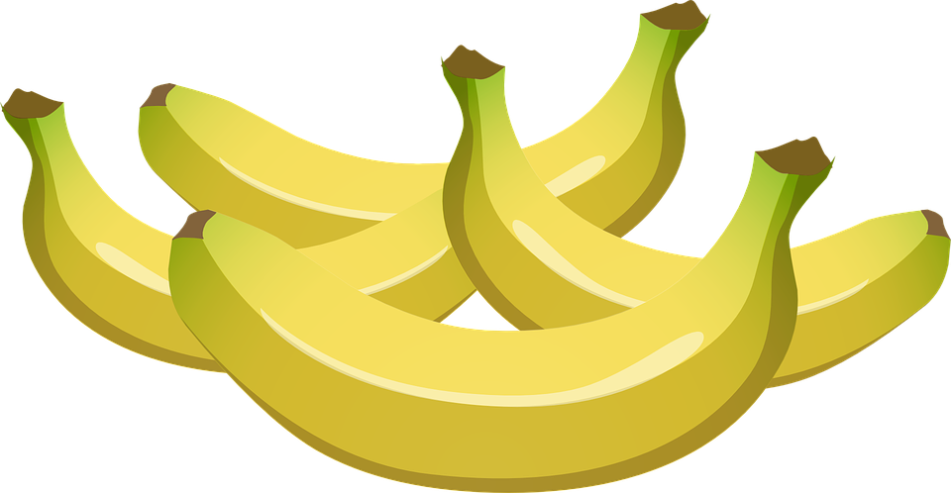
Finish these sentences
I like bananas, but ...
He enjoys breakfast and …
My mom wants juice or …
Would you like noodles or …
I missed lunch because …
Notes:
Get students to finish these sentences verbally.

Slide 20
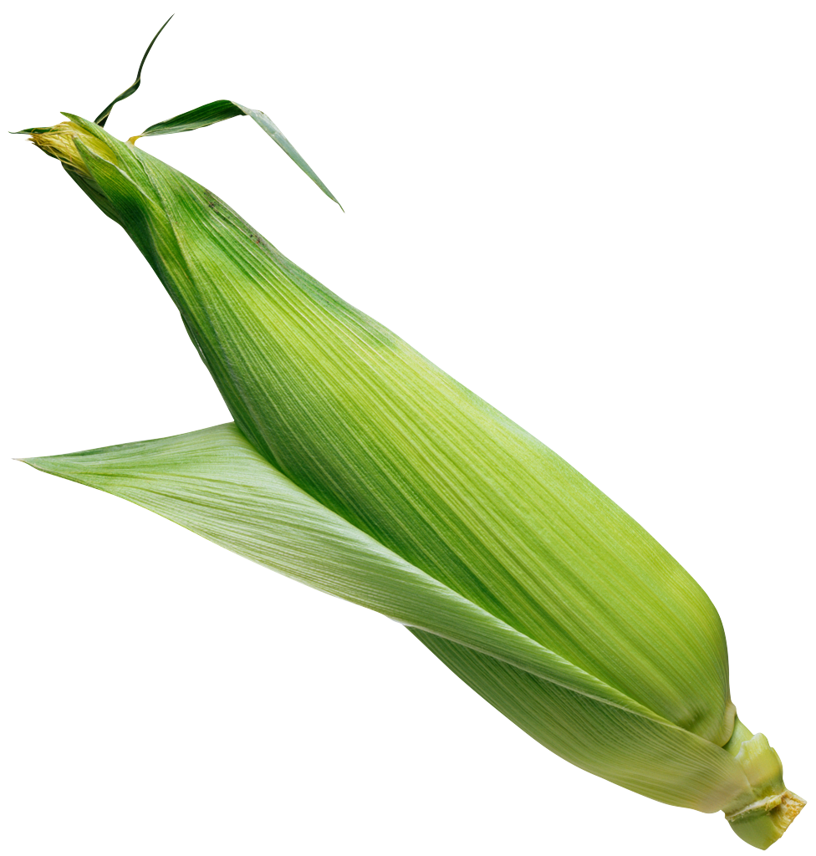
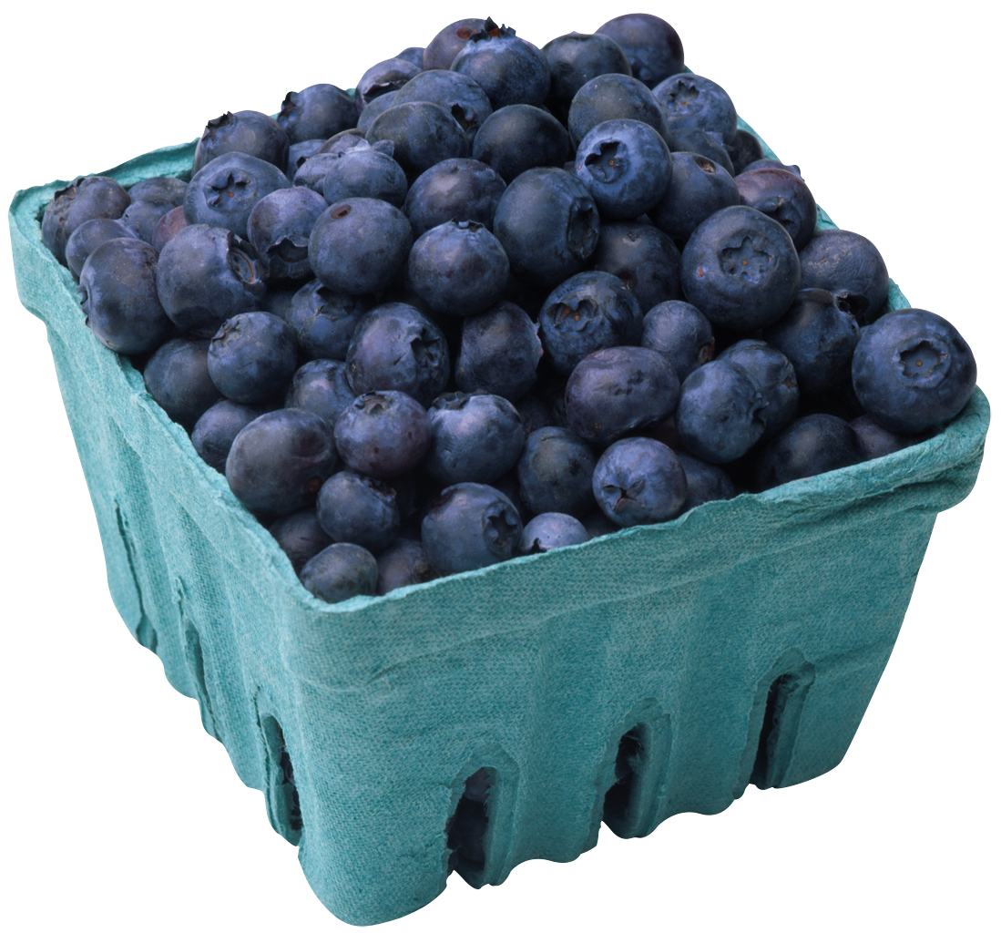
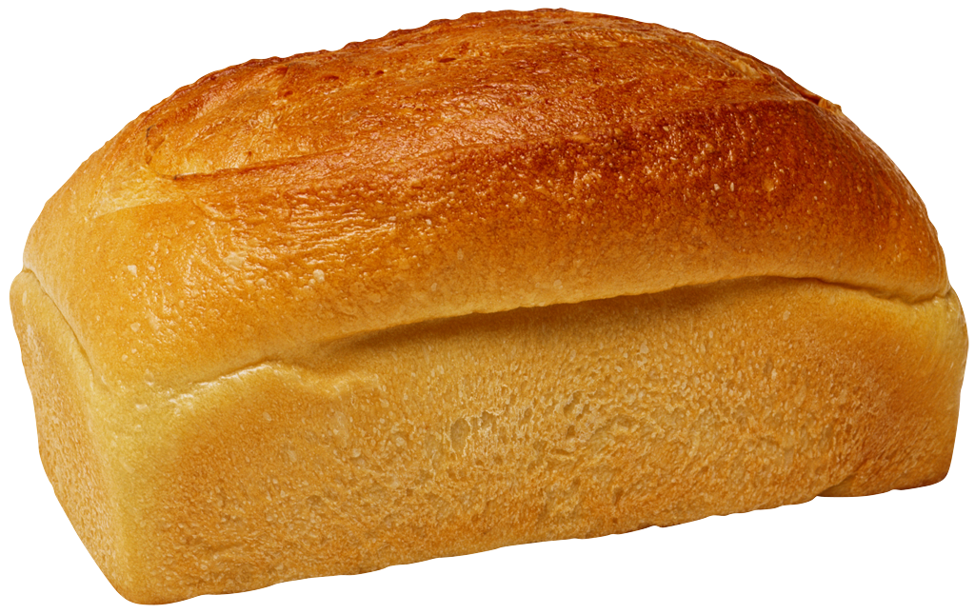
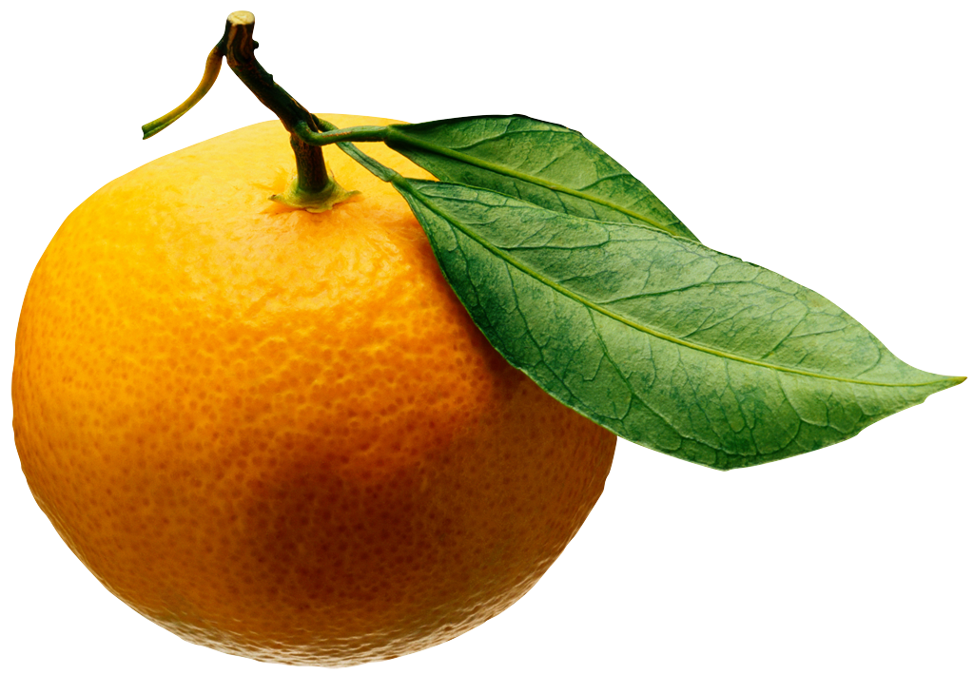
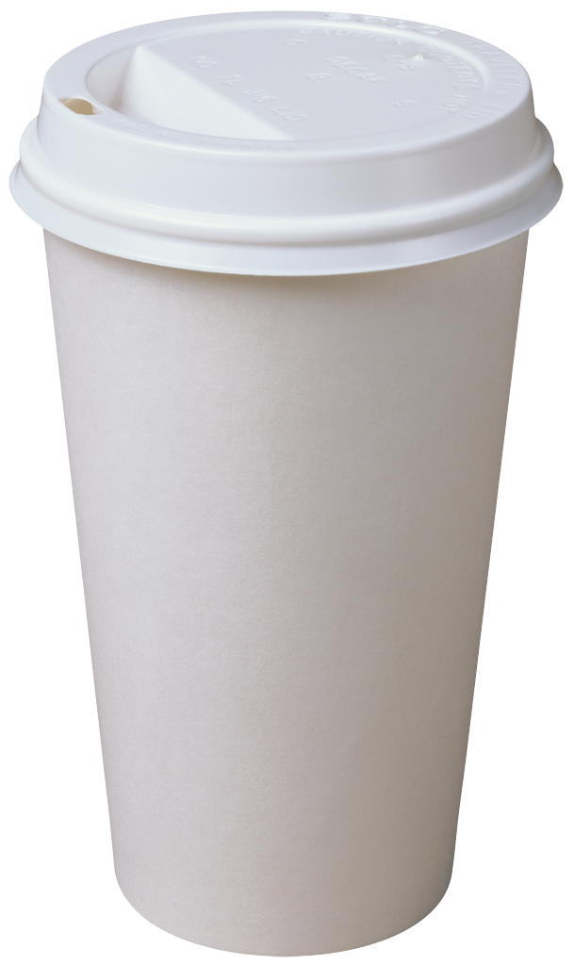
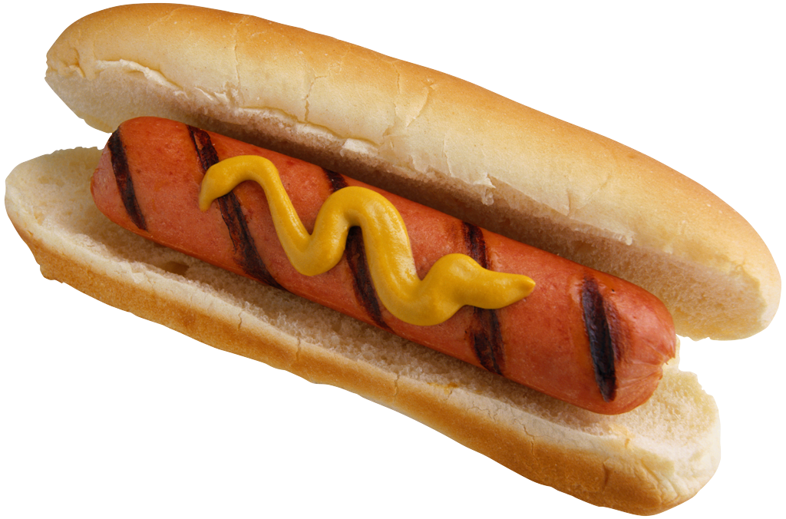
Pictionary
Notes:
Take out a piece of paper. Choose one of the food vocabulary words we have learned in this unit. Draw a picture with a marker. Show the class and have them guess what you drew.

Slide 21
Complete the text with “and”, “or”, “but”, or “because”
I wake up at 8:30 in the morning. I am hungry ______ there isn’t any food in the fridge. I want milk, cereals ______ orange juice. Then, I go to the shop ______ it is locked ______ it’s closed. I go back home and into the kitchen. There is some grapefruit juice and brown bread. ______ I don’t like grapefruit juice ______ brown bread! This is not a good morning, so I go back to
bed until the shop opens.
Notes:
Get the students to do this activity silently and write down what conjunction goes where.

Slide 22
Complete the text with “and”, “or”, “but”, or “because”
I wake up at 8:30 in the morning. I am hungry but there isn’t any food in the fridge. I want milk, cereals and orange juice. Then, I go to the shop but it is locked because it’s closed. I go back home and into the kitchen. There is some grapefruit juice and brown bread. But I don’t like grapefruit juice and brown bread! This is not a good morning, so I go back to
bed until the shop opens.
Notes:
Explain the answers.

Slide 23
Correct the underlined word using “and”, “or”, “but”, or “because”
1. We won’t have a picnic but it’s cold.
2. They don’t like meat because fish.
3.It’s summer because I’m not hot.
4. Take your umbrella and it’s raining.
5. Do you want cheese because grapes?
Notes:
Do this activity verbally. Take up the answers. 1. because 2. or/and 3. but 4. because 5. or

Slide 24
Differences
Describe the difference between these foods. Talk about colour, size, shape, food group, and anything else you can think of.
fried chicken
broccoli
Notes:
Prompt the students to compare and contrast the two photos.

Slide 25
What did I learn today?
Reviewed “mine”, “yours”, “but”, “because”, “or” and “and”
Practiced “ing”, “ng”, “dr” and “tr” words
Foods around the world
How to read a story
Notes:
Review the lesson.

Slide 26
Homework
Notes:
For homework, students should make al list of what they eat for one day and decide if it belongs to plants, animals or both.

