Slide 1
Lesson 8: Tutoring FOOD

Slide 2
What we will learn today
New “ing” words
Practicing “and”
Using “and”, “but”, “or” and “because”
Writing about a meal
Matching words and pictures
Using pronouns
Notes:
Go over the learning goals.

Slide 3
Complete the text with “and”, “or”, “but”, or “because”
1.​ ​I am going to the movies_______ Nick ​is coming too. ​
2.​ ​I had five bars of chocolate ​____________ I was hungry. ​
3.​ ​My friend is 7 years old _________ ​I am only 5 years old.
4.​ ​Carla had chips ________ she could have cake. ​
​5.​ ​I wanted to buy popcorn at the movies ________ there was no popcorn left. ​
6.​ ​Shannon was crying ___________ ​she fell and hurt her leg. ​
Notes:
Go over the learning goals.

Slide 4
What we will learn today
1.​ ​I am going to the movies and Nick ​is coming too. ​
2.​ ​I had five bars of chocolate because I was hungry. ​
3.​ ​My friend is 7 years old and ​I am only 5 years old.
4.​ ​Carla had chips or she could have cake. ​
5.​ ​I wanted to buy popcorn at the movies but there was no popcorn left. ​
6.​ ​Shannon was crying because​she fell and hurt her leg. ​
Notes:
Go over the learning goals.

Slide 5
Where does “and” go?

Slide 6
Where does “and” go?

Slide 7
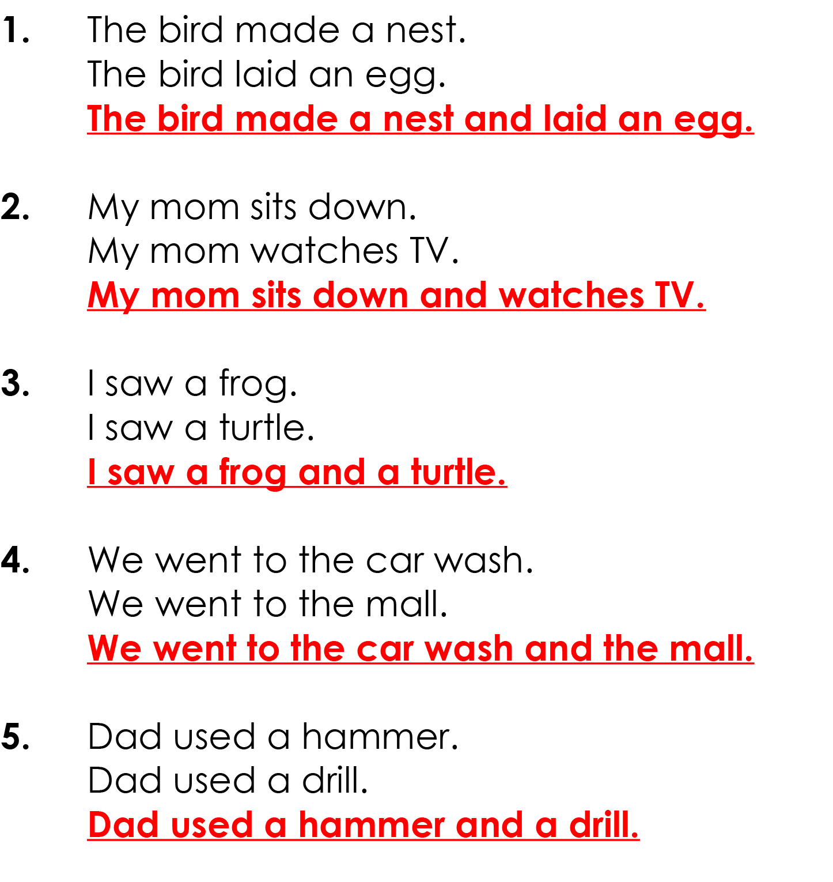
Answer key

Slide 8
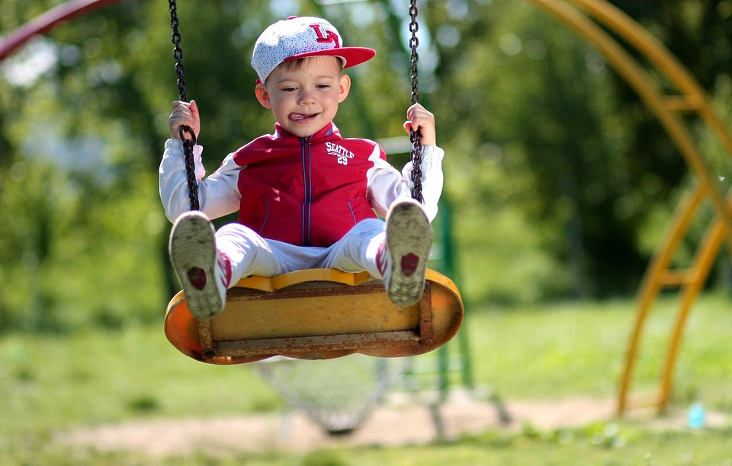
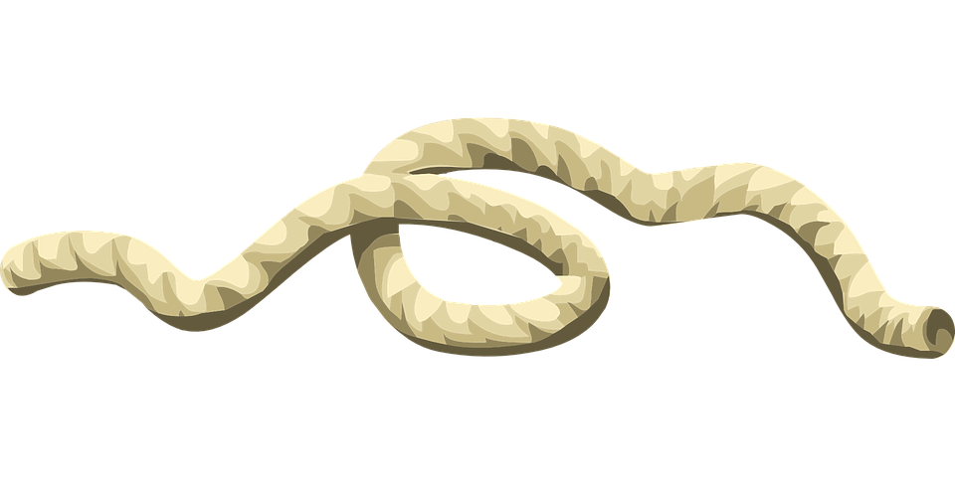
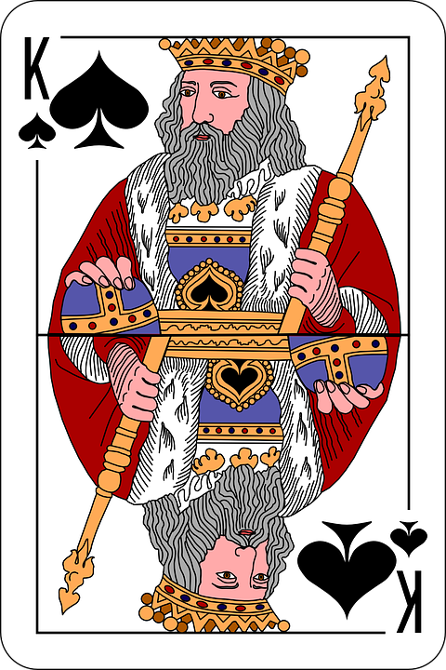
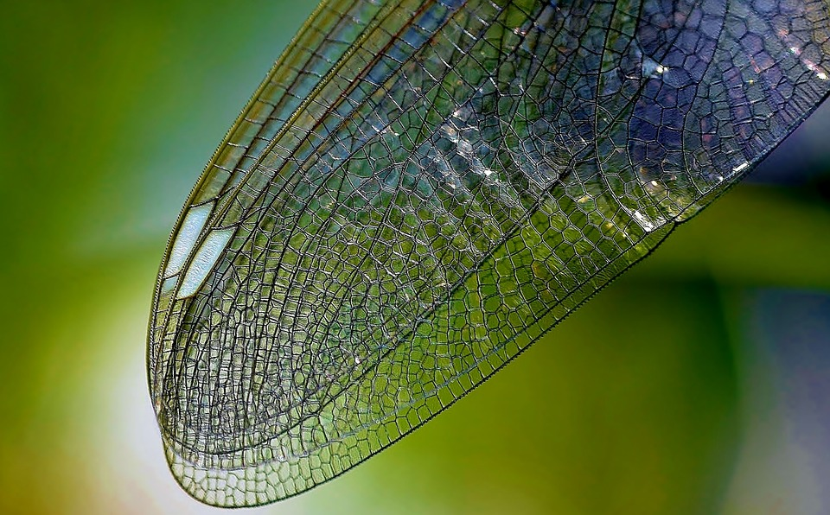
Look up these words and match to the picture
king
sting
wing
string
swing
Notes:
Go over the learning goals.

Slide 9
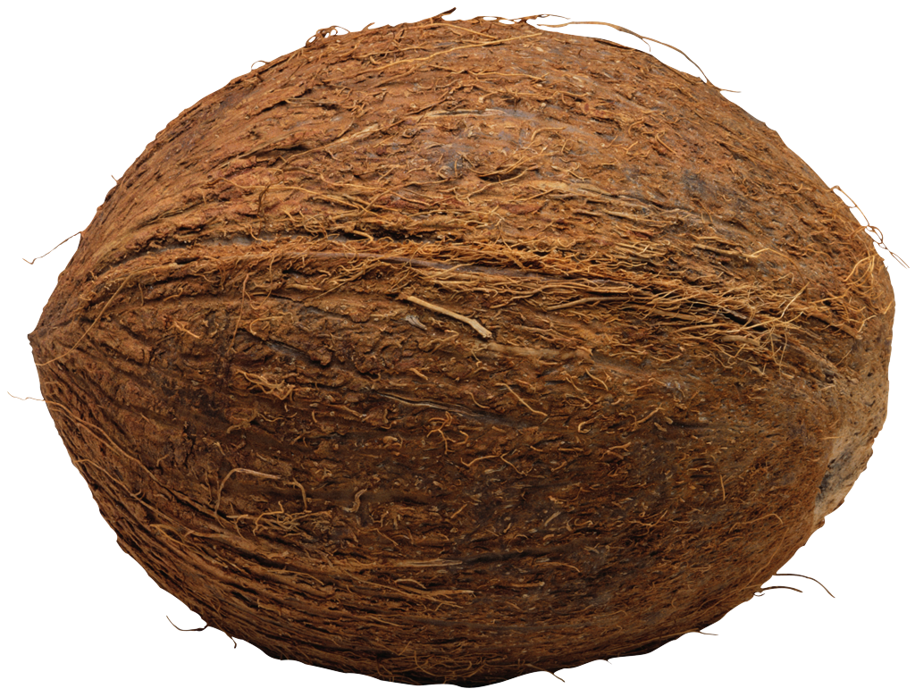
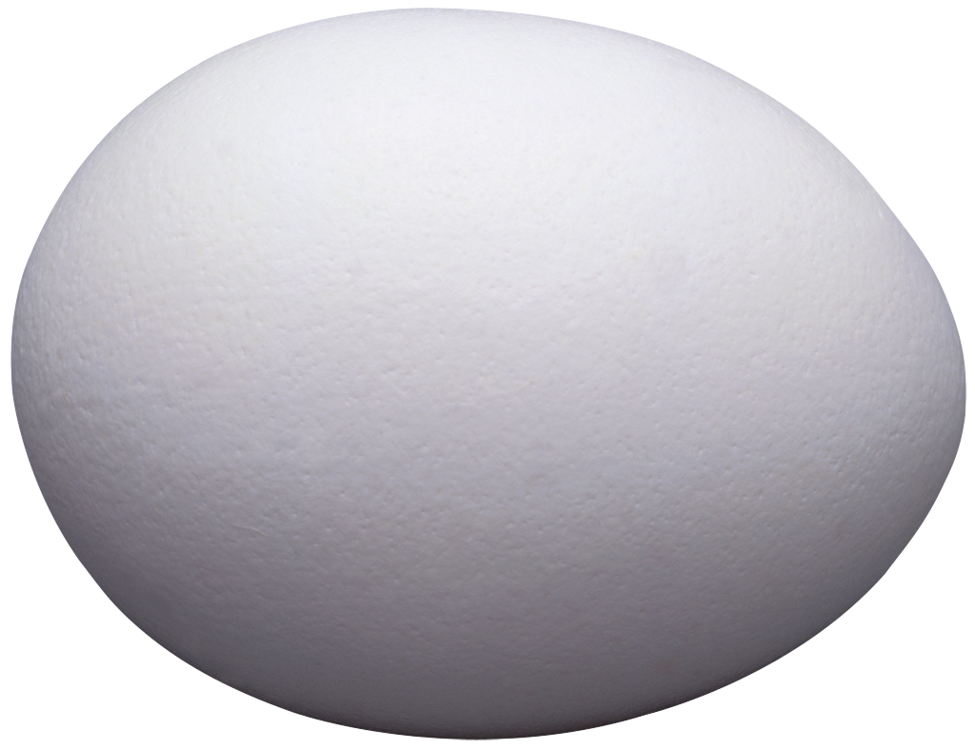
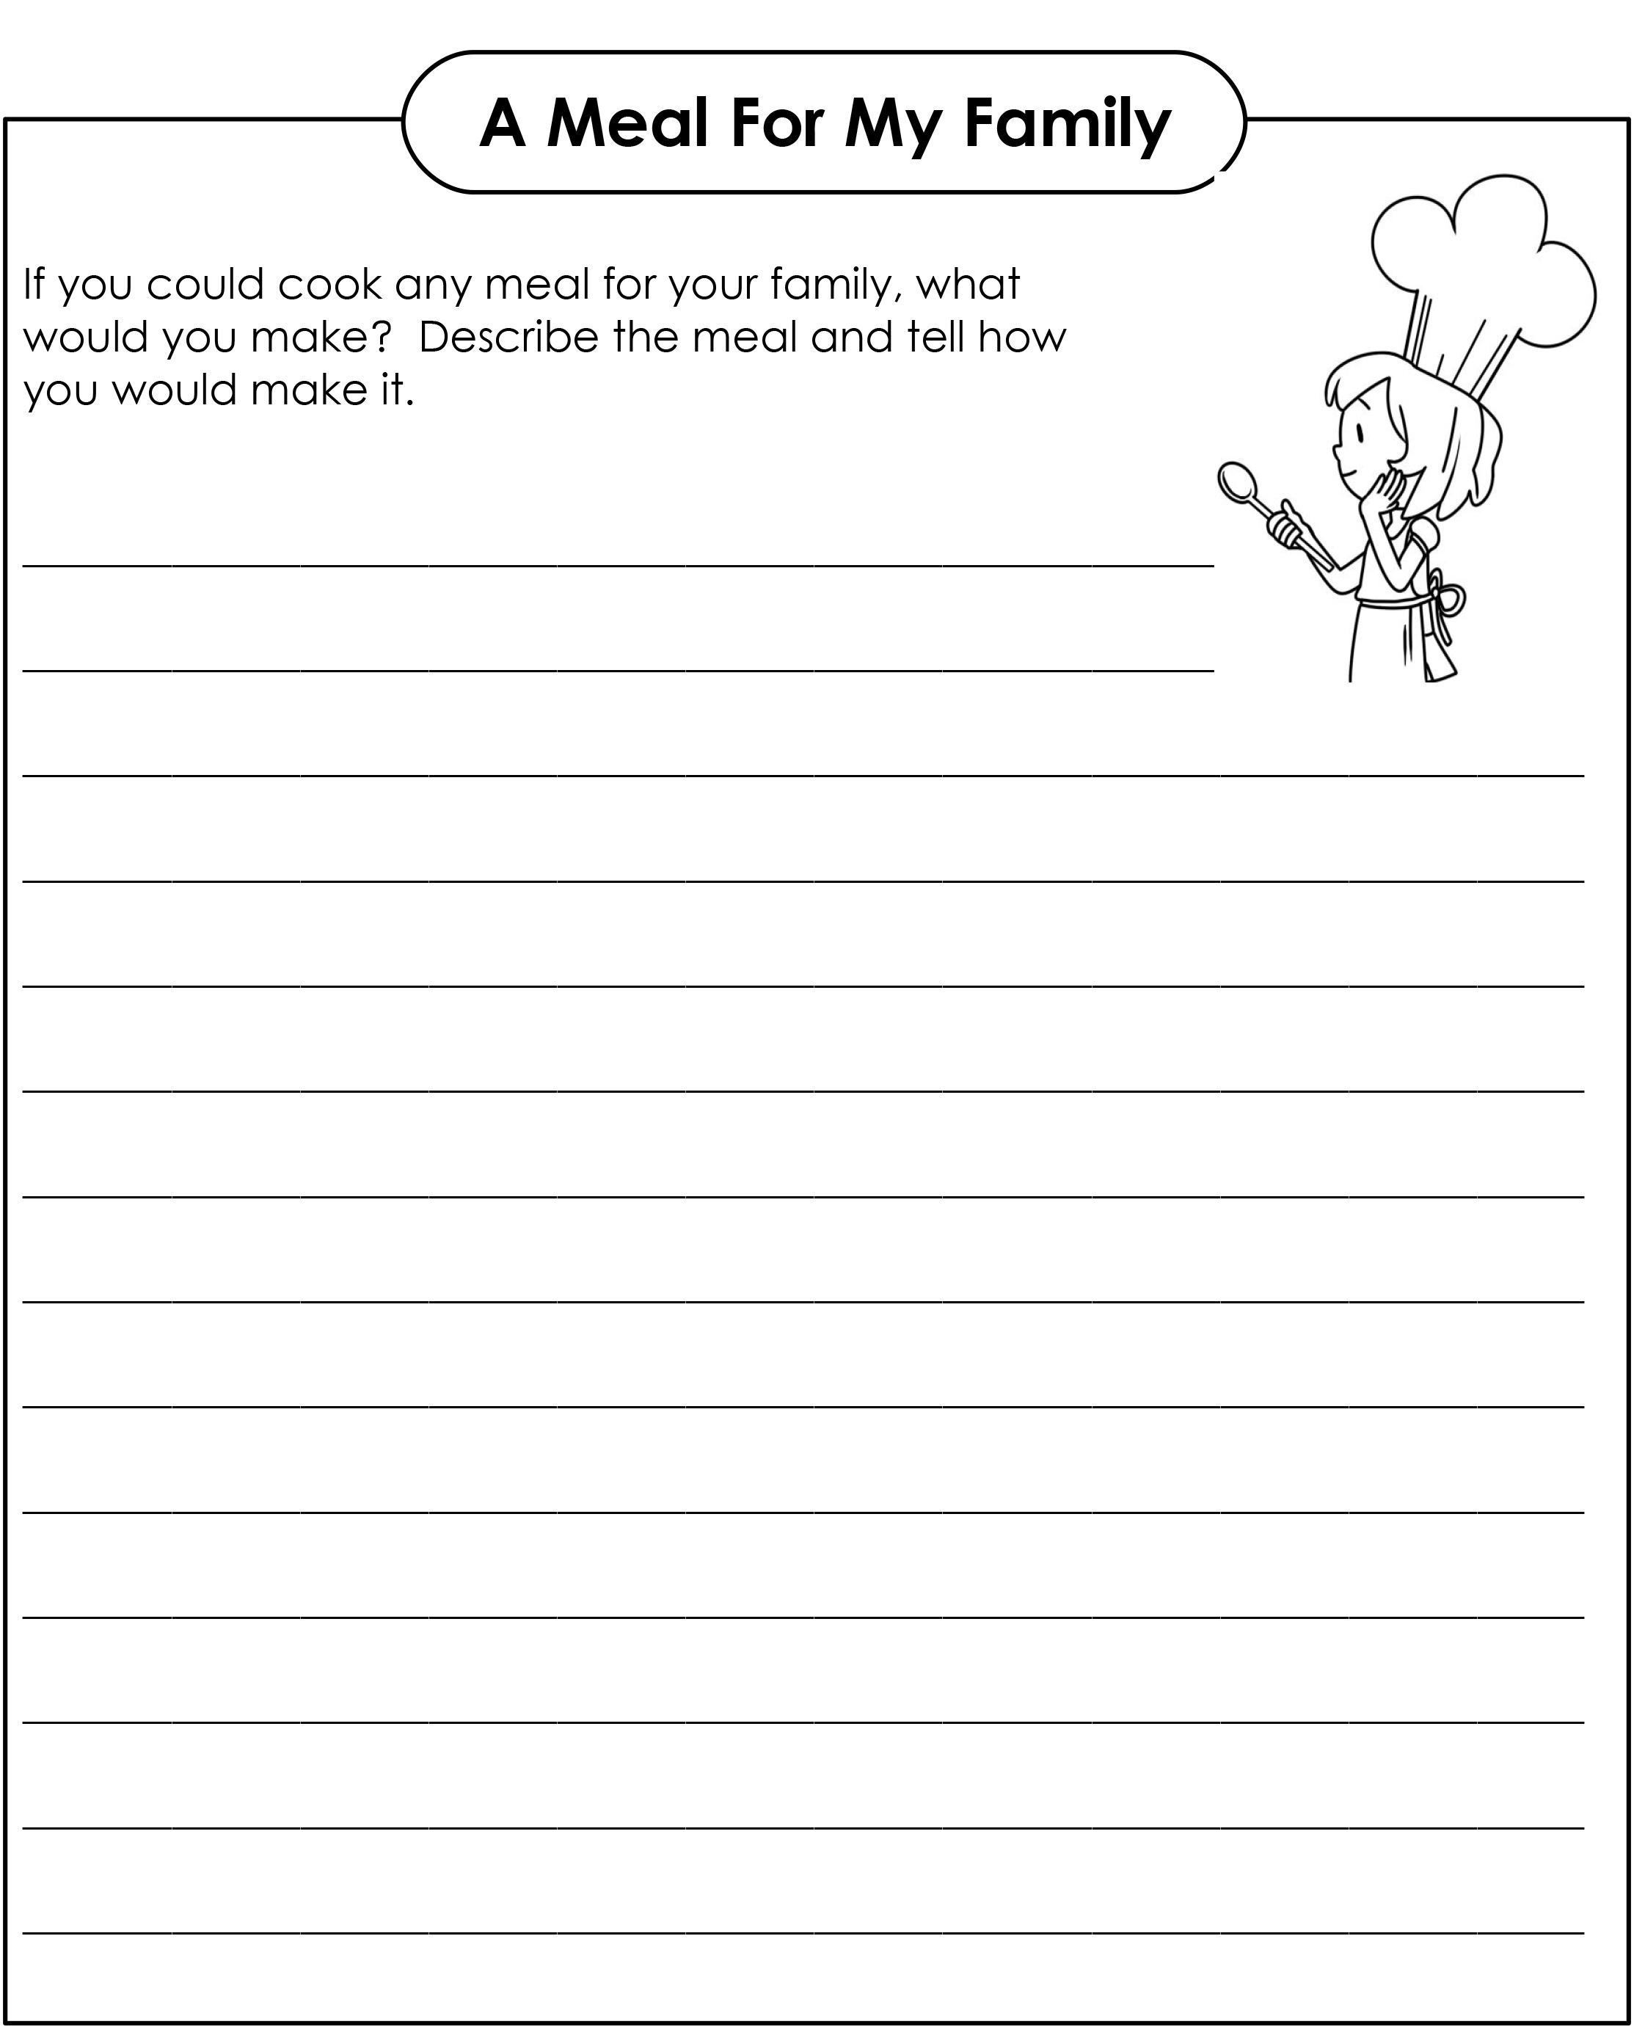
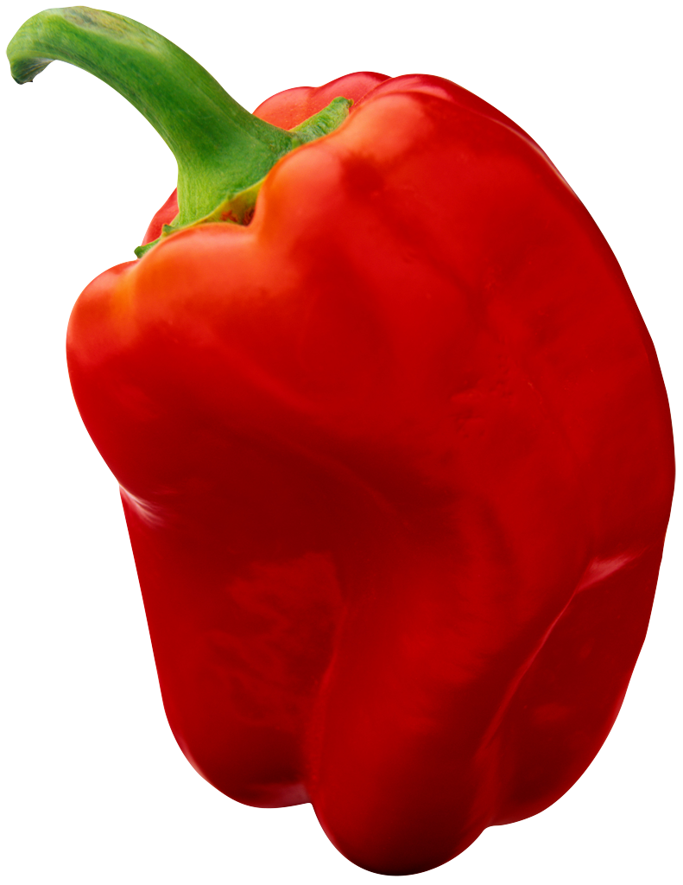
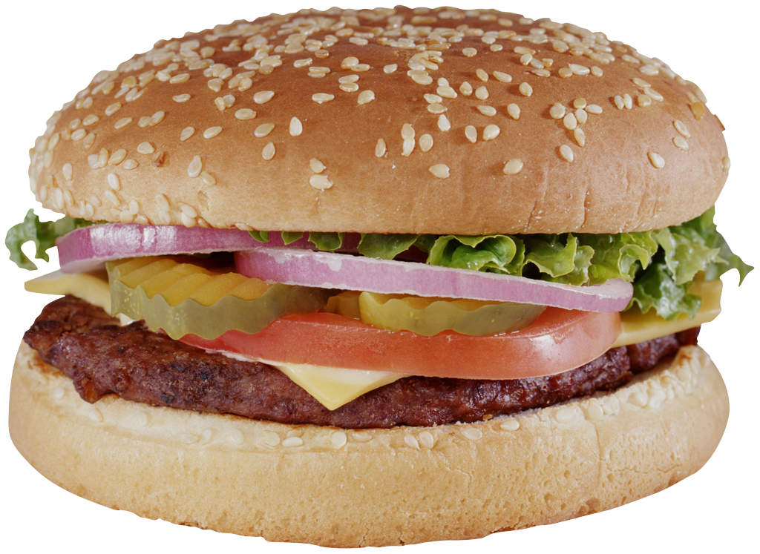
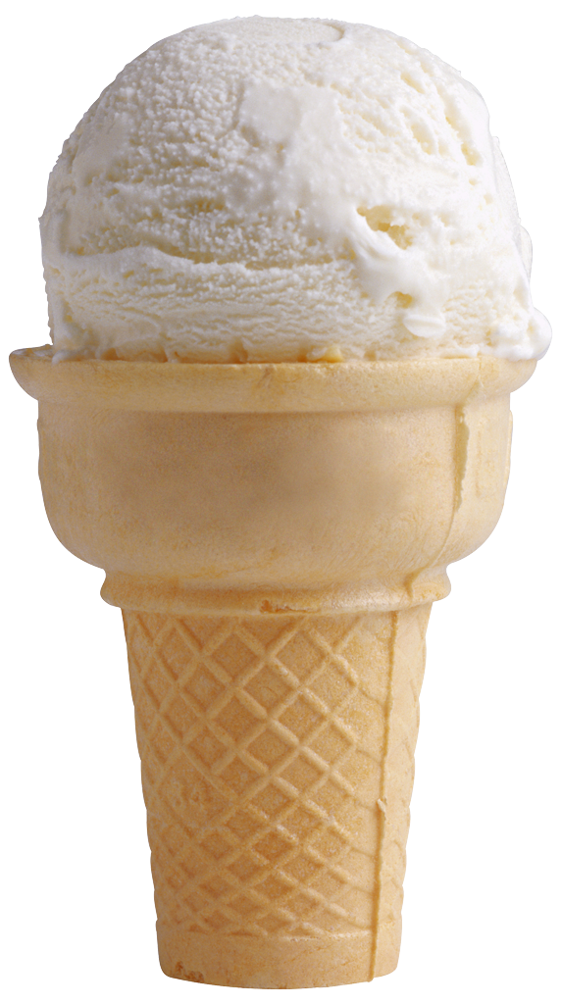
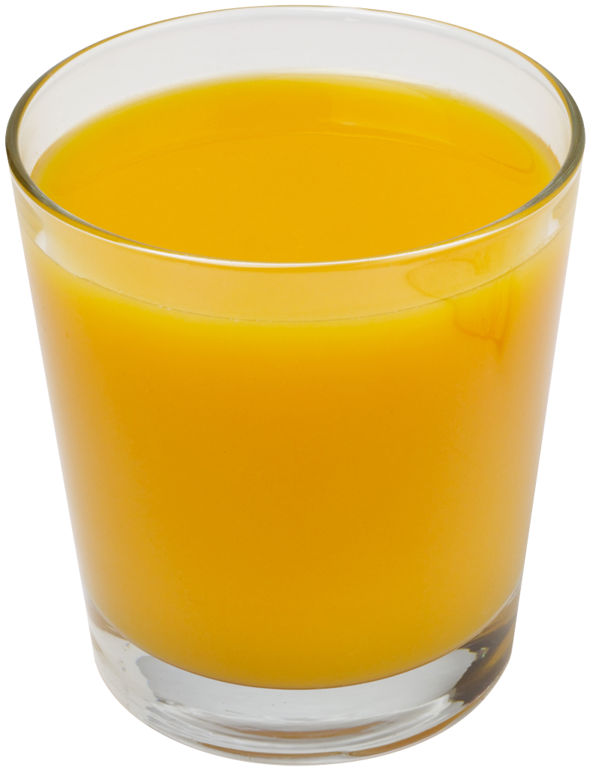
Writing about food

Slide 10
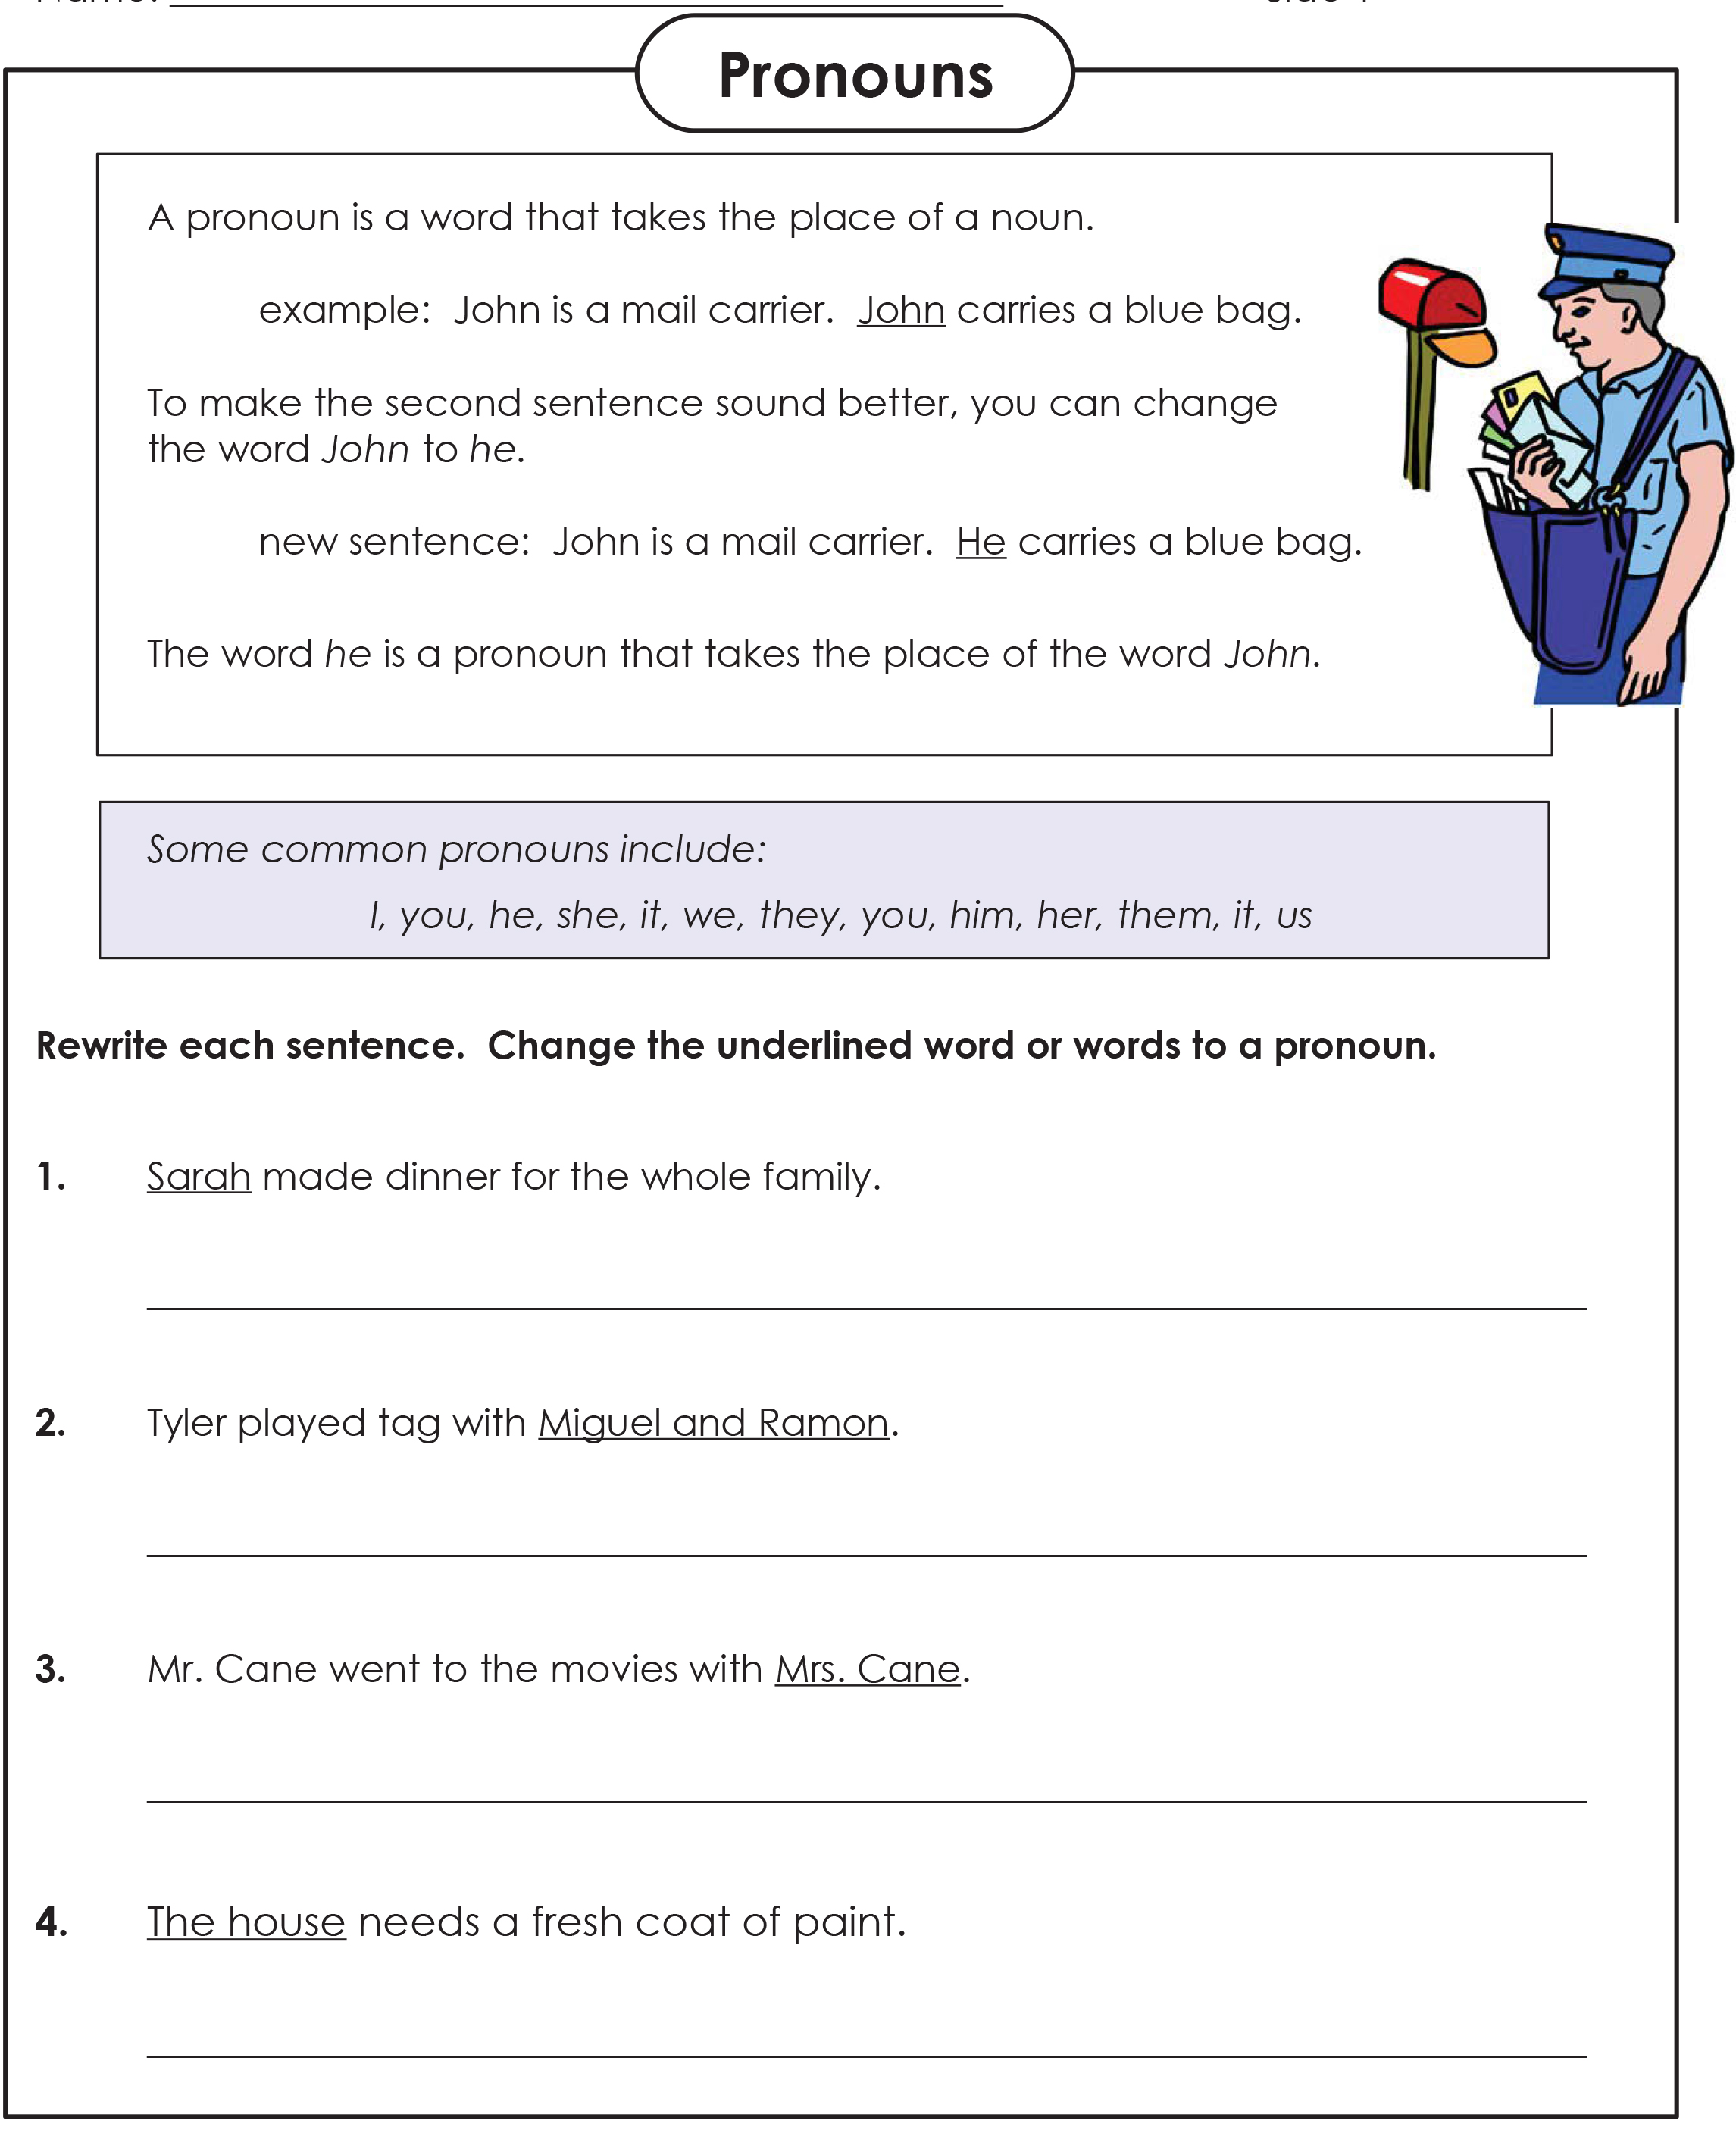
Pronoun Practice

Slide 11
Answers
Notes:
Go over the learning goals.

Slide 12
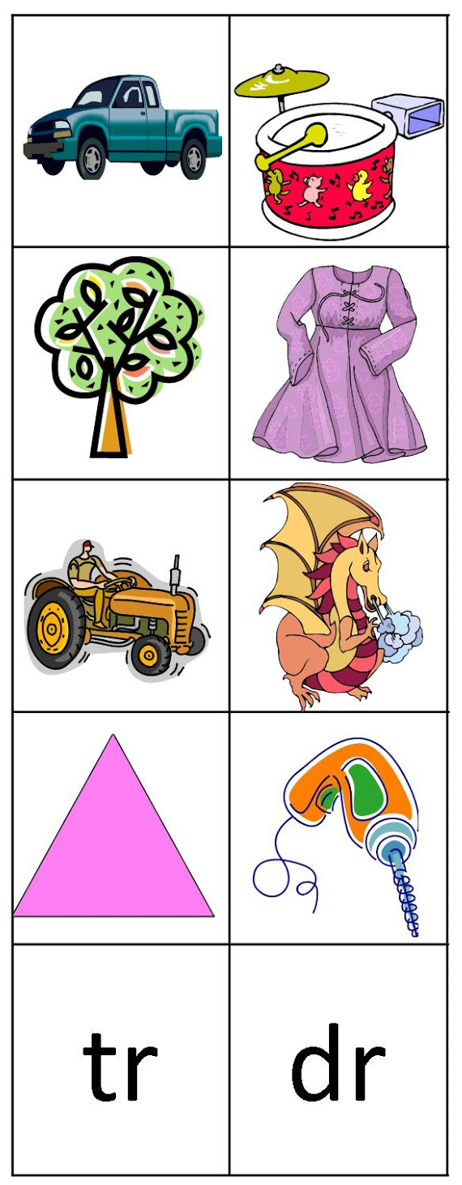
“dr” and “tr”
What words match with each picture?
Look up triangle and tractor
truck tree
drill triangle
dress drum
dragon tractor
Notes:
Go over the learning goals.

Slide 13
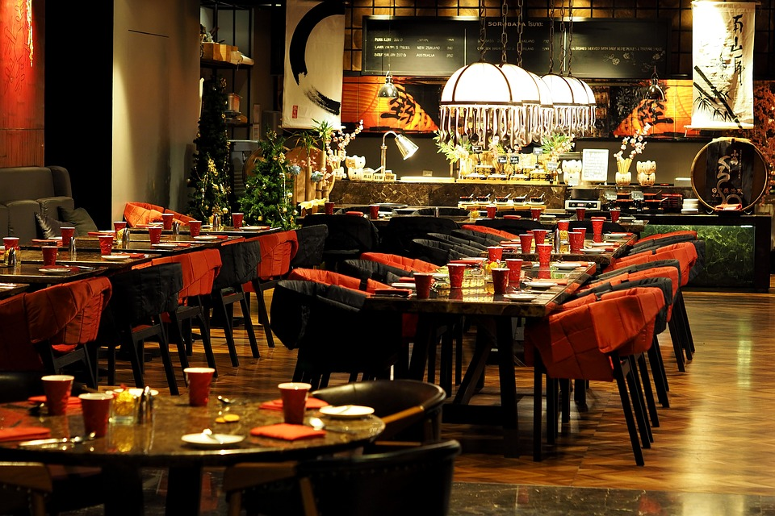
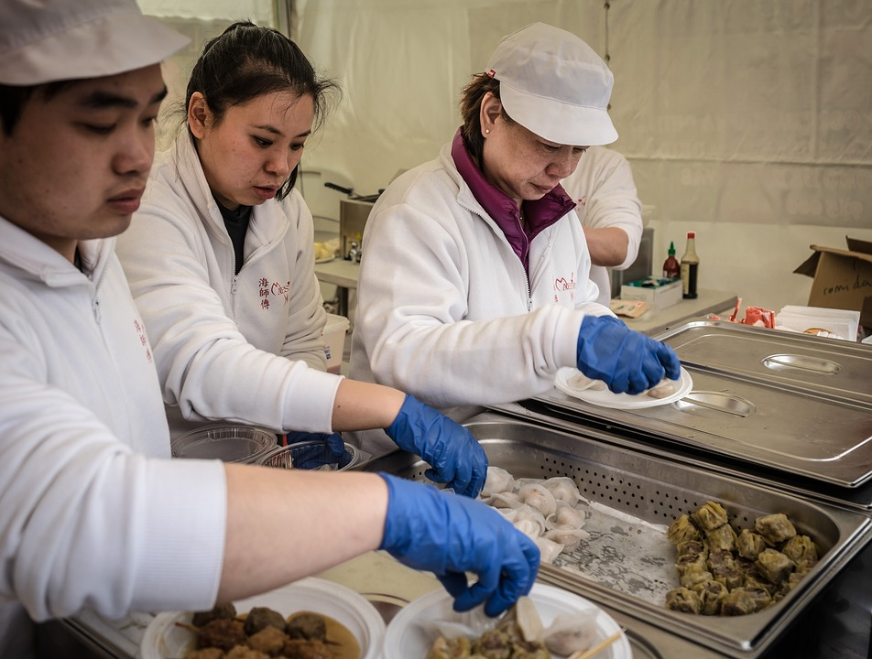
Homework
Imagine you opened your own restaurant. Name your restaurant.
Explain what the restaurant looks like, who works there, and what you serve. Write one paragraph about your restaurant.
Notes:
Explain homework

Slide 14
What did I learn today?
New “ing” words
Practicing “and”
Using “and”, “but”, “or” and “because”
Writing about a meal
Matching
Notes:
Review the lesson.

