Slide 1


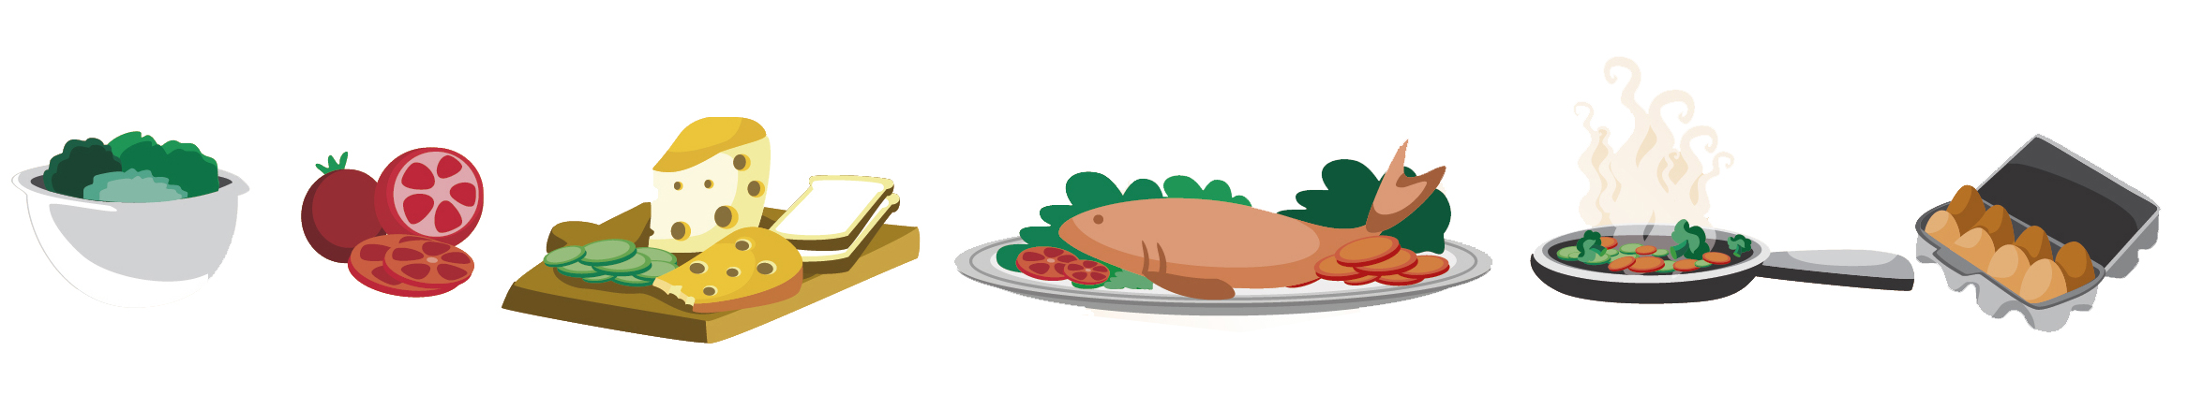
Lesson 9
FOOD

Slide 2

What we will learn today
New ‘sn’ and ‘ar’ words
Using the sn’ and ‘ar’ sound in sentences
Using “and”, “or”, “but”, “because”, “his”, “hers”, “theirs”, “ours” and “its”

Slide 3
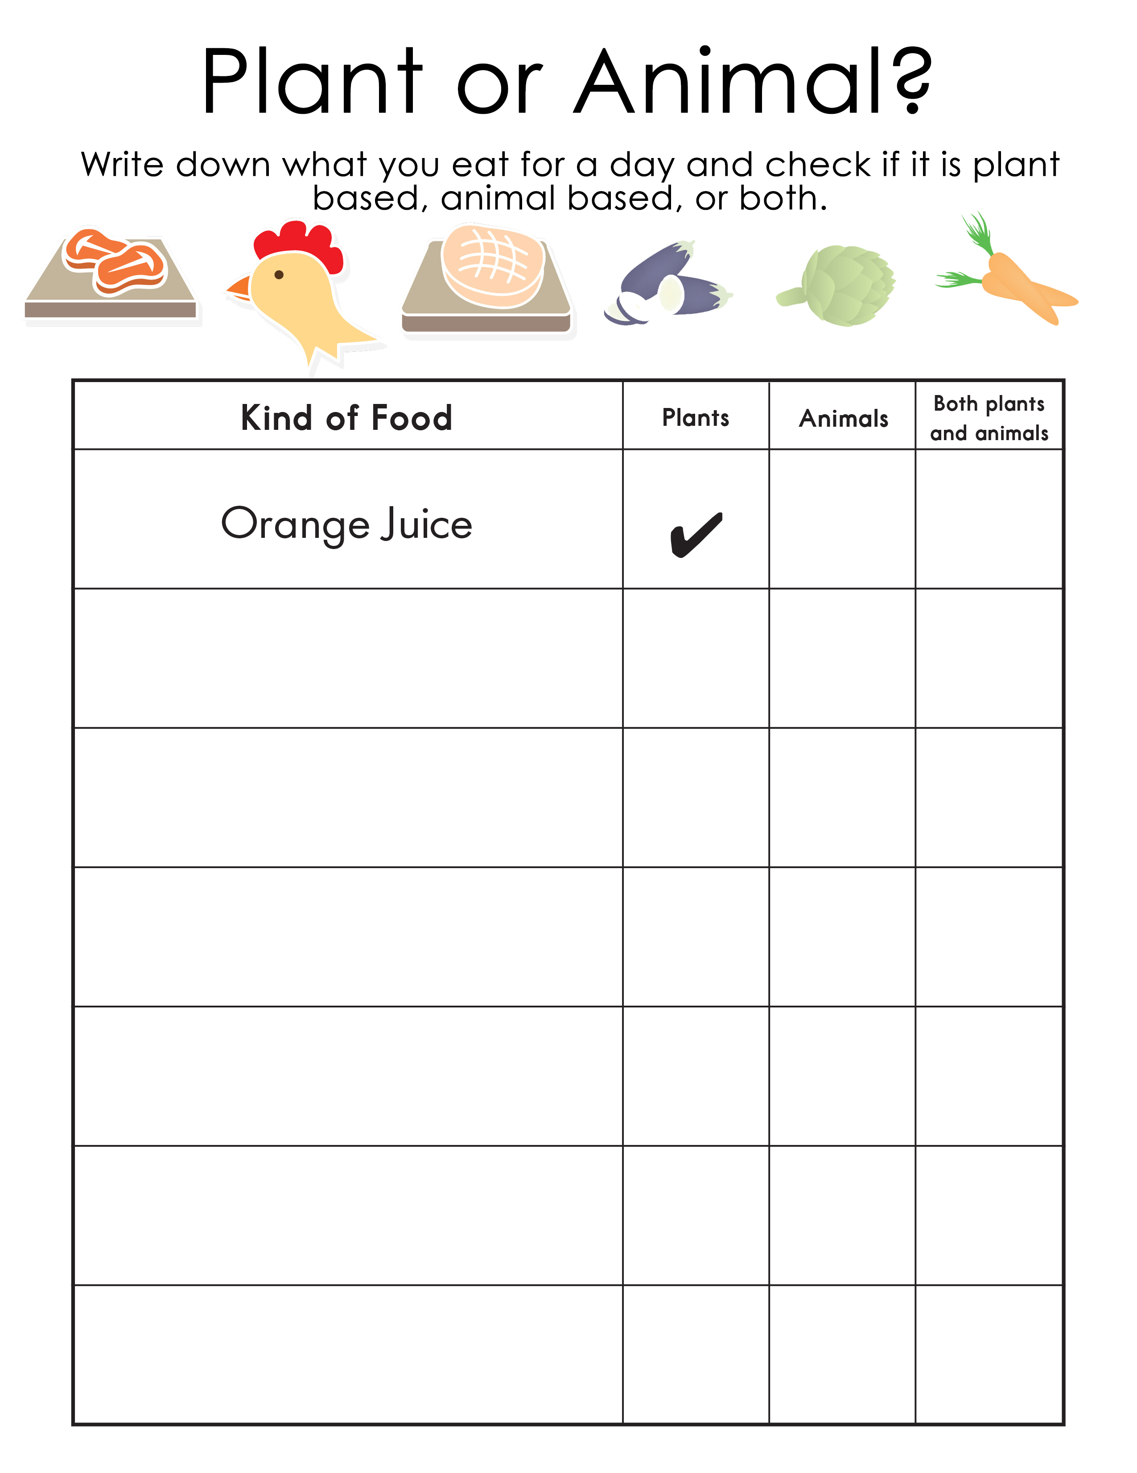
What did you eat?

Slide 4


The SN Sound

Slide 5


The AR Sound

Slide 6
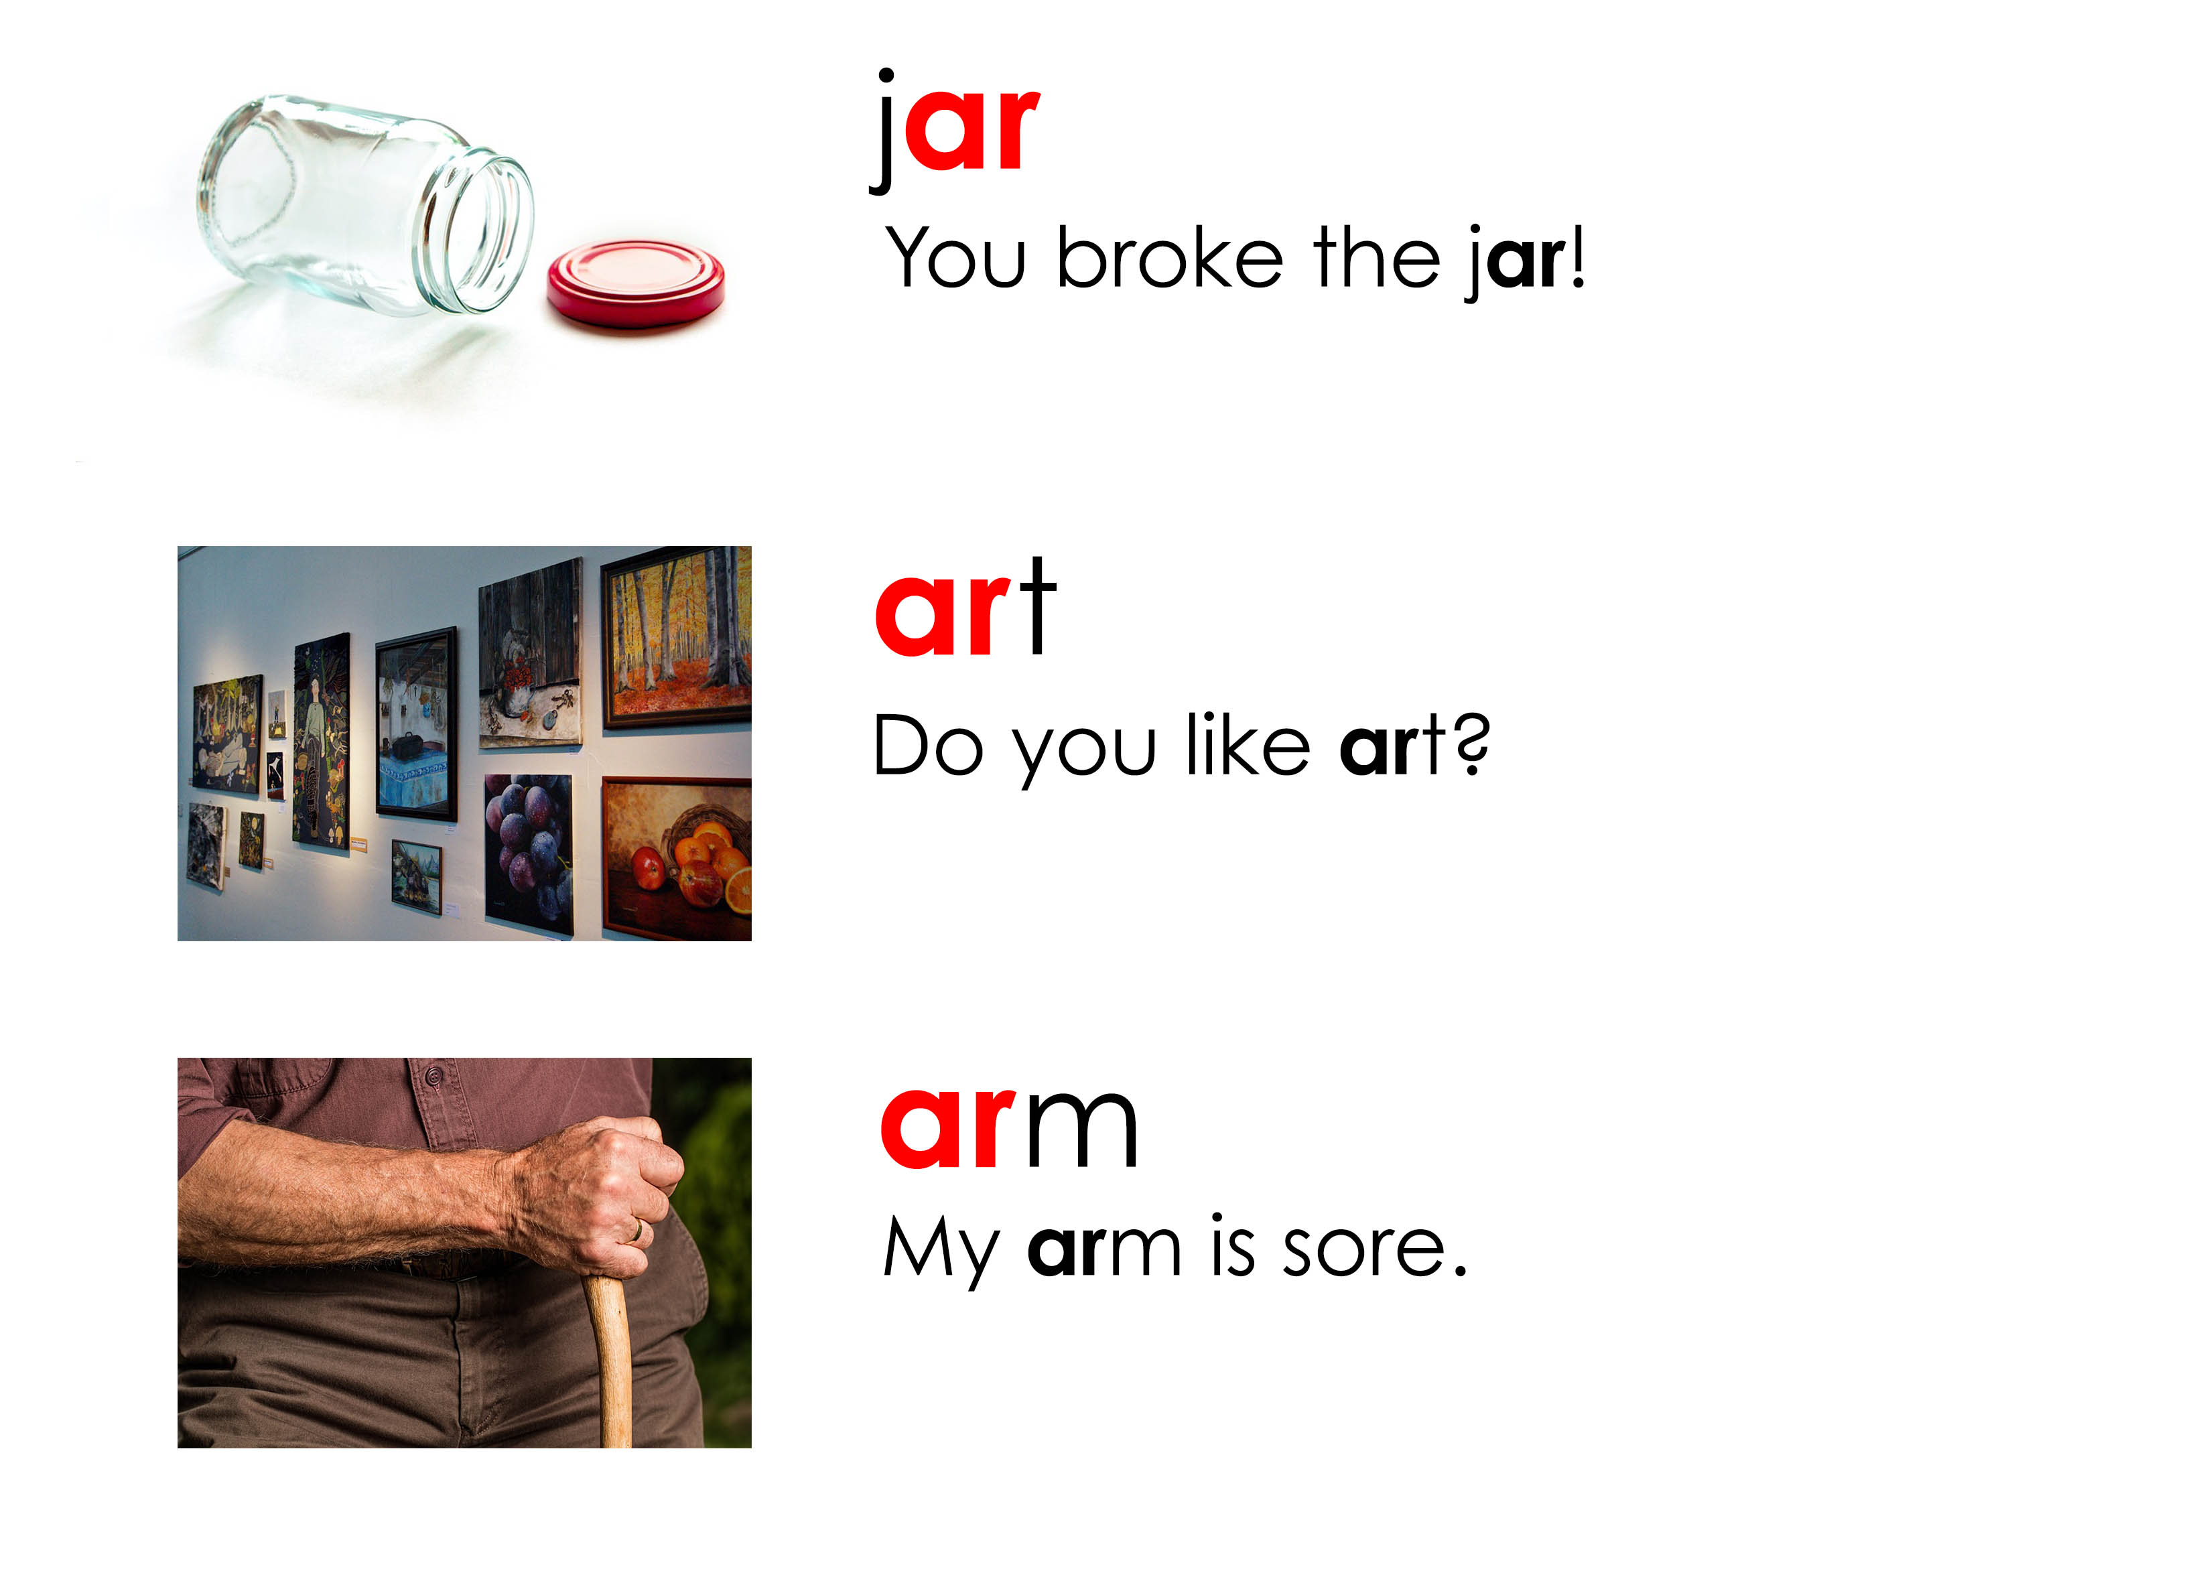
Let’s practice pronouncing the AR sound

Slide 7
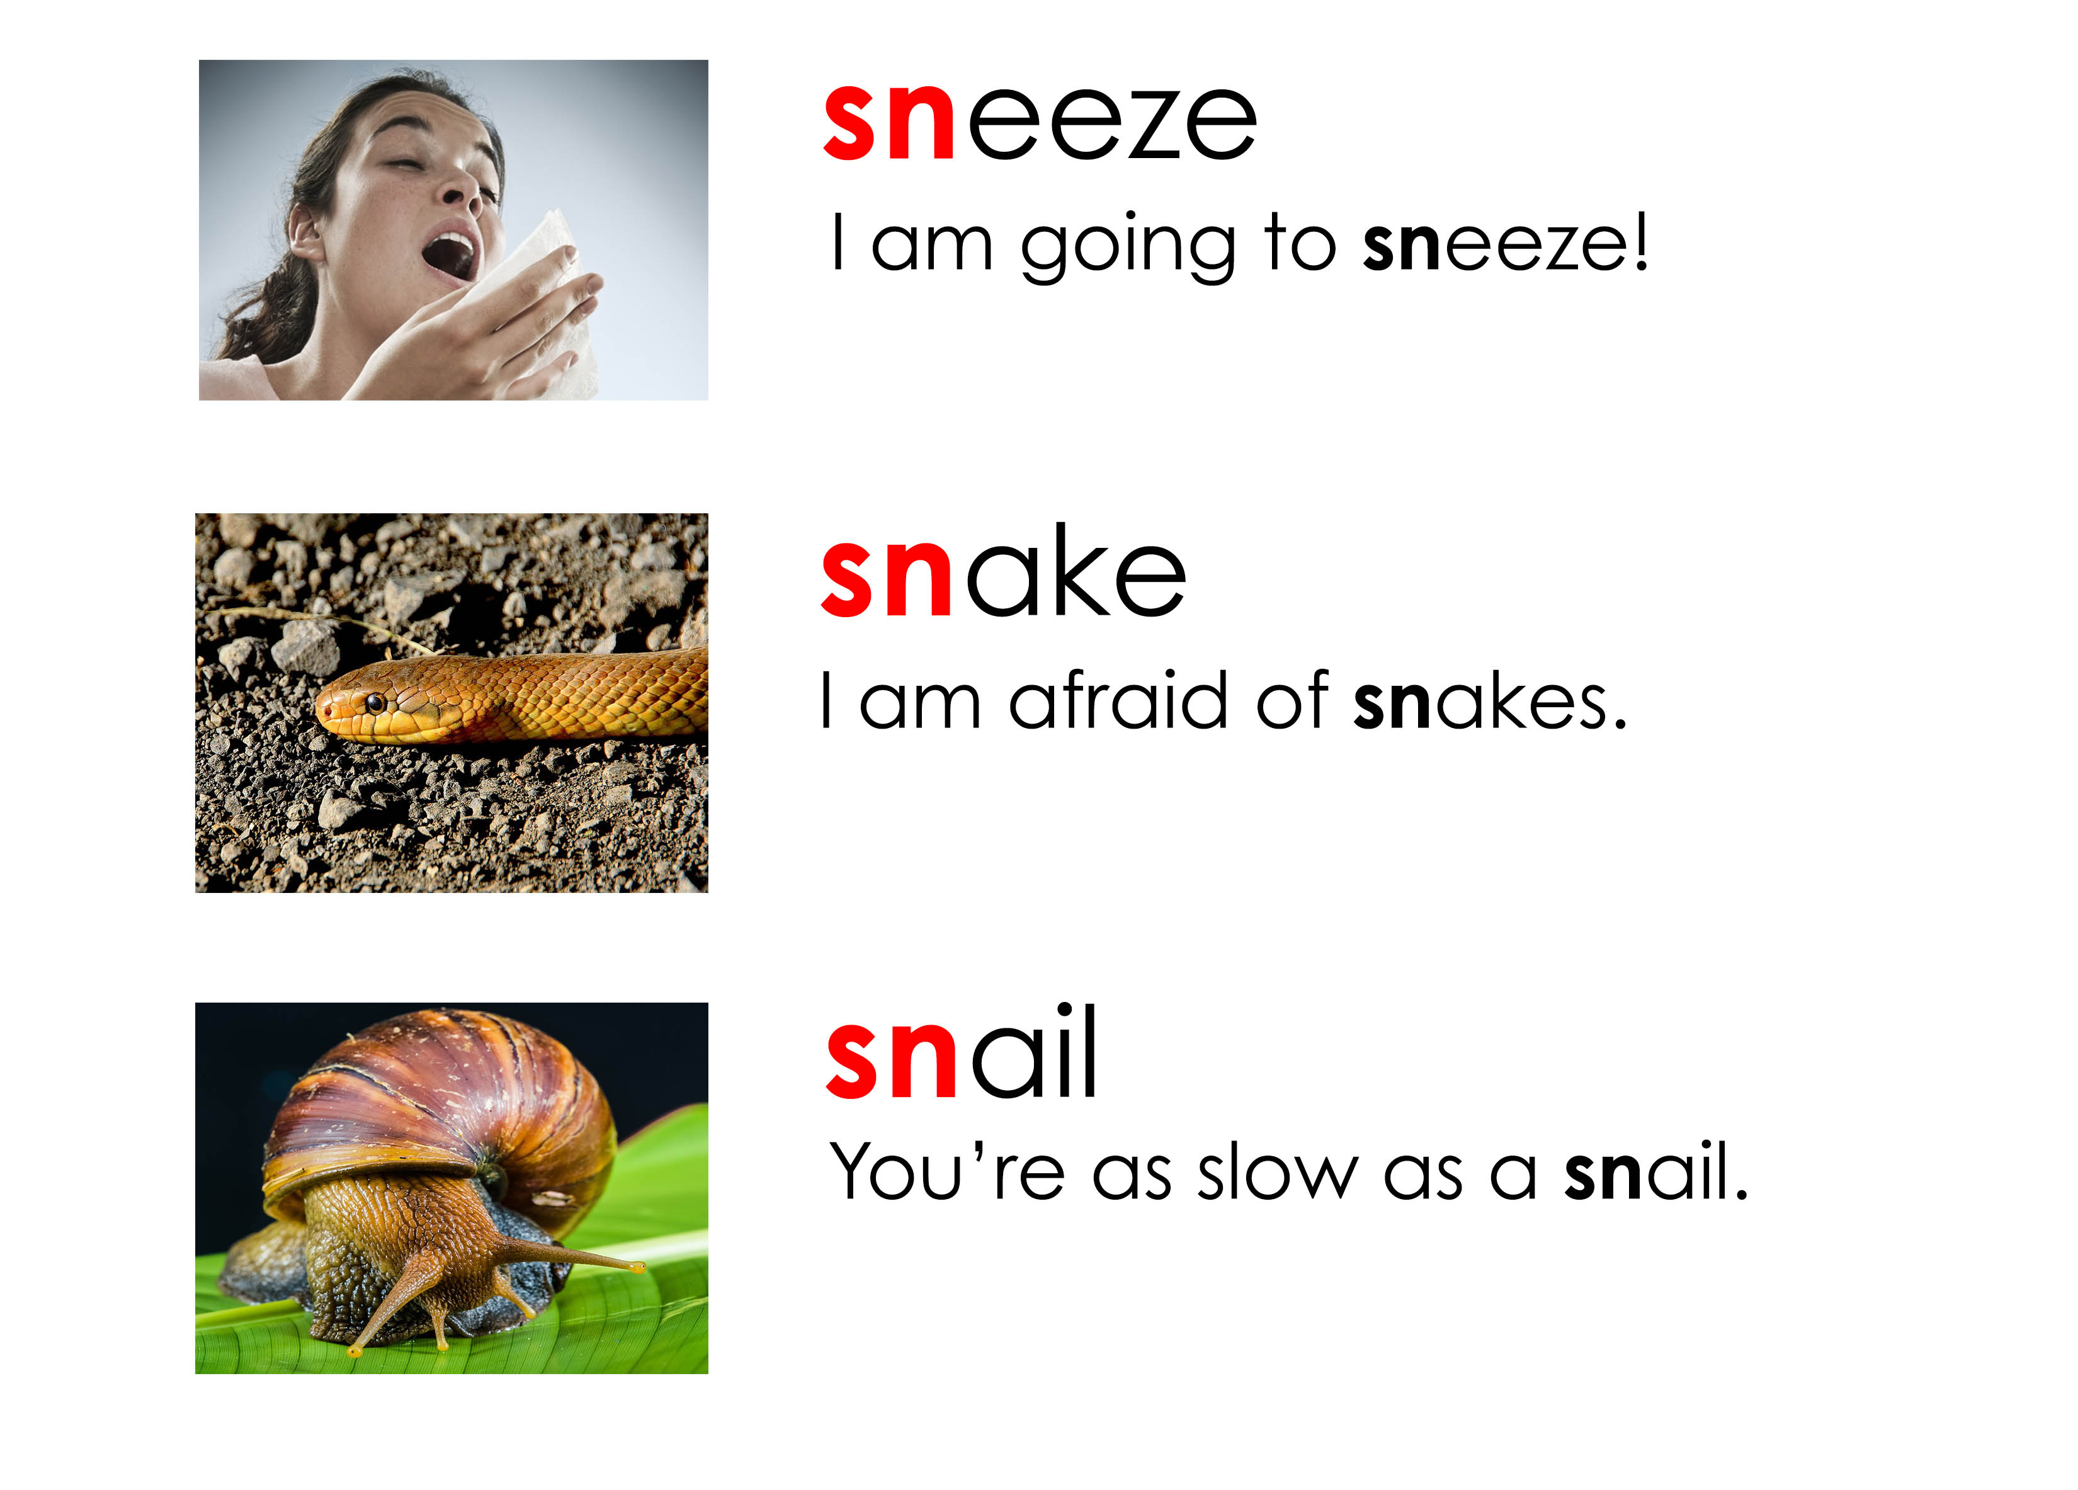
Let’s practice pronouncing the SN sound

Slide 8

Let’s do some acting

Slide 9
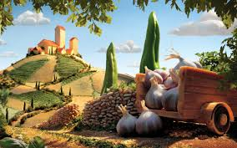
Food Scapes
http://twistedsifter.com/2013/08/surreal-landscapes-made-from-food-carl-warner/

Slide 10
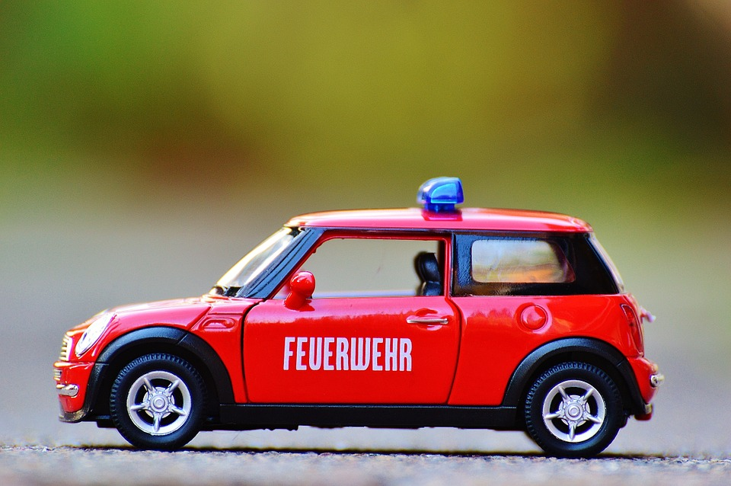

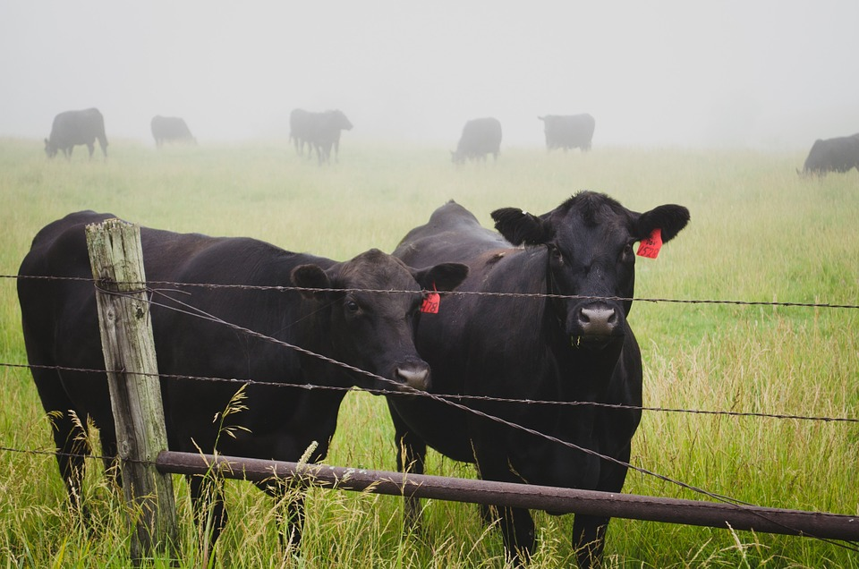
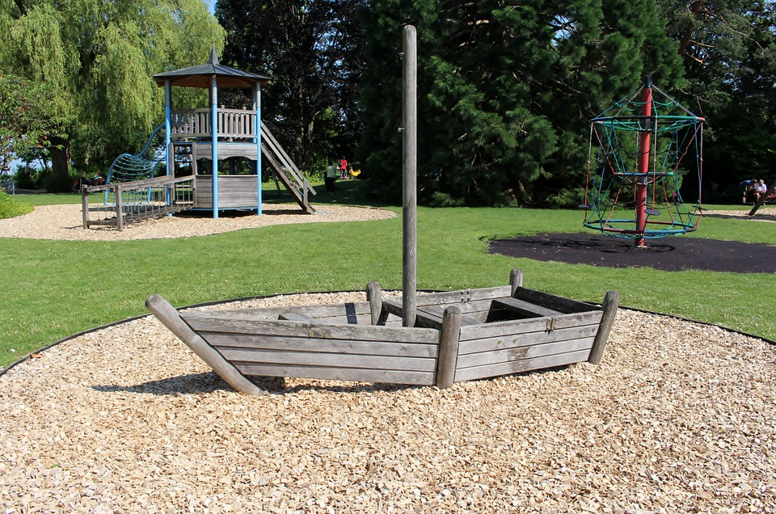
Some other “ar” words
car
dark
farm
park

Slide 11
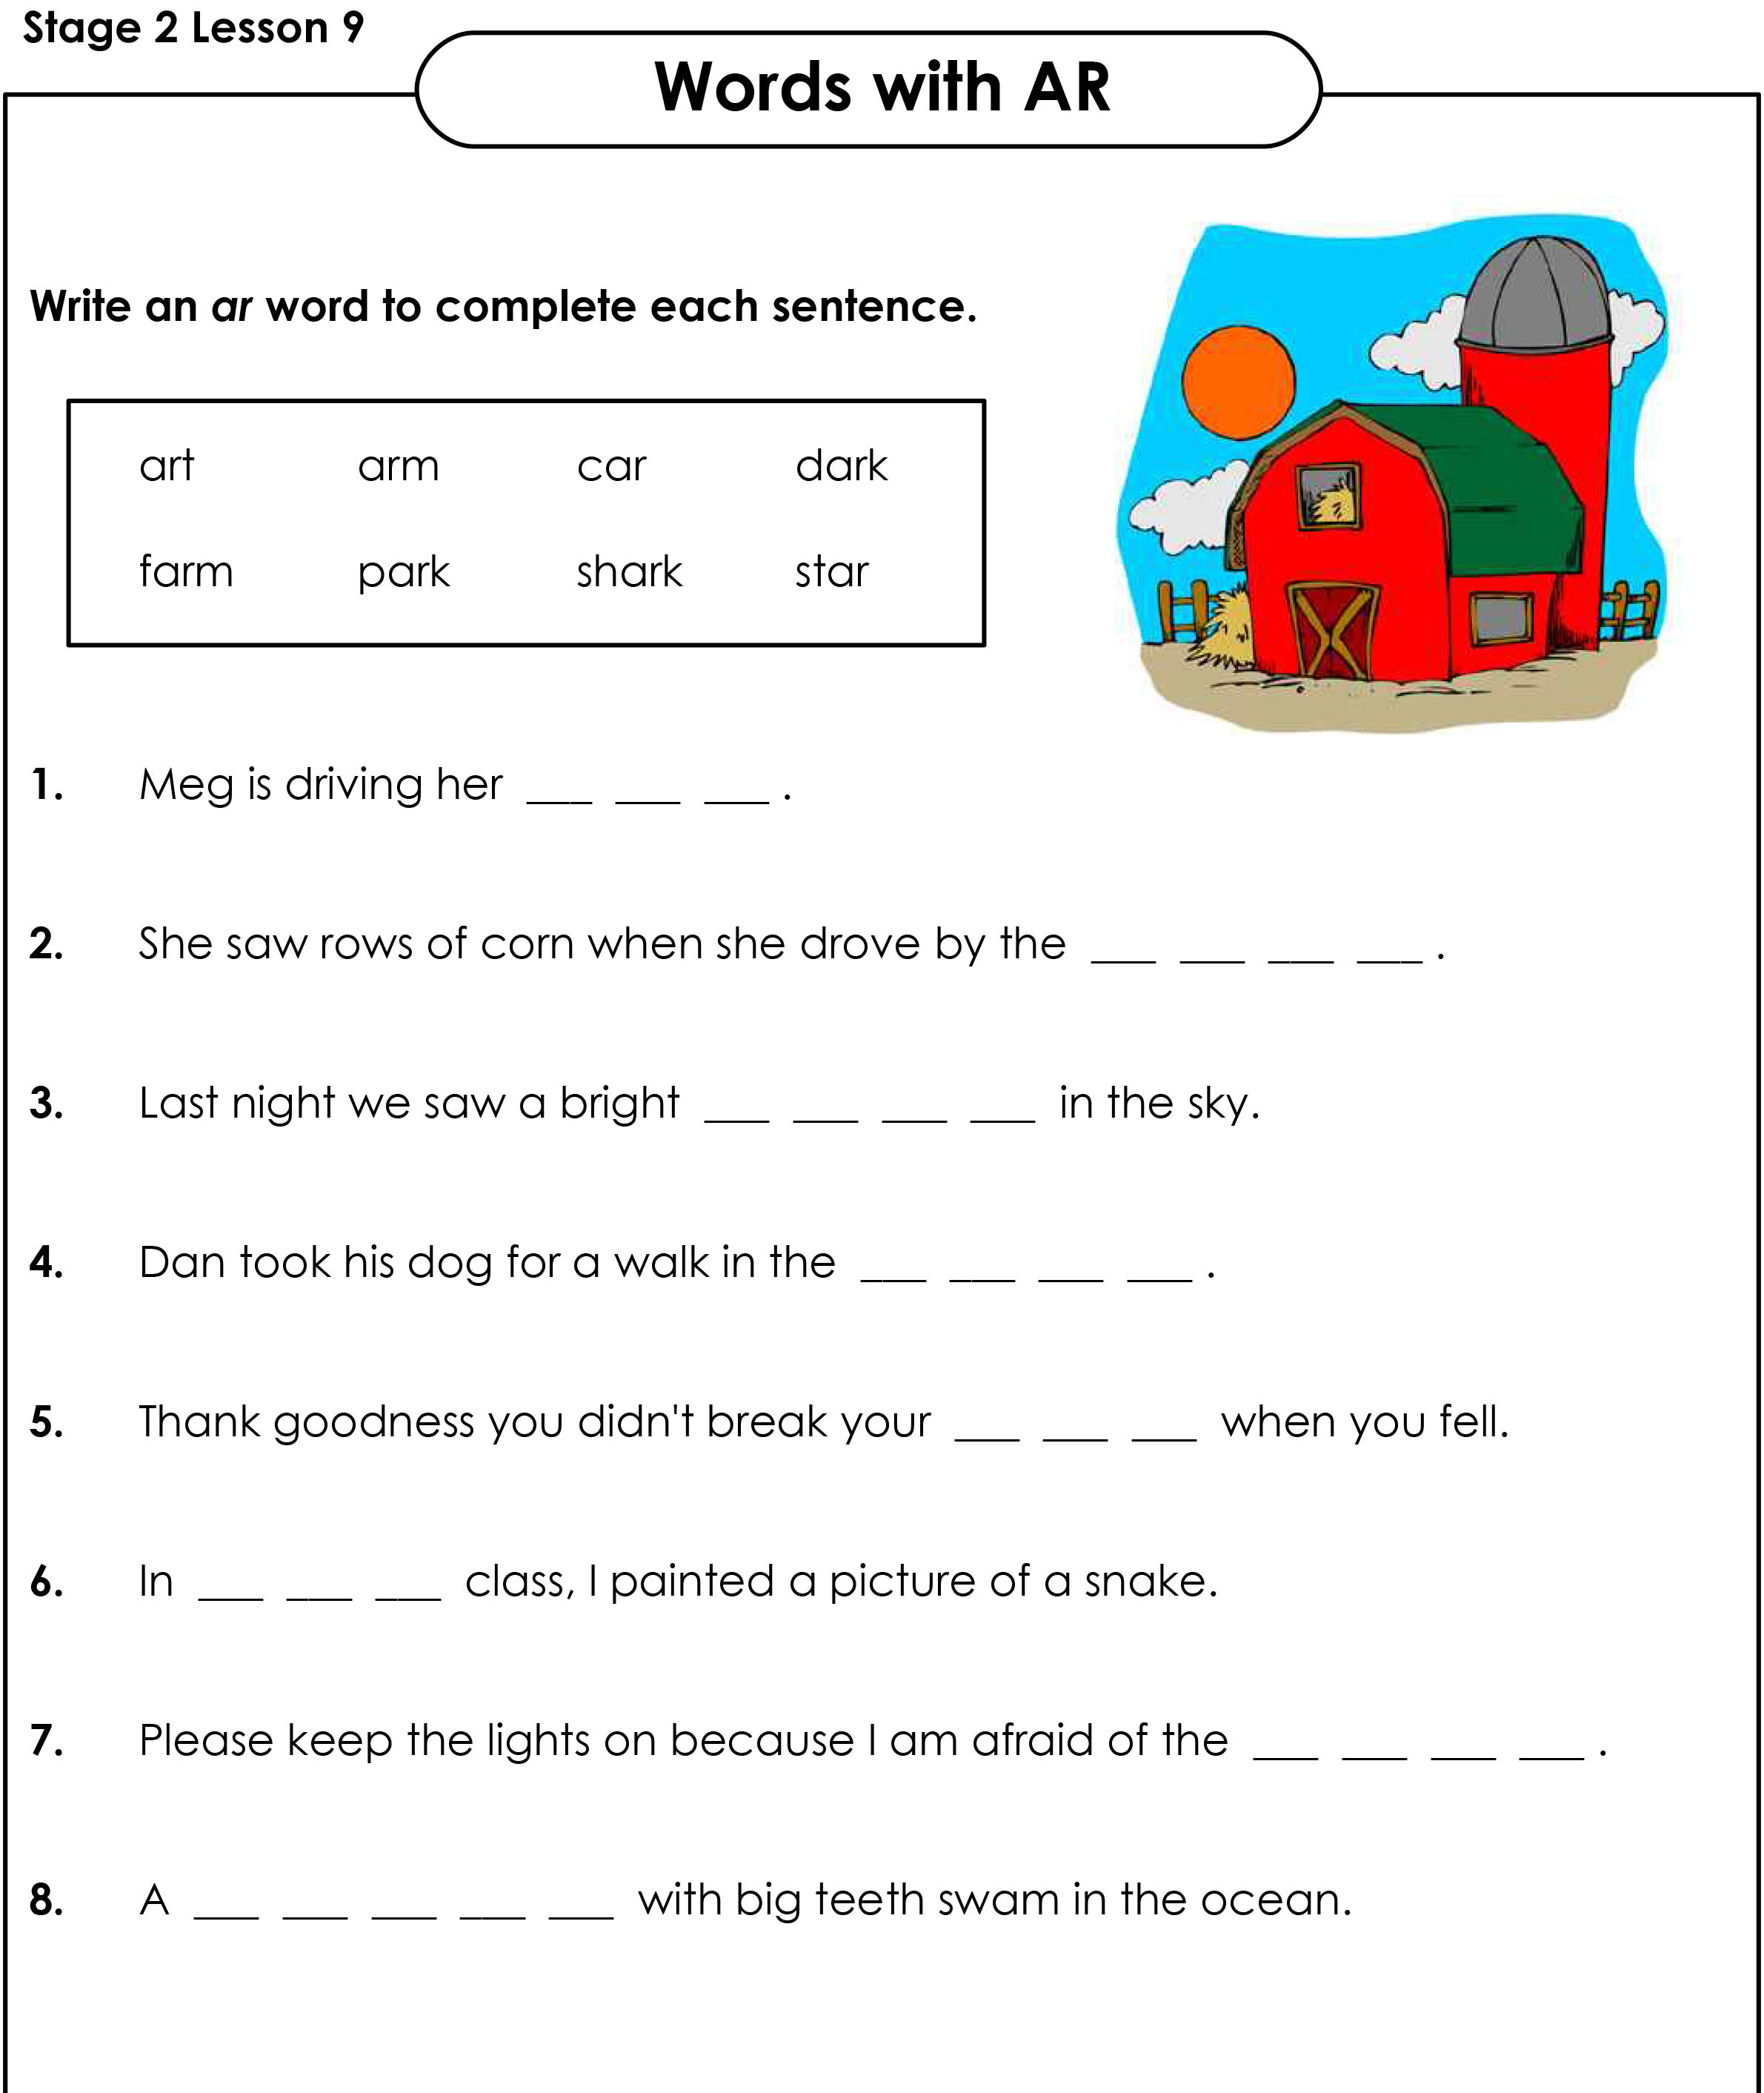
Fill in the blanks

Slide 12
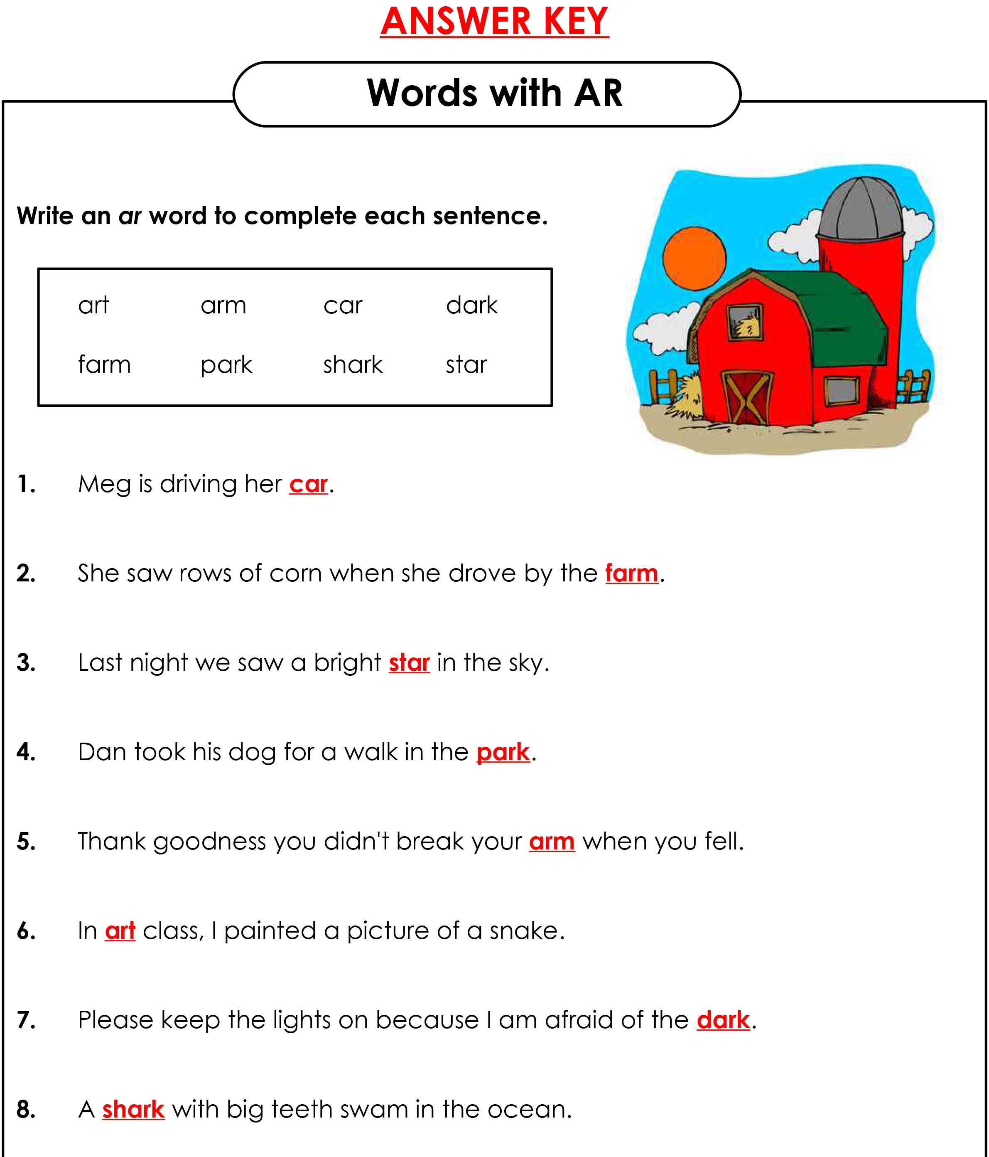
Answers

Slide 13



His, Hers, Its
His, hers and its are possessive pronouns.
His, hers, and its are possessive pronouns that show ownership of a noun.
His = males
Hers = females
its = animal or an object

Slide 14
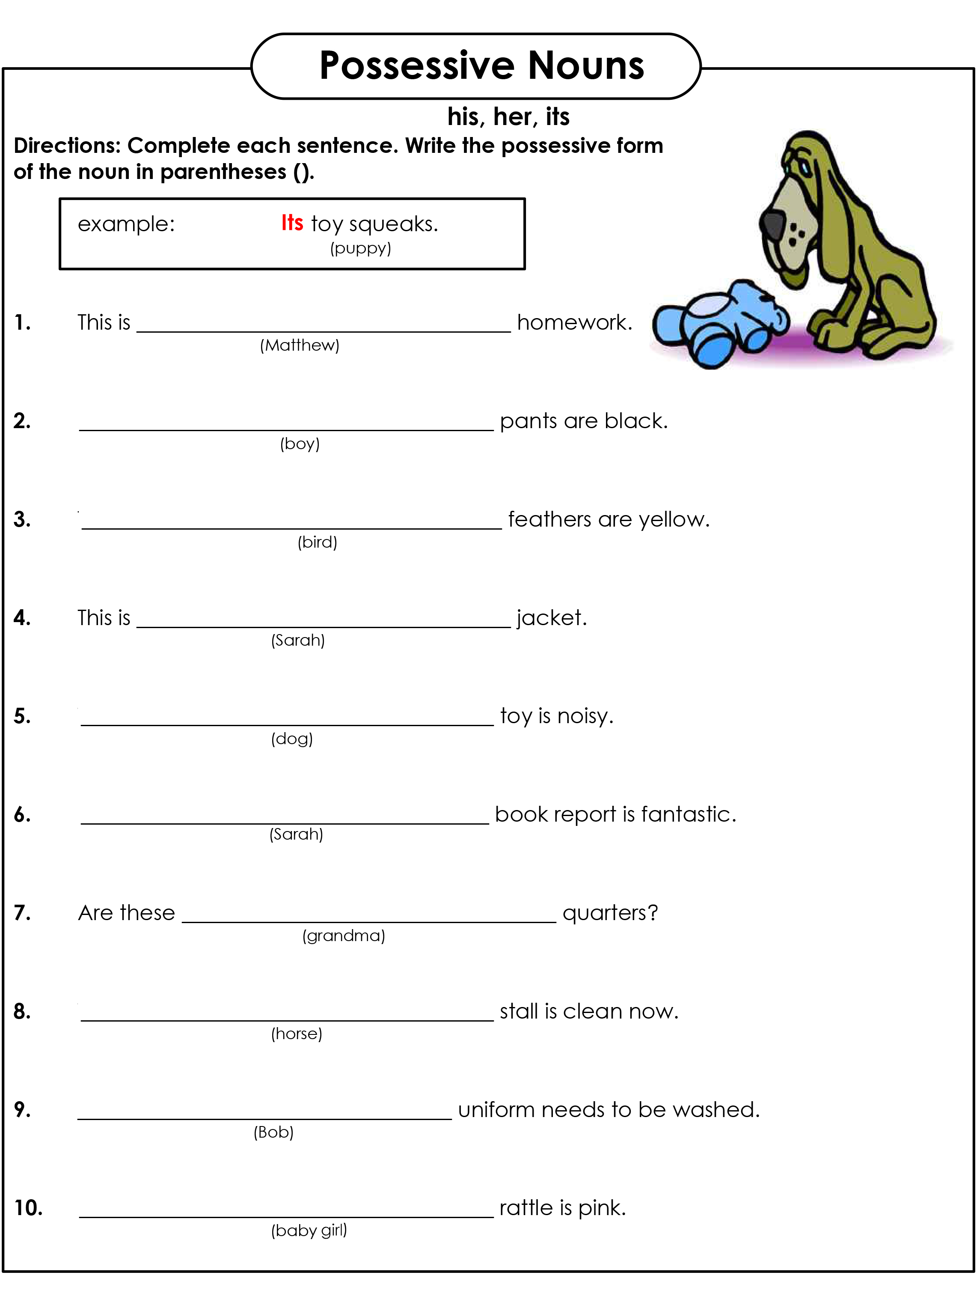
His, hers, its

Slide 15
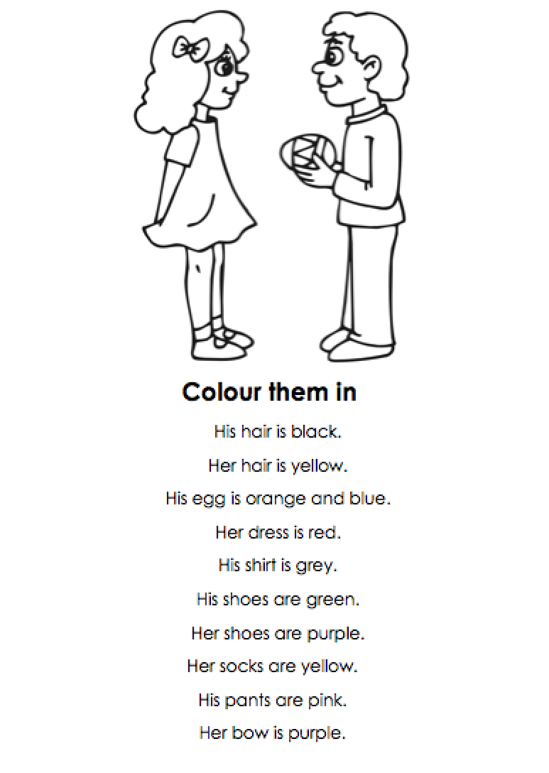
Let’s Colour

Slide 16

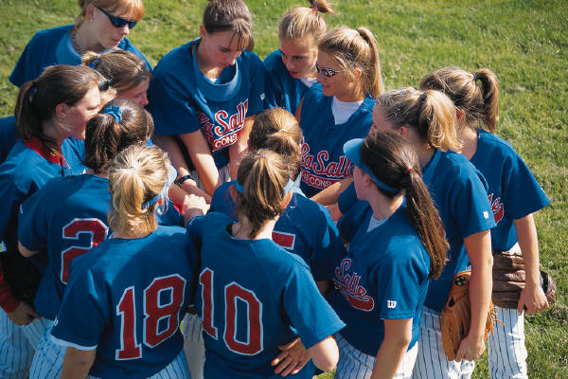
Theirs and ours
Ours and theirs are plural possessive pronouns that show ownership of a noun.
Ours = we
Theirs = they

Slide 17

Ours or theirs?

Slide 18
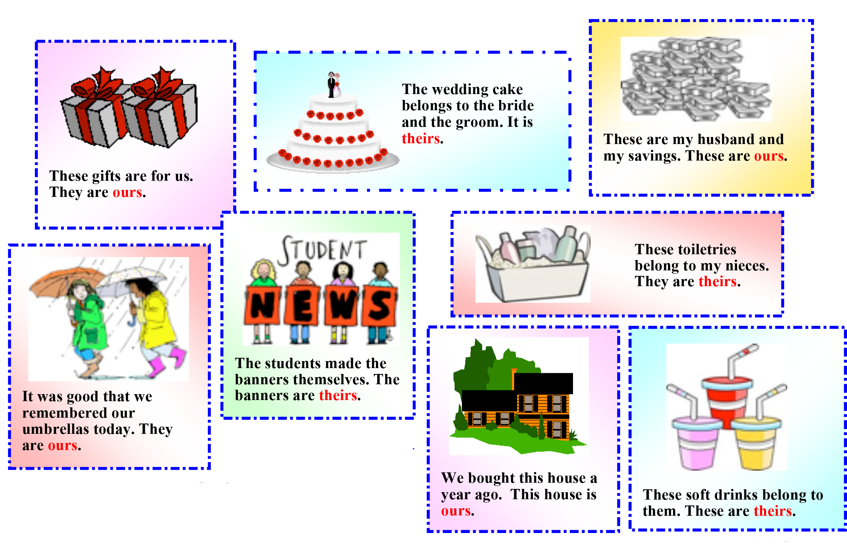
Answers

Slide 19
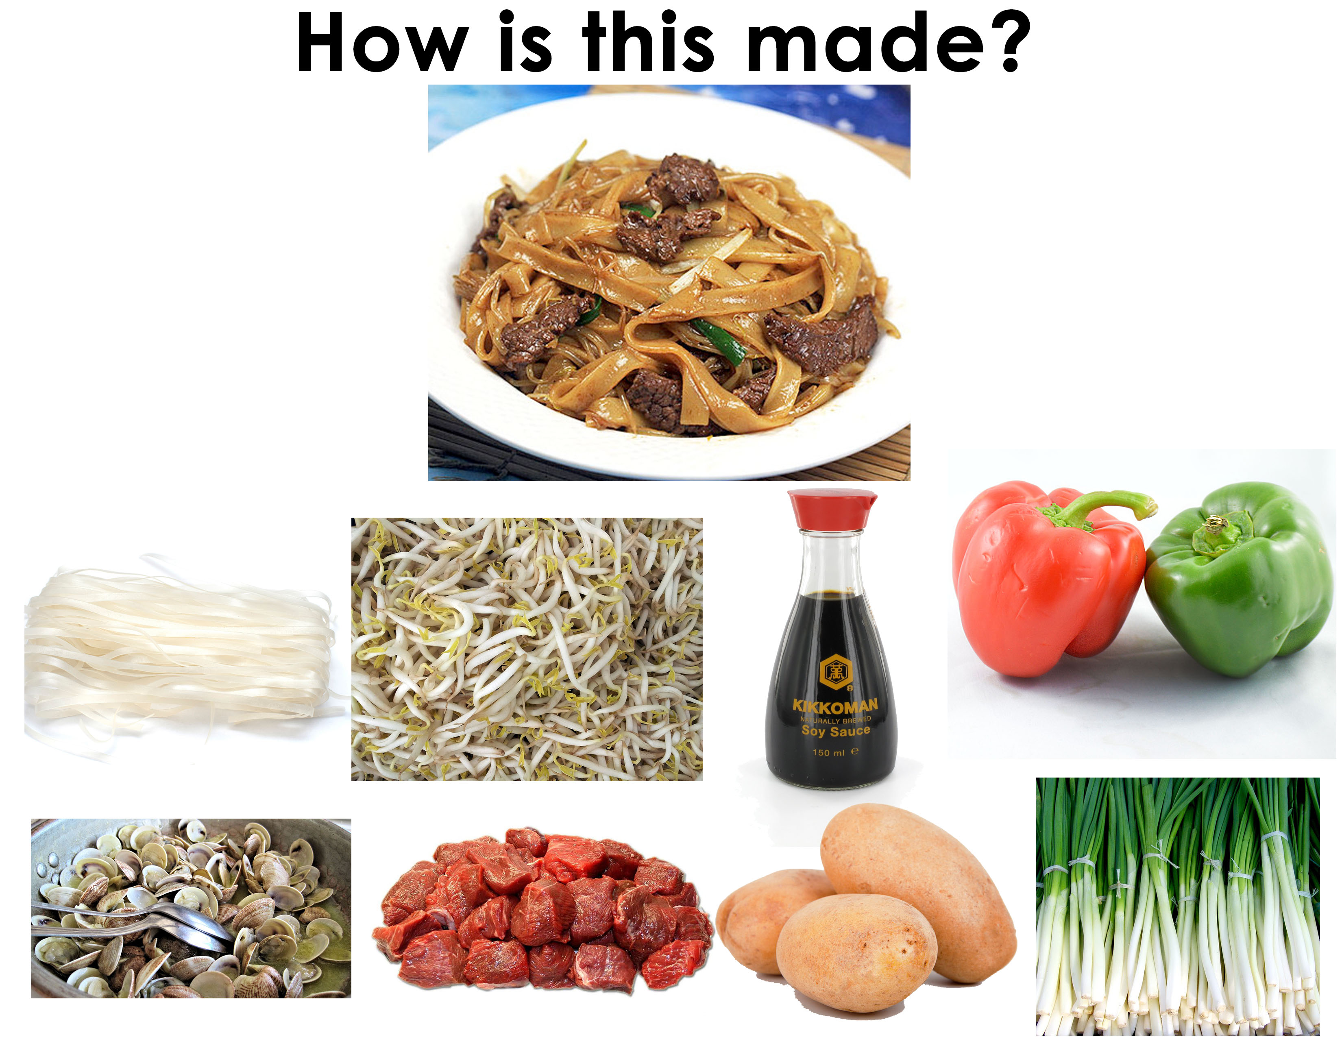

Slide 20
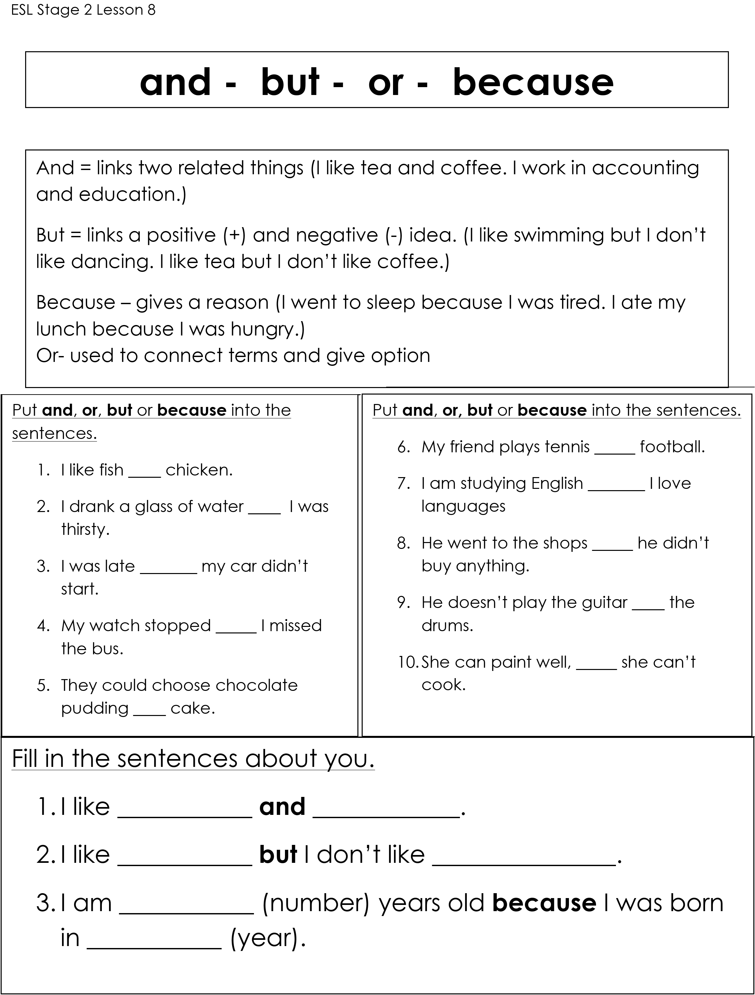
And, but, or, because

Slide 21
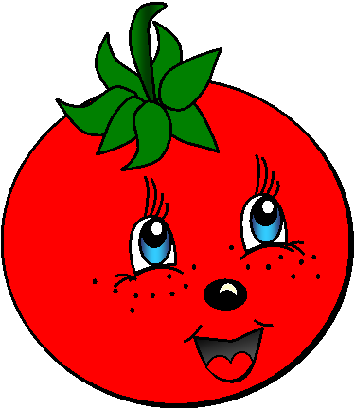


VEGETABLES
CHOOSE
mushroom
tomato
lettuce
pepper
cucumber
potato
cabbage
onion
carrot
peas
What is it?
egg-plant

Slide 22
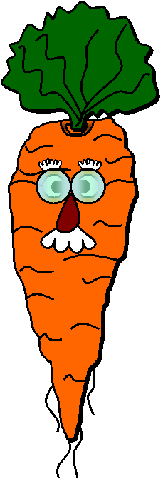
VEGETABLES
CHOOSE
mushroom
tomato
lettuce
pepper
cucumber
potato
cabbage
onion
carrot
peas
What is it?
egg-plant

Slide 23
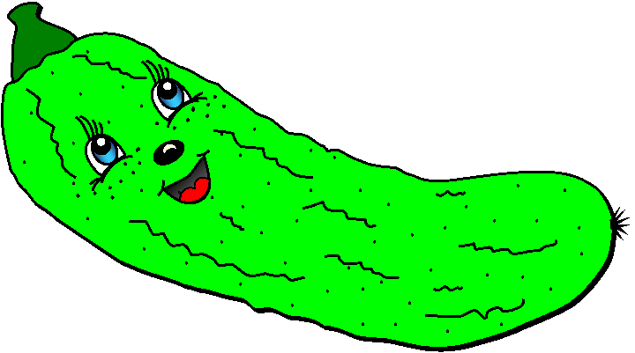
VEGETABLES
CHOOSE
mushroom
tomato
lettuce
pepper
cucumber
potato
cabbage
onion
carrot
peas
What is it?
egg-plant

Slide 24
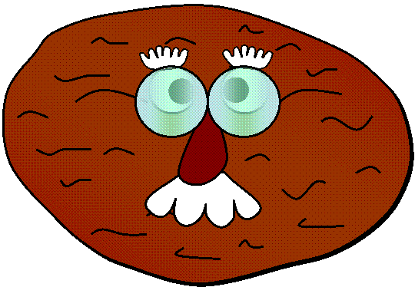
VEGETABLES
CHOOSE
mushroom
tomato
lettuce
pepper
cucumber
potato
cabbage
onion
carrot
peas
What is it?
egg-plant

Slide 25
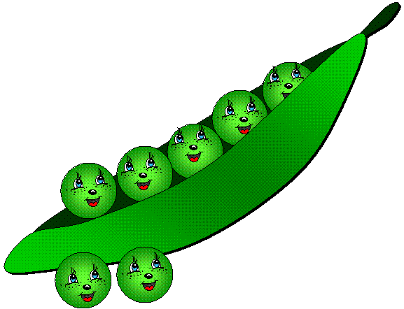
VEGETABLES
CHOOSE
mushroom
tomato
lettuce
pepper
cucumber
potato
cabbage
onion
carrot
What are they?
peas
egg-plant

Slide 26

VEGETABLES
CHOOSE
mushroom
tomato
lettuce
pepper
cucumber
potato
cabbage
onion
carrot
peas
What is it?
egg-plant

Slide 27


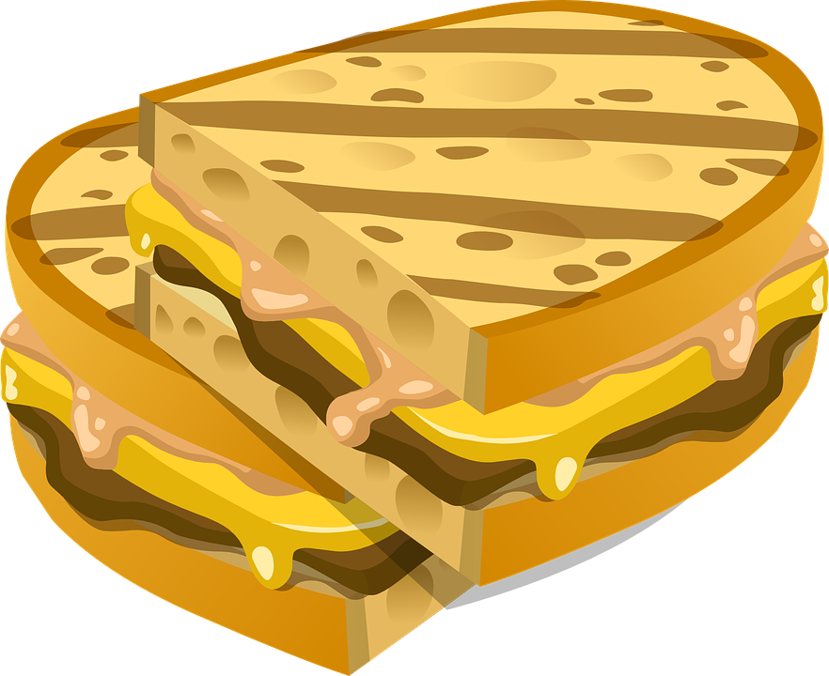

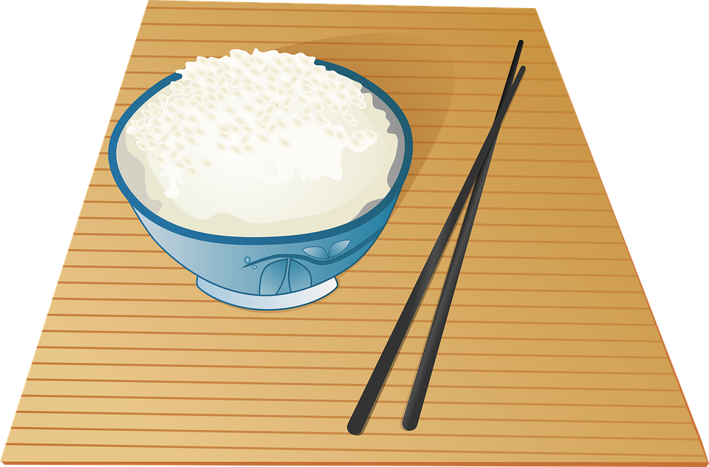
Does this food come from plants or animals?

Slide 28

What did we learn?
Saying the ‘sn’ and ‘ar’ sound
New “sn” and ‘ar’ words
Practiced “and”, “or”, “but”, “because”, “his”, “hers”, “theirs”, “ours” and “its”

Slide 29


Homework
Condiments are sauces that we put in our food to give it some extra flavor.
What condiments do you use in your culture?
Match these words with the condiments in the photo: honey, maple syrup, mustard, salt, jam mayonnaise, sugar, vinegar, barbecue sauce, soy sauce, pepper, hot sauce, wasabi and ketchup.
See condiment picture on the next slide.

Slide 30
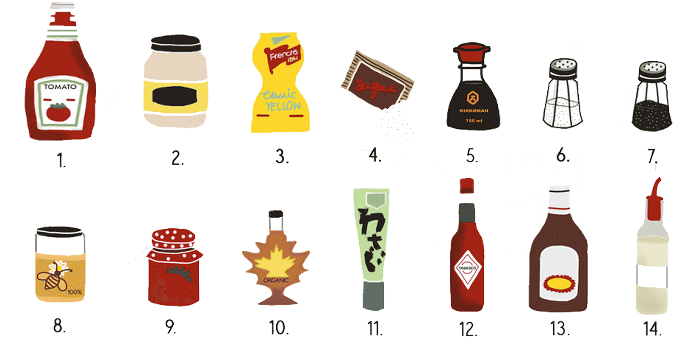
Homework
Identify the condiments honey, maple syrup, mustard, salt, jam mayonnaise, sugar, vinegar, barbecue sauce, soy sauce, pepper, hot sauce, wasabi and ketchup.

