Slide 1


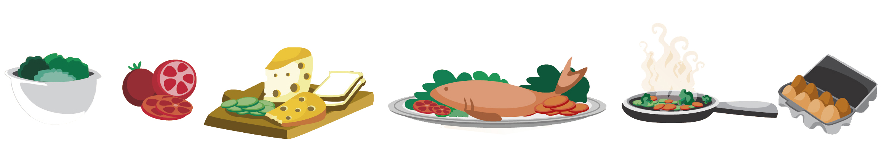
Lesson 9
FOOD

Slide 2

What we will learn today
New ‘sn’ and ‘ar’ words
Using the sn’ and ‘ar’ sound in sentences
Using “and”, “or”, “but”, “because”, “his”, “hers”, “theirs”, “ours” and “its”
Notes:
Go over the learning goals.

Slide 3
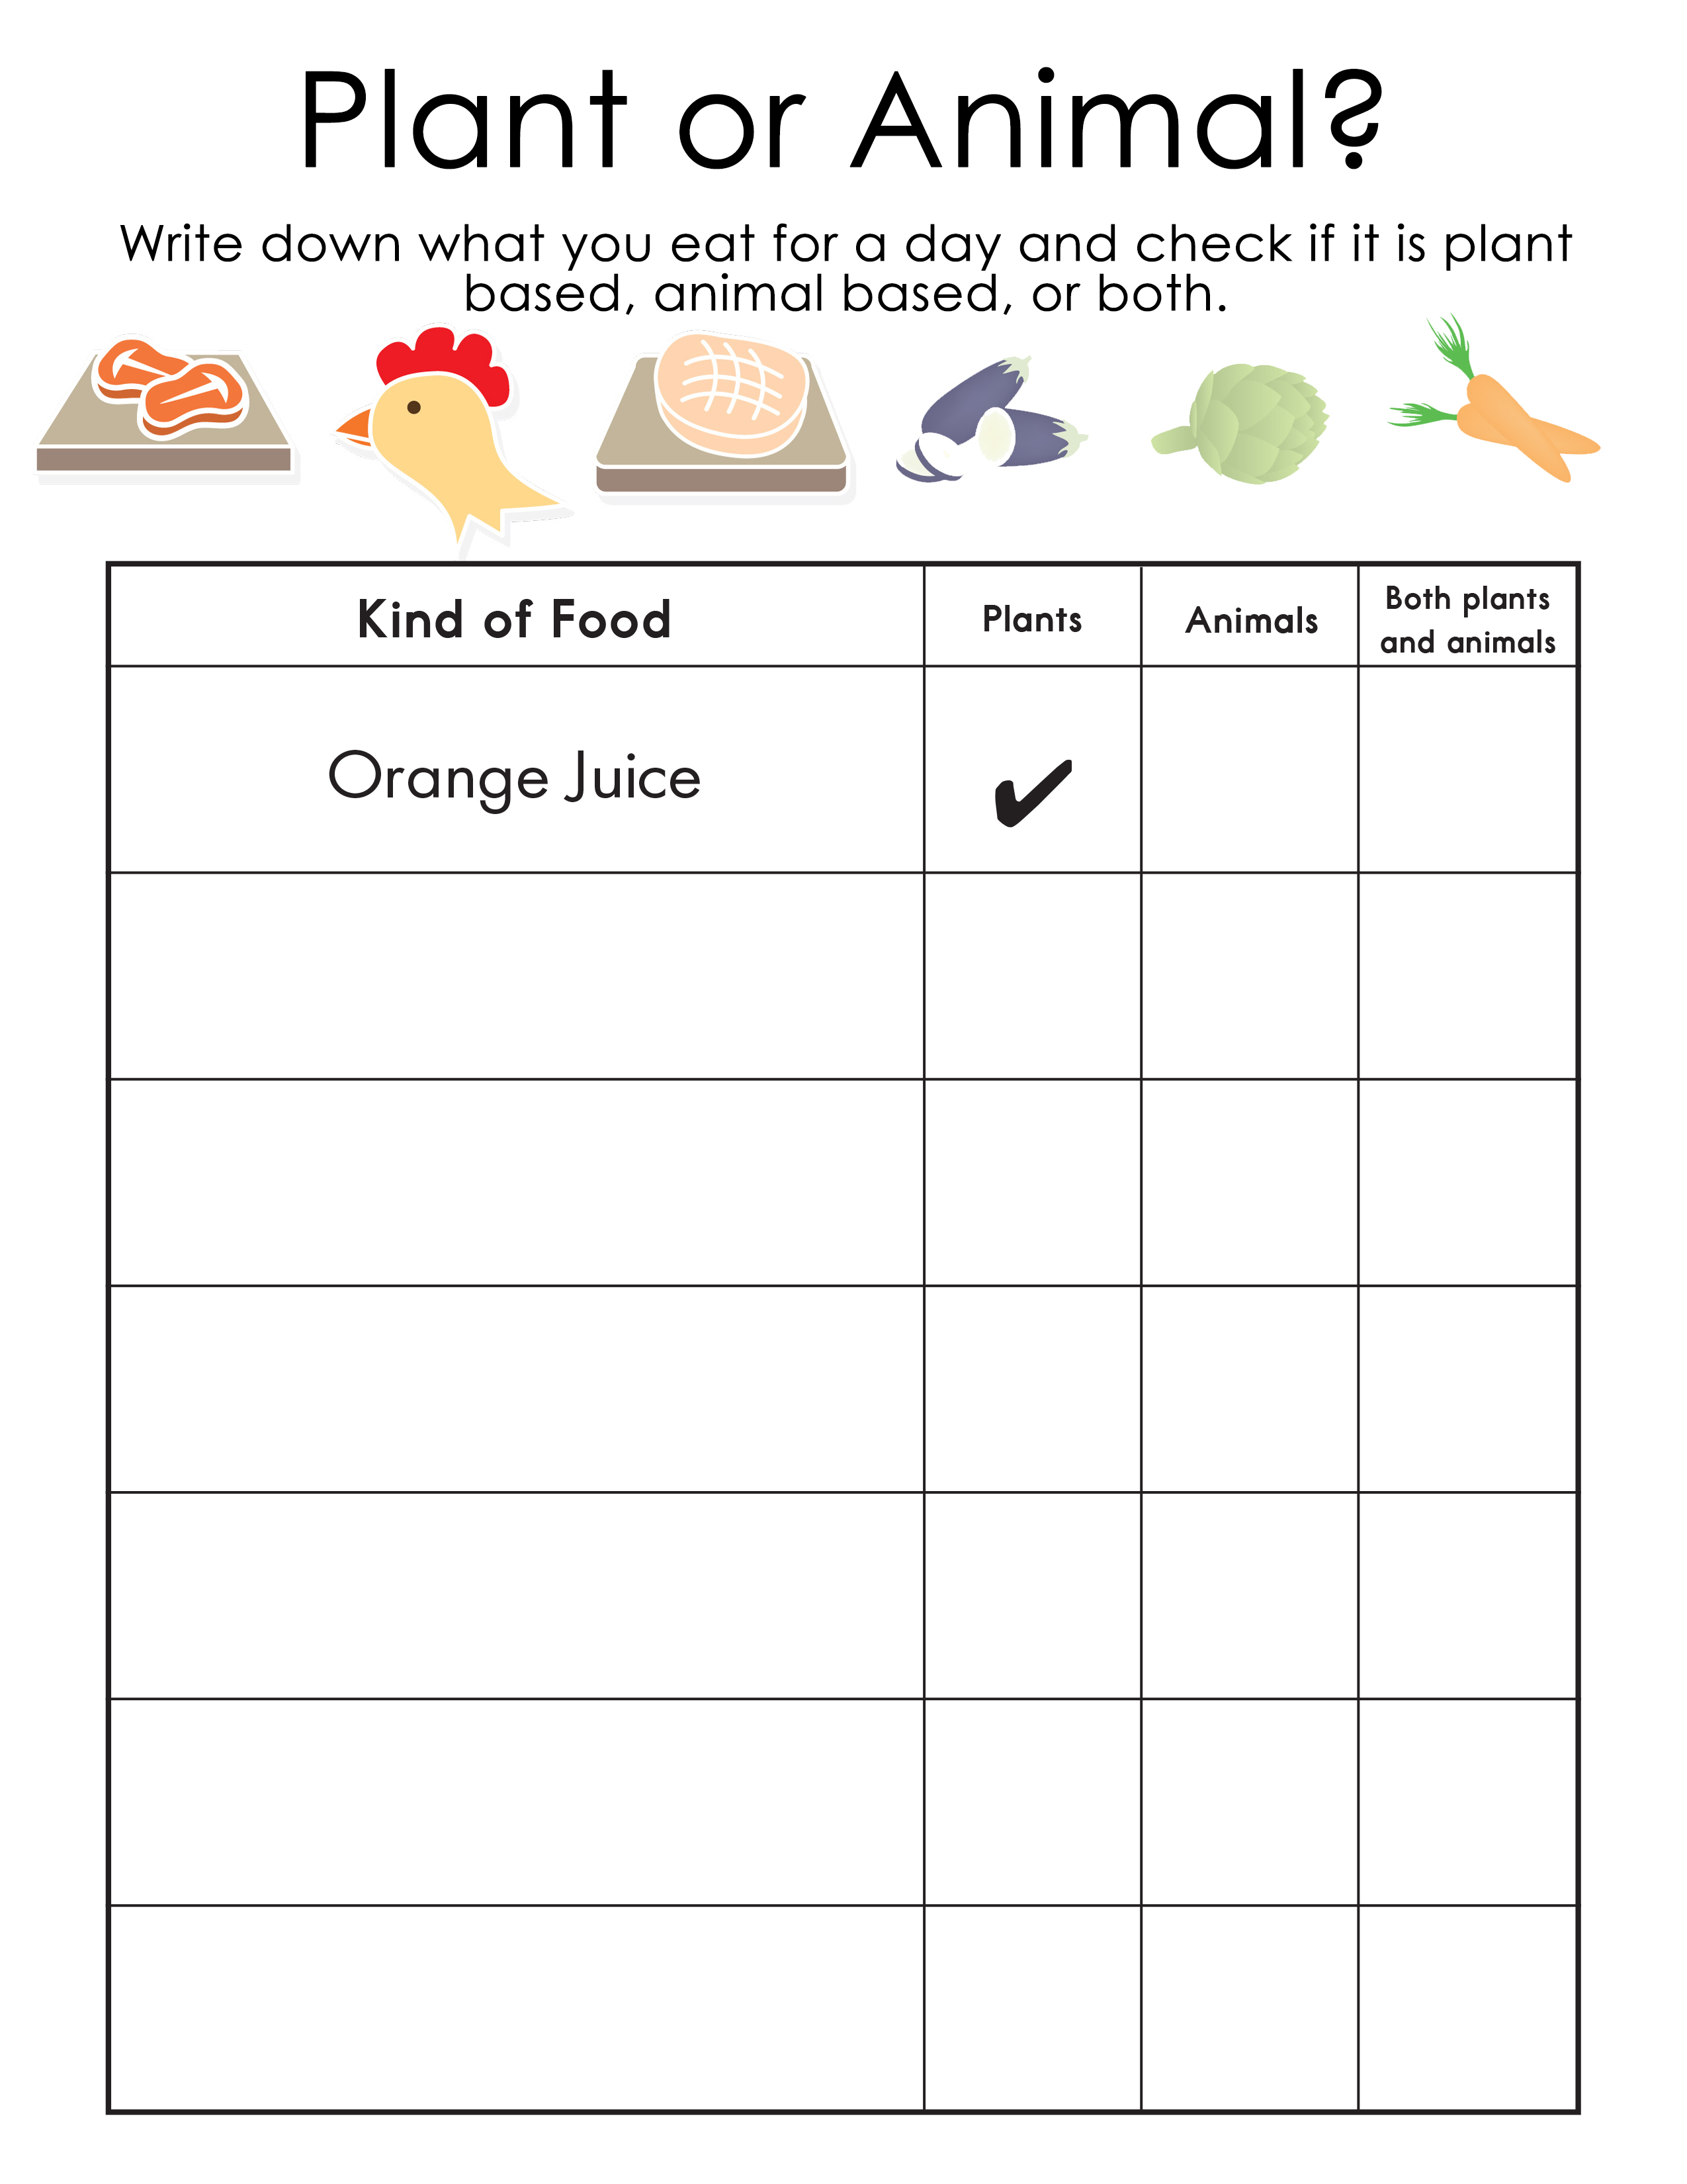
What did you eat?
Notes:
Go over the homework with the students. Get the to read each meal they had and say if it was from plants/animals or both.

Slide 4


The SN Sound
Notes:
Start with the S sound. Notice that the tongue feels pretty flat in your mouth, although high in the mouth. The sides of the tongue line the inner sides of your top teeth where they meet the gums. The tip of the tongue does not make contact with your teeth. To create the 'n sound', the air is blocked from leaving the mouth by pressing the tip against the tooth ridge and the sides of the front of the tongue against the side teeth. . Demonstrate for the students, and have them repeat the sound.

Slide 5


The AR Sound
Notes:
The tip and center of the tongue are set low, inside the bottom teeth. The top of the tongue is nearly even with the top of the bottom teeth. To transition to the 'r' portion of the sound, the body of the tongue moves upward. The mid-section of the tongue rises so the sides of the tongue touch the middle teeth. Demonstrate for the students, and have them repeat the sound.

Slide 6
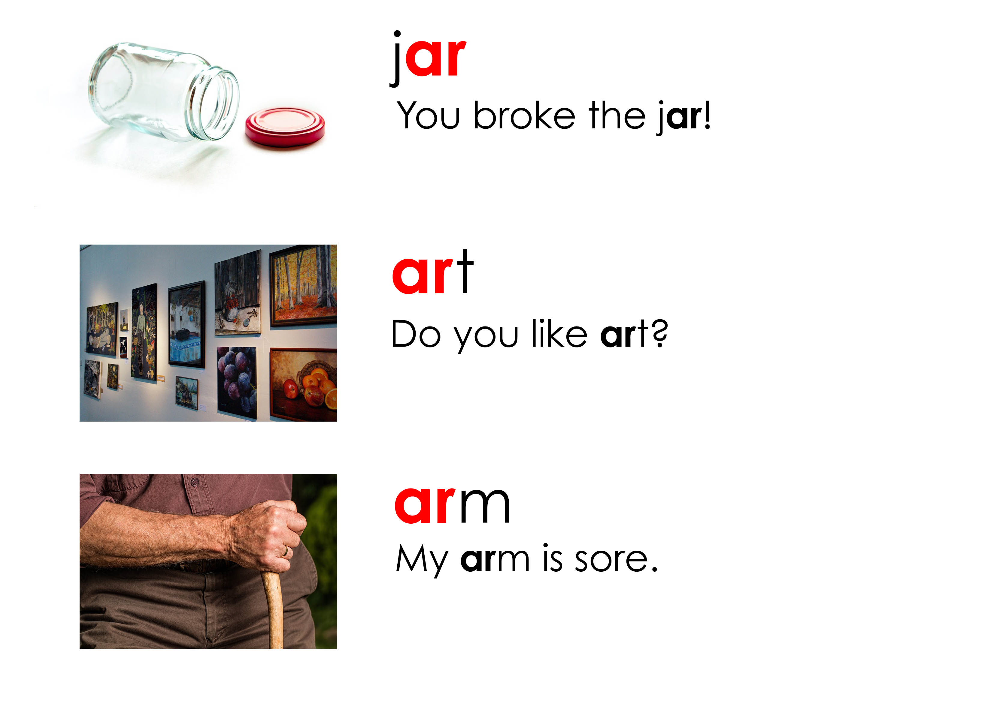
Let’s practice pronouncing the AR sound
Notes:
Say each word, articulating it clearly. Then say the word again, in a more natural way. Read the sentence accompanying the word. Instruct the students to repeat the word, chorally and then individually. Then, instruct the students to repeat each sentence, chorally and then individually.

Slide 7
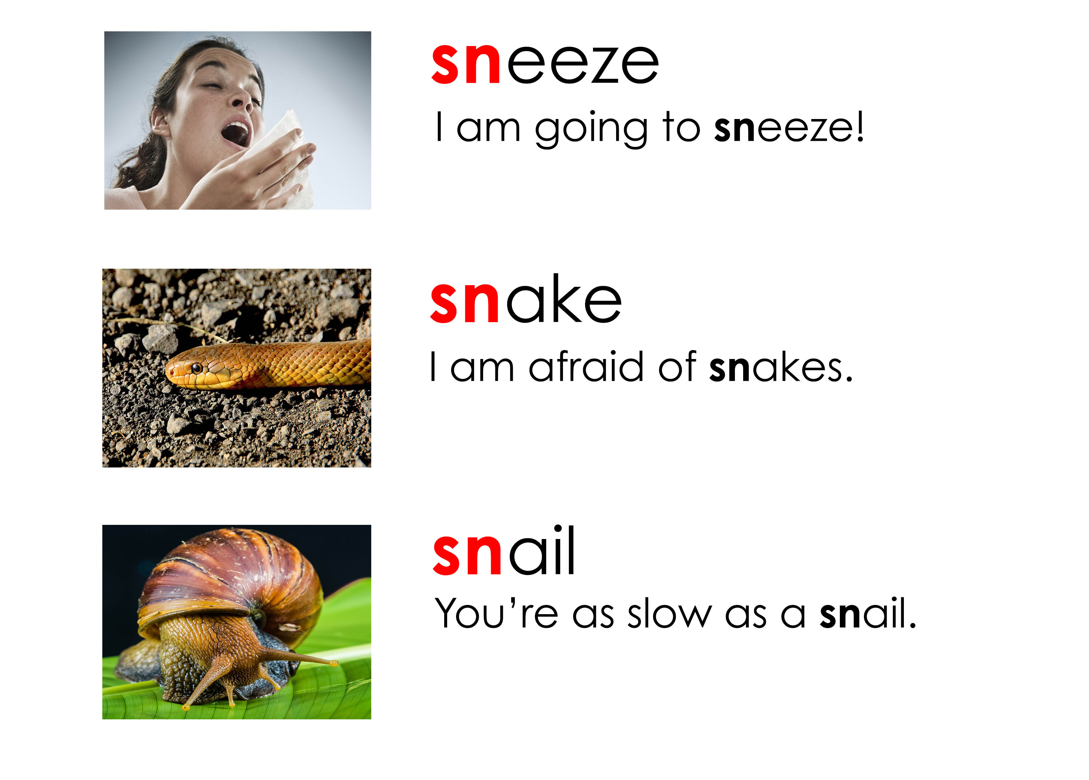
Let’s practice pronouncing the SN sound
Notes:
Say each word, articulating it clearly. Then say the word again, in a more natural way. Read the sentence accompanying the word. Instruct the students to repeat the word, chorally and then individually. Then, instruct the students to repeat each sentence, chorally and then individually.

Slide 8

Let’s do some acting
Notes:
Demonstrate the follow hand gestures to the student: hello (wave), goodbye (wave), it’s cold (arms around shoulders), it’s hot (fan your face with hand), come here (move your index finger), Me! (touch your chest), OK (make the OK sign), I don’t know (pull shoulders and hands up), Shhhh (index finger in front of mouth), Stop (hand up, palm up)

Slide 9
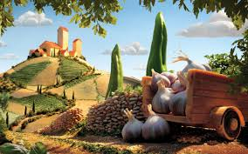
Food Scapes
http://twistedsifter.com/2013/08/surreal-landscapes-made-from-food-carl-warner/
Notes:
Show students Carl Warner’s food art. Ask them to point out foods they recognize.

Slide 10
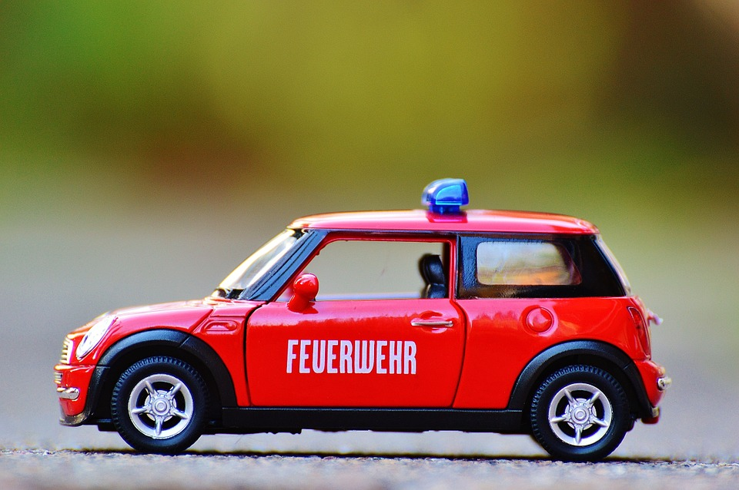

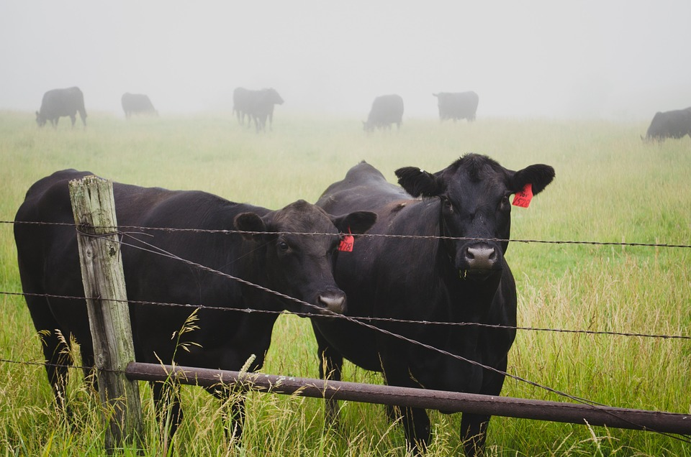
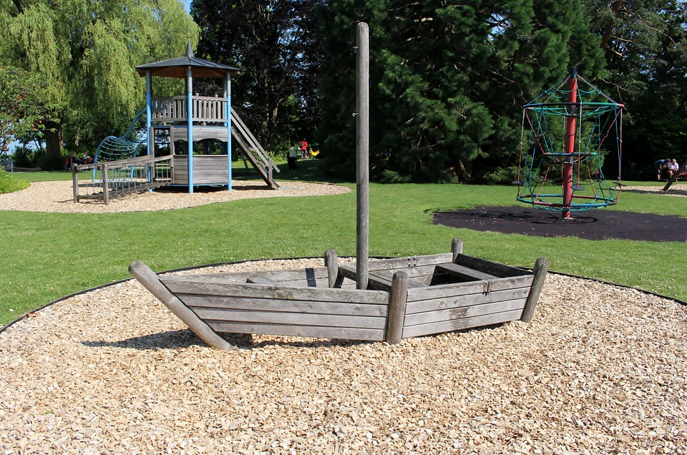
Some other “ar” words
car
dark
farm
park
Notes:
Pre-teach this vocabulary for the following activity.

Slide 11
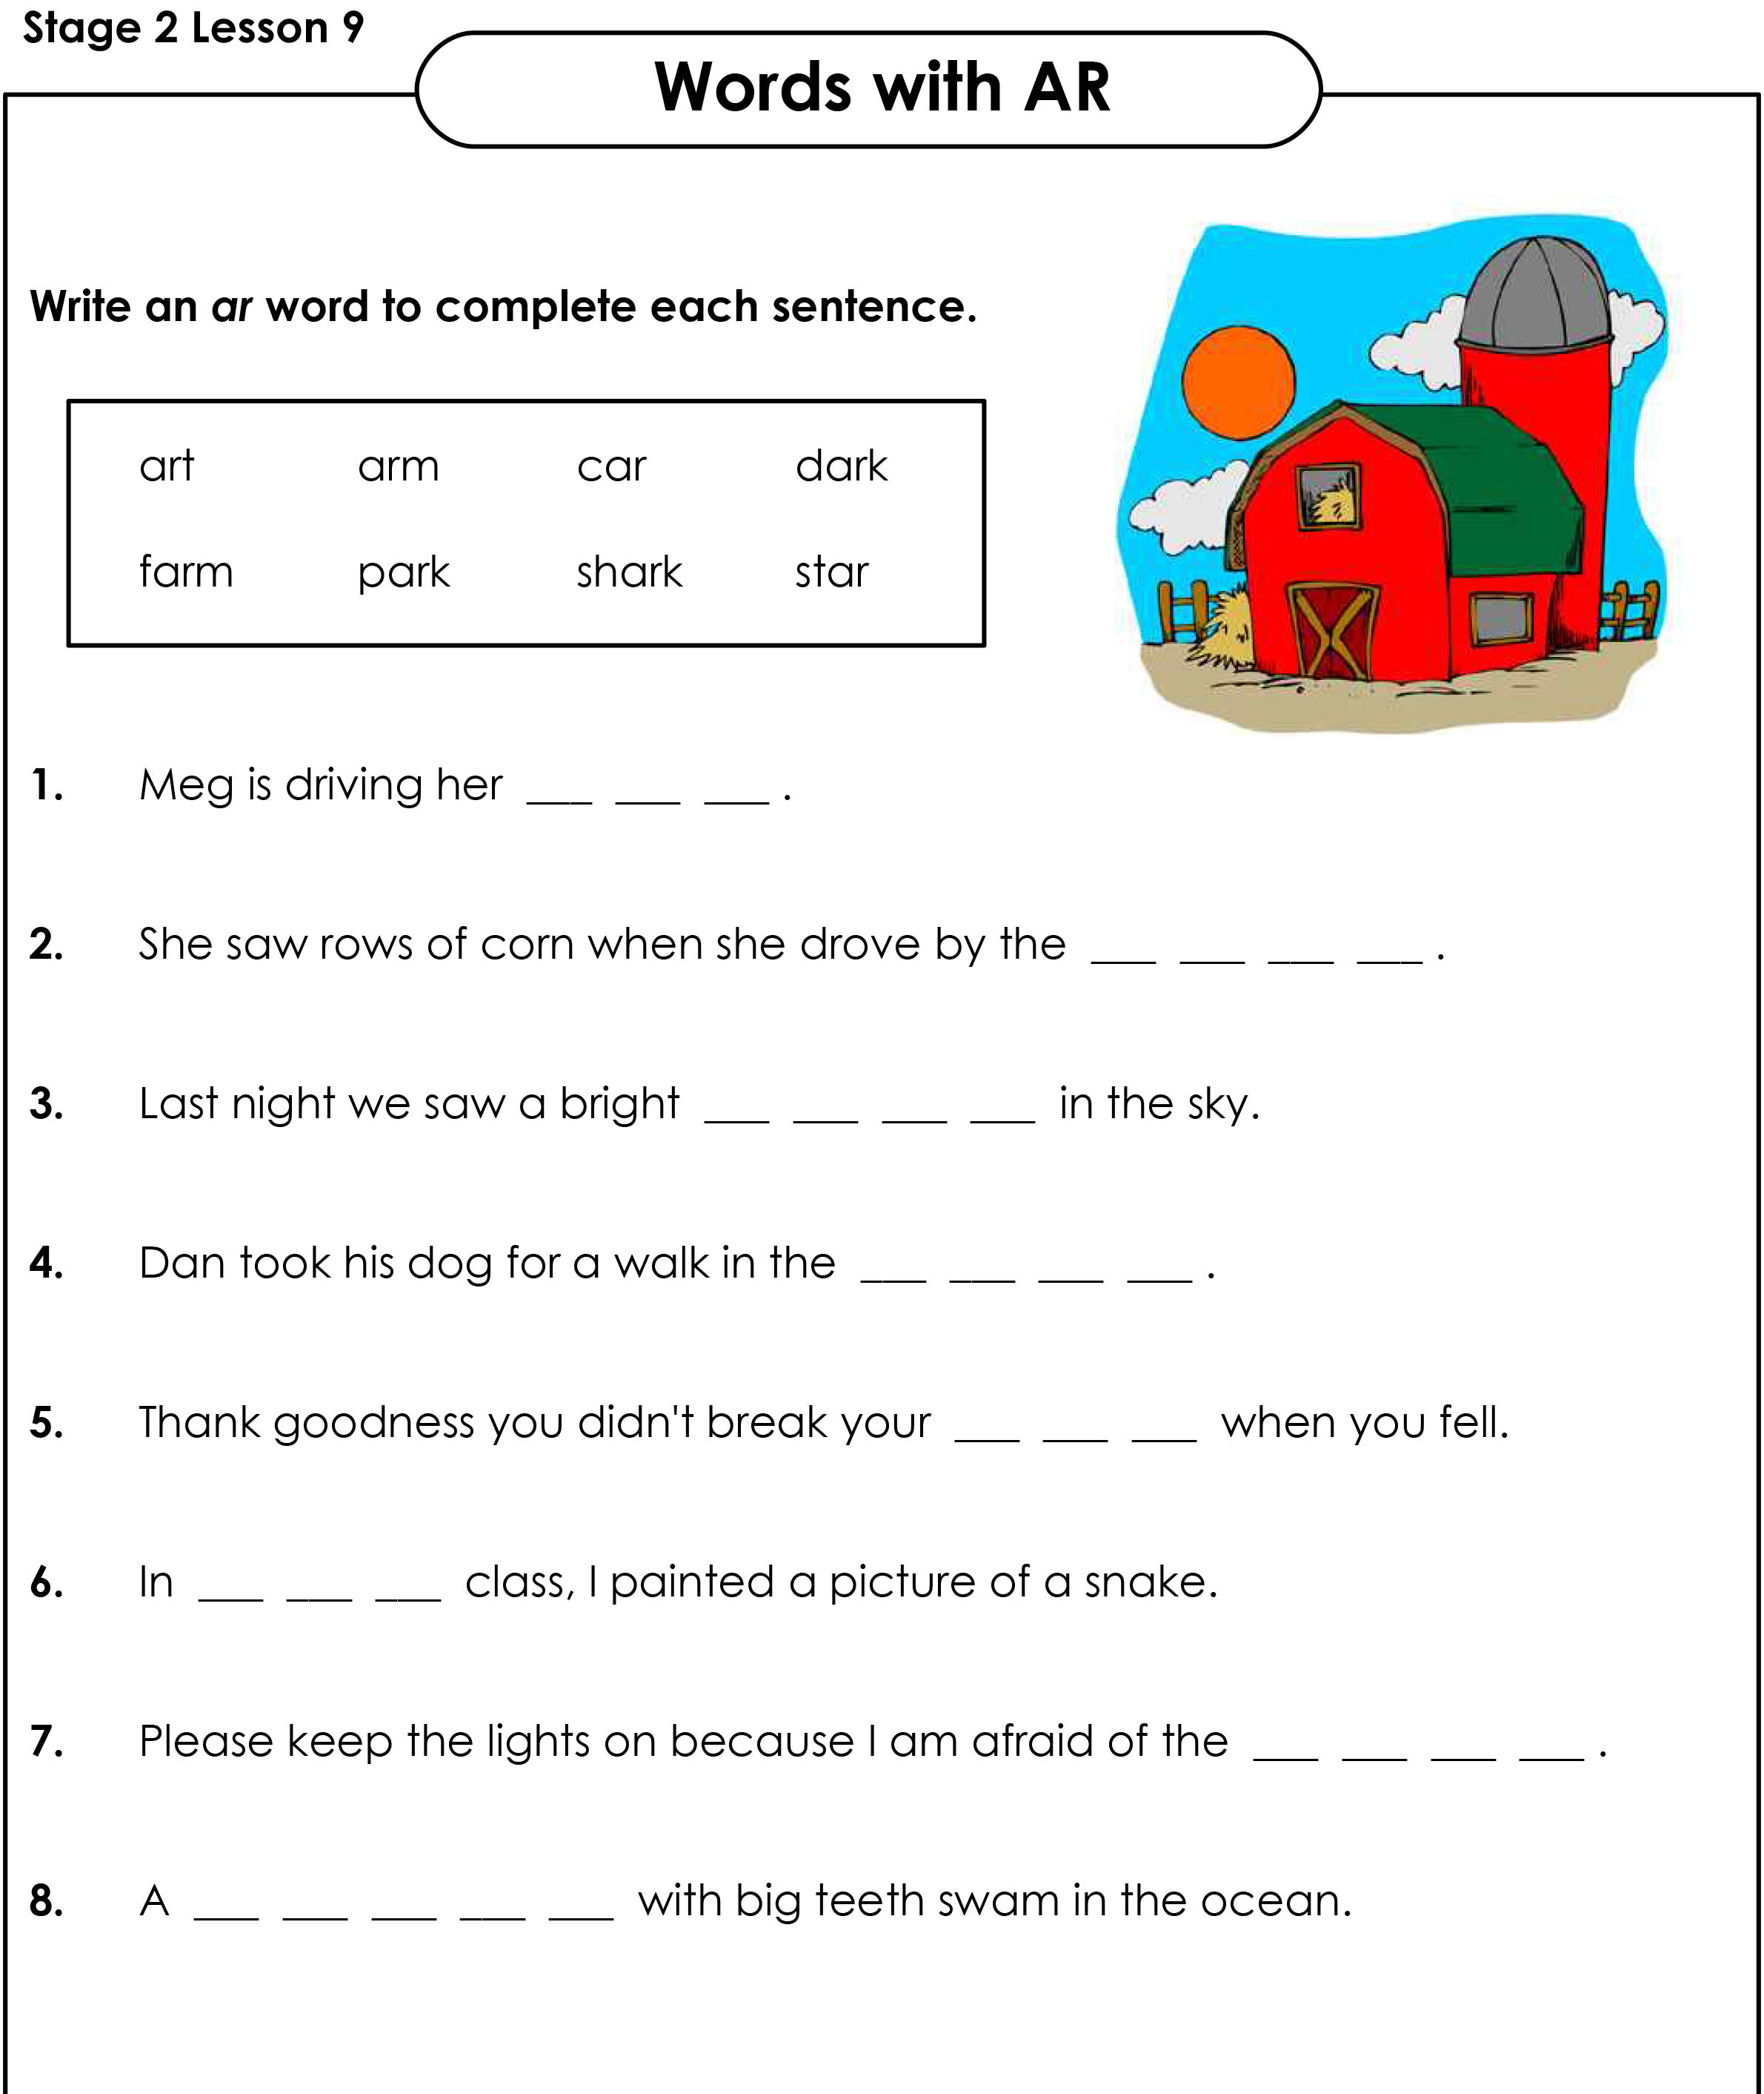
Fill in the blanks
Notes:
Get students to work on the “AR Worksheet.pdf”

Slide 12
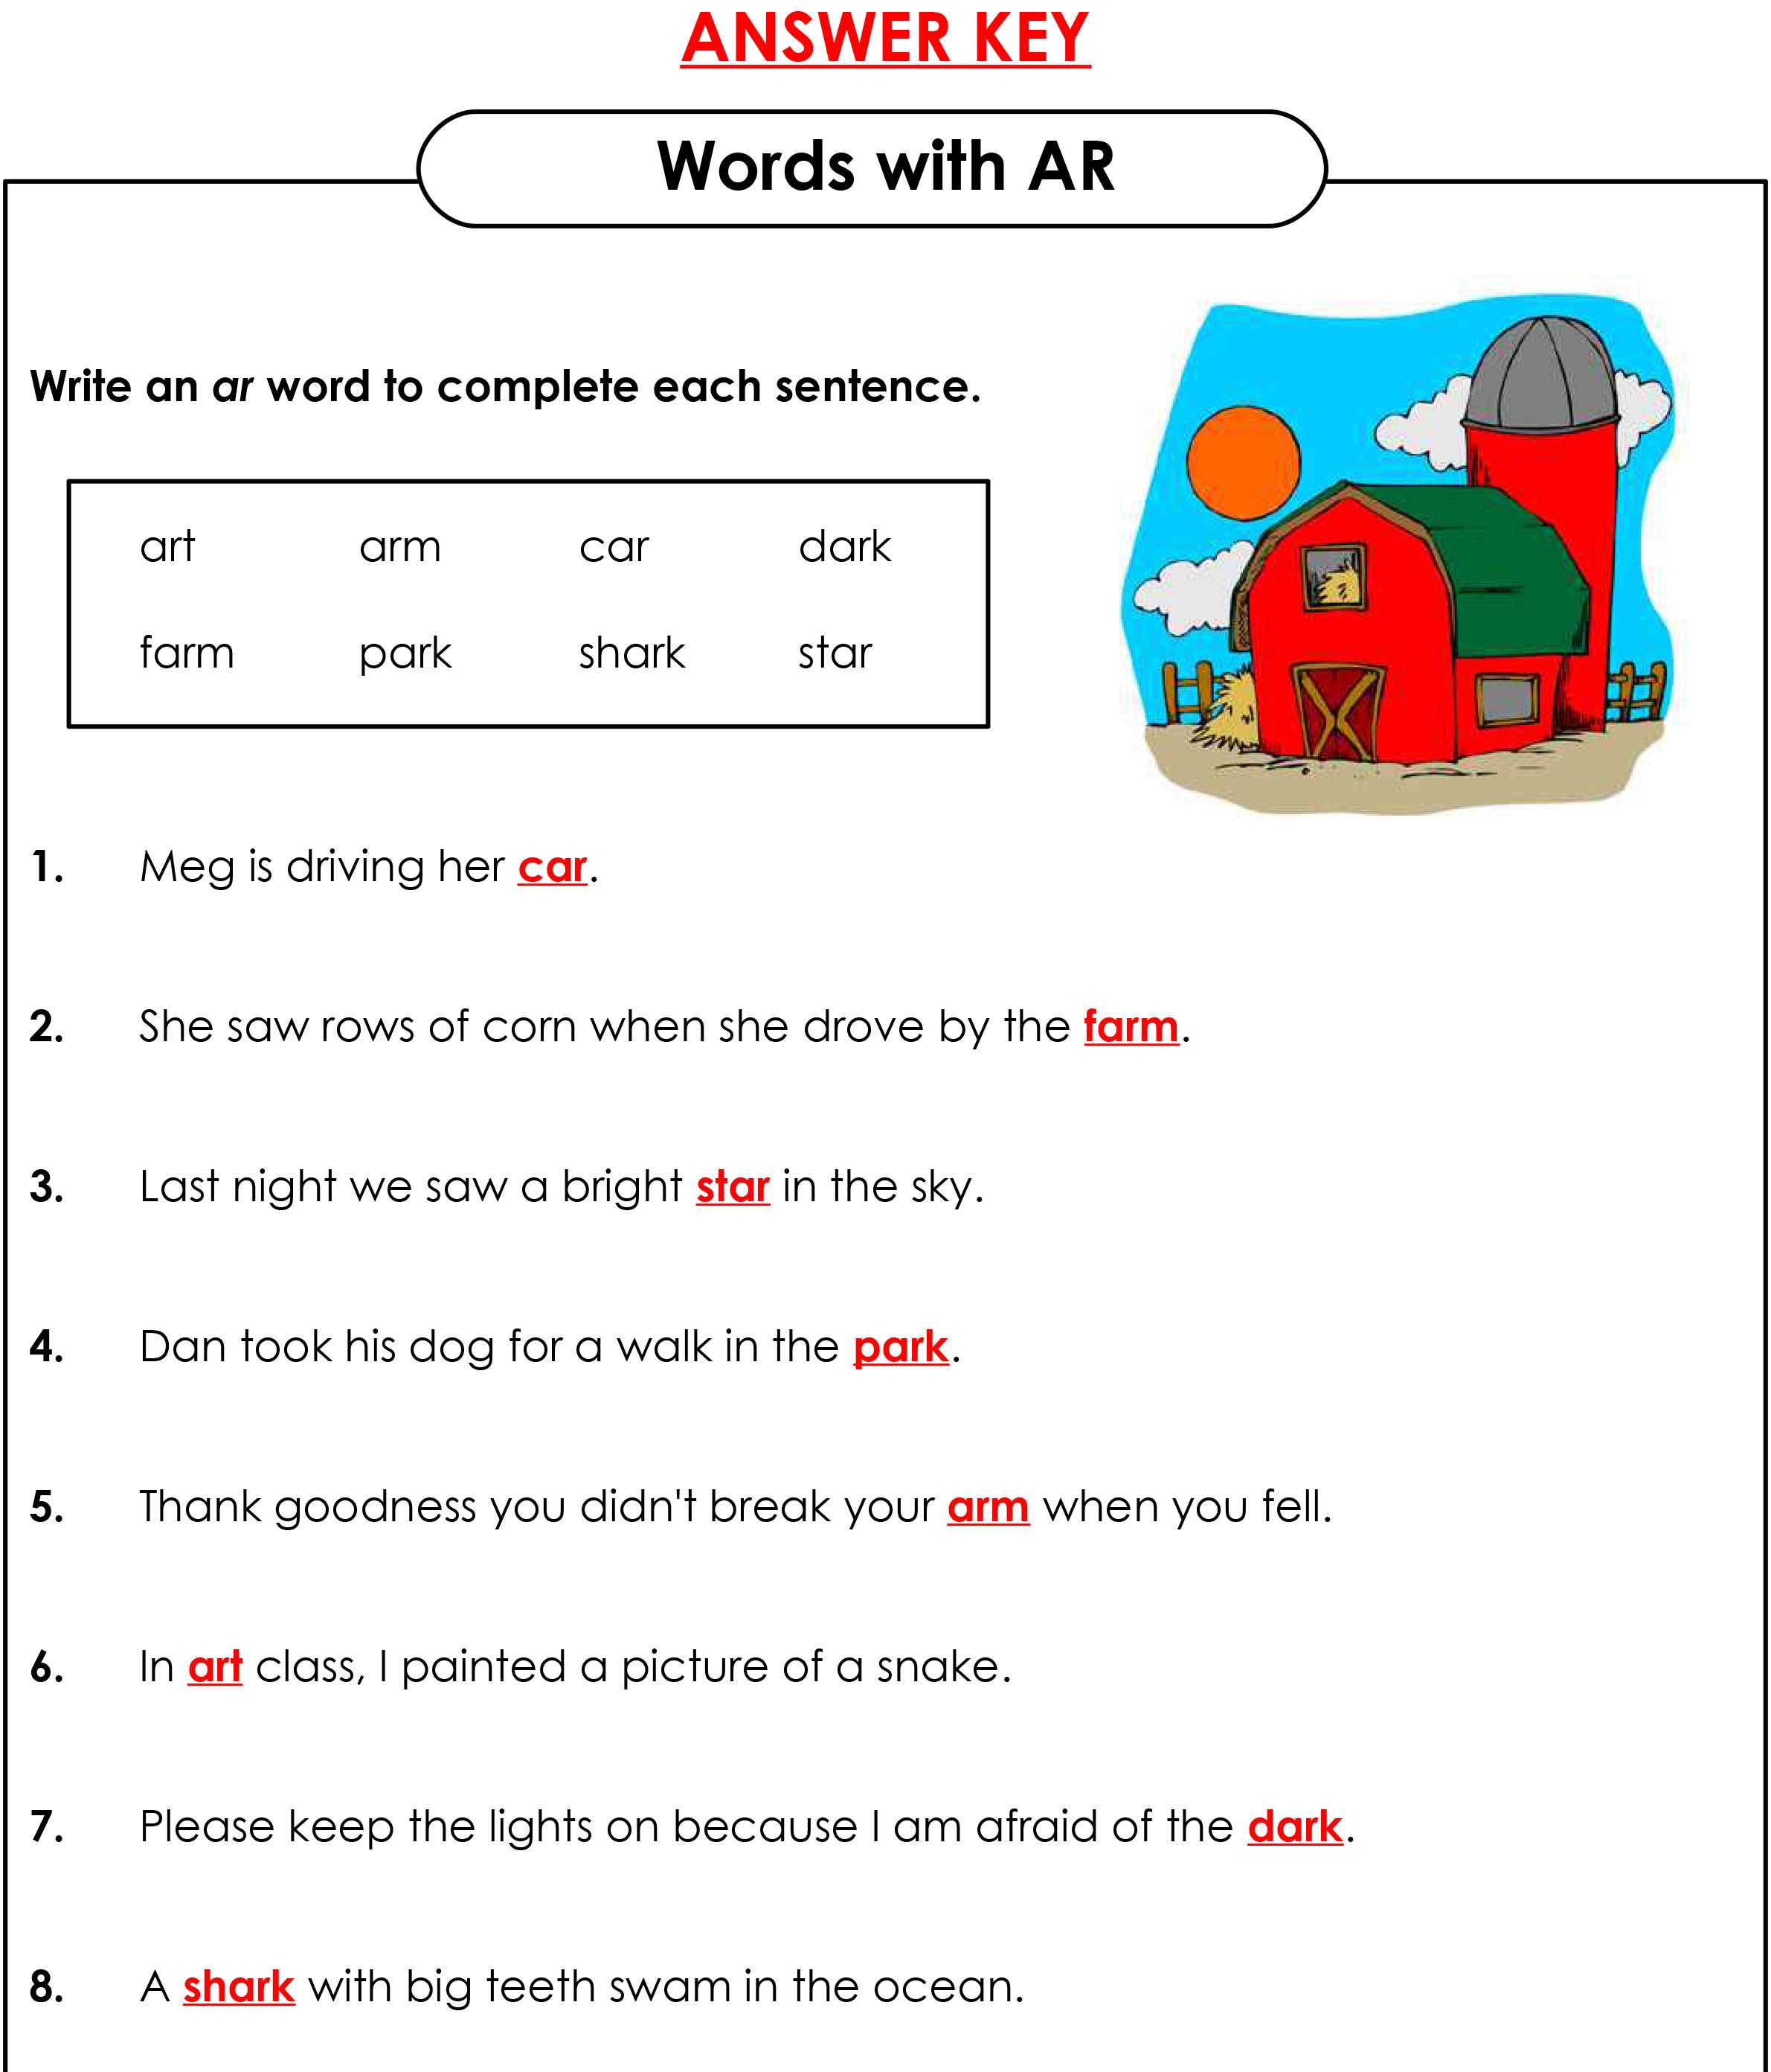
Answers
Notes:
Take up the answers

Slide 13



His, Hers, Its
His, hers and its are possessive pronouns.
His, hers, and its are possessive pronouns that show ownership of a noun.
His = males
Hers = females
its = animal or an object
Notes:
Explain slide.

Slide 14
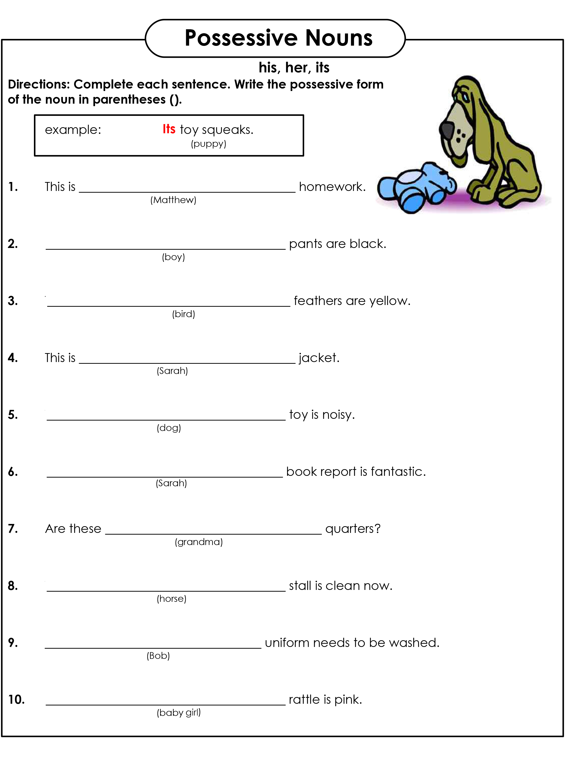
His, hers, its
Notes:
Get students to take out “His Hers its Worksheet.pdf”.
Answers: 1. his 2. his 3. its 4. her 5. its 6. her 7. her 8. its 9. his 10. hers

Slide 15
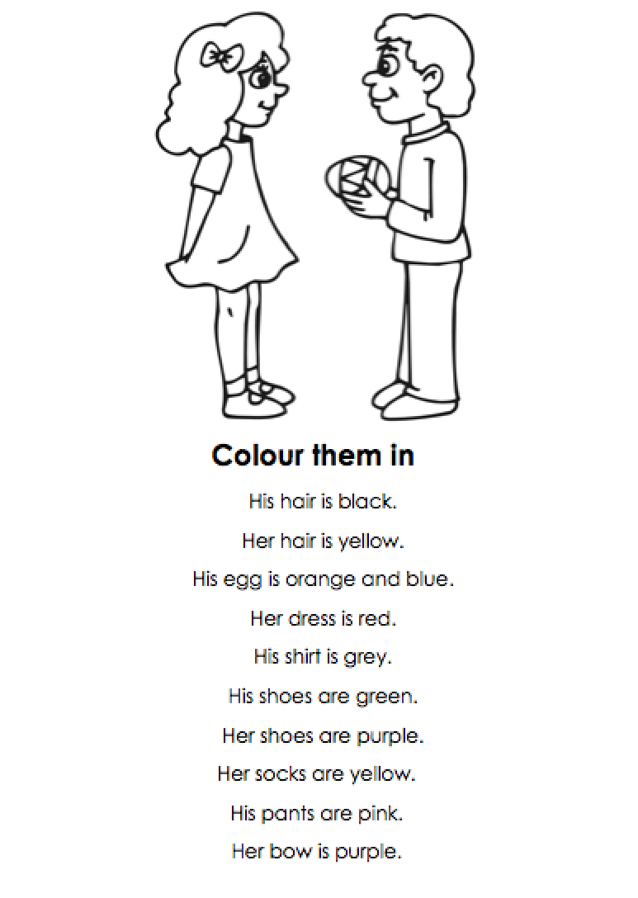
Let’s Colour
Notes:
Do this worksheet as a group. Get each student to colour one part as you go through the list.

Slide 16

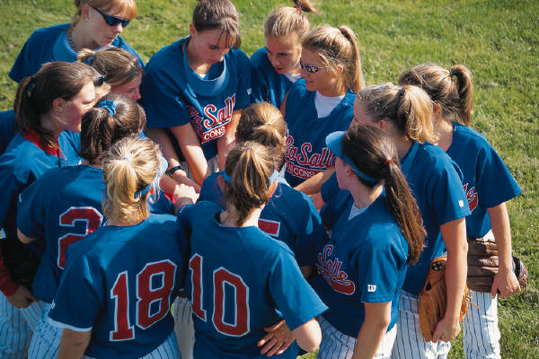
Theirs and ours
Ours and theirs are plural possessive pronouns that show ownership of a noun.
Ours = we
Theirs = they
Notes:
Explain slide.

Slide 17

Ours or theirs?
Notes:
Do this activity orally. Alternate between each students.

Slide 18

Answers
Notes:
Take up the answers.

Slide 19
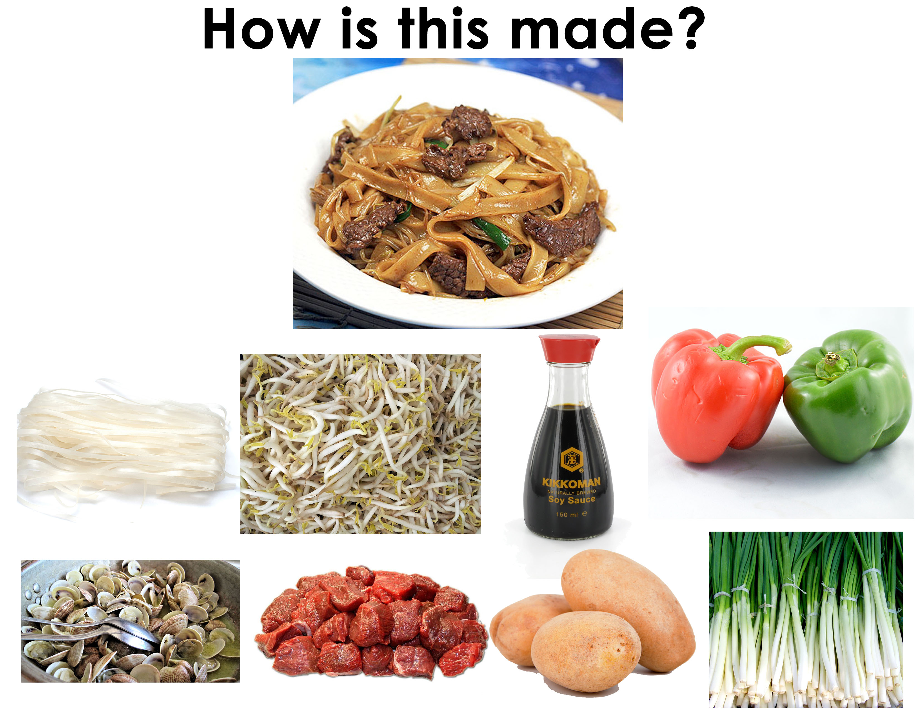
Notes:
Ingredients: rice noodles, soy sauce, green onion, beef, bean sprouts

Slide 20
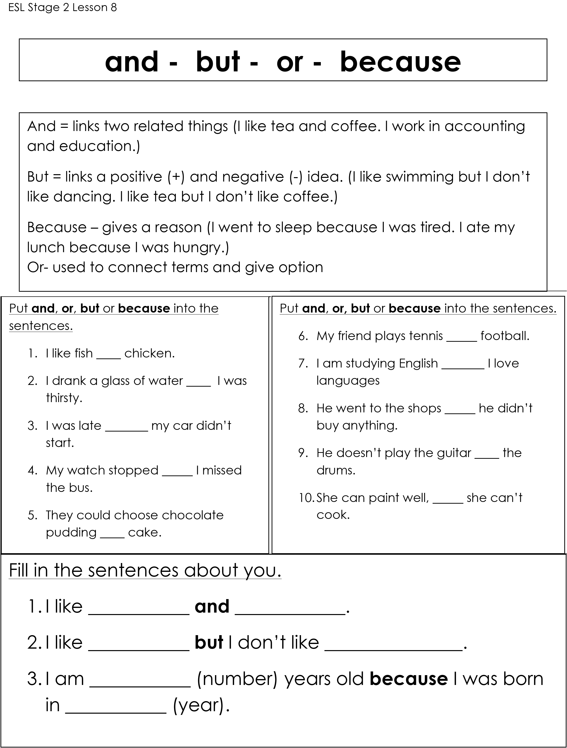
And, but, or, because
Notes:
Get students to take out “And Or But aBecause Worksheet Review.pdf”. Go over what each conjunction means and have then do the activity.
1. And 2. because 3. because 4. and 5. or 6. and 7. because 8. but 9. or 10. but

Slide 21



VEGETABLES
CHOOSE
mushroom
tomato
lettuce
pepper
cucumber
potato
cabbage
onion
carrot
peas
What is it?
egg-plant

Slide 22
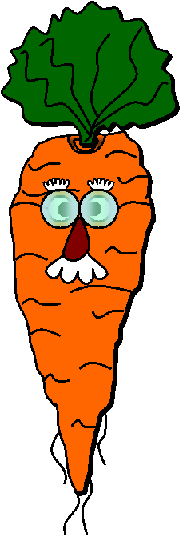
VEGETABLES
CHOOSE
mushroom
tomato
lettuce
pepper
cucumber
potato
cabbage
onion
carrot
peas
What is it?
egg-plant

Slide 23
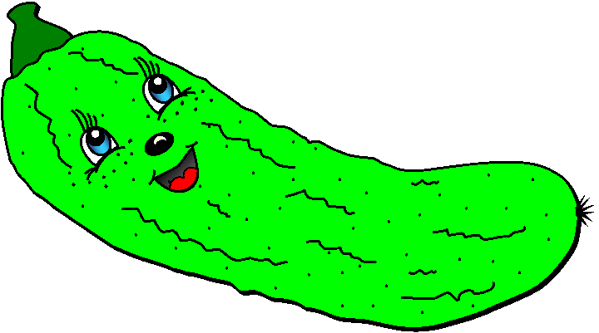
VEGETABLES
CHOOSE
mushroom
tomato
lettuce
pepper
cucumber
potato
cabbage
onion
carrot
peas
What is it?
egg-plant

Slide 24
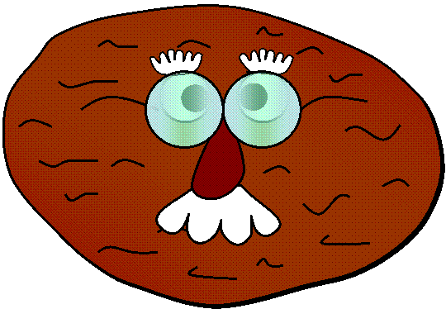
VEGETABLES
CHOOSE
mushroom
tomato
lettuce
pepper
cucumber
potato
cabbage
onion
carrot
peas
What is it?
egg-plant

Slide 25
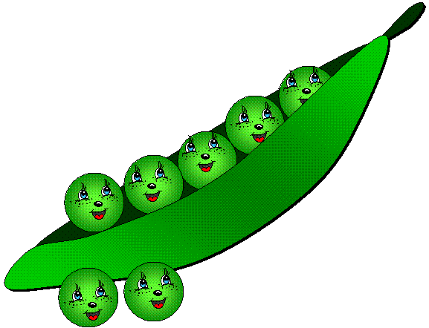
VEGETABLES
CHOOSE
mushroom
tomato
lettuce
pepper
cucumber
potato
cabbage
onion
carrot
What are they?
peas
egg-plant

Slide 26

VEGETABLES
CHOOSE
mushroom
tomato
lettuce
pepper
cucumber
potato
cabbage
onion
carrot
peas
What is it?
egg-plant

Slide 27


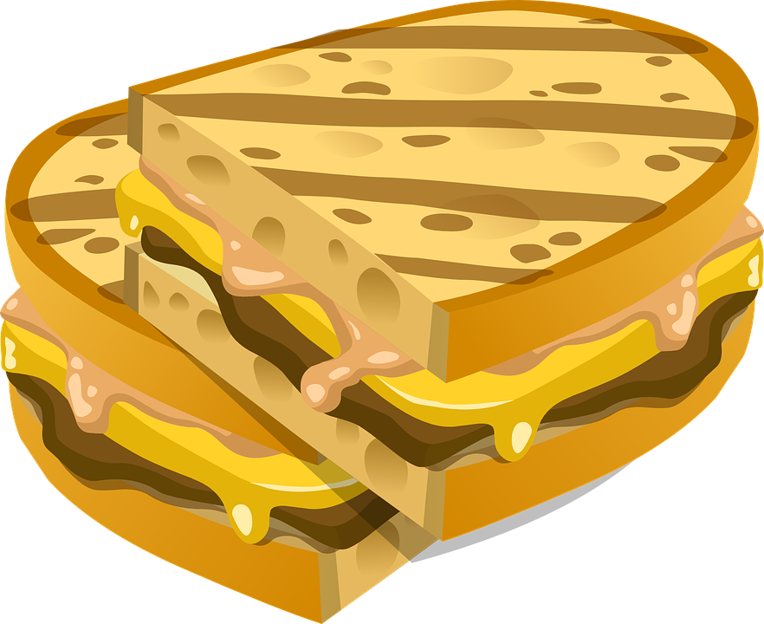

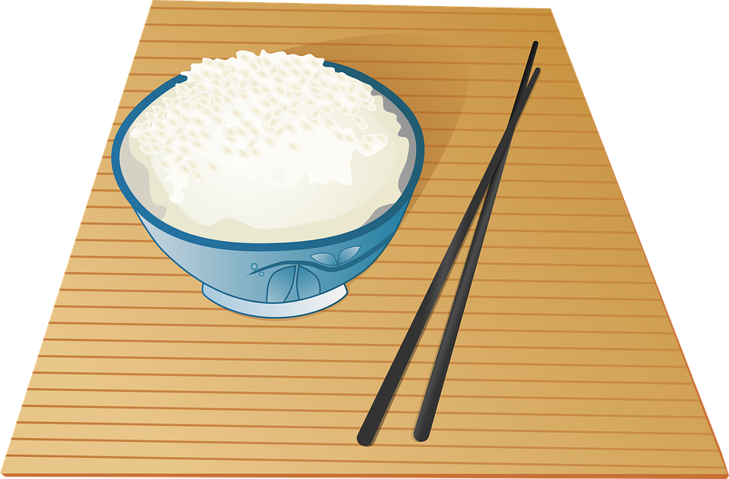
Does this food come from plants or animals?

Slide 28

What did we learn?
Saying the ‘sn’ and ‘ar’ sound
New “sn” and ‘ar’ words
Practiced “and”, “or”, “but”, “because”, “his”, “hers”, “theirs”, “ours” and “its”

Slide 29


Homework
Condiments are sauces that we put in our food to give it some extra flavor.
What condiments do you use in your culture?
Match these words with the condiments in the photo: honey, maple syrup, mustard, salt, jam mayonnaise, sugar, vinegar, barbecue sauce, soy sauce, pepper, hot sauce, wasabi and ketchup.
See condiment picture on the next slide.
Notes:
Go through the individual questions, and answer each to model answers for the students. Pose the question to each student. Remind students that adjectives are describing words for nouns for question. Ask students to write down the answers before the next class.

Slide 30
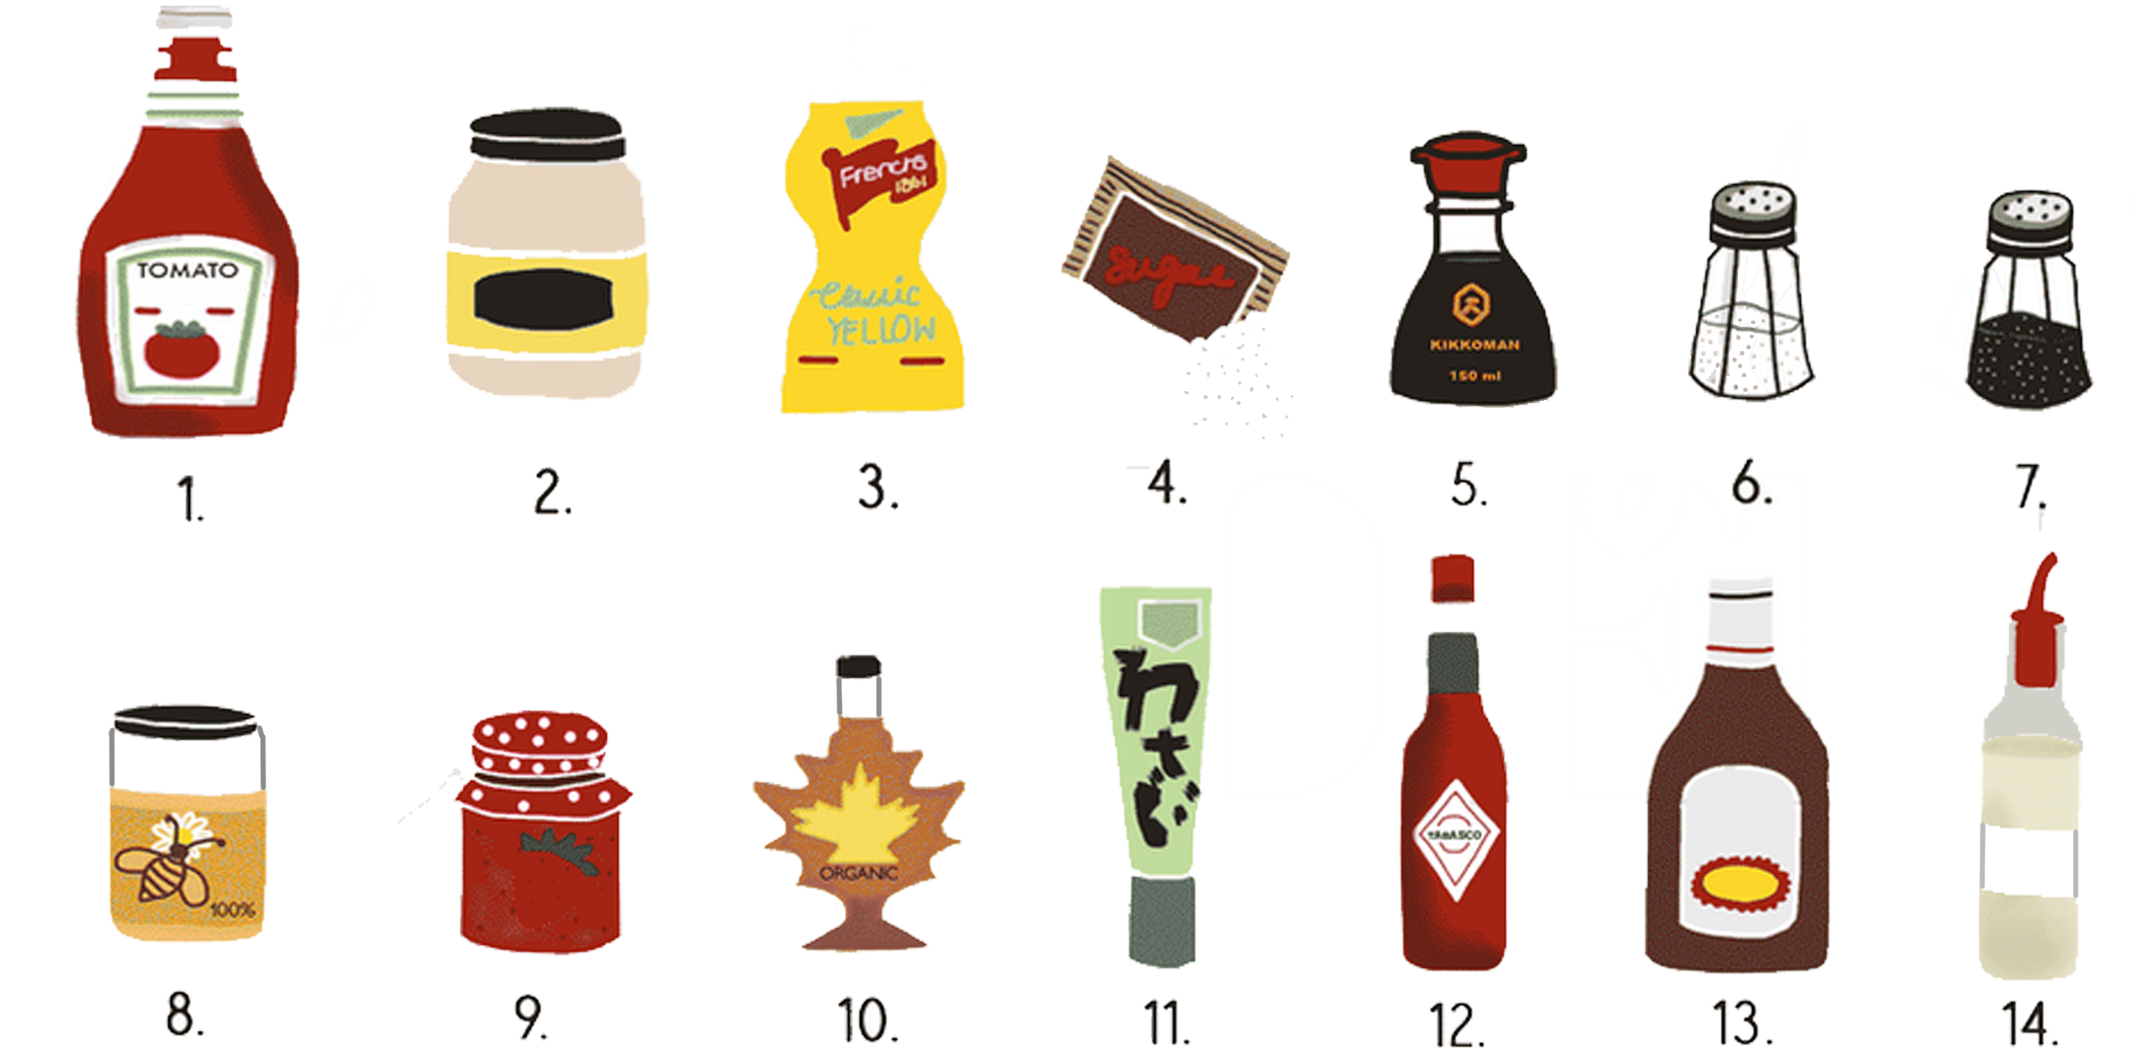
Homework
Identify the condiments honey, maple syrup, mustard, salt, jam mayonnaise, sugar, vinegar, barbecue sauce, soy sauce, pepper, hot sauce, wasabi and ketchup.

