Slide 1
Lesson 9: Tutoring FOOD

Slide 2
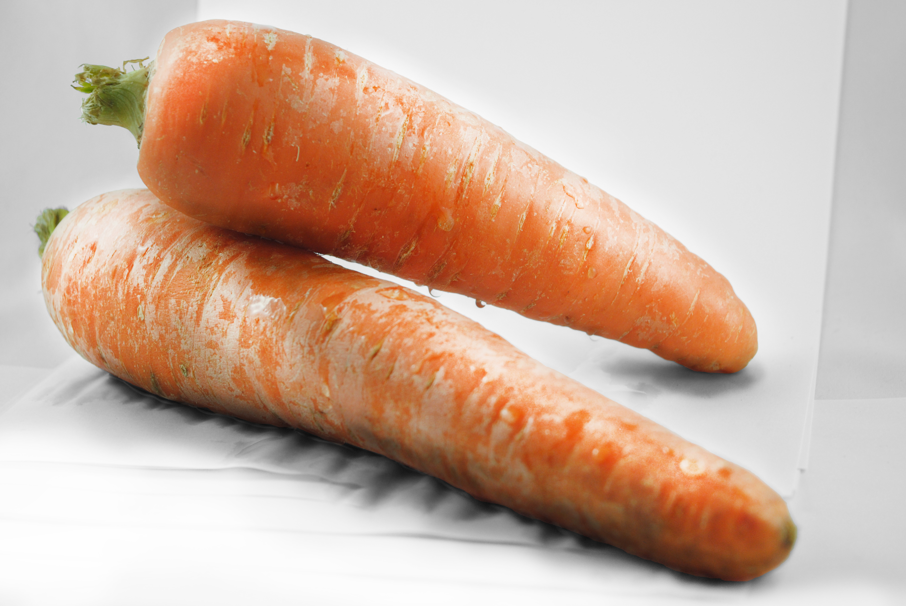
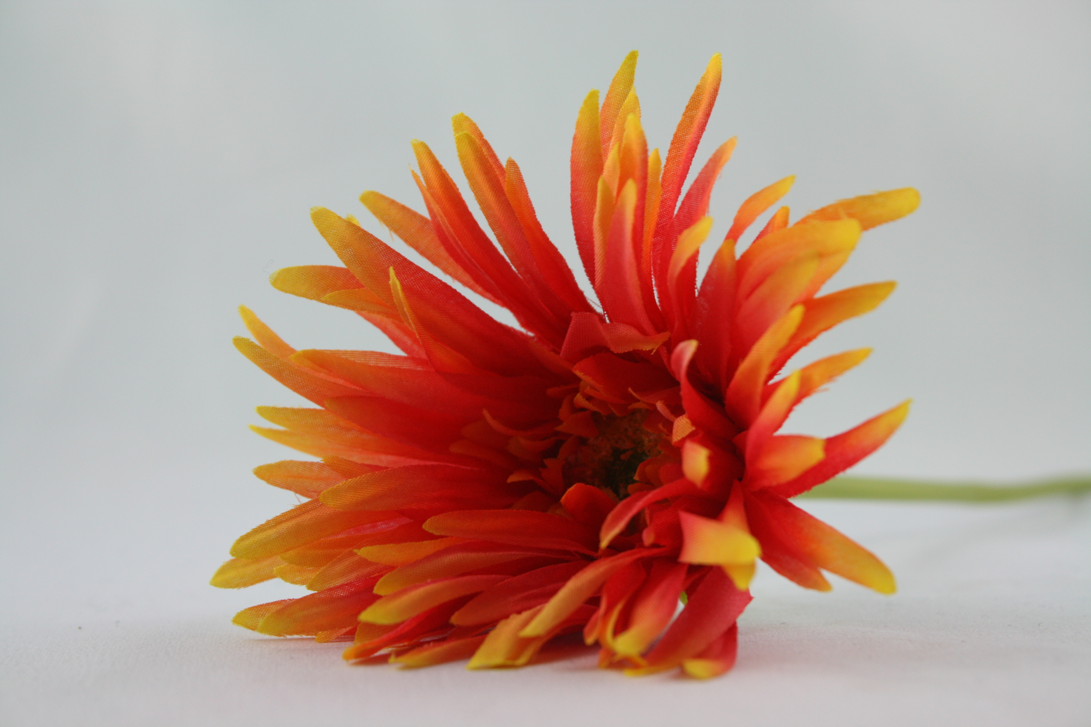
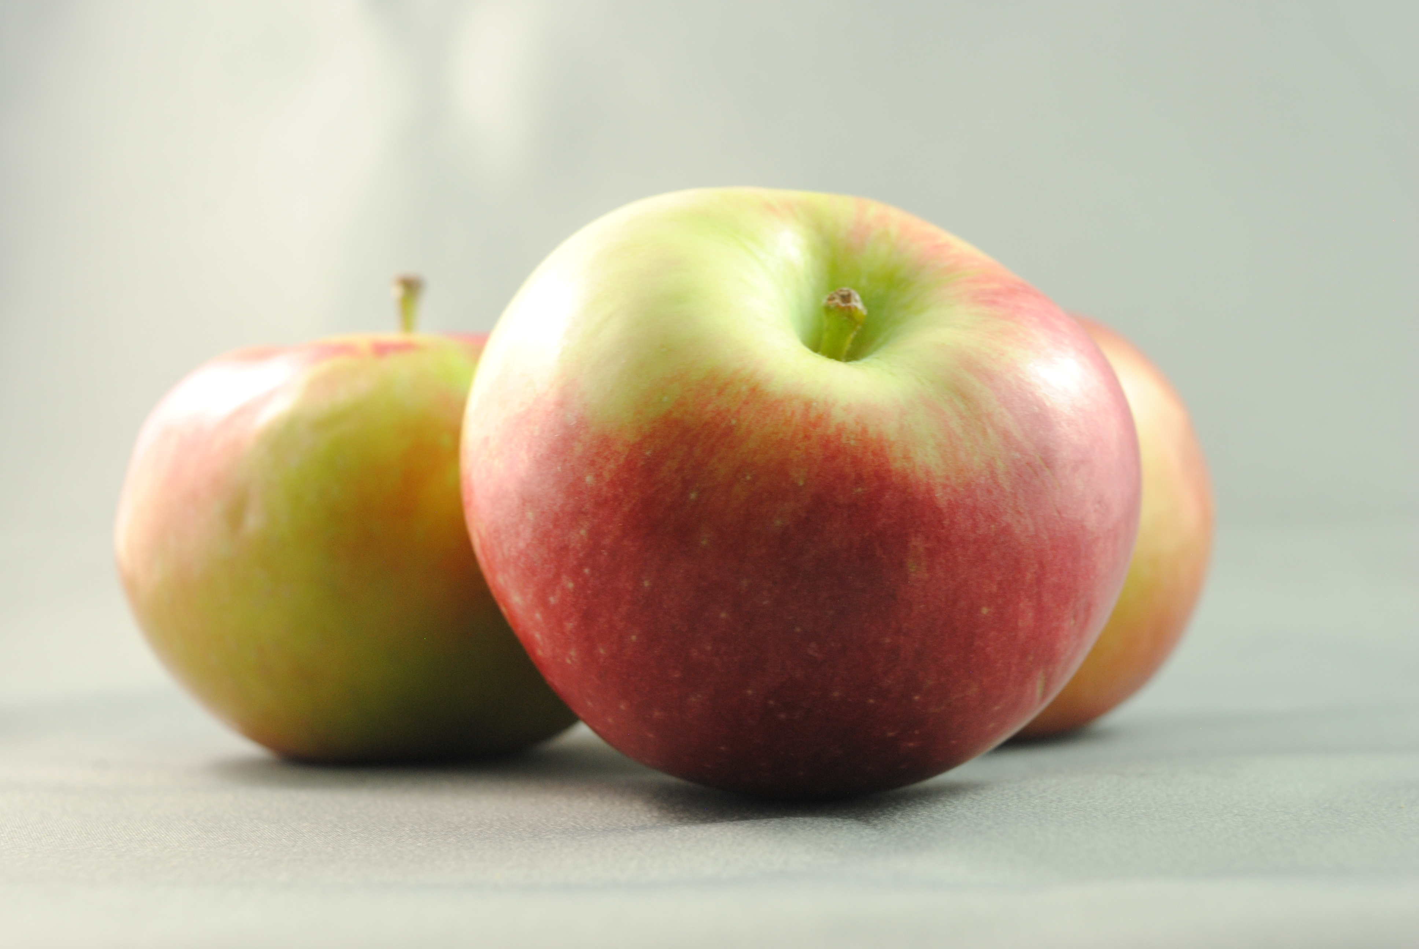
What doesn’t belong?
Notes:
Go over the name of each object. Have students figure out what doesn’t belong and explain why.

Slide 3
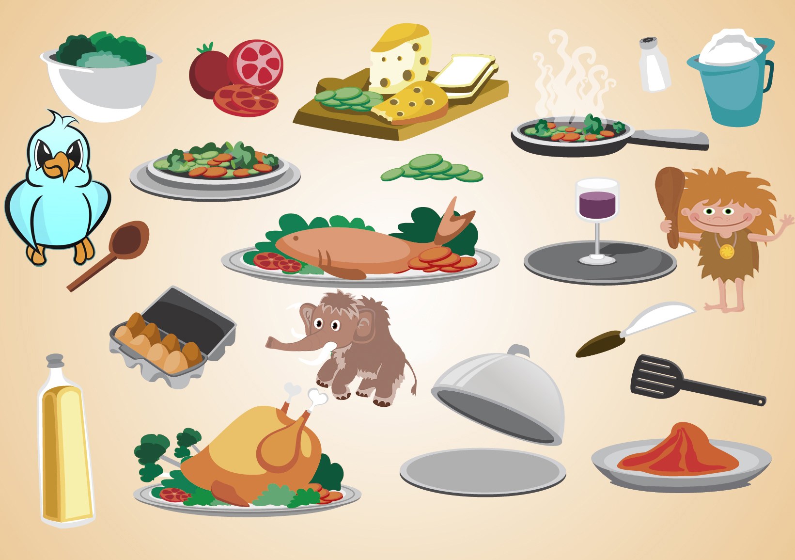
What doesn’t belong?
Notes:
Go over the name of each object. Have students figure out what doesn’t belong and explain why.

Slide 4
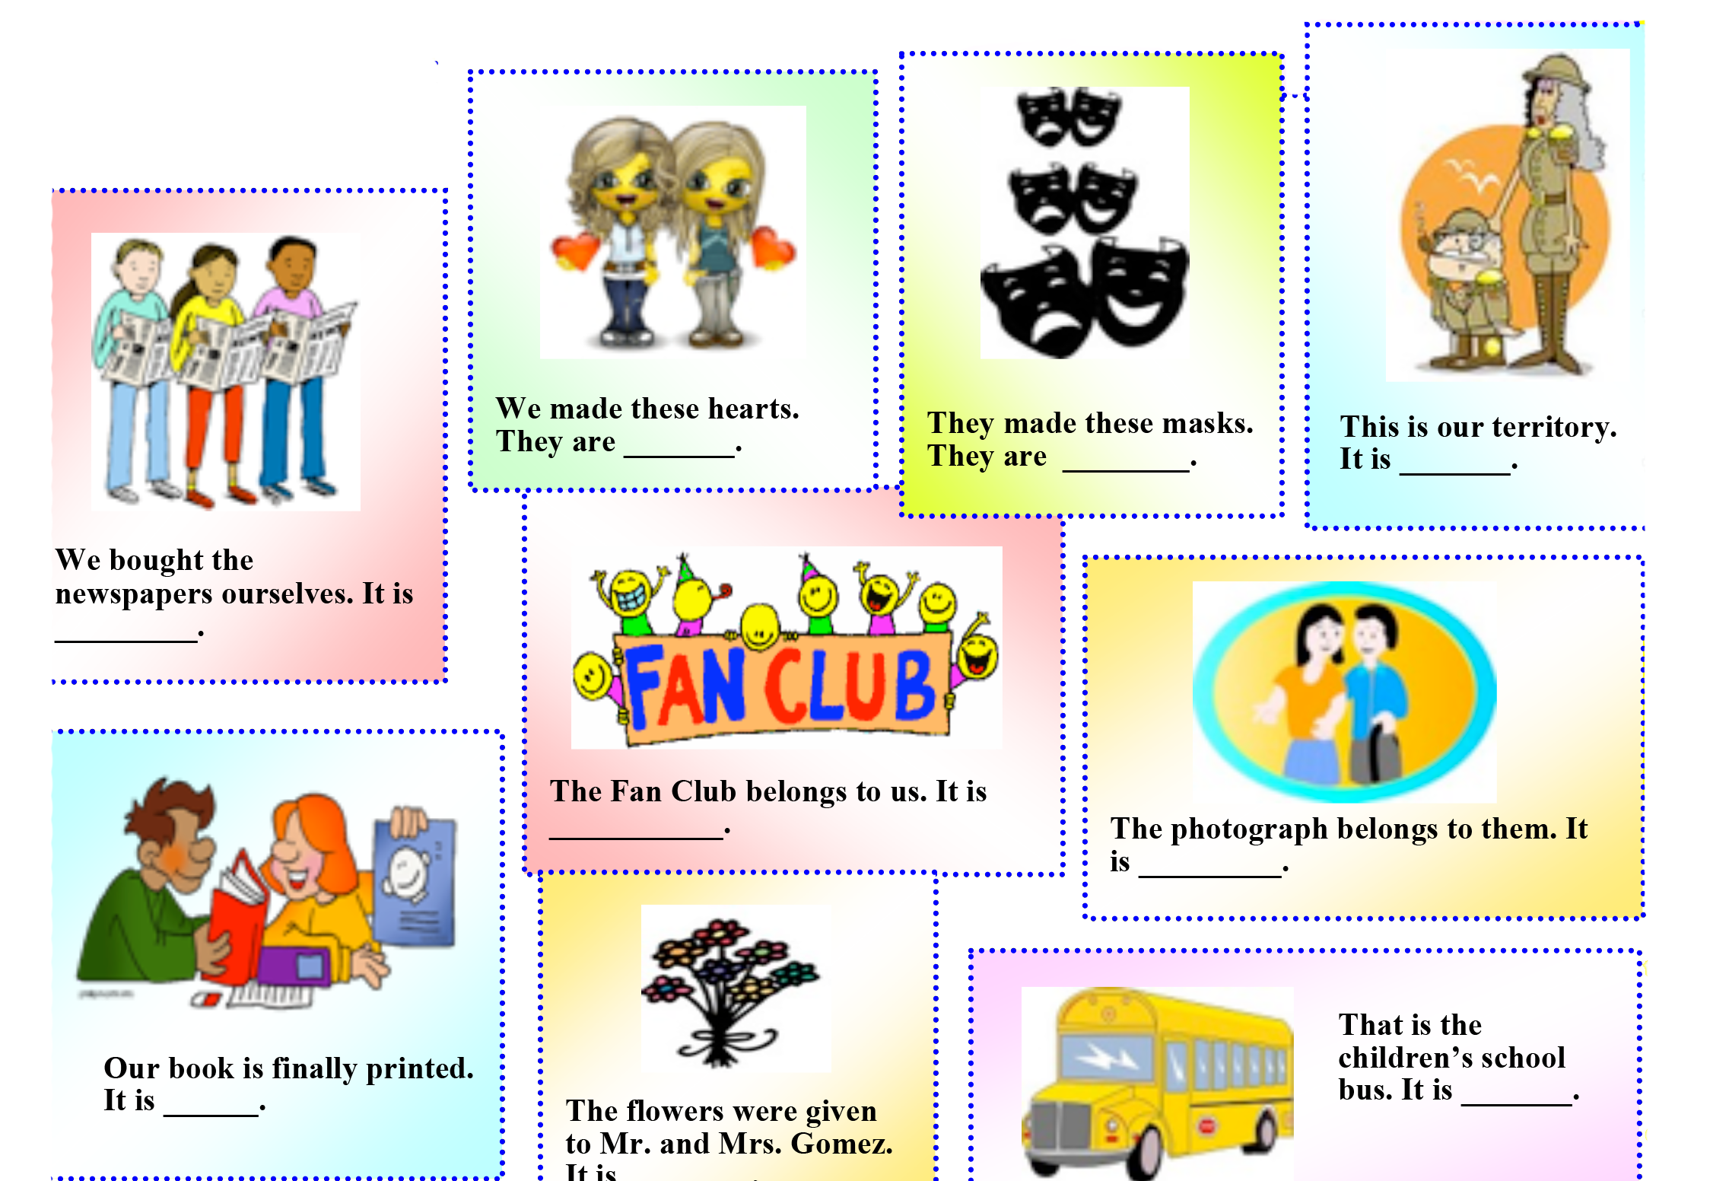
Ours or theirs?

Slide 5
Answers

Slide 6
His, Hers, Its
Tim's new car is awful. I simply don't like anything that's _____. (He)
2. These boys are his children and those over there are _____.(She)
3. This is her lunch bag. This is______. (She)
4. This is his drink. This is______. (His)
5. This is her notebook. This is _____.
6. Those are her roses. Those roses are______. (She)

Slide 7
Answers
Tim's new microwave is awful. I simply don't like anything that's his. (He)
2. These boys are his children and those over there are hers.(She)
3. This is her lunch bag. This is hers. (She)
4. This is his drink. This is his. (His)
5. This is her notebook. This is _____.
6. Those are her roses. Those roses are hers. (She)

Slide 8
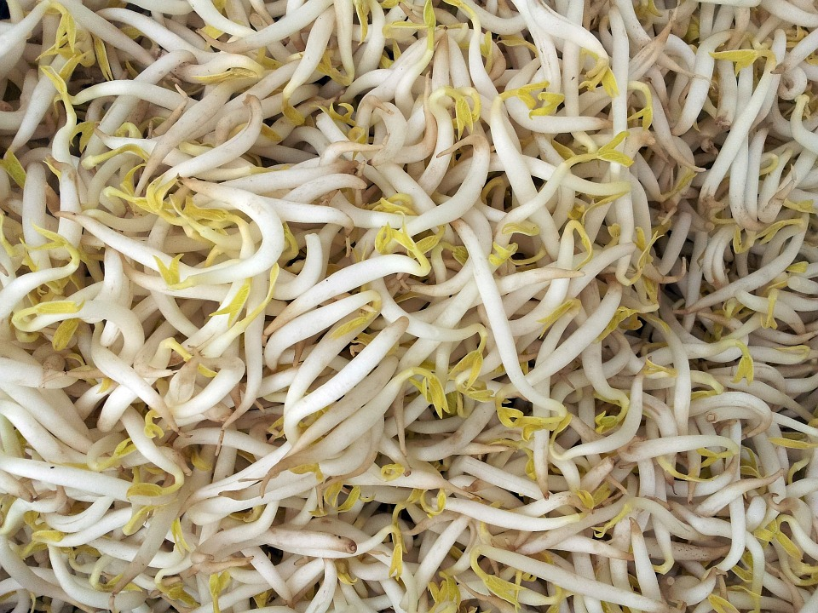
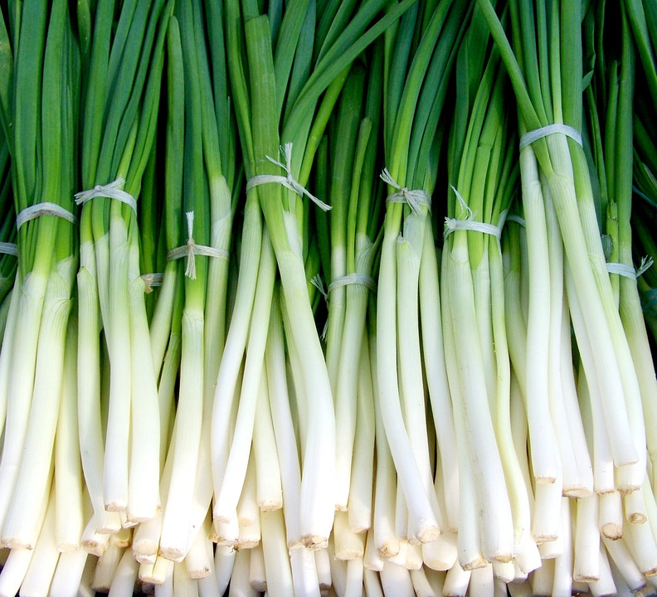
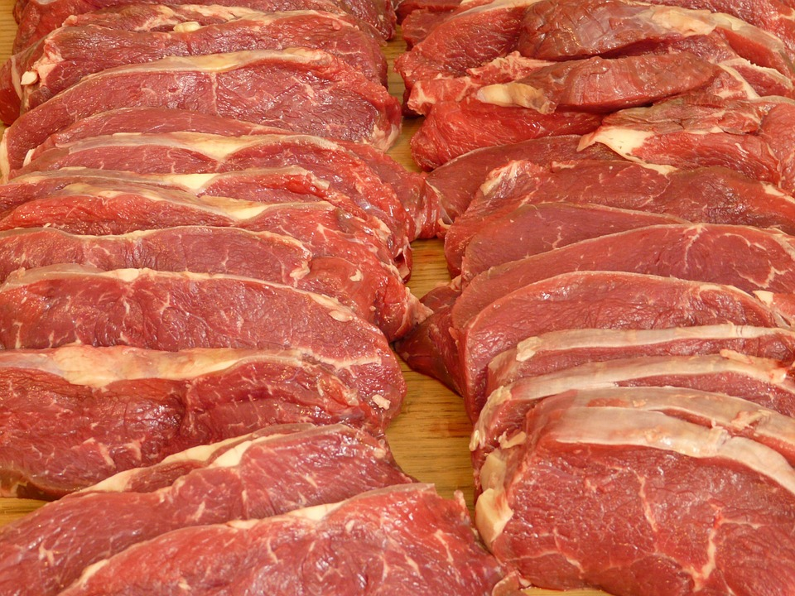
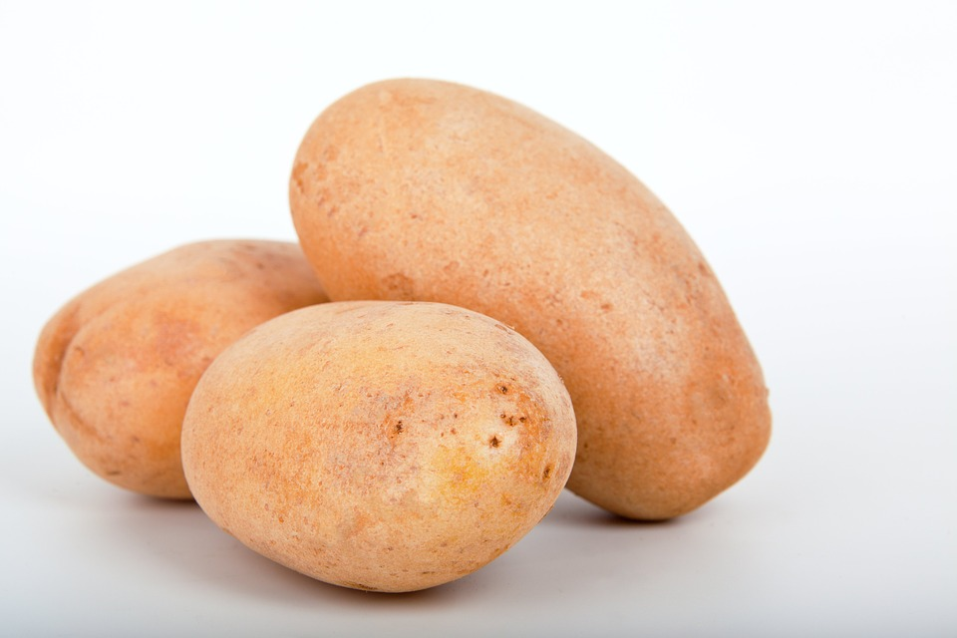
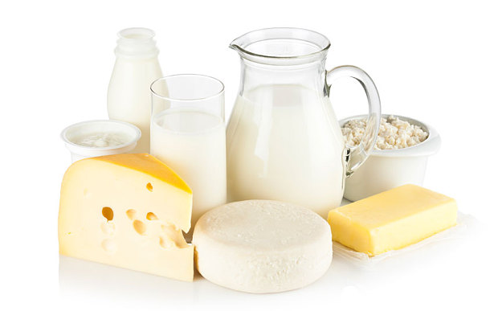
Does this food come from plants or animals?
Notes:
Ask the student if the food picture comes from plants or animals?

Slide 9
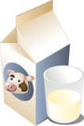
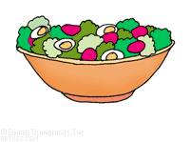
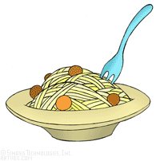
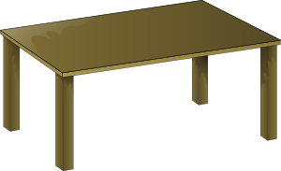
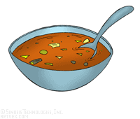
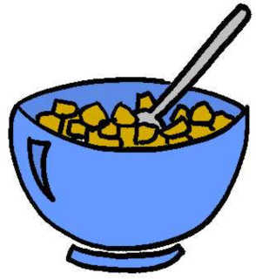
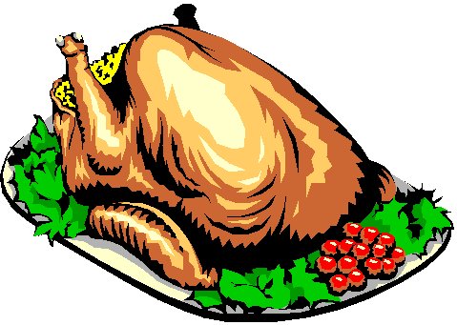
Mike usually has
and for breakfast.
toast
milk

Slide 10
Mike usually has
and for breakfast.
toast
milk

Slide 11
Tommy usually has
and
for lunch.
soup,
water,
hamburger,
chips

Slide 12
Tommy usually has
for lunch.
soup,
water,
and
hamburger,

Slide 13
Minie usually has
and for lunch.
fish,
salad
juice

Slide 14
Minie usually has
and for lunch.
fish,
salad
juice

