Slide 1

The Long Division
Illustration using Examples

Slide 2
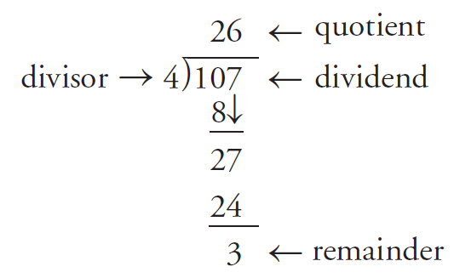
Introduction
Recall that long division can be used to determine the quotient of two numbers.
For example, 107 ÷ 4 can be evaluated as follows:

Slide 3

Introduction
Every division statement that involves numbers can be rewritten using multiplication and addition. The multiplication is the quotient, and the addition is the remainder.
For example, since 107 = (4)(26) + 3 then:
The quotient is 26, and the remainder is 3.

Slide 4
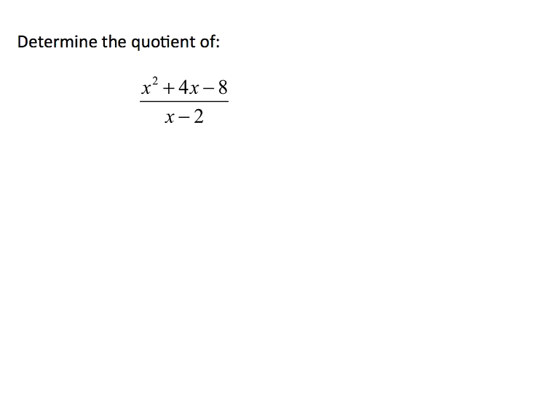
Example 1 – Video Demonstration

Slide 5
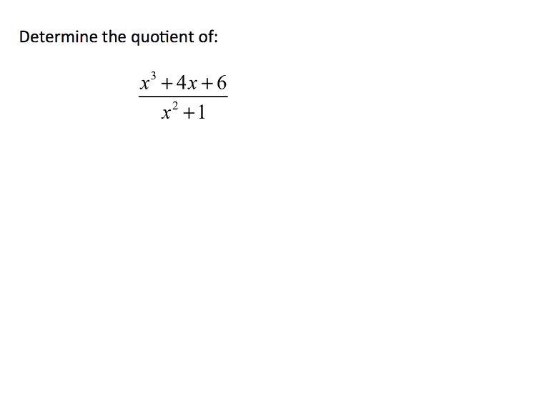
Example 2 – Video Demonstration

Slide 6
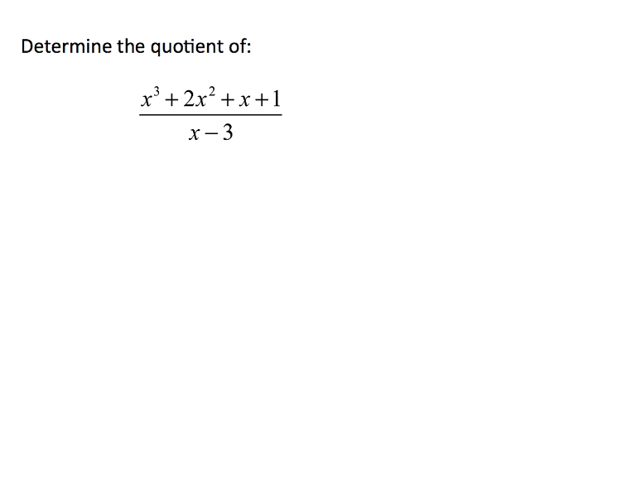
Example 3 – Video Demonstration

Slide 7
Example 4
Divide and write the division statement:

Slide 8
Example 4 - Solution
First we need to write the polynomial in order of descending powers, just as numbers are written in order of place value:
Now we can apply the long division.

Slide 9
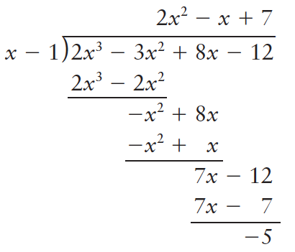
Example 4 - Solution

Slide 10
Example 5
Divide and write the division statement:

Slide 11
Example 5 - Solution
The polynomial does not have an x² term, so insert 0x² as a placeholder.
Now we can apply the long division.

Slide 12
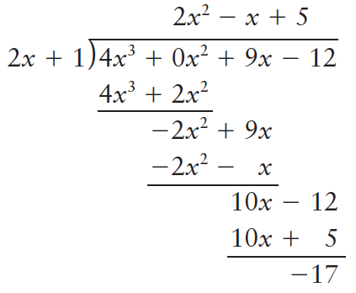
Example 5 - Solution

Slide 13
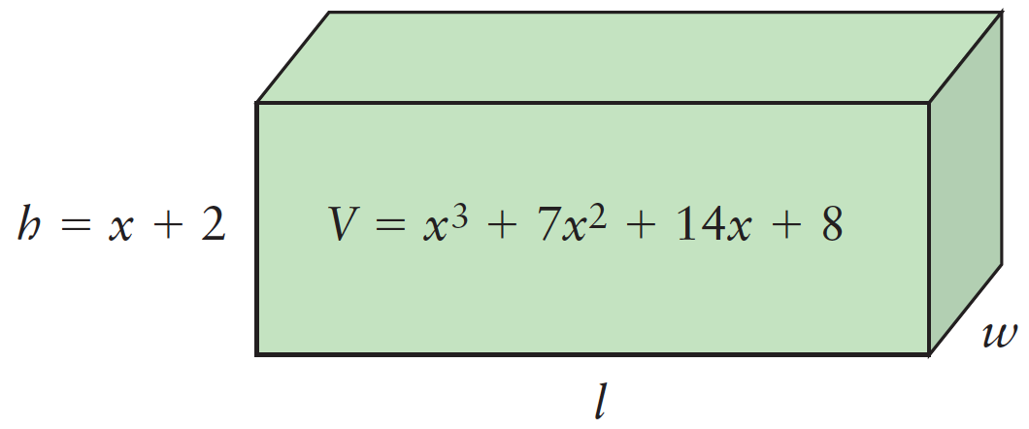
Example 6
The volume, V , in cubic centimetres, of a rectangular box is given by:
V(x) = x³ + 7x² + 14x + 8.
Determine expressions for possible dimensions of the box if the height, h, in centimetres, is given by x + 2.

Slide 14
Example 6 - Solution
Divide the volume by the height to obtain an expression for the area of the base of the box.
That is, V / h = lw , where lw is the area of the base.

Slide 15
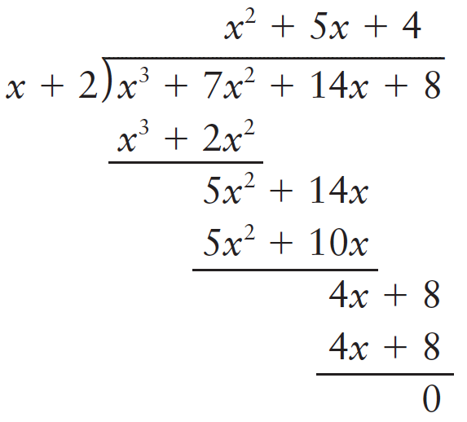
Example 6 - Solution
Since the remainder is 0, the volume, V, can be expressed as (x + 2)(x² + 5x + 4).

Slide 16
Example 6 - Solution
The quotient x² + 5x + 4 represents the area of the base of the box. This expression can be factored as (x + 1)(x + 4).
The factors represent the possible width and length of the base of the box.
Expressions for the possible dimensions of the box, in centimetres, are:
(x + 1), (x + 2), and (x + 4).

Slide 17
Example 7
Determine the remainder of:

Slide 18
Example 7 - Solution
Write the terms of the dividend and the quotient in descending order, by degree.
Since there is no x²-term in the dividend, we use 0 as the coefficient of x² to make the like terms line up properly.

Slide 19
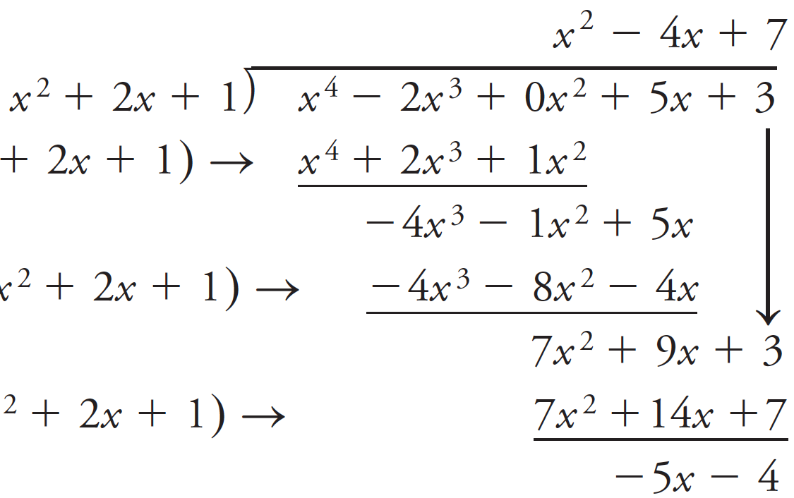
Example 7 - Solution
Remainder

Slide 20

If you have any questions, please do not hesitate to contact your teacher.
Thank you!

