Slide 1


Solutions
Note: Slides Contain Audio

Slide 2
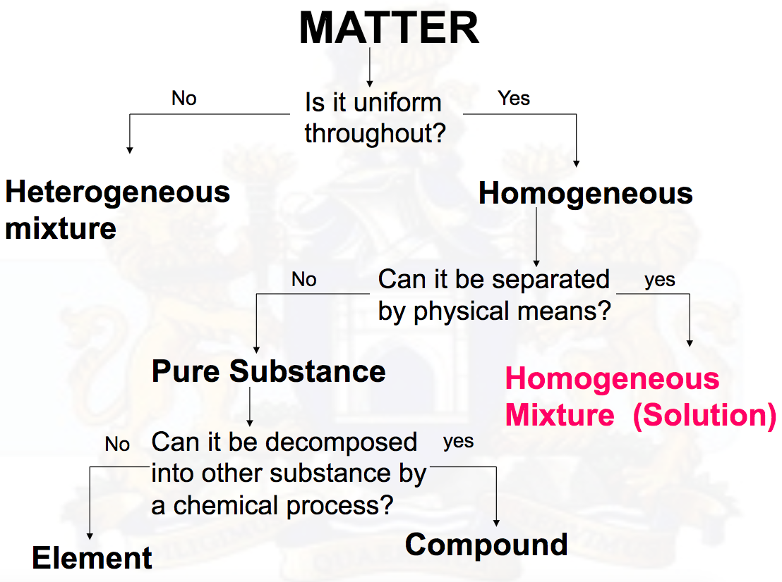
A solution is a homogeneous (uniform throughout) mixture of two or more substances. Samples taken from two different locations in a solution will have the exact same composition.

Slide 3
Solutions are homogenous mixtures which means they have only one phase (visible part) and all of the components of the mixture are evenly distributed throughout.
Heterogeneous mixtures have 2 or more phases, such as oil & water mixed together. Some mixtures may appear homogenous such as blood, but are actually heterogeneous when examined under the microscope.

Slide 4
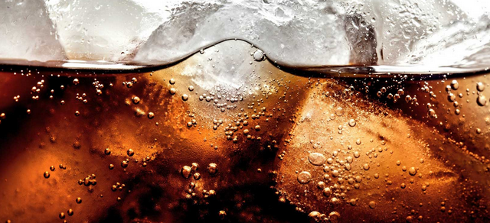
Solutions can exists as solids, liquids or gases.
Solutions can exist as a mixture of two substances in different states (liquid-liquid, gas-gas, solid-solid, solid-liquid, gas-liquid, solid, gas)
CO₂ gas in can of pop
Metal alloys (steel)
Salt water

Slide 5
Solutions are made up of at least 2 components: Solute & Solvent
Solvent – The substance that does the dissolving (the substance that is in greater quantity)
Solute – the substance that is dissolved (the substance in lesser quantity).
Examples: Salt (solute) dissolved in water (solvent)
40% Alcoholic beverage = 40% alcohol (solute)/60 % water (solvent)
75% Alcohol beverage = 75% alcohol (solvent)/25% water (solute)

Slide 6
A solution with a high percentage of solute is concentrated. A solution with a low percentage of solute is dilute.

Slide 7
The most common types of solutions are aqueous solutions. Aqueous solutions are any solutions that have water as the solvent. Many common products are in fact aqueous solutions such as pop, shampoo, bleach, etc.

Slide 8
Success!
You have reached the end of this learning activity. You will know that you have achieved the goals for this lesson when you can describe what a solution is, can compare homogeneous and heterogeneous mixtures and can describe solutions in terms of solutes, solvents and concentration.
Back to Start

