Slide 1

Solubility

Slide 2
Let the tap water run for two minutes in order to make sure that you get as cold a water temperature as possible. Add 250 mL of water to a glass. Add sugar to your water, ¼ teaspoon at a time. Record how much sugar you can add until it does not dissolve anymore. Repeat the experiment with the hottest possible water you can get from the hot water tap. Note the amount of sugar that dissolved. Now, predict how much sugar will dissolve if you use a solution of 125 mL of cold water mixed with 125 mL of hot water. Repeat the experiment with this lukewarm solution. According to your results, will the graph be linear or exponential?

Slide 3

Solubility is a characteristic of a solute that describes its ability to dissolve in a given solvent. Quantitatively, solubility describes the maximum amount of solute that will dissolve in a given quantity of solvent at a given temperature. Any extra solute that is added after the maximum is reached will no longer dissolve.
Typically, solubility is quantified as the maximum mass of solute that can be dissolved in 100 g of water at a given temperature.

Slide 4
Typically solubility is quantified as the maximum mass of solute that can be dissolved in 100 g of water at a given temperature.
This table shows that calcium is insoluble (does not dissolve) in water at 20 ˚C, while sucrose is very soluble in water at 20 ˚C as a maximum of 204.0 g of sucrose will dissolve in 100 g of water at that temperature.
Compound | Solubility (g/100 g of H₂O at 20 ˚C)
Calcium Carbonate - CaCO₃ | 0.0
Sodium Chloride - NaCl | 36.0
Sucrose - C₁₂H₂₂O₁₁ | 204.0

Slide 5
A solution that contains less than the maximum amount of solute that will dissolve is called an unsaturated solution. As more solute is added the solution approaches the maximum amount of solute that will dissolve. When the solution contains the maximum amount of solute in it that can dissolve is called a saturated solution. A solution with greater than the maximum amount of solute dissolved in it is called a supersaturated solution.

Slide 6
To test the saturation level of a solution, you can add more solute to the solvent. If the added solute dissolves then the solution is unsaturated. If the added solute does not dissolve then the solution is saturated.
Added solute dissolves
Added Solute does not dissolve

Slide 7
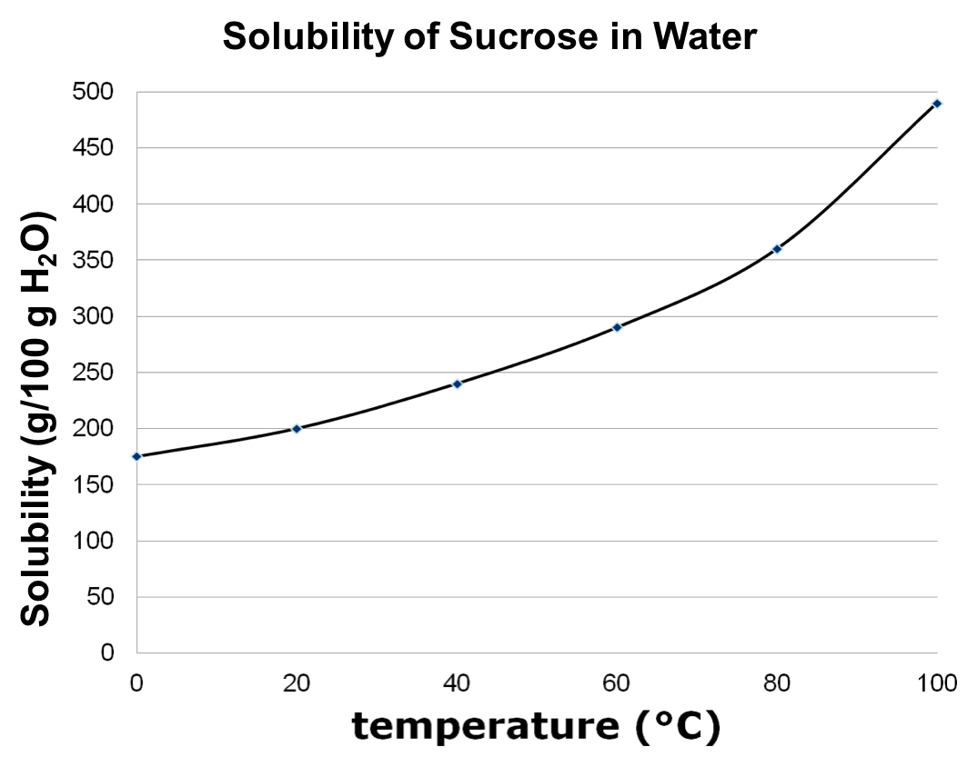
Solubility is a measure of the amount of solute that can be dissolved in a given solvent at a given temperature. As the temperature of the solvent changes, so does the ability of the solute to dissolve. This relationship can be represented graphically by using a solubility curve. In the graph the solubility of sucrose increases as the temperature of the water increases. Therefore, more sucrose will dissolve in 100 g of water as the temperature goes up.

Slide 8
200 g of sucrose will dissolve in 100 g of water at 20 ˚C. This solution will be saturated.
If 100 g of sucrose is added to 100 g of water at 20 ˚C, all of it will dissolve and the solution will be unsaturated.
If 300 g of sucrose are added to 100 g of water at at 20 ˚C not all of the solute will dissolve. The solution is saturated.
3.
1.
2.

Slide 9
At 40 ˚C, a solution of 300 g of sucrose would be saturated with excess undissolved solute.
If the solution were heated up to 62˚C, the solution would become saturated.
If the solution were further heated to 80 ˚C, the solution would become unsaturated.
1
2
3

Slide 10
Any point on the curve is a saturated solution.
Any point above the curve represents a saturated solution with undissolved solute in it.
Any point below the curve represents an unsaturated solution.
Saturated with Undissolved Solute
Saturated
Unsaturated

Slide 11
The vertical difference between a point below the curve and a point on the curve represents the mass of solute that needs to be added to produce a saturated solution at that temperature.
The vertical difference between a point above the curve and a point on the curve represents the mass of solute that will be undissolved at that temperature.
200 g of solute will be undissolved at this temperature. (400 g – 200 g = 200 g)
190 g of solute would need to be added to produce a saturated solution at this temperature (240 g – 50 g = 190 g)

Slide 12
The solubility for most ionic compounds increases as the temperature increases.
Different ionic compounds have different responses to changes in temperature.

Slide 13
The solubility of gases in liquids tends to decrease as the temperature rises.
This has serious environmental implications. Oxygen dissolved in water is crucial for survival of aquatic life. If ocean temperatures increase → less oxygen dissolved in the water → suffocation

Slide 14
Pressure affects the solubility of gases in liquids. Increased pressure increases the solubility.
A sealed bottle of pop is under high pressure. CO₂ is soluble at this temperature and pressure so no bubbles are visible, indicating the gas is dissolved. When the bottle is opened, pressure reduces, CO₂ is less soluble and bubbles form as undissolved CO₂ is released.
Unsealed Bottle:
Lower Pressure = Bubbles form as undissolved CO₂ is released from the liquid.
Sealed Bottle:
High Pressure = No bubbles. All CO₂ gas is dissolved.

Slide 15
Test Your Understanding
Given the following solubility curve, classify a solution that contains 10 g/ 100 g H₂O of potassium chloride (KCl) at 50 ˚C.
(Click the correct answer)
Saturated
Unsaturated
Super saturated

Slide 16
Test Your Understanding
The solution will be unsaturated at that temperature. as the point is below the curve for KCl.
Saturated
Unsaturated
Super saturated

Slide 17
Test Your Understanding
What mass of solute is required to saturate a solution containing 50 g/100 g H₂O of NaNO₃ at 10 ˚C?
80 g/100 g H₂O
50 g/100 g H₂O
30 g/100 g H₂O

Slide 18
Test Your Understanding
80 g – 50 g = 30 g
30 g/100 g H₂O is required to saturate the solution.
80 g/100 g H₂O
50 g/100 g H₂O
30 g/100 g H₂O

Slide 19
Success!
You have reached the end of this learning activity. You will know that you have achieved the goals for this lesson when you can define solubility, describe the different categories of saturation and can read and interpret solubility curves.
Back to Start

