Slide 1

Given the following reaction that produces solid barium sulfate and aqueous sodium chloride determine the volume of 0.42 mol/L Na₂SO₄ that is required to react completely with all of the barium ions in 500.0 mL of a 0.100 mol/L BaCl₂ solution
BaCl₂ (aq) + Na₂SO₄ (aq) --> BaSO₄ (s) + 2 NaCl (aq)
Start with concentration and volume of given substance.
Convert into amount in moles
Use mole ratio to determine amount of substance required or produced
Convert amount in moles into volume or concentration
NOTE: Slides contain audio explanation. Click on the speaker icon to play audio on each slide.

Slide 2
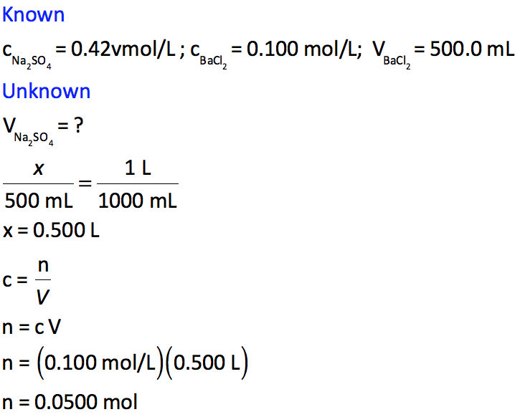
1. List known and unknown values

Slide 3
2. Convert Units to L
Therefore, the volume of barium chloride solution is 0.500 L

Slide 4
3. Solve for the amount, in moles, of BaCl₂ in 0.500 L of 0.100 mol/L solution
Therefore, 0.0500 mol of barium chloride are present in 0.500 L of a 0.1 mol/L solution.

Slide 5
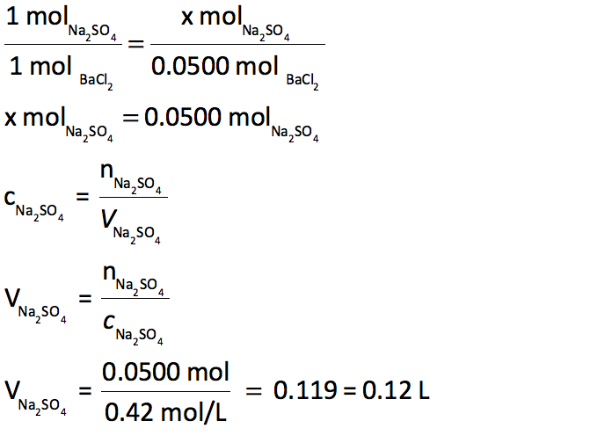
4. Use the mole ratio to determine the amount of Na₂SO₄ required to react with 0.0500 mol BaCl₂
Therefore, 0.0500 mol of Na₂SO₄ are required to react with 0.0500 mol of BaCl_{2.}

Slide 6
5. Determine the volume of 0.42 mol/L Na₂SO₄ solution that contains 0.0500 mol of Na₂SO₄
Therefore, the minimum volume of 0.42 mol/L Na₂SO₄ solution required to react with 500 mL of 0.100 mol/L BaCl₂ solution is 0.12 L

