Slide 1

A balloon contains 30.0 L of helium gas at a pressure of 103 kPa. What is the volume of the helium when the balloon rises to an altitude where the pressure is only 25.0 kPa, if the temperature remains constant. (Round your final answer to 3 significant figures).

Slide 2
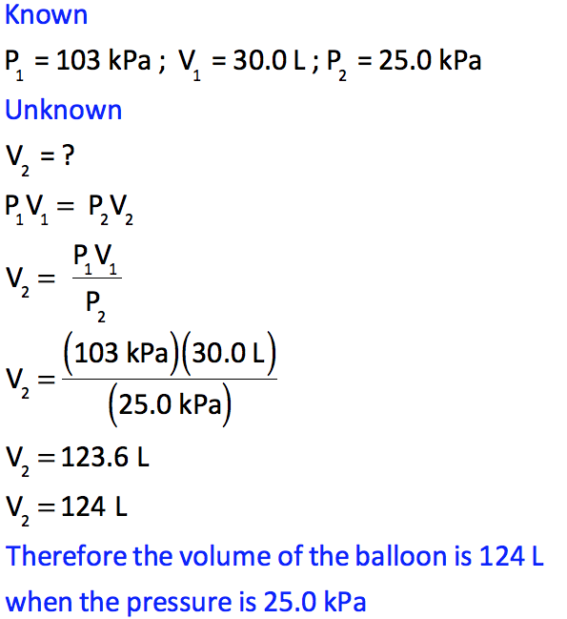
A balloon contains 30.0 L of helium gas at a pressure of 103 kPa. What is the volume of the helium when the balloon rises to an altitude where the pressure is only 25.0 kPa, if the temperature remains constant. (Round your final answer to 3 significant figures).

Slide 3
A balloon contains 30.0 L of helium gas at a pressure of 103 kPa. What is the volume of the helium when the balloon rises to an altitude where the pressure is only 25.0 kPa, if the temperature remains constant. (Round your final answer to 3 significant figures).

Slide 4
A balloon contains 30.0 L of helium gas at a pressure of 103 kPa. What is the volume of the helium when the balloon rises to an altitude where the pressure is only 25.0 kPa, if the temperature remains constant. (Round your final answer to 3 significant figures).

Slide 5
A balloon contains 30.0 L of helium gas at a pressure of 103 kPa. What is the volume of the helium when the balloon rises to an altitude where the pressure is only 25.0 kPa, if the temperature remains constant. (Round your final answer to 3 significant figures).

