Slide 1

Calculate the temperature in ˚C required to cause 4.9 L of a gas originally at 32.1°C to contract to a volume of 2.5 L. Assume pressure is kept constant. (Round your final answer to 3 significant figures).

Slide 2
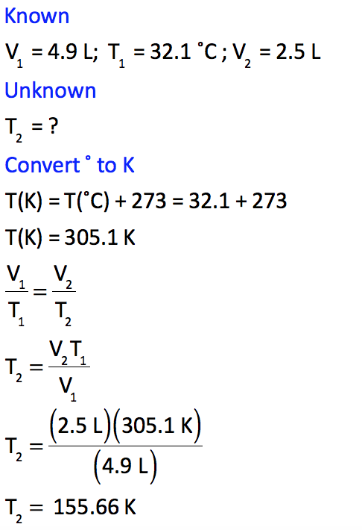
Calculate the temperature in ˚C required to cause 4.9 L of a gas originally at 32.1°C to contract to a volume of 2.5 L. Assume pressure is kept constant. (Round your final answer to 3 significant figures).

Slide 3
Calculate the temperature in ˚C required to cause 4.9 L of a gas originally at 32.1°C to contract to a volume of 2.5 L. Assume pressure is kept constant. (Round your final answer to 3 significant figures).

Slide 4
Calculate the temperature in ˚C required to cause 4.9 L of a gas originally at 32.1°C to contract to a volume of 2.5 L. Assume pressure is kept constant. (Round your final answer to 3 significant figures).

Slide 5

Calculate the temperature in ˚C required to cause 4.9 L of a gas originally at 32.1°C to contract to a volume of 2.5 L. Assume pressure is kept constant. (Round your final answer to 3 significant figures).

Slide 6
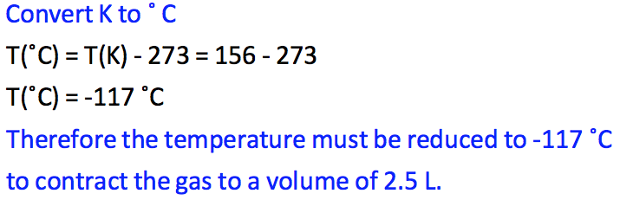
Calculate the temperature in ˚C required to cause 4.9 L of a gas originally at 32.1°C to contract to a volume of 2.5 L. Assume pressure is kept constant. (Round your final answer to 3 significant figures).

Slide 7

Calculate the temperature in ˚C required to cause 4.9 L of a gas originally at 32.1°C to contract to a volume of 2.5 L. Assume pressure is kept constant. (Round your final answer to 3 significant figures).

