Slide 1
The volume of a gas-filled balloon is 30.0 L at a temperature of 313 K and 153 kPa pressure. What would the volume be at standard temperature & pressure (STP)
Note: Standard temperature = 273 K and standard pressure = 101.3 kPa.
(Round your final answer to 3 significant figures).

Slide 2
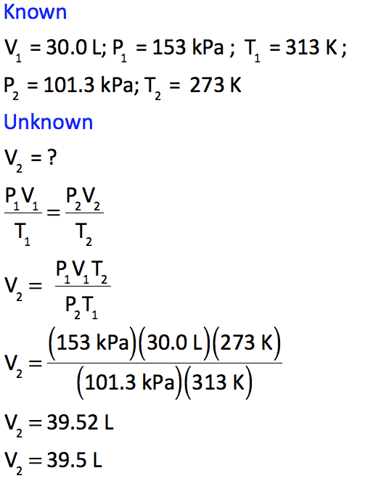
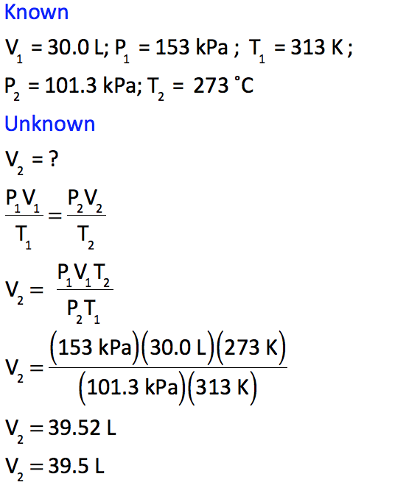
The volume of a gas-filled balloon is 30.0 L at a temperature of 313 K and 153 kPa pressure. What would the volume be at standard temperature & pressure (STP)
Note: Standard temperature = 273 K and standard pressure = 101.3 kPa.
(Round your final answer to 3 significant figures).

Slide 3
The volume of a gas-filled balloon is 30.0 L at a temperature of 313 K and 153 kPa pressure. What would the volume be at standard temperature & pressure (STP)
Note: Standard temperature = 273 K and standard pressure = 101.3 kPa.
(Round your final answer to 3 significant figures).

Slide 4
The volume of a gas-filled balloon is 30.0 L at a temperature of 313 K and 153 kPa pressure. What would the volume be at standard temperature & pressure (STP)
Note: Standard temperature = 273 K and standard pressure = 101.3 kPa.
(Round your final answer to 3 significant figures).

Slide 5
The volume of a gas-filled balloon is 30.0 L at a temperature of 313 K and 153 kPa pressure. What would the volume be at standard temperature & pressure (STP)
Note: Standard temperature = 273 K and standard pressure = 101.3 kPa.
(Round your final answer to 3 significant figures).

Slide 6

The volume of a gas-filled balloon is 30.0 L at a temperature of 313 K and 153 kPa pressure. What would the volume be at standard temperature & pressure (STP)
Note: Standard temperature = 273 K and standard pressure = 101.3 kPa.
(Round your final answer to 3 significant figures).

