Slide 1


Properties of Gases

Slide 2
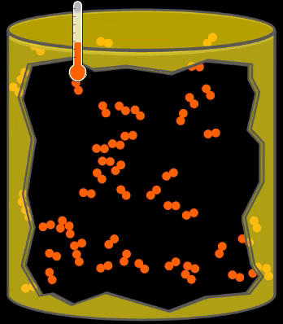
Properties of Gases
Particles of matter in their gaseous state have the following properties:
  They are relatively far apart from each other, compared to the particles in liquids and gases. Between the particles is empty space.
  Gases can be compressed due to the spaces between particles.
  Gas particles in a container spread out to fill the entire volume.
  They move constantly in a rapid and random motion.
  When gas particles collide they bounce off each other.

Slide 3
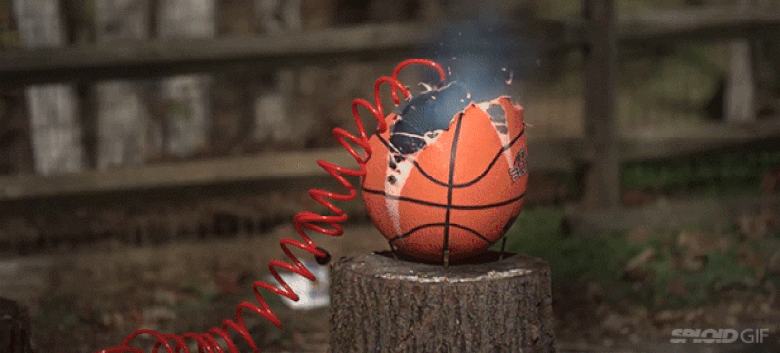
Gas Pressure
Gas Pressure is the force exerted by the particles of a gas on the walls of a container, per unit of surface. This force is caused by the movement of the particles within the container, as they collide with each other and the surface of the container.
Pressure is increased when the number of collisions increases this can be achieved in different ways:
  more particles are added to a container → more collisions.
  temperature increases → particles move faster → more collisions.
  volume decreases → less space for particles to move around in → more collisions.
Pressure is decreased when the number of collisions decreases. Therefore, removing particles, reducing temperature or increasing volume will all lead to fewer collisions and reduced pressure.

Slide 4
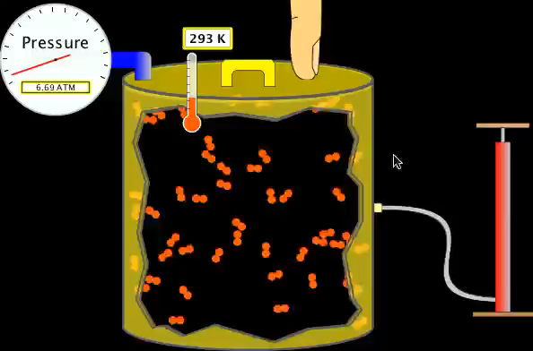
Factors Affecting Gas Pressure
Hover over the image and click play to begin.

Slide 5
Measuring Pressure
Pressure can be measured using different tools, including a pressure gauge or a barometer, which is used to measure atmospheric pressure.
The standard units used to measure pressures is the pascal (Pa) or kilopascal (kPa); 1 kPa = 1000 Pa
Other common units of pressure used are:
  atmospheres (atm); 1 atm = 101.3 kPa
  millimeters of mercury (mm Hg); 760 mm Hg = 101.3 kPa = 1 atm

Slide 6
Test Your Understanding
A pressure gauge records a pressure of 450 kPa. What is this measurement expressed in units of atmospheres and mm Hg? (rounded to 2 significant figures) Click on the correct answer.
3.4 atm; 4.4x10³ mm Hg
4.3 atm; 4.3x10³ mm Hg
4.4 atm; 3.4x10³ mm Hg

Slide 7
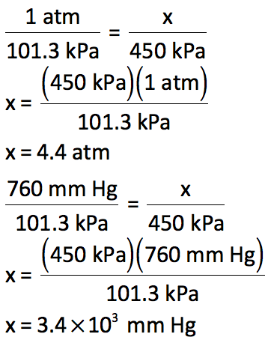
Answer
A pressure gauge records a pressure of 450 kPa. What is this measurement expressed in units of atmospheres and mm Hg?
3.4 atm; 4.4x10³ mm Hg
4.3 atm; 4.3x10³ mm Hg
4.4 atm; 3.4x10³ mm Hg

Slide 8
Atmospheric Pressure
Atmospheric pressure is the pressure of the air around you. This pressure is also sometimes called air pressure.
Air is a mixture of gases which exert pressure on the Earth’s surface.
Atmospheric pressure is greatest at the lowest points on earth as the air is densest the closer to the surface it is. This means there are more air molecules pushing down closer to the surface than at higher elevations.
If you climb up a mountain, the atmospheric pressure is lower because the air is less dense.

Slide 9
Success!
You have reached the end of this learning activity. You will know that you have achieved the goals for this lesson when you can describe: the characteristics of gas particles, how different factors affect pressure, how pressure is measured and what factors contribute to atmospheric pressure.
Back to Start

