Slide 1

The gas in a used aerosol can is at a pressure of 103 kPa at 25.0 ˚C. If the can is thrown onto a fire, what will the pressure be when the temperature reaches 928 ˚C, assuming the volume remains constant?

Slide 2
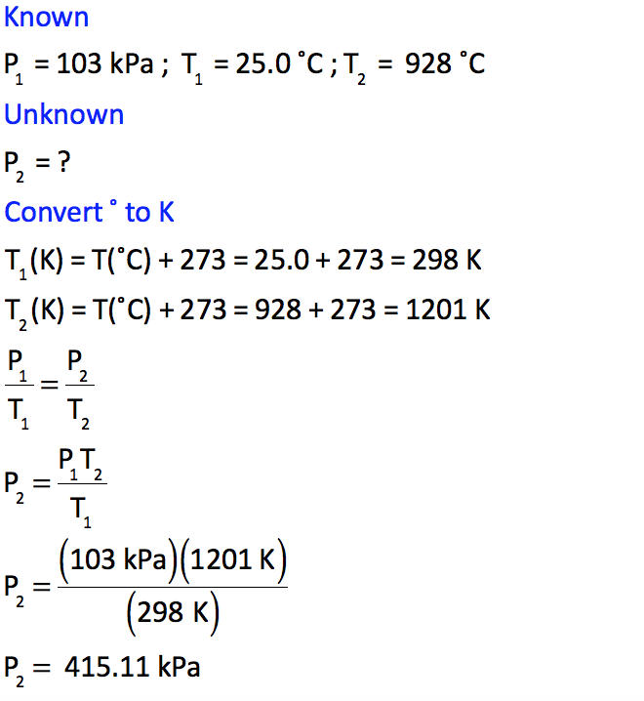
The gas in a used aerosol can is at a pressure of 103 kPa at 25.0 ˚C. If the can is thrown onto a fire, what will the pressure be when the temperature reaches 928 ˚C, assuming the volume remains constant?

Slide 3
The gas in a used aerosol can is at a pressure of 103 kPa at 25.0 ˚C. If the can is thrown onto a fire, what will the pressure be when the temperature reaches 928 ˚C, assuming the volume remains constant?

Slide 4
The gas in a used aerosol can is at a pressure of 103 kPa at 25.0 ˚C. If the can is thrown onto a fire, what will the pressure be when the temperature reaches 928 ˚C, assuming the volume remains constant?

Slide 5
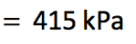
The gas in a used aerosol can is at a pressure of 103 kPa at 25.0 ˚C. If the can is thrown onto a fire, what will the pressure be when the temperature reaches 928 ˚C, assuming the volume remains constant?

Slide 6

The gas in a used aerosol can is at a pressure of 103 kPa at 25.0 ˚C. If the can is thrown onto a fire, what will the pressure be when the temperature reaches 928 ˚C, assuming the volume remains constant?

