Slide 1

The Lifecycle of the Cell

Slide 2
Cells, like all living things go through a cycle during their lifetime. Like you, cells are born, they grow and mature into fully functioning cells and eventually they either divide to form two smaller cells because they have grown too big, or they die when they can no longer function properly to maintain life. In fact, as you read this now, there are cells in and on your body that are being newly born; cells that are growing and maturing; cells that are mature and carrying out their normal everyday functions; cells that are dying; and cells that are dead.

Slide 3
A good example of cells constantly undergoing this cycle are your skin cells. Take a look at your arm, what do you see?
When you see your arm, or any skin on the surface of your body, what you are specifically looking at are skin (or epithelial) cells, however the cells on the surface of your arm are not living, they are actually dead cells. If you scratch your arm and see some white flakes come off your skin, these are the dead skin cells on the surface. Click to take a closer look. If you were to take a microscope and look closer at your arm what would it look like?

Slide 4
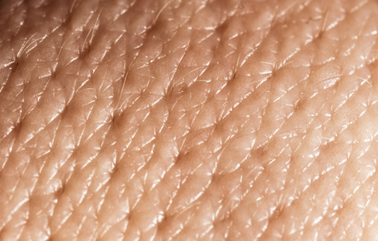
If you were to take a microscope and look closer at the skin on your arm what would it look like?
When you see your arm, what you are actually looking at are skin cells, however most of these cells are not living, they are dead.
Your skin is actually made up of many layers of cells, the outer, or surface layer is made up of old, dead cells. This layer acts as a sort of protective layer for the body, protecting the live skin cells underneath.
These living skin cells are produced in the deeper layers of the skin where they mature over time as they travel from the deeper layers outwards towards the surface.
As these cells progress from the deeper layers, they go through a cycle of events from when they are born as they grow until they are too big to properly function at which point they will divide to form 2 new cells that are smaller than the original parent cell. This cycle of events is known as the cell cycle and cells constantly move through this cycle during their lifetime.

Slide 5
The cell cycle regulates how a cell behaves during its lifetime and also regulates how long a cell lives. Cells die for many different reasons, sometimes because they have suffered some sort of injury or damage, such as exposure to a toxic substance. Cells also die as a normal part of the functioning of a healthy organism when they are no longer useful. This type of controlled cell death is known as apoptosis. The dead cells on the surface of your skin for the most part will have died from this mechanism.

Slide 7
Cells, like all living things go through a cycle during their lifetime. Like you, cells are born, they grow and mature into fully functioning cells and eventually they die when they can no longer function properly to maintain life. In fact, as you read this now, there are cells in and on your body that are being newly born cells that are growing and maturing, cells that are mature and carrying out their normal everyday functions, cells that are dying and cells that are dead.
A good example of cells constantly undergoing this cycle are your skin cells. Take a look at your arm, what do you see?
When you see your arm, what you are actually looking at are skin cells, however most of these cells are not living, they are dead.
Your skin is actually made up of many layers of cells, the outer, or surface layer is made up of old, dead cells. This layer acts as a sort of protective layer for the body, protecting the live skin cells underneath.
These living skin cells are produced in the deeper layers of the skin where they mature over time as they travel from the deeper layers outwards towards the surface.

