Slide 1
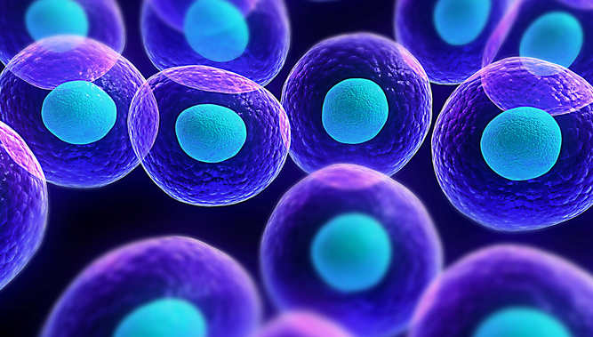

Cells, Tissues & Systems

Slide 2
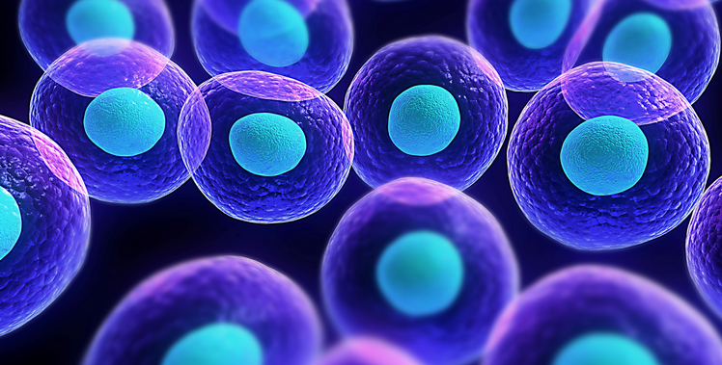
Cells are the building blocks of all living things. This means that every organism that is alive is made up of cells. The smallest living things in existence are made up of just one, single, individual cell; while other more complex organisms, such as humans are made up of trillions (10¹²) of cells.

Slide 3
Cells are the basic structures of all living organisms. Organisms that are made up of just a single cell, such as amoeba, are called unicellular; while organisms made up of groups of cells, such as humans are called multicellular.
Unicellular - Amoeba
Multicellular - Human

Slide 4
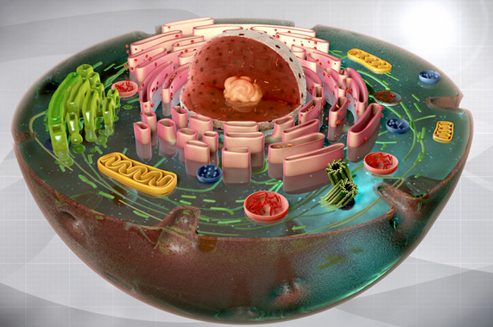
On a very basic level, cells are tiny compartments that carry out the functions to maintain life. Cells carry out many different important tasks to help keep an organism alive. These tasks include:
Obtaining food and energy
Converting energy for use inside the cell
Building and maintaining structures
Eliminating waste
Reproduction
To carry out these different functions, cells contain different specialized structures called organelles.

Slide 5
In complex multicellular organisms, cells group together to form specific types of tissues, such as muscle tissue or nervous tissue.

Slide 6
These cells that group together as tissues, then further group together for form organs such as the lungs, heart and brain.

Slide 7
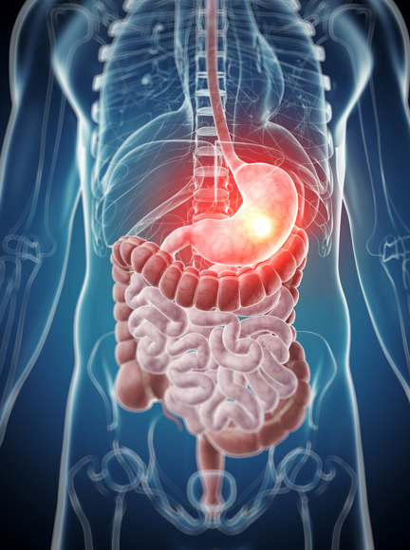
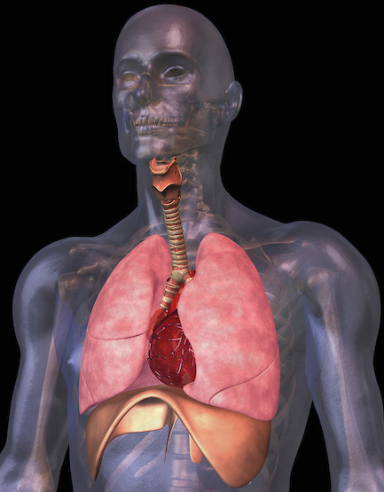
In multicellular organisms cells group together to form tissues, tissues can group together to form organs, organs can then group together to form systems such as the digestive system or respiratory system.
Digestive System
Respiratory System

Slide 8
The final level of organization of cells in multicellular organisms occurs when multiple systems of organs combine to form a fully functioning organism, made up of trillions of cells grouped into different types of tissues. These tissues then further group into different types organs. These tissues group into different types of systems. Together these systems group to form a fully functioning living organism.

Slide 9
SUCCESS!
You did it! You’ve reached the end of this activity.
You’ll know that you have met the learning goals for this activity when you can:
provide a basic definition of a cell.
list some of the the basic functions of a cell.
explain the difference between a unicellular and multicellular organism.
explain how cells are organized into tissues, organs and systems in multicellular organisms.

